Slide 1
figure.1
+n(n=99)

Slide 2
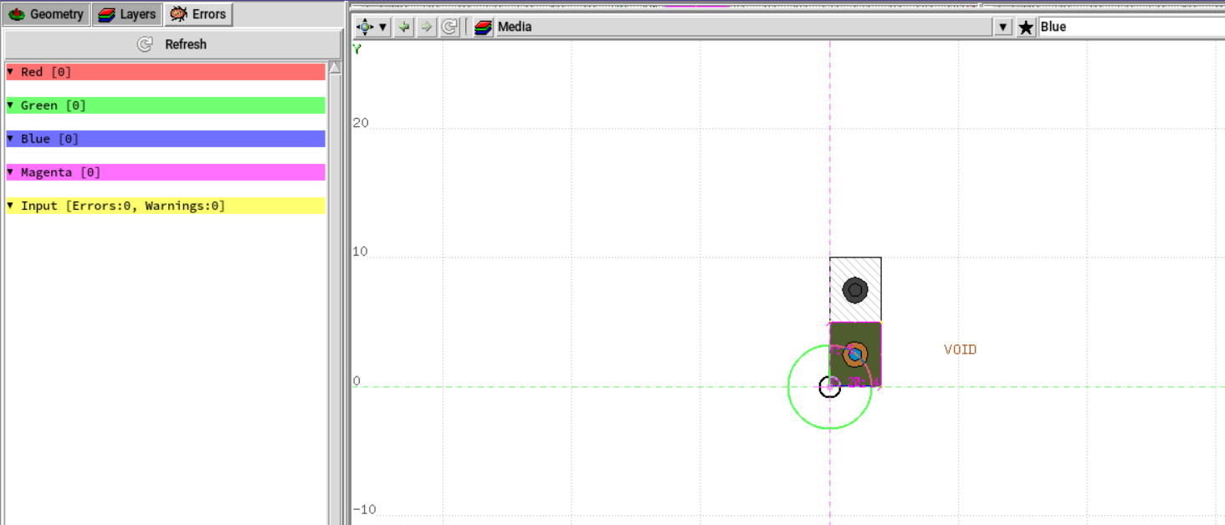
figure.2
Replication geometry
prototype

