Slide 1

E-M FLUKA (EMF)
EM interactions and options
Beginners FLUKA Course

Slide 2
Topics
General settings
Interactions of leptons/photons
  Photon interactions
    Photoelectric
    Compton
    Rayleigh
    Pair production
    Photonuclear
    Photomuon production
  Electron/positron interactions
    Bremsstrahlung
    Scattering on electrons
  Muon interactions
    Bremsstrahlung
    Pair production
    Nuclear interactions
Ionization energy losses
  Continuous
  Delta-ray production
Transport
  Multiple scattering
  Single scattering
These are common to all charged particles,
although traditionally associated with EM

Slide 3
E-M FLUKA (EMF) at a glance
Energy range for e⁺ , e⁻ , γ : 1 keV- 1000 TeV
Full coupling in both directions with hadrons and low-energy neutrons
Energy conservation within computer precision
Up-to-date cross section tabulations from EPDL97 database
EMF is activated by default….and with most DEFAULTS options,
except: EET-TRAN, NEUTRONS, SHIELDING
To de-activate EMF:
EMF EMF-OFF
With EMF-OFF, E.M. energy is deposited on the spot
Consider also the DISCARD command
Production and transport of optical photons (Cerenkov, scintillation) is implemented. Since it needs user coding, it is not treated in this beginners course

Slide 4
Transport thresholds
E.M particles are transported until their energy falls below a pre-set threshold. In FLUKA, this energy threshold can be set REGION BY REGION.
HOW to choose?
It depends on the “granularity” of the geometry and/or of the scoring mesh and on the “interest” in a given region. Energy/range tables are very useful (see for instance http://physics.nist.gov )
Warning 1: to reproduce correctly electronic equilibrium, neighboring regions should have the same electron energy ( NOT range) threshold. To be kept in mind for sampling calorimeters
Warning 2 : Photon thresholds should be lower than electron thresholds (they travel more)
Warning 3: low thresholds are CPU eaters
EMFCUT e±Thresh γThresh Reg1 Reg2 Step
♦
♦The EMFCUT card has
more options: see later

Slide 5
Production Thresholds
Let’s introduce a concept that is treated again in the discussion of ionization energy losses: the separation between CONTINUOUS and DISCRETE energy deposition:
The simulation of all atomic interaction processes is not possible in all-purposes MCs, because
  the modeling of very low energy transfer would need detailed atomic/molecular physics
  the CPU time would diverge
  1) ONLY interactions resulting in a “substantial” energy transfer are simulated explicitly
  2) All other interactions are “condensed” in a continuous energy loss along the particle step
Condition 1) is implemented by setting a threshold for the energy of the produced secondary particle

Slide 6
Production Thresholds -II
For electromagnetic interactions:
BY MATERIAL !
EMFCUT e±Thresh γThresh Felmcs Mat1 Mat2 Step PROD-CUT
Felmcs is related to multiple scattering. = 0 below 10 keV , = 1 above
Warning 1: production and transport thresholds are set by default, depending on the DEFAULTS card. DO NOT RELY on them, choose those best suited for your problem
Warning 2: if prod-cut << transport cut, CPU is wasted in producing/dumping particles on spot. Sometimes it could be convenient to define several “equal” materials with different production thresholds

Slide 7
Photon interactions

Slide 8
Photoelectric effect
Detailed treatment of | Fluorescence
Photoelectron | Angular distribution
Approximate | Auger effect
Effect of photon | Polarization
Fluorescence after photoelectric is activated only with a subset of DEFAULTS
CPU time vs. precision in small granularity
To activate/deactivate it:
EMFFLUO Flag Mat1 Mat2 Step
Flag > 0 | Activate
Flag < 0 | De-Activate
Warning: check consistency with production/transport thresholds

Slide 9
Compton and Rayleigh
Account for atomic bonds using inelastic Hartree-Fock form factors (very important at low E in high Z materials)
NEW : Compton with atomic bonds and orbital motion ( as better alternative to form factors)
  Atomic shells from databases
  Orbital motion from database + fit
  Followed by fluorescence
Account for effect of photon polarization
Inelastic Form Factors, Compton profile and Rayleigh scattering are activated only with a subset of DEFAULTS .
To activate/deactivate:
EMFRAY Flag Reg1 Reg2 Step
Look in the manual for further details

Slide 10
Compton profile examples
500 keV γ on Au
E’/E
50 keV γ on Au
E’/E
green = free electron
blue = binding with form factors
red =binding with shells and orbital motion
Larger effect at very low energies, where, however, the dominant process is photoelectric.
Visible: shell structure near E’=E, smearing from motion at low E’

Slide 11
Effect of EMFFLUO and EMFRAY
Photoelectric
line
Form-factor suppressed
X-rays escape
lines

Slide 12
Polarization
By default, source photons are NOT polarized. Polarization can be set by
POLARIZA Pcosx Pcosy Pcosz Flag1 Fraction Flag2
Flag1 ➔ Pol. direction wrt direction of motion, Fraction + flag2 ➔ fraction of polarized/unpolarized or polarized/orthogonally polarized photons (see the manual for further details)
Effect of photon polarization
Deposited dose
by 30 keV photons on Water
at 3 distances from beam axis
as a function of penetration depth for 3 orientations wrt the polarization direction

Slide 13
Pair Production
Angular and energy distribution of e⁺,e⁻ described correctly (no “fixed angle” or similar approximation)
No approximations near threshold
Differences between emitted e⁺ and e⁻ at threshold accounted for

Slide 14
Photonuclear interactions
Photon-nucleus interactions in FLUKA are simulated over the whole energy range, through different mechanisms:
Giant Resonance interaction
Quasi-Deuteron effect
Delta Resonance production
Vector Meson Dominance (γ ≡ρ,Φ mesons) at high energies
Nuclear effects on the initial state (i.e. Fermi motion) and on the final state (reinteraction / emission of reaction products) are treated by the FLUKA hadronic interaction model (PEANUT) ➔ INC + pre-equilibrium + evaporation/fission/breakup
The (small) photonuclear interaction probability can be enhanced through biasing

Slide 15
Photonuclear interactions: options
Photonuclear interactions are NOT activated with any default
To activate them:
PHOTONUC Flag Mat1 Mat2 Step
Flag controls activation of interactions, with the possibility to select a subset of the photonuclear mechanisms
Since the photonuclear cross section is very small, PHOTONUC should be always accompanied by LAM-BIAS (see lecture on biasing)
LAM-BIAS Factor Mat PHOTON
Applications:
electron accelerator shielding and activation
neutron background by underground muons (together with muon photonuclear interactions (option MUPHOTON)
Notes:
15

Slide 16
Photonuclear Interactions: benchmark
Yield of neutrons per incident electron as a function of initial e⁻ energy. Open symbols: FLUKA, closed symbols: experimental data (Barber and George, Phys. Rev. 116, 1551-1559 (1959))
Left: Pb, 1.01 X₀ (lower points) and 5.93 X₀ (upper)
Right: U, 1.14 and 3.46 X₀

Slide 17
Photonuclear int.: example
Reaction:
²⁰⁸Pb(γ,x n)
20≤Eγ ≤140 MeV
Cross section for multiple neutron emission as a function of photon energy, Different colors refer to neutron multiplicity ≥ n , with 2 ≤ n ≤ 8
Symbols: exp. data (NPA367, 237 (1981) ; NPA390, 221 (1982) )
Lines: FLUKA

Slide 18
Photomuon production
Muon pair production by photons is NOT activated with any default
To activate it:
PHOTONUC Flag Lambias Mat1 Mat2 Step MUMUPAIR
Flag controls activation of interactions, with the possibility to select a subset of the photonuclear mechanisms
Biasing of photomuon production can be done directly with this card, setting what(2)

Slide 19
Electron/Positron interactions

Slide 20
Bremsstrahlung
Energy-differential cross sections based on the Seltzer and Berger database, interpolated and extended to a finer energy mesh, tip, and larger energies
Finite value at tip energy
Extended to 1000 TeV taking into account the LPM (Landau-Pomeranchuk-Migdal) effect
Soft photon suppression (Ter-Mikaelyan) polarization effect
Special treatment of positron bremsstrahlung with ad hoc spectra at low energies
Detailed photon angular distribution fully correlated to energy

Slide 21
Bremsstrahlung: benchmark
2 MeV electrons on Iron,
Bremsstrahlung photon spectra
measured (dots)
and
simulated (histos)
at three different angles

Slide 22
Bremsstrahlung: benchmark II
12 and 20.9 MeV electrons on a W-Au-Al target,
bremsstrahlung photon spectra in the forward direction
measured (dots) and simulated (histos)

Slide 23
Bremsstrahlung: benchmark III
Esposito et al., LNF 93-072
ADONE storage ring
1.5 GeV e⁻
Bremss. on the residual gas in the straight sections
Measured with TLD’s matrices at different distances from the straight Section
Here: dose vs. horizontal position at different vertical positions , d=218cm

Slide 24
Other e± interactions
Positron Annihilation
At rest and in flight according to Heitler.
In annihilation at rest, account for mutual polarization of the two photons
Scattering
e⁺ : Bhabha
e^{- :} Møller

Slide 25
Electron scattering:
Transmitted (forward) and backscattered (backward) electron angular distributions for 1.75 MeV electrons on a 0.364 g/cm² thick Copper foil Measured (dots) and simulated (histos) data

Slide 26
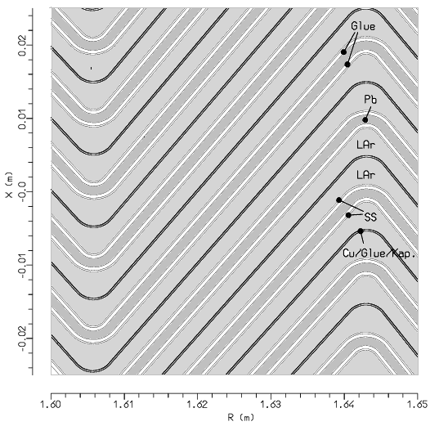
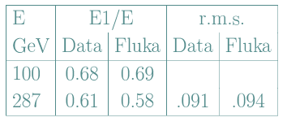
The ATLAS EM “accordion” calo (standalone test beams)
Detail of the FLUKA geometry and
response vs. electron impact position
deposited energy
287 GeV
electron
beam
Stars : fluka
Dots: expt. (RD3 collab.)
impact position
Energy resolution 10-100 GeV:
Longitudinal Development

Slide 27
Muon interactions

Slide 28
Bremsstrahlung and pair production
At high energies, bremsstrahlung and pair production are important also for muons and charged hadrons. For instance, in Lead the muon energy loss is dominated by these processes above 300 GeV.
For muons and all charged hadrons:
Bremsstrahlung :implemented in FLUKA including the effect of nuclear form factors
Pair Production :implemented
Activation of these processes and thresholds of EXPLICIT γ and e± production depend on the DEFAULTS chosen. They are controlled by the card
PAIRBREM Flag e±Thresh γThresh Mat1 Mat2 Step
Below threshold, energy loss is accounted for in a continuous approximation

Slide 29
Energy Deposition spectrum in the Atlas tile-calorimeter prototype
300 GeV muons on iron + scintillator structure
ionization
Bremsstrahlung +
Pair production

Slide 30
Muon Photonuclear Reactions
Schematic view of a μ hadronic interaction.
The interaction is mediated by a virtual photon.
The final state can be more
complex
The cross section can be factorized (following Bezrukov-Bugaev) in
virtual photon production and photon-nucleus reaction.
Nuclear screening is taken into account.
Only Virtual Meson Interactions are modeled, following the
FLUKA meson-nucleon interaction models.
Nuclear effects are the same as for hadron-nucleus interactions

Slide 31
Muon photonuclear: options
μ photonuclear interactions are NOT activated with any default
To activate them:
MUPHOTON Flag Mat1 Mat2 Step
Flag controls activation of interactions, with the possibility to simulate the interaction without explicit production and transport of secondaries
( this gives the correct muon energy loss/ straggling)
Since the μ photonuclear cross section is very small, MUPHOTON should be always accompanied by LAM-BIAS ( see lecture on biasing)
LAM-BIAS Factor Mat MUON+ MUON-

Slide 32
Muon-induced neutron background in underground labs
PRD64 (2001) 013012
Neutron production rate as a function of muon energy
Stars+line : FLUKA simulation with a fit to a power law.
Exp. points:
abscissa →average μ energy
at the experiment's depth:
20 m.w.e.
25 m.w.e.
C) 32 m.w.e. (Palo Verde)
D) 316 m.w.e.
E) 750 m.w.e.
F) 3650 m.w.e. (LVD)
G) 5200 m.w.e. (LSD)

Slide 33
Muon Capture

Slide 34
Muon Capture II

Slide 35
Electromagnetic dissociation

Slide 36
Electromagnetic dissociation
Note: Electromagnetic dissociation is already relevant for interactions of
few GeV/n ions in heavy targets.

Slide 37
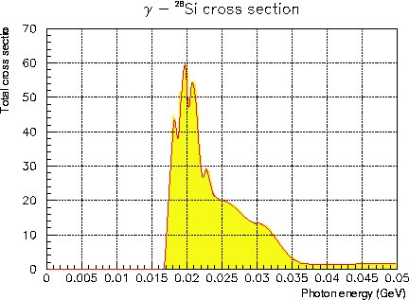
Electromagnetic dissociation: example
Left: ²⁸Si(g,tot) as recorded in FLUKA database, 8 interval Bezier fit as used for the Electromagnetic Dissociation event generator.

Slide 38
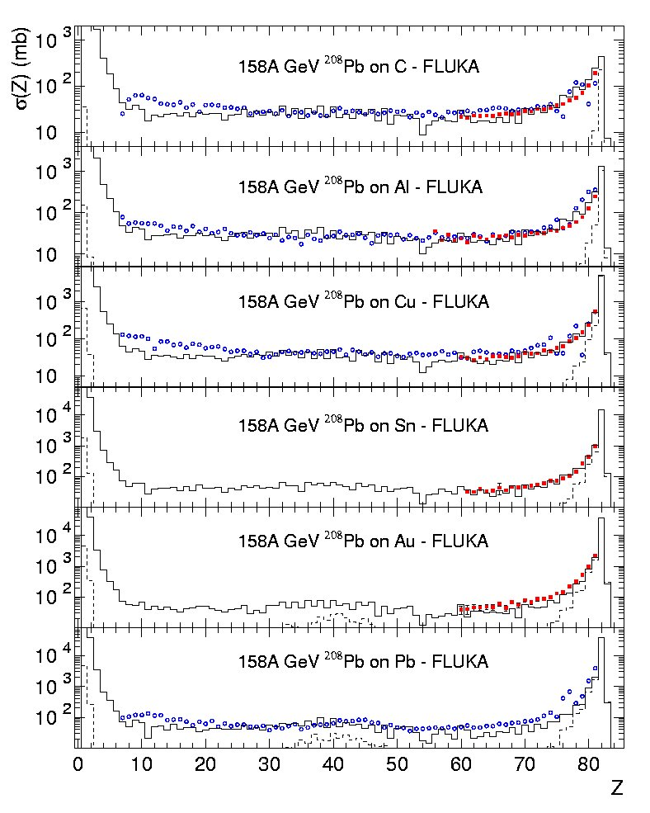
158 GeV/n fragmentation
Fragment charge cross section for 158 AGeV Pb ions on various targets. Data (symbols) from NPA662, 207 (2000), NPA707, 513 (2002) (blue circles) and from C.Scheidenberger et al. PRC70, 014902 (2004) (red squares), histos are FLUKA (with DPMJET-III) predictions: the dashed histo is the electromagnetic dissociation contribution

Slide 39
Electromagnetic dissociation - Benchmarks
Fragment charge cross sections for
10.6 GeV/n Au ions on Al and Pb.
FLUKA: solid histogram(total)
dashed histogram (em diss.)
Exp. data: symbols
PRC52, 334 (1995)

Slide 40
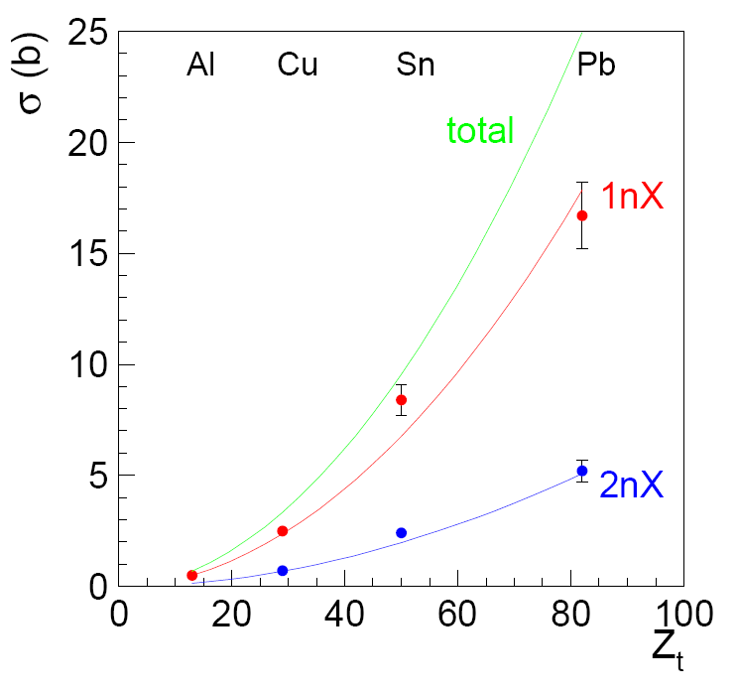
Electromagnetic dissociation - Benchmarks
Electromagnetic dissociation cross sections (total, 1nX, 2nX) for 30GeV/n Pb ions on
Al, Cu, Sn, and Pb targets.
FLUKA: lines (calculated cross section as a function of target charge)
Exp. data: M.B.Golubeva et al.,

