Slide 1
Handling of errors and crashes
Beginners FLUKA Course

Slide 2


Slide 3
DON’T PANIC
(Lecturer: +33450FLORIAN)
[your favorite teacher]

Slide 4
Overview
We often receive request of help from users
90% of times these requests are simple problems that the user could have located himself: the first purpose of this lecture is to help you how to spot an error which depends on the user.
In the 5% of cases a real FLUKA problem is found. To locate this kind of error is slightly more complicated, but the second purpose of this lecture is exactly concerning this.
In the other 5% of cases, the debate is on the meaningfulness of results. This has nothing to do with this lecture....

Slide 5
Verify your installation
Please ensure you have downloaded the right version of FLUKA for your platform and you have all packages needed for compiling and executing fortran programs
Typically for linux distributions you will need the
  g77 or compat-gcc-34-g77
  libg2c
Test if everything compiles ok by setting the correct $FLUPRO variable and
  cd $FLUPRO
  make
If everything is Ok you make will compile all fluka tools and the default executable $FLUPRO/flukahp

Slide 6
FLUKA Running procedure
When rfluka is executed the following procedure takes place
  Check the existence of $FLUPRO
  Check the existence of the executable
  default: $FLUPRO/flukahp
  Create a temporary directory named fluka_#### where #### is the process id given by the system to the rfluka job
  Run the executable which in turn it will create a
  <input>.log / .out / .err files containing the output of fortran file units 6, 11, 15, see the (IOUNIT) include file
  Check the existence of the ran<input>### the random number seed from the previous cycle if any otherwise create one based on the RANDOMIze card

Slide 7
Running through flair
Don’t forget that flair is using by default the “nohup” program to run (See the submit command in the Preferences dialog)
nohup is used to detach the execution of rfluka from the current terminal. This is important otherwise when you exit flair or your terminal the run will stop.
nohup is generating by default a “nohup.out” file located in your project directory containing a copy of all output of rfluka printed on the screen.
The nohup.out is not accessible from the “Output Files” but only from the “File Browser”

Slide 8
Attaching Mechanism in flair
flair is using a file based mechanism to identify the status of a run.
  Increases portability across various platforms and batch systems.
  However if the files are not generated, and you get the message “Waiting to attach” is impossible for flair to understand if there is a real problem or the run takes a long time to start
  Please look at the “Output Files” to find out the problem
The “Output Files” offers the possibility to delete all files and temporary directories generated by FLUKA is a good habit to clean them before starting a run.

Slide 9
Remember!!
ALWAYS look the content of the
<input>###.out
<input>###.log
<input>###.err
The error message most probably will be either
on the LAST line of the <input>###.out
WARNING: echo order of input cards is not the same as in the input
or
on the FIRST line of <input>###.log

Slide 10
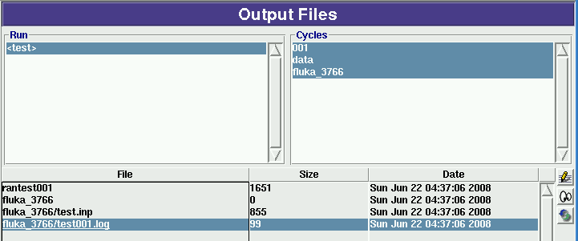
Waiting to attach
Double clicking on the .log file we see the message
there is an error accessing the executable file. Either it doesn’t exist or you have no permission

Slide 11
FLUKA version is expired...
You get the following message:
**** This version is obsolete and/or ****
**** you are not allowed to use FLUKA ****
**** Please contact Alfredo Ferrari ****
**** CERN-AB/ATB, tel.+41-22-76-76119 ****
**** or look for an updated version ****
**** at http://www.fluka.org ****
You have to download an updated version:
Download, recompile (if you have user routines) and relink.

Slide 12
Something wrong in the input file!
By far this is the most common problem. This is easily recognizable, since in the *.out file the echo of all line of input file is reported. In case of problem, the output stops with the last card correctly interpreted DURING the last pass.
In case the problem is in the geometry please look the file fort.16 in the fluka_#### directory
Be careful: sometimes non visible control characters may appear in a file sent via-mail (not for all mail clients!). In this case use “dos2unix” (a specific rpm in linux exists) They can be eliminated also using simple perl, or editor commands)
Remember to check always the first cycle you requested (typically input_001.out).

Slide 13

Typical examples of this case: ^{[1/3]}
You are using fixed format, but the SDUM identifying the particle is not well aligned
Another misalignment in fixed format the finale E of BLACKHOLE is lost

Slide 14


Typical examples of this case: ^{[2/3]}
You mistyped a FLUKA command ROT-DEF instead of ROT-DEFI
You gave a numerical value without the “.”
FLUKA expects all numbers with a floating point representation even the integers ONLY if they are not aligned to the right

Slide 15

Typical examples of this case: ^{[3/3]}
Another misalignment in fixed format: the E-03
Remember
The total line length should not be greater than 132 characters

Slide 16
General: Files and Unit numbers
Never use unit numbers smaller than 20 or higher than 99
<20 They are reserved by FLUKA
>99 Depends on fortran
Never mix the output of different scoring cards in the same unit
When programming prefer to use the routine OAUXFI that will correctly determine the location of the file you want to read from the following locations:
  Running temporary directory fluka_#####
  Current directory where .inp is located
  FLUKA directory pointed by $FLUPRO

Slide 17
General: RANDOMIze
You run several cycles and the statistical errors appears to be ZERO.
Most probably you are starting the same histories on every cycle. This is a typical error if the RANDOMIze card does not exist!
Verify the existence of RANDOMIze card and that WHAT(1)=1.0
You get the following message in the fluka_### dir
**** No Random file available !!!!!! ****
Abort called from FLRM64 reason NO RANDOM FILE Run stopped!
STOP NO RANDOM FILE
Most probably the error is on the previous cycle which didn’t generate a random number seed

Slide 18
Primary particle cards
Remember that for HEAVY IONS the Energy or Momentum in the beam card is PER NUCLEON, while in all other cards in FLUKA the energy is the total kinetic one.
Verify that your primary source BEAMPOS is NOT defined on a surface boundary, but is always inside a region.
If you define a SOURCE routine the standard FLUKA source is NOT CALLED. You have to define all distributions

Slide 19
Geometry: Have you debugged it?
Sometimes input errors are in the geometry
3 types of mistakes:
  trivial (wrong data cards)
  essential (non defined space points, multiple definition of space points): see the lectures on geometry and the use of DEBUG in the GEOEND card
  Precision errors due to insufficient digits or huge geometries
  See also the use of RAY to trace and analyze your geometry

Slide 20
Geometry: Trivial mistake…
There a ZCC is defined with only 2 numbers instead than 3.
You will find:
The important geometry errors may appear as a lot of messages in the *.out and *.err file, complaining that a point in space is not defined, cannot be reached, etc.
Remember the need for proper normalization of direction cosines! (magfld, source etc.) You will get a lot of (warning) messages also in those cases, but this is not a true error...

Slide 21
Geometry: Parenthesis expansion
Starting the run you get the following message in the first line of xxx.log file:
Subscript out of range on file line 56, procedure rpnorm.f/rpnorm.
Attempt to access the 114705-th element of variable tx.
You have exceeded the maximum expansion limit for parenthesis. Which is 100 000.
WARNING even with a simple region expression you could easily reach this limit especially if you are using infinite bodies!

Slide 22
Geometry: Errors during tracking ^{[1/2]}
Geofar: Particle in region 3 (cell # 0) in position 1.000000000E+00 0.000000000E+00 1.000000000E+00 is now causing trouble, requesting a step of 6.258867675E-07 cm to direction -2.285059979E-01 -9.412338141E-01 2.487245789E-01, error count: 0 [...skipped...] Particle index 3 total energy 5.189748600E-04 GeV Nsurf 0 We succeeded in saving the particle: current region is n. 2 (cell # 0
Getting GEOFAR errors during tracking is pointing to:
  errors in the geometry
  Numerical precision errors
FLUKA will try to “save” the problematic particles. But if they are too many it will stop the run.
G1 errors means a problem in your geometry. Please check your geometry for possible errors.
LATTICE are VERY sensitive to numerical precision. Use as many digits as possible to ensure proper description of the lattice, transformation and prototype.

Slide 23
Geometry: Errors during tracking ^{[2/2]}
The error position is given by the following vector operation
position + step * direction

Slide 24
Media: MATERIAL errors
That you have specified a material for every region
You specified the density for the MATERIALs
You supplied the Z,A when specific isotopes are requested
You DON’T supply any Z or A when a compound is requested
When you want to override an existing FLUKA material ALWAYS specify the index WHAT(4)
No holes in MATERIAL indices are allowed

Slide 25
Media: COMPOUND
Mixing fractions (signs)
Recursion
Numbers out of order when copying/pasting (Use always the NAMES format)

Slide 26

LOW-MAT errors ^{[1/2]}
There a material has been defined using a name which has no correspondence with the low energy neutron cross sections available in FLUKA (see chap. 10 of the manual). In this case POTASS instead of POTASSIU
Check the names of the materials.
Check the use of LOW-MAT cards: check if are using the updated parameters listed in the manual. Do you really need LOW-MAT? This is necessary only in a limited number of cases and it is easy to misinterpret this command if you are not an expert user.
[Read carefully the manual about this]

Slide 27
LOW-MAT errors ^{[2/2]}
WARNING on the change of the temperature
  New library with 260 groups uses: 296 K
  Old library with 72 groups uses: 293 K
When an error is printed FLUKA prints the SDUM of the LOW-MAT card. If the SDUM is empty you will see nothing in the output

Slide 28
Scoring: USRBIN/EVENTBIN
*** Activity/fission/neutron balance binnings cannot be track-length!!!
USRBIN scoring method:
Track-length quantities: that can be distributed along a track,
e.g. fluence, energy deposition…
WHAT(1)>=10
Point-wise quantities: that have to be scored on a point, or in the middle of the step!
e.g Activity, Fission, Neutron balance…
WHAT(1)<10

Slide 29
Preprocessor
Preprocessor directives are very powerful, but very quickly can make your input unreadable. Please use with care
  Check every #if should have a corresponding #endif
  Up to 10 nesting are allowed
  Up to 40 definitions

Slide 30
Merging cycles from different inputs
Verify that you didn’t merge cycles from different runs that the input has been modified.
It’s a good habit to clean the files before starting a run.
Flair offers this possibility from the “Output Files” frame.
It’s good to develop the habit to clean the output files from test runs.

Slide 31
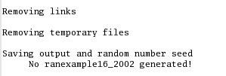
What is left after these problems
These errors are not generating exceptions. The temporary directory is erased and you remain with this message on the standard output:

Slide 32
FLUKA users and the manual
All reported here so far implies that a FLUKA user is living symbiotically with the Manual....

Slide 33
NOW PANIC
(Alfredo: +33450ALFREDO)

Slide 34
Run time errors with exceptions...
These are caused in 90% of cases by problems in user’s code or user’s configuration
You will see a message of this kind:
The temporary directory remains there. You will find the *.log, *.out, *.err files, a core.* file and the last random seed
The last random seed allows to restart your run from a configuration which was the one occurring at maximum 5 minutes of CPU before the error!
You can easily spot the problem using the GNU debugger (gdb).

Slide 35
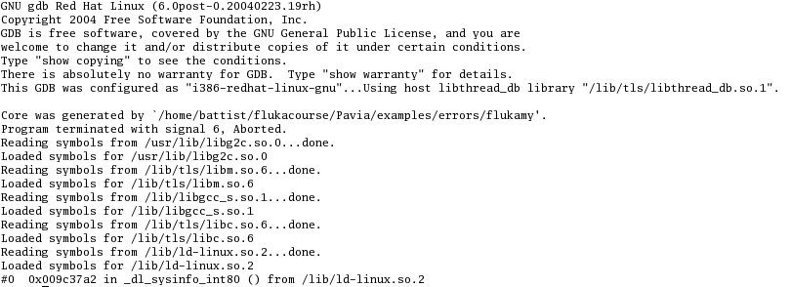
Using gdb ^{[1/5]}
Go inside the temporary directory
type: gdb ../flukahp core.nnnn
From flair you can double click on the core file from the
“Output Files” Frame

Slide 36
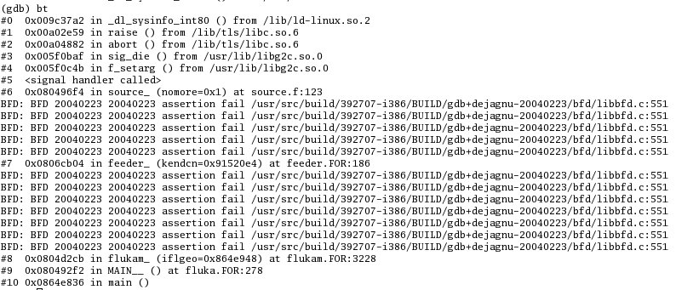
Using gdb ^{[2/5]}
3) give the command bt (or where)
Here it is!
frame #6 in source.f
at line 123

Slide 37

Using gdb ^{[3/5]}
4) type: frame 6
5) you can inspect variable content, for instance:
A negative kinetic energy!!!!!

Slide 38
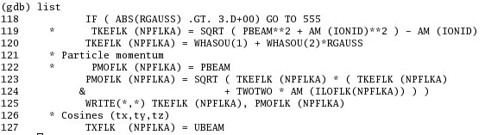
Using gdb ^{[4/5]}
6) you can list the nearby lines:
It’s quite obvious that this was not a protected
statement!

Slide 39
Using gdb ^{[5/5]}
In the remaining 5% of cases there will be an error inside a FLUKA routine.
In that case, if you have not the source, prepare a report with the gdb results and send it to fluka-discuss@fluka.org together with a tar file containing: input, user routines (if any), additional auxiliary files, last random seed, and any other possible useful information.

Slide 40
Other cases ^{[1/3]}
In case you are using SOURCE, and by mistake you sample an energy (or momentum) larger than the WHAT(1) value of the BEAM card (maximum of dE/dx tabulation), then an ABORT will be generated at run time.
The *.out file will contain the following message:

Slide 41
Other cases ^{[2/3]}
An error in reading Unit 14 refers to nuclear.bin: your nuclear.bin file might be corrupted or missing (check all your binary files in $FLUPRO) or doesn’t match the FLUKA distribution
Error in reading Unit 1: a problem in the random seed! Often in case when you start in with rfluka using –N n with n>0 : check for the existence of ran***n in the launch directory!

Slide 42

Other cases ^{[3/3]}
The above message occurs whenever the seed for the run is not available (or is corrupted).
Example: if, for instance you ask for n cycles, and cycle #n-k ends with an error, then the seed for cycle#n-k+1 is not produced and therefore all runs from n-k+1 to n will crash in this way...

Slide 43
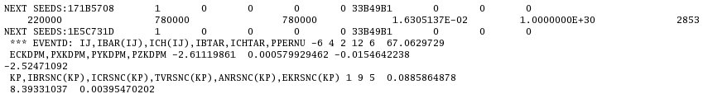
The *.err file
The *.err file will report errors, but also a lot of warning which have a meaning mostly for the developers.
For instance: the following messages are not errors!
No. of events
remaining to be simulated
No. of events
simulated so far

Slide 44
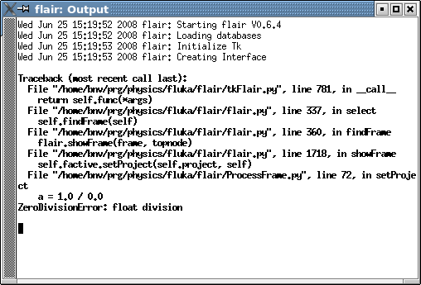
Flair output window
The output window of flair contains all messages from flair, fluka, processing and plotting tools.
Always consult it in case of problem or on doubt that something goes wrong
A Traceback means that
something went wrong
with flair

Slide 45
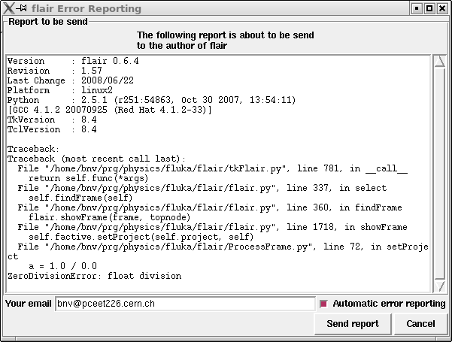
Flair Error Report
In case of Traceback, when closing flair or after too many messages flair will propose to send the traceback to the author for further investigation
Please send this report
unless if you are sure that
is due to your fault
e.g. opening a problematic
input, directory non
existant etc.
It will be good to provide
also a small description on
how to reproduce the
problem.
The text box is editable

Slide 46
Doubts on the results?
FLUKA reads the input file in many passages. Therefore the order of the cards do not correspond in some cases to the order that FLUKA will process the card!
Firstly (and not only in case of doubts) read the FAQ of FLUKA
Secondly make a search in the FLUKA discussion list for a similar problem
Thirdly If you really cannot understand, or if you need to ask about physics related problems, once again write to fluka-discuss@fluka.org

