Slide 1

FLUPIX and VirtualBox
Beginners FLUKA Course

Slide 2
Introduction
FLUPIX (FLUKA in KNOPPIX) is a FLUKA (www.fluka.org) + Flair (www.fluka.org/flair) Live CD based on Knoppix (www.knoppix.net), a Free and Open Source Live Linux CD.
Knoppix is a GNU/Linux distribution that boots and runs completely from CD. It includes recent linux software and desktop environments
The CD contains the minimum possible working version of Linux with KDE, with all the necessary packages for compiling and running FLUKA and Flair. Total size ~500MB
The CD is specially configured for running under VirtualBox (www.virtualbox.org) an open source virtual machine by Sun. It is available under many platforms (all Linux, M$ Windows, Mac OS, OpenSolaris)
Software location inside FLUPIX
  FLUKA: /usr/local/fluka
  FLAIR: /usr/local/flair

Slide 3
VirtualBox
VirtualBox is an x86 virtualization software package originally created Innotek and now being developed by Sun Microsystems as part of its Sun xVM virtualization platform.
It is installed on an existing host operating system; within this application, additional operating systems, each known as a Guest OS, can be loaded and run, each with its own virtual environment.
For example, Linux can be guest hosted on a single virtual machine running Microsoft Windows XP as the Host OS; or, XP and Windows Vista can run as guest OSes on a machine running OpenSolaris.

Slide 4
Installation of FLUPIX for Vbox
A faster and easier way of running FLUPIX is through VirtualBox.
You will need the following packages
  VirtualBox-X.Y.Z-Win_x86.msi
  The windows setup program of VirtualBox. Install this program in your Windows OS or Mac OS.
  flupix-200X-YYY.iso
  The FLUPIX bootable CD iso image. Copy this image in a directory were you have ~500MB of space
  FLUPIX_VM_Vbox.zip
  The default configuration of FLUPIX for VirtualBox. Unpack the content of the zip file to copy them to
  C:\Documents And Settings\username\.VirtualBox
  or
  C:\Users\username\.VirtualBox

Slide 5
Setting up
The FLUPIX_VM_Vbox.zip contains a predefined VM named FLUPIX that is attaching two Virtual disks
  home.vdi Dynamic size disk up to 8 Gb, formatted in ext2 used for working space
  swap.vdi Fixed size disk of 256MB used for swapping
The first time that you will start VirtualBox it will complain for the location of flupix-XXXX-X.iso image
  Select the CD/DVD Images tab.
  Select the flupix iso image and click on Release button
  Click on Remove button
  Click on Add button and locate the correct ISO image
Then on the CD/DVD Rom tab
  Check the Mount CD/DVD Drive
  Check the ISO Image File
  Select the flupix iso image

Slide 6
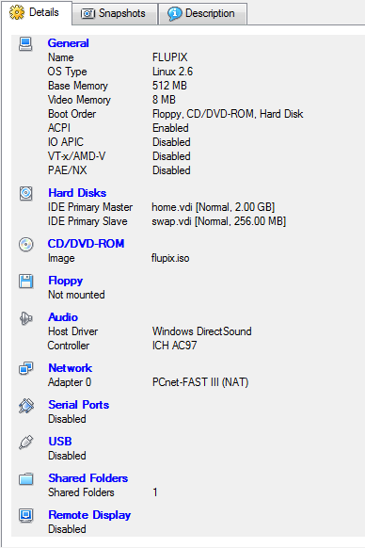
FLUPIX Settings
Memory Settings:
Minimum requirement RAM:512MB and Swap:256MB
  Linux needs at least 256MB to run
  FLUKA needs ~400MB
  with DPMJET ~500MB
  Some FLUKA tools need ~500MB
  FLAIR memory is dynamic

Slide 7

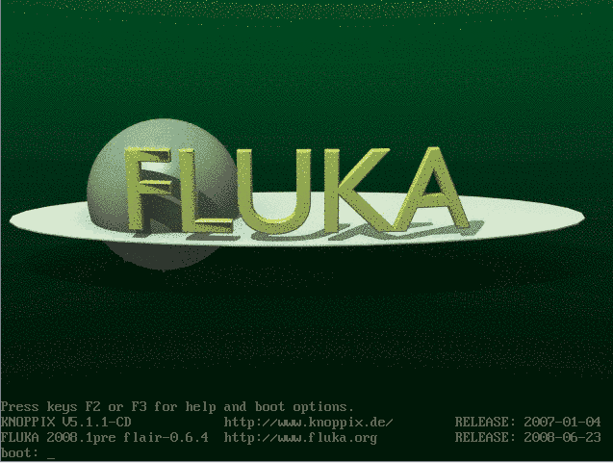
Starting the VM
Click on the Start button
Function keys F1, F2, F3 will toggle between the available pages for booting options.
It is sufficient to just hit the Enter key to continue booting

Slide 8
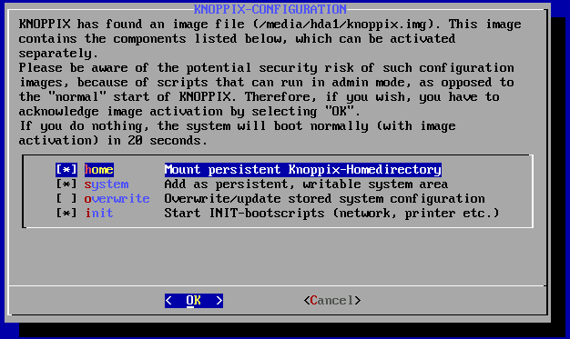
Booting
During booting knoppix will try to identify your hardware and available devices
Since the system is pre-configured, knoppix will find the persistent image on the first virtual disk and it will ask you to load it. Click on Ok
DO NOT SELECT
the overwrite
unless you want
to reset the default
settings

Slide 9
Working space
The linux root directory “/” is mounted as readonly from the FLUPIX iso file.
However you have the possibility of writing and installing extra programs on the “/” directory using the persistent data image (see below)
The home.vdi is mounted as /mnt/hda1 or /media/hda1 and it contains the following:
  knoppix.img an image disk of 100MB the persistent data image of knoppix.
  work work directory assigned to user knoppix.
  This directory is accessible also from /home/knoppix/work
The swap.vdi contains a memory swap disk of 256MB
REMEMBER that your default home directory is located inside the knoppix.img and is limited to 100MB
For simulation use always the work directory

Slide 10
Interface
FLUPIX has precompiled the utilities from VirtualBox that allows
  Mouse integration (only in X11). The mouse of the host is used as such from the guest system. In all other displays the guest is getting the FULL control of the mouse
  A special driver for X11 video, for faster and smoother graphics (Change the video driver in /etc/X11/xorg.conf to “vboxvideo”)
  Time synchronization with the host system
  Folder sharing from the host to the guest system.
Remember the “Right-Ctrl” key is the default Host key of your Virtual Machine. With the use of this key you can redirect all input (keyboard+mouse) from your host to your guest system and many other.

Slide 11
Accessing your host directories
There are several ways of accessing directories from the host system.
The easiest way is through the use of a Shared Folder
Create a Shared folder from your VirtualBox and give a name e.g. home
From FLUPIX call the command
vboxmount home ~/home
The command will create a directory ~/home and mount the Shared folder home to it
Add the command to your profile script to be executed on every login.
You cannot run FLUKA inside a shared folder since symbolinc links are not supported

Slide 12
Shutting down
Always try to shutdown correctly the VirtualMachine, from the KDE menu.
Otherwise you can end up with a corrupted persistent image.
You can even save the machine state, which is equivalent like StandBy. It will create a file equal to the size of the RAM defined 512MB

