Slide 1
Flair Introduction
Beginners FLUKA Course

Slide 2
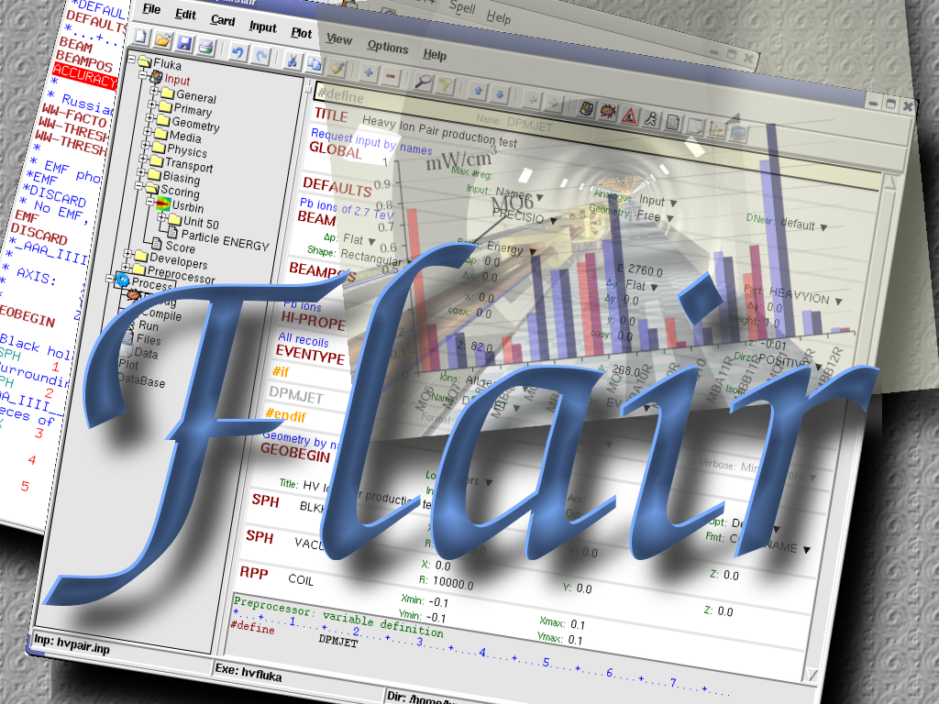
About
/fleə(r)/ n [U,C] natural or instinctive ability (to do something well,
    to select or recognize what is best, more useful, etc.
    [Oxford Advanced Dictionary of Current English]

Slide 3
Why is UI design important
User Interfaces are what allows end users to interact with an application.
A good UI will make an application intuitive and easy to use
Excellent applications without good UI will be less popular than inferior ones with a good UI

Slide 4
What makes a good UI?
General:
Simple
Intuitive
Respects the commonly accepted conventions
Visually organized
Native look
Easily install and setup
Extensible / Programmable
FLUKA:
Do not hide the inner functionality
Provide a platform for working/analyzing results

Slide 5
Software choices ^{[1/2]}
Requirements:
Open source software
Multiplatform with easy installation
Minimum requirements on other package
Large community of users and years of development
Python [http://www.python.org]
is a scripting language which is:
interpreted
interactive
object-oriented
like pseudo code
dynamically typed
available for many platforms
extensible with C-API

Slide 6
Software choices ^{[2/2]}
Tkinter [http://wiki.python.org/moin/TkInter]
default GUI toolkit for Python.
Good for simple UIs.
Portable, wrapper around tk/tcl
Gnuplot [http://www.gnuplot.info]
is a command-line driven, interactive function plotting program specially suited for scientific data representation. Gnuplot can be used to plot functions and data points in both two and three dimensions and in many different formats.
Povray [http://www.povray.org]
POV-Ray™ is short for the Persistence of Vision™ Raytracer, a tool for producing high-quality computer graphics. POV-Ray™ is copyrighted freeware. POV-Ray is the worlds most popular raytracer.

Slide 7
What is flair ^{[1/2]}
FLUKA Advanced Interface [http://www.fluka.org/flair]
All-in-one User friendly graphical Interface
With minimum requirements on additional software
Working in an intermediate level:
Not hiding the inner functionality of FLUKA
Front-End interface:
Fully featured Input file Editor
    mini-dialogs for each card, allows easy and almost error free editing
    Uniform treatment of all FLUKA cards
    Card grouping in categories and card filtering
    Error checking and validation of the input file during editing
Geometry: transformation, optimizations and debugging
Compilation of the FLUKA Executable
Running and monitoring of the status of a/many run(s)

Slide 8
What is flair ^{[2/2]}
Back-End interface:
Inspection of the output files (core dumps and directories)
Output file viewer dividing into sections
Post processing (merging) the output data files
Plot generation through an interface with gnuplot
Input information, USRxxx, RESNUCLEI and geometry
3D photo-realistic images with PovRay (ToDo)
Other Goodies:
Access to FLUKA manual as hyper text
Checking for release updates of FLUKA and flair
Nuclear wallet cards
Library of materials
Database of geometrical objects (ToDo)
Programming python API

Slide 9
Concepts: Flair Project
Store in a single file all relevant information:
  Project notes
  Links to needed files: input file, source routines, output files …
  Multiple runs from the same input file, as well running status
  Procedures on how to run the code
  Rules on how to perform data merging
  Information on how to post process and create plots of the results
You can consider flair as an editor for the project files.
Can handle any FLUKA input format (reading & writing), but internally it works using the names format for the input, free with names for the geometry (Recommended way of working)
The format is plain ASCII file with extension: .flair
Note: If you want to copy a project you need to copy also all linked files especially the input and source routines!

Slide 10
Installation
Flair web site to download code and documentation
http://www.fluka.org/flair
Installation procedure
  RPM method: strongly recommended! on systems that support the RPM. The RPM will create all file association, menu items and keep track of updates and files installed.
  The RPM will install the program to: /usr/local/flair
  and will create the following launcher programs:
    /usr/local/bin/flair flair program
    /usr/local/bin/fm FLUKA manual
    /usr/local/bin/pt Periodic Table
    /usr/local/bin/fless Fluka output viewer
  tar.gz method: Manual installation on platforms like (MS-Windows, Mac OS…). Please follow the instructions on the http://www.fluka.org/flair/download.html and for special instruction on the FAQ http://www.fluka.org/flair/faq.html

Slide 11
Version Numbering
Flair version numbering, has the form: flair-M.m-R
M: Major version, this number is increased by one only when a major modification in the structure of the program takes place. During the initial phase of development is 0.
m: Minor version, this number is increased by one every time an addition in the program’s functionality is made. e.g. Adding new plotting forms, mechanism, databases etc.
R: Patch level, this number is increased when bug fixes take place or minor changes in the functionality. e.g. Addition of extra fields in a form etc.
The About Dialog of the program displays the Major and minor version as well the CVS release number, every time changes in the program are committed to the CVS server.
The Update dialog of flair will ask the user to check on the web every 30 days (default) for a new flair version (M.m) and FLUKA release.

Slide 12


Starting flair
Programs Menu
Click the icon of Flair from the programs menu. Flair is registered under the Science/Physics category
Note: freedesktop however places this category in various places depending your linux distribution and window manager
Typical places:
  Applications
  Edutainment
  Edutainment / Science
  Scientific
Window Manager (only via RPM or DEB installation):
Flair makes an association of the following extensions:
*.flair *.fluka, *.inp
Console
Type the command /usr/local/bin/flair
It is recommended to place in your PATH the /usr/local/bin directory

Slide 13
Startup
During startup flair will perform the following:
Open an “xterm” to be used as the Output window
Display the About Dialog
Check for the existence of FLUPRO variable, and if not found will open the Preferences dialog to set explicitly the FLUKA path.
WARNING: Window managers (GNOME, KDE…), as well command shells (bash, tcsh, ash…) have a different configuration file where they expect the environment variable.
Display the “Tip of the Day” dialog
Open the “Check for Updates” dialog (every 30 days interval)

Slide 14
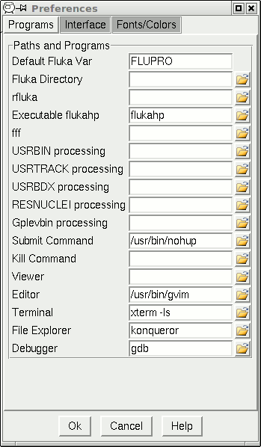
Basic Preferences
The program tab of preferences allows the user to set the default programs and directories
Set your FLUKA directory,
to override $FLUPRO
Set your favorite editor
Set your favorite console program
Set your favorite file browser

Slide 15
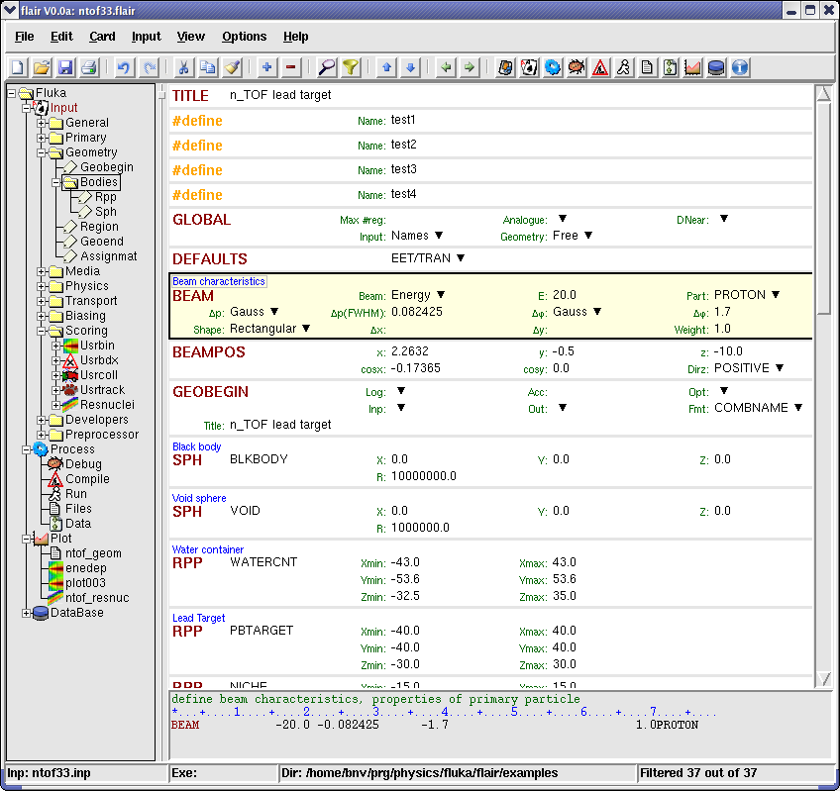
Program Interface
  Wrapper of standalone applications
  Tree browser to select application
  Allow different ways of viewing the same object
  Input:
    Filtering Cards
    Show card links
    Units: i.e. 20 GeV/c (ToDo)
    Data validation
    Import/Export on various formats
  Process:
    Debugging
    Compilation
    Run monitoring
    Merging
  Plotting:
    Interface to plot packages
    Table of Isotopes
  Python Libraries:
    Input file manipulation
    Processing
    Plotting
Tree
Browser
Embedded
Applications

Slide 16
Menus
File Edit Card Input View Tools Help
File I/O, export to other formats, printing, recent projects
Edit Common editing features: Cut, Paste, Add, Del, Clone, Filter
Card Add or change cards in input; grouped by Categories
Input Commands to manipulate input cards
View Accessing various views of flair
Tools General purpose commands: Terminal, Browser, Preferences
Help Access to help, check for updates, web page, about dialog
Keyboard Short cut: F10 or Alt-F, E, C, I, V, T, H

Slide 17
Toolbar
Undo/Redo
Find/Filter
Project Control I/O
Cut/Copy/Paste
Add/Del/Clone/Toggle
Move Up/Down
Quick Access to:
Project Frame
Input Editor
Process Summary
Compile
Debug Geometry
Run
View output files
Data merging
Plots
Databases
Help

Slide 18
Input Templates
When requesting a new input or a new project flair will prompt to select an input template
flair default templates are prefixed with “D:”
User templates will be prefixed with “U:”
The user can create his own set of input templates. They are normal FLUKA input files and they have to be placed in the directory (create the directory if not existing)
~/.flair/templates

Slide 19
Input Editor
With the input editor the user can manipulate the input cards.
  Add card to input
  Edit & modify existing ones
  Copy & Paste
  Clone (Duplicate)
  Import from other input files
  Validate the correctness of the cards
  Error filtering
  Rearrange order
The editor will always try to rearrange the input cards (only if needed) to create a valid FLUKA input file.
e.g. body cards outside the GEOBEGIN..GEOEND will be moved inside

Slide 20
Card Categories
For easier access, cards are groups in the following categories:
General General purpose (TITLE, DEFAULTS, GLOBAL…)
Primary Definition of the primary starting particles
Geometry Cards related to the definition of the geometry bodies/regions/lattices plotting and rotations/translations
… Bodies Subcategory containing only the bodies definition
Media Definition and assignment of materials
Physics Setting physics properties of the simulation
Transport Modify the way particles are transported in FLUKA
Biasing Cards for importance biasing definition
Scoring Cards related to scoring
Developers …reserved for FLUKA developers…
Preprocessor definitions for creating conditional input files

Slide 21
Concepts: Extended Cards ^{[1/2]}
Flair is treating the input file as a list of extended cards
Each extended card contains:
  Comment: All commented lines preceding the card(s) as well the inline comments
  Tag: The 8 character word identifying the card. All tags not recognized by flair will be converted to #error
  Whats: Multiple number of whats (0=sdum, 1-6 first line, 7-12 continuation line...)
  Extra: multi line string of extra information for special cards like REGION, TITLE, PLOTGEOM etc.
  State (Enable/Disable)

Slide 22
Concepts: Extended Cards ^{[2/2]}
Flair has introduced a few special cards to homogenise the FLUKA input file representation:
  REGION, referring to a region declaration in geometry
  COMPOUND, all compound cards related to one material are joined in one card
  END card for bodies/regions is no longer required
Cards can be edited with the flair editor through the use of the minidialogs, forcing the user to enter the “correct” information. Or through the Edit dialog (Ctrl-E) that the user has full control of the card
Flair will try to find the best floating point representation of each number, to ensure the maximum accuracy; number of digits that fits in the specific width (10 for the fixed format, 22 for the free format)

Slide 23

Anatomy of a card mini-dialog ^{[1/2]}
For each extended card flair has a mini dialog (currently in 4 columns), interpreting all information stored in the card
* Beam characteristics
BEAM -20.0 -0.082425 -1.7 1.0PROTON
Comment
Interpreted
Value of WHAT(1)
Drop down list box
with possible options
Label
Grey box
Shows currently
editing item
Tag

Slide 24

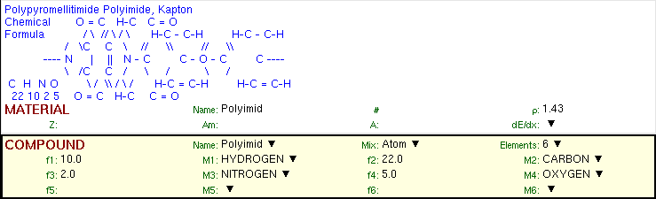
Anatomy of a card mini-dialog ^{[2/2]}
* Energy deposition in 3D binning
USRBIN 10.0 ENERGY -50.0 45.0 54.0 36.0EneDep
USRBIN -45.0 -54.0 -33.0 100.0 100.0 100.0&
* Polypyromellitimide Polyimide, Kapton
* Chemical O = C H-C C = O
* Formula / \ // \ / \ H-C - C-H H-C - C-H
* / \C C \ // \\ // \\
* ---- N | || N - C C - O - C C ----
* \ /C C / \ / \ /
* C H N O \ / \\ / \ / H-C = C-H H-C = C-H
* 22 10 2 5 O = C H-C C = O
MATERIAL 1.43 Polyimid
COMPOUND 10.0 HYDROGEN 22.0 CARBON 2.0 NITROGENPolyimid
COMPOUND 5.0 OXYGEN Polyimid

Slide 25
Editing Cards
While in input editor you are working in two modes
Card mode: where you manipulate the cards as a unit. Copy, paste, delete, change order of cards
Edit mode: where you manipulate the contents of the card. Edit mode is activated immediately after adding a new card or by hitting Enter or with the mouse click. To leave edit mode click the Esc or with the mouse click somewhere else.
The active item (what) is highlighted with a grey rectangle and highlighted also in the card viewer below the editor.
Shift+Mouse or Shift+Up/Down arrows selects a range of cards

Slide 26
Validating input and Error correction
flair validates the input file while loading and each card during editing.
Errors are highlighted with red.
For the moment only syntactical errors are checked, and a few logical errors.
Popup-menu option “Show errors” displays a short message on what is expected as correct value.
Menu item “Input / Filter Invalid” shows only the invalid cards from the last filtered view

Slide 27
Material Database
flair contains an internal database of ~500 predefined materials / compounds.
Some (~300) with the Sternheimer parameters
Please use this data as Reference only!
Validate always the correctness of the data
If errors found please contact the author
The database can be edited, and populated with your own materials. In this case a local copy of the database will be made in ~/.flair directory

Slide 28
Starting a Run
Flair can start a single run based on the input file, or multiple runs by overriding some options, like #defines, title, random number seed and number of starting particles
Flair will try to “attach” to a run. Using only the information from the output files generated by FLUKA, flair will try to identify the directory where the run takes place and monitor the progress of the Run.
During the execution of the run the user can view the output files in the “Files Frame”

Slide 29
Tips & Tricks
Mouse
  right-click opens the popup-menu with the most
  important actions
Keyboard Check the accelerators on the menus
  Ctlr-Enter Performs the default action in every frame.
  Add a card in the Input Editor
  Ctrl-Space Access popup-menu (like right-clicking)
  Listboxes All listboxes in flair are searchable and case
  insensitive. Type the first characters of the
  string you are searching and the closest
  match will be highlighted.
  Ctrl-G repeats the search. Space
  selects/deselect item
  +, -, Ins While editing the REGION expression shows
  a list of all available bodies

Slide 30
ToDo: Features to be added
Interface
  Exportation of processing scripts and various formats (Geant...)
  Import from other codes (MCNP…)
Input Editor
  A group of flair cards for manipulating the input file. Including dynamic transformations, variables, vector operations, etc.
Post Processing
  Re-binning or USRBINs
  Maximum trace
Plotting:
  Information of Input File
  3D Ray Tracing interface to povray
  Particle tracks

Slide 31
How to Contribute
Python programming
  Parsing and processing output files
  Web based database for sharing resources with other users
  ...
Input Editor
  Cards Layout, in other formats (from 3 up to 8 columns)
  Labels have to be intuitive, if something is not comprehensible please propose an alternative
Manual, Online documentation, Tips database
Icons for tool bars and cards
Gnuplot scripts or ideas for better presentation
Comments & Ideas, on new features that one wants to see
Testing, Bug reporting
...

Slide 32
Known Bugs / Limitations
Unicode / International characters do not work well and should be avoided
Gnuplot <4.2 has a bug in the number of palette colors
Inline comments, and comments inside REGION definition are treated as one comment preceding the input card
REMEMBER always that the .flair and .inp are different thing. Do not save the project as .inp or the input file as .flair

Slide 33
Other goodies
Flair has a lot of functionality that is not covered in this tutorial. I would advice the users to go through the various menus and help page and try it out.

