Slide 1
FLUKA: Flair Plots
Beginners FLUKA Course

Slide 2
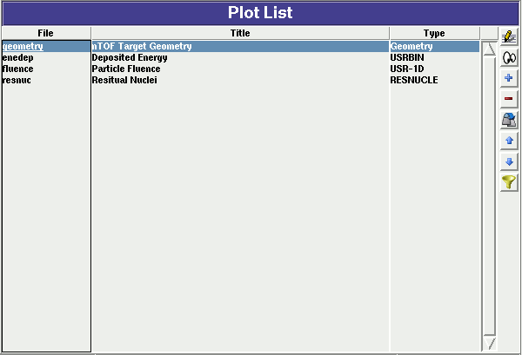
Plot List
Plots can be created in the “Plot” list frame. Either Add new plots or Clone from existing ones.
It is important to set a unique filename for each plot. This filename will be used for every auxiliary file that the plot needs (the extension will change)
The Filter button creates automatically one plot for each processed unit
Hit Enter or click the Edit icon to display the plotting dialog
Plot Types
Geometry For geometry plots
USRBIN For plotting the output of USRBIN
USR-1D To plot single differential quantities from cards
USRBDX, USRTRACK, USRCOLL, USRYIELD
USR-2D To plot double differential from USRBDX
RESNUCLE To plot 1d or 2d distributions of RESNUCLEi
USERDUMP To plot the output of USERDUMP. Useful for visualizing the source distribution (ToDo)

Slide 3
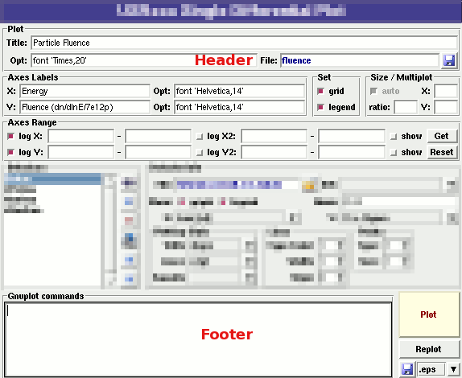
Plotting Frames
All plot types share some common fields:
Title + options, Filename, Axis Labels, Legends (Keys) and Gnuplot Commands.
Plot button (Ctrl-Enter) will generate all the necessary files to display the plot, ONLY if they do not exist.
Re-Plot will force the creation of all files regardless their state
Check the gnuplot manual to provide additional customization commands: e.g. To change the title font to Times size=20, add in the Opt: field the command: font ‘Times,20’

Slide 4
General Tips
To set some default parameters for gnuplot create a file called ~/.gnuplot
The output window displays all the commands that are sent to gnuplot. As well as the errors. In case of problem always consult the output window!
In the Gnuplot commands you can fully customize the plot by adding manually commands. Please consult the gnuplot manual for available commands
All buttons and fields have tool tips. Move the cursor on top of a field to get a short description

Slide 5
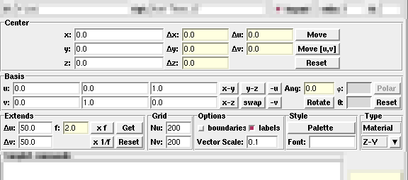
Geometry Plotting
For geometry plotting the following information is needed (Fields with white background):
  Center (x,y,z) point defining the center of your plot
  Basis (U,V): Two perpendicular axis vectors defining the new system
  Extends (DU, DV) of the plot. The total width/height will be twice the extends
  Scanning grid (NU, NV): how many points to scan
  Plotting type (Only borders, Regions, Materials, …)

Slide 6
Geometry plotting
All input fields with light-yellow background are used to perform operations on the previous fields. e.g. to rotate the basis-vectors
When the “Plot” button is pressed, flair will create a temporary input file containing only the geometry and the related information together with the appropriate PLOTGEOM card. It will start a FLUKA run, and on exit it will convert the PLOTGEOM file in a format that gnuplot understands

Slide 7
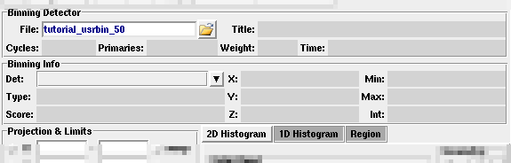
USRBIN
With the USRBIN plotting frame you can perform 2D or 1D projections of the data or errors from USRBIN data.
For the moment the special binning and region binning is not supported
Set the usrbin summary file in the File: field
Select from Det: the detector to use.
All the available detector information will be displayed
The information Mininum, Maximum and Integral will be filled after displaying the plot!

Slide 8
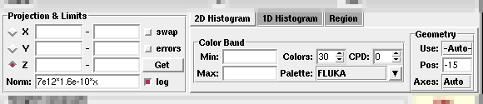
USRBIN (2D Plot)
Select the “2D Histogram” tab
Select the projection axis and limits
swap: will exchange the plotting X and Y axis
errors: will plot the error values as color plot
Get: will get the projection limits from the gnuplot window
Norm: is the normalization value or expression. You can even define a function to use as normalization using as argument x: e.g. 5*x**2+4*x
log: select linear or log in the color bar axis

Slide 9
USRBIN (2D Plot) ^{cont.}
The Minimum, Maximum, Colors and CPD (Colors per decade) are interconnected.
log10(Max) = log10(Min) + Colors/CPD
Once the value is changed in one field, the other will be calculated accordingly
Palette: offers a possibility to the user to choose from various predefined palettes. The user can define his own palette using the “set palette” command from the “Gnuplot commands” text box

Slide 10
USRBIN (2D plot) ^{cont..}
Superimpose the geometry can be done either automatically or manually.
  Auto: Select –Auto- in the Use: field of the Geometry and the program will try to draw the geometry at the middle of the limits on the projection axis. To change the position modify the Pos: value
  Manual: The dropdown listbox will display also a list of all geometry plots in the flair project. Select the one you prefer and the plotting axis. The manual mode can be used in special cases when the usrbin file do not contain the absolute coordinates
The color palette is predefined in flair, but the user can modify it with the “set palette” gnuplot command. See gnuplot help page for more info.

Slide 11
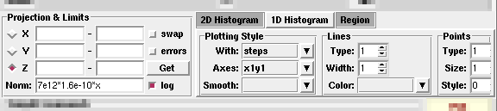
USRBIN (1D-plots)
Select the “1D Histogram” tab
Select the projection axis from “Projection & Limits” as before
WARNING: When making projections the error is typically underestimated.

Slide 12
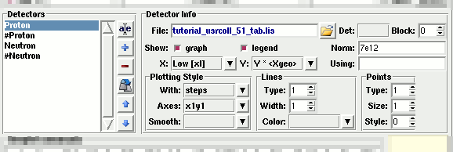
USR-1D Single Differential Plot
USR-1D is able to plot the 1D single differential information from the USRBDX, USRCOLL, USRTRACK and USRYIELD cards (The 2D information is not handled).
The file type in use should have the extension _tab.lis and are generated by the FLUKA data merging tools (See Data Frame)
You can superimpose many scoring output in a single plot.

Slide 13
USR-1D Single Differential Plot
The basic steps to create a plot are:
Add or Clone a _tab.lis file, in the Detectors listbox.
Select the detector to be used from the Det: dropdown listbox
Set a name in the Name: field. Names starting with # will not be displayed as keys in the plot
Select the X: and Y: information to plot as well the Style:
X,Y,Style have different values.
Note: Different combination will be interpreted in different way from gnuplot, resulting to maybe unwanted results
You have the possibility to select:
  Plotting axes
  Smoothing of the plot
  Color, line type, width, point sizes etc.
  (Enter the command “test” in the gnuplot command and hit “Plot” you will get a plot of all possible types)
  Predefined styles

Slide 14
USR-1D Plots
X: choices:
[xl, xh refer to the limits of each individual bin of the histogram]
  GeoMean [sqrt(xl*xh)] Geometrical mean. Should be used
  if X is scored as a log-histogram
  Mean [(xl+xh)/2] Normal mean. For linear scoring
  Low [xl] Low value of the bin
  High [xh] High value of the bin
Y: choices:
  Y Y-bin value as given by FLUKA
  Y × <X> Y-bin value multiplied by the mean
  X value of the bin (Isolethargic)
  Y × <Xgeo> Y-bin value multiplied by the geometrical X-mean of the bin (Isolethargic)
  Y × Xl -//- with the X-low value of the bin
  Y × Xh -//- with the X-high value of the bin
  Y × DX -//- with the width of the bin

Slide 15
USR-1D Plots
Style: has a huge list of choices as given by gnuplot. You can consult gnuplot manual for the description of the options. Some suggested settings are the following:
  To make a line/scatter plot with or without errors
  X: GeoMean (if scored in log), Mean (if scored in linear)
  Y: Y × < Xgeo or X>, for isolethargic plotting
  Style: lines, linespoints, dots, errorbars, yerrorbars, errorlines…
  To make a histogram
  X: Xlow [xl]
  Y: what ever choice you want to plot
  Style: steps
  or
  X: Xhigh [xh]
  Style: histeps

Slide 16
USR-1D Plots
You have the possibility to superimpose plots. Useful if you want to show a histogram with the errorbars superimposed.
You can selected angular slices from USRBDX data using the “Block” option
You can superimpose experimental data or any other data file and override all options using the “Using:” input field

Slide 17
USERDUMP
Still under development
Particle tracks (use with care)
Visualize the source particles distribution, as well superimposed with the geometry.

