Slide 1

FLUKA
Combinatorial Geometry
Beginners FLUKA Course

Slide 2
Introduction
Principle of Combinatorial Geometry: Basic convex shapes (bodies) like cylinders, spheres, parallelepipeds, etc. are combined to more complex shapes called regions. This combination is done by the boolean operations union, intersection and subtraction.
The Combinatorial Geometry used by FLUKA is loosely based on the package developed at ORNL for the neutron and gamma-ray transport program Morse (M.B. Emmett ORNL-4972 1975) which was based on the original combinatorial geometry by MAGI (Mathematical Applications Group, Inc., W. Guber et al, MAGI-6701 1967).

Slide 3
Input
The input format for the geometry is different from that adopted elsewhere in FLUKA, i.e. the number and length of the input fields is different.
The recommended format is called free format. For backward compatibility there are also other formats. Free format is not the default one!
One advantage of free format is that alignment of the input parameters is not necessary. Bodies and regions are identified by names.
In fixed format alignment is mandatory. Bodies and regions are identified by numbers and not by names which makes creation and updating of the geometry difficult.

Slide 4
Basic Concepts
Four concepts are fundamental in the FLUKA CG:
  Bodies - basic convex objects + infinite planes & infinite cylinders
  Zones - sub-region defined only with intersection and subtraction of bodies (used internally)
  Regions - are defined as boolean operations of bodies (union of zones)
  Lattices - duplication of existing objects (translated & rotated)
In the original description bodies were convex solid bodies (finite portions of space completely delimited by surfaces of first or second degree, i.e. planes or quadrics). In FLUKA, the definition has been extended to include infinite cylinders (circular and elliptical) and planes (half-spaces).
Use of such “infinite bodies” is encouraged since it makes input less error-prone. They also provide a more accurate and faster tracking.

Slide 5
Bodies
Each body divides the space into two regions inside and outside.
The outside region is pointed to by the normal on the surface.
3-character code of available bodies:
  RPP: Rectangular parallelepiped
  SPH: Sphere
  XYP, XZP, YZP: Infinite half space delimited by a coordinate plane
  PLA: Generic infinite half-space
  XCC, YCC, ZCC: Infinite circular cylinder, parallel to coordinate axis
  XEC, YEC, ZEC: Infinite elliptical cylinder, parallel to coordinate axis
  RCC: Right circular cylinder
  REC: Right elliptical cylinder
  TRC: Truncated right angle cone
  ELL: Ellipsoid of revolution
Other bodies ARB, RAW, WED, BOX
  don’t use them, they cause sometimes rounding problems

Slide 6
The Black Hole
To avoid infinite tracking the particles must stopped somewhere. This has to be insured by the user by defining a region surrounding the geometry and assigning the material BLCKHOLE to it.
All particles that enter the blackhole are absorbed (they disappear). Further blackhole regions can be defined by the user if necessary.
The blackhole is the outermost boundary of the geometry. Inside the blackhole region:
Each point of space must belong to one and only one region!

Slide 7
Combinatorial Geometry Input
CG input must respect the following sequential order:
GEOBEGIN card
VOXELS card (optional, see Voxel lecture)
Geometry title (and reading format options)
Body data
END card
Region data
END card
LATTICE cards (optional, see Lattice lecture)
Region volumes (optionally requested by a flag in the Geometry title, used together with SCORE)
GEOEND card
Cards having a * in column 1 are treated as comments.

Slide 8
Free format
Free format has been introduced recently and is recommended with respect to the other formats, which will be kept however for reasons of back compatibility. Its main advantages, in addition to the freedom from strict alignment rules, are the possibility to modify the input sequence without affecting the region description (for instance, by inserting a new body) and the availability of parentheses to perform complex boolean operations in the description of regions.
Free format input is used for both body and region if requested by COMBNAME in the GEOBEGIN card, or by a GLOBAL command at the beginning of the input file.

Slide 9
GEOBEGIN card
9
The meanings of the WHAT and SDUM parameters are:
WHAT(1) flag for switching off geometry error messages: don't touch!!
Default = 0.0 (all geometry error messages are printed)
WHAT(2) used to set the accuracy parameter – use with care !
WHAT(3) = logical unit for the geometry input.
If > 0.0 and different from 5, the name of the corresponding file must be input on the next card. Otherwise, the geometry input follows.
WHAT(4) = logical unit for the geometry output. If > 0.0 and different from 11, the name of the corresponding file must be input on the next card. Otherwise, geometry output is printed on the standard output.
WHAT(5) Parenthesis optimization level (see FLUKA manual)
WHAT(6) not used
SDUM = COMBNAME or COMBINAT
COMBNAME selects free format, COMBINAT fixed format
Default: COMBINAT (!)
Can be overwritten by WHAT(5) of a possible GLOBAL card
Notes:
9

Slide 10
The geometry title card
This card has no keyword, it is the line that follows the GEOBEGIN card (unless voxels are used).
Three variables are input in the CG Title card: IVOPT, IDBG, TITLE.
The format is (2I5, 10X, A60).
The first integer value (IVOPT = Input Volumes OPTion) indicates
how to normalize the quantities scored in regions by the option SCORE
IVOPT = 0 → no region volumes will be input before GEOEND
IVOPT = 3 → region volumes will be input before GEOEND. As many volume values must be input as there are geometry regions, in this format: (7E10.5).
IDBG is a flag used to request different kinds of geometry fixed format input.
IDBG = 0 activates free format
IDBG = -10 or -100 activates fixed and high accuracy format
10
Notes:
10

Slide 11
Bodies

Slide 12
Bodies
The input for each body consists of
the 3-letter code indicating the body type
a unique "body name" (8 character maximum, alphanumeric identifier, case sensitive)
a set of geometrical quantities defining the body (their number depends on the body type as explained below).
A maximum of 132 characters per line are accepted, use extra lines if required.
The different items, separated by one or more blanks, or by one of the separators , / ; : can extend over as many lines as needed.
All numbers are in cm!

Slide 13
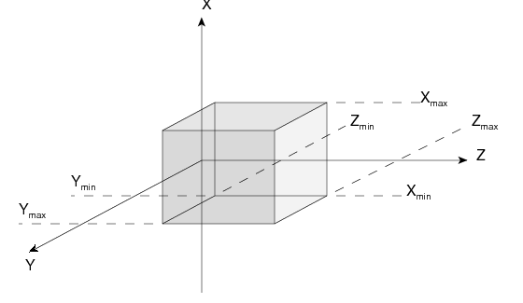
Rectangular Parallelepiped: RPP
An RPP has its edges parallel to the coordinate axes.
It is defined by 6 numbers in the following order:
X_{min} , X_{max} , Y_{min} , Y_{max} , Z_{min} , Z_{max}
(minimum and maximum coordinates which bound the parallelepiped).
Notes:
13

Slide 14
Rectangular Parallelepiped: RPP
Free format
RPP SmlBrick -20.0 +20.0 -50.0 +50.0 -38.5 +38.5
An RPP definition extends over one single card in default fixed format, or over two cards in high-accuracy body fixed format 4 kinds of infinite half-spaces.
Example in fixed format (the comment lines shown are allowed input lines):
*...+....1....+....2....+....3....+....4....+....5....+....6....+....7....+.
RPP 4 -20.0 +20.0 -50.0 +50.0 -38.5 +38.5
* (a parallelepiped centered on the origin)
High-accuracy fixed format
*...+....1....+....2....+....3....+....4....+....5....+....6....+....7....+.
RPP 4 -20.0 +20.0 -50.0
+50.0 -38.5 +38.5
Notes:
14

Slide 15
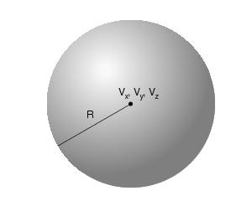
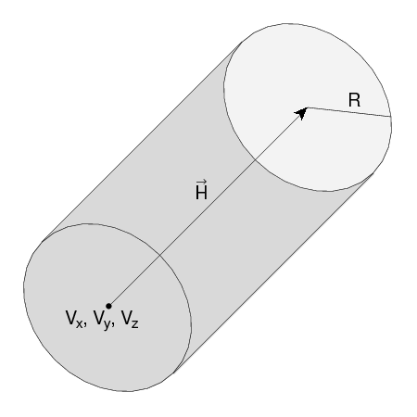
Sphere and circular cylinder
Sphere: SPH
A SPH is defined by 4 numbers: Vx, Vy, Vz (coordinates of the centre), R (radius)
Right circular cylinder: RCC
An RCC can have any orientation in space. It is limited by a cylindrical surface and by two plane faces ⊥ to its axis. Each RCC is defined by 7 numbers:
Vx, Vy, Vz (centre of one face);
Hx, Hy, Hz (vector corresponding to the cylinder height, pointing to the other face); R (cylinder radius).

Slide 16
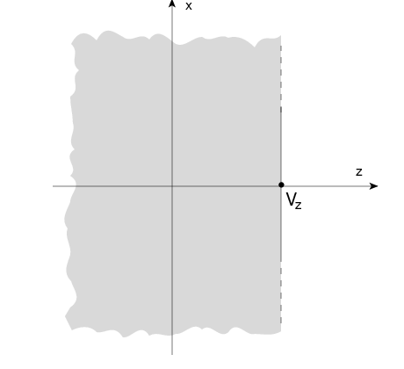
Infinite half-space parallel to coordinate axis
There are 4 kinds of infinite half-spaces.
Three are delimited by planes perpendicular to the coordinate axes:
Delimited by a plane ⊥ to the x-axis. Code: YZP
Delimited by a plane ⊥ to the y-axis. Code: XZP
Delimited by a plane ⊥ to the z-axis. Code: XYP
All defined by a single number: Vx (resp. Vy, or Vz), the coordinate of the plane on the corresponding perpendicular axis.
The half-space “inside the body” is the
position of points for which:
x < Vx (resp. y < Vy, or z < Vz)

Slide 17
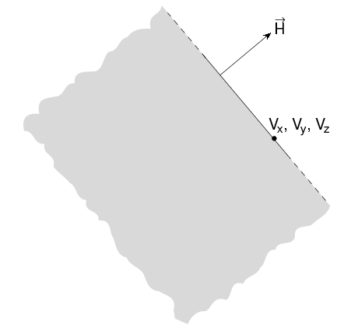
Arbitrarly orientated infinite half-space: PLA
A PLA defines the infinite half space delimited by a generic plane. A PLA is defined by 6 numbers:
Hx, Hy, Hz (vector of arbitrary length ⊥ to the plane);
Vx, Vy, Vz (any point lying on the plane). The half-space “inside the body” is that from which the vector is pointing (i.e. the vector points "outside").

Slide 18
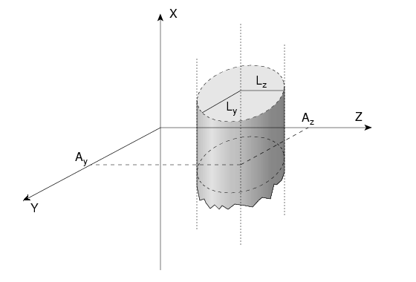
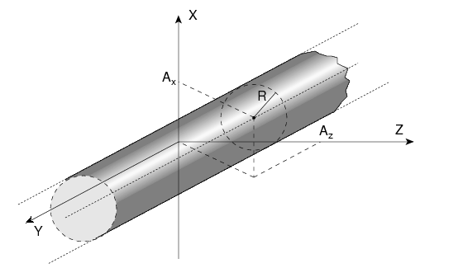
Infinite cylinders
Infinite Circular Cylinder || to coordinate axis: XCC, YCC, ZCC
Each XCC ( YCC, ZCC) is defined by 3 numbers: Ay, Az for XCC (Az, Ax for YCC, Ax, Ay for ZCC) (coordinates of the cylinder axis), R (cylinder radius)
Infinite Elliptical Cylinder || to coordinate axis: XEC, YEC, ZEC
Each XEC ( YEC, ZEC) is defined by 4 numbers: Ay, Az for XEC (Az, Ax for YEC, Ax, Ay for ZEC) (coordinates of the cylinder axis); Ly, Lz for XEC (Lz, Lx for YEC, Lx, Ly for ZEC) (semi-axes of the ellipse)

Slide 19
Regions

Slide 20
Concept
Regions are defined as combinations of bodies obtained by boolean operations:
Regions are not necessarily simply connected (they can be made as the union of two or more non contiguous or partially overlapping zones) but must be of homogeneous material composition.
 | Union | Subtraction | Intersection
Free Format | | | – | +
Fixed format | OR | – | +
Mathematically | ∪ | – | ∩

Slide 21
Regions
Input for each region starts on a new line and extends on as many continuation lines as are needed. It is of the form:
REGNAME NAZ boolean-zone-expression
or
REGNAME NAZ boolean-zone-expression | boolean-zone-expression | …
REGNAME is the region “name” (an arbitrary unique alphanumeric character string chosen by the user). The region name must begin by an alphabetical character and must not be longer than 8 characters.
NAZ is a rough guess for the number of regions which can be entered leaving the current region, normally 5
“boolean-zone-expression” is a sequence of one or more body names preceded by the operators + (intersection) or – (complement or substraction). A zone expression can be contained inside one set of left and right parentheses. Several zone expressions can be combined by the union operator | .

Slide 22
Regions
| operators are used to join zones defined all bodies between them, each body being preceded by its + or – sign.
In evaluating the expressions, the highest operator precedence is given to parentheses, followed by +, - and the | operator.
If one line is not sufficient, any number of continuation lines can be added.
Blanks are ignored.
Notes:
1. Not true, | can be in the middle. + in the first body is not required!

Slide 23
Meaning of + and - operators
If a body number appears in a zone description preceded by a +
operator, it means that the zone being described is wholly contained inside the body.
If a body number appears in a zone description preceded by a –
operator, it means that the zone being described is wholly outside the body.
Zones must be finite: obviously, in the description of each zone and
hence of each region the symbol + must appear at least once.

Slide 24
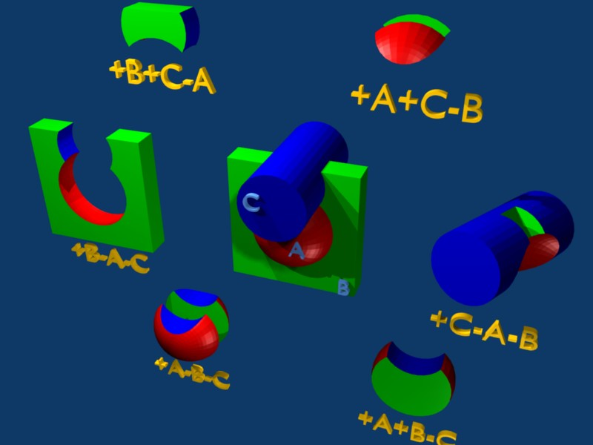
Illustration of the + and – operators

Slide 25
Meaning of the + - operators
Target 4 +Outer +CutPlane
* (the above region is the part of space common to bodies Outer and
* CutPlane)
Regex 7 +Red -Blue -Green +Yellow
* (the above region is the part of space common to body Red and Yellow,
* excluding however that which is inside body Blue and that which is
* inside Green)
Air 5 +Room
* (the latter region coincides entirely with body Room)

Slide 26
Meaning of the | (OR) operator
The | (or OR) operator is used as a boolean union operator in order to combine zones (subregions partially overlapping or not). Zones are formed as intersections or differences as explained above, and then the region is formed by a union of these zones.
Examples:
*...+....1....+....2....+....3....+....4....+....5....+....6....+....7...
SA7 11OR +4 +6 -7 -8OR +6 +3 -21
* <---- first subregion -----><- second subregion ->
Ground 5 | +Body9 | +Body15 | +Body1 | +Body8 -Body2 | +Body8 -Body3 |
* <- 1st -><- 2nd -><- 3rd -><---- 4th ----><---- 5th ---->
| +Body8 +Body18 | +Body12 -Body10 -Body11 -Body13 -Body14
* <----- 6th -----><------- 7th and last subregion -------->
* (continuation line)
Notes:
Not true again for the two or more!!!!!!!!!!

Slide 27
Parenthesis
Parentheses are grouping together combinations of bodies. Parentheses can be used in free format only.
Examples:
*...+....1....+....2....+....3....+....4....+....5....+....6....+....7...
* Subtract from body2 regions regR03, regR04, regR05
regV02 5 +body2 - (+body4 -body3)
- (+body6 -body5 |+body8 -body7) - body9 -body10
regR03 5 +body4 -body3
regR04 5 +body6 -body5 |+body8 -body7
regR05 5 +body9 | +body10
Nested parentheses are supported, however:
parentheses should be used with care since their expansion can generate a quickly diverging amount of terms. A partial optimization is performed on planes (aligned with the axes) and bounding boxes only
Notes:
Not true again for the two or more!!!!!!!!!!

Slide 28
Important Notes
Whenever it is possible, the following bodies should be preferred:
PLA, RPP, SPH, XCC, XEC, XYP
XZP, YCC, YEC, YZP, ZCC, ZEC
These make tracking faster, since for them extra coding ensures that unnecessary boundary intersection calculations are avoided when the length of the next step is smaller than the distance to any boundary of the current region.
Always use as many digits as possible in the definition of the body parameters, particularly for body heights (RCC, REC), and for direction cosines of bodies with slant surfaces. The free format or the high-accuracy fixed format should always be used in these cases.
Avoid as much as possible using two bodies which share independently the same surface (e.g. two RPP’s with a common face). Rather make one or both bigger and cut both with a common plane.

Slide 29
Precision Errors
Modeling assumptions
Avoid touching surfaces!
Especially when floating point operations are involved.
Use cutting surfaces B instead.
Or force partial overlap of objects
RCC
RCC
A
B
B
PLA
RCC
A
+A+B
+A-B
A
B
A-B
+B

Slide 30
Precision Errors
FLUKA uses double precision arithmetic:
Double precision significant digits 16
Due to rounding errors: ~14 significant digits
Precision is relative to the position.
Avoid objects like:
  BOX: arbitrary oriented in space. It is difficult to ensure perpendicularity of the surfaces
  ARB, WED: use surfaces instead
If and only if there is no other solution, one can relax the geometry precision with the WHAT(2) on the GEOBEGIN card.
USE WITH CAUTION!

Slide 31
Geometry Errors and Debugging

Slide 32
Geometry Errors
During execution the code always needs to know the region where a particle is located at every step.
The program will stop only if a particle’s position doesn’t not belong to any region.
It will issue an error message on the .err file with the particle position.
IMPORTANT! It will not stop if a particle’s position belongs to more than one region. It will accept the first region it finds but results will be meaningless!!

Slide 33
Some hints
Never start a particle from a surface. You could get a geometry error even if the geometry is correct because FLUKA cannot determine the region.
FLUKA tries to correct this by moving the particle a bit.
However if it happens too often the run will stop.
To avoid this the starting point of the beam particle must be slightly moved
Never eject a particle along a surface (for the same reason)

Slide 34
Geometry Debugging
Possible types of errors
“Point” belonging to more than one region
  The program will not stop during execution, nor a error message will appear!
“Point” not belonging to any region
  The program will stop with an error message when a particle will enter to this region
Universe not enclosed by a black body region (Geometry = Universe + Black hole)
Precision errors
Lattice replica←→basic cell mismatch (see lattice lecture)
Debugging Tools
GEOEND card with the DEBUG option
Error messages during simulation
PLOTGEOM card (see manual, used automatically by Flair)

Slide 35
Debugging
GEOEND card activates the geometry debugger. Detects both undefined or multiple defined points in a selected X,Y,Z mesh
Two cards are needed
First card
WHAT(1)=X_{max} WHAT(2)=Y_{max} WHAT(3)=Z_{max}
WHAT(4)=X_{min} WHAT(5)=Y_{min} WHAT(6)=Z_{min}
SDUM = DEBUG
Second Card
WHAT(1)=Nx WHAT(2)=Ny WHAT(3)=Nz
SDUM = &
WARNING!
The program stops if too many errors are found.
A message will be issued on the output unit.
GEOEND Xmax Ymax Zmax Xmin Ymin Zmin DEBUG
GEOEND Nx Ny Nz &

Slide 36
Debugging
If no error is found, no .err file will be created.
REMINDER: If the debugger doesn't find any error it doesn't mean that the geometry is error free!
One has to experiment, changing the GEOEND settings especially for the critical/complicated regions.
Errors will be listed in the .err file in the form:
**** Lookdb: Geometry error found ****
**** The point: -637.623762 -244.554455 -96.039604 ****
  Point is contained in more than one region
  **** is contained in more than 1 region ****
  **** (regions: 6 7) ****
  Not contained in any region
  **** is not contained in any region

Slide 37
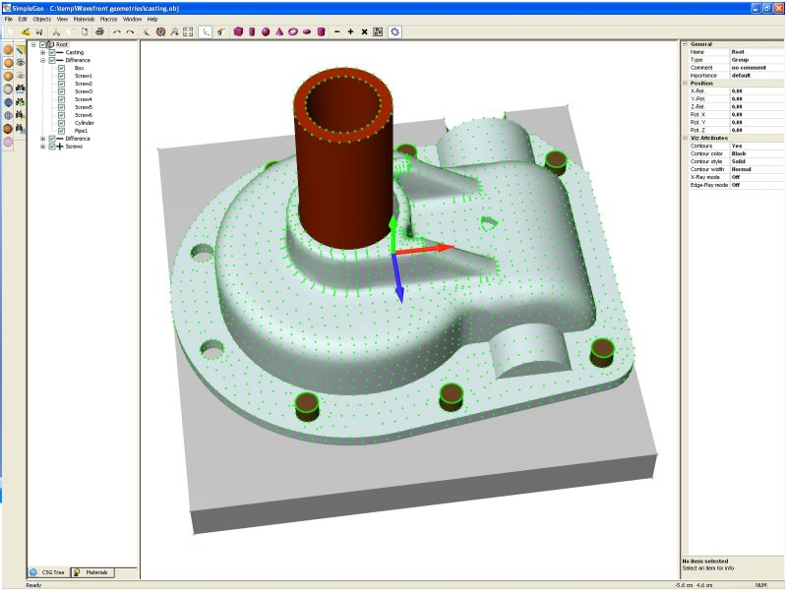
Auxilliary program: Simple Geo

Slide 38
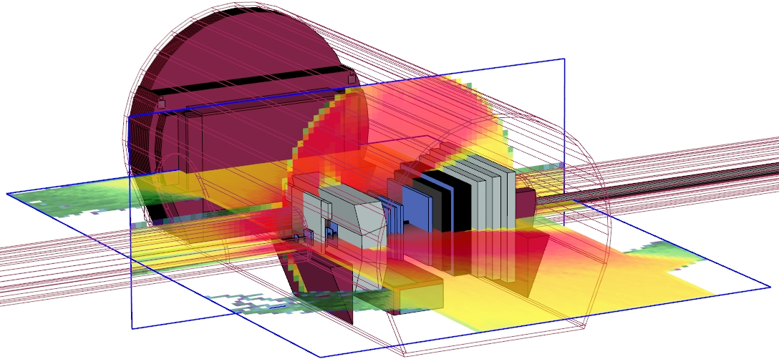
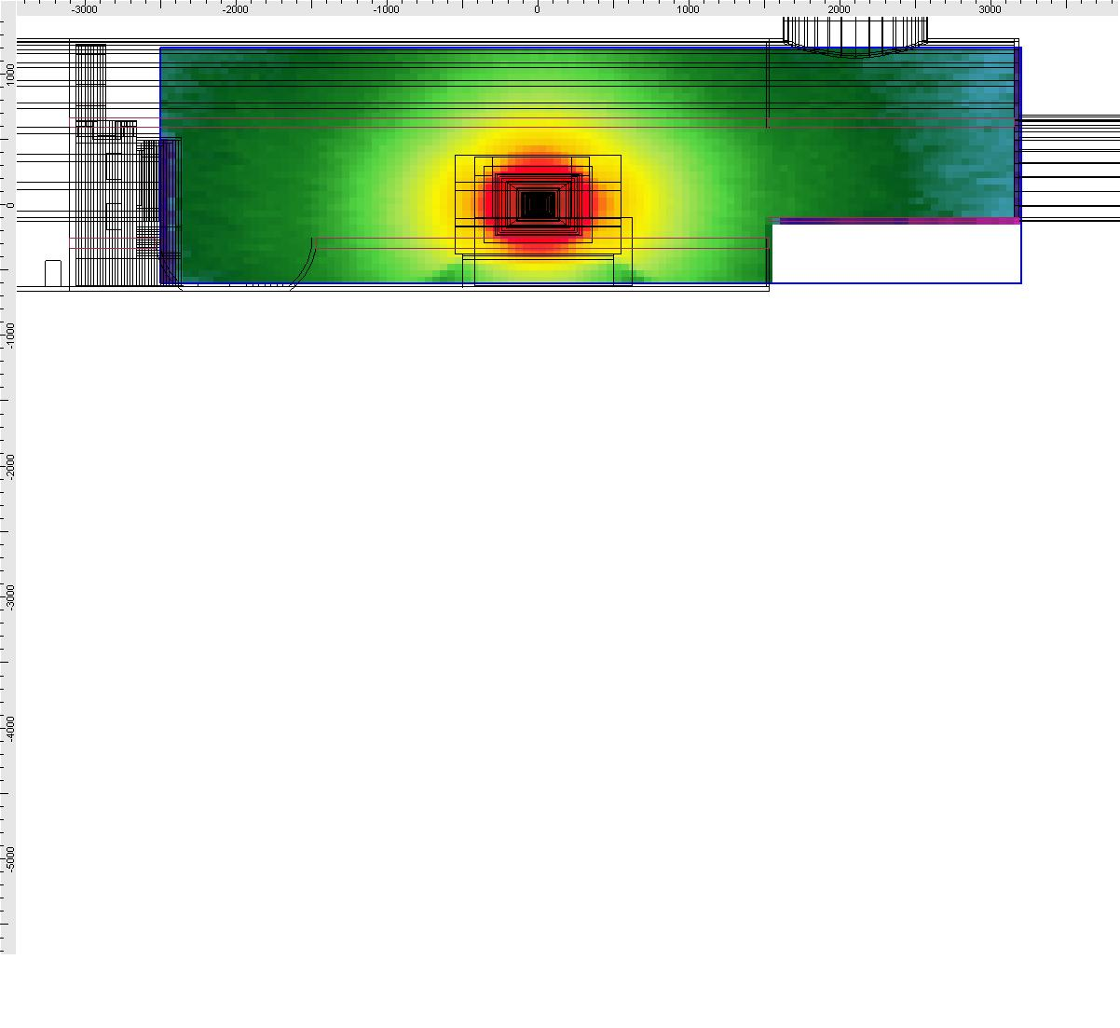
Auxiliary program: SimpleGeo
SimpleGeo is an interactive solid modeler which allows for flexible and easy creation of the models via drag & drop, as well as on-the-fly inspection
Imports existing geometries for viewing
Creating new geometries from scratch
Export to various formats (FLUKA, MCNP, MCNPX)
Download, Tutorials, etc.: http://theis.web.cern.ch/theis/simplegeo
Operating system: Windows only

Slide 39
Extra Slides

Slide 40
The geometry title card: IDBG
The second integer value IDBG can be used to modify the format with which body and region data are read:
IDBG
0 or 10 default fixed format for both bodies and regions
-10 high-accuracy fixed format for bodies; default fixed region
-100 high-accuracy fixed format for bodies; region fixed format
allowing more than 10000 regions
100 default fixed format for bodies; region fixed format
allowing more than 10000 regions
Any other value should be avoided.
The value of IDBG is irrelevant if free format has been requested (see the GLOBAL and GEOBEGIN commands)

Slide 41
The fixed geometry input format: regions
Each body is referred to by its sequential number in the body
description table.
Input for each region extends on one or more cards, in a format which depends on the value of IDBG on the Geometry Title
card.
If IDBG = 0, 10 or -10, region input format is
(2X, A3, I5, 9(A2,I5))
if IDBG = 100 or -100, region input format is
(2X, A3, I5, 7(A2,I7))

Slide 42
The fixed geometry input format: regions
The 3 characters in columns 3-5 are:
on the first card of a given region, an arbitrary non-blank string chosen by the user (it can be used, together with optional comment cards, to help identifying the region or the region material).
Note: that regions are identified in FLUKA by an integer number corresponding to the order of their input definition. Therefore it can be useful (but not mandatory) to have that number appearing in the string.
For instance, if the 5th region is air, it could be labeled AI5.
On all continuation cards, columns 3-5 must be blank.

Slide 43
Parentheses Expansion
Parentheses expansion is almost like converting
from: product of sums
to: sum of products
Product operators are: +/-, Sum operator: |
The final result will be an expression in the normal form. Unions of all possible combinations of the bodies in the expression!
Initially the code removes all repeated terms:
A + A = A
A – A = ∅
expA | expA = expA
Use parentheses with care!!!
It can easily create an expansion with thousands of terms!

Slide 44
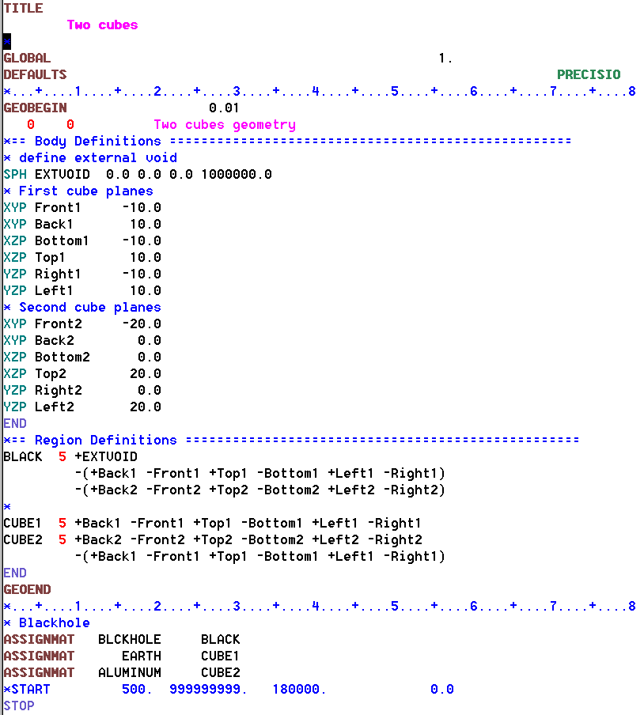
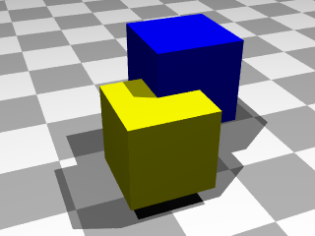
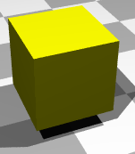
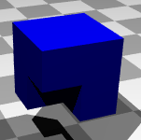
Parentheses Expansion
CUBE1
CUBE2

Slide 45
Parentheses Expansion
BLACK Region (36/108)
OR +Bottom1 +Bottom2 +EXTVOID
OR +Bottom1 +EXTVOID +Front2
OR +Bottom1 +EXTVOID +Right2
OR +Bottom1 +EXTVOID -Back2
OR +Bottom1 +EXTVOID -Left2
OR +Bottom1 +EXTVOID -Top2
OR +Bottom2 +EXTVOID +Front1
OR +Bottom2 +EXTVOID +Right1
OR +Bottom2 +EXTVOID -Back1
OR +Bottom2 +EXTVOID -Left1
OR +Bottom2 +EXTVOID -Top1
OR +EXTVOID +Front1 +Front2
OR +EXTVOID +Front1 +Right2
OR +EXTVOID +Front1 -Back2
OR +EXTVOID +Front1 -Left2
OR +EXTVOID +Front1 -Top2
OR +EXTVOID +Front2 +Right1
OR +EXTVOID +Front2 -Back1
OR +EXTVOID +Front2 -Left1
OR +EXTVOID +Front2 -Top1
OR +EXTVOID +Right1 +Right2
OR +EXTVOID +Right1 -Back2
OR +EXTVOID +Right1 -Left2
OR +EXTVOID +Right1 -Top2
OR +EXTVOID +Right2 -Back1
OR +EXTVOID +Right2 -Left1
OR +EXTVOID +Right2 -Top1
OR +EXTVOID -Back1 -Back2
OR +EXTVOID -Back1 -Left2
OR +EXTVOID -Back1 -Top2
OR +EXTVOID -Back2 -Left1
OR +EXTVOID -Back2 -Top1
OR +EXTVOID -Left1 -Left2
OR +EXTVOID -Left1 -Top2
OR +EXTVOID -Left2 -Top1
OR +EXTVOID -Top1 -Top2
CUBE1 Region (1/6)
+Back1 +Left1 +Top1 -Bottom1 -Front1 -Right1
CUBE2 Region (6/42)
OR +Back2 +Bottom1 +Left2 +Top2 -Bottom2 -Front2 -Right2
OR +Back2 +Front1 +Left2 +Top2 -Bottom2 -Front2 -Right2
OR +Back2 +Left2 +Right1 +Top2 -Bottom2 -Front2 -Right2
OR +Back2 +Left2 +Top2 -Back1 -Bottom2 -Front2 -Right2
OR +Back2 +Left2 +Top2 -Bottom2 -Front2 -Left1 -Right2
OR +Back2 +Left2 +Top2 -Bottom2 -Front2 -Right2 -Top1

Slide 46
Region Optimization
Geometrical optimization can drastically reduce the number of sub-zones.
Currently work is going on for 2 types of optimization to be implemented in FLUKA
Elimination of same type of planes (XYP, XZP, YZP) inside a sub-zone (product).
Optimization of sub-zones based on the bounding boxes of the bodies.
  Infinite objects have an infinite bounding box on some of the dimensions ie. XYP, ZCC etc.
  PLAnes do not have a bounding box
  For each sub-zone after the expansion, if the intersection of the bounding boxes is impossible the sub-zone is discarded

Slide 47
Expansion Optimization
BLACK Region (30/90)
OR +Bottom1 +EXTVOID
OR +Bottom1 +EXTVOID +Front2
OR +Bottom1 +EXTVOID +Right2
OR +Bottom1 +EXTVOID -Back2
OR +Bottom1 +EXTVOID -Left2
OR +Bottom2 +EXTVOID +Front1
OR +Bottom2 +EXTVOID +Right1
OR +Bottom2 +EXTVOID -Back1
OR +Bottom2 +EXTVOID -Left1
OR +EXTVOID +Front2
OR +EXTVOID +Front1 +Right2
OR +EXTVOID +Front1 -Left2
OR +EXTVOID +Front1 -Top2
OR +EXTVOID +Front2 +Right1
OR +EXTVOID +Front2 -Left1
OR +EXTVOID +Front2 -Top1
OR +EXTVOID +Right1
OR +EXTVOID +Right1 -Back2
OR +EXTVOID +Right1 -Top2
OR +EXTVOID +Right2 -Back1
OR +EXTVOID +Right2 -Top1
OR +EXTVOID -Back1
OR +EXTVOID -Back1 -Left2
OR +EXTVOID -Back1 -Top2
OR +EXTVOID -Back2 -Left1
OR +EXTVOID -Back2 -Top1
OR +EXTVOID -Left2
OR +EXTVOID -Left1 -Top2
OR +EXTVOID -Left2 -Top1
OR +EXTVOID -Top2
CUBE1 Region (1)
+Back1 +Left1 +Top1 -Bottom1 -Front1 -Right1
CUBE2 Region (3/18)
OR +Front1 +Left2 +Top2 -Bottom2 -Front2 -Right2
OR +Back2 +Left2 +Top2 -Bottom2 -Front2 -Left1
OR +Back2 +Left2 +Top2 -Front2 -Right2 -Top1
The optimization process can correct
only for some of the “obvious” things

