Slide 1
FLUKA - Basics
Beginners FLUKA Course

Slide 2
How to download and install Fluka
Two ways of downloading the FLUKA software:
From the FLUKA website http://www.fluka.org
From NEA databank http://www.nea.fr through the liaison officer from your institute
It is mandatory to be registered as FLUKA user. Follow the following link:
http://www.fluka.org/download.html
After registration (or using your user-id and password) normally you can then proceed in downloading the latest official release version.
Before continuing we just need to find out one more thing, the ‘shell’ you’re using on your computer (mostly bash or tcsh). For this purpose please issue the following command in a terminal window:
echo $SHELL
You will then get as a results the current shell which is used on your computer, i.e., one of the following:
/bin/bash
/bin/tcsh

Slide 3
How to download and install Fluka
First identify the location of the FLUKA distribution file: fluka2008.3b-linuxAA.tar.gz.
Depending on the OS and the method you used most probably will be located in one of the following directories:
/media/FLUKA/Software # in case you are using the USB stick
or $HOME # if you downloaded from the web
$HOME/Desktop # -//- depending on your browser
We will create a directory FLUKA under your home directory to install FLUKA.
The following commands issued from a terminal/console window will perform the entire installation.
cd # change directory to your home
mkdir FLUKA # create a directory called FLUKA
cd FLUKA # change to the FLUKA directory
tar xzf /media/disk/Software/ fluka2008.3b-linuxAA.tar.gz
# expand the FLUKA package
export FLUPRO=$HOME/FLUKA # set FLUPRO in bash shell or similar or setenv FLUPRO $HOME/FLUKA # set FLUPRO in tcsh shell or similar
make # compile FLUKA

Slide 4
Persistent settings
The only thing left to do is to make these settings persistent on your computer, i.e., you don’t have to set the environment variable again when you open a new terminal or log into your computer. We will thus add the following lines into your shell configuration file in your main directory.
bash users:
cd
emacs [or any editor] .bashrc
“go to the end of the document and add the following”
export FLUPRO=${HOME}/FLUKA
export PATH=${PATH}:$FLUPRO:$FLUPRO/flutil
tcsh users:
cd
emacs [or any editor] .tcshrc
“go to the end of the document and add the following”
setenv FLUPRO ${HOME}/FLUKA
setenv PATH ${PATH}:$FLUPRO:$FLUPRO/flutil
The changes will be activated on the next login or if you type the command
source .bashrc
source .tcshrc
Notes:
4

Slide 5
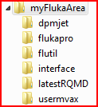
FLUKA directory structure
The tar command will create the following directory structure in your fluka installation directory: ~/work/FLUKA
Root directory of FLUKA
DPMJET data files
All FLUKA commons
Utility programs and scripts
Interface libraries to DPMJET
Interface libraries to rQMD
Fortran user routines

Slide 6
FLUKA release: main directory $FLUPRO
Main Library:
libflukahp.a (object collection)
Physics data files:
Basic Scripts: (in $FLUPRO/flutil)
sigmapi.bin
elasct.bin
brems_fin.bin
cohff.bin
gxsect.bin
neuxsc-ind_260.bin
neuxsc-ind_72.bin
nuclear.bin
fluodt.dat
e6r1nds3.fyi
jef2.fyi
jendl3.fyi
xnloan.dat
rfluka
lfluka
fff
Random Number seed
random.dat
Important Directories
flukapro/ all fluka commons
usermvax/ user routines
flutil/ general utilities

Slide 7
What’s inside the physics data files:
sigmapi.bin: pion-N double-diff. cross sections
elasct.bin: elastic scattering cross sections
brems_fin.bin: bremsstrahlung cross sections
cohff.bin: atomic form factor tabulations
gxsect.bin photon cross sections
neuxsc-ind_72.bin: low energy neutron multi-group cross sections (72 groups)
neuxsc-ind_260.bin: low energy neutron multi-group cross sections (260 groups)
nuclear.bin: nuclear masses, mass excesses, levels,
and many other nuclear data for
evaporation, pre-equilibrium,
Fermi break up and photonuclear xs
gamma and beta databases
fluodt.dat: Fluorescence data (photoelectric effect)
e6r1nds3.fyi:
jef2.fyi: Fission products (for neutrons with
jendl3.fyi: E<20 MeV)
xnloan.dat:

Slide 8
Available Documentation
fluka2008.manual ASCII version of the manual (easy to edit)
FM.pdf current version of the FLUKA manual
CERN-2005-10.pdf official reference for FLUKA
or navigate the manual, online version (www.fluka.org)
or (when using FLAIR) press F1 to get an interactive manual (which can be also called on prompt level by calling ‘fm.py’’)
or (at a further stage) the FAQ available at: http://www.fluka.org/Faq.html
or (at a further stage) the archive of fluka-discuss: http://www.fluka.org/MailingList.html

Slide 9
FLUKA Release Notes Fluka2008.3b
The latest major release was a major step in the FLUKA development cycle with respect to the last official release version Fluka2006.3b. It added a few new features and there are a few major physics improvements.
This recent intermediate update (3b) contains a few small fixes and a significant functionality improvement with respect to Fluka2008.3.7 (the latest respin of Fluka2008.3). Most of them are likely to be irrelevant for the majority of the users, however it is safer and recommended to immediately move to Fluka2008.3b. The move should be painless since there is no change in the physics, apart the new functionality which is described below (and which is not activated by default).
Compton scattering with taking fully into account the binding and orbital electron motion: up to now FLUKA included two possibilities for the treatment of Compton scattering:
"naive" scattering on free electrons
Compton scattering corrected by an inelastic form factor, S(q,Z)
Now a third possibility has been added, where both binding effects and orbital motion of all electronic shells of all elements are accounted for. This is particularly relevant for low energy photons and/or heavy elements

Slide 10
FLUKA Release 2008 New Features
New neutron cross section library below 20 MeV, including 260 neutron and 42 gamma groups: 31 neutron groups are thermal (1 in the previous library).
All neutron cross section data are freshly computed from the most recent evaluated nuclear data files.
Please note that the new 260 group library is now the default one (even though the "old" 72 group one is still distributed).
New radioactive decay database, now including also conversion electron and Auger lines- Heavy ion pair production
New implementation of the BME model with vastly improved performances for peripheral collisions
A new neutrino-nucleus event generator, built from scratch for FLUKA, including quasi-elastic, resonance, and deep-inelastic event generation (thanks to M. Lantz, P.R. Sala, G. Smirnov, G. Battistoni, and A. Ferrari)

Slide 11
Input example
FLUKA is driven by the user almost completely by means of an input file (.inp) which contains directives issued in the form of DATA CARDS
The standard release provides a simple case to test the installation: example.inp (Production of particles in p-Be collisions with a 50 GeV/c proton beam.)
Different examples are used along this course, which will be varied in different ways for didactic reasons
We will start with a minimum input file and after each lecture we will enhance our example with more and more functionality
It is strongly recommended that for every exercise you create a subdirectory i.e., ex1, ex2, ex3 where all the necessary input and output file will be stored
For better clarity before starting a new exercise you will get the solution of the previous one, to be picked up at the course website: http://www.fluka.org/fluka.php?id=course&sub=intro&which=demokritos2009

Slide 12
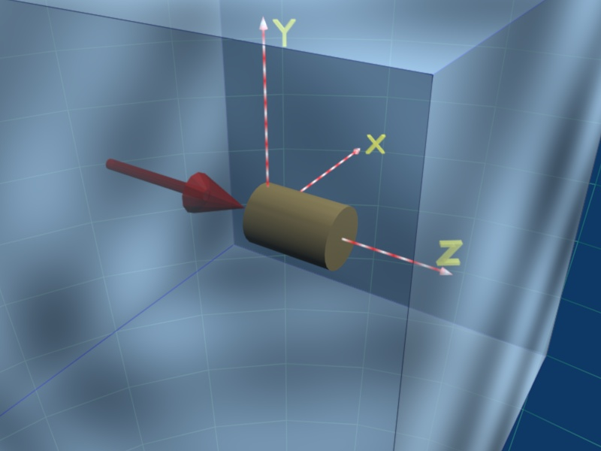
A Simple Example
TITLE
FLUKA Course Exercise
*23456789 123456789 123456789 123456789 123456789 123456789 123456789 123456789
DEFAULTS NEW-DEFA
BEAM -3.5 -0.082425 -1.7 0.0 0.0 1.0PROTON
BEAMPOS 0.0 0.0 0.1 0.0 0.0 0.0
*23456789 123456789 123456789 123456789 123456789 123456789 123456789 123456789
GEOBEGIN COMBNAME
0 0 Cylindrical Target
SPH BLK 0.0 0.0 0.0 10000.
* vacuum box
RPP VOI -1000. 1000. -1000. 1000. -1000. 1000.
* Lead target
RCC TARG 0.0 0.0 0.0 0.0 0.0 10. 5.
END
* Regions
* Black Hole
BLKHOLE 5 +BLK -VOI
* Void around
VAC 5 +VOI -TARG
* Target
TARGET 5 +TARG
END
GEOEND
*23456789 123456789 123456789 123456789 123456789 123456789 123456789 123456789
ASSIGNMA BLCKHOLE BLKHOLE
ASSIGNMA VACUUM VAC
ASSIGNMA LEAD TARGET
*
RANDOMIZ 1.0
START 10.0 0.0
STOP
VAC
p⁺ beam
TARGET
BLKHOLE

Slide 13
Prepare the working space
We don’t want to run inside the $FLUPRO directories therefore:
Go to your home directory and create a subdirectory named Work:
cd
mkdir work
cd work
mkdir exercises
Change to the examples subdirectory and create a new one named: ex1
cd exercises
mkdir ex1
cd ex1
Get the source example file from the course website (copy all the ex_1*??? files to your subdirectory: ~/work/exercises/ex1) http://www.fluka.org/fluka.php?id=course&sub=intro&which=demokritos2009
download ex_1*

Slide 14
Now let’s test the installation
Soon after you have created your standard FLUKA we can run the first example:
No. of previous cycle (default is 0)
No. of Last cycle
(default is 5)
$FLUPRO/flutil/rfluka -e $FLUPRO/flukahp -N0 -M1 ex1
Specifies the executable
name: if it is flukahp in $FLUPRO (default) then it can be omitted
Name of the datacard input file. It must be a file named ****.inp and .inp has to be omitted.

Slide 15
What rfluka does:
It creates a temporary subdirectory: $PWD/fluka_nnnn
($PWD means the current directory)
where nnnn is the system process-id assigned to FLUKA. There all necessary assignments are defined and output files are written.
elasct.bin → $FLUPRO/ elasct.bin
fluodt.dat → $FLUPRO/ fluodt.dat
fort.1 → ../ranex_1001
fort.11 → ex_1001.out
fort.12 → libec_thihecufealw_10t.pemf
fort.15 → ex_1001.err
fort.16 → “geometry scratch”
fort.2 → ranex_1002
neuxsc.bin → $FLUPRO/ neuxsc-ind_260.bin
nuclear.bin → $FLUPRO/ nuclear.bin
sigmapi.bin → $FLUPRO/ sigmapi.bin
xnloan.dat → $FLUPRO/ xnloan.dat

Slide 16
At the end of the FLUKA run:
If everything is OK the temporary directory disappears
And the relevant results are copied in the start directory:
Removing links
Removing temporary files
Saving output and random number seed
Saving additional files generated
Moving fort.33 to /home/battist/FlukaCourse/ex_1001_fort.33
Moving fort.47 to /home/battist/FlukaCourse/ex_1001_fort.47
Moving fort.48 to /home/battist/FlukaCourse/ex_1001_fort.48
Moving fort.49 to /home/battist/FlukaCourse/ex_1001_fort.49
Moving fort.50 to /home/battist/FlukaCourse/ex_1001_fort.50
End of FLUKA run
by default you have ex_100n.log, ex_100n.out,
ex_100n.err and ranex_100m (seed for cycle m = n+1)
Additional files resulting from the scoring required by the user

Slide 17
Checking FLUKA during the run
Look in the temporary directory:
a) Initialization phase ends when the *.err file is opened.
b) Inside *.err file and (at the end of *.out file) the progress in the number of events is given in the line immediately following the one which starts by “NEXT SEEDS”:
NEXT SEEDS: C8888D 0 0 0 0 0 33B49B1 0 0 0
1 9 9 0.0000000E+00 1.0000000E+30 0
NEXT SEEDS: C88894 0 0 0 0 0 33B49B1 0 0 0
2 8 8 5.0010681E-03 1.0000000E+30 0
NEXT SEEDS: C8889A 0 0 0 0 0 33B49B1 0 0 0
3 7 7 3.3340454E-03 1.0000000E+30 0
…..
AVERAGE CPU TIME CONSUMED PER EVENT
EVENTS ALREADY
COMPLETED
EVENTS TO BE
COMPLETED

Slide 18
Tips & Tricks
How to make a “clean” stop of FLUKA run
Here “clean” means performing CLOSE of all files and removing the temporary directory and files.
In the temporary run directory: touch fluka.stop To stop the present cycle
or touch rfluka.stop To stop all remaining cycles
The clean stop will occur at the next CPU-time check, i.e., at the same time when printing the random number calls : see START card instructions (5th parameter) for the frequency of these checks!!
If the check is never performed it means that the program has entered an infinite loop (probably a fault in user code)

Slide 19
A New Way to “Go FLUKA” - FLUPIX
Besides the current FLUKA distribution you also got the current version of FLUPIX distributed on your USB stick. Some of your computers were already installed using this very flexible way to perform FLUKA calculations in a platform independent way:
FLUPIX
(FLUka in knopPIX)
© Vasilis.Vlachoudis@cern.ch 2008
FLUPIX is a KNOPPIX (www.knoppix.org) version of the Live CD, with pre-installed FLUKA and flair and all the necessary tools in for performing FLUKA runs.
FLUPIX can run from a CD/DVD, bootable USB or through any virtual machine from any host operating system (Ms Windows, Mac OS, Linux, Solaris etc.). FLUPIX includes all the additions of VirtualBox (www.virtualbox.org) a free and open source Virtual machine supported by Sun, that provides easy installation and high performance way.
More details will be given in a moment by Vasilis

