Slide 1

The FLUKA Code
An Introduction to FLUKA:
a multipurpose Interaction and Transport MC code
Beginners’ FLUKA Course

Slide 2
FLUKA
Main authors: A. Fassò, A. Ferrari, J. Ranft, P.R. Sala
Contributing authors: G.Battistoni, F.Cerutti, T.Empl, M.V.Garzelli, M.Lantz, A. Mairani, V.Patera, S.Roesler, G. Smirnov, F.Sommerer, V.Vlachoudis
Developed and maintained under an INFN-CERN agreement Copyright 1989-2008 CERN and INFN
http://www.fluka.org
>2000 users

Slide 3



The FLUKA international Collaboration
M.Brugger, F. Cerutti, A. Ferrari, M. Mauri, G. Lukasik, S. Roesler, L. Sarchiapone, G. Smirnov, F. Sommerer ,C. Theis, S. Trovati, H. Vinke, V.Vlachoudis
CERN
A. Fassò
SLAC, USA
J. Ranft
Univ. of Siegen, Germany
G. Battistoni, F. Broggi, M. Campanella, P. Colleoni, E. Gadioli, S. Muraro, P.R. Sala
INFN & Univ. Milano, Italy
M. Carboni, C. D’Ambrosio, A. Ferrari, A. Mostacci, V. Patera, M. Pelliccioni, R. Villari
INFN Frascati
M.C. Morone
Univ. Roma II, Italy
A. Margiotta, M. Sioli
INFN & Univ. Bologna, Italy
A. Mairani, K. Parodi
DKFZ & HIT, Heidelberg, Germany
A. Empl, L. Pinsky
Univ. of Houston, USA
K.T. Lee, T. Wilson, N. Zapp
NASA-Houston, USA
S. Rollet
ARC Seibersdorf Research, Austria
M. Lantz
Chalmers Univ. of Technology, Sweden
6th FLUKA course, CERN 2008
3

Slide 4
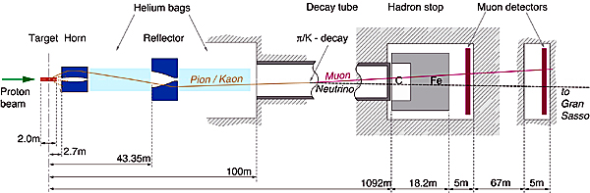
FLUKA Applications
Cosmic ray physics
Neutrino physics
Accelerator design (→ n_ToF, CNGS, LHC systems)
Particle physics: calorimetry, tracking and detector simulation etc.
(→ ALICE, ICARUS, ...)
ADS systems, waste transmutation, (→”Energy amplifier”, FEAT, TARC,…)
Shielding design
Dosimetry and radioprotection
Space radiation
Hadrontherapy
Neutronics

Slide 5
The History
The early days
1962: Johannes Ranft (Leipzig) and Hans Geibel (CERN): Monte Carlo for high-energy proton beams
The beginning:
The name:
1970: study of event-by-event fluctuations in a NaI calorimeter (FLUktuierende KAskade)
Early 70’s to ≈1987: J. Ranft and coworkers (Leipzig University) with contributions from Helsinki University of Technology (J. Routti, P. Aarnio) and CERN (G.R. Stevenson, A. Fassò)
Link with EGS4 in 1986, later abandoned
The modern code: some dates
Since 1989: mostly INFN Milan (A. Ferrari, P.R. Sala): little or no remnants of
older versions. Link with the past: J. Ranft and A. Fassò
1990: LAHET / MCNPX: high-energy hadronic FLUKA generator No further update
1993: G-FLUKA (the FLUKA hadronic package in GEANT3). No further update
1998: FLUGG, interface to GEANT4 geometry
2000: grant from NASA to develop heavy ion interactions and transport
2001: the INFN FLUKA Project
2003: official CERN-INFN collaboration to develop, maintain and distribute FLUKA

Slide 6
The FLUKA Code design - 1
Sound and updated physics models
  Based, as far as possible, on original and well-tested microscopic models
  Optimized by comparing with experimental data at single interaction level: “theory driven, benchmarked with data”
  Final predictions obtained with minimal free parameters fixed for all energies, targets and projectiles
  Basic conservation laws fulfilled “a priori”
  ➔ Results in complex cases, as well as properties and scaling laws, arise naturally from the underlying physical models
  ➔ Predictivity where no experimental data are directly available
It is a “condensed history” MC code, with the possibility use of single instead of multiple scattering

Slide 7
The FLUKA Code design - 2
Self-consistency
  Full cross-talk between all components: hadronic, electromagnetic, neutrons, muons, heavy ions
  Effort to achieve the same level of accuracy:
    for each component
    for all energies
  Correlations preserved fully within interactions and among shower components
  FLUKA is NOT a toolkit! Its physical models are fully integrated

Slide 8

The Physics Content of FLUKA
Nucleus-nucleus interactions 100 MeV/n – 10000 TeV/n
New model (BME, under development): from Coulomb Barrier
Electromagnetic and μ interactions 1 keV – 10000 TeV
Hadron-hadron and hadron-nucleus interactions 0–10000 TeV
Neutrino interactions (new DIS and RES generator!)
Charged particle transport including all relevant processes
Transport in magnetic field
Neutron multigroup transport and interactions 0 – 20 MeV
Analog calculations, or with variance reduction
new library with 260 groups

Slide 9
The FLUKA course: an Introduction
How:
This course is intended to provide users with the basic (and possibly more than basic!) knowledge of:
  The most relevant FLUKA instructions and options
  The physics models adopted in FLUKA
  The different scoring options embedded in FLUKA
  The different running options
  How to insert user code in FLUKA
  The tools to plot results
  The right approach to the existing documentation
  The procedures to overcome difficulties and problems and related debugging tools
  etc. etc.

Slide 10
Method:
There will be formal lectures but they will be followed much as possible by practical (simple) examples.
Emphasis will be given to practice.
If possible we shall try to transform your questions into cases of general interest.

Slide 11
A possible problem:
People here are not at the same level of FLUKA knowledge. There are those who already have some experience, maybe not negligible.
However we need to start from scratch.
We apologize to the experienced people and beg them to be patient: it’s not excluded a-priori that they can learn something new also concerning the very basic elements!

Slide 12
A glimpse of FLUKA

Slide 13
The FLUKA version
  FLUKA2008.n(x)(.m)
Major version
Respin
Minor version
Patch level
Since 2006 each version is going to be maintained for 2 years max.
In this course we are using FLUKA2008.3
(just released a few days ago)

Slide 14
The FLUKA license (it is not GPL):
Standard download: binary library + user routines.
  FLUKA can be used freely for scientific and academic purposes,
  ad-hoc agreement for commercial purposes
  It cannot be used for weapon related applications
  It is not permitted to redistribute the code (single user, single site)
  User can add their own scoring, sources etc through a wide set of user routines, provided they don’t modify the physics
  Relevant references for each FLUKA version can be found in the documentation
It is possible, by explicit signature of license, to download (!!! now from NEA as well !!!) the source for researchers of scientific/academic Institutions.
  FLUKA cannot be copied, even in part, into other codes, or translated into another language without permission.
  The user cannot publish results with modified code, unless explicit authorization is granted in advance.

Slide 15
Using FLUKA
Platform: Linux with g77, Linux with g95, Mac OSX with g95
Under test: Linux and Mac OSX (gfortran), Windows-Cygwin (g95)
The code can compiled/run only on with operating systems, compilers (and associated) options tested and approved by the development team
Standard Input:
Command/options driven by “data cards” (ascii file) . Graphical interface is available!!!!
Standard Geometry (“Combinatorial geometry”): input by “data cards”
Standard Output and Scoring:
Apparently limited but highly flexible and powerful
Output processing and plotting interface available

Slide 16
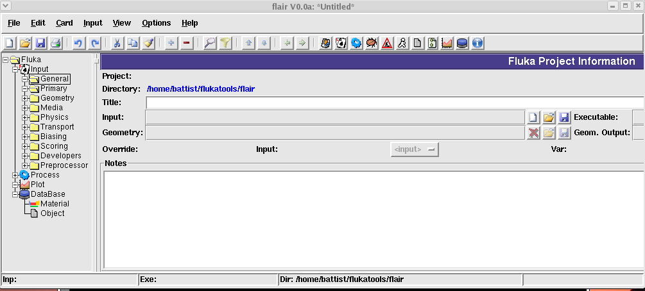
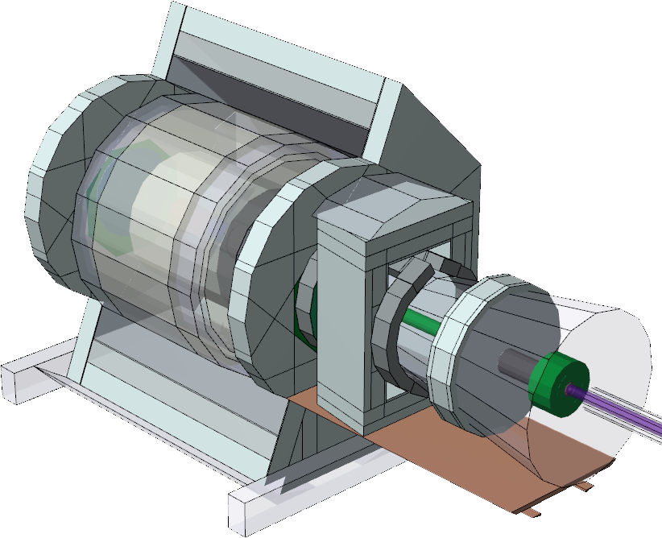
Examples of user interfaces
And now a graphical tool exists to prepare geometry, running under windows
(by. C. Theis, CERN)
A FLUKA run can be managed through a graphical interface. Here is an example using python + Tk (FLAIR, V.Vlachoudis, CERN)

Slide 17
FLUKA-2008.3 Release Notes
This FLUKA release is a major step in the FLUKA development cycle with respect to the last official release version Fluka2006.3b. It adds a few new features and there are a few major physics improvements.
As it is obvious from the name, the major revision number of this release is 2008 and the minor revision number is 3.
With this release all FLUKA version older or equal to 2006.3 are obsolete and they shall no longer be used

Slide 18
FLUKA Release New Features
New neutron cross section library below 20 MeV, including 260 neutron and 42 gamma groups: 31 neutron groups are thermal (1 in the previous library) (thanks to D. Ene, A. Fassò, A.Ferrari, G. Panini, F. Sommerer) . .
  Please note that the new 260 group library is now the default one (even though the "old" 72 group one is still distributed).
Heavy ion pair production
New implementation of the BME model with vastly improved performances for peripheral collisions (BME is available on request)
A new neutrino-nucleus event generator, including quasi-elastic, resonance, and deep-inelastic interactions (thanks to M. Lantz, P.R. Sala, G. Smirnov, G. Battistoni, and A. Ferrari)
An enhanced version of the PEANUT event generator which should significantly improve residual nuclei predictions in the intermediate energy range, and more in general should further improve predicted particle spectra

Slide 19
FLUKA Release New Features
New radioactive decay database, now including also conversion electron and Auger lines
New generalized particles:
  Dose (GeV/g) (DOSE, generalized particle id 228)
  Dose equivalent (pSv) (DOSE-EQ, generalized particle id 240)
  1 MeV neutron Si equivalent fluence (for Silicon damage) (SI1MEVNE, generalized particle id 236)
  High energy hadron fluence scoring (hadrons with energy larger than 20 MeV) (HADGT20M, generalized particle id 237)
New option AUXSCORE
  easy filtering of estimators (see scoring lecture)
  choice of conversion coefficients for DOSE-EQ

Slide 20
Examples of FLUKA Applications

Slide 21
The TARC experiment at CERN:

Slide 22
The TARC experiment: neutron spectra
FLUKA + EA-MC (C.Rubbia et al.)

Slide 23
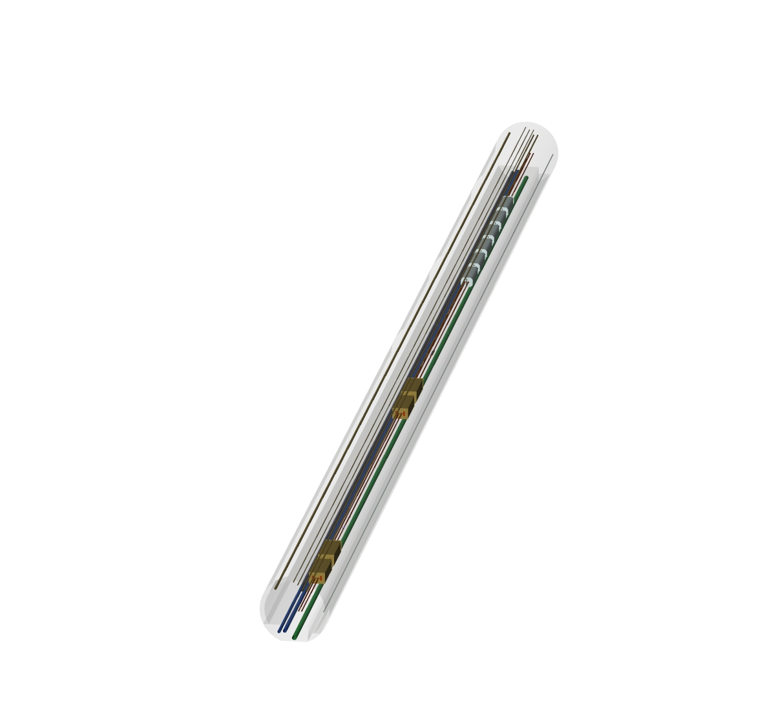
Applications – LHC collimation region
Magnets
Collimators
FLUKA geometry
visualized with
SimpleGeo

Slide 24
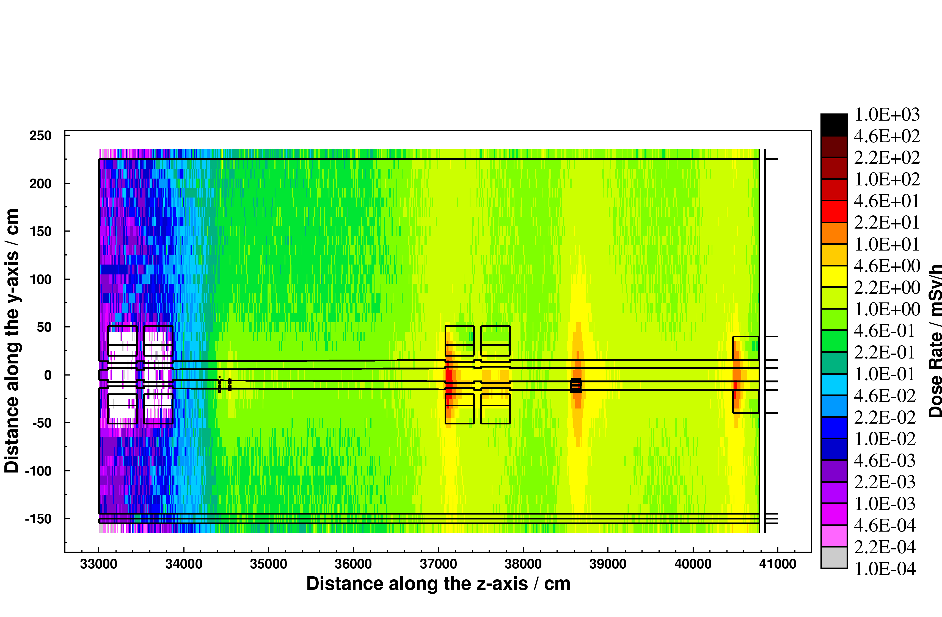
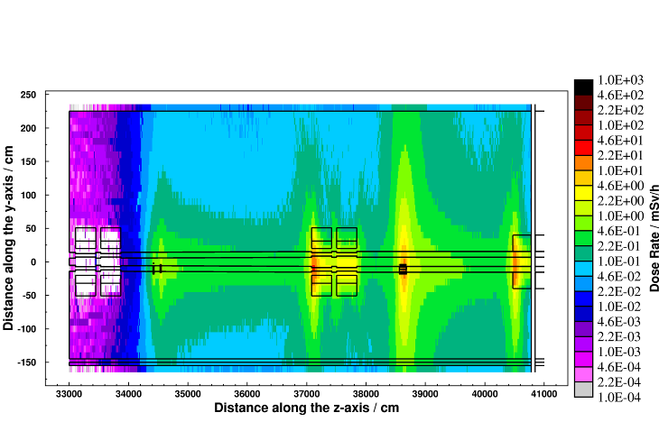
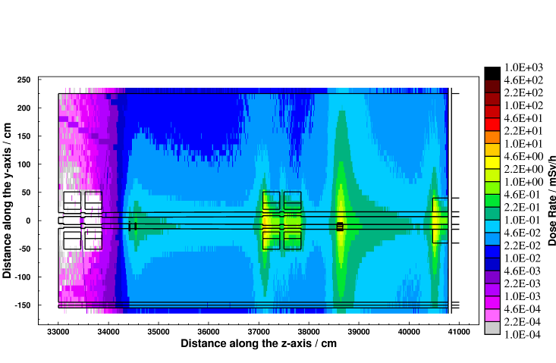
Applications – LHC collimation region
Cooling time
Residual dose rate (mSv/h)
after one year of operation
8 hours
1 week
4 months
CERN-SC-2005-092-RP-TN
6th FLUKA course, CERN 2008
24

Slide 25
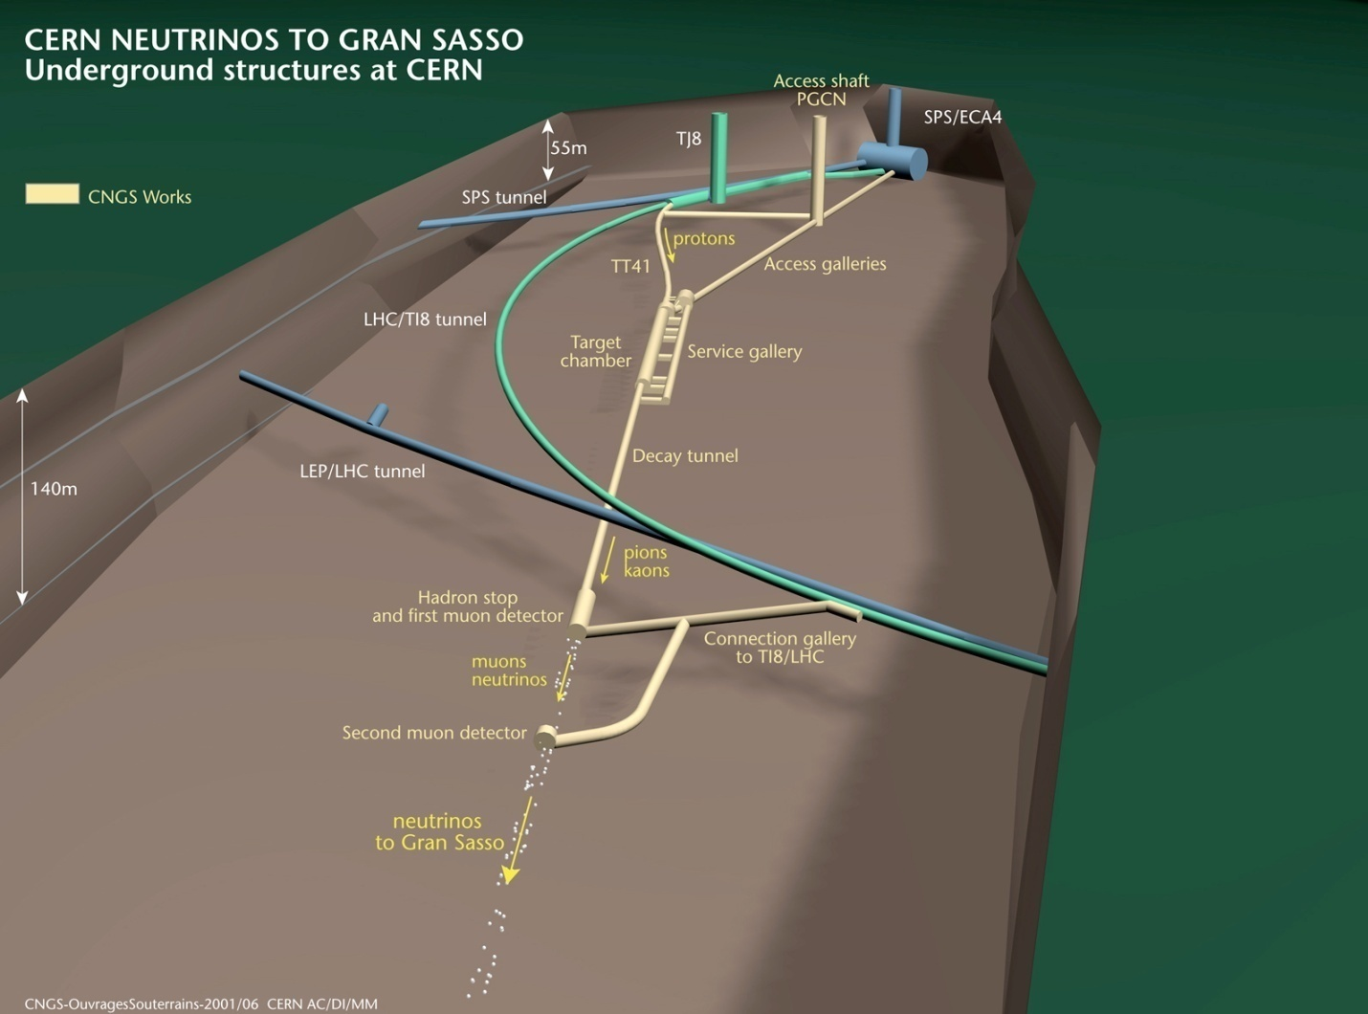
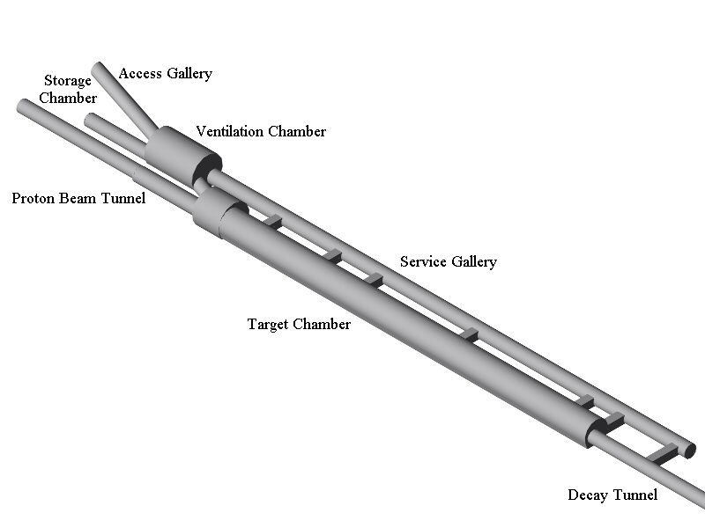
Applications – CNGS

Slide 26
Cern Neutrino to Gran Sasso
Engineering and physics: target heating,
shielding, activation, beam monitors, neutrino spectra
Muons in muon pits: horiz. distribution for beam alignment
Energy dep. in CNGS target rods, GeV/cm³/pot

Slide 27
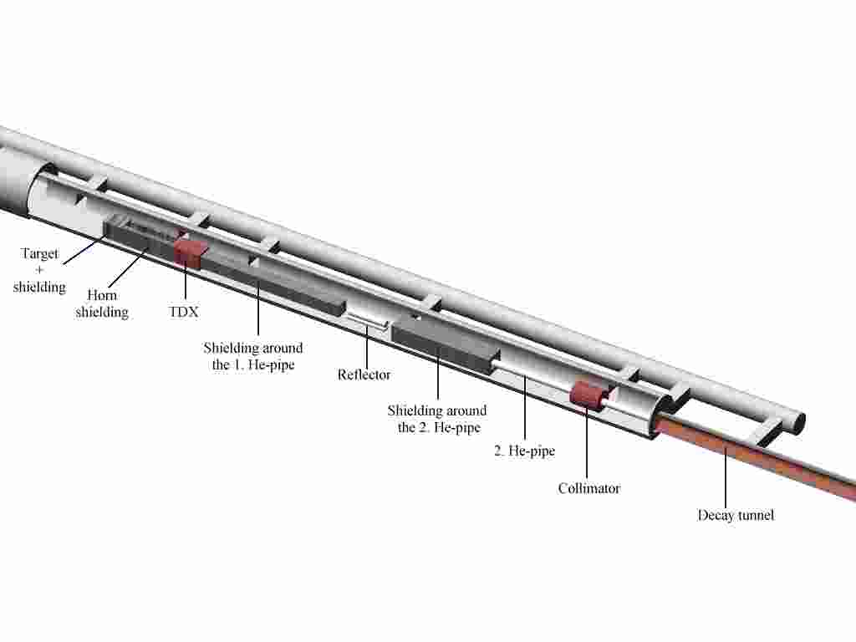
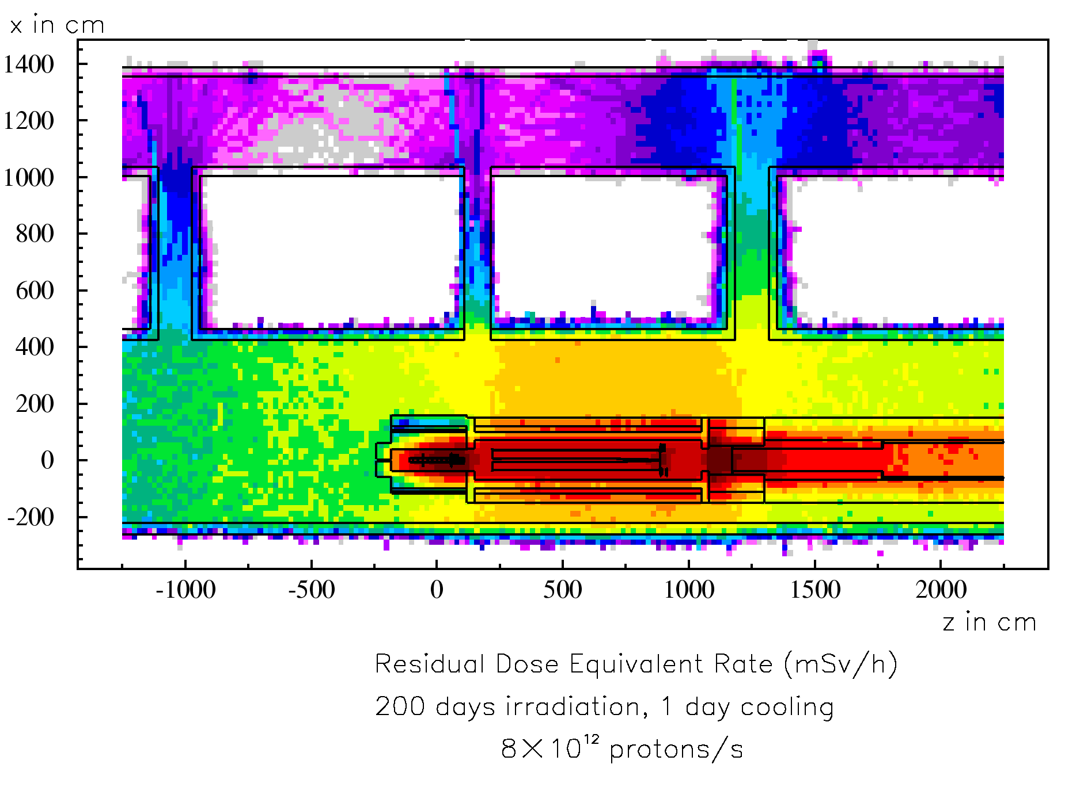
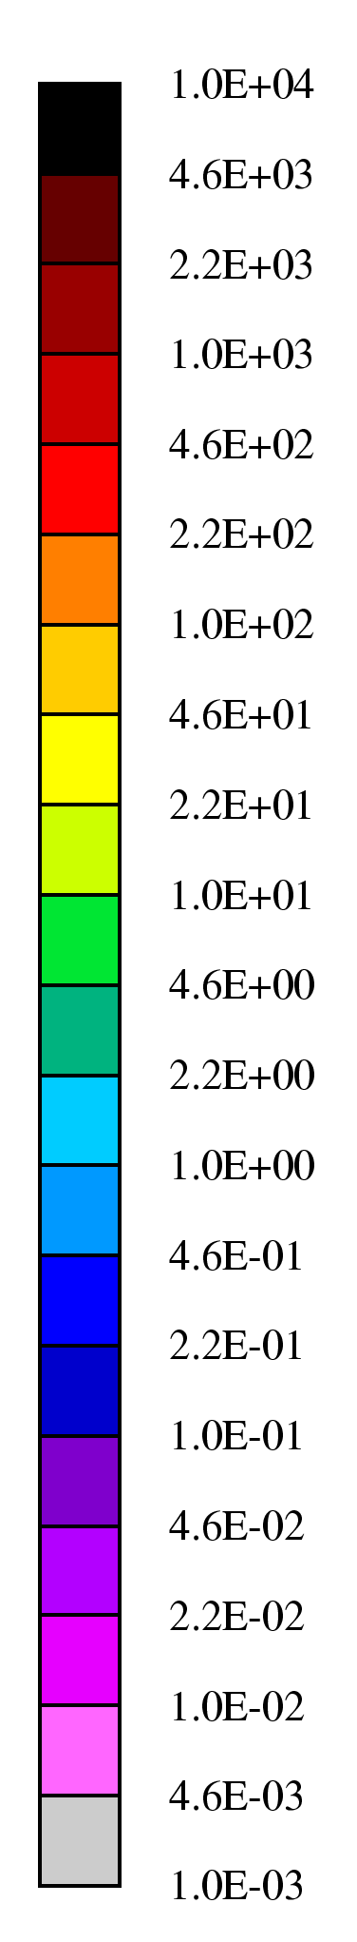
Applications – CNGS
mSv/h
Example:
t_{cool} = 1 day
100
10
1
6th FLUKA course, CERN 2008

Slide 28
(3D) Calculation of Atmospheric ν Flux
The first 3-D calculation of atmospheric neutrinos was done with FLUKA.
The enhancement in the horizontal direction, which cannot be predicted by a 1-D calculation, was fully unexpected, but is now generally acknowledged.
In the figure: angular distribution of ν_{μ}, ‾ν_{μ,,} ν_{e}, ‾ν_{e}..
In red: 1-D calculation

Slide 29
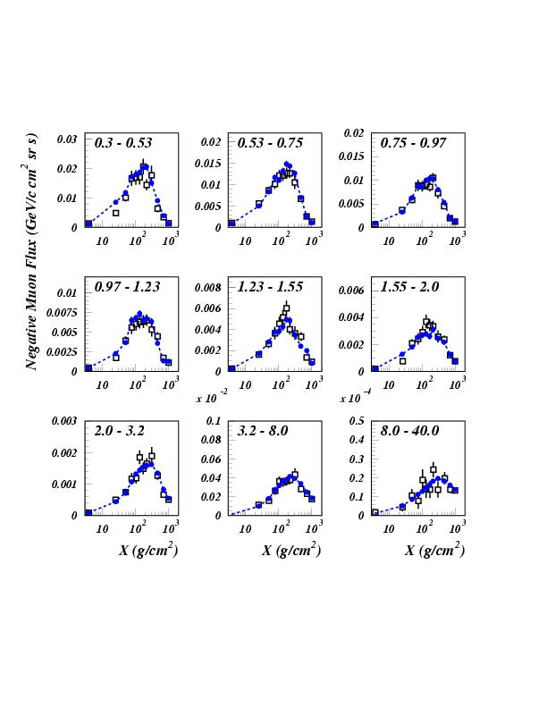
Negative muons at floating altitudes: CAPRICE94
Open symbols: CAPRICE data
Full symbols: FLUKA
primary spectrum normalization ~AMS-BESS
Astrop. Phys., Vol. 17, No. 4 (2002) p. 477

Slide 30
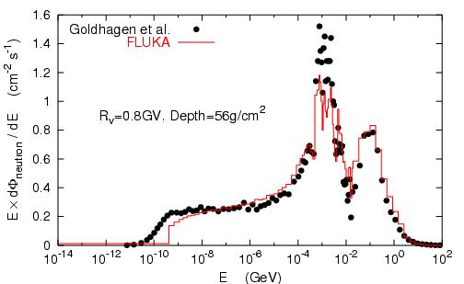
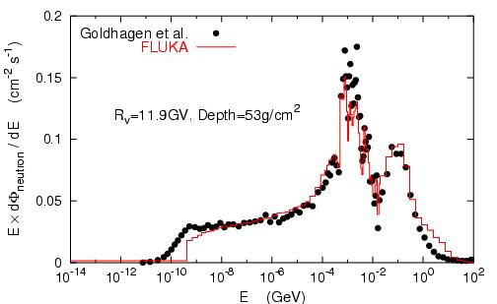
Neutrons on the ER-2 plane at 21 km altitude
Measurements:
Goldhagen et al., NIM A476, 42 (2002)
Note one order of magnitude difference depending on latitude
FLUKA calculations:
Roesler et al., Rad. Prot. Dosim. 98,
367 (2002)

Slide 31
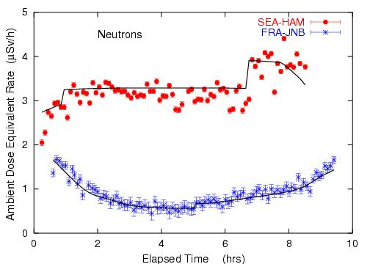
Dosimetry Applications
Roesler et al.,
Rad. Prot. Dosim.
98, 367 (2002)
Ambient dose equivalent from neutrons at solar maximum on commercial flights from Seattle to Hamburg and from Frankfurt to Johannesburg.
Solid lines: FLUKA simulation

Slide 32
Dosimetry applications: doses to aircrew and passengers
Toilet or Galley
AIRBUS 340
Wing fuel tank
Cockpit
Ferrari et al, Rad. Prot.
Dosim. 108, 91 (2004)
Business Class
Economic Class
Center fuel tank
Hold

Slide 33
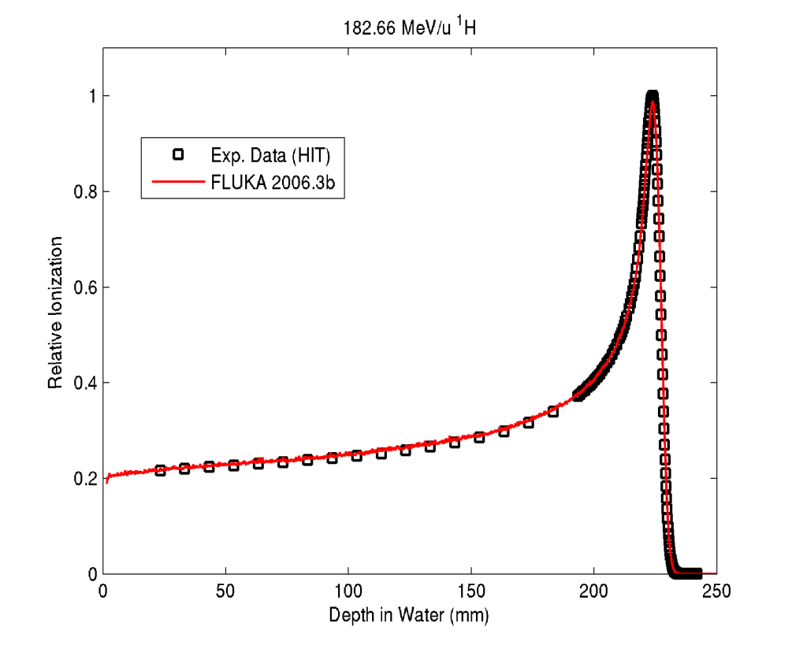
Experimental validation against measured Bragg curve in Proton and Carbon ion therapy
Protons (183 MeV/u) in Water
¹²C ions (400 MeV/u) in Water
FLUKA
Preliminary
Preliminary
Exp. Data (points) taken at HIT:
D. Schardt, P. Steidl, K. Parodi, S. Brons et al.
Simulation: K. Parodi
Exp. Data (points) from Haettner et al, Rad. Prot. Dos. 2006
Simulation: A. Mairani, PhD Thesis, Pavia, 2007
Notes:
Absolute

Slide 34

Using the information from the patient CT in the MC I
The Voxel Geometry
FLUKA can embed voxel structures within its standard combinatorial geometry
Transport through the voxels is optimized and efficient
Raw CT-scan outputs can be imported
The GOLEM phantom Petoussi-Henss et al, 2002

Slide 35
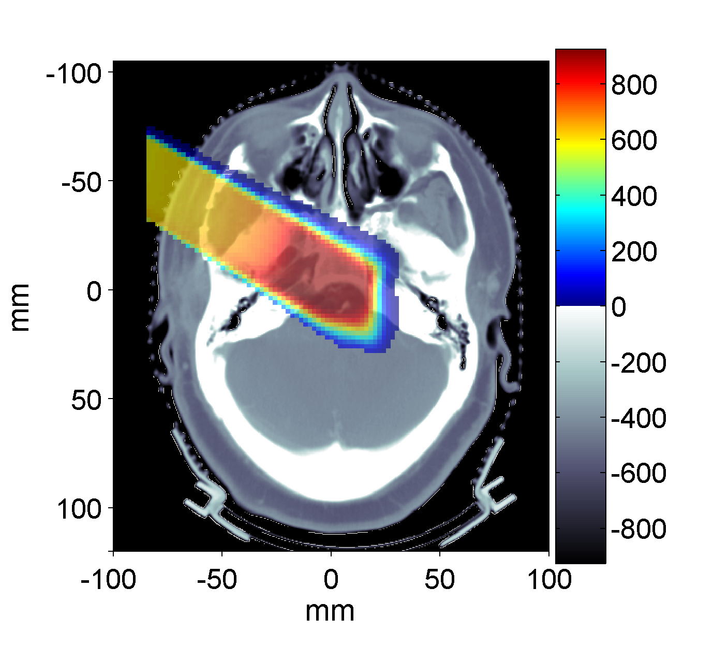
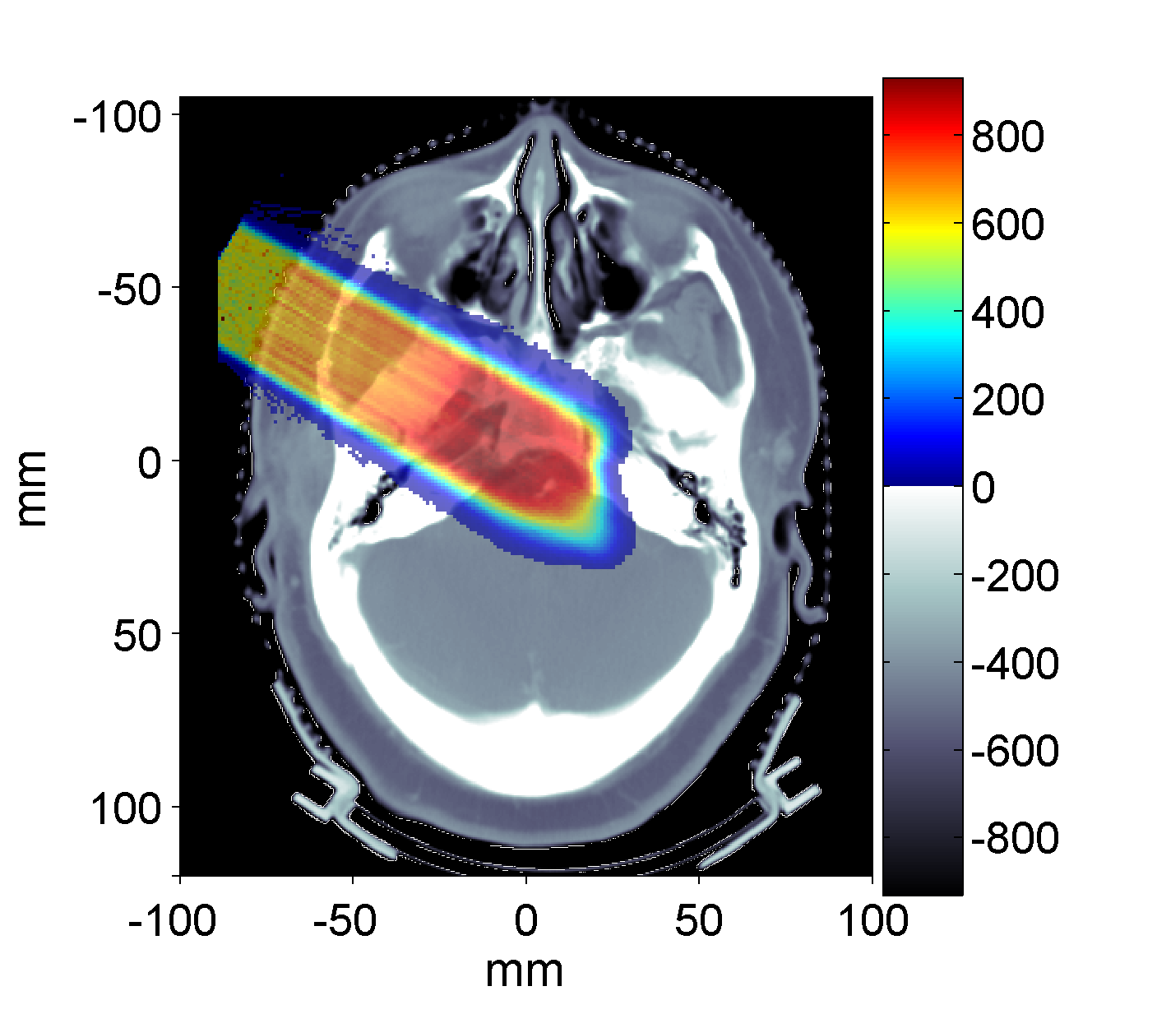
Proton therapy: MC vs Focus/XiO for a Clivus Chordoma Patient at MGH
Treatment Planning
mGy
FLUKA
mGy
Parodi et al, JPCS 74, 2007
Prescribed dose: 1 GyE
MC : ~ 5.5 10⁶ protons in 10 independent runs
(11h each on Linux Cluster mostly using 2.2GHz Athlon processors)

Slide 36
The FLUKA mailing lists
fluka-users@fluka.org
Users are automatically subscribed here when registering on the web site. It is used to communicate the availability of new versions, patches, etc.
fluka-discuss@fluka.org
Users are encouraged to subscribe at registration timed, but can uncheck the relevant box. It is used to have user-user and user-expert communication about problems, bugs, general inquiries about the code and its physics content
users are strongly encouraged to keep this subscription

Slide 37
end

Slide 38
Code complexity
Inelastic h-N: ∼72000 lines
Cross sections (h-N and h-A), and elastic (h-N and h-A): ∼32000 lines
(G)INC and preequilibrium (PEANUT): ∼114000 lines
Evap./Fragm./Fission/Deexc.: ∼27000 lines
ν-N interactions: ∼35000 lines
A-A interactions:
  FLUKA native (including BME): ∼8000 lines
  DPMJET-3: ∼130000 lines
  (modified) rQMD-2.4: ∼42000 lines
FLUKA in total (including transport, EM, geometry, scoring): ∼680000 lines
… + ∼20000 lines of ancillary off-line codes used for data pre-generation
… and ∼30000 lines of post-processing codes

Slide 39
General use: installation and run by a single user on a single machine
Run can be managed also in computer farms (clusters)
experimented under GRID
Notes:
39

