Slide 1
FLUKA The Standard Output
Beginners FLUKA Course

Slide 2
The FLUKA Standard Output
FLUKA provides a standard output file that contains plenty of useful information:
(fortran unit 11, inp###.out from rfluka)
It must be checked at least once when setting up a simulation and always in case of doubts/crashes
(together with inp###.err and inp###.log files)
Let’s have a look to ex_3001.out (editor or flair output viewer:
Process – Files – select ex_3001.out , or
fless ex_3001.out)

Slide 3
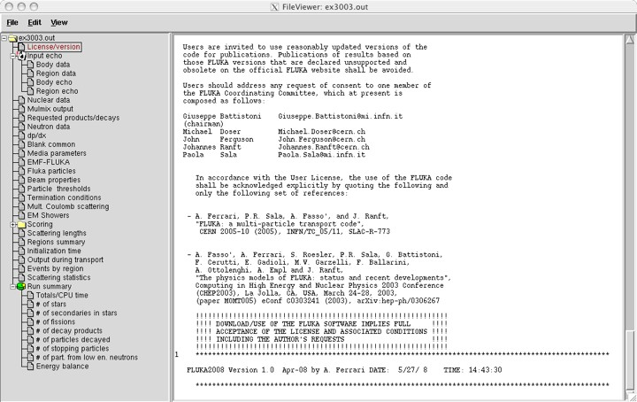
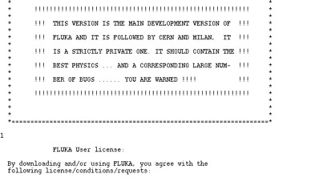
License/version
First comes the
Banner Page,
and the license
... other info including disclaimer,
limitations and references.
Header with the
FLUKA version and
the date of the run

Slide 4
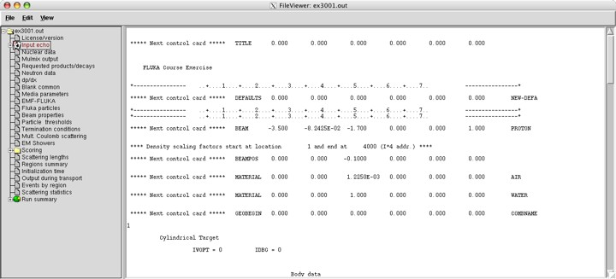
Input echo
The data cards are parsed in groups, and do not appear in same order as they are inserted in the input file…
For instance: TITLE is the first to appear, then all comment cards are listed together, followed by the beam related cards, etc. etc.
4

Slide 5
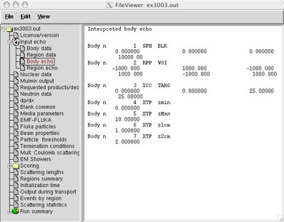
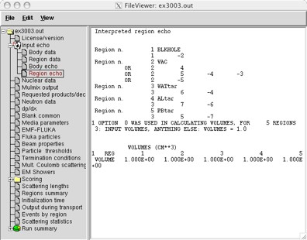
Input echo – Geometry output
Followed by the geometry output, if not redirected
(see GEOBEGIN card).
Echo of the commands is presented, together with interpretation
and correspondence between numbers and names

Slide 6
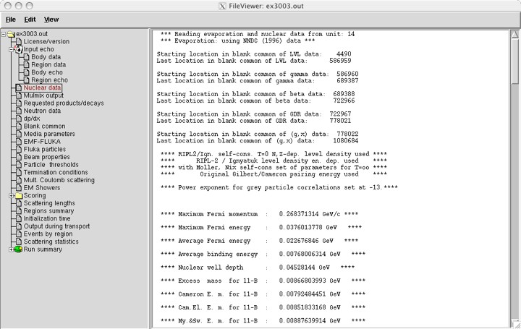
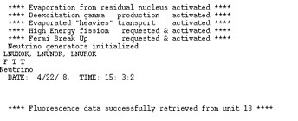
Nuclear data
Information
about the
basic nuclear
data file used in
the program
some memory allocation details…
.
.
.
.
.
.
active options
for the
nuclear model
6

Slide 7
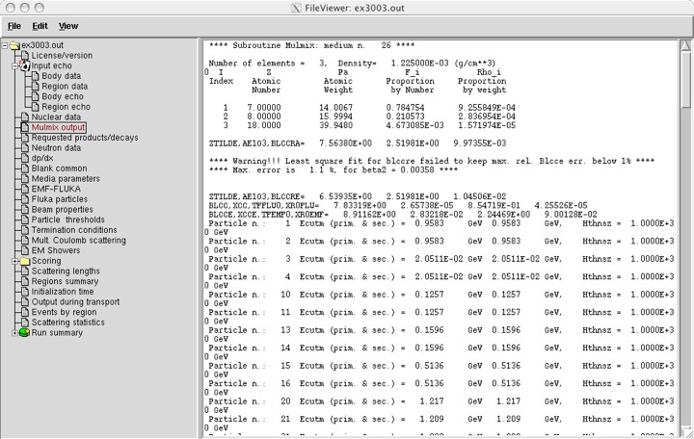
Material properties
Material properties,
multiple scattering
parameters
the warning is normal!
7

Slide 8
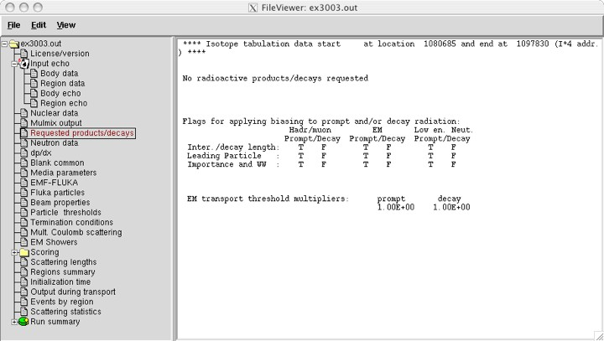
Radiation Decay
Info on decay
radiation options
Radiation
biasing

Slide 9
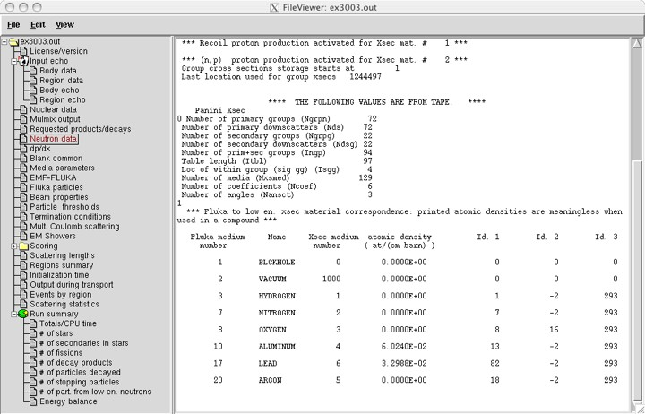
Neutron data
Low-energy neutron
info, material
correspondence
More info on low-neut cross sections if requested
LOW-NEUT
9

Slide 10
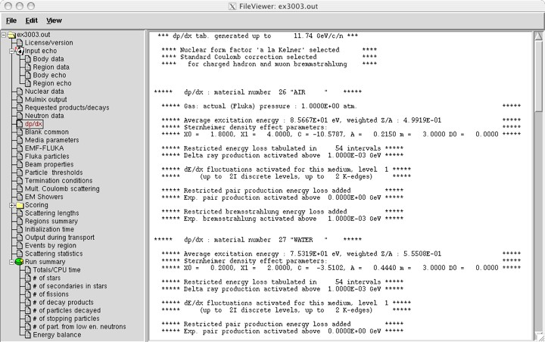
Material Parameters – dp/dx
Material-dependent
parameters for
ionization energy
losses
Check δ-ray and bremss. threshold (DELTARAY, PAIRBREM)
10

Slide 11
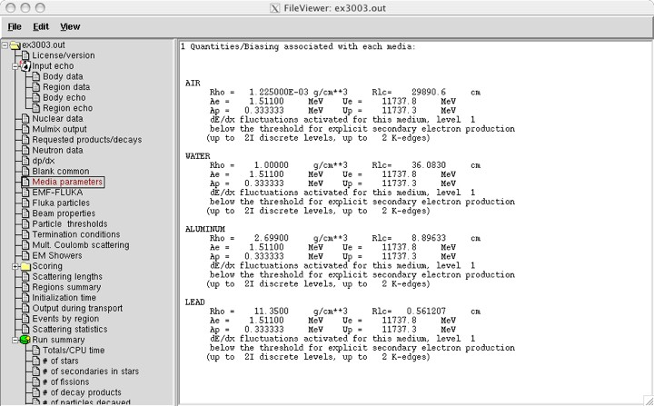
Material parameters – Transport thresholds
Upper limit for e± in MeV
Same for photons
Production threshold for e± in MeV
(Total energy, not just kinetic)
11

Slide 12
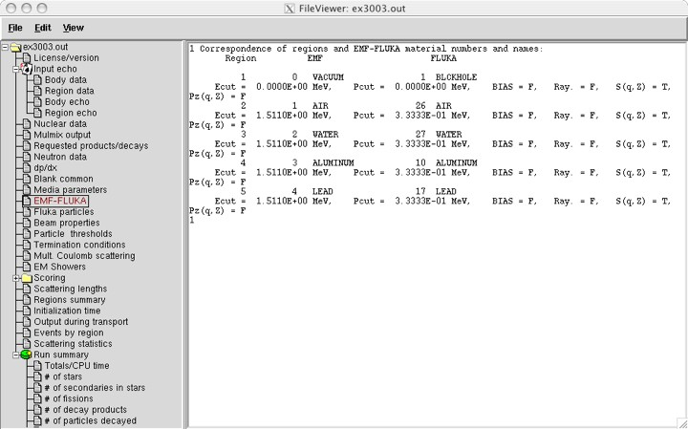
Material parameters – EMF-FLUKA
Transport threshold for e± and photons in MeV
(Total energy, not just kinetic)
12

Slide 13
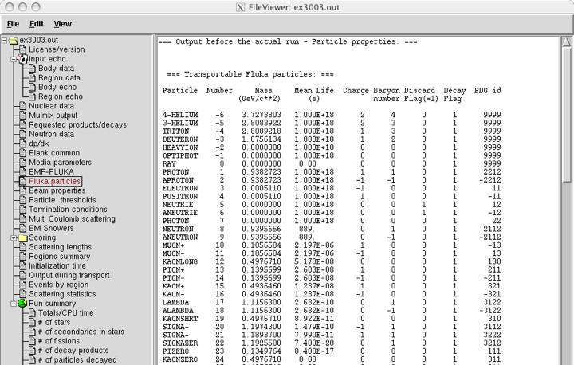
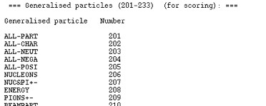
FLUKA Particles
exhaustive list of FLUKA particles
...and many more
13
...continues on your screen!

Slide 14
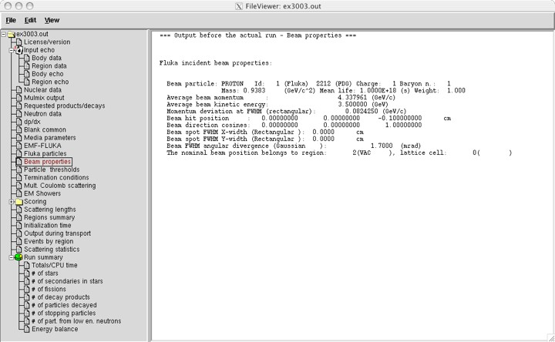
Input interpreted summary – Beam
Check the starting region
14

Slide 15
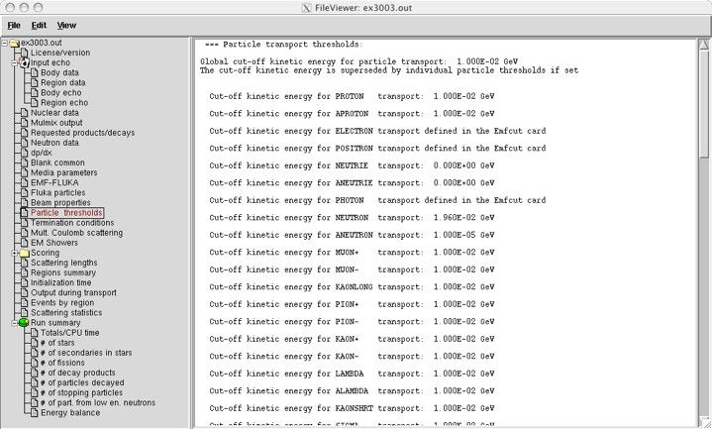
Input interpreted summary – Thresholds
15

Slide 16
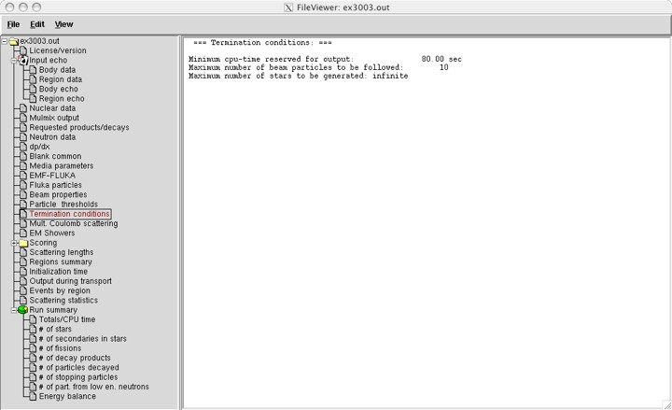
Input interpreted summary – TC, MCS, EM
16

Slide 17
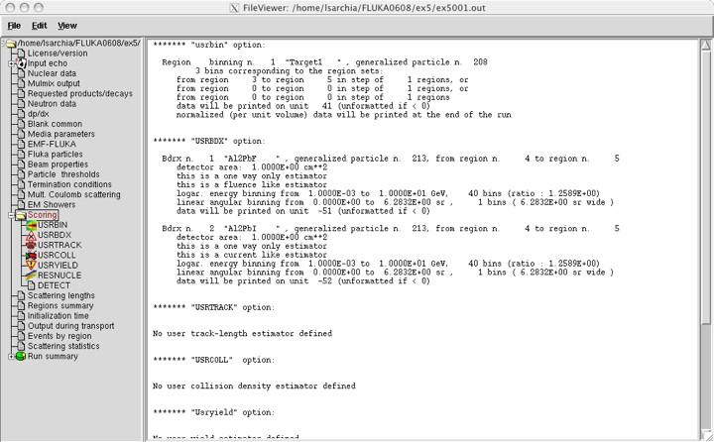
Scoring none in ex3, check ex5 output
Complete description of
each estimator requested
17

Slide 18
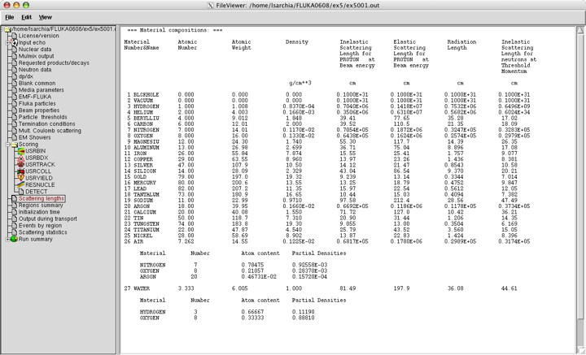
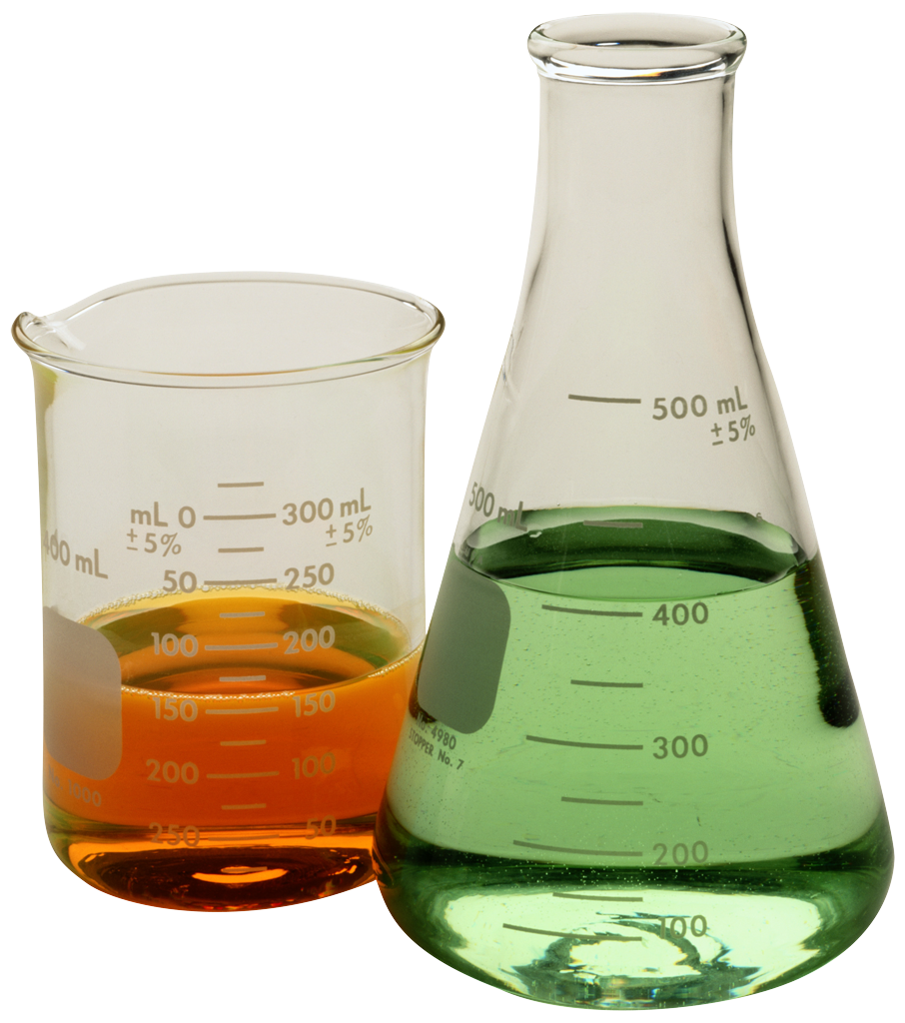
Materials – Scattering lengths
Data related to the beam particle type
specified in the BEAM card
Compounds
interpreted
composition
18

Slide 19
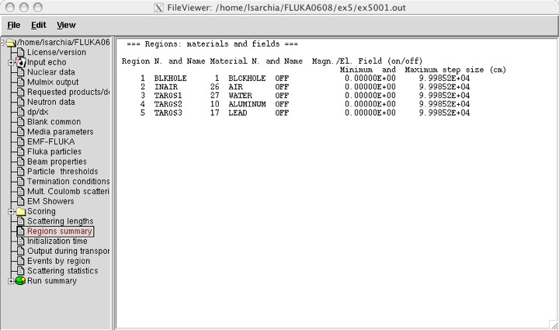
Regions summary
Useful way to check
material assignment
Minimum step size
set with STEPSIZE option
…maximum step size
not yet implemented

Slide 20
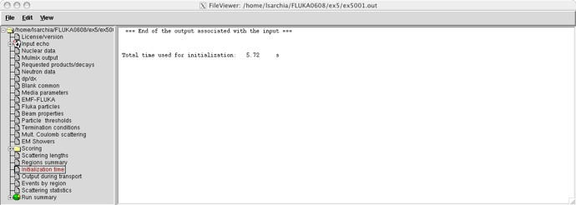
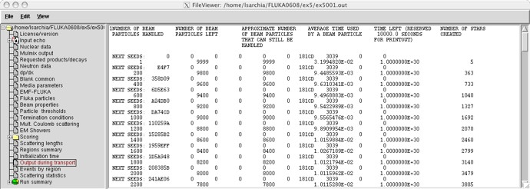
Runtime Info – Output associated with the run
Periodic echo of:
event number, time, random seed

Slide 21
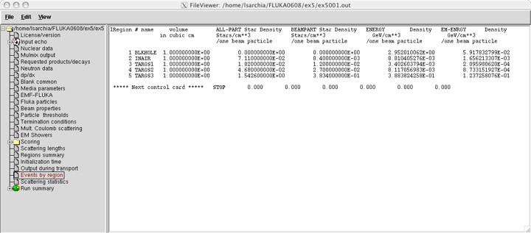
Results – Scoring
Results of SCORE options for all region:
very useful for debugging and for cross-check with estimators
# inelastic interactions of primary particles
The volume is not automatically evaluated,
you have to specify it in the geom. description
21

Slide 22
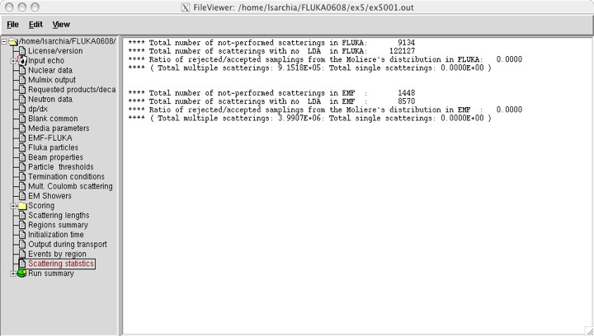
Results – Statistics of Coulomb scattering
22

Slide 23
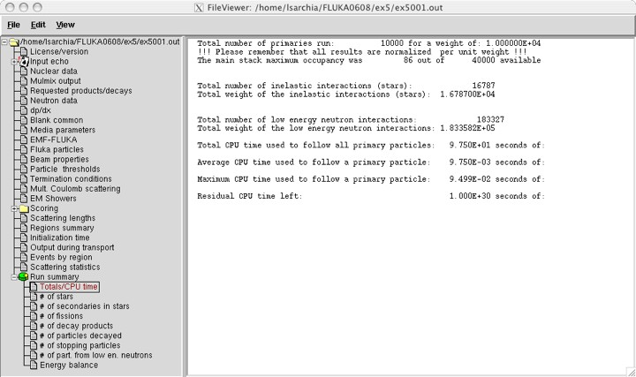
Results – Statistics of the run
CPU time is not real time!

Slide 24
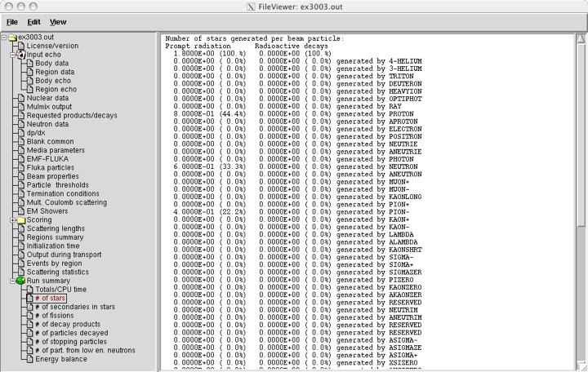
Run summary: detailed statistics
Detailed statistics for
each particle type

Slide 25
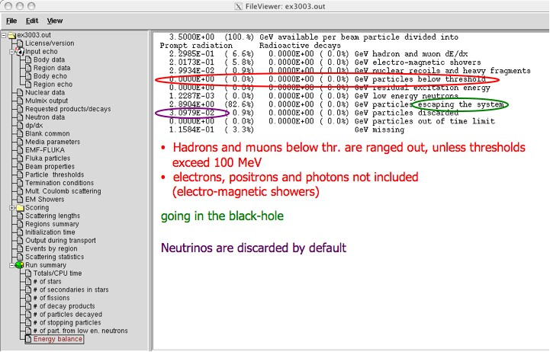
Energy Balance
Calculated by difference: in pure e-m problems it should be 0, while in
hadronic problems it is the energy spent in endothermic
nuclear reactions ( ≈ 8 MeV/n) , or gained in exothermic
(i.e., mostly neutron capture): it is –total Q

Slide 26
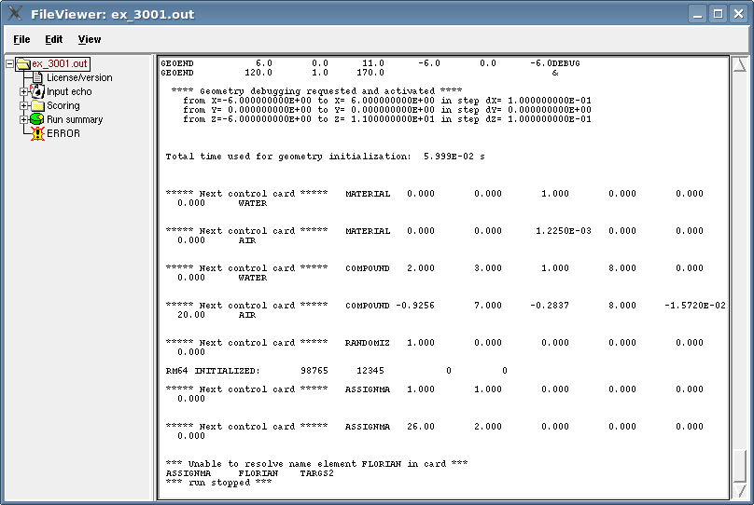
Error message

Slide 27
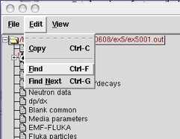
Tips and tricks
You can always CTRL-F or Edit – Find for a specific word in a selected section or in the whole output file.

