Slide 1
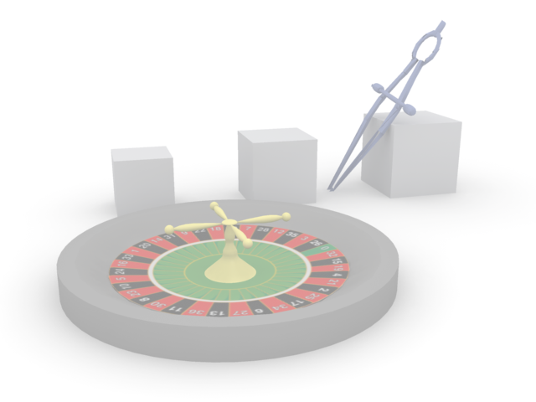
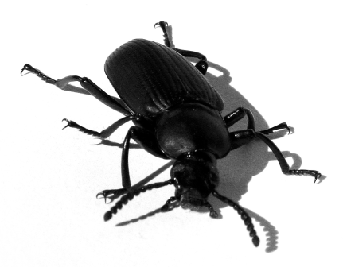

Visual debugging with SimpleGeo
Chris Theis

Slide 2

Overview
SimpleGeo’s visual debugger
Running a few examples

Slide 3
Geometry errors
Geometry errors
Geometry errors Debugging methods Examples
Two types of errors
Overlapping regions FLUKA won’t crash but the results may be not what you had intended.
Undefined regions program crash

Slide 4
SimpleGeo’s approach
Geometry errors
Geometry errors Debugging methods Examples
Basic idea is similar to FLUKA:
Test if particles at specified positions encounter an unambiguous and well-defined region description
The “black magic”:
How do you define those positions that should be tested?
ATTENTION: The debugger checks the geometry only!!! It does not include diagnostics for
misaligned values in the input file!

Slide 5
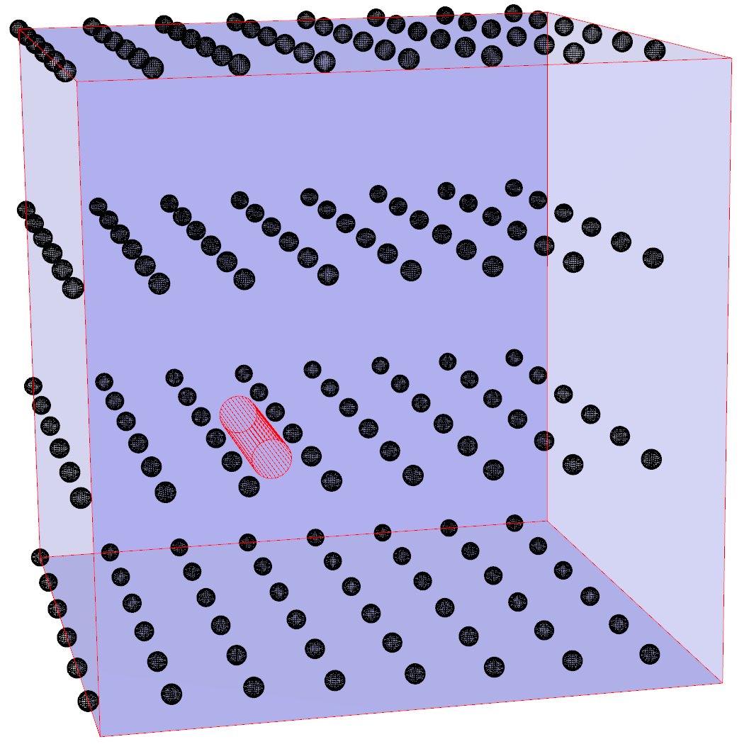
Grid debugging
Geometry errors Debugging methods
Geometry errors Debugging methods Examples
Definition of a region of interest (ROI) via XMin, XMax, YMin, YMax,
ZMin, ZMax
Specification of how many steps should be taken in each direction
The problem:
Errors located in between the equidistant step sizes
cannot be found by definition!

Slide 6
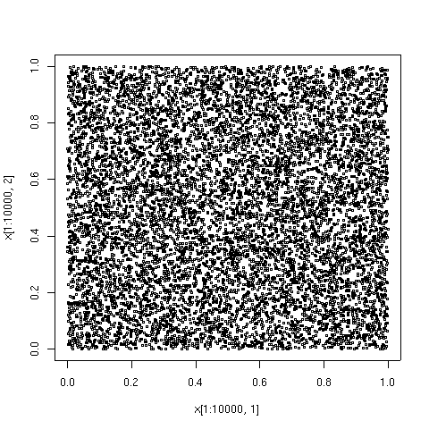
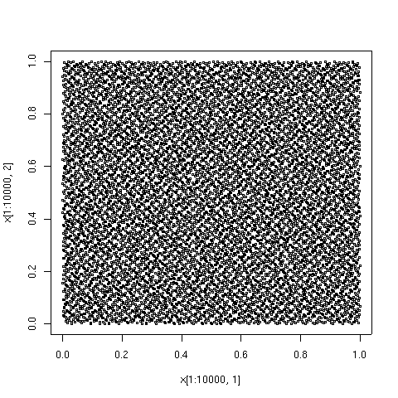
Other methods
Geometry errors
Geometry errors Debugging methods
Geometry errors Debugging methods Examples
Monte Carlo sampling of the region
Due to the randomness the probability to find very small errors exists.
Drawback: Tendency to cluster at low sampling rates. Uniformity is reached only by a large number of samples.
Quasi-Monte Carlo sampling of the region
Faster convergence towards uniformity.
Drawback: Very complex mathematics involved (but this can be compensated for by highly optimized sampling routines).
Monte Carlo sampling (500 points)
Quasi Monte Carlo sampling (500 points)
* Images courtesy of R. Dodier, Wikipedia
http://en.wikipedia.org/wiki/Low-discrepancy_sequence

Slide 7

Algorithms available in SimpleGeo
Geometry errors
Geometry errors Debugging methods
Geometry errors Debugging methods Examples
Grid sampling
- Equidistant points in each direction X, Y, Z
Stochastic sampling (Monte Carlo method)
- Uniform distribution of points in a box
Importance sampling
- Exponential distribution of points in a sphere
Quasi Monte Carlo (recommended)
(low discrepancy, jittered stratified, latin hypercube)
- Quasi-random distribution of points in a box

Slide 8
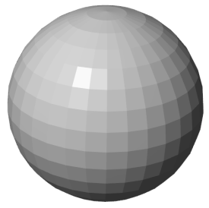
A first example
Geometry errors Debugging methods Examples
Geometry errors Debugging methods Examples
Import ngen_e1.inp from the folder data/Debugging
Activate the automatic build on the toolbar
Reset the camera clicking on the toolbar
You will now see the surrounding blackhole
Turn off the visibility of the blackhole
(Click on the checkbox next to the region named 001_Diff or click on the gray sphere and press the Space key)

Slide 9

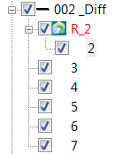
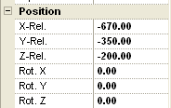

A first example
Geometry errors Debugging methods Examples
Geometry errors Debugging methods Examples
Select region 002_Diff in the CSG tree
We want to debug everything inside this region
Expand the region and select the primitive
named 2, which is the source primitive of
reference node R_2 and surrounds our
region of interest (ROI)
Note the position & extension –
they form our ROI

Slide 10
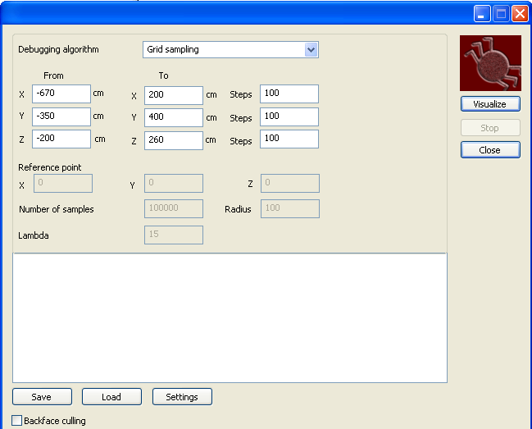
Debug the geometry
Geometry errors Debugging methods Examples
Geometry errors Debugging methods Examples
Open the debugger via the menu “File” - “Debug geometry”
Enter the coordinates
of our ROI or load
them from the file
ngen_e1.sdb
Click on the bug to
start
Start

Slide 11
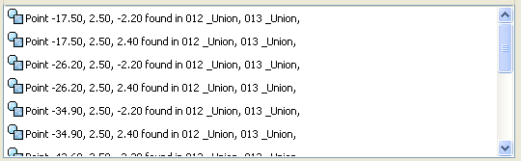
The result
Geometry errors Debugging methods Examples
Geometry errors Debugging methods Examples
Debugging can be stopped anytime. All errors found so far will be displayed.
After some time the following overlaps will be found:
Click on one of the entries and the respective region will be automatically selected in the CSG tree

Slide 12
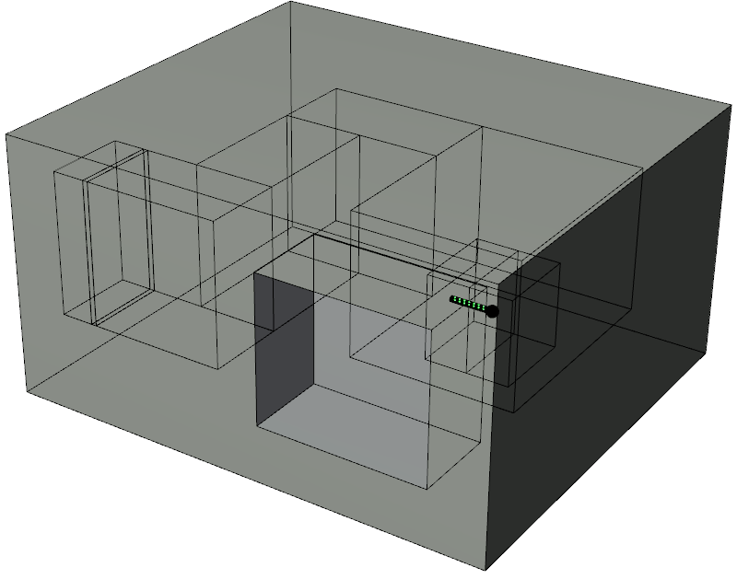
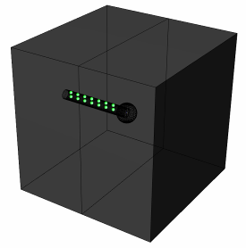
The result
Geometry errors Debugging methods Examples
Geometry errors Debugging methods Examples
Select “View” - “Overlay sketch” to render all regions inside our ROI
Click on the “Visualize” button in the debugger dialog
Overlapping points
Marked by green spheres

Slide 13
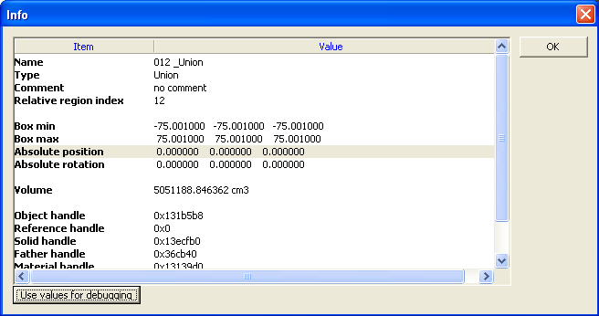
Taking a closer look
Geometry errors Debugging methods Examples
Geometry errors Debugging methods Examples
Regions #12 and #13 are problematic
refine the ROI for debugging
Select 012_Union in the CSG tree
Double click on the right mouse
button to open the context menu,
and select Node-info.
The values of Box min & Box max
are the extensions of the bounding box.
Click on “Use values for debugging” to
transfer the bounding box values to the debugger.

Slide 14
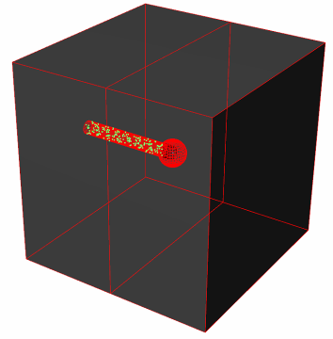
Taking a closer look
Geometry errors Debugging methods Examples
Geometry errors Debugging methods Examples
Turn off the visibility of all regions except 012_Union and 013_Union
Select Low discrepancy or Latin Hypercube as the debugging algorithm and start the debugger.
There is an error in the region
description of region # 12, which
lacks a cut plane.

Slide 15
A second example
Geometry errors Debugging methods Examples
Geometry errors Debugging methods Examples
Close the debugger, create a new scene and import ngen_e2.inp from the folder data/Debugging
Activate the automatic build on the toolbar
Reset the camera clicking on the toolbar
You will now see the surrounding blackhole
Turn off the visibility of the blackhole
(Click on the checkbox next to the region named 001_Diff or click on the gray sphere and press the Space key)

Slide 16
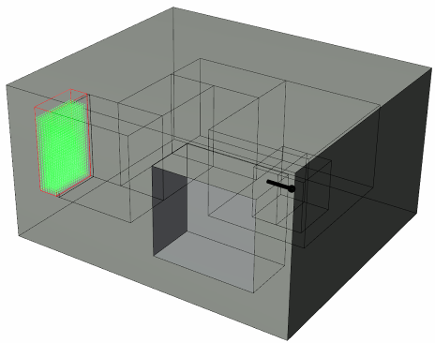
A second example
Geometry errors Debugging methods Examples
Geometry errors Debugging methods Examples
Load the debug parameters from ngen_e2.sdb
Start the debugger
A huge amount of over-laps is found in 007_Int and 008_Int.
Hint: Select 007_Int in the CSG tree and
then select 008_Int. You will see that both
have the same red contours. This means that
they are identical!

Slide 17
A third example
Geometry errors Debugging methods Examples
Geometry errors Debugging methods Examples
Close the debugger, create a new scene and import ngen_e4.inp from the folder data/Debugging
Activate the automatic build on the toolbar
Reset the camera clicking on the toolbar
You will now see the surrounding blackhole
Turn off the visibility of the blackhole
(Click on the checkbox next to the region named 001_Diff or click on the gray sphere and press the Space key)

Slide 18
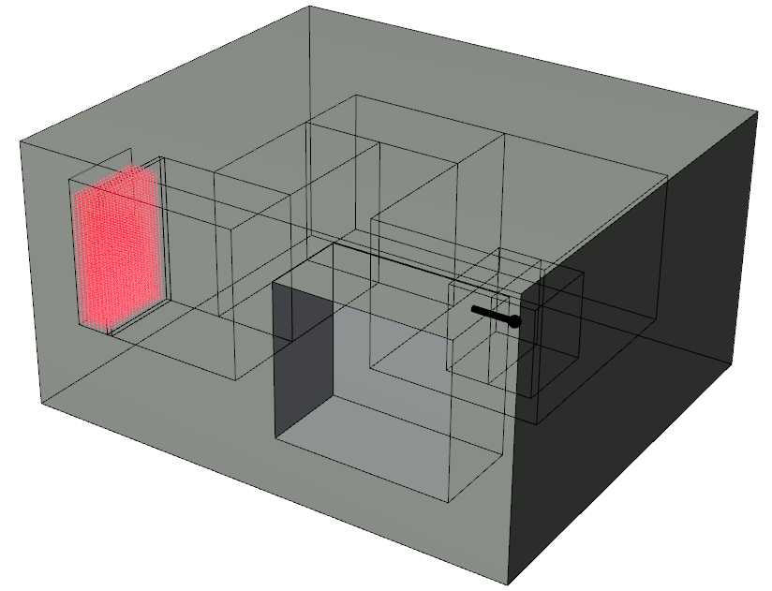
A third example
Geometry errors Debugging methods Examples
Geometry errors Debugging methods Examples
Load the debug parameters from ngen_e3.sdb
Start the debugger
A huge amount of undefined points was found and marked by red spheres.
A region is missing

Slide 19
Final remarks
Geometry errors Debugging methods Examples
Which algorithm is the best?
- The best is a total, uniform coverage of the region.
possible only with infinitely many steps
Combine and try various methods.
1.) Low discrepancy/Latin Hypercube/Jittered stratified
(recommended in the first place)
2.) Stochastic sampling
3.) Grid sampling

