Slide 1
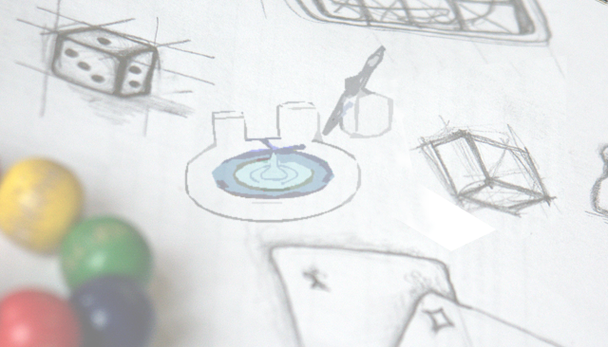
Building a geometry with
SimpleGeo
Chris Theis

Slide 2
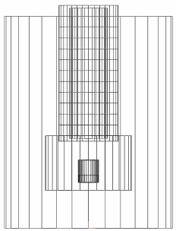
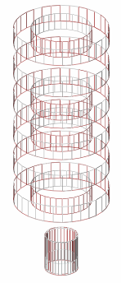
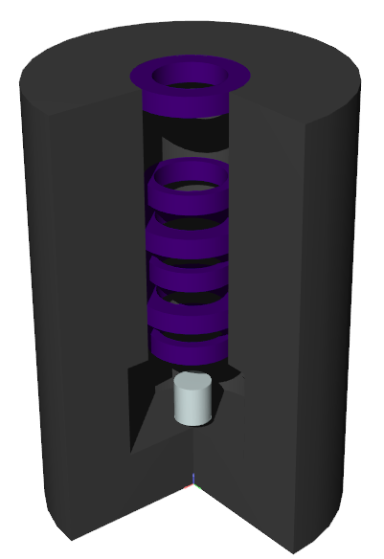
What we would like to build…
Collimators
Irradiator with a lead container,
a radioactive source including
its encapsulation and some collimators
Source

Slide 3
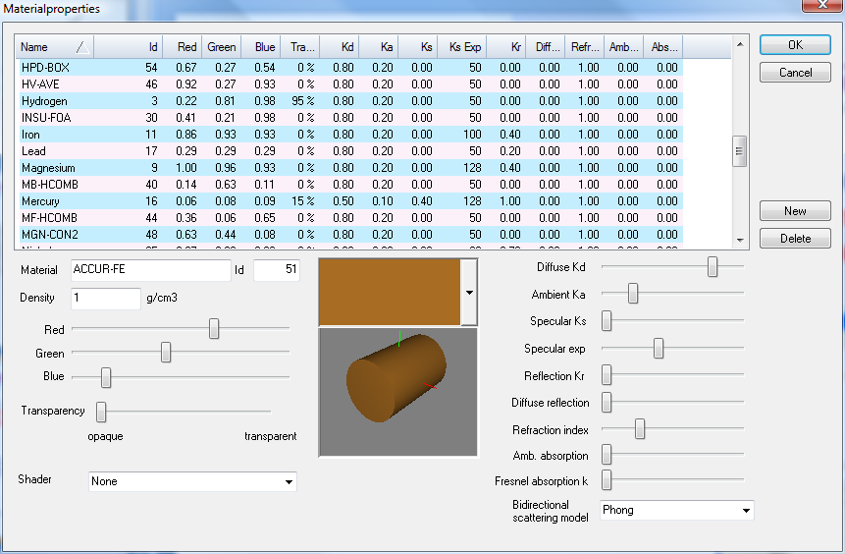
Creating an additional material
We need to create Cesium, which is not included in the list of standard materials. Do not forget to specify the physical property of the material with the created numerical ID in the input file for FLUKA!
Select “Edit” in the the “Materials” menu.
Press “New” in the material property dialog
Enter Cesium & set the color properties
A material with ID 26 will be created.
This material database will be stored in the same directory as your geometry. They must
be kept in one place!

Slide 4
More on materials…
In FLUKA Materials are assigned by a numerical ID
The physical parameters must be specified in the input file
If the standard materials are overwritten in an imported input
the material name in SimpleGeo and the one in FLUKA will
NOT match, because SimpleGeo uses the standard materials
of FLUKA2005.6.
This causes no problem because in the exported FLUKA input
the assignment is based on the numerical ID! However, it is
strongly discouraged to overwrite standard material numbers
to avoid confusion!!

Slide 5
External & internal void
Bodies
External void -> Cylinder: X = 0, Y = 0, Z = -200, R = 400, H = 600
Name = ExtVoid
Internal void -> Cylinder: X = 0, Y = 0, Z = -150, R = 250, H = 400
Name = IntVoid
AirOut -> Cylinder: X = 0, Y = 0, Z = -100, R = 200, H = 300
Name = AirOut
Regions
External void: Type = Difference (ExtVoid – IntVoid),
Name = RExtVoid
Material = Blackhole

Slide 6


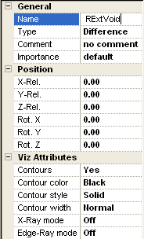
Creating a region
Add difference
Change the name
Existing bodies in the CSG tree
Hint: Edit fields for numerical parameters like position, size, radius etc. can evaluate mathematical expressions! For example one can enter “305 +(25*3)” which will evaluate to 380.

Slide 7


Creating a region
Drag “ExtVoid” and drop it over “RExtVoid”.
Do the same with “IntVoid”.
The difference of ExtVoid – IntVoid
has been finished.
(The first body in a difference is
always the one which is subtracted from)

Slide 8
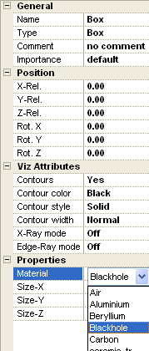

Material assignments
Regions consisting of 1 body only:
Select the material in the property view
Regions made up of boolean operations:
Select the top-most node of the region (a boolean operator) and select the material in the property view

Slide 9
Creating a region with references
Regions
Internal void: Type = Difference (IntVoid – AirOut),
Name = RIntVoid
Material = Air
One of these bodies exists and is already
used in another region description!
Reference nodes
They share the geometry, position, orientation etc. but NOT the material!

Slide 10

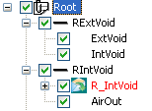
Creating a region with references
Create a difference with the name RIntVoid
Select the body IntVoid in the region RExtVoid.
Press the Shift key and drag IntVoid and drop it over RIntVoid
while holding Shift pressed!
Also drag and drop the body AirOut over RIntVoid
Finally you’ll have
References are marked by
the envelope icon and
automatically have a R_ prefix

Slide 11
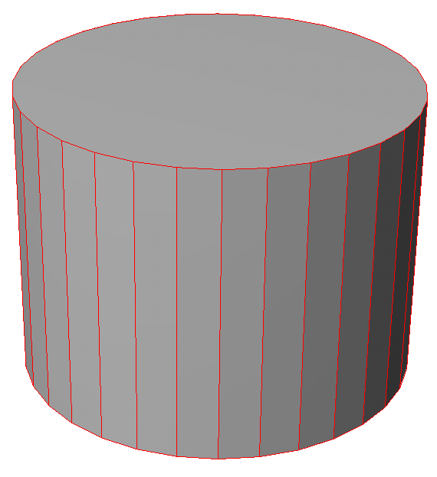
Visibility
Hint: Selected (sub)regions
are always shown with
red contours
Now turn off the visibility be clicking on the checkbox of the
upper-most node

Slide 12
Create the next bodies/regions
Bodies
Lead container -> Cylinder: X = 0, Y = 0, Z = 0, R = 18, H = 45
Name = LeadCon
Air inside 1 -> Cylinder: X = 0, Y = 0, Z = 16, R = 5.5, H = 31
Name = AirIn1
Air inside 2 -> Cylinder: X = 0, Y = 0, Z = 7, R = 8, H = 10
Name = AirIn2
Regions
Lead container: Type = Difference (LeadCon – AirIn1 – AirIn2),
Name = LeadCol
Material = Lead

Slide 13
Creating another region with references
Regions
Air outside: Type = Difference (AirOut –LeadCon – AirIn1)
Name = ROuterAir
Material = Air
All of these bodies exist and are already
used in other region descriptions!
We need reference nodes again

Slide 14

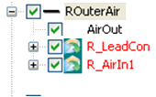
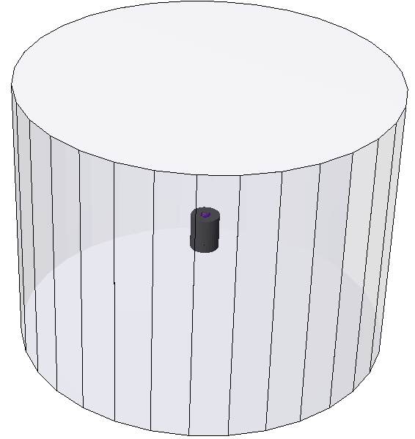
Creating a region with references
Create a difference with the name ROuterAir
Drag and drop the body AirOut, which becomes the first child node
Select the body AirIn1 in the region LeadCol.
Press the Shift key and drag AirIn1 and drop it over ROuterAir
while holding Shift pressed!
Repeat step 4 with LeadCon
Finally you’ll have
Turn off the visibility of ROuterAir

Slide 15
Creating further bodies/regions
Bodies
Air inside 3 -> Cylinder: X = 0, Y = 0, Z = 16.5, R = 3.5, H = 30
Name = AirIn3
Collimator 1 -> Cylinder: X = 0, Y = 0, Z = 17, R = 4.5, H = 2
Name = Coll1
You can clone a body pressing
Ctrl + C. But don’t forget to
change the parameters
and the name!
Collimator 2 -> Cylinder: X = 0, Y = 0, Z = 21, R = 5.5, H = 2
Name = Coll2
Collimator 3 -> Cylinder: X = 0, Y = 0, Z = 25, R = 4.5, H = 2
Name = Coll3
Collimator 4 -> Cylinder: X = 0, Y = 0, Z = 29, R = 5.5, H = 2
Name = Coll4
Collimator 5 -> Cylinder: X = 0, Y = 0, Z = 33, R = 4.5, H = 2
Name = Coll5
Collimator 6 -> Cylinder: X = 0, Y = 0, Z = 43, R = 5.5, H = 2
Name = Coll6

Slide 16
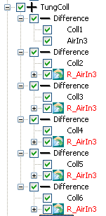
Creating further bodies/regions
Regions
Tungsten collimator: Type = Union
(Coll1 – AirIn3) | (Coll2 – AirIn3) | (Coll3 – AirIn3) |
(Coll4 – AirIn3) | (Coll5 – AirIn3) | (Coll 6 - AirIn3)
Name = TungColl
Material = Tungsten
Don’t forget to use references
for already existing bodies! You
can clone existing bodies and
references by dragging and dropping
them while holding the Ctrl key.

Slide 17
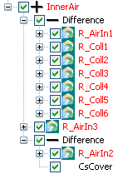
Creating further bodies/regions
Bodies
Cs source cover -> Cylinder: X = 0, Y = 0, Z = 8.4, R = 1.9, H = 4.2
Name = CsCover
Regions
Air inside: Type = Union
(AirIn1 – Coll1 – Coll2 – Coll3 – Coll4 – Coll5 – Coll6) |
(AirIn3 ) |
(AirIn2 – CsCover)
Name = InnerAir
Material = Air

Slide 18
Creating further bodies/regions
Bodies
Cs source inside -> Cylinder: X = 0, Y = 0, Z = 8.5, R = 1.8, H = 4.0
Name = CsInner
Al separator plane -> Plane: X = 0, Y = 0, Z = 9.8
Name = CsAlSep
Regions
Source: Type = Difference (CsInner - CsAlSep)
Name = Source
Material = Cesium
Source cover: Type = Difference (CsCover - CsInner)
Name = SourceCov
Material = Iron
Al part of the source: Type = Intersection (CsInner x CsAlSep)
Name = AlSrcPart
Material = Aluminum

Slide 19
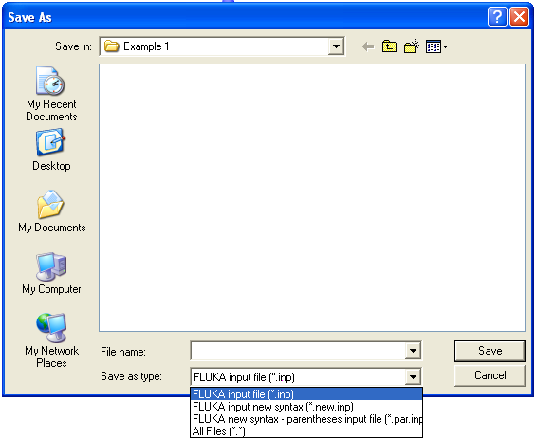
Export to FLUKA
SimpleGeo supports the following formats for exporting to FLUKA
Old syntax with numbers
New syntax with names and without parentheses
New syntax with names and with parentheses
In the export dialog you can select the respective format from the
drop-down list at the bottom of the dialog.
In this case select the option
FLUKA input new syntax (*.new.inp)

Slide 20
In the end…
Final version of the geometry with one part removed

Slide 21

You can find more examples in the gallery on the website
Website: www.cern.ch/theis/simplegeo

