Slide 1
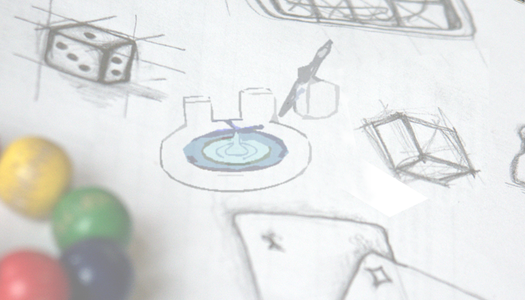
Basic steps with SimpleGeo
Chris Theis

Slide 2

Overview
Approaches for geometry construction
(CAD, CSG)
SimpleGeo – an interactive geometry modeler
Plugin concept

Slide 3
Current status
CAD vs. CSG SimpleGeo Status & outlook
Current status
Textual input
2D cuts (supplied by FLUKA via PLOTGEOM)
Goal
Combined interactive modeling & 3D visualization
& debugging which is independent of the syntax
and format
Ways to go: CAD or CSG?

Slide 4
Why not use AutoCAD, etc…?
CAD vs. CSG SimpleGeo Status & outlook
What is the difference between CAD & CSG?
C
A
D
C
S
G
Mathematical properties
must be preserved!
The “looks” must be correct

Slide 5


Mathematical properties?
CAD vs. CSG SimpleGeo Status & outlook
CAD
CSG
“So, what’s the big deal?”
Tracking
Point in polyhedron test with
Considering N x M faces
Solving x² + y² +z² = R²

Slide 6
SimpleGeo - a hybrid solution
CAD vs. CSG SimpleGeo Status & outlook
CAD vs. CSG SimpleGeo Status & outlook
CAD
Can be rendered directly
with “ordinary” GFX - cards
CSG
Output for MC – codes
Hierarchical structure
SimpleGeo
Complex modeling algorithms
Numerical issues

Slide 7

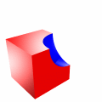

Constructive solid geometry
CAD vs. CSG SimpleGeo Status & outlook
Basic idea
Solids are point sets (= primitives) that can be operated on
Geometry
Set of primitive solids combined with boolean operations
Union
Difference
Intersection
Group

Slide 8
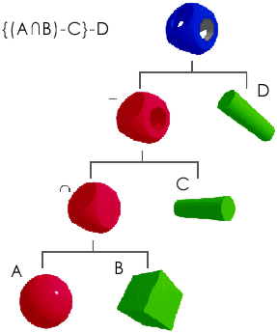
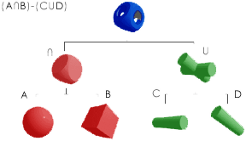
Recursive CSG tree
CAD vs. CSG SimpleGeo Status & outlook
Original images courtesy of N. Stewart
Recursive CSG tree
Normalized CSG tree
CSG trees are not unique. Different constructions can yield the same result.

Slide 9
Loading a FLUKA input
CAD vs. CSG SimpleGeo Status & outlook
CAD vs. CSG SimpleGeo Status & outlook
Select “File” -> “Import”* and open the file named NeutronGenerator.inp located in the directory data\NeutronGen
If more than 10 regions are loaded the automatic build function is disabled. You’ll immediately be notified of this.
Press the automatic build button on the toolbar
Press the “Reset view” button.
* Versions >2.0 support the new syntax with names as well as the old syntax with numbers. In view of the free format a delimiter (e.g. space) between the values is mandatory! If this is not present a warning will be displayed.

Slide 10
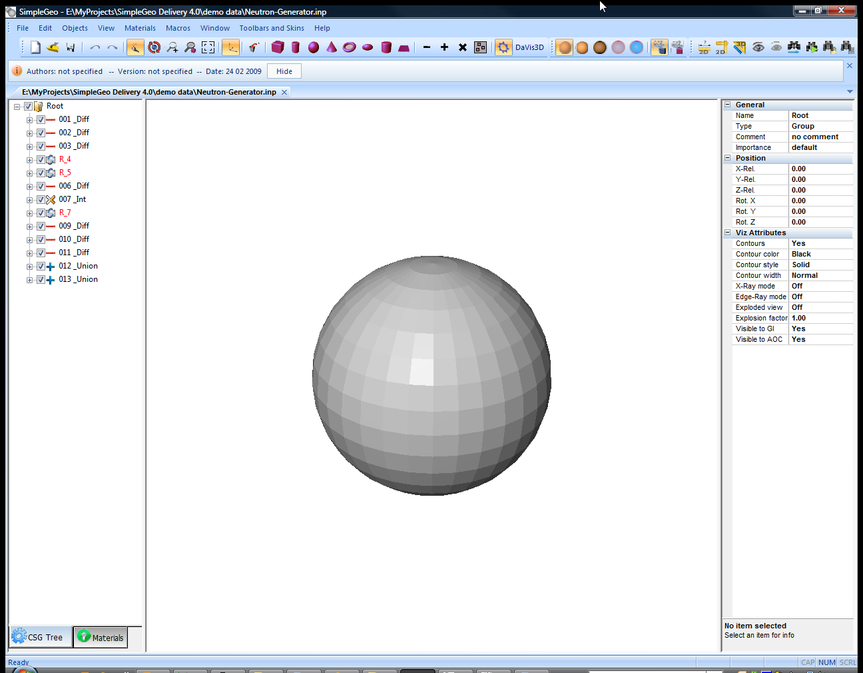
CSG tree
Properties
External void

Slide 11
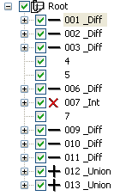
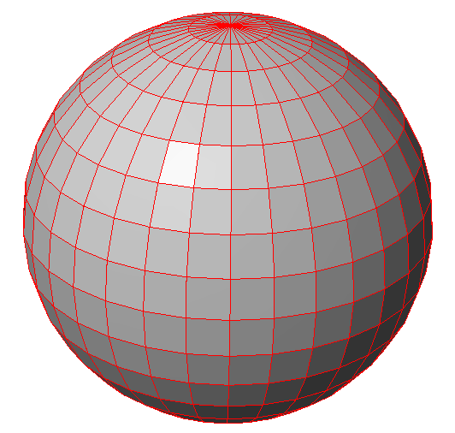
Next step –object identification
CAD vs. CSG SimpleGeo Status & outlook
CAD vs. CSG SimpleGeo Status & outlook
Activate the “identify” function on the toolbar
Click on the gray sphere and the identified region will automatically be selected in the CSG tree. Selected (sub)regions
are shown with red contours

Slide 12
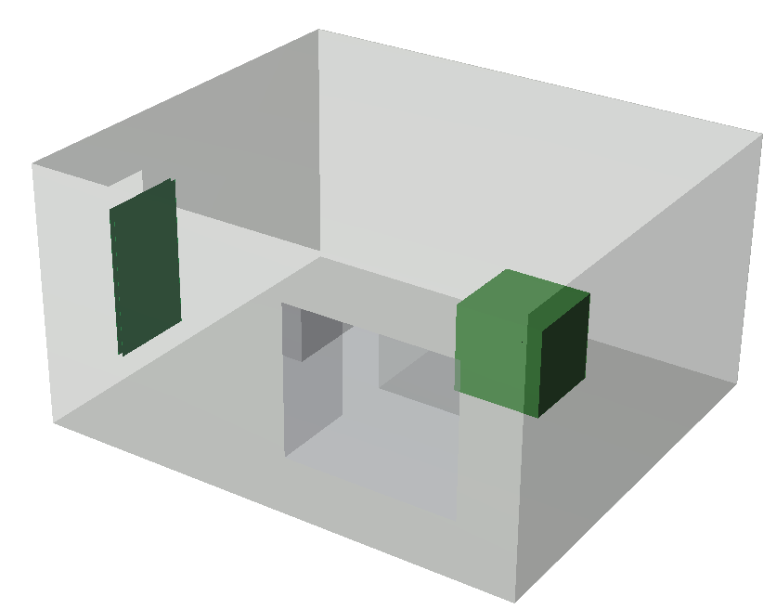
Change visibility
CAD vs. CSG SimpleGeo Status & outlook
CAD vs. CSG SimpleGeo Status & outlook
Turn off the visibility of the surrounding blackhole by pressing Space or by clicking on the checkbox in the CSG tree.
* More on visibility (saving, loading, …) can be found in the manual’s FAQ section 2.8 & 2.9

Slide 13
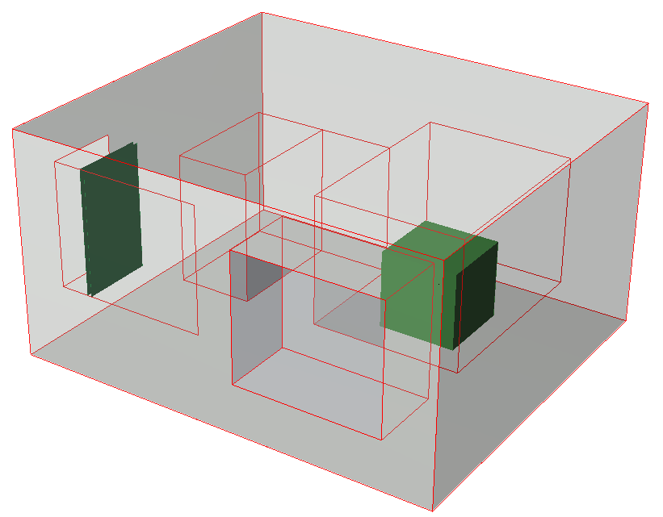
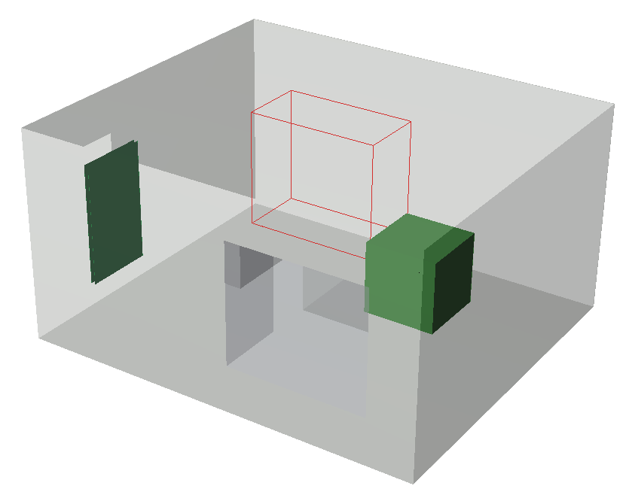
Checking regions/subregions
CAD vs. CSG SimpleGeo Status & outlook
CAD vs. CSG SimpleGeo Status & outlook
Select region labeled “002_Diff”
The results of the selected
region/subtree are marked in red.
Select body number 4 of the region 002_Diff
Only this body/subregion is
marked in red.

Slide 14
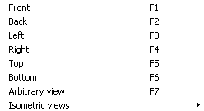
Camera control
CAD vs. CSG SimpleGeo Status & outlook
CAD vs. CSG SimpleGeo Status & outlook
A number of predefined views are available from the “View” menu.
Select one and move the mouse over the render view which will trigger a redraw with the selected perspective.

Slide 15

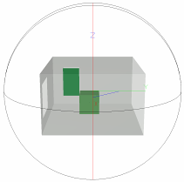
Camera control 2
CAD vs. CSG SimpleGeo Status & outlook
CAD vs. CSG SimpleGeo Status & outlook
For dynamic and more flexible camera control active the SpaceBall on the toolbar.
A ball with its 3 main arcs is drawn
on top of the geometry. Moving the
mouse near an arc will active it. Any
movement of the mouse with the
left mouse button pressed will move
the arc and thus, the camera.

Slide 16
Camera control 3
CAD vs. CSG SimpleGeo Status & outlook
CAD vs. CSG SimpleGeo Status & outlook
For more flexibility you can grab the SpaceBall even at points that are not placed on an arc. For this you have to keep the Shift key pressed together with the left mouse button.
On slow graphics cards this operation might slow down. Keeping the Ctrl key pressed in addition will reduce the level of detail shown during the movement!

Slide 17
Camera control 4
CAD vs. CSG SimpleGeo Status & outlook
CAD vs. CSG SimpleGeo Status & outlook
If you want to zoom in you can do this with a mouse wheel while the SpaceBall is activated. Otherwise select the zoom function on the toolbar.
Just draw a rectangle around the area you would like to zoom in on. To reset to the normal view use the “Reset View” button.

Slide 18
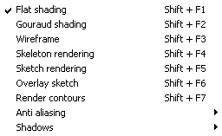
Visualization modes
CAD vs. CSG SimpleGeo Status & outlook
CAD vs. CSG SimpleGeo Status & outlook
Several different rendering options are available from the “View” menu.
Non shaded views allow for better performance, especially on slow graphics cards.

Slide 19
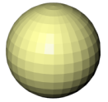

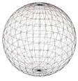
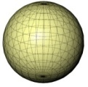
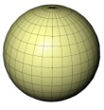
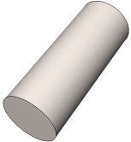
Visualization modes
CAD vs. CSG SimpleGeo Status & outlook
CAD vs. CSG SimpleGeo Status & outlook
Flat shading
  Default mode
Gouraud shading
  More complex shading supporting shiny high-lights
Wireframe
  Triangulated wireframe mode
Skeleton rendering
  Colored wireframe mode
Sketch rendering
  Black & white triangulated wireframe mode
Overlay sketch
  Can be combined with Flat or Gouraud shading. Allows for inspecting
  regions that are located inside other regions.
Render contours
  Can be combined with Flat or Gouraud shading. Only the outermost
  contours are drawn
Render hard contours
  Only hard edges will be drawn which is useful, for example, for cylindrical bodies.

Slide 20
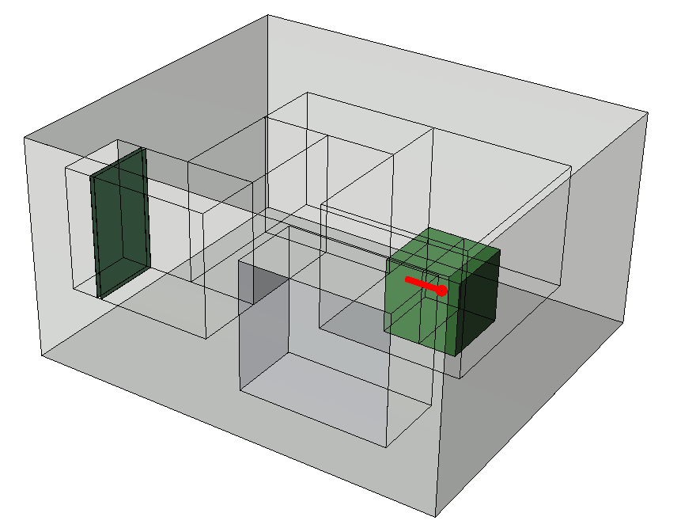
Visualization modes
CAD vs. CSG SimpleGeo Status & outlook
CAD vs. CSG SimpleGeo Status & outlook
Try to combine “Flat” shading with “Render contours”.
Try to combine “Flat” shading
with “Overlay sketch”. This will
allow you to see inside the
surrounding air and show
you the maze.

Slide 21
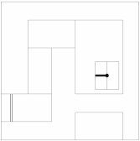
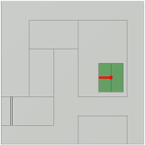
More on rendering options
CAD vs. CSG SimpleGeo Status & outlook
CAD vs. CSG SimpleGeo Status & outlook
There are several other rendering options:
  Aliasing: Softening of jagged contour lines. High-end
  gfx cards can do this “on-the-fly” to some extent.
  Parallel projection, allows you to obtain flat looking images. The look is similar to 2D sections if the camera is set to the correct position.

Slide 22
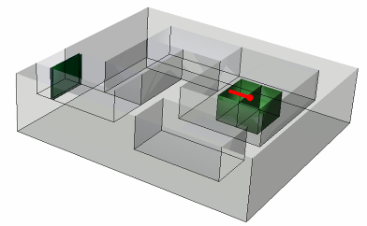
Clipping planes
CAD vs. CSG SimpleGeo Status & outlook
CAD vs. CSG SimpleGeo Status & outlook
Clipping planes remove everything on one side of the plane. You can select various predefined planes from the “View” - “Clipping planes” menu.
Activating the Identify function
from the toolbar you can
interactively change the position
of the clipping plane while moving
the mouse with the left button
pressed.

Slide 23
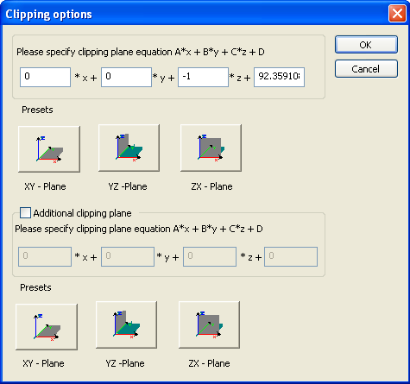
More on clipping planes
CAD vs. CSG SimpleGeo Status & outlook
CAD vs. CSG SimpleGeo Status & outlook
The options (plane equation) of the clipping planes are available under the “Clipping planes” – “Settings…” item. There you can define the type, position and orientation.
The orientation can be flipped by changing the sign for example.

Slide 24

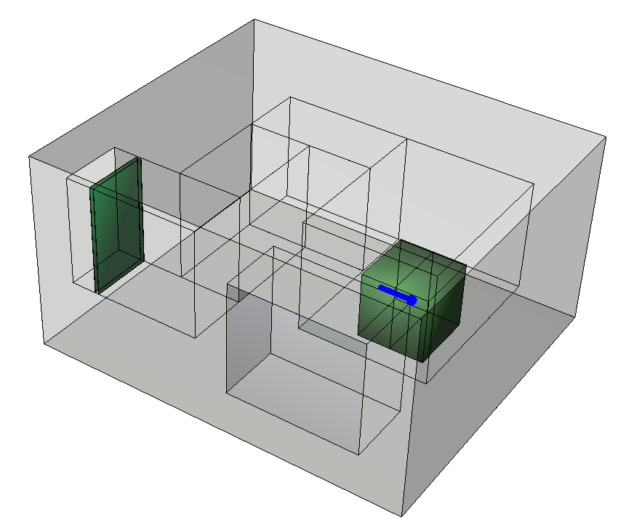
Emphasizing an object
CAD vs. CSG SimpleGeo Status & outlook
CAD vs. CSG SimpleGeo Status & outlook
If you want to emphasize an object you can select different options (color, line style, line width) for this one region only. First select the region and then choose the visualization attributes in the property view.
These settings will be effective in any rendering mode where contours are shown.

Slide 25
Navigation in the CSG tree
CAD vs. CSG SimpleGeo Status & outlook
CAD vs. CSG SimpleGeo Status & outlook
You can immediately jump to a region number X by choosing “Go to region...” from the “Edit” menu or by pressing Ctrl + G.
To find regions choose “Find node” from the “Edit” menu or press Ctrl + F.
  Various search criterions like name, comments, materials and type are available.

Slide 26
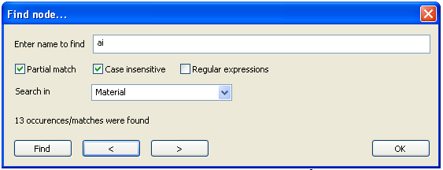
Searching in the CSG tree
CAD vs. CSG SimpleGeo Status & outlook
CAD vs. CSG SimpleGeo Status & outlook
Several search refinements options are available. The options given
above will find every node which has a material assignment that partially
matches “ai” in its name. In our case we will find all nodes with a
material assignment of “Air”. Pressing the < and > key automatically jumps
to the respective node in the CSG tree.
If requested regular expressions are available for more complex searches.

Slide 27
Saving images & geometries…
CAD vs. CSG SimpleGeo Status & outlook
CAD vs. CSG SimpleGeo Status & outlook
The currently visible geometry can be saved to an image by selecting “Save Image” from the “File” menu, or it can be copied to the clipboard via “Edit” – “Copy to clipboard” for immediate insertion in other Windows applications.
The geometry can be exported to different raytracing packages via “File” - “Export” - “3D objects”. These packages do not support interactivity but supply photorealistic images.

Slide 28
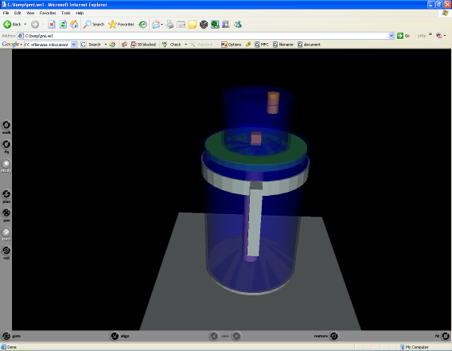
Saving images & geometries…
CAD vs. CSG SimpleGeo Status & outlook
CAD vs. CSG SimpleGeo Status & outlook
One supported file format is VRML. You can pass these files on to collaborators who can inspect them in a web browser using any freely available VRML plugin.
(e.g. CORTONA). They do not need SimpleGeo!
For ray-tracing packages only regions that are currently visible are saved to avoid cluttering.
Images can be saved in various formats or directly exported to other Windows programs
via the clipboard.

Slide 29
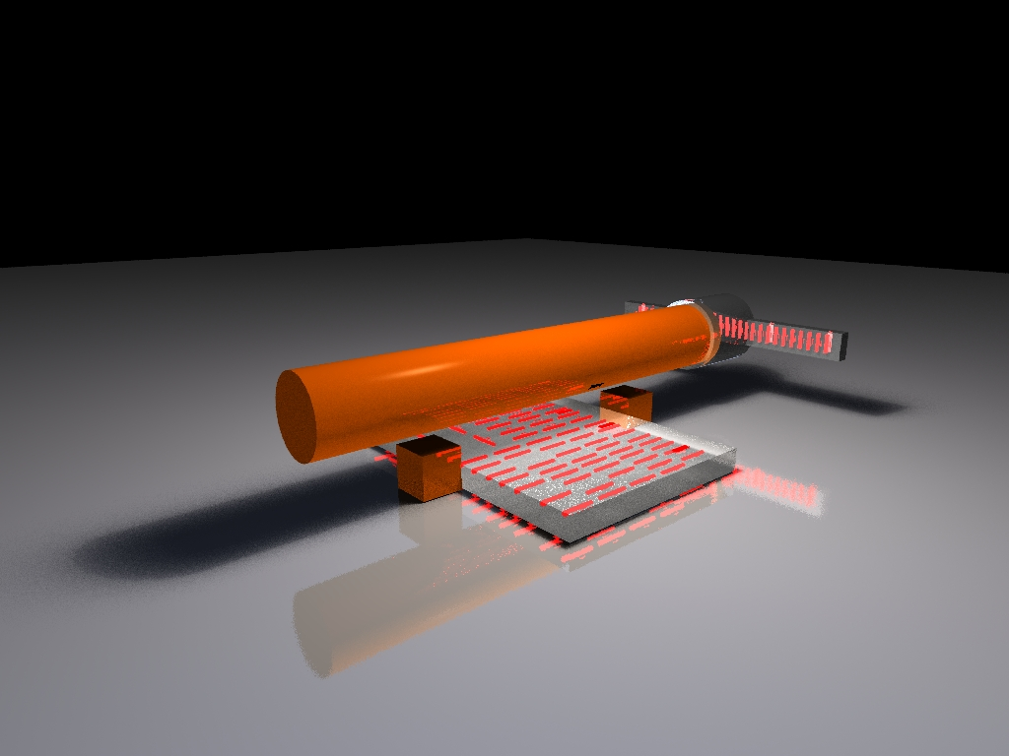
Ray-traced geometry
CAD vs. CSG SimpleGeo Status & outlook
CAD vs. CSG SimpleGeo Status & outlook
Geometry courtesy
of M. Fuerstner

Slide 30
Key features
CAD vs. CSG SimpleGeo Status & outlook
Interactive creation & modification of a geometry
via drag & drop
Import of FLUKA, ALIFE, WAVEFRONT, PLY
Export to FLUKA, MCNP(X), PHITS*
Export to various 3D raytracing packages
Arbitrary camera viewpoints
VB-Script like macro language
Relative coordinate frames of nodes
Undo/Redo functionality
Volume & mass calculation of regions
* This exporter is currently in beta state

Slide 31
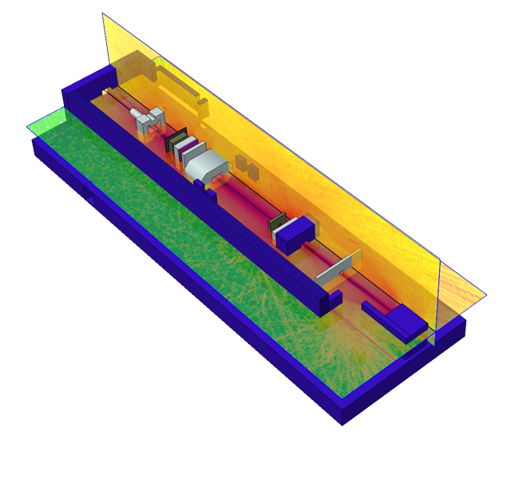
Examples
CAD vs. CSG SimpleGeo Status & outlook
Model courtesy
of E. Feldbaumer

Slide 32
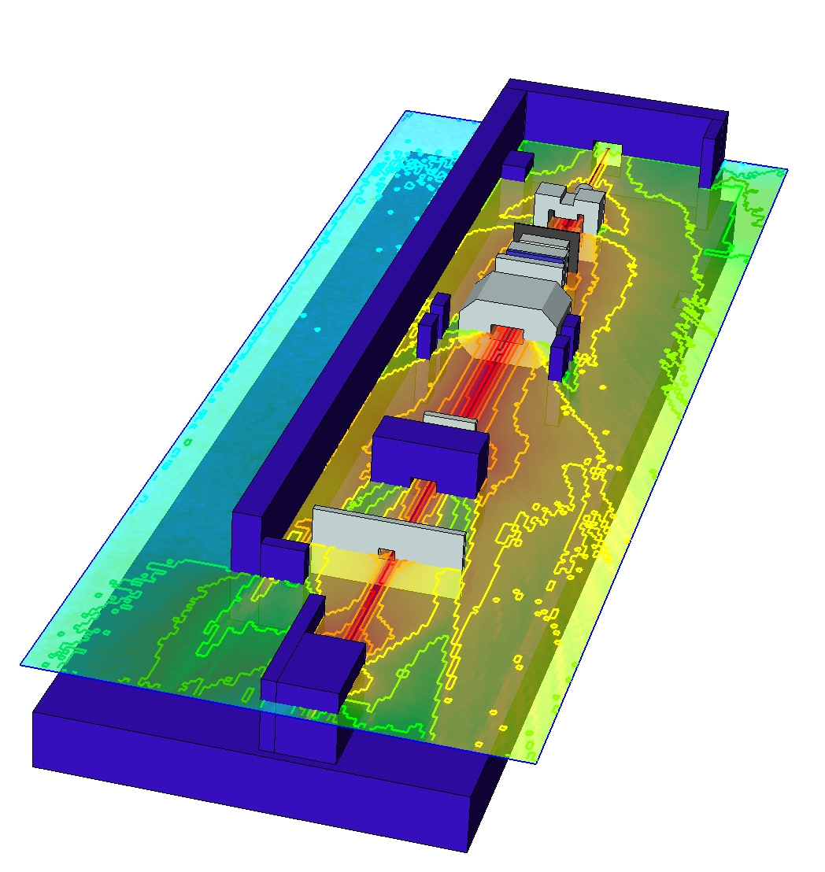
Examples
CAD vs. CSG SimpleGeo Status & outlook
Model courtesy
of E. Feldbaumer

Slide 33
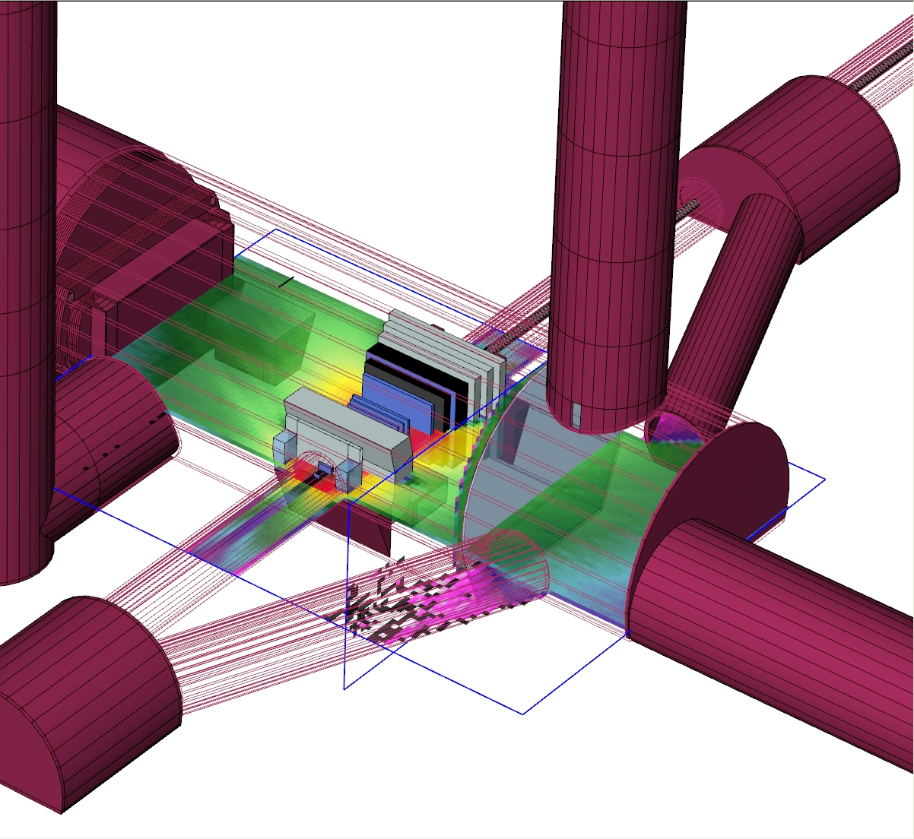
Examples
CAD vs. CSG SimpleGeo Status & outlook
CAD vs. CSG SimpleGeo Status & outlook

Slide 34
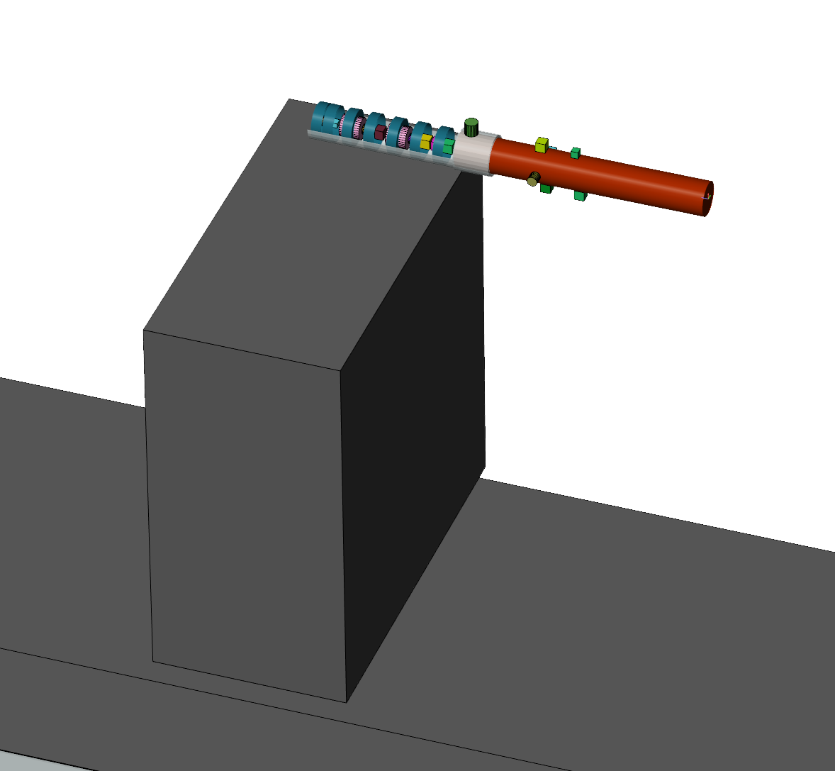
Examples
CAD vs. CSG SimpleGeo Status & outlook
Model courtesy
of M. Brugger & S. Roesler

Slide 35
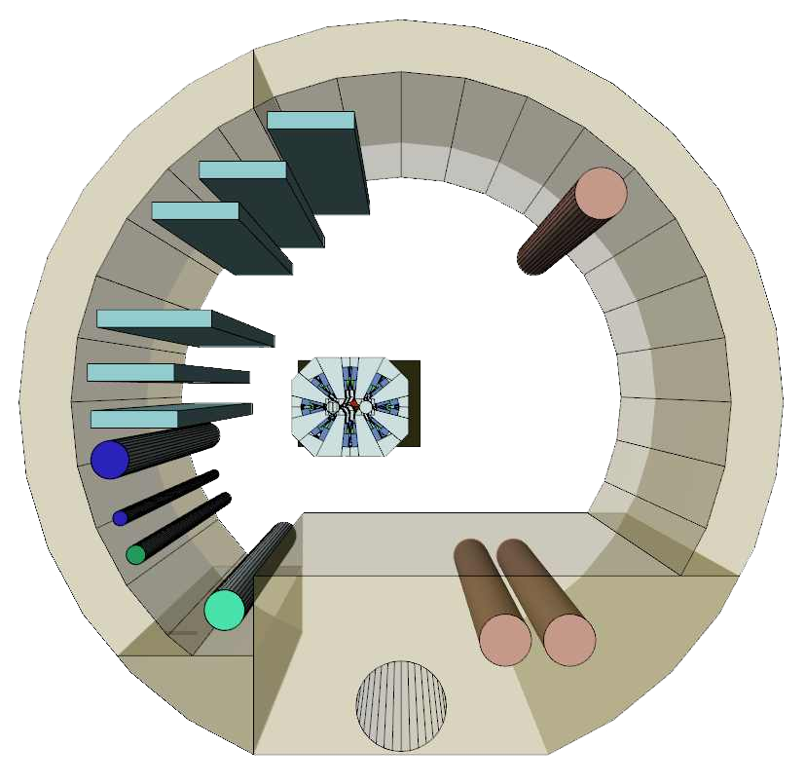
Examples
CAD vs. CSG SimpleGeo Status & outlook
Model courtesy
of H. Vincke

Slide 36
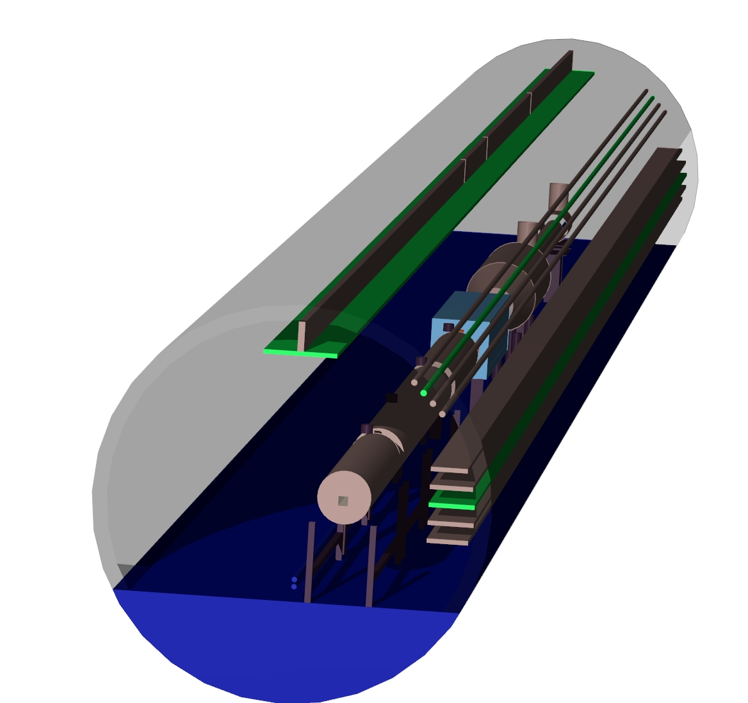
Examples
CAD vs. CSG SimpleGeo Status & outlook
Model courtesy
of L. Nicolas

Slide 37
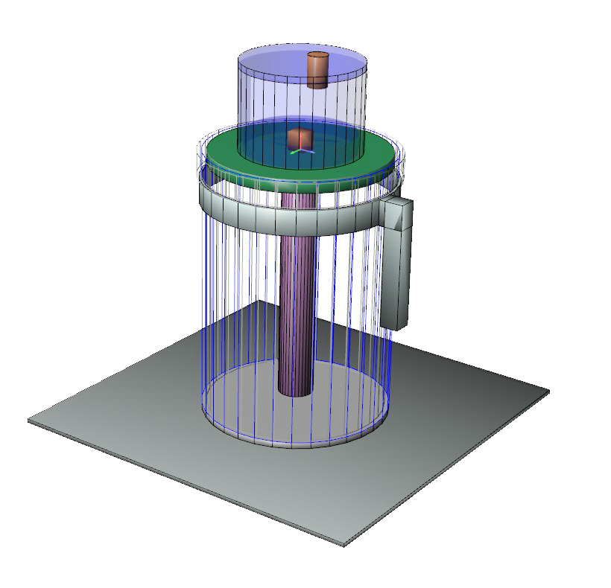
Examples
CAD vs. CSG SimpleGeo Status & outlook
Model courtesy
of H. Vincke

Slide 38
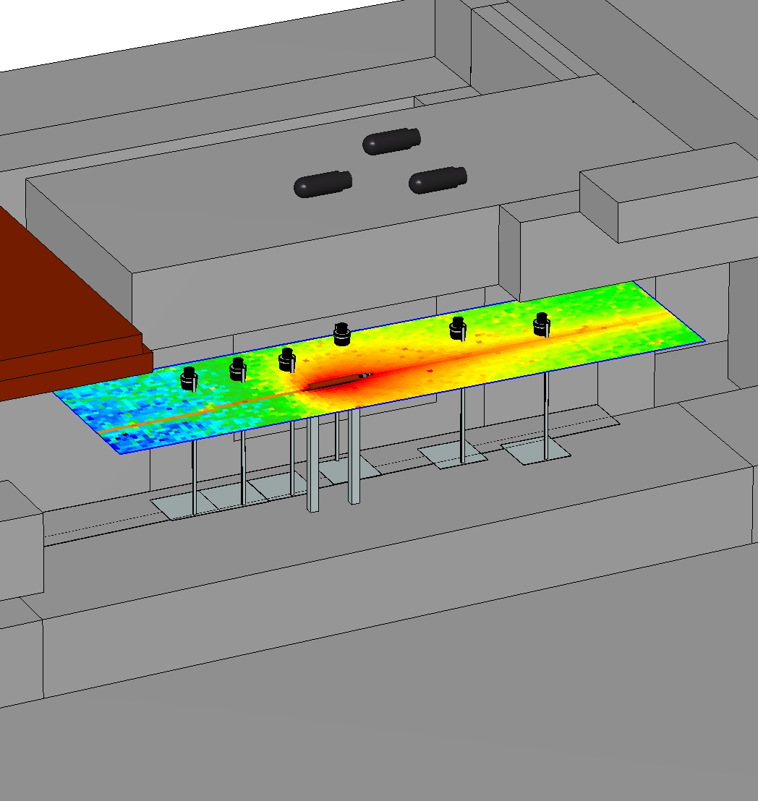
Examples
CAD vs. CSG SimpleGeo Status & outlook
Model courtesy
of H. Vincke

Slide 39
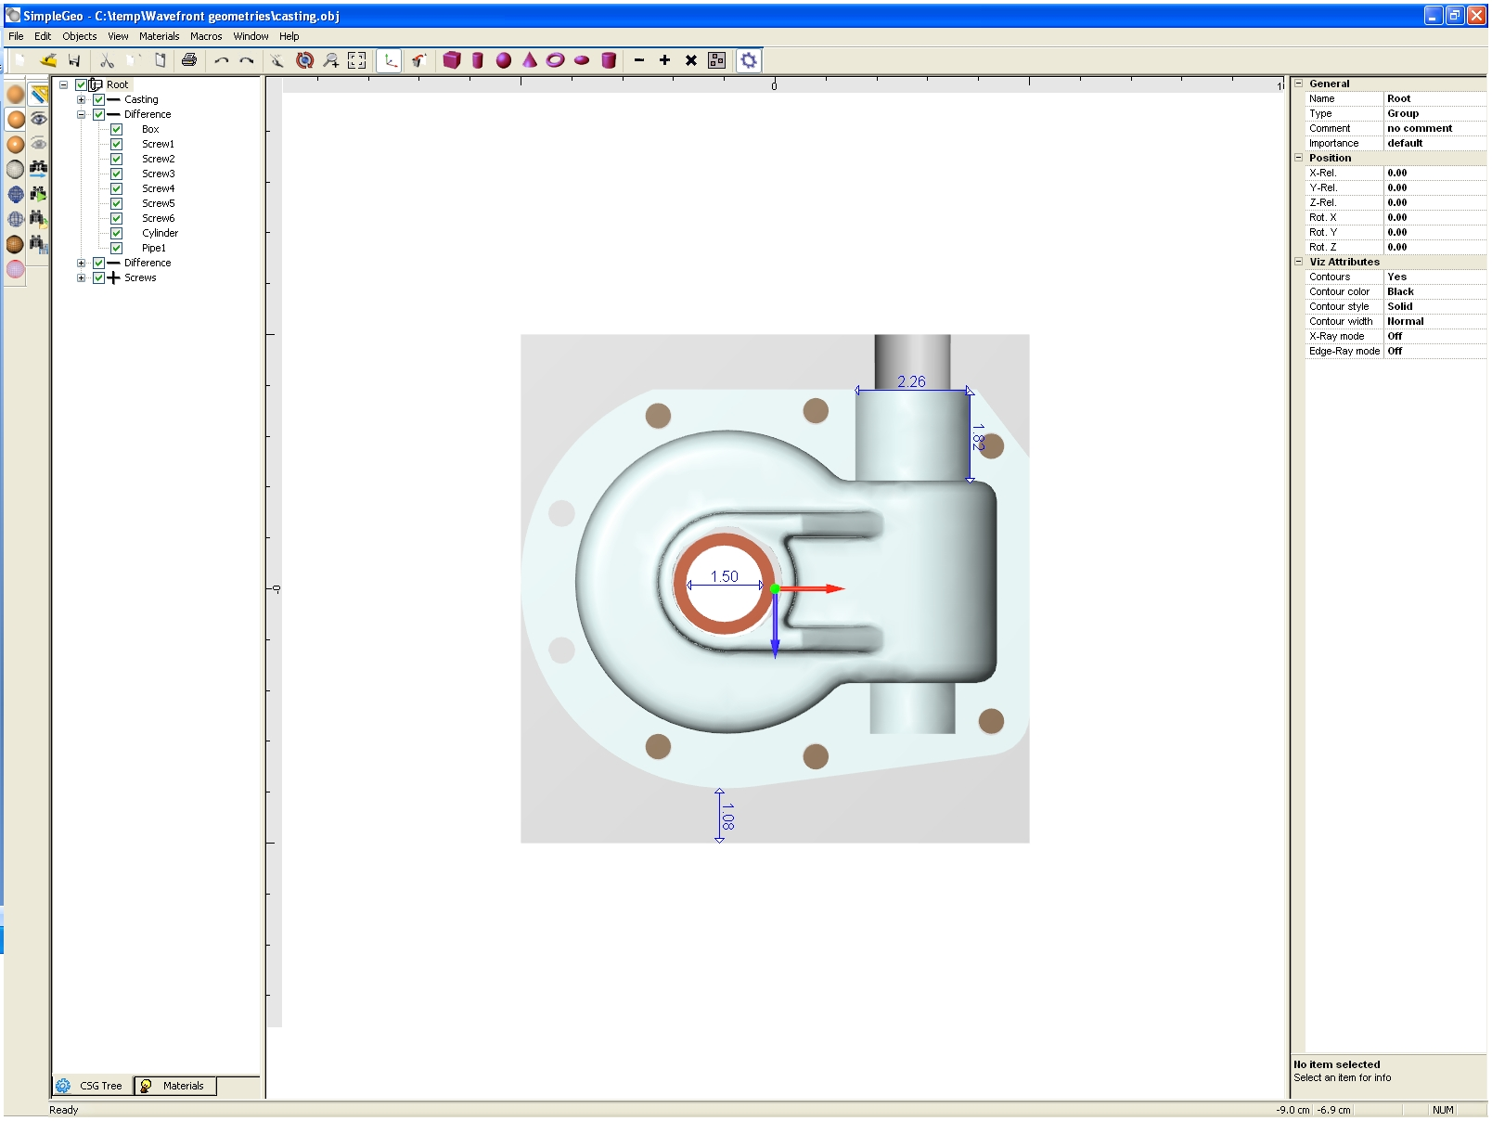
Examples – 2D measures
CAD vs. CSG SimpleGeo Status & outlook

Slide 40
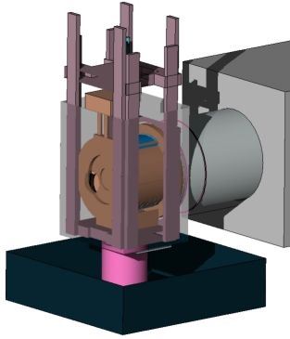
Examples
CAD vs. CSG SimpleGeo Status & outlook
Model courtesy
of E. Lebbos

Slide 41

Thank you for your attention
Website: www.cern.ch/theis/simplegeo
Author: Christian.Theis {at} cern . ch

