Slide 1
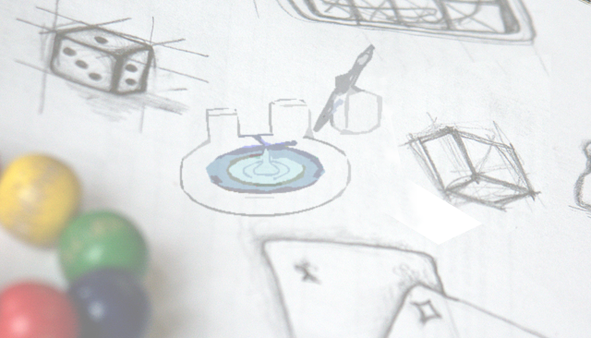
SimpleGeo render plugins
Chris Theis

Slide 2
SimpleGeo architecture
GUI
Graphical user interface
GIMLI
Geometric input modeling
language interface
SG-PLEX
SimpleGeo plugin extensions
Command manager
Importer/
Exporter
CSG – Engine
Proprietary
Renderer
Portable
Standard C++
B-Rep - Kernel
OpenGL

Slide 3
Plugins
Plugins are extensions that can be loaded
at runtime
They can be used to
extend SimpleGeo’s proprietary renderer
act as 3rd pary import/export filter
…
They are contained in the file SGPluginsX.X.zip which should be unpacked into the SimpleGeo installation directory (recommended).

Slide 4
Available plugins
DaVis 3D (see the demo in the videos directory)
reads FLUKA USRBIN, XYZ and GRIDCONV files
displays the binned data of up to 3 planes (XY,YZ,ZX) than can be interactively moved through the data set
data can be superimposed on top of geometry
the color tables are user configurable and interpolate if requested

Slide 5
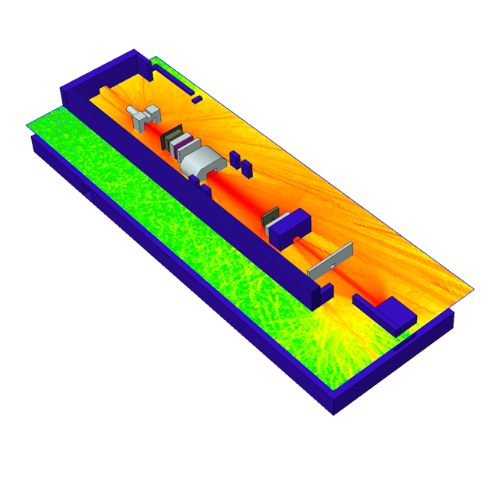
SimpleGeo/DaVis3D
Courtesy of E. Feldbaumer,
H. Vincke

Slide 6
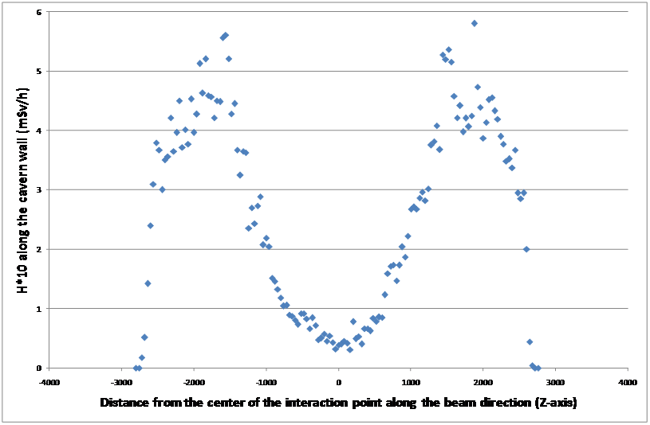
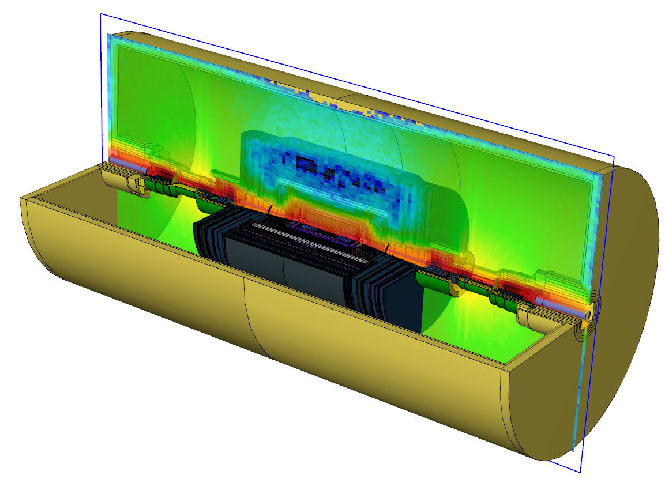
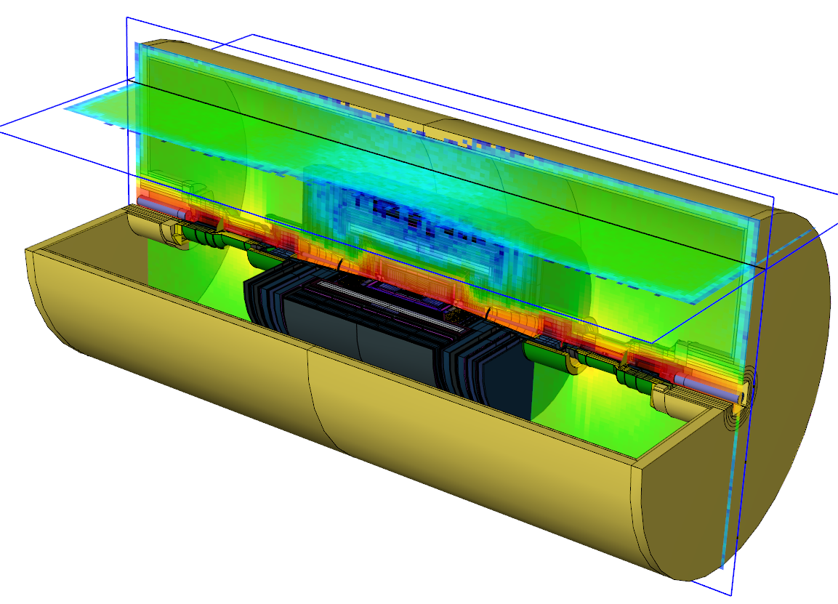
Data extraction
Extraction of values (planes, profile functions or single bins)

Slide 7
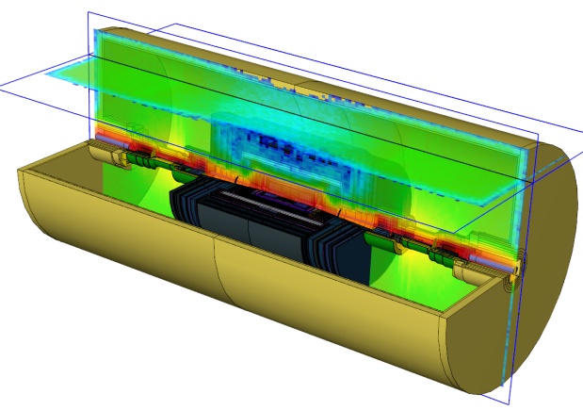
Data extraction
Profiles can be extracted taking 1 bin into account along the intersection of 2 planes → statistical fluctuations
Solution: “Averaged profiles”: (DaVis3D version >=3.5)
an arbitrary averaging volume can be defined which is moved along the intersection and the resulting profile is extracted

Slide 8
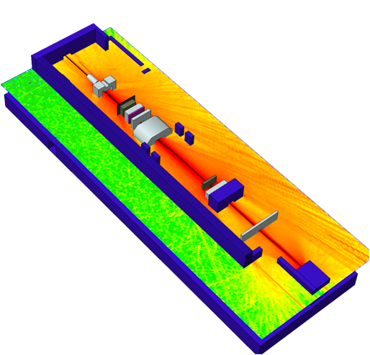
Data post-processing
Question:
What’s the average dose
at a workplace?
Solution:
Rough estimate from the
2D dose map (might not match in 3D!)
Foresee a geometric region in the input
Courtesy of E. Feldbaumer,
H. Vincke

Slide 9
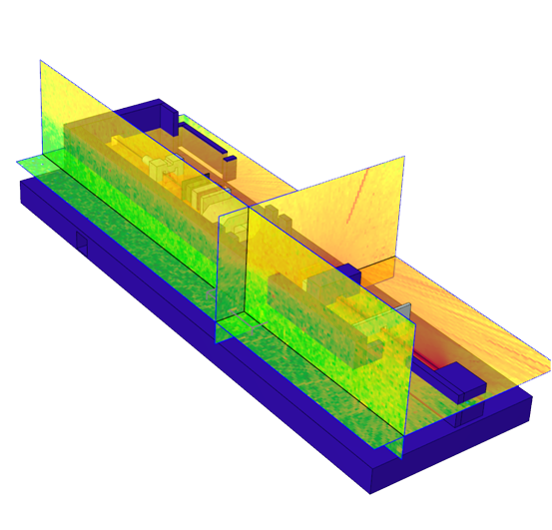
Data post-processing
Courtesy of E. Feldbaumer,
H. Vincke
Alternative solution with
DaVis3D
Define arbitrary volume
interactively while browsing the data.
Calculate averages on-the-fly while
moving the volume through the data set

Slide 10
More post processing options
The following post – processing options are available for FLUKA USRBIN files (ASCII format):
Averaging over several USRBIN results including error calculation
(inconsistent weights are treated accordingly)
Sum of several USRBIN results
Difference of 2 USRBIN results
Ratio of 2 USRBIN results

Slide 11
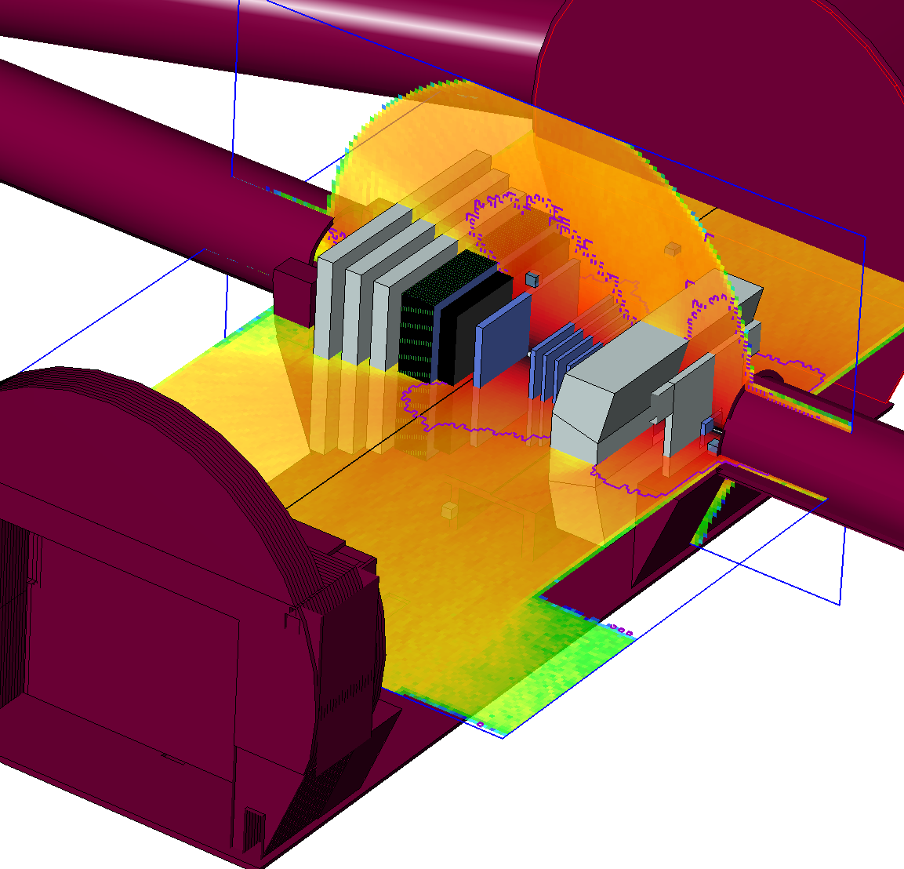
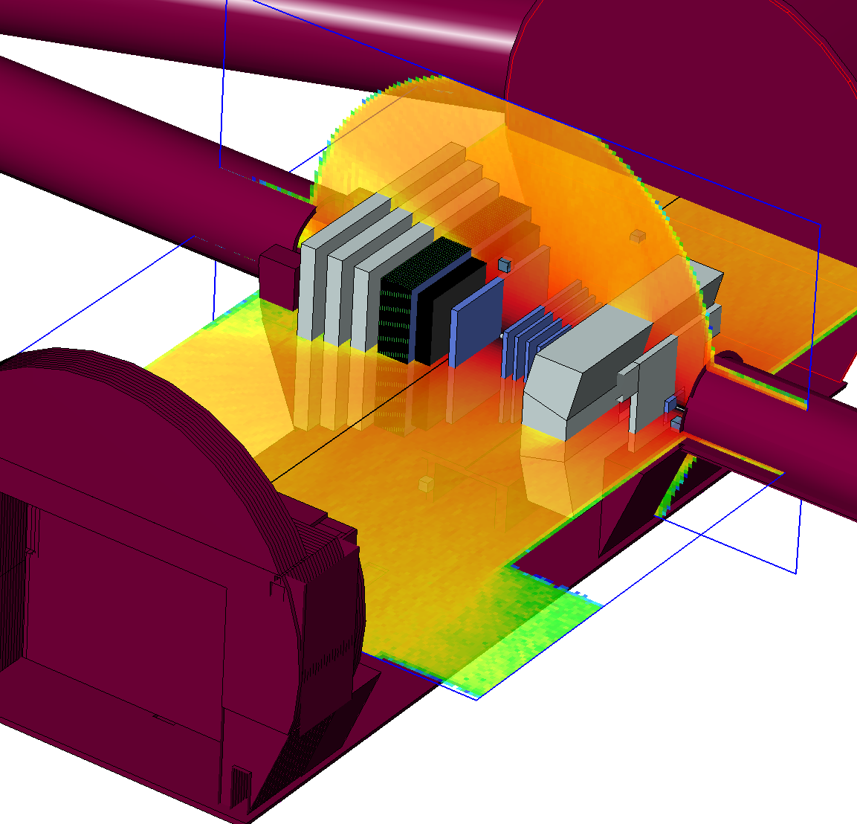
Threshold detection
Typical question:
Where is the dose >1 mSv/h?
Development of an automatic threshold
contouring algorithm

Slide 12
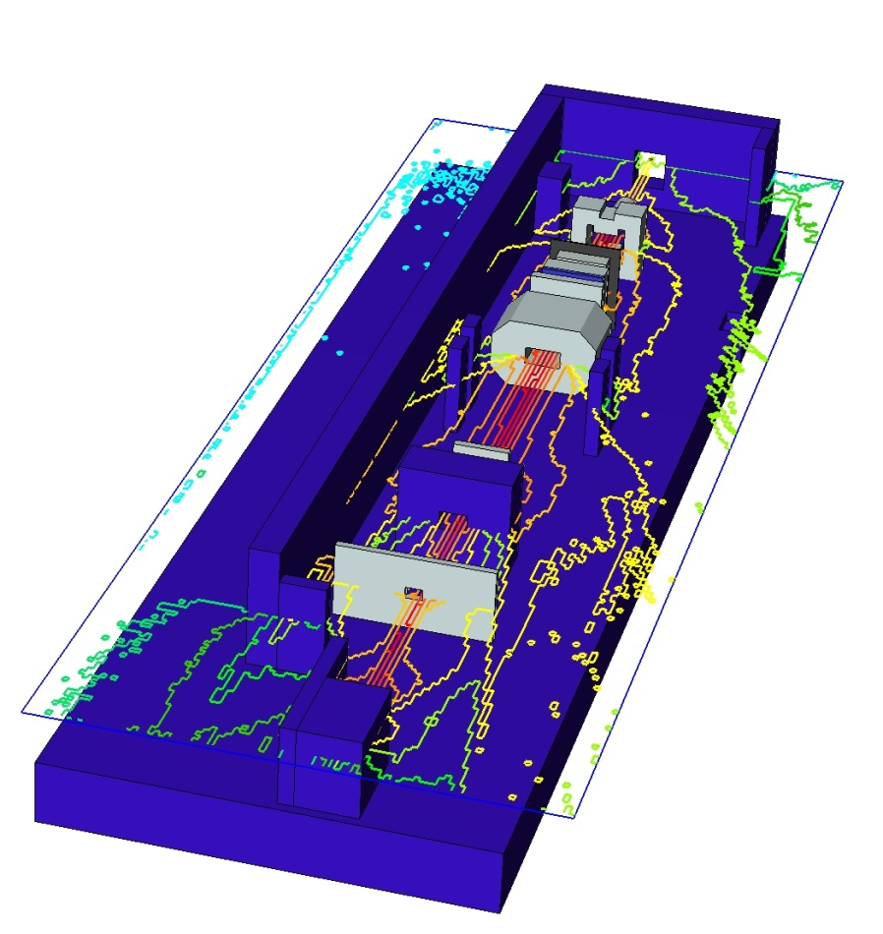
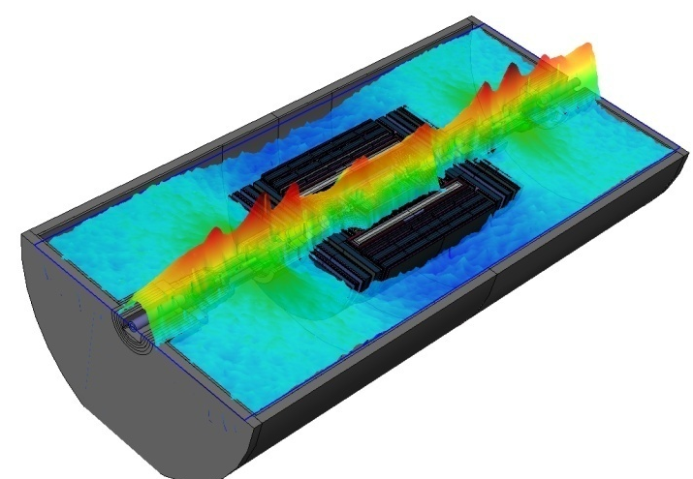
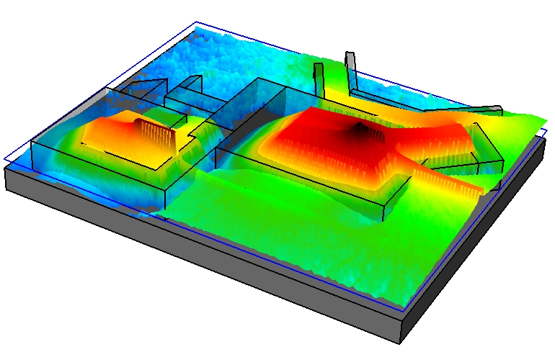
Additional visualization modes
Contour rendering
Smoothed extrusion
rendering

Slide 13
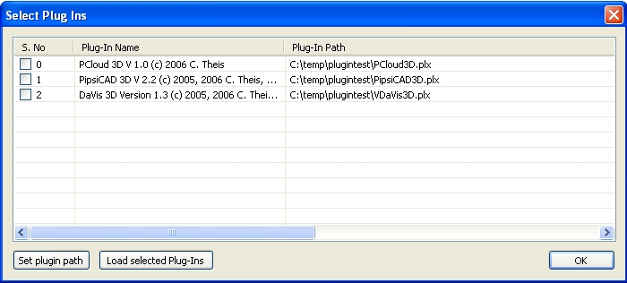
“Hands-on” example of DaVis 3D
Load the plugin via the menu item Macros -> Load plugins
The path which is searched for the plugins can be set by the Set plugin path button.
Tick the check box next to the “DaVis 3D” plugin and click on Load selected plugins!
Click on OK.
Hint: Creating copies of the *.plx files allows for loading
Multiple instances of the same plugin. Thus, DaVis3D can
be loaded several times to display different USRBINs in
parallel.

Slide 14
DaVis 3D example
New icons should appear in the tool bar which activate the respective plugin
Activate the Space ball from the toolbar
Load the file Hill.dat from the sub-directory DaVis3D - Hill dose example and build the geometry with the automatic update button
Activate the plugin-dialog by pressing the plugin button

Slide 15
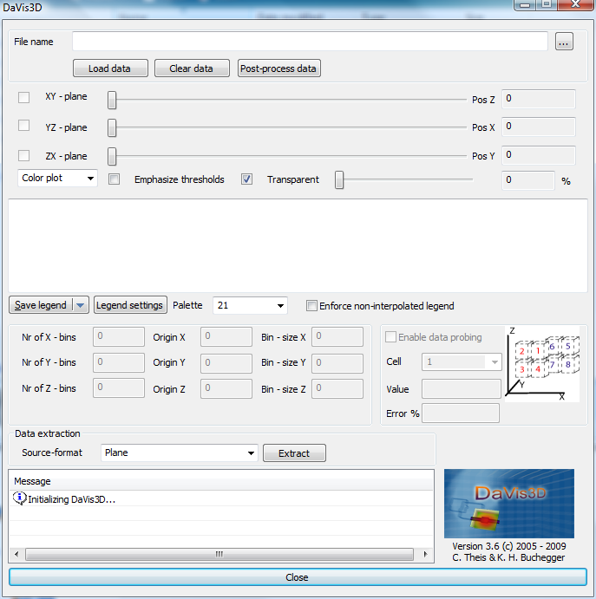
DaVis 3D example
Screenshot of the
main dialog

Slide 16
DaVis 3D example
Click on the button to select the data file Hill.amb74_001.usrbin in the sub-directory DaVis3D - Hill dose example . (This is an example of protons hitting a target in an underground area with a shaft to the surface).
Press the load button to load the data.
Tick one or more of the checkboxes to active the respective planes for visualization of the data. They can be moved using the slider next to the check box.
The number of colors used can be selected from the Palette drop-down box.

Slide 17
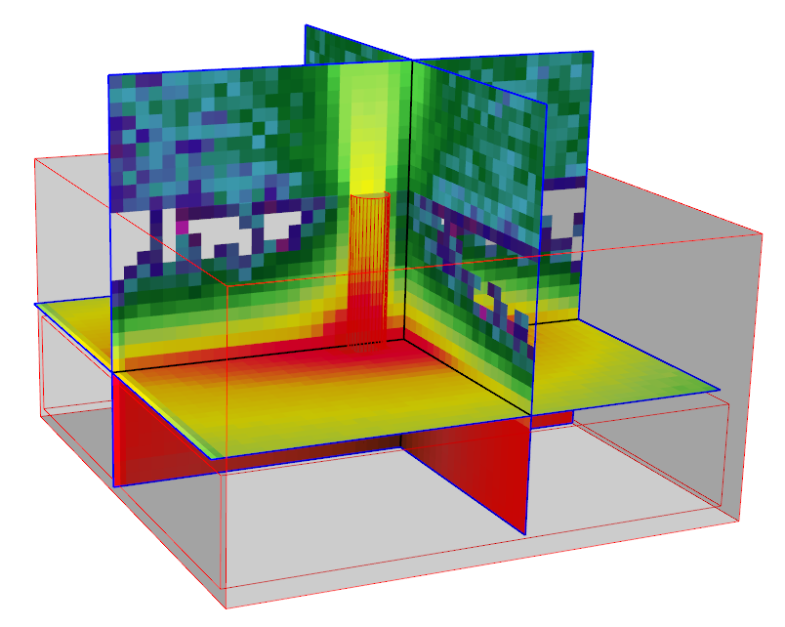
DaVis 3D example
If you want to look into what is happening inside the hill, then select the node Hill in the CSG tree and set the visualization attribute X-Ray mode to On. Consequently, the material will be transparent and you should get something like the following picture

Slide 18
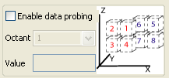
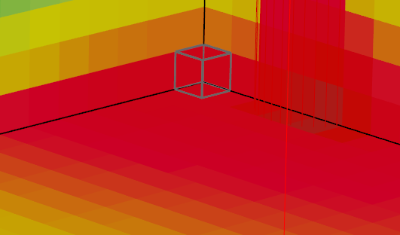
Advanced DaVis 3D example
Getting the results of one single bin:
All three planes must be selected and the bin values of the 8 voxels adjacent to their intersection point can be obtained via ticking the Enable data probing check box.
Select one of the eight octant bins or the average over all 8 bins. The currently selected bin is outlined as a grey box in the rendering.

Slide 19
Advanced DaVis 3D example
Getting the results of all values on a 2D plane:
Move the respective plane to the appropriate position.
Select Plane as the source of the data extraction and press the Extract button. *In version 1.5 this functionality is obtained by the extract data button.
Select the respective plane and the data will be exported in a 2D matrix.

Slide 20
Advanced DaVis 3D example
Getting the results of the values at the intersection of 2 planes = profile function.
Move the respective 2 planes to the appropriate position.
Select Profile as the source of the data extraction and press the Extract button. * Version >= 3.5 also averaged profiles are available.
Select the respective planes and the data will be exported as a 1D function.
See next page for an example for hadron fluence as a function of distance to the particle interaction point.

Slide 21
Advanced DaVis 3D example
1.00E+14
z = 1200 cm from IP
z = 900 cm from IP
1.00E+13
z = 200 cm from IP
2
]
1.00E+12
Hadron fluence (E > 20 MeV) [1/cm
1.00E+11
1.00E+10
1.00E+09
Y
1.00E+08
-250
-225
-200
-175
-150
-125
-100
-750
-500
-250
0
250
500
750
1000
1250
1500
1750
2000
2250
X
0
0
0
0
0
0
0
2500
2750
3000
IP
cm

Slide 22
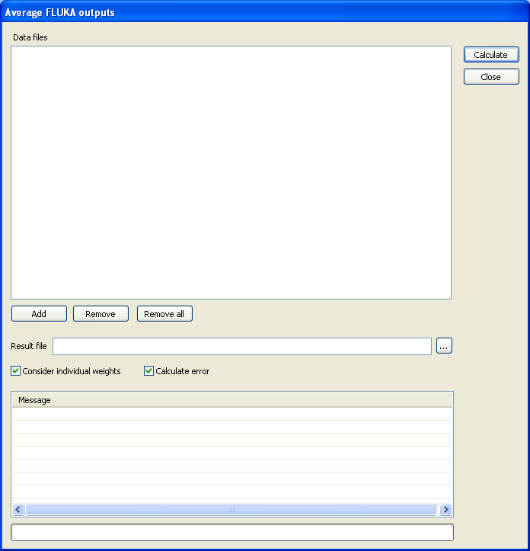
Advanced DaVis 3D example
Calculating the average & error of several FLUKA USRBIN files:
(requires version 2.4.3 or above)
Click on the Average data button.
In the new dialog use the Add button to add all files that should be averaged. (ASCII files only!!!, but XYZ, R-Z, R-Z-Phi does not matter). In the file dialog multiple files can be selected at once!
Set the resulting file name or use the suggested one.
Press the calculate button
*Files with different weights are taken into account accordingly.

Slide 23
Available plugins
PipsiCAD 3D (co-author: Helmut Vincke, who implemented the first generation of PipsiCAD)
reads ASCII files produced by available user routines
superimposes color encoded particle tracks on top of geometry
color encoding and transparency is user configurable
interactive application of filters with respect to particle energy and particle type
Animate particle tracks as a function of time

Slide 24
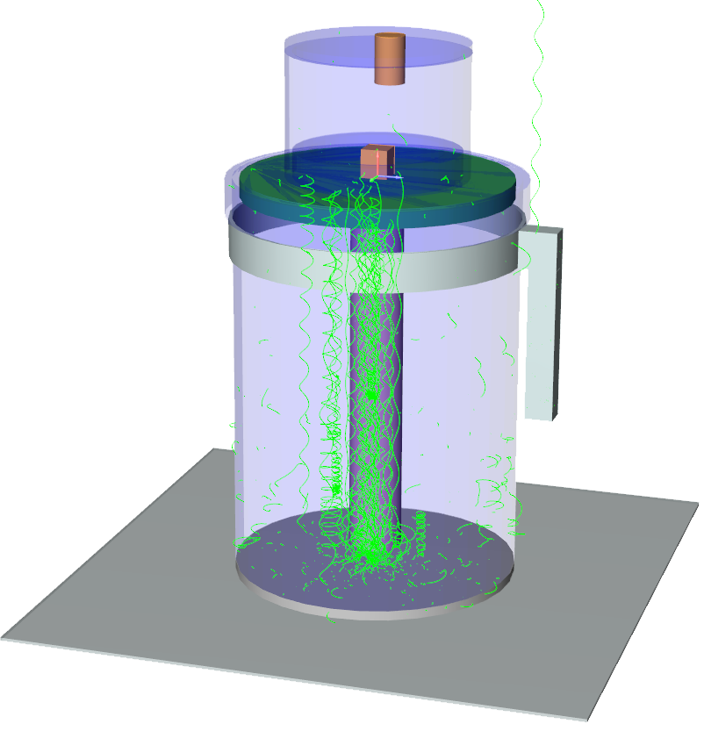
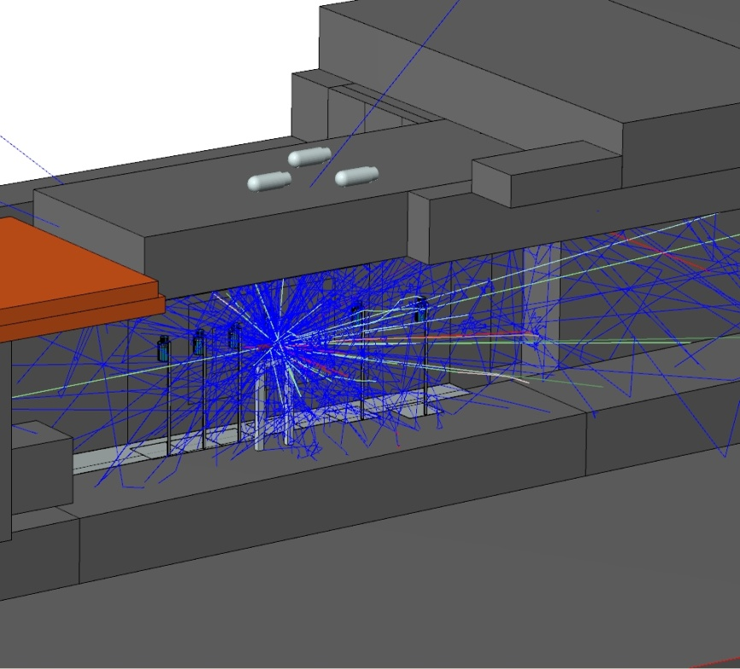
PipsiCAD3D
Ionization chamber with e⁻ tracks
in a magnetic field.
Courtesy of Helmut Vincke
Neutron tracks due to 1 proton hitting
the CERF target.
1.00E+14
z = 1200 cm from IP
z = 900 cm from IP
1.00E+13
z = 200 cm from IP
2
1.00E+12
1.00E+11
1.00E+10
1.00E+09
1.00E+08
-250
-225
-200
-175
-150
-125
-100
-750
-500
-250
0
250
500
750
1000
1250
1500
1750
2000
2250
2500
2750
3000
0
0
0
0
0
0
0
IP
cm

Slide 25
Steps to run PipsiCAD3D
Compile and link the proprietary mgdraw.f to FLUKA
Add a USERDUMP statement to your input to produce a collision tape
Run your simulation to create a collision tape
Run the linux interface PipsiCAD_SimpleGeo.linux to select the energy range & binning of the particles that will be extracted
Load your geometry and the PipsiCAD3D plugin in SimpleGeo
Load the created data file with the plugin and press the "Visualize" button
Optionally, you might select track evolution display and animate the resulting tracks. (see www.cern.ch/theis/simplegeo/download/CERF_tracks.avi for an example)
Please refer to the manual for a more detailed description.

Slide 26
Available plugins
PCloud 3D
reads ASCII files produced by FLUKA 2Step routines (open format and very simple)
various display modes for particles (position, direction, energy scaled direction)
color encoding and transparency are user configurable
interactive application of filter with respect to particle types
statistical information with respect to particle type or particle type and energy

Slide 27
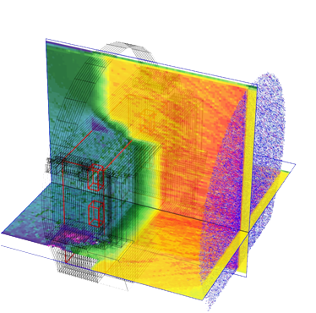
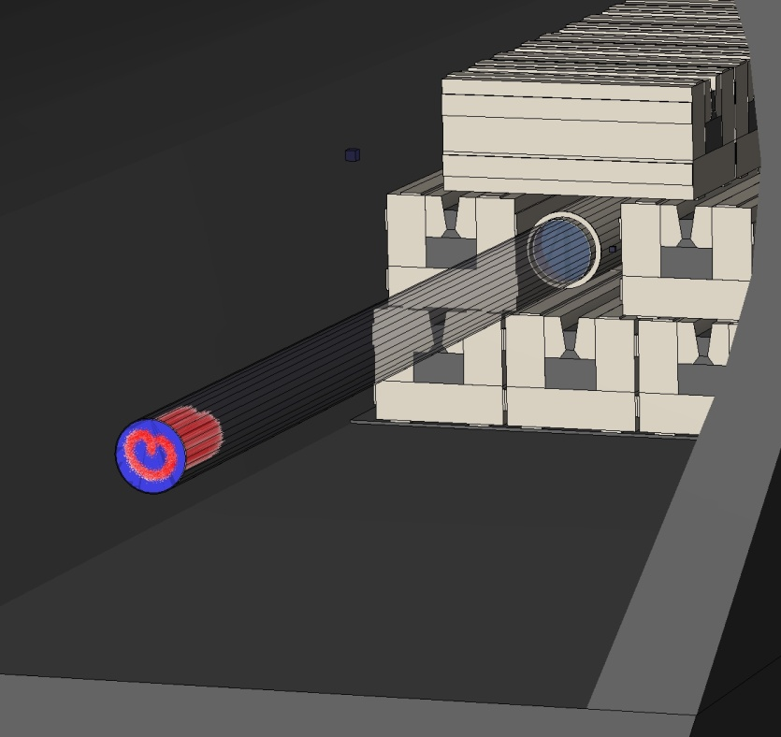
PCloud3D
particle position & direction visualization
Verification of a special beam particle distribution
Courtesy of J. Vollaire
Hadrons directed towards the LHCb shielding,
combined with fluence visualization by DaVis3D

Slide 28
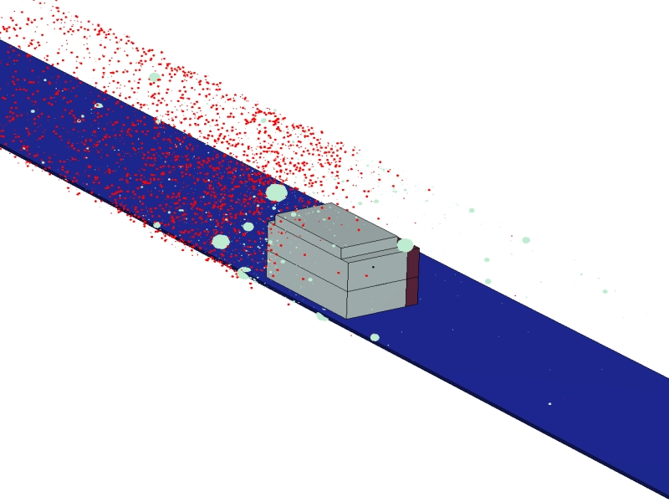
IsoVis3D
Reads FLUKA - ISODUMP files created by the 2-step activation routines developed by S. Roesler
Visualizes the spatial + weight distribution of isotopes
Filters can be applied for either the isotope types and/or weight
Relative abundance of each isotope can be analyzed with weights taken into account

Slide 29
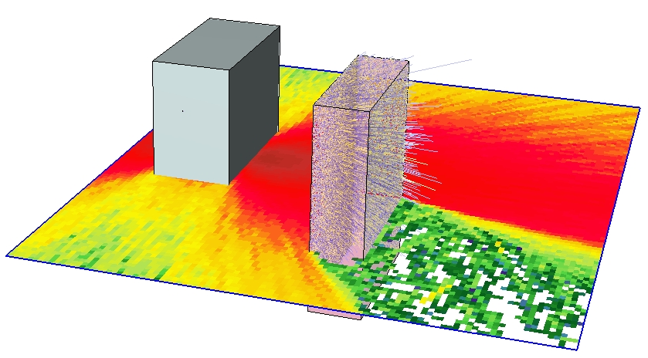
Combining DaVis3D + PCloud3D
Proton beam impinging
on an iron block
Secondary particles entering a second iron block

