Slide 1
The FLUKA User Routines How to tailor FLUKA to specific user’s needs User programming in the FLUKA environment
Beginners FLUKA Course

Slide 2
Why User Routines
Fluka offers a rich choice of options for scoring most quantities and for applying variance reduction techniques, without requiring the users to write a single line of code.
However there are special cases where “ad-hoc” routines are unavoidable, because the required information cannot be obtained through standard options.
A number of template of user routines (available in the usermvax directory) can be modified/activated by the user allow to fulfill non-standard tasks

Slide 3
What is available for the users
The templates of all user routines are in the directory $FLUPRO/usermvax
The include files containing the COMMON blocks are in the directory $FLUPRO/flukapro (see later)
The compiling and linking scripts which are in the directory $FLUPRO/flutil
Flair can be used to edit, compile and link user routines in order to build a user-specific FLUKA executable

Slide 4
A first look at the correspondence between some of the user routines and FLUKA commands
USRGCALL
usrglo.f
USRICALL
(usrein.f)‏
usrini.f
SOURCE
source.f
MAT-PROP
usrmed.f
Emphasis of this lecture is here
Event Loop:
USERDUMP
mgdraw.f
USERWEIG
comscw.f
fluscw.f
usrrnc.f
USROCALL
usrout.f
(usreou.f)‏

Slide 5
A possible classification in terms of their use (1)‏
Event generation, physics, kinematics
source.f
soevsv.f
udcdrl.f
formfu.f
User run control
usrini.f
usrein.f
usrout.f
usreou.f
Properties of medium
magfld.f
usrmed.f
User global settings
usrglo.f

Slide 6
A possible classification in terms of their use (2)‏
in association to FLUKA output
comscw.f
fluscw.f
endscp.f
fldscp.f
musrbr.f
lusrbl.f
fusrbv.f
usrrnc.f
Intercepting particle stack
mdstck.f
stupre.f
stuprf.f
Biasing
usbset.f
usimbs.f

Slide 7
A possible classification in terms of their use (3)‏
To drive optical photon transport
abscff.f
dffcff.f
frghns.f
ophbdx.f
queffc.f
rflctv.f
rfrndx.f
To manage lattice geometry
lattic.f
To access (almost) everything
mgdraw.f
See the relevant chap. of manual

Slide 8
Compiling and linking FLUKA user routines
A FLUKA executable with user routines is in general application specific. It must be named and kept separately from the standard FLUKA
Everything is managed today by FLAIR, however it is important to know the following details (managed automatically inside FLAIR):
$FLUPRO/flutil/fff is the compiling script with the proper path to the INCLUDE subdirectory and the required compiler (g77) options
Example: $FLUPRO/flutil/fff usrini.f generates usrini.o
then $FLUPRO/flutil/lfluka –m fluka –o flukamy usrini.o will perform the
proper linking generating the executable here called flukamy
Tip: $FLUPRO/flutil/lfluka –m fluka –o flukamy usrini.f will automatically call $FLUPRO/flutil/fff

Slide 9
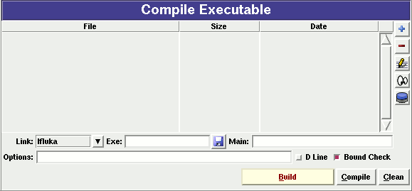
Help by FLAIR
FLAIR has a button in the Compile frame which allows to scan the input file for possible cards that require the use of user routines
It allows to copy the template routine from $FLUPRO/usermvax to the project directory

Slide 10
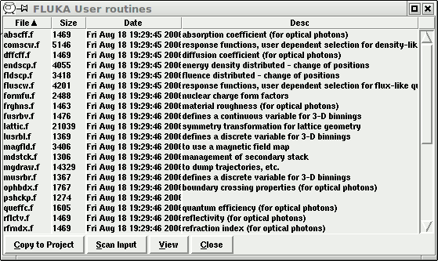

Slide 11
Basics about FLUKA routines/functions
Written in Fortran 77
Double Precision everywhere, except for variables beginning
with a letter within (i-n)
Common blocks are in files which are loaded by INCLUDE statement
All include files are in $FLUPRO/flukapro
Each routine must start with the following includes/common blocks:
INCLUDE ’(DBLPRC)’
INCLUDE ’(DIMPAR)’
INCLUDE ’(IOUNIT)’
Note the parentheses which are an integral part of the Fluka INCLUDE file names
Users may add their own common(s) which may reside in different
places

Slide 12
Basic FLUKA Include Files
DBLPRC: included in all routines of Fluka, contains (as PARAMETERS) the most common physical and mathematical constants and the declaration
IMPLICIT DOUBLE PRECISION (A-H,O-Z)‏
DIMPAR: dimensions of the most important arrays
IOUNIT: logical input and output unit numbers (FLUKA uses those from 1 to 19, they must be considered as reserved)
Users are encouraged to adhere to the “Fluka style” by using systematically double precision (except for calling external single precision scoring packages), and to use constants defined in this file for maximum accuracy and consistency
Important: take some time to study the content of DBLPRC

Slide 13
Some important COMMON blocks in short (1)‏
BEAMCM: beam properties of primary (BEAM and BEAMPOS)
CASLIM: number of primary particles followed
EMFSTK: particle stack for electrons and photons
SOURCM: user variables and information for a user-written source
FHEAVY: stack of heavy secondaries created in nuclear evaporation
GENSTK: properties of each secondary created in a hadronic event
LTCLCM: LaTtice CeLl CoMmon (needed when writing symmetry
transformations for Lattice Geometry)‏
FLKMAT: material properties
FLKSTK: main Fluka particle stack
SOUEVT: variables describing the source event
TRACKR: variables concerning the properties of transported
particle (track) at run time
PAPROP: particle properties (masses, charges, mean lives…)
SCOHLP: variables concerning the current estimator type

Slide 14
Converting Names↔Number
FLUKA converts all Names given in the input file to Numbers: all the arguments that you will find in user routines are numeric
To get the number starting from a region name
CALL GEON2R ( REGNAM, NREG, IERR )‏
* Input variable:
* Regnam = region name (CHAR*8)
*
* Output variables:
* Nreg = region number
* Ierr = error code (0 on success, 1 on failure)
To get the name of a region when you know the number:
CALL GEOR2N ( NREG, REGNAM, IERR )‏
* Input variable:
* Nreg = region number
*
* Output variables:
* Regname = region name (CHAR*8)
* Ierr = error code (0 on success, 1 on failure)
Similar routines
for lattice geometry

Slide 15
source (user written source: generation of initial kinematics)‏
Subroutine SOURCE is probably the most frequently used user routine. It is activated by option SOURCE and is used to sample primary particle properties from distributions (in space, energy, time, direction or mixture of particles) which cannot be described with the BEAM, BEAMPOS and BEAMAXES cards. At each call, one (or more) particle(s) must be loaded onto COMMON FLKSTK (particle bank) before returning control. These values can be read from a file, generated by some sampling algorithm, or just assigned.

Slide 16
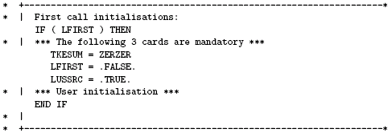
Using source
Option SOURCE allows the user to input up to 18 numerical values (WHASOU(1),(2). . . (18)) and one 8-character string (SDUSOU) which can be accessed by the subroutine by including the following line:
INCLUDE ’(SOURCM)’
The user can insert any first time initialization within the following IF block:

Slide 17
Using source (continues...)‏
The user can load onto the FLKSTK stack one or more particles at each call: for each particle loaded the pointer must be increased by 1
weight of the particle (values different from 1 → biased source, advanced users)
update the total weight of the primaries (don’t change):

Slide 18
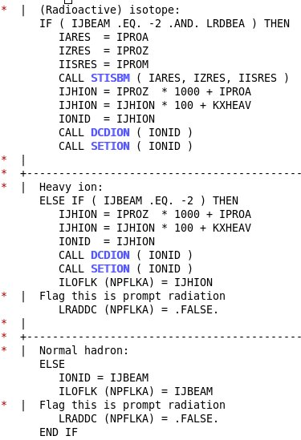
Using source: setting the particle id
The template sets the type of particle equal to the one defined by the BEAM card (plus HI-PROPE if used).
Whichever valid particle id can be set inside the source (may be different event by event)
Heavy ion
“Normal” particle

Slide 19
Using source: assigning momentum energy
In the template routine, the momentum is taken from the BEAM option (PBEAM, in COMMON BEAMCM, which contains all values defined by options BEAM and BEAMPOS)
The user can select a momentum from a spectrum or a file
Alternatively the user can sample/assign the kinetic energy and derive the momentum. Be coherent!
Even when using SOURCE, the BEAM card remains mandatory. The momenta (or energies) assigned in SOURCE can never be larger than the momentum/energy set in BEAM (it is the one used during initialization)!!

Slide 20
Using source: setting position and direction‏
Direction cosines assignment:
It is also possible to assign a polarization:
Finally, initial space coordinate assigned/read/sampled:
Be careful to ensure the cosine proper normalization within machine accuracy!!! Ie…

Slide 21
Using source (continues...)‏
The following lines can remain as they are
Don’t change the lines below:
…….
At the end, source makes a copy into SOEVSV of the generated particles in case this info is required by some user routine at scoring stage

Slide 22
Using the FLUKA Random Number Generator in user routines
Fundamental for SOURCE!!! No other external random generators must be used, otherwise the history reproducibility will be lost
… = FLRNDM (XDUMMY)‏
returns a 64-bit random number [0-1)‏
CALL FLNRRN (RGAUSS)‏
returns a normally distributed random number RGAUSS
CALL FLNRR2 (RGAUS1,RGAUS2)‏
returns an uncorrelated pair of normally distributed random numbers: RGAUS1 and RGAUS2
CALL SFECFE (SINT,COST)‏
returns SINT and COST, sine and cosine of a random azimuthal angle
SINT**2 + COST**2 = 1.D+00
CALL RACO (TXX, TYY, TZZ)‏
returns a random 3D direction (TXX, TYY, TZZ) such that:
TXX**2 + TYY**2 + TZZ**2 = 1.D+00

Slide 23
Useful routines
CALL OAUXFI (‘file’, LUN, ‘CHOPT’, IERR)‏
to open an auxiliary file (to read data or parameters) looking automatically for the file in some default locations (temporary directory, working directory, $FLUPRO, $HOME)
CALL FLABRT (‘name’,’message’)‏
this allows to force a FLUKA abort on user request: it might be useful to perform a debugging (using gdb for instance)‏
CALL SFLOOD ( XXX, YYY, ZZZ, UXXX, VYYY, WZZZ )‏
returns in XXX, YYY, ZZZ a random position ON the surface of a sphere of radius 1 and centre 0 (multiply XXX, YYY, ZZZ by the actual radius and add the centre coordinates) and UXXX, VYYY, WZZZ are random cosines distributed so as to generate a uniform and isotropic fluence inside the sphere numerically given by
1/(π R²)‏
R being the sphere radius.

Slide 24
Converting Names↔Number regions in users routines
To get the number starting from a region name
CALL GEON2R ( REGNAM, NREG, IERR )‏
* Input variable:
* Regnam = region name (CHAR*8)
*
* Output variables:
* Nreg = region number
* Ierr = error code (0 on success, 1 on failure)
To get the name of a region when you know the number:
CALL GEOR2N ( NREG, REGNAM, IERR )‏
* Input variable:
* Nreg = region number
*
* Output variables:
* Regname = region name (CHAR*8)
* Ierr = error code (0 on success, 1 on failure)
Similar routines
for lattice geometry

Slide 25
comscw (weighting energy deposition or star production)‏
Activated by option USERWEIG with WHAT(6) > 0.0. Energy and stars obtained via SCORE, USRBIN and EVENTBIN, and production of residual nuclei obtained via RESNUCLEi are multiplied by the value returned by this function. The user can implement any desired logic according to the argument list (particle type, position, region, amount deposited, particle generation), or information available in COMMON SCOHLP (binning number, type of scored quantity). The scored quantity is given by the flag ISCRNG (in SCOHLP):
ISCRNG = 1 → Energy density binning ISCRNG = 2 → Star density binning
ISCRNG = 3 → Residual nuclei scoring

Slide 26
comscw (continues...)‏
The binning/detector number is given by JSCRNG (in SCOHLP) and is printed in output between the estimator type and the detector name.
Note that a detector of residual nuclei can have the same JSCRNG number as a binning (use the value of ISCRNG to discriminate).
Further information can be obtained including COMMON TRACKR (for instance particle’s total energy, direction cosines, age). TRACKR contains also special user variables (both integer and in double precision) which can be used to save information about particles which have undergone some particular event.
If data concerning the current material are needed, it can be accessed as MEDIUM(MREG) if file (FLKMAT) is included.

Slide 27
usrini (USeR INItialization)‏
Subroutine USRINI is called every time a USRICALL card is read in the input stream, before particle showering starts. Useful for initialisation: ie reading and manipulating data from one or more files, calling other private routines, etc.
The calling parameters can be used by the user to pass variables/flags to the routine.

Slide 28
usrein (USeR Event INitialization)‏
Subroutine USREIN is called just before the start of an event. An event is the full history of a group of related particles and their descendants.
If primaries are loaded into stack by the input option BEAM, there is only one source particle per event; there can be more if the user routine SOURCE is used to load particles into stack. USREIN is always called: the default version of USREIN does nothing.

Slide 29
usrout (USeR OUTput)‏
Subroutine USROUT is called every time a USROCALL card is read in the input stream. It is used for user-written output in addition to the standard one provided by default.
The calling parameters can be used by the user to pass variables/flags to the routine.

Slide 30
usreou (USeR Event OUtput)‏
Subroutine USREOU is called at the end of each event, namely after all event primary particles and their descendants have been transported.
USREOU is always called: the default version of USREOU does nothing. The user can plug in any kind of event analysis, output, etc.

Slide 31
Mathematical library in FLUKA
FLUKA contains many mathematical routines of general utility, so in general it should not be necessary to call external mathematical libraries:
flgaus: Gaussian adaptative integration
simpsn: Simpson integration
gamfun: Gamma fuction
radcub: Real solutions of 3rd order algebric equation
flgndr: Legendre polinomials
yinter, finter,
d..intp: interpolation routines
rordin, rordde: Sorting of vector values
..............
Also: expansion in Laguerre and Chebyshev polynomials, Bezier fit, and many others...
For users who access the FLUKA source: they are in mathmvax directory
At some time it will be possible to have a short-writeup for their use.

Slide 32
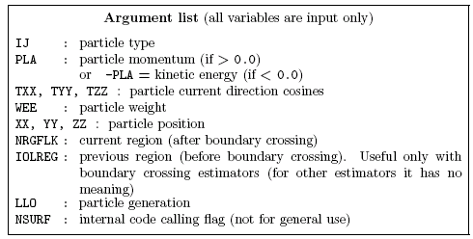
fluscw (weighting fluence, current and yield)‏
Similar to COMSCW. Function FLUSCW is activated by option USERWEIG, with WHAT(3) > 0.0. Yields obtained via USRYIELD, fluences calculated with USRBDX, USRTRACK, USRCOLL, USRBIN, and currents calculated with USRBDX are multiplied by the value returned by this function.

Slide 33
fluscw (continues...)‏
The user can implement any desired logic according to the argument list (particle type, energy, direction, weight, position, region, boundary, particle generation), or information available in COMMON SCOHLP (binning or detector number, estimator type). The estimator type is given by the flag ISCRNG (in COMMON SCOHLP):
ISCRNG = 1 → Boundary crossing estimator
ISCRNG = 2 → Track-length binning
ISCRNG = 3 → Track-length estimator
ISCRNG = 4 → Collision density estimator
ISCRNG = 5 → Yield estimator

Slide 34
magfld (definition of a magnetic field)‏
MAGFLD is activated by option MGNFIELD with WHAT(4-6)=0.0 and is used to return intensity and direction of a magnetic field based on the current position and region. It is called only if the current region has been flagged as having a non-zero magnetic field by option ASSIGNMAt , with WHAT(5) = 1.0.
The magnetic field spatial distribution is often read and interpolated from an external field map.

Slide 35
Beware of the usual need for the normalization of direction cosines!
Note that in any case the direction cosines must be properly normalised in double precision even if B = 0.0.
The recommended algorithm is:

Slide 36
A very special user routine: mgdraw.f

Slide 37
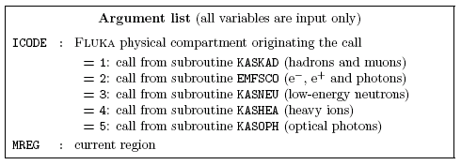
mgdraw (general event interface)‏
The most general interface to FLUKA content (if you know how to use it...)‏
Subroutine MGDRAW, activated by option USERDUMP with WHAT(1) ≥ 100.0, usually writes a “collision tape”, i.e., a file where all or selected transport events are recorded. The default version (unmodified by the user) offers several possibilities, selected by WHAT(3) in USERDUMP.

Slide 38
mgdraw (continues...)‏
The different ENTRY points of MGDRAW
Additional flexibility is offered by a user entry USDRAW, interfaced with the most important physical events happening during particle transport.
The user can modify of course also any other entry of this subroutine:
BXDRAW called at boundary crossings,
EEDRAW called at event end,
MGDRAW called at each step, for trajectory drawing and dE/dx energy deposition events,
ENDRAW for recording of point energy deposition events,
SODRAW for recording of source events

Slide 39
mgdraw (continues...)‏
The format of the output file can be changed, and different combinations of events can be written to file.
But the most interesting aspect of the routine is that the six entries (all of which, if desired, can be activated at the same time by setting USERDUMP with WHAT(3) = 0.0 and WHAT(4) ≥ 1.0) constitute a complete interface to the whole Fluka transport. Therefore, MGDRAW can be used not only to write a collision tape,
but to do any kind of complex analysis. Typical: event by event output (common for HEP applications).

Slide 40
mgdraw: the MGDRAW entry
MTRACK: number of energy deposition events along the track
JTRACK: type of particle
ETRACK: total energy of the particle
WTRACK: weight of the particle
NTRACK: values of XTRACK, YTRACK, ZTRACK: end of each track segment
MTRACK: values of DTRACK: energy deposited at each deposition event
CTRACK: total length of the curved path
Other variables are available in TRACKR (but not written by MGDRAW unless the latter is modified by the user: particle momentum, direction cosines, cosines of the polarisation vector, age, generation, etc. see a full list in the comment in the INCLUDE file).

Slide 41
mgdraw: the BXDRAW entry
Called at Boundary Crossings

Slide 42
mgdraw: the EEDRAW entry
Called at Event End

Slide 43
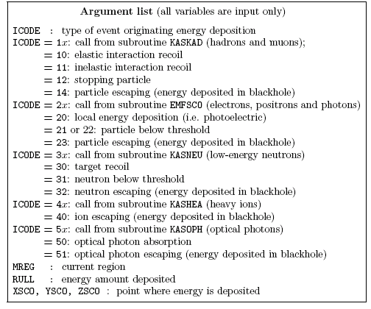
mgdraw: the ENDRAW entry
Called at
pointlike Energy
Deposition dumps
(for example:
stopping particles,
photoelectric eff.,
etc.)‏

Slide 44
mgdraw: the SODRAW entry
SODRAW writes by default, for each source or beam particle:
NCASE: (in COMMON CASLIM, with a minus sign to identify SODRAW output) number of primaries followed so far
NPFLKA: (in COMMON FLKSTK) stack pointer
NSTMAX: (in COMMON FLKSTK) highest value of the stack
pointer encountered so far
TKESUM: (in COMMON SOURCM) total kinetic energy of the
primaries of a user written source, if applicable.
Otherwise = 0.0
WEIPRI: (in COMMON SUMCOU) total weight of the primaries
handled so far

Slide 45
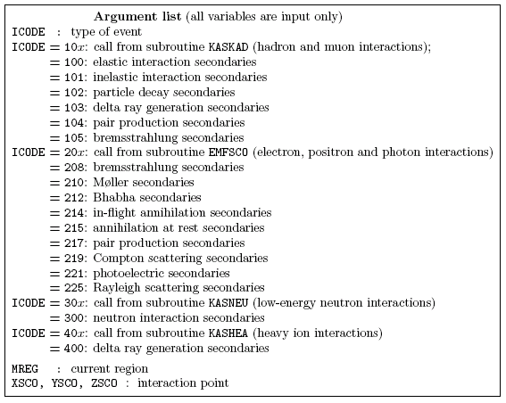
mgdraw: the USDRAW entry
USDRAW is called
after each
particle interaction
(requested by the
user with option
USERDUMP,
WHAT(4) ≥ 1.0)‏

Slide 46
When mgdraw should better not be used
When biasing is requested
Whenever low-energy neutrons (E<20 MeV) are used, unless one has a deep knowledge of the peculiarities of their transport (ie kerma, etc)
(or at least one has to be a very experienced user
to manage these cases without making mistakes...)

Slide 47
END

