Slide 1

The FLUKA Code
An Introduction to FLUKA:
a Multipurpose Interaction and Transport MC code
FLUKA Beginner’s Course

Slide 2
FLUKA
Main authors: A. Fassò, A. Ferrari, J. Ranft, P.R. Sala
Contributing authors: G. Battistoni, F. Cerutti, M. Chin, T. Empl, M.V. Garzelli, M. Lantz, A. Mairani, V. Patera, S. Roesler, G. Smirnov,
F. Sommerer, V. Vlachoudis
Developed and maintained under an INFN-CERN agreement Copyright 1989-2011 CERN and INFN
>5000 users
http://www.fluka.org

Slide 3


















The FLUKA international Collaboration
T. Boehlen, M. Brugger, F. Cerutti, M. Chin, Alfredo Ferrari, A. Lechner, A. Mereghetti, S. Roesler, G. Smirnov,
C. Theis, R. Versaci, Heinz Vincke, Helmut Vincke, V. Vlachoudis, J.Vollaire, CERN
A. Fassò, Jefferson Lab, USA J. Ranft, Univ. of Siegen, Germany
G. Battistoni, F. Broggi, M. Campanella, F. Cappucci, E. Gadioli, S. Muraro, P.R. Sala, INFN & Univ. Milano, Italy
L. Sarchiapone, INFN Legnaro, Italy G. Brunetti, A. Margiotta, M. Sioli, INFN & Univ. Bologna, Italy
V. Patera, INFN Frascati & Univ. Roma La Sapienza, Italy
M. Pelliccioni, INFN Frascati & CNAO, Pavia, Italy A. Mairani, CNAO Pavia, Italy
M. Santana, SLAC, USA M.C. Morone, Univ. Roma II, Italy
K. Parodi, I. Rinaldi, HIT, Heidelberg, Germany
L. Lari, Univ. of Valencia, Spain A. Empl, L. Pinsky, B. Reddell, Univ. of Houston, USA
V. Boccone, Univ. of Geneva, Switzerland K.T. Lee, T. Wilson, N. Zapp, NASA-Houston, USA
S. Rollet, AIT, Austria
M. Lantz, Uppsala Univ., Sweden S. Trovati, PSI, Switzerland
G. Lukasik, Poland P. Colleoni, Ospedali Riuniti di Bergamo, Italy
M.V. Garzelli, Nova Gorica Univ., Slovenia Anna Ferrari, FZR Rossendorf, Germany

Slide 4
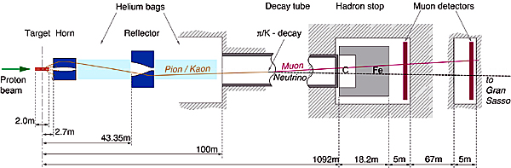
FLUKA Applications
Cosmic ray physics
Neutrino physics
Accelerator design (→ n_ToF, CNGS, LHC systems)
Particle physics: calorimetry, tracking and detector simulation etc.
(→ ALICE, ICARUS, ...)
ADS systems, waste transmutation, (→”Energy amplifier”, FEAT, TARC,…)
Shielding design
Dosimetry and radioprotection
Radiation damage
Space radiation
Hadron therapy
Neutronics

Slide 5
The History
The early days
1962: Johannes Ranft (Leipzig) and Hans Geibel (CERN): Monte Carlo for high-energy proton beams
The beginning:
The name:
1970: study of event-by-event fluctuations in a NaI calorimeter (FLUktuierende KAskade)
Early 70’s to ≈1987: J. Ranft and coworkers (Leipzig University) with contributions from Helsinki University of Technology (J. Routti, P. Aarnio) and CERN (G.R. Stevenson, A. Fassò)
Link with EGS4 in 1986, later abandoned
The modern code: some dates
Since 1989: mostly INFN Milan (A. Ferrari, P.R. Sala): little or no remnants of
older versions. Link with the past: J. Ranft and A. Fassò
1990: LAHET / MCNPX: high-energy hadronic FLUKA generator No further update
1993: G-FLUKA (the FLUKA hadronic package in GEANT3). No further update
1998: FLUGG, interface to GEANT4 geometry
2000: grant from NASA to develop heavy ion interactions and transport
2001: the INFN FLUKA Project
2003: official CERN-INFN collaboration to develop, maintain and distribute FLUKA

Slide 6
The FLUKA Code design - 1
Sound and updated physics models
  Based, as far as possible, on original and well-tested microscopic models
  Optimized by comparing with experimental data at single interaction level: “theory driven, benchmarked with data”
  Final predictions obtained with minimal free parameters fixed for all energies, targets and projectiles
  Basic conservation laws fulfilled “a priori”
  ➔ Results in complex cases, as well as properties and scaling laws, arise naturally from the underlying physical models
  ➔ Predictivity where no experimental data are directly available
It is a “condensed history” MC code, however with the possibility to use single instead of multiple scattering

Slide 7
The FLUKA Code design - 2
Self-consistency
  Full cross-talk between all components: hadronic, electromagnetic, neutrons, muons, heavy ions
  Effort to achieve the same level of accuracy:
    for each component
    for all energies
  Correlations fully preserved within interactions and among shower components
  FLUKA is NOT a toolkit! Its physical models are fully integrated

Slide 8
The Physics Content of FLUKA
60 different particles + Heavy Ions
Nucleus-nucleus interactions from Coulomb barrier up to 10000 TeV/n
Electron and μ interactions 1 keV – 10000 TeV
Photon interactions 100 eV - 10000 TeV
Hadron-hadron and hadron-nucleus interactions 0–10000 TeV
Neutrino interactions
Charged particle transport including all relevant processes
Transport in magnetic fields
Neutron multigroup transport and interactions 0 – 20 MeV
Analog calculations, or with variance reduction

Slide 9
The FLUKA course: an Introduction
How:
This course is intended to provide users with the basic (and possibly more than basic!) knowledge of:
  The most relevant FLUKA instructions and options
  The physics models adopted in FLUKA
  The different scoring options embedded in FLUKA
  The different running options
  The tools to plot results
  The right approach to the existing documentation
  The procedures to overcome difficulties and problems and related debugging tools
  etc. etc.

Slide 10
Method
There will be formal lectures but they will be followed as much as possible by practical (simple) examples.
Emphasis will be put on the practice.
If possible we shall try to transform your questions into cases of general interest.

Slide 11
A possible problem
People here are not all at the same level of FLUKA knowledge. There are those who already have some experience, maybe not negligible.
However we need to start from scratch.
We apologize to the experienced people and beg them to be patient: it’s not excluded a priori that they can learn something new also concerning the very basic elements!

Slide 12
A glimpse of FLUKA

Slide 13
The FLUKA version
  FLUKA20xx.n(y)(.m)
Major version
Respin
Minor version
Patch level
Since 2006 each version is going to be maintained for 2 years max.
In this course we are using FLUKA2011.2

Slide 14
The FLUKA license (it is not GPL):
Standard download: binary library + user routines.
  FLUKA can be used freely for scientific and academic purposes,
  ad-hoc agreement for commercial purposes
  It cannot be used for weapon related applications
  It is not permitted to redistribute the code (single user, single site)
  Users can add their own scoring, sources, etc. through a wide set of user routines, provided they do not modify the physics
  Relevant references for each FLUKA version can be found in the documentation
It is possible, by explicit signature of license, to download
the source for researchers of scientific/academic Institutions. (!!! now from NEA as well !!!)
  FLUKA can neither be copied into other codes (not even partially), nor translated into another language without permission.
  The user cannot publish results with modified code, unless explicit authorization is granted in advance.

Slide 15
Using FLUKA
Platform: Linux with g77 and gfortran
Work in progress: Mac OSX with gfortran
The code can be compiled/run only using operating systems, compilers (and associated) options tested and approved by the development team
Standard Input:
Command/options driven by “data cards” (ascii file) .
Graphical interface is available!!!!
Standard Geometry (“Combinatorial geometry”): input by “data cards”
Standard Output and Scoring:
Apparently limited but highly flexible and powerful
Output processing and plotting interface available

Slide 16
The FLUKA mailing lists
fluka-users@fluka.org
Users are automatically subscribed here when registering on the web site. It is used to communicate the availability of new versions, patches, etc.
fluka-discuss@fluka.org
Users are encouraged to subscribe at registration time, but can uncheck the relevant box. It is used to have user-user and user-expert communication about problems, bugs, general inquiries about the code and its physics content
users are strongly encouraged to keep this subscription
Notes:
16

Slide 17
Disclaimer
A good FLUKA user is not one that only masters technically the program
BUT a user that:
  Indeed masters technically the code;
  Know its limitations and capabilities;
  Can tune the simulation to the specific requirements and needs of the problem under study;
  but most of all
  Has a critical judgment on the results
Therefore in this course we will equally focus on:
  The technical aspects of the code
  [building your input, geometry, scoring, biasing, extracting results…]
  as well as
  The underlying physics and MC techniques

Slide 18
Examples of FLUKA Applications

Slide 19
The TARC experiment at CERN:

Slide 20
The TARC experiment: neutron spectra
FLUKA + EA-MC (C.Rubbia et al.)

Slide 21
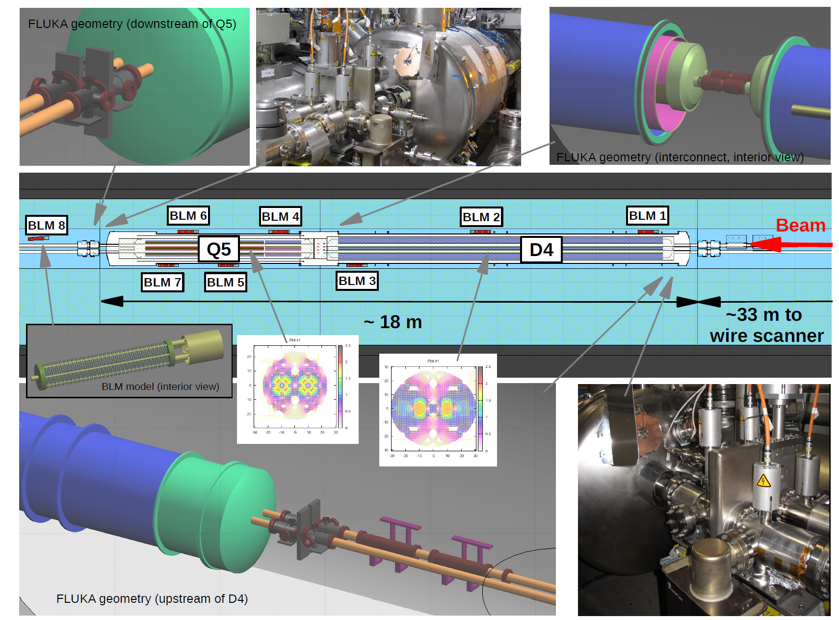
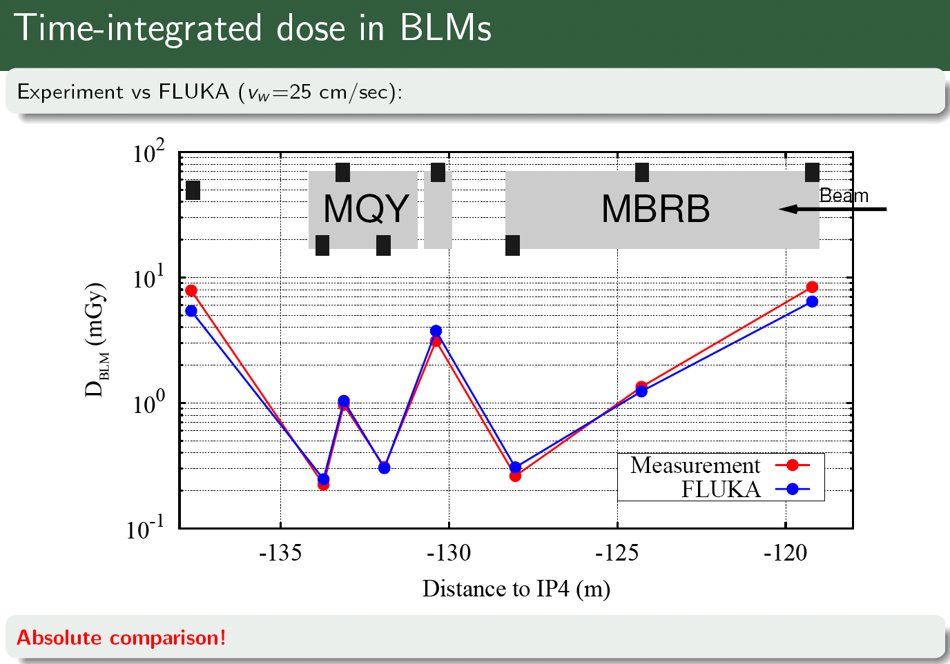
Application & Benchmarking – LHC operation
Test quench induced by the wire scanner on 2010 Nov 1 on the left of P4 at 3.5TeV

Slide 22
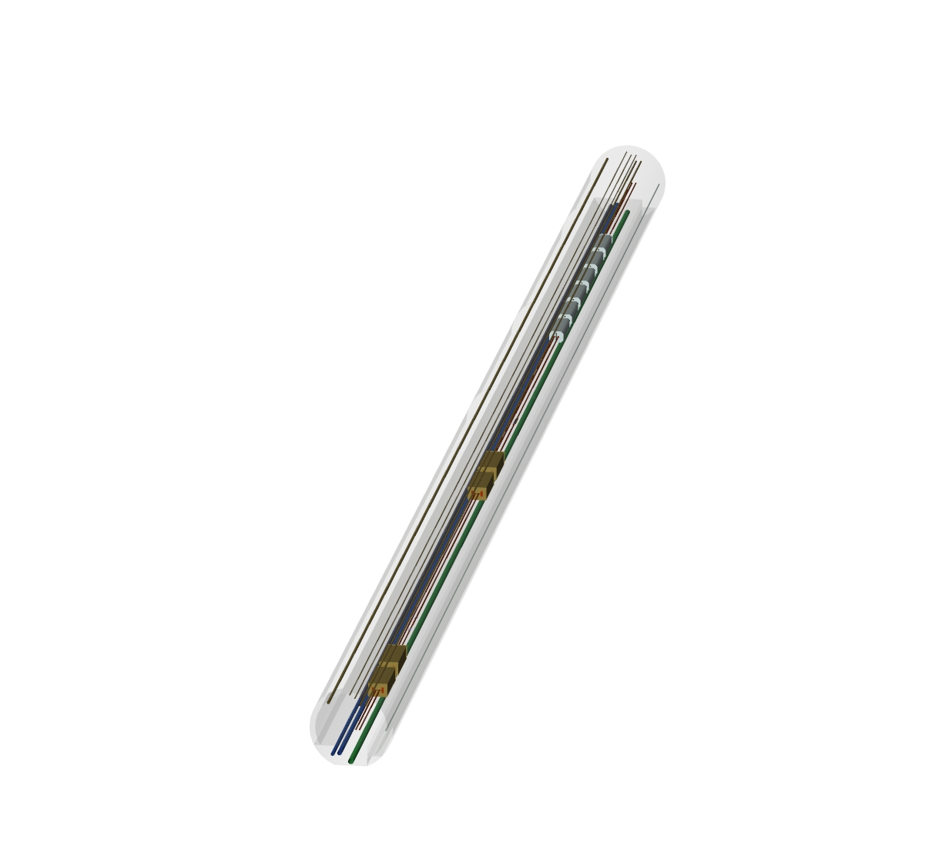
Applications – LHC collimation region
Magnets
Collimators
FLUKA geometry
visualized with
SimpleGeo

Slide 23
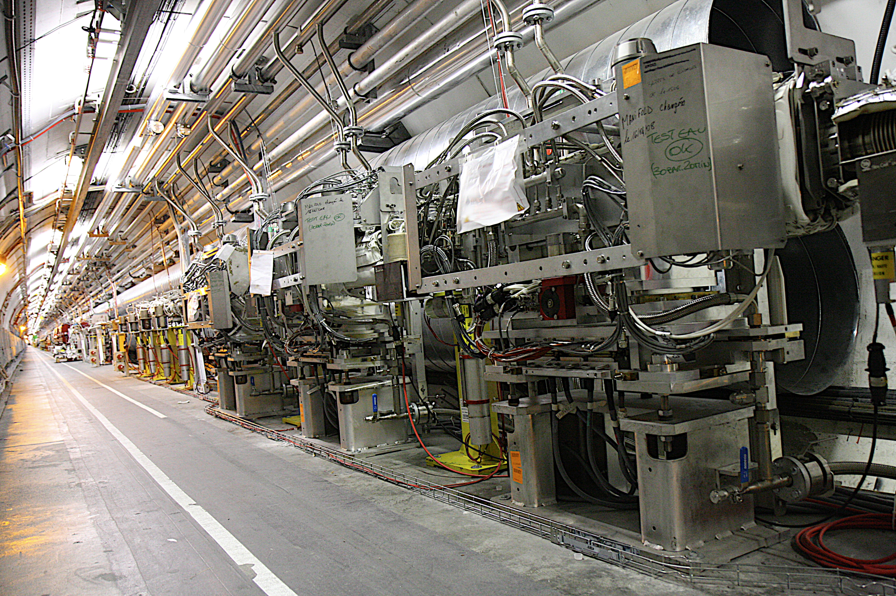
Example: 3 Primary Collimators IR7
Skew
Horizontal
Vertical

Slide 24
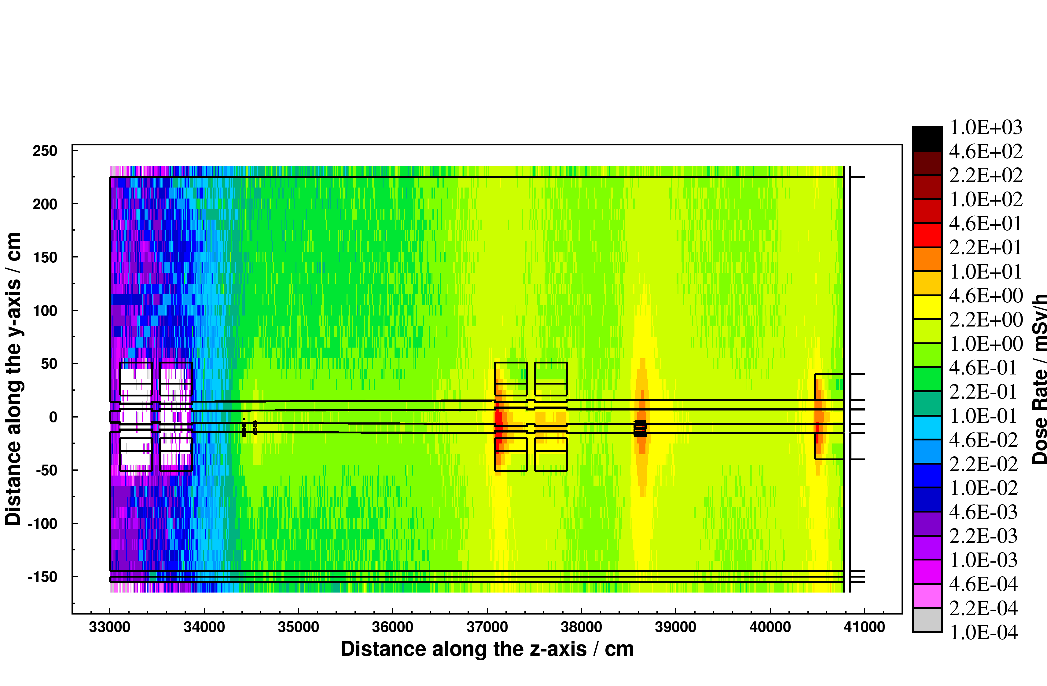
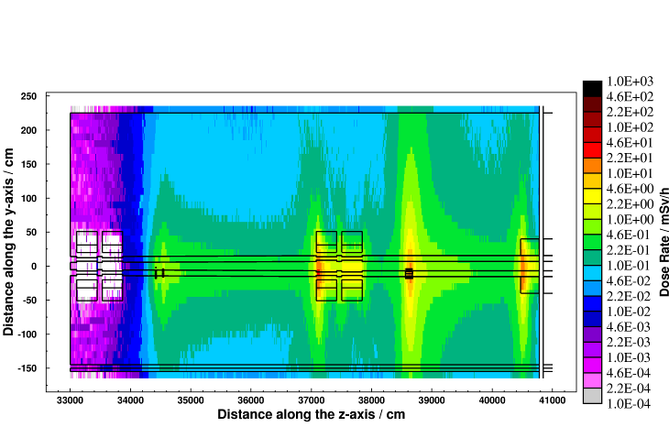
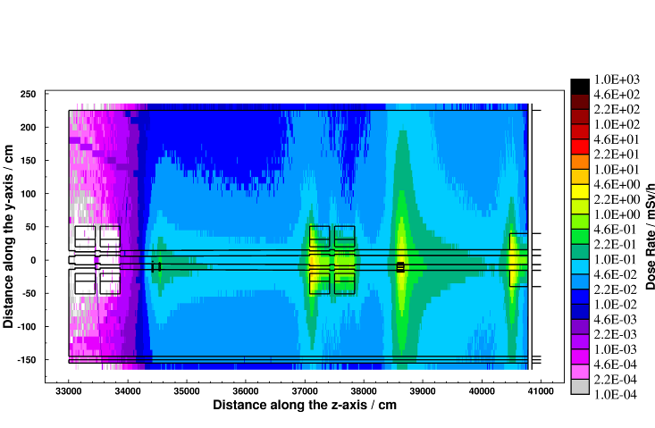
Applications – LHC collimation region
Cooling time
Residual dose rate (mSv/h)
after one year of operation
8 hours
1 week
4 months
CERN-SC-2005-092-RP-TN
6th FLUKA course, CERN 2008
24

Slide 25
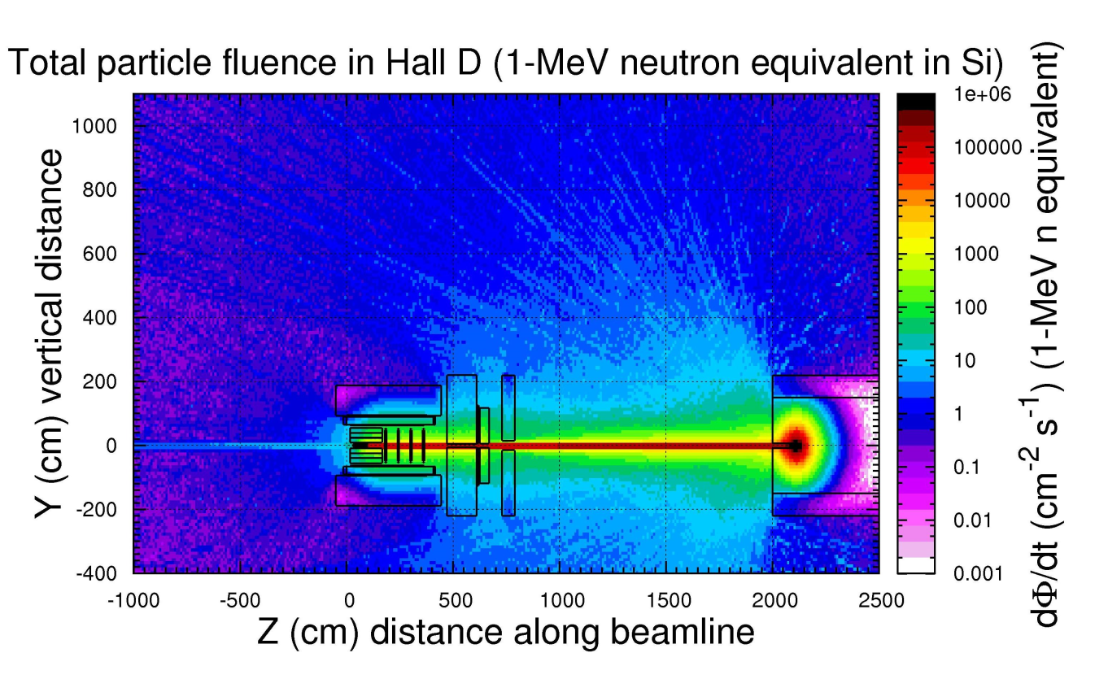
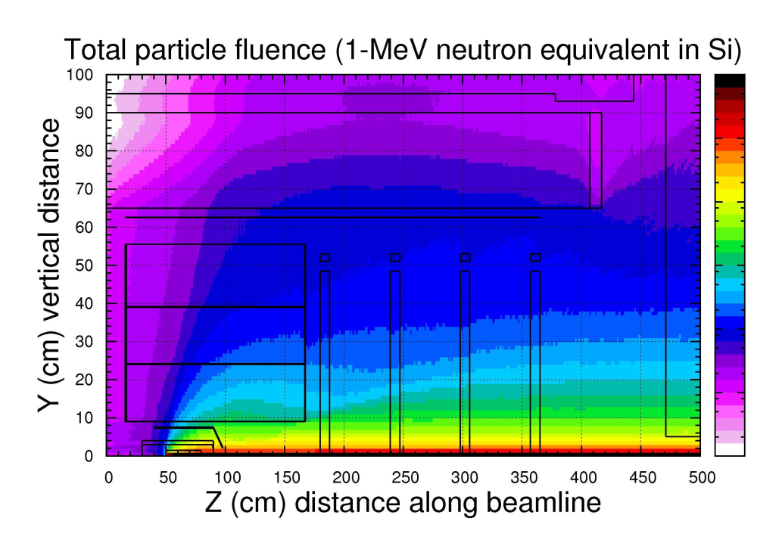
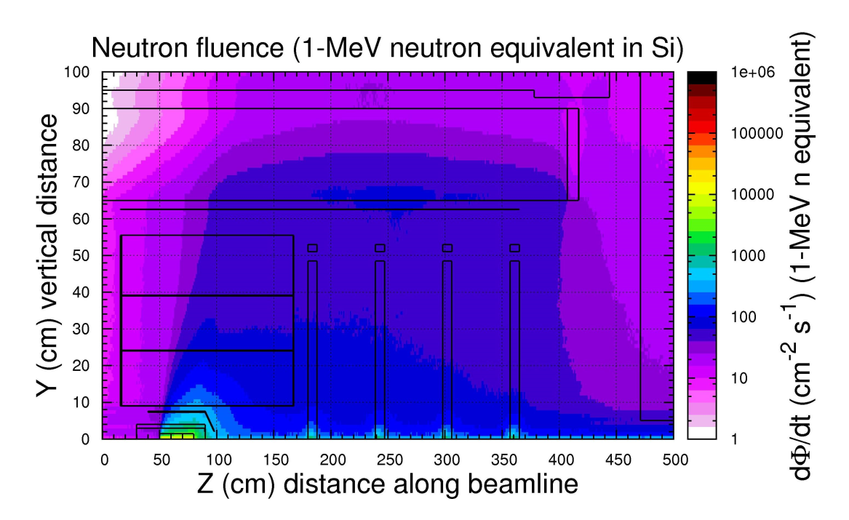
Calculated 1-MeV neutron equivalent fluence rate in Si
(GlueX experiment at Jlab)

Slide 26
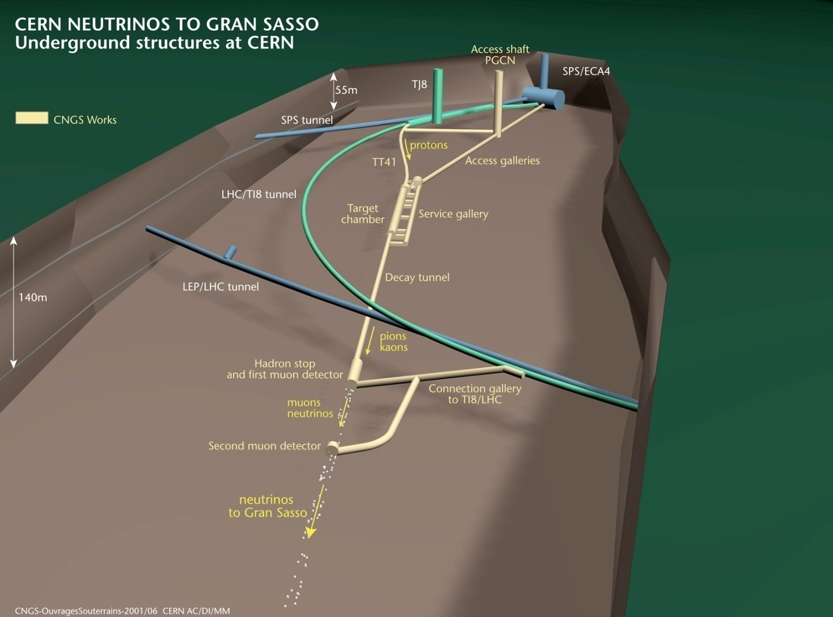
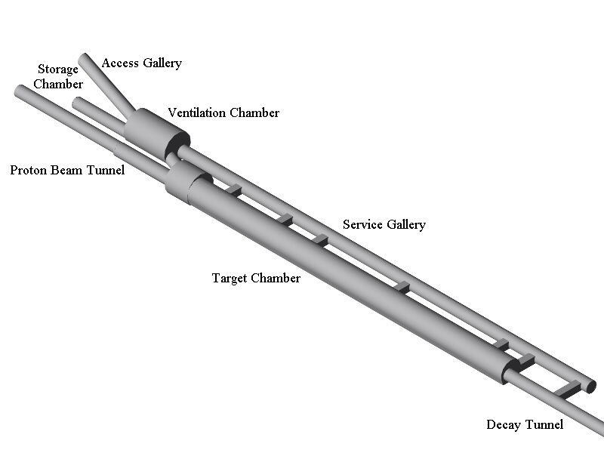
Applications – CNGS

Slide 27
Cern Neutrino to Gran Sasso
Engineering and physics: target heating,
shielding, activation, beam monitors, neutrino spectra
Muons in muon pits: horiz. distribution for beam alignment
Energy deposition in CNGS target rods, GeV/cm³/pot

Slide 28
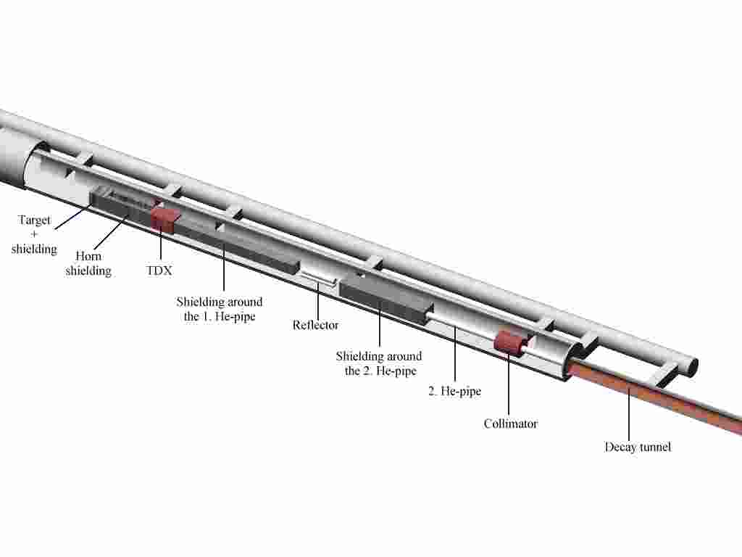
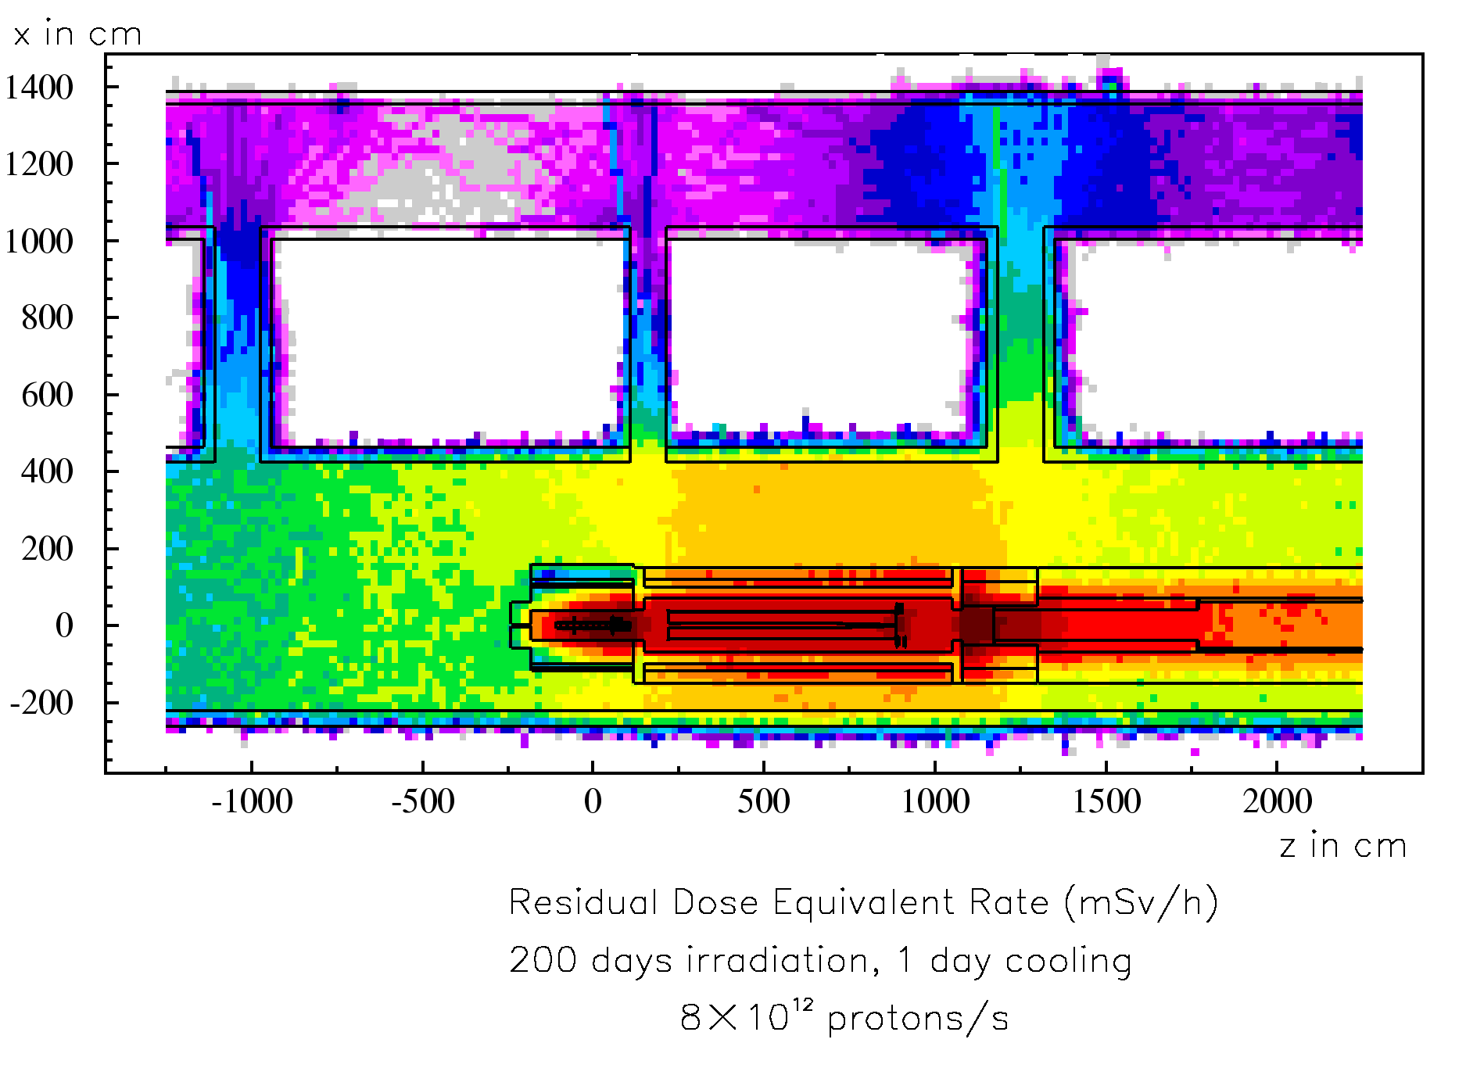
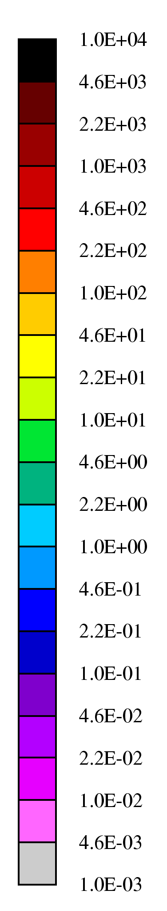
Applications – CNGS
mSv/h
Example:
t_{cool} = 1 day
100
10
1
6th FLUKA course, CERN 2008

Slide 29
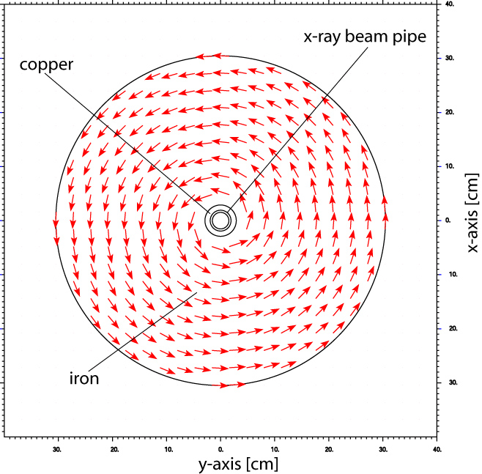
Effect of a magnetic muon spoiler in the LCLS tunnel
The spoiler allows to reduce
the shielding thickness in the
forward direction.
dose rate map without spoiler
the same with spoiler
Magnetic field map used by FLUKA

Slide 30
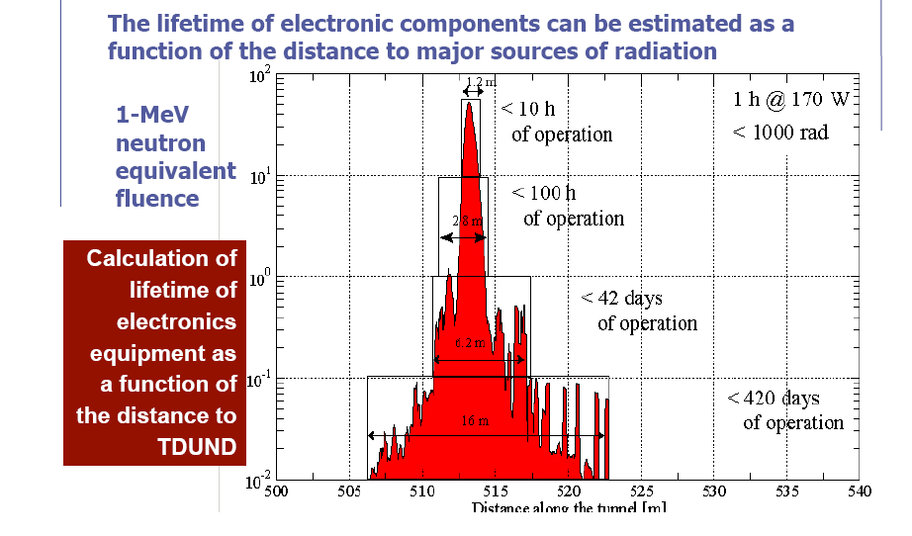
Damage to electronics
SLAC: Damage to electronics near the dumps at the LCLS (Linear Coherent Light Source)

Slide 31
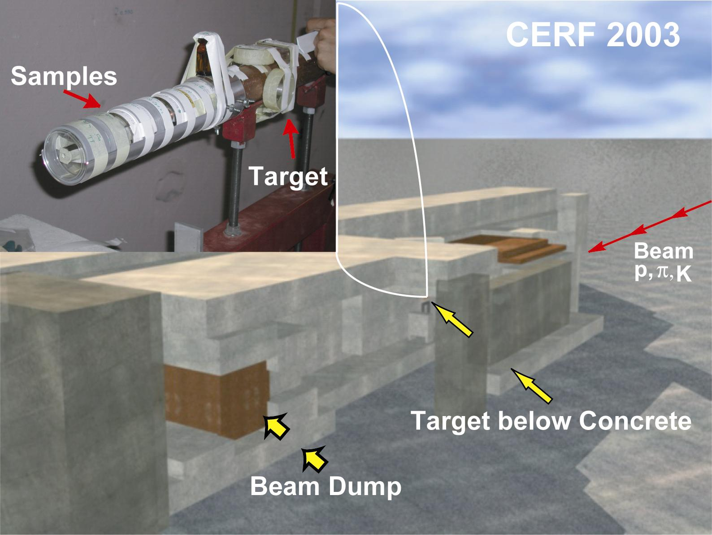
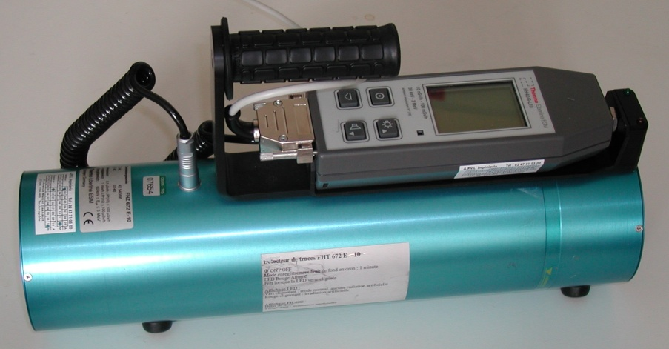
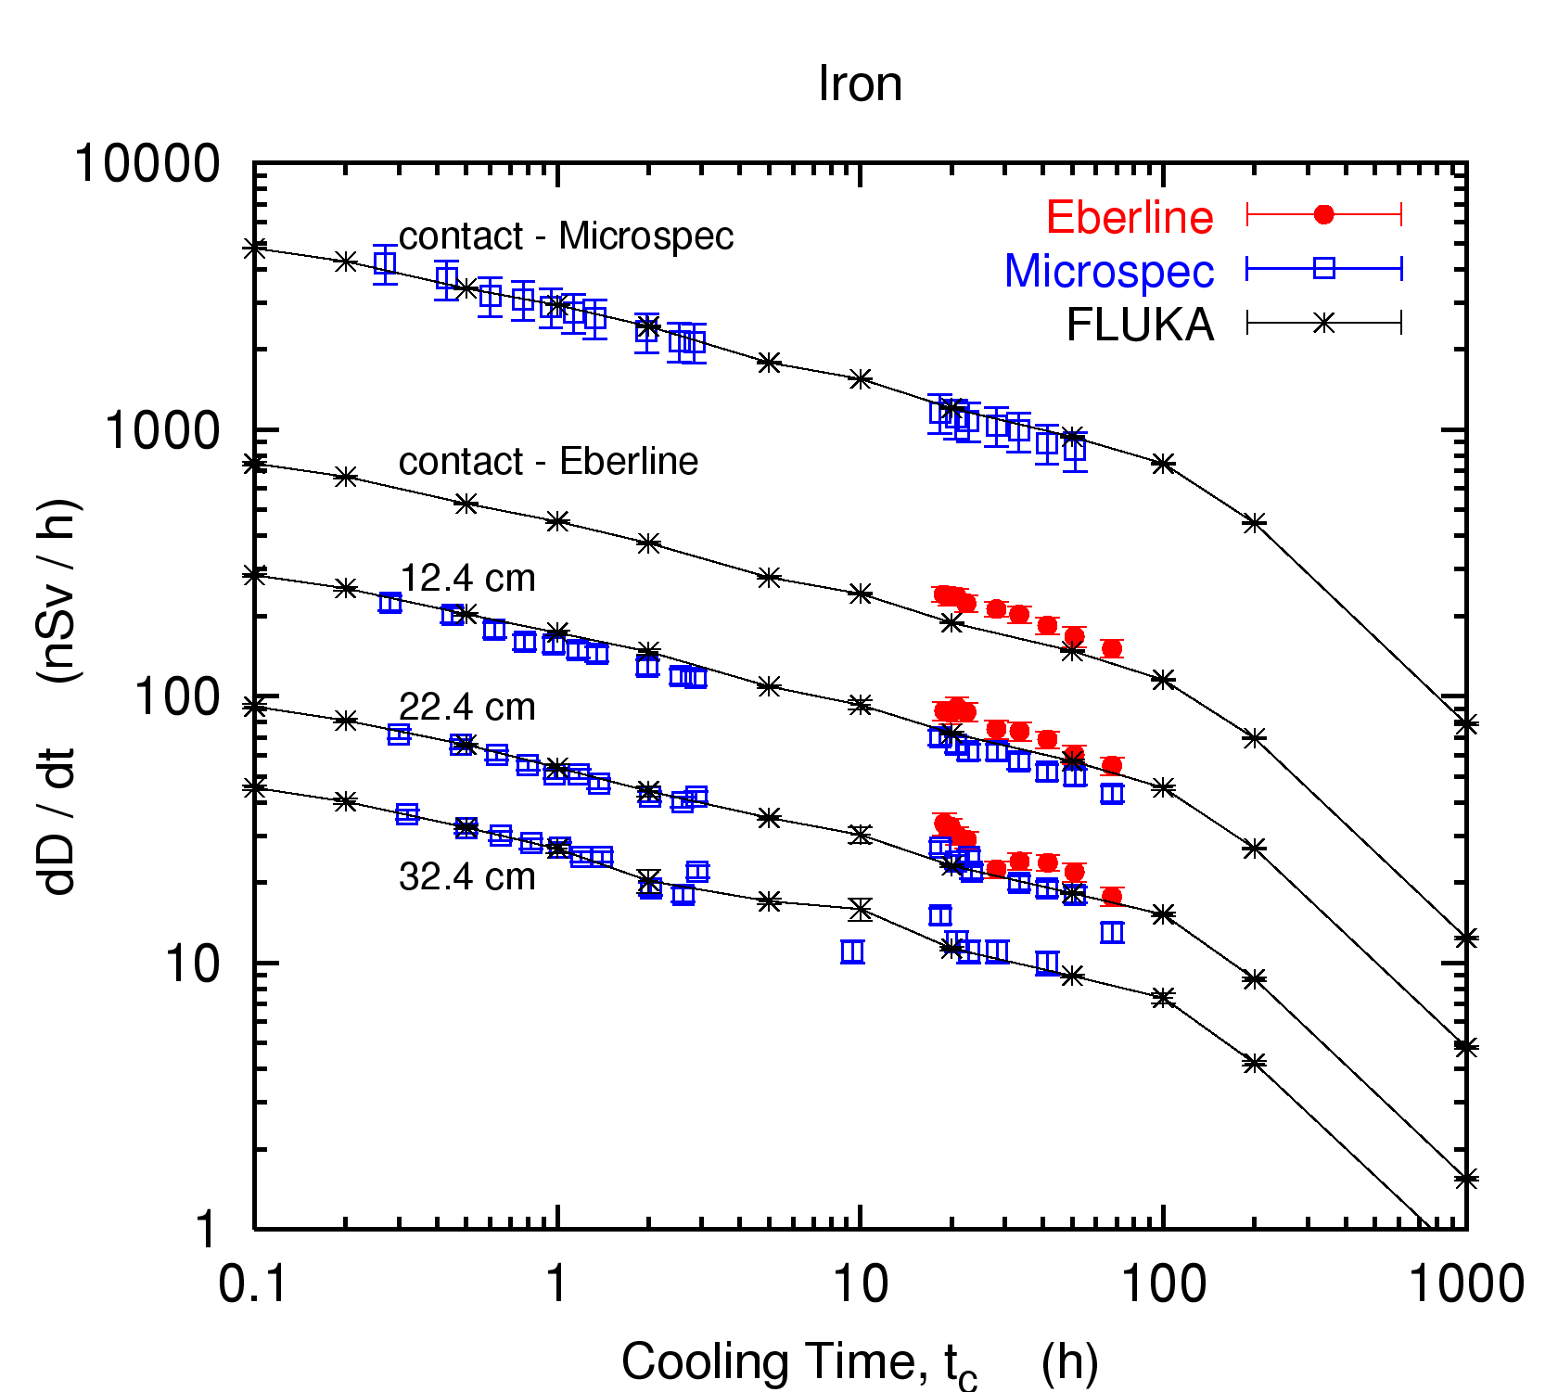
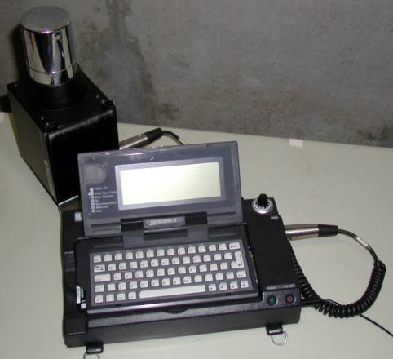
CERN-EU High-Energy Reference Field facility (CERF)
Thermo-Eberline dose-meter FHZ 672
samples in contact with a 50 cm long, 7 cm diameter copper target, centred on the beam axis
Microspec

Slide 32
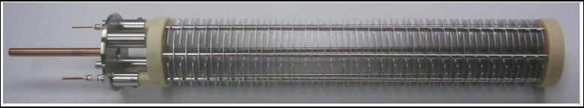
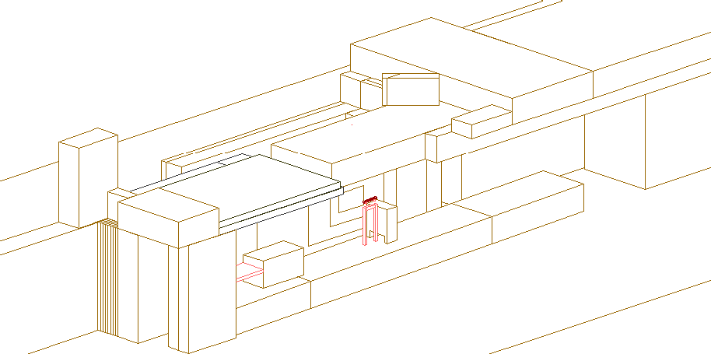
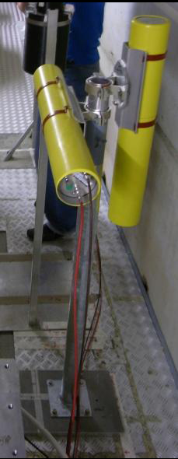
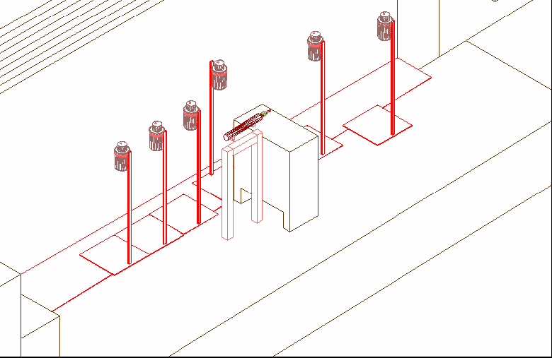
Test of instrumentation : Beam Loss Monitors at CERF
CERN-EN-NOTE-2010-002-STI
CERF setup
BLM’s positions

Slide 33
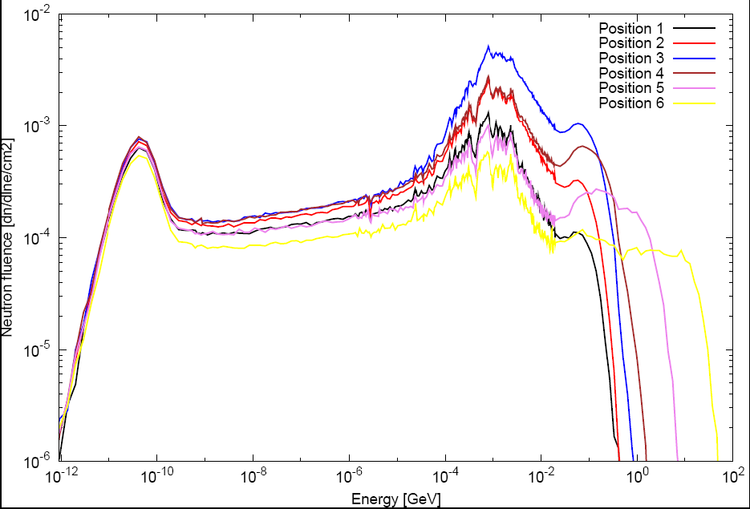
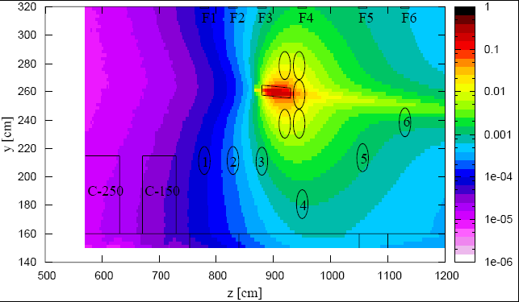
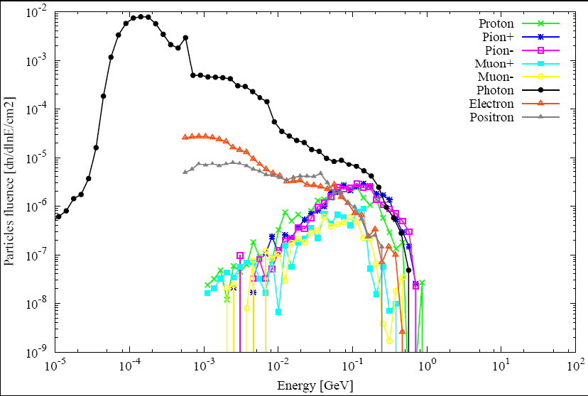
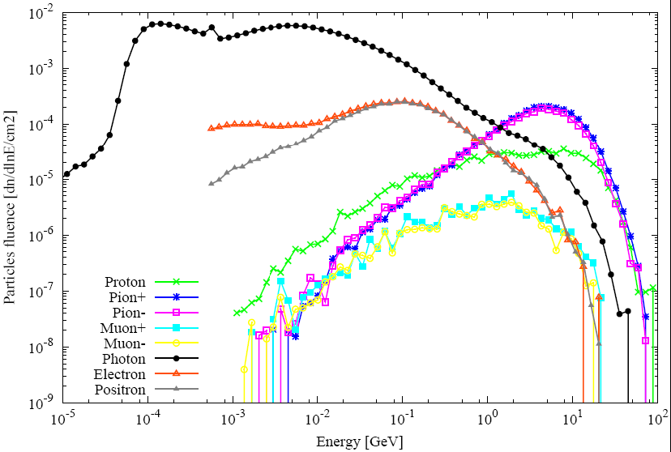
CERF particle spectra
Neutron spectra
ch hadrons
Ch Had
and γ BLM 6
Ch. Had. and γ BLM1

Slide 34
(3D) Calculation of Atmospheric ν Flux
The first 3-D calculation of atmospheric neutrinos was done with FLUKA.
The enhancement in the horizontal direction, which cannot be predicted by a 1-D calculation, was fully unexpected, but is now generally acknowledged.
In the figure: angular distribution of ν_{μ},‾ν_{μ,,} ν_{e},‾ν_{e}
In red: 1-D calculation

Slide 35
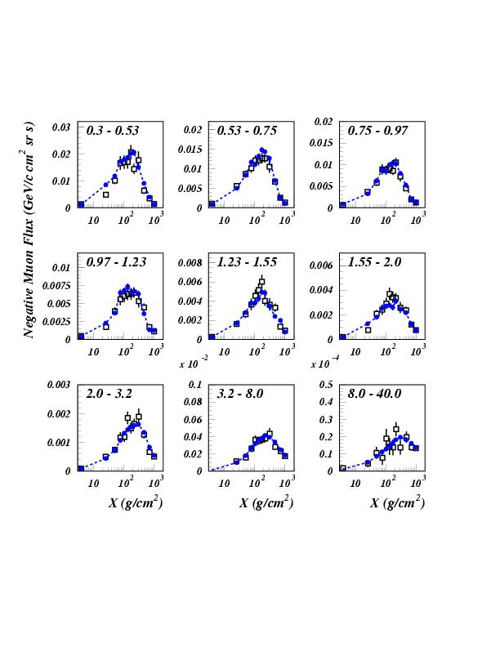
Negative muons at floating altitudes: CAPRICE94
Open symbols: CAPRICE data
Full symbols: FLUKA
primary spectrum normalization ~AMS-BESS
Astropart. Phys., Vol. 17, No. 4 (2002) p. 477

Slide 36
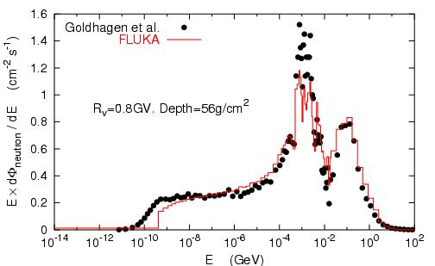
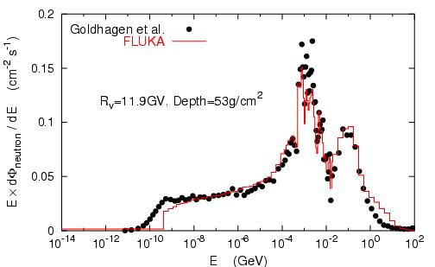
Neutrons on the ER-2 plane at 21 km altitude
Measurements:
Goldhagen et al., NIM A476, 42 (2002)
Note one order of magnitude difference depending on latitude
FLUKA calculations:
Roesler et al., Rad. Prot. Dosim. 98,
367 (2002)

Slide 37
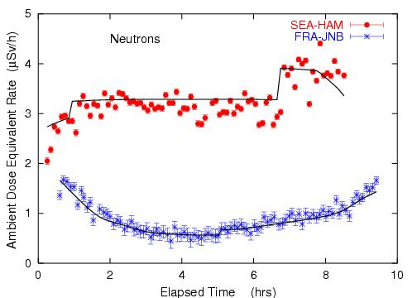
Dosimetry Applications
Roesler et al.,
Rad. Prot. Dosim.
98, 367 (2002)
Ambient dose equivalent from neutrons at solar maximum on commercial flights from Seattle to Hamburg and from Frankfurt to Johannesburg.
Solid lines: FLUKA simulation

Slide 38
Dosimetry applications: doses to aircrew and passengers
Toilet or Galley
AIRBUS 340
Wing fuel tank
Cockpit
Ferrari et al, Rad. Prot.
Dosim. 108, 91 (2004)
Business Class
Economic Class
Center fuel tank
Hold

Slide 39
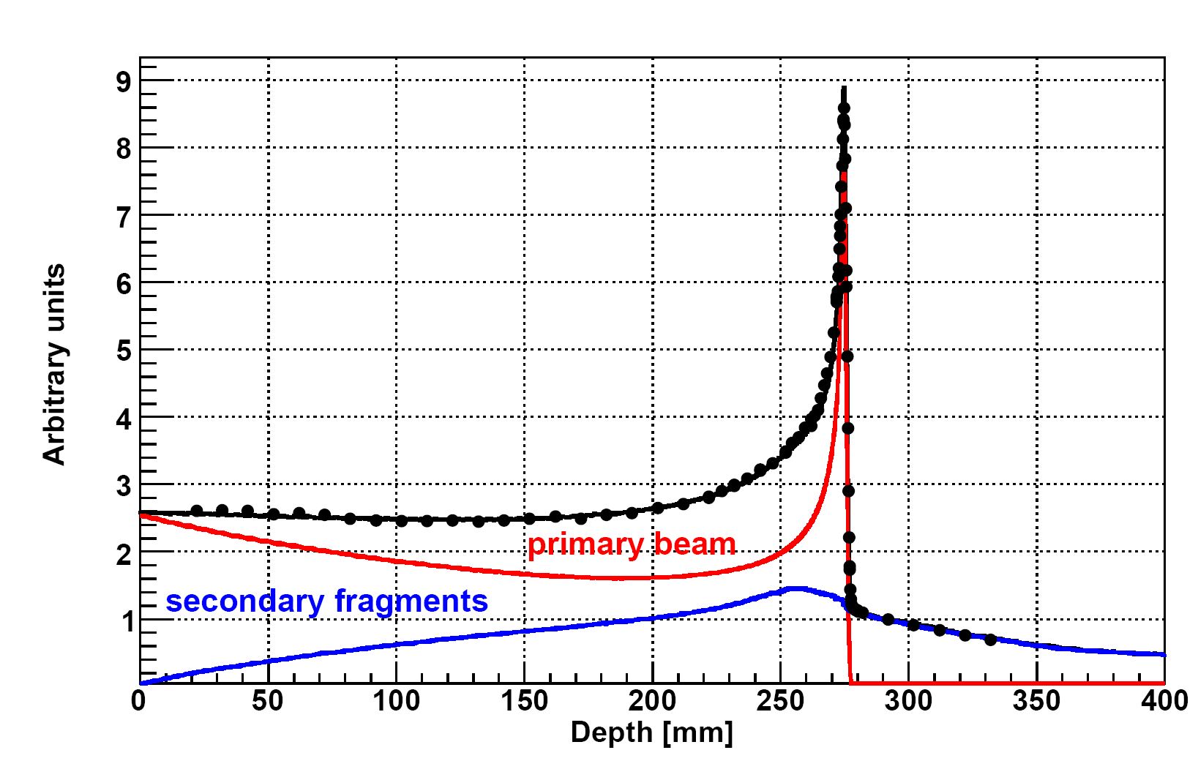
Carbon Ion Therapy
Bragg peak in a water phantom
400 MeV/A C beam:
The importance of fragmentation
Exp. Data (points) from Haettner et al, Rad. Prot. Dos. 2006
Simulation: A. Mairani PhD Thesis, 2007, Nuovo Cimento C, 31, 2008

Slide 40

Using the information from the patient CT in the MC
The Voxel Geometry
FLUKA can embed voxel structures within its standard combinatorial geometry
Transport through the voxels is optimized and efficient
Raw CT-scan outputs can be imported
The GOLEM phantom Petoussi-Henss et al, 2002

Slide 41
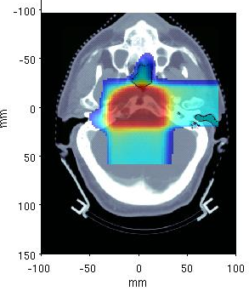
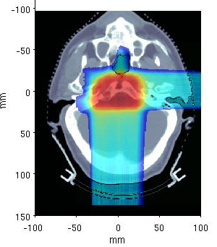
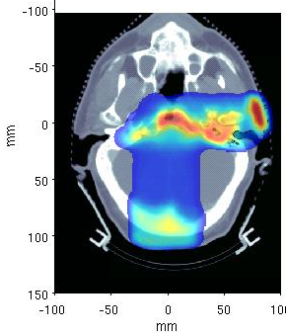
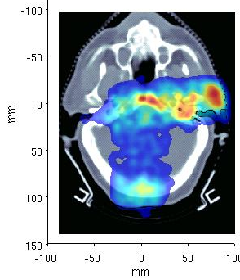
Proton therapy: dose and PET distributions from MC, Head
Clival Chordoma, 0.96 GyE / field, ΔT₁ ~ 26 min, ΔT₂ ~ 16 min
2 Field
1 Field
MC PET
Meas. PET
TP Dose
MC Dose
K. Parodi et al., PMB52, 3369 (2007)

