Slide 1
Installing and Running
FLUKA Beginner’s Course

Slide 2
How to download and install FLUKA
Two ways of downloading the FLUKA software:
From the FLUKA website http://www.fluka.org
From NEA databank http://www.nea.fr through the liaison officer from your institute
It is mandatory to be registered as FLUKA user. Follow the link:
http://www.fluka.org/download.html
After registration (or using your user-id and password) you can proceed in downloading the latest official release version.

Slide 3
How to download and install FLUKA
First identify the location of the FLUKA distribution file: fluka2011.2-linuxAA.tar.gz
Depending on the operating system and the method you used most probably will be located in one of the following directories:
/media/FLUKA/Software # in case you are using the USB stick
or $HOME # if you downloaded from the web
$HOME/Desktop # depending on your browser
We will create a directory FLUKA under your home directory to install FLUKA.
The following commands issued from a terminal/console window will perform the entire installation.
cd # changes directory to your home
mkdir FLUKA # creates a directory called FLUKA
cd FLUKA # changes to the FLUKA directory
tar xzf /media/FLUKA/Software/fluka2011.2-linuxAA.tar.gz
# expands the FLUKA package
# set FLUPRO environment variable
export FLUPRO=$HOME/FLUKA # sets FLUPRO in bash shell or similar or setenv FLUPRO $HOME/FLUKA # sets FLUPRO in tcsh shell or similar
make # compiles a FLUKA executable and
auxiliary programs

Slide 4
Persistent settings
To make these settings persistent on your computer, i.e., you don’t have to set the FLUPRO environment variable again when you open a new terminal or log into your computer, we will add the following lines into your shell configuration file in your main directory.
bash users:
cd
emacs [or any editor] .bashrc
add the following:
export FLUPRO=${HOME}/FLUKA
export PATH=${PATH}:$FLUPRO:$FLUPRO/flutil
tcsh users:
cd
emacs [or any editor] .tcshrc
add the following:
setenv FLUPRO ${HOME}/FLUKA
setenv PATH ${PATH}:$FLUPRO:$FLUPRO/flutil
The changes will be activated on the next login or if you type the command
source .bashrc
source .tcshrc
Notes:
4

Slide 5
FLUKA release: main directory $FLUPRO
Main Library:
libflukahp.a (object collection)
Physics data files:
Basic Scripts: (in $FLUPRO/flutil)
sigmapi.bin
elasct.bin
brems_fin.bin
cohff.bin
gxsect.bin
neuxsc-ind_260.bin
nuclear.bin
fluodt.dat
e6r1nds3.fyi
jef2.fyi
jendl3.fyi
xnloan.dat
Fad/*
DDS/*
rfluka
lfluka
fff
Random Number seed
random.dat
Important Directories
flukapro/ all FLUKA commons
usermvax/ user routines
flutil/ general utilities

Slide 6
What’s inside the physics data files:
sigmapi.bin: pion-N double-diff. cross sections
elasct.bin: elastic scattering cross sections
brems_fin.bin: Bremsstrahlung cross sections
cohff.bin: atomic form factor tabulations
gxsect.bin photon cross sections
neuxsc-ind_260.bin: low energy neutron multi-group cross sections (260 groups)
nuclear.bin: nuclear masses, mass excesses, levels, and many other nuclear data for evaporation, pre-equilibrium, Fermi break up and photonuclear cross sections gamma and beta databases
fluodt.dat: Fluorescence data (photoelectric effect)
e6r1nds3.fyi:
jef2.fyi: Fission products (for neutrons with
jendl3.fyi: E<20 MeV)
xnloan.dat:
Fad/* : BME pre-equilibrium particle angular distribution
DDS/* : BME pre-equilibrium particle energy spectra

Slide 7
Available Documentation
fluka2011.manual ASCII version of the manual (easy to edit)
FM.pdf current version of the FLUKA manual
CERN-2005-10.pdf official reference for FLUKA (manual not up to date)
or navigate the manual, online version (www.fluka.org)
or (when using FLAIR) press F1 to get an interactive manual (which can be also called on prompt level by calling ‘fm.py’’)
or (at a further stage) the FAQ available at: http://www.fluka.org/fluka.php?id=faq&mm2=3
or (at a further stage) the archive of fluka-discuss: http://www.fluka.org/MailingList.html
Release notes

Slide 8
A New Way to “Go FLUKA” - FLUPIX
Besides the current FLUKA distribution you also got the current version of FLUPIX distributed on your USB stick.
FLUPIX
(FLUka in knopPIX)
© Vasilis.Vlachoudis@cern.ch 2008
FLUPIX is a Fedora (originally KNOPPIX, www.knoppix.org) based version of the Live CD, with pre-installed FLUKA and flair and all the necessary tools in for performing FLUKA runs.
FLUPIX can run from a CD/DVD, bootable USB or through any virtual machine from any host operating system (Ms Windows, Mac OS, Linux, Solaris etc.). FLUPIX includes all the additions of VirtualBox (www.virtualbox.org) a free and open source Virtual machine supported by Sun, that provides easy installation and high performance.

Slide 9
Introduction
FLUPIX (FLUKA in KNOPPIX*) is a bare-bones Live ISO containing:
FLUKA
Flair
All necessary tools for analysis (gnuplot, processing programs…)
LXDE – Lightweight Desktop
VirtualBox additions
Minimal size of ~300MB
The ISO is specially mastered to run under VirtualBox (www.virtualbox.org) an open source virtual machine by Sun. It is available under many platforms:
all Linux
MS Windows
Mac OS
OpenSolaris
* Originally it was based on knoppix. The present version is based on Fedora
9

Slide 10
VirtualBox
VirtualBox is an x86 virtualization software package originally created by Innotek and now being developed by Sun Microsystems as part of its Sun xVM virtualization platform.
It is installed on an existing host operating system (OS); within this application, additional operating systems, each known as a Guest OS, can be loaded and run, each with its own virtual environment.
For example, Linux can be guest hosted on a single virtual machine running Microsoft Windows XP as the Host OS ; or, XP and Windows Vista can run as guest operating systems on a machine running OpenSolaris.
10

Slide 11
Installation of FLUPIX for VirtualBox
You will need the following packages
VirtualBox-X.Y.Z-Win_x86.msi The windows setup program of VirtualBox. Install this program in your Windows OS or Mac OS.
flupix-20XX-YYY.iso The FLUPIX bootable CD-ISO image.
flupix-vdi.zip The default configuration of FLUPIX for VirtualBox. Unpack the content of the zip file to copy them to C:\Documents And Settings\username\.VirtualBox or C:\Users\username\.VirtualBox
11

Slide 12
Setting up
The flupix-vdi.zip contains a predefined VM named FLUPIX that is attaching two Virtual disks
home.vdi Dynamic size disk up to 8 Gb, formatted in ext4 used for working space
swap.vdi Fixed size disk of 256MB used for swapping
Set the location of the ISO image
Select the CD/DVD Images tab.
Select the flupix iso image (if present) and click on Release button, then click on Remove button
Click on Add button and locate the correct ISO image
Then on the CD/DVD Rom tab
Check the Mount CD/DVD Drive
Check the ISO Image File
Select the flupix ISO image
12

Slide 13
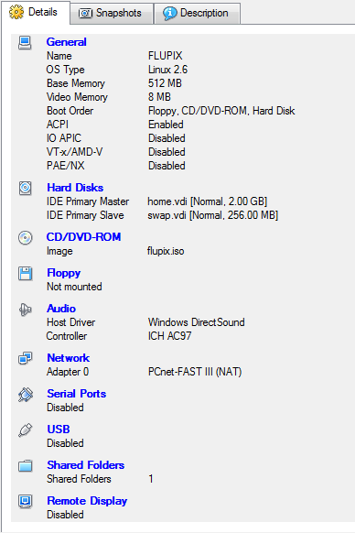
FLUPIX Settings
Memory Settings:
Minimum requirement RAM: 512 Mb Swap: 256 Mb
Recommended: RAM: 1 Gb Swap: 512 Mb
Linux needs at least 256MB to run
FLUKA needs ~400 Mb with DPMJET ~500 Mb
Some FLUKA tools need ~500Mb
FLAIR memory is dynamic
13

Slide 14
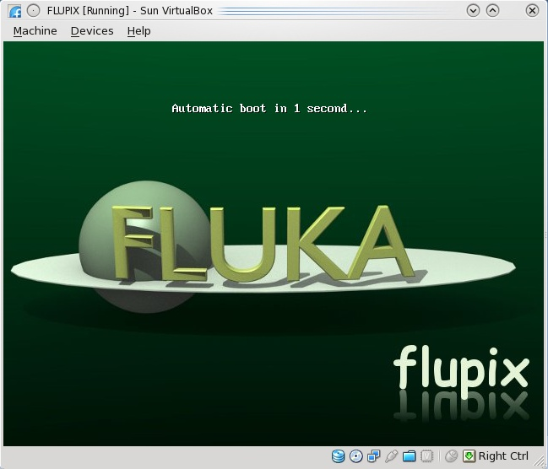
Starting the VM
Select the FLUPIX VM and click on the Start button
It will start the boot in 1s. [If you want to change the parameters press Tab]
Booting will take about 20-30s
14

Slide 15
Working space
The linux root directory “/” is mounted as readonly from the FLUPIX iso file.
However you have the possibility of writing and installing extra programs on the “/” ONLY temporary for the session
You can use super-user priviliges with the “sudo” command with no password
The home.vdi if flagged with a label “/home” and will be mounted as /home and it contains the following:
flupix: your persistent user flupix home directory.
The swap.vdi contains a memory swap disk of 256MB
15

Slide 16
Interface
FLUPIX has precompiled the utilities from VirtualBox that allows
Mouse integration (only in X11). The mouse of the host is used as such from the guest system. In all other displays the guest is getting the FULL control of the mouse
A special driver for X11 video, for faster, smoother and hardware accelerated graphics.
Time synchronization with the host system
Folder sharing from the host to the guest system.
Remember the “Right-Ctrl” key is the default Host key of your Virtual Machine. With the use of this key you can redirect all input (keyboard+mouse) from your host to your guest system and many other.
16

Slide 17
Accessing your host directories
There are several ways of accessing directories from the host system.
The easiest way is through the use of a Shared Folder
Create a Shared folder from your VirtualBox and give a name e.g. home
From FLUPIX call the command vboxmount home ~/home
The command will create a directory ~/home and mount the Shared folder home to it
Add the command to your profile script to be executed on every login.
You cannot run FLUKA inside a shared folder since symbolic links (needed by FLUKA) are not supported
17

Slide 18
Shutting down FLUPIX
Always try to shutdown correctly the VirtualMachine, from the menu. Otherwise you can end up with a corrupted persistent image.
You can even save the machine state, which is equivalent like StandBy. It will create a file equal to the size of the RAM defined 512MB
18

Slide 19
Input example
FLUKA is driven by the user almost completely by means of an input file (.inp) which contains directives issued in the form of DATA CARDS
The standard release provides a simple case to test the installation: example.inp (Production of particles in p-Be collisions with a 50GeV/c proton beam.)
Different examples are used along this course, which will be varied in different ways for didactic reasons
We will start with a minimum input file and after each lecture we will enhance our example with more and more functionality
It is strongly recommended that for every exercise you create a subdirectory i.e., ex1, ex2, ex3 where all the necessary input and output file will be stored
For better clarity before starting a new exercise you will get the solution of the previous one, to be picked up at the course website: http://www.fluka.org/fluka.php?id=course&sub=program&navig=2&which=heidelberg2011

Slide 20
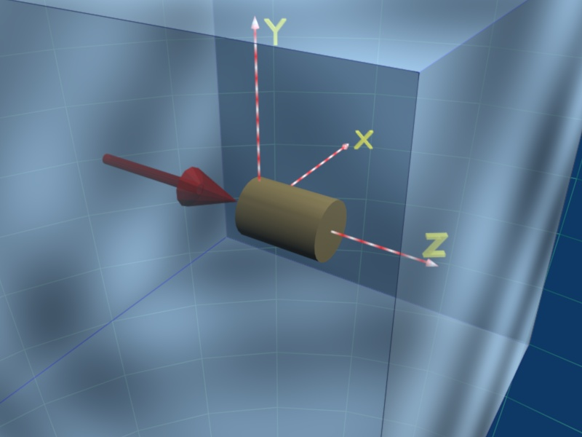
A Simple Example
TITLE
FLUKA Course Exercise
*...+....1....+....2....+....3....+....4....+....5....+....6....+....7....+....*
DEFAULTS NEW-DEFA
BEAM -3.5 -0.082425 -1.7 0.0 0.0 1.0PROTON
BEAMPOS 0.0 0.0 0.1 0.0 0.0 0.0
*...+....1....+....2....+....3....+....4....+....5....+....6....+....7....+....*
GEOBEGIN COMBNAME
0 0 Cylindrical Target
SPH BLK 0.0 0.0 0.0 10000.
* vacuum box
RPP VOI -1000. 1000. -1000. 1000. -1000. 1000.
* Lead target
RCC TARG 0.0 0.0 0.0 0.0 0.0 10. 5.
END
* Regions
* Black Hole
BLKHOLE 5 +BLK -VOI
* Void around
VAC 5 +VOI -TARG
* Target
TARGET 5 +TARG
END
GEOEND
*...+....1....+....2....+....3....+....4....+....5....+....6....+....7....+....*
ASSIGNMA BLCKHOLE BLKHOLE
ASSIGNMA VACUUM VAC
ASSIGNMA LEAD TARGET
*...+....1....+....2....+....3....+....4....+....5....+....6....+....7....+....*
RANDOMIZ 1.0
START 10.0 0.0
STOP
VAC
p⁺ beam
Geometry
TARGET
BLKHOLE

Slide 21
Prepare the working space
We don’t want to run inside the $FLUPRO directories therefore:
Go to your home directory and create a subdirectory named ex1:
cd
mkdir ex1
cd ex1
Get the source example file from the course website (copy all the ex1* files to your subdirectory: ex1) http://www.fluka.org/fluka.php?id=course&sub=program&navig=2&which=heidelberg2011
download ex1*

Slide 22
Now let’s test the installation
After you have created your standard FLUKA we can run the first example:
No. of previous cycle (default is 0)
No. of Last cycle
(default is 5)
$FLUPRO/flutil/rfluka -e $FLUPRO/flukahp -N0 -M1 ex1
Specifies the executable
name: if it is flukahp in $FLUPRO (default) then it can be omitted
Name of the input file. It must be a file named ****.inp and .inp has to be omitted.

Slide 23
What rfluka does:
It creates a temporary subdirectory: $PWD/fluka_nnnn
($PWD means the current directory)
where nnnn is the system process-id assigned to FLUKA. There all necessary assignments are defined and output files are written.
elasct.bin → $FLUPRO/elasct.bin
fluodt.dat → $FLUPRO/fluodt.dat
fort.1 → ../ranex_1001
fort.11 → ex_1001.out
fort.12 → libec_thihecufealw_10t.pemf
fort.15 → ex_1001.err
fort.16 → “geometry scratch”
fort.2 → ranex_1002
neuxsc.bin → $FLUPRO/neuxsc-ind_260.bin
nuclear.bin → $FLUPRO/nuclear.bin
sigmapi.bin → $FLUPRO/sigmapi.bin
xnloan.dat → $FLUPRO/xnloan.dat

Slide 24
At the end of the FLUKA run:
If everything is OK the temporary directory disappears
And the relevant results are copied in the start directory:
Removing links
Removing temporary files
Saving output and random number seed
Saving additional files from scoring requested by the user
Moving fort.33 to /home/username/work/ex1/ex1001_fort.33
Moving fort.47 to /home/username/work/ex1/ex1001_fort.47
Moving fort.48 to /home/username/work/ex1/ex1001_fort.48
Moving fort.49 to /home/username/work/ex1/ex1001_fort.49
Moving fort.50 to /home/username/work/ex1/ex1001_fort.50
End of FLUKA run
by default you have ex100n.log, ex100n.out,
ex100n.err and ranex100m (seed for cycle m = n+1)

Slide 25
Checking FLUKA during the run
Look in the temporary directory:
a) Initialization phase ends when the *.err file is created.
b) Inside *.err file and (at the end of *.out file) the progress in the number of events is given in the line immediately following the one which starts by “NEXT SEEDS”:
NEXT SEEDS: C8888D 0 0 0 0 0 33B49B1 0 0 0
1 9 9 0.0000000E+00 1.0000000E+30 0
NEXT SEEDS: C88894 0 0 0 0 0 33B49B1 0 0 0
2 8 8 5.0010681E-03 1.0000000E+30 0
NEXT SEEDS: C8889A 0 0 0 0 0 33B49B1 0 0 0
3 7 7 3.3340454E-03 1.0000000E+30 0
…..
AVERAGE CPU TIME CONSUMED PER EVENT
EVENTS ALREADY
COMPLETED
EVENTS TO BE
COMPLETED

Slide 26
Tips & Tricks
How to make a “clean” stop of FLUKA run
Here “clean” means closing all files, writing scoring output and removing the temporary directory and files.
In the temporary run directory: touch fluka.stop To stop the present cycle
or touch rfluka.stop To stop all remaining cycles
The clean stop will occur at the next CPU-time check, i.e., at the same time when printing the random number calls : see START card instructions (5th parameter) for the frequency of these checks!!
If the check is never performed it means that the program has entered an infinite loop (probably a fault in user code)

