Slide 1
Introduction to Flair
FLUKA Beginner’s Course

Slide 2
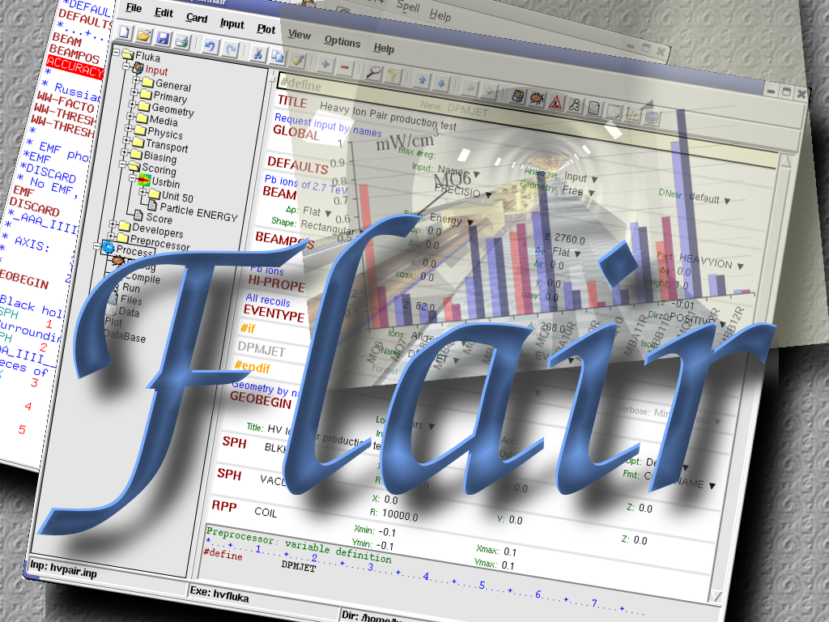
About
/fleə(r)/ n [U,C] natural or instinctive ability (to do something well,
    to select or recognize what is best, more useful, etc.
    [Oxford Advanced Dictionary of Current English]

Slide 3
What is flair ^{[1/2]}
FLUKA Advanced Interface [http://www.fluka.org/flair]
All-in-one User friendly graphical Interface;
Minimum requirements on additional software;
Working in an intermediate level
Not hiding the inner functionality of FLUKA
Front-End interface:
Fully featured Input file Editor
    Mini-dialogs for each card, allows easy and almost error free editing
    Uniform treatment of all FLUKA cards
    Card grouping in categories and card filtering
    Error checking and validation of the input file during editing
Geometry: interactive visualization editing, transformation, optimizations and debugging (tomorrows talk);
Compilation of the FLUKA Executable;
Running and monitoring of the status of a/many run(s)

Slide 4
What is flair ^{[2/2]}
Back-End interface:
Inspection of the output files (core dumps and directories)
Output file(s) viewer dividing into sections
Post processing (merging) the output data files
Plot generation through an interface with gnuplot;
Other Goodies:
Access to FLUKA manual as hyper text
Checking for release updates of FLUKA and flair
Nuclear wallet cards
Library of materials
Database of geometrical objects (Not yet completed)
Programming python API
Everything is accessible with keyboard shortcuts

Slide 5
Concepts: Flair Project
Store in a single file all relevant information:
  Project notes
  Links to needed files: input file, source routines, output files …
  Multiple runs from the same input file, as well running status
  Procedures on how to run the code
  Rules on how to perform data merging
  Information on how to post process and create plots of the results
You can consider Flair as an editor for the project files.
Can handle any FLUKA input format (reading & writing), but internally it works using the names format for the input, free with names for the geometry (Recommended way of working)
The format is plain ASCII file with extension: .flair
Note: If you want to copy a project you need to copy also all linked files especially the input and source routines!

Slide 6
Installation
Flair web site to download code and documentation
http://www.fluka.org/flair
Installation procedures:
  RPM/DEB method (Linux): strongly recommended! on systems that support the RPM/DEB. The package will create all file association, menu items and keep track of updates and files installed.
  The package will install the program to: /usr/local/flair
  and will create the following launcher programs:
    /usr/local/bin/flair flair program
    /usr/local/bin/fm FLUKA manual
    /usr/local/bin/pt Periodic Table
    /usr/local/bin/fless FLUKA output viewer
  tar.gz method (MacOS, MS-Windows). Please follow the instructions on:
  http://www.fluka.org/flair/download.html
  and for special instruction on the FAQ:
  http://www.fluka.org/flair/faq.html

Slide 7


Starting flair
Programs Menu (Linux)
Click the icon of Flair from the programs menu;
Flair is registered under the Science/Physics category but depending your Linux distribution and window manager it might appear in different sub-menus (i.e. Applications, Education, Science or Others).
Window Manager (Linux, only via RPM or DEB installation)
Flair makes an association of the following extensions:
Console
Type the command flair. Remember to place in your $PATH the directory where flair is installed!
 | *.flair |  | *.fluka *.inp

Slide 8
Startup
Unless you specify any option during startup flair will perform the following operation:
Open an “xterm” to be used as the Output window;
Display the About Dialog;
Check for the existence of a FLUKA installation (FLUPRO environment variable), and if not found will open the Preferences dialog to set explicitly the FLUKA path;
WARNING: Window managers (GNOME, KDE…), as well command shells (bash, tcsh, ash…) have a different configuration file where they expect the environment variable.
Display the “Tip of the Day” dialog;
Open the “Check for Updates” dialog (every 30 days interval).

Slide 9
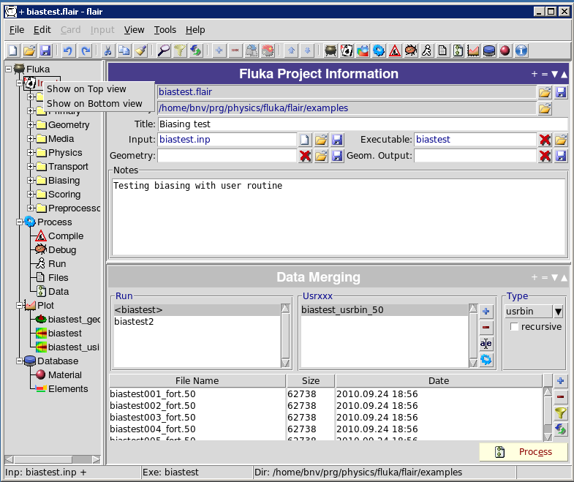
Interface
active
+ vertical/horizontal
= equalize
minimize
maximize
Mouse:
left opens on active
right select where to view
2 working frames
inactive
click to activate
input modified and not saved

Slide 10
Menus
File Edit Card Input View Tools Help
File I/O, export to other formats, printing, recent projects
Edit Common editing features: Cut, Paste, Add, Del, Clone, Filter
Card Add or change cards in input; grouped by Categories
Input Commands to manipulate input cards
View Accessing various views of flair
Tools General purpose commands: Terminal, Browser, Preferences
Help Access to help, check for updates, web page, about dialog
Keyboard Short cuts (Linux/Windows): F10 or Alt+F, E, C, I, V, T, H

Slide 11
Toolbar
Undo/Redo
Find/Filter
Project Control I/O
Cut/Copy/Paste
Add/Del/Clone/Toggle
Move Up/Down
1
2
3
4
5
6
7
8
9
10
11
12
13
Quick Access to:
Project Frame
Input Editor
Geometry Editor (if installed)
Process Summary
Compile executables/Add user routines
Debug Geometry
Run/monitor simulations
View output files
Data merging
Plots
Databases (not yet functional)
Material Database
Help

Slide 12
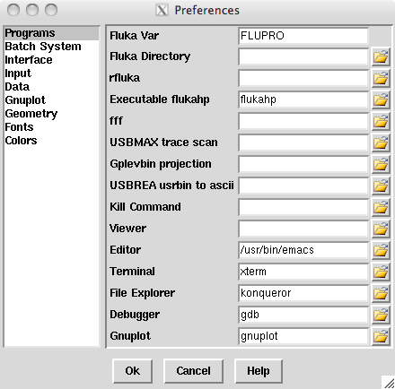
Basic Preferences
The program tab of preferences allows the user to set the default programs and directories
Set your FLUKA directory,
to override $FLUPRO
Set your favorite editor
Set your favorite console program (xterm, nxterm, kconsole…)
Set your favorite file browser for example:
“konqueror” for Linux with KDE
“open” for the finder in MacOS

Slide 13
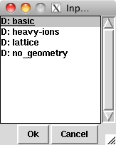
Input Templates
Default template: basic.inp
When requesting a new input or a new project flair will prompt to select an input template:
Flair default templates are prefixed with “D:”
User templates will be prefixed with “U:”
TITLE
GLOBAL 1.0 1.0
DEFAULTS NEW-DEFA
BEAM
BEAMPOS
GEOBEGIN COMBNAME
0 0
* Black body
SPH blkbody 0.0 0.0 0.0 10000000.0
* Void sphere
SPH void 0.0 0.0 0.0 1000000.0
* Cylindrical target
RCC target 0.0 0.0 0.0 0.0 0.0 10.0 5.0
END
* Black hole
BLKBODY 5 +blkbody -void
* Void around
VOID 5 +void -target
* Target
TARGET 5 +target
END
GEOEND
* ..+....1....+....2....+....3....+....4....+....5....+....6....+....7..
ASSIGNMA BLCKHOLE BLKBODY
ASSIGNMA VACUUM VOID
ASSIGNMA COPPER TARGET
RANDOMIZ 1.0
START
STOP
The user can create his own set of input templates. They are normal FLUKA input files and they have to be placed in the directory ~/.flair/templates (create the directory if not existing)

Slide 14
Input Editor
With the input editor the user can manipulate the input cards:
  Add card to input;
  Edit & modify existing ones;
  Copy & Paste;
  Clone (Duplicate);
  Import from other input files;
  Validate the correctness of the cards;
  Error filtering;
  Rearrange order;
The editor will always try to rearrange the input cards (only if needed) to create a valid FLUKA input file.
e.g. body cards outside the GEOBEGIN/GEOEND parts will be moved inside
Note: Automatic rearranging of cards cannot work if “#include” cards are present. The user have to do it manually.

Slide 15
Card Categories
For easier access, cards are groups in the following categories:
General General purpose (TITLE, DEFAULTS, GLOBAL…);
Primary Definition of the primary starting particles;
Geometry Cards related to the definition of the geometry bodies/regions/lattices plotting and rotations/translations;
  Bodies Subcategory containing only the bodies definition;
  Transformations Subcategory containing only the geometrical directives;
Media Definition and assignment of materials;
Physics Setting physics properties of the simulation;
Transport Modify the way particles are transported in FLUKA;
Biasing Cards for importance biasing definition;
Scoring Cards related to scoring;
Flair flair special cards;
Preprocessor Definitions for creating conditional input files.

Slide 16
Concepts: Extended Cards ^{[1/2]}
Flair is treating the input file as a list of extended cards;
Each extended card contains:
  Comment: All commented lines preceding the card(s) as well the inline comments;
  Tag: The 8 character word identifying the card. All tags not recognized by flair will be converted to #error;
  WHATs: Multiple number of WHATs (0=sdum, 1-6 first line, 7-12 continuation line...)
  Extra: multi line string of extra information for special cards like REGION, TITLE, PLOTGEOM etc.
  State (Enable/Disable);
Flair recognize automatically (and separates them from the comments) all the disabled valid FLUKA cards;

Slide 17
Concepts: Extended Cards ^{[2/2]}
The region definition in the in geometry is emphasized by the presence of a card named “REGION”;
All the COMPOUND cards related to one material are joined in one card;
Cards are edited with the flair editor through the use of the mini-dialogs, forcing the user to enter the correct information (default);
The user can nevertheless gain full control of the card using the Edit dialog (Ctrl-E);
Flair will try to find the best floating point representation of each number, to ensure the maximum accuracy; number of digits that fits in the specific width (10 for the fixed format, 22 for the free format).
Function evaluation: a field value starting with = will force flair to evaluate its content as a function e.g.
BEAMPOS x: =2*10+length
Flair will create a valid fluka input containing the evaluation of the formula and keep the formula inside the comments as
*@what.1 =2*10+length

Slide 18

Anatomy of a card mini-dialog ^{[1/2]}
For each extended card flair has a mini dialog (currently in 4 columns), interpreting all information stored in the card
* Beam characteristics
BEAM -20.0 -0.082425 -1.7 1.0PROTON
Comment
Interpreted
Value of WHAT(1)
Drop down list box
with possible options
Label
Grey box
Shows currently
editing item
Tag

Slide 19

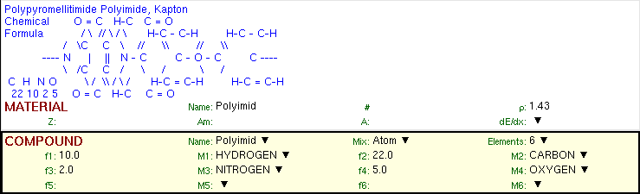
Anatomy of a card mini-dialog ^{[2/2]}
* Energy deposition in 3D binning
USRBIN 10.0 ENERGY -50.0 45.0 54.0 36.0EneDep
USRBIN -45.0 -54.0 -33.0 100.0 100.0 100.0&
* Polypyromellitimide Polyimide, Kapton
* Chemical O = C H-C C = O
* Formula / \ // \ / \ H-C - C-H H-C - C-H
* / \C C \ // \\ // \\
* ---- N | || N - C C - O - C C ----
* \ /C C / \ / \ /
* C H N O \ / \\ / \ / H-C = C-H H-C = C-H
* 22 10 2 5 O = C H-C C = O
MATERIAL 1.43 Polyimid
COMPOUND 10.0 HYDROGEN 22.0 CARBON 2.0 NITROGENPolyimid
COMPOUND 5.0 OXYGEN Polyimid

Slide 20
Editing Cards
While in input editor you can work in two modes:
Card mode: manipulate the cards as a unit (e.g. to copy, paste, delete, change order of cards);
Edit mode: manipulate the contents of the card.
Edit mode is activated immediately after adding a new Card, by hitting Enter or with the mouse click.
To leave edit mode click the Esc or with the mouse click somewhere else.
The active item (what) is highlighted with a grey rectangle and highlighted also in the card viewer below the editor.
A range of cards can be selected with:
Shift + Mouse ;
Shift + Up/Down arrows;

Slide 21
Validating input and Error correction
Flair validates the input file while loading and each card during editing;
Errors are highlighted in red;
For the moment only syntactical errors are checked, and a few logical errors;
Popup-menu option “Show errors” displays a short message on what is expected as correct value;
Menu item “Input / Filter Invalid” shows only the invalid cards from the last filtered view.

Slide 22
Material Database
Flair contains an internal database of ~500 predefined materials and/or compounds;
Some (~300) with the Sternheimer parameters;
Please use these data as Reference only!
Validate always the correctness of the data;
If errors found please contact the author;
The database can be edited, and populated with your own materials. In this case a local copy of the database will be made in ~/.flair directory.

Slide 23
Starting a Run
Flair can starts a simulation (single run) based on the input file
Multiple runs can started be by overriding some options, like #defines, title, random number seed and number of starting particles (primaries);
Flair will try to “attach” to a run. Using only the information from the output files generated by FLUKA, flair will try to identify the directory where the run takes place and monitor the progress of the selected run.
During the execution of the run the user can view the output files in the “Files Frame”

Slide 24
Tips & Tricks
Mouse
  right-click opens the popup-menu with the most
  important actions
Keyboard Check the accelerators on the menus
  Ctlr-Enter Performs the default action in every frame.
  e.g. Add a card in the Input Editor
  start a run in the Run Frame
  Ctrl-Space Access popup-menu (like right-clicking)
  Listboxes All listboxes in flair are searchable and case
  insensitive. Type the first characters of the
  string you are searching and the closest
  match will be highlighted.
  Ctrl-G repeats the search. Space
  selects/deselect item
  +, -, Ins While editing the REGION expression shows
  a list of all available bodies

Slide 25
Known Bugs / Limitations
Unicode / International characters do not work well and should be avoided;
Gnuplot:
  <4.2 has a bug in the number of palette colors, and on the cblabel for the wxt terminal;
  4.4.3 has a non linear behavior on the palette colors for the xterm terminal
Inline comments, and comments inside REGION definition are treated as one comment preceding the input card;
REMEMBER always that the .flair and .inp are different thing. Do not save the project as .inp or the input file as .flair

Slide 26
Other goodies
Flair has a lot of functionality that is not covered in this tutorial.
Most of it will be shown during the exercises of the course
We would advice the users to go through the various menus and help page and try it out.

Slide 27
Flair Geometry Editor
Part I: The Editor as a viewer
FLUKA Beginner’s Course

Slide 28
Starting the Geometry Editor
Click on icon
or from Menu
→ View
→ Geometry Editor
or with
[F4] shortcut
Either start flair with option -g

Slide 29
Geometry editor
Working on 2D cross sections of the geometry;
Interactive visual editing of the geometry in 2D;
Debugging bodies/regions in a graphical way;
Fast 3D rendering of the geometry;
Pros
Fast display of complex geometries;
Many user-customizable layers;
Graphical editing of the bodies with snapping mechanism to generate accurate coordinates;
Visual selection and editing of zones w/o the need to know the orientation of bodies;
Use full analytical curve of bodies with no conversion to vertices/edges;
Interactive debugging with information of problematic bodies, regions and/or zones;
Cons
Tricky to orientate in an unknown geometry;
Difficult to find region using the expression;

Slide 30
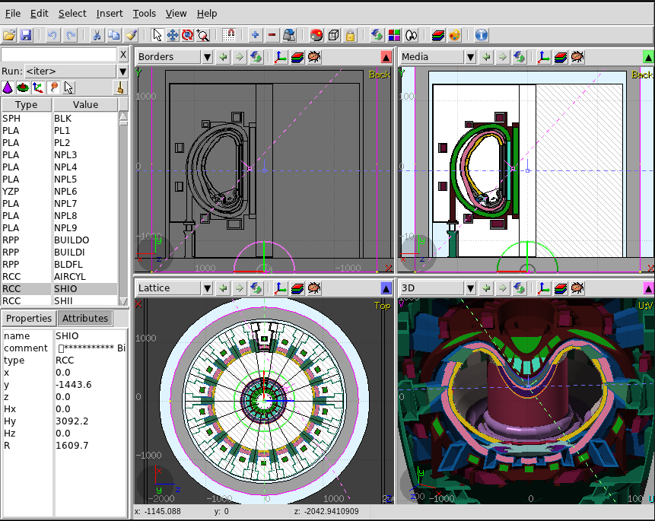
Geometry Editor: Interface
Tools
Filter
Borders
Red
Media
Green
Filtered
Objects
Lattice
Blue
3D
Magenta
Properties
& Attributes
Automatically refreshes every time the input is changed

Slide 31
Viewport axes System
v
Each viewport is defined by:
Origin center of viewport
Basis relative axes system u, v, w.
w is coming out of the screen towards the user
Extends zooming
Note:
Each viewport is facing towards
negative –w
If bodies A, B are touching the viewport like on the plot.
Only body B will be visible
w
u
A
w
B

Slide 32
Navigation - Keyboard
[arrows] pan viewport
Ctrl + [arrows] orbit viewport around u,v axes
+ [Shift] rotates by 90º
Page Up/ Page Down pan viewport front/back
Ctrl + PgUp/PgDn rotate viewport around w axis
= / - zoom in / zoom out
o open projection dialog to set the
origin/basis/save/recall etc…
0 (zero) Center to origin
1, 2 front [X:Y] / back [-X:Y]
3, 4 left [Z:Y] / right [-Z:Y]
5, 6 top [Z:X] / bottom [-Z:X]
  Assuming: Z = direction of the beam (horizontal)
  X = horizontal
  Y = vertical

Slide 33
Navigation – Mouse ^{[1/2]}
With the left mouse button:
Select the appropriate action pan/orbit/zoom with:
  Menu → Tools
  Toolbar
  Keyboard shortcut
Click and drag the desired viewport
 | function | key | description
 | Pan | x | Pan viewport
 | Orbit | t | Orbit viewport using a virtual trackball
 | Zoom | z | Drag area to zoom In ([Ctrl] to zoom out)
 |  | Shift-Z | Zoom viewport on selected items
 |  | Alt-Left | Go to previous in history projection
 |  | Alt-Right | Go to next in history projection

Slide 34
Navigation – Mouse ^{[2/2]}
With the middle mouse button
  alone Pan/Move viewport
  Ctrl orbit projection using a virtual trackball
  Ctrl-Middle-Shift orbit projection using a virtual trackball with steps of 15 degrees
  Shift select rectangle region and zoom into
  Shift-Middle-Ctrl select rectangle region and zoom out
Wheel (if any) zoom in/zoom out
  Ctrl-Wheel pan/move forward or backward
  Ctrl-Shift-Wheel smoother pan/move forward/backward
When laptop mode is enabled in the Preferences/Geometry then the middle and right buttons are swapped

Slide 35
Navigation – Viewport lines ^{[1/2]}
Description:
Dashed lines represent other viewports (the intersection of other viewports with the current one);
The center is represented with a square;
Viewing direction w is indicated by a short line;
When another viewport is outside the view window, the viewport-line will be displayed on the closest edge;
Actions: Select + left mouse button
Drag the center square to reposition the viewport
Drag the line close to the center to reposition the viewport along the vertical w axis
Drag the extremities to rotate it
3D Viewing
direction

Slide 36
Navigation – Viewport lines ^{[2/2]}
Centering Viewports
When snapping to grid is activated
The center of the viewport will be aligned to the grid (step of 1/10 of the main grid)
[Shift] key while toggle the snapping action;
Alternative, it can be centered on the vertices of the selected bodies;
By dragging a viewport center it always moves the center on the current viewing plane.
Press [Ctrl] if you want to have a relative move
36

Slide 37
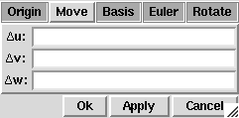
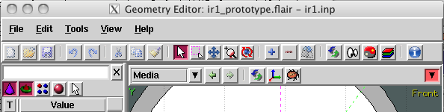
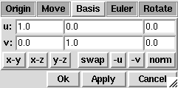
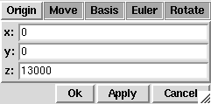
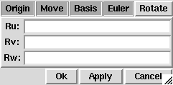
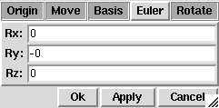
Navigation – Projection dialog
With the projection [o] button you can change, move, shift, rotate, save and reload the projection of a viewport
Shift the coordinate system
Change the reference axis
Set the origin of the viewport
Rotate around the (u,v,w) axis
Rotate around the Cartesian axis
37

Slide 38
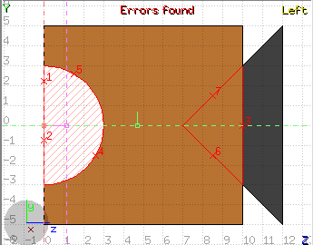
Debugging Geometry Errors ^{[1/2]}
Undefined
region
Overlapping
regions
Errors found notifies that are errors in the geometry (on the current projection):
The areas affected by the errors are outlined with a Red stroke:
  Areas filled with a full color correspond to overlapping regions;
  Areas filled with red lines correspond to a missing region definition;
  Body segments that are involved in the errors are numbered;
Clicking the icon [Ctrl-g] displays the dialog with the errors.
Touching surfaces are checked against 10 significant digits
Non-strictly geometrical errors (i.e. missing Material Assignment to a region, non recognized cards) are also notified;

Slide 39
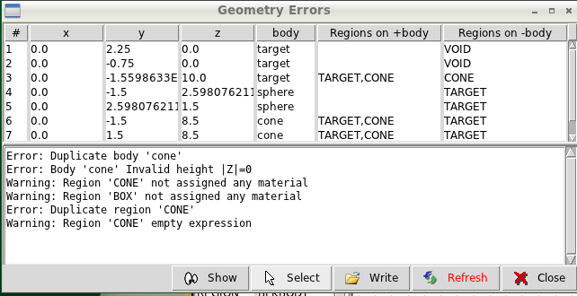
Debugging Geometry Errors ^{[2/2]}
Geometry Errors
Input File Errors or Warnings
x, y, z Coordinates of the error (on the surface of body)
body Body with the x,y,z point on surface generating the error
+body Regions found on the + side of the body.
Regions where the body should be subtracted to remove the error
-body Regions found on the – side of the body.
Regions that the body should be intersected to remove the error
+/- are defined according to the normal on the surface,+ refers to outside, - to inside

