Slide 1
FLUKA
Combinatorial Geometry
FLUKA Beginner’s Course

Slide 2
Introduction
Principle of Combinatorial Geometry
Basic objects called bodies (such as cylinders, spheres,
parallelepipeds, etc.) are combined to form more complex
objects called regions.
This combination is done using Boolean operations:
union, intersection, and subtraction.
1 complex
object
3 basic
objects

Slide 3
Introduction
Initially, FLUKA Combinatorial Geometry was similar to the package developed at ORNL for the neutron and gamma-ray transport program Morse (M.B. Emmett ORNL-4972 1975).
It was based on the original combinatorial geometry by MAGI (Mathematical Applications Group, Inc., W. Guber et al, MAGI-6701 1967).
The present FLUKA CG package has been highly improved:
addition of “infinite bodies”
possibility of using body and region names instead of numbers and getting rid of alignment rules,
availability of parentheses
expansion and roto-translation of bodies
comments
repetition of patterns (lattices)
voxels

Slide 4
Geometry input format
The input file format for the geometry is different from
the one adopted anywhere else in FLUKA
(i.e. the number and length of the input fields is different)
Different formats can be used (due to backward compatibility)
Fixed format
Alignment is mandatory
Bodies and regions are identified by numbers
(rather than names), this makes geometry editing
more difficult
Name based format
It is the recommended format
It is NOT the default!

Slide 5
Name based format
It has many advantages, the main are:
input parameter alignment is not necessary
bodies and regions are identified by names
possible to edit the input sequence without affecting the region description (e.g. inserting a new body)
parentheses can be used to perform complex Boolean operations in the description of regions.
Name based format input is used for both body and region
It is activated
either by a GLOBAL command at the beginning of the input file
or putting SDUM = COMBNAME in the GEOBEGIN card

Slide 6
Basic Concepts
Four concepts are fundamental in the FLUKA CG:
Bodies: basic convex objects, plus infinite planes, infinite cylinders, and generic quadric surfaces
Zones: sub-regions defined only via bodies intersection and subtraction
Regions: defined as Boolean operations on bodies (union of zones)
Lattices: duplication of existing objects (translated & rotated), will be explained in a separate lecture
In the original CG (Morse) bodies were convex solid bodies
(i.e. finite portions of space completely delimited by surfaces
of first or second degree, i.e. planes or quadrics)
FLUKA has been extended to include: infinite cylinders (circular and elliptical), planes (half-spaces), and generic quadrics (surfaces described by 2nd degree equations)
Use of “infinite bodies” is encouraged: input are less error-prone and tracking is faster and more accurate.

Slide 7
Basic Concepts: The Black Hole
All particles entering a black-hole are absorbed (they vanish)
FLUKA geometry MUST be embedded into a BLCKHOLE region
(to avoid tracking particles to infinity)
The outer surface of the BLCKHOLE region must be a single closed body (e.g. a sphere).
Further black-hole regions can be defined by the user if desired

Slide 8
Combinatorial Geometry Input
CG input must respect the following structure:
GEOBEGIN card VOXELS card (optional, see advanced geometry lecture) Geometry title (and reading format options) Body data END card Region data
END card
LATTICE cards (optional, see advanced geometry lecture) Region volumes (optionally requested by a flag in the Geometry title, used together with the SCORE command) GEOEND card
Reminder for txt format input files:
an asterisk (*) in the 1st column comments the line

Slide 9
GEOBEGIN card
WHAT(1) not used
WHAT(2) set accuracy parameter – use with extreme care !
WHAT(3) logical unit for the geometry input. Geometry input can be read from file; should be >20.0
WHAT(4) logical unit for the geometry output
Log feature; should be >20.0 ; Default is standard output
WHAT(5) Parenthesis optimization level (see FLUKA manual)
WHAT(6) not used
SDUM COMBNAME or COMBINAT
COMBNAME selects name based format, COMBINAT fixed format
Default: COMBINAT (!)
Is overwritten by WHAT(5) of a possible GLOBAL card
Notes:
9

Slide 10
Geometry TITLE card
This card has no keyword, it is the line that follows the GEOBEGIN card (unless voxels are used) and its format is (2I5, 10X, A60)
The card gets three inputs: IVLFLG, IDBG, TITLE
IVLFLG (Input VoLumes FLAG) triggers the normalization of the quantities scored in regions by the option SCORE
IVLFLG= 0 → no normalization applied
IVLFLG= 3 → results divided by region volumes given before GEOEND. Volume value for each region must be provided, format: (7E10.5).
IDBG select different kinds of geometry fixed format input:
IDBG = 0 : default fixed format
IDBG = -10 or -100 : high accuracy fixed format
Notes:
10

Slide 11
Bodies

Slide 12
Bodies
Each body divides the space into two domains: inside and outside.
3-character code of available bodies:
RPP: Rectangular ParallelePiped
SPH: SPHere
XYP, XZP, YZP: Infinite half space delimited by a coordinate plane
PLA: Generic infinite half-space, delimited by a PLAne
XCC, YCC, ZCC: Infinite Circular Cylinder, parallel to coordinate axis
XEC, YEC, ZEC: Infinite Elliptical Cylinder, parallel to coordinate axis
RCC: Right Circular Cylinder
REC: Right Elliptical Cylinder
TRC: Truncated Right angle Cone
ELL: ELLipsoid of revolution
QUA: QUAdric
Other (deprecated) bodies: ARB, RAW, WED, BOX
Do not use them, because they can cause rounding problems

Slide 13
Bodies
The input for each body consists of:
the 3-letter code indicating the body type (RPP, ZCC...)
a unique "body name" (alphanumeric identifier, 8 character maximum, case sensitive)
a set of geometrical quantities defining the body
(the number depends on the body type, see next slides)
Different items can extend over as many lines as needed
(Maximum 132 characters per line accepted)
Different items have to be separated by one or more blanks,
or by one of the separators , / ; :
All values are in cm!

Slide 14
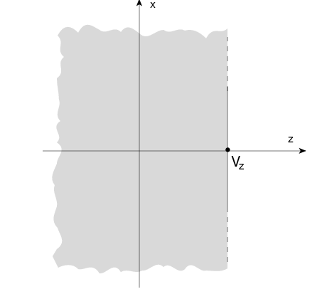
Infinite half-space parallel to coordinate axis
There are 4 kinds of infinite half-spaces
Three are delimited by planes perpendicular to the coordinate axes:
Delimited by a plane ⊥ to the x-axis. Code: YZP
Delimited by a plane ⊥ to the y-axis. Code: XZP
Delimited by a plane ⊥ to the z-axis. Code: XYP
All defined by a single number:
Vx (resp. Vy, or Vz),
coordinate of the plane on the
corresponding perpendicular axis
Points for which:
x < Vx (resp. y < Vy, or z < Vz)
are “inside the body”
inside
outside

Slide 15
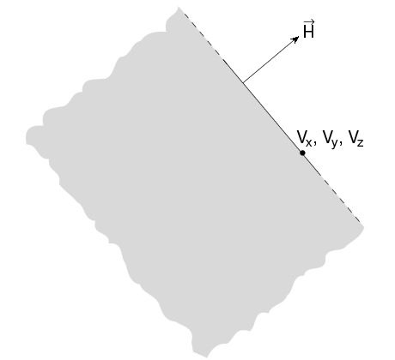
Arbitrarily orientated infinite half-space: PLA
A PLA defines the infinite half space delimited by a generic plane
A PLA is defined by 6 numbers:
Hx, Hy, Hz (vector ⊥ to the plane, arbitrary length);
Vx, Vy, Vz (any point lying on the plane)
The half-space “inside the body” is that from which the vector is pointing (i.e. the vector points "outside").
outside
inside

Slide 16
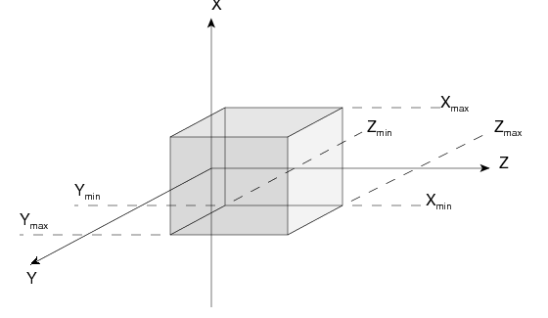
Rectangular Parallelepiped: RPP
An RPP has its edges parallel to the coordinate axes
It is defined by 6 numbers in the following order:
X_{min} , X_{max} , Y_{min} , Y_{max} , Z_{min} , Z_{max}
(min and max coordinates delimiting the parallelepiped)
Notes:
16

Slide 17
Rectangular Parallelepiped: RPP
An RPP definition extends over one single card in default fixed format, or over two cards in high-accuracy body fixed format
Example in fixed format (the comment lines shown are allowed input lines):
*...+....1....+....2....+....3....+....4....+....5....+....6....+....7....+.
RPP 4 -20.0 +20.0 -50.0 +50.0 -38.5 +38.5
* (a parallelepiped centered on the origin)
High-accuracy fixed format
*...+....1....+....2....+....3....+....4....+....5....+....6....+....7....+.
RPP 4 -20.0 +20.0 -50.0 +50.0 -38.5 +38.5
Notes:
17

Slide 18
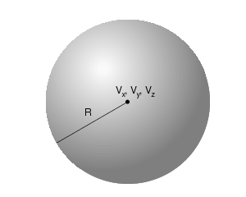
Sphere
Sphere: SPH
A SPH is defined by 4 numbers:
Vx, Vy, Vz (coordinates of the centre), R (radius)

Slide 19
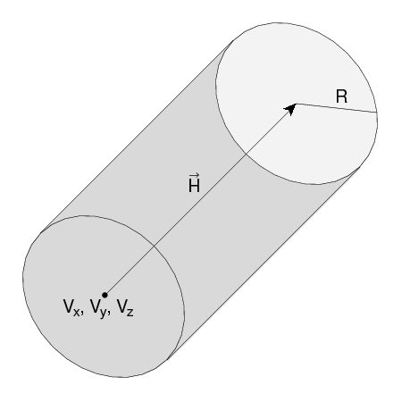
Circular cylinder
Right circular cylinder: RCC
An RCC can have any orientation in space
Limited by a cylindrical surface and two plane faces ⊥ to its axis.
Each RCC is defined by 7 numbers:
Vx, Vy, Vz (centre of one face);
Hx, Hy, Hz (vector corresponding to the cylinder height, pointing toward the other face);
R (cylinder radius).

Slide 20
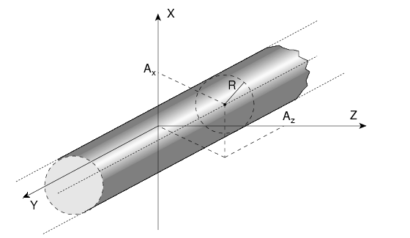
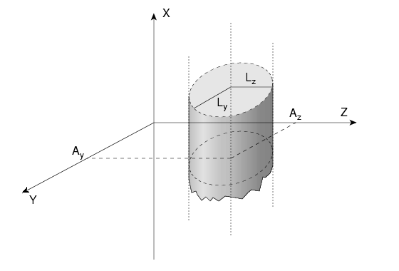
Infinite cylinders
Infinite Circular Cylinder parallel to coordinate axis: XCC, YCC, ZCC
Each XCC ( YCC, ZCC) is defined by 3 numbers:
Ay, Az for XCC
(Az, Ax for YCC, Ax, Ay for ZCC) (coordinates of the cylinder axis),
R (cylinder radius)
Infinite Elliptical Cylinder parallel to coordinate axis: XEC, YEC, ZEC
Each XEC ( YEC, ZEC) is defined by 4 numbers: Ay, Az for XEC
(Az, Ax for YEC, Ax, Ay for ZEC) (coordinates of the cylinder axis); Ly, Lz for XEC
(Lz, Lx for YEC, Lx, Ly for ZEC) (semi-axes of the ellipse)

Slide 21
Arbitrary generic quadric: QUA
A QUA allows to insert a quadric surface
This is defined by a 2nd degree equation F(x,y,z) = 0
Each QUA is defined by 10 numbers:
A_{xx}, A_{yy}, A_{zz}, A_{xy}, A_{xz}, A_{yz}, A_{x}, A_{y}, A_{z}, A₀
corresponding to the equation:
A_{xx} x² + A_{yy} y² + A_{zz} z² + A_{xy} xy + A_{xz} xz + A_{yz} yz +
+ A_{x} x + A_{y} y + A_{z} x + A₀ = 0
A QUA definition extends over two cards in default fixed format,
and over 4 cards in high-accuracy body fixed format.

Slide 22
Regions

Slide 23
Concept
Regions are defined as combinations of bodies obtained by boolean operations:
Regions are not necessarily simply connected (they can be the union of two or more non contiguous or partially overlapping zones) but must be of homogeneous material composition
Each point of space must belong to one and only one region!
 | Union | Subtraction | Intersection
Name based format | | | – | +
Fixed format | OR | – | +
Mathematically | ∪ | – | ∩

Slide 24
Regions
Input for each region starts on a new line and extends on as
many continuation lines as are needed. It is of the form:
REGNAME NAZ boolean-zone-expression
or
REGNAME NAZ boolean-zone-expression | boolean-zone-
expression | …
REGNAME is the region “name”
alphanumeric identifier, 8 character maximum, case sensitive
Must start by an alphabetical character
NAZ See next slide
“boolean-zone-expression” See next slides

Slide 25
Regions
NAZ (Number of Adjacent Zones) is a rough estimate of the number of zones a particle can enter when leaving the current region zones (5 by default). What actually matters is the NAZ sum over all regions, defining the size of the contiguity list
While tracking, the program searches in the contiguity list for the neighbor zones of each zone. If the zone is not yet in the list, the whole geometry is scanned and it is added to the list with its neighbor zones
When the NAZ limit is reached (i.e. the list is full) the code prints a warning: GEOMETRY SEARCH ARRAY FULL. This is not lethal: the calculation continues but with a reduced efficiency
If you have more than 1000 regions, you must issue a GLOBAL card putting in WHAT(1) a higher limit (not beyond 10000)

Slide 26
Regions Boolean expression
zones are defined by intersections and/or subtraction of bodies, each body being preceded by its + or – sign
| (OR) operators are used to join zones
In evaluating the expressions, the highest operator precedence is given to parentheses, followed by +, - and the | operator
Parentheses are available in name based format (use with care!)
If one line is not sufficient, any number of continuation lines can be added
Blanks are ignored
Notes:
1. Not true, | can be in the middle. + in the first body is not required!

Slide 27
Meaning of + and - operators
If a body number (or name) appears in a zone description preceded by a + operator, it means that the zone being described is wholly
contained inside the body.
If a body number appears in a zone description preceded by
a – operator, it means that the zone being described is wholly
outside the body.
Zones must be finite: normally in the description of each zone and
hence of each region the symbol + must appear at least once.

Slide 28
Meaning of the + and – operators
Target 5 +Outer +CutPlane
* (the above region is the part of space common to bodies Outer and * CutPlane)
Regex 5 +Red -Blue -Green +Yellow
* (the above region is the part of space common to body Red and Yellow,
* excluding however what is inside body Blue and what is inside Green)
Air 5 +Room
* (the latter region coincides entirely with body Room)

Slide 29
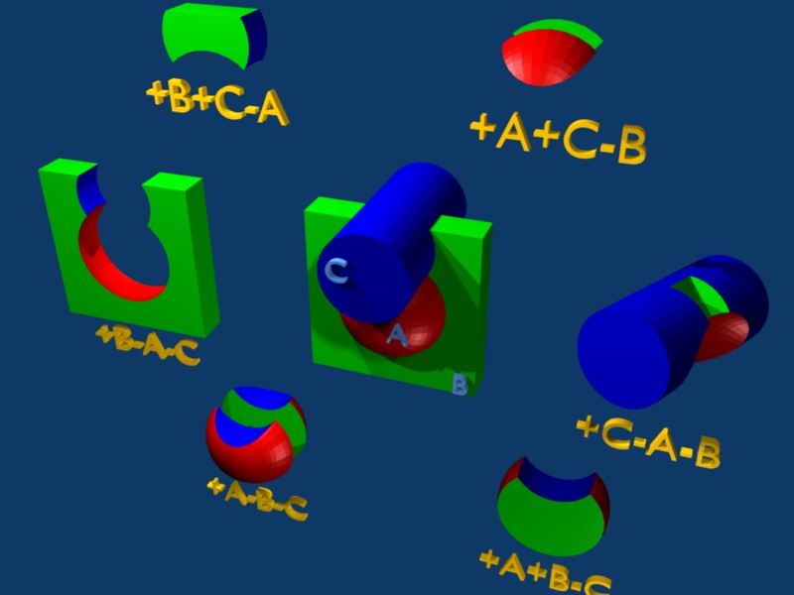
Meaning of + and - operators

Slide 30
Meaning of the | (OR) operator
The | (or OR) operator is used as a Boolean union operator in order to combine zones (sub regions partially overlapping or not).
Zones are formed as body intersections or subtractions as previously explained
The regions are formed by the union of these zones.
Examples:
Ground 5 | +Body9 | +Body15 | +Body1 | +Body8 -Body2 | +Body8 -Body3
* <- 1st -><- 2nd -><- 3rd -><---- 4th ----><---- 5th --->
* (continuation line)
| +Body8 +Body18 | +Body12 -Body10 -Body11 -Body13 -Body14
* <----- 6th -----><------- 7th and last zone -------->
Notes:
Not true again for the two or more!!!!!!!!!!

Slide 31
Geometry Example “F” shaped target
Y
Material: Copper
Surrounded by vacuum
Black hole: spherical shell from 1000 to 10000 cm radius
5
4
3
2
X
1 cm thick in x direction
1
Z
0
1
2
3
4
5
6

Slide 32
Geometry example “F”: Bodies
Several possibilities for bodies, e.g.:
2
2
2
1
3
1
3
3
3
1
1
2
(A) Separated bodies
(B) Separated bodies
(C) overlapping
(D) subtraction
The 4 options are equivalent. We will use C.

Slide 33
Geometry example “F”: REGIONS
Y
BLKBODY: outermost region like a shell
2 spheres needed: SPOUT, SPIN
Expression: SPOUT - SPIN
TARGET: the F shaped object
Parallelepipeds: VERTI, TOP, MIDDLE
Expression: VERTI | TOP | MIDDLE
VOID: region around the target
Everything inside SPIN that is not target
Expression: SPIN –VERTI – TOP –MIDDLE
After all regions are created: assign material to each region with ASSIGNMA
5
TOP
4
3
MIDDLE
2
VERTI
X
1
1 cm in x
Z
0
1
2
3
4
5
6

Slide 34
Geometry example “F”: input file
GEOBEGIN COMBNAME 0 0 The copper F SPH SPIN 0.0 0.0 0.0 1000. SPH SPOUT 0.0 0.0 0.0 10000. RPP VERTI 0.0 1. 0.0 5. 0.0 1. RPP TOP 0.0 1. 4. 5. 0.0 3. RPP MIDDLE 0.0 1. 2. 3. 0.0 3. END * Black hole BLKBODY 5 +SPOUT -SPIN * Void around VOID 5 +SPIN -TOP -VERTI -MIDDLE * Target TARGET 5 TOP | VERTI | MIDDLE END GEOEND ASSIGNMA BLCKHOLE BLKBODY ASSIGNMA VACUUM VOID ASSIGNMA COPPER TARGET

Slide 35
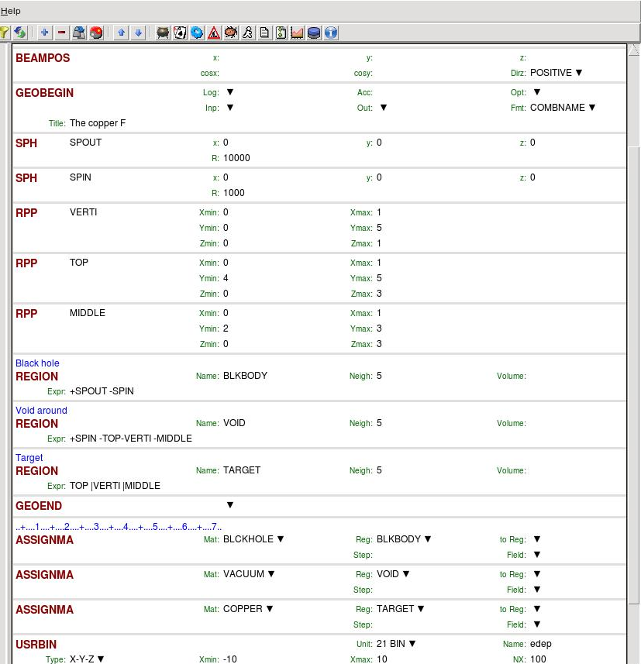
Geometry example “F”: input

Slide 36
Example: Igloo
blkbody
Y
Y [cm]
inner
Z
pla
void
Z [cm]

Slide 37
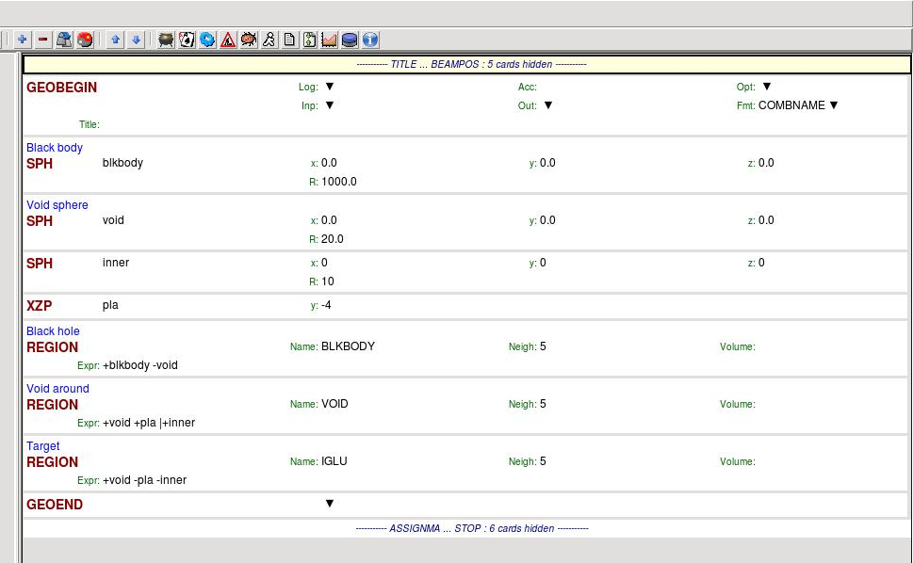
Example: Igloo

Slide 38
Remarks

Slide 39
Important Notes
Whenever it is possible, the following bodies should be preferred:
PLA, RPP, SPH, XCC, XEC, XYP
XZP, YCC, YEC, YZP, ZCC, ZEC, QUA
These bodies make the tracking faster, since for them extra coding ensures that unnecessary boundary intersection calculations are avoided when the length of the next step is smaller than the distance to any boundary of the current region.
Always use as many digits as possible in the definition of the body parameters, particularly for body heights (RCC, REC, TRC), and for direction cosines of bodies with slant surfaces. The name based format or the high-accuracy fixed format should always be used in these cases.

Slide 40
Precision Errors
Modeling assumptions
Avoid touching surfaces!
When floating point operations are involved.
Use cutting surface B instead
Or force partial overlap of bodies
RCC
RCC
A
B
B
PLA
RCC
A
+A+B
+A-B
A
B
A-B
+B

Slide 41
Tracking accuracy
FLUKA uses systematically double precision arithmetic
(i.e. 16 significant digits)
GEOBEGIN’s WHAT(2)*10⁻⁶cm is the absolute accuracy (AA)
requested for tracking and boundary identification
The relative accuracy (RA) achievable in double precision is
of the order of 10⁻¹⁴-10⁻¹⁵.
AA should be larger than RA*L , being L the largest coordinate value
in the considered problem, i.e. the whole geometry size
(The outer blackhole shell containing the system does not count)
For very large and very small geometries, you may, respectively,
need to increase or decrease the WHAT(2) default value of 0.0001.

Slide 42
Geometry Errors and Debugging

Slide 43
Geometry Errors
During execution the code always needs to know the region where a particle is located at every step
The program will stop only if a particle position does not belong to any region An error message will be printed in the .err file with the particle position
IMPORTANT! It will not stop if a particle position belongs to more than one region. It will accept the first region it finds but the results will completely unreliable!!

Slide 44
Geometry Errors
Further types of errors
Problem space not enclosed by a black body region
Never start a primary particle along a surface. You could get a geometry error even if the geometry is correct because FLUKA cannot determine the region
Precision errors
Lattice replica ←→ basic cell mismatch
(see advanced geometry lecture)
Debugging Tools
GEOEND card with the DEBUG option
(handled through a dedicated Flair frame)
Error messages during simulation in the .err file
Geometry plotting by Flair
(automatically invoking the PLOTGEOM card)
FLAIR Geometry Editor (very powerful! See dedicated lecture)
Simplegeo

Slide 45
Debugging
GEOEND card activates the geometry debugger. Detects both undefined or multiple defined points in a selected X,Y,Z mesh
Two cards are needed First card WHAT(1)=X_{max} WHAT(2)=Y_{max} WHAT(3)=Z_{max} WHAT(4)=X_{min} WHAT(5)=Y_{min} WHAT(6)=Z_{min} SDUM = DEBUG
Second Card WHAT(1)=Nx WHAT(2)=Ny WHAT(3)=Nz SDUM = &
WARNING! The program stops if too many errors are found A message will be issued on the output unit
GEOEND Xmax Ymax Zmax Xmin Ymin Zmin DEBUG
GEOEND Nx Ny Nz &

Slide 46
Debugging
If no error is found, no .err file will be created.
REMINDER: If the debugger does not find any error it does not mean that the geometry is error free!
One has to experiment, changing the GEOEND settings especially for the critical/complicated regions.
Errors will be listed in the .err file in the form: **** Lookdb: Geometry error found **** **** The point: -637.623762 -244.554455 -96.039604 ****
Point is contained in more than one region **** is contained in more than 1 region **** **** (regions: 6 7) ****
Not contained in any region **** is not contained in any region

Slide 47
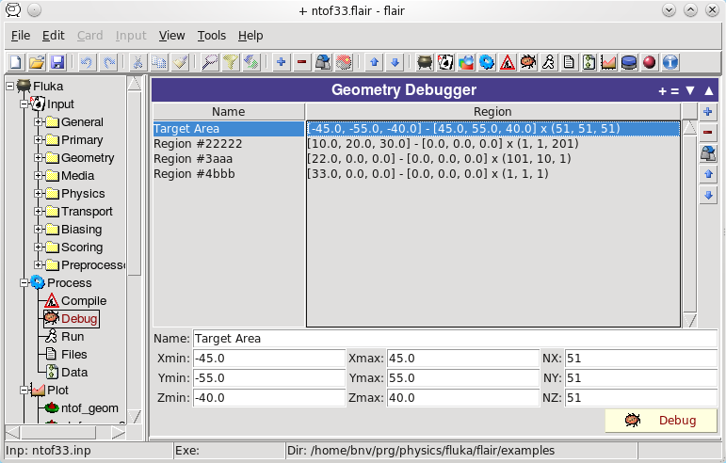
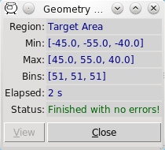
Debugging
It can be easily run through Flair

Slide 48
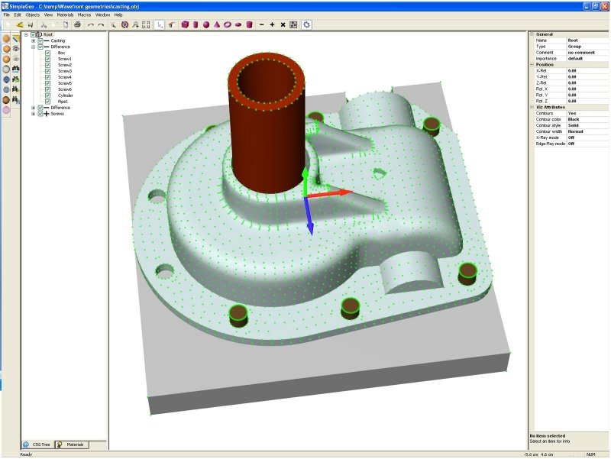
Auxiliary program: SimpleGeo

Slide 49
Auxiliary program: SimpleGeo
SimpleGeo is an interactive solid modeler which allows for flexible and easy creation of the models via drag & drop, as well as on-the-fly inspection
Imports existing geometries for viewing
Creating new geometries from scratch
Export to various formats (FLUKA, MCNP, MCNPX)
Download, Tutorials, etc.: http://theis.web.cern.ch/theis/simplegeo
Operating system: Windows only

