Slide 1
Standard output and plotting
FLUKA Beginner’s Course

Slide 2
The FLUKA Standard Output
FLUKA provides a standard output file that contains plenty of useful information:
(fortran unit 11, inp###.out from rfluka)
It must be checked at least once when setting up a simulation and always in case of doubts/crashes
(together with inp###.err and inp###.log files)
Let’s have a look at ex_3001.out (editor or flair output viewer:
Process – Files – select ex_3001.out , or
fless ex_3001.out)

Slide 3
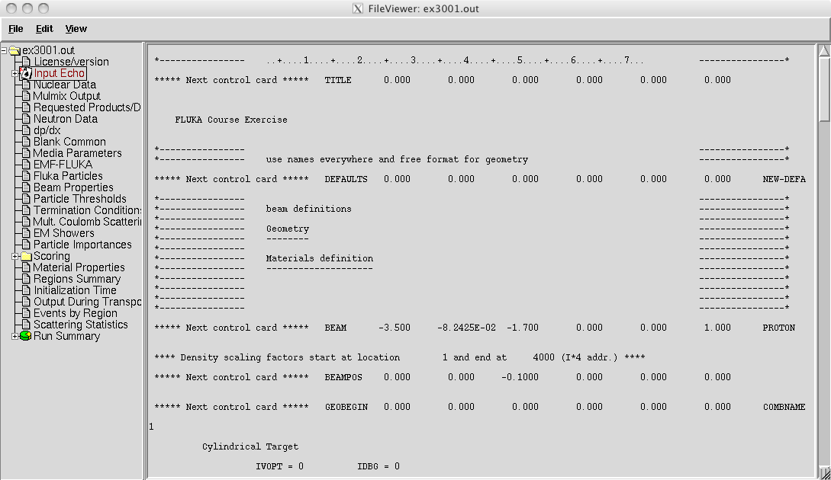
Input echo
The data cards are parsed in groups, and do not appear in same order as they are inserted in the input file…
TITLE is the first to appear, then all comment cards are listed together, followed by the beam related cards, etc...
3

Slide 4
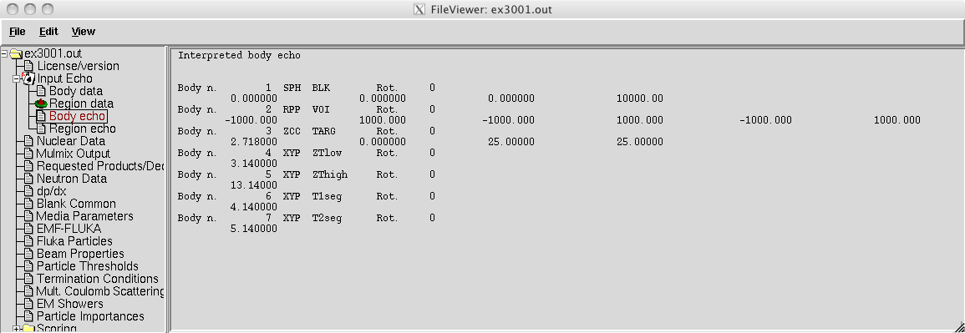
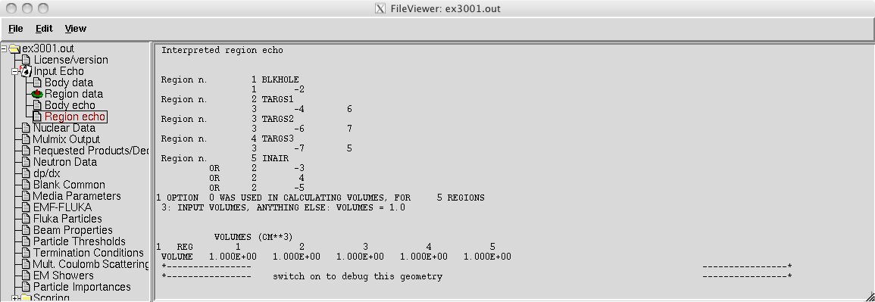
Input echo – Geometry output
Followed by the geometry output, if not redirected (see GEOBEGIN card).
Echo of the commands is presented together with interpretation and correspondence between numbers and names

Slide 5
Nuclear data [1/3]
information about the basic nuclear data file used
Some memory allocation details
5

Slide 6
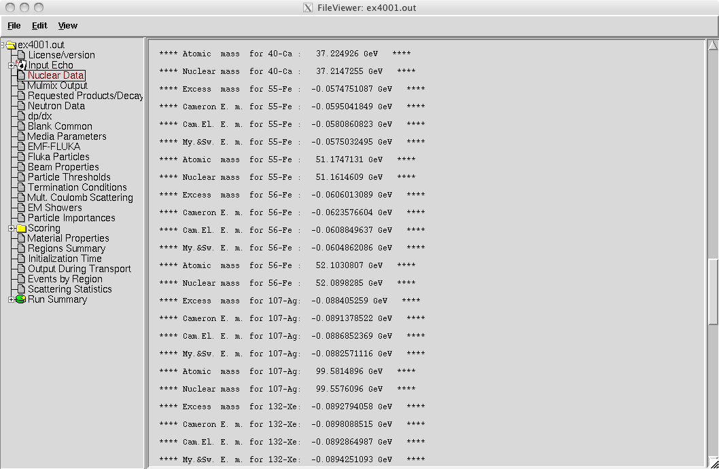
Nuclear data [2/3]
Nuclear data used in the program
6

Slide 7
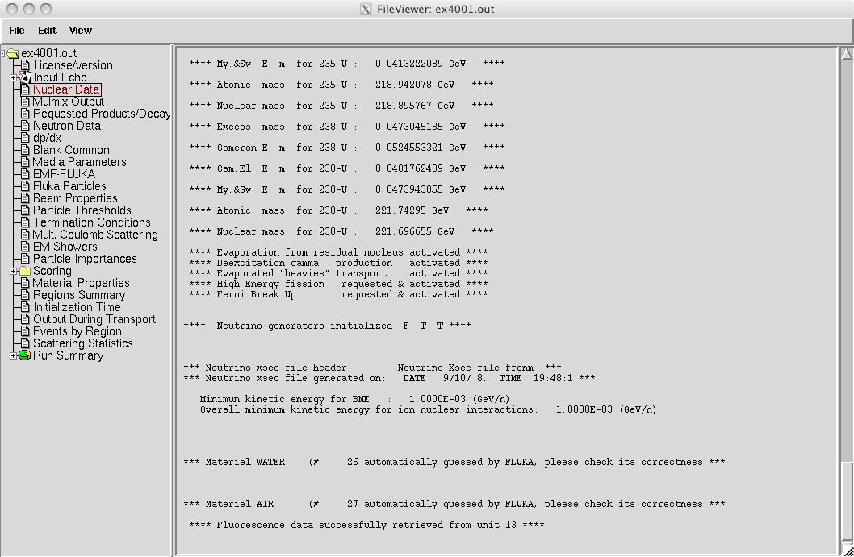
Nuclear data [3/3]
active options for the nuclear model
7

Slide 8
Material properties
Material properties,
multiple scattering
parameters
This warning is normal!
8

Slide 9
Radiation Decay
info on the decay radiation options
Radiation biasing

Slide 10
Neutron data
Low-energy neutron info, material
correspondence.. More info on
low energy neutron cross section
if the LOW-NEUT card is specified
10

Slide 11
Material Parameters – dp/dx
Material-dependent
parameters for
ionization energy losses
Check δ-ray and bremss. threshold (DELTARAY,PAIRBREM)
11

Slide 12
Material parameters – Transport thresholds
production threshold for e± in MeV (total energy, not only kinetic)
upper limit for e± in MeV
zoom
same for photons
12

Slide 13
Material parameters – EMF-FLUKA
transport threshold for e± (Ecut) and photons (Pcut) in MeV (total energy, not only kinetic)
13

Slide 14
FLUKA Particles
exhaustive list of FLUKA particles
...and many more
...continues on your screen!
14

Slide 15
Input interpreted summary – Beam
Check where the beam is starting
15

Slide 16
Input interpreted summary – Thresholds
16

Slide 17
Input interpreted summary – TC, MCS, EM
17

Slide 18
Scoring
Complete description of each requested estimator
18

Slide 19
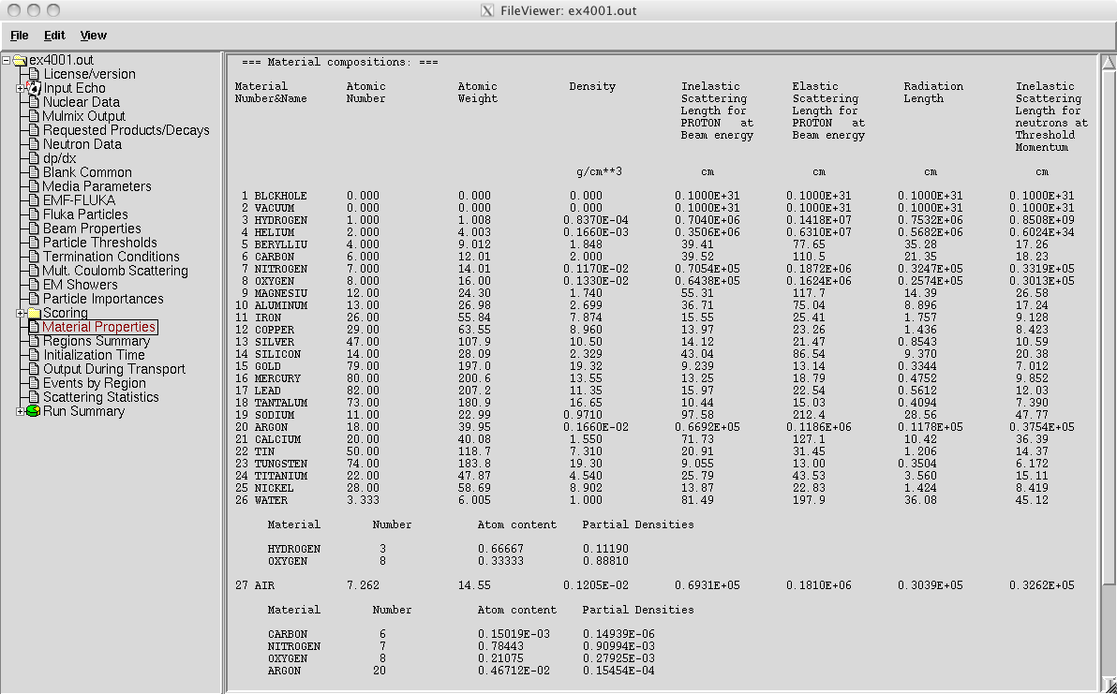
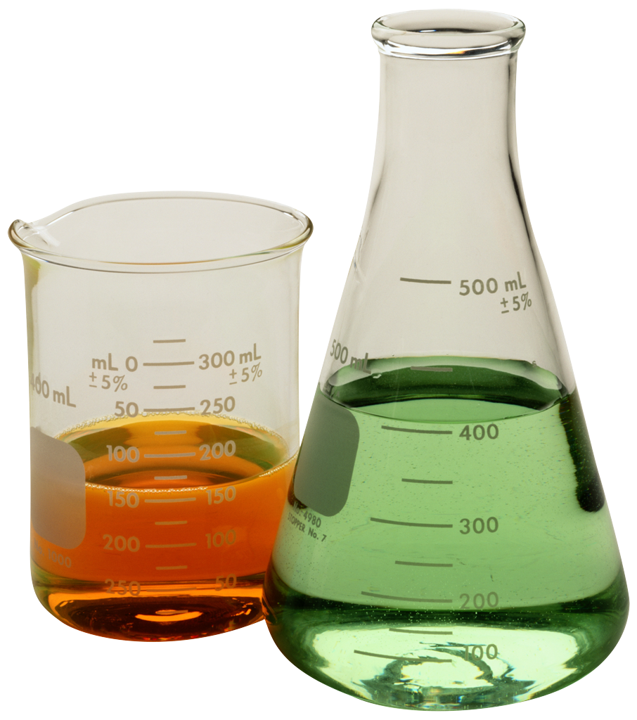
Materials – Scattering lengths
Data related to the beam particle type specified in the BEAM card
Compound interpreted composition
19

Slide 20
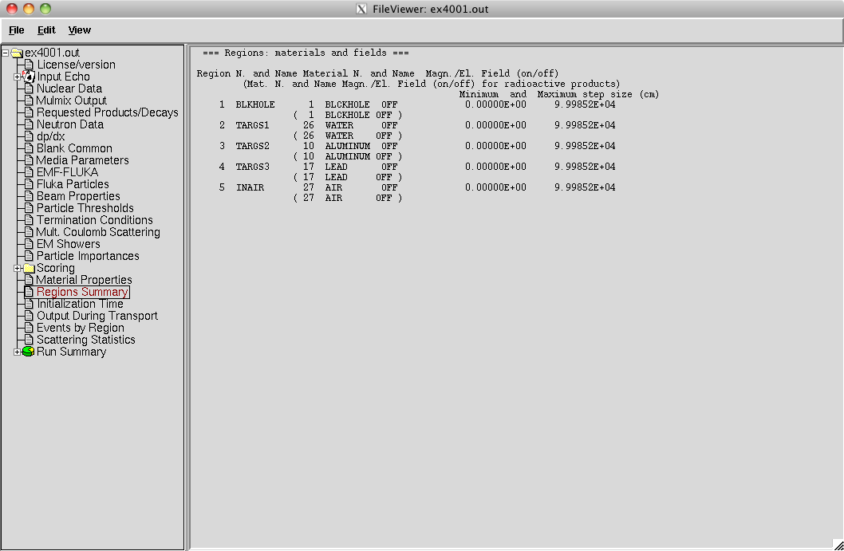
Regions summary
Useful way to check
material assignment
Minimum/Maximum step sizes (set with STEPSIZE option otherwise default vaues are set)

Slide 21
Initialization time / Run informations
event number, time, random seed, average time used per primary available during the run

Slide 22
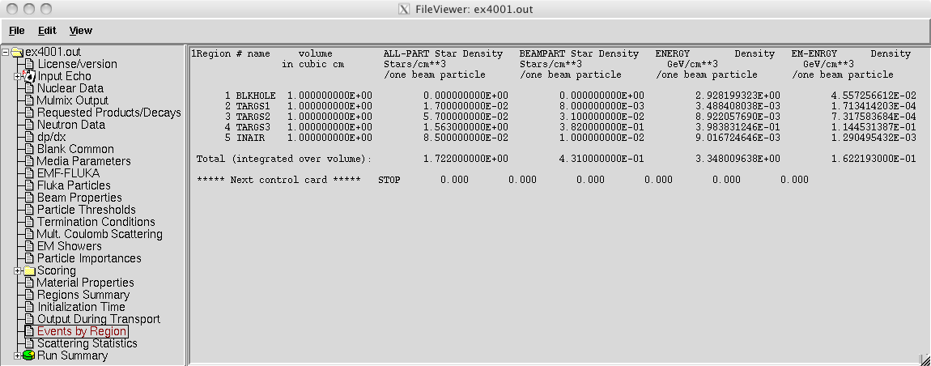
Results – Scoring
Results of SCORE options for all region:
very useful for debugging and for cross-check with estimators
# inelastic interactions of primary particles
The volume is not automatically evaluated,
you have to specify it in the geom. description
22

Slide 23
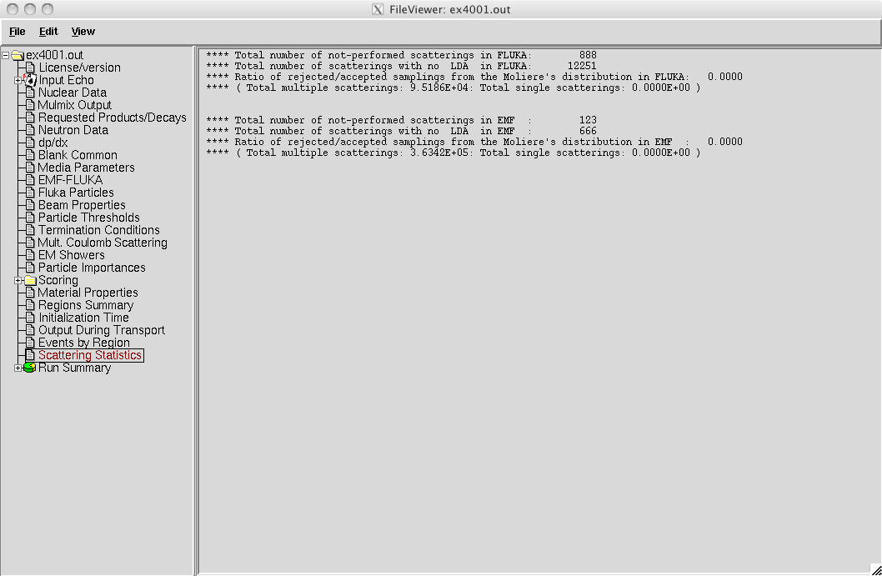
Results – Statistics of Coulomb scattering
23

Slide 24
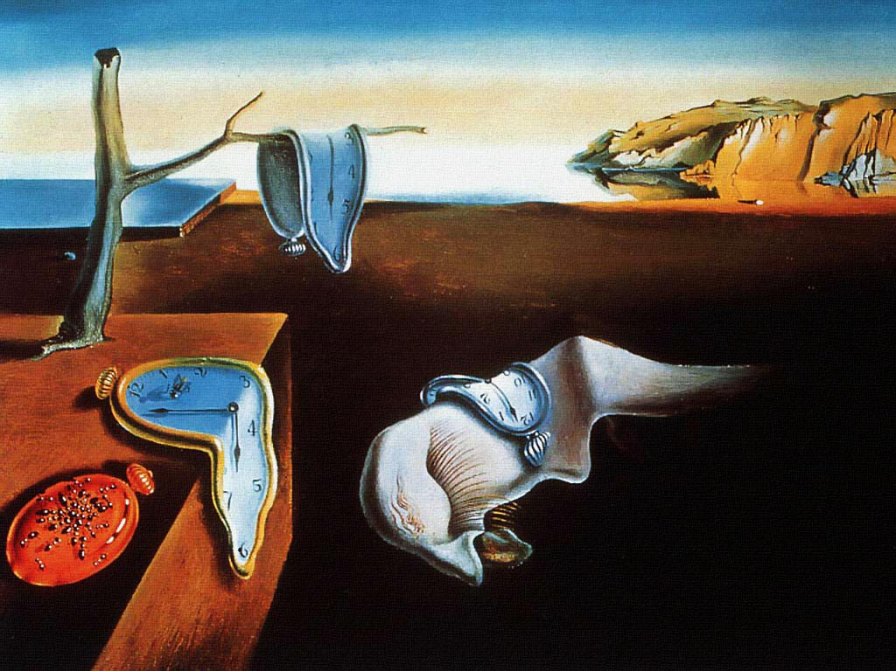
Results – Statistics of the run
CPU time is not real time!

Slide 25
Run summary: detailed statistics
Detailed statistics per each particle

Slide 26
Energy Balance
Particles below threshold:
Hadrons and muons below threshold are ranged out unless the threshold >100 MeV;
e±/γ (EM- showers are not included).
Escaping the system: going to blackholes.
Discarded particle (i.e. neutrinos).
Missing Energy: Calculated by difference:
pure EM problems it should be 0;
in hadronic problems it is the energy spent in endothermic nuclear reactions (≈ 8 MeV/n), or gained in exothermic (i.e. mostly neutron capture): it is –total Q.

Slide 27
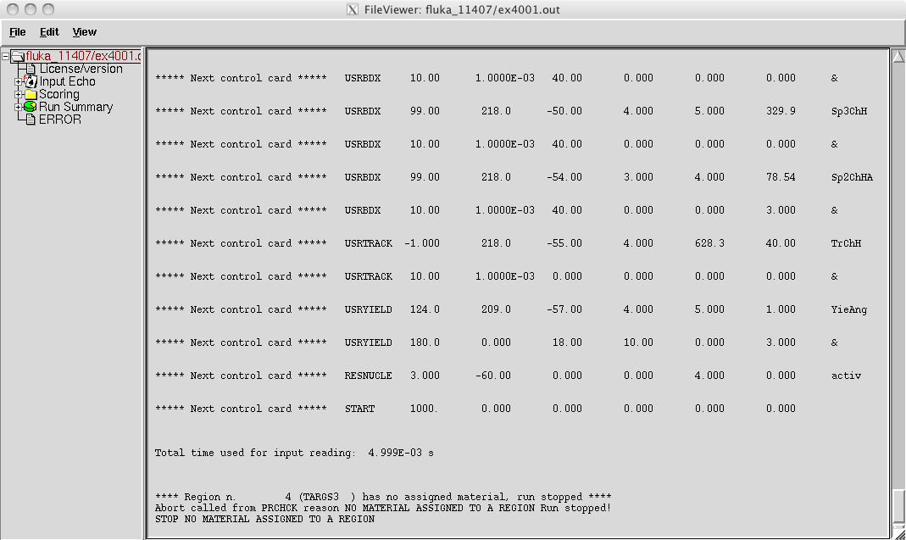
Error message

Slide 28
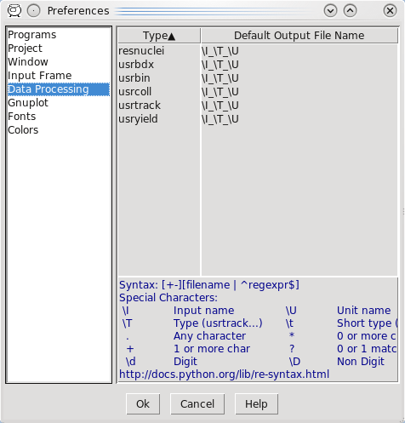
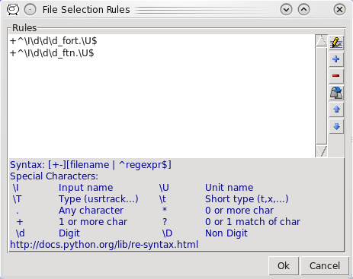
Flair: Data Processing
Flair initially scans the input for possible unformatted output data for each scoring card. It creates automatic rules for processing (merging).
If in the mean time you have modified the input click the “automatic” scan
The default names are generated by the rules specified in the preference dialog
The automatic rules can be modified by manually adding or removing files or by advanced pattern matching with the filter dialog

Slide 29
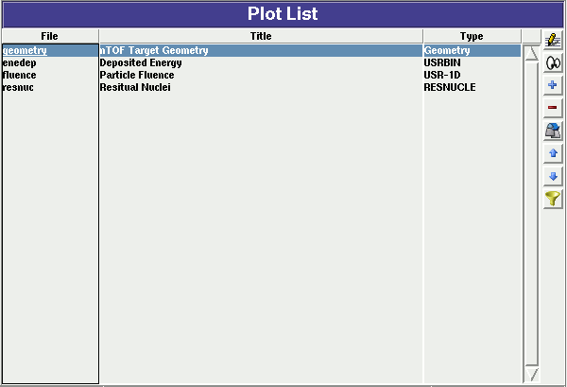
Plot List
Plots can be created in the “Plot” list frame. Either Add new plots or Clone from existing ones.
It is important to set a unique filename for each plot. This filename will be used for every auxiliary file that the plot needs (with different extensions)
The Filter button creates automatically one plot for each processed unit
Double click on a plot, or hit Enter or click the Edit icon to display the plotting dialog
The list box is editable with a “Slow Double Click”
Right-click brings a popup menu with all options
Plot Types
Geometry For geometry plots
USRBIN For plotting the output of USRBIN
USR-1D To plot single differential quantities from cards USRBDX, USRTRACK, USRCOLL, USRYIELD
USR-2D To plot double differential from USRBDX
RESNUCLE To plot 1d or 2d distributions of RESNUCLEi
USERDUMP To plot the output of USERDUMP. Useful for visualizing the source distribution (ToDo)

Slide 30
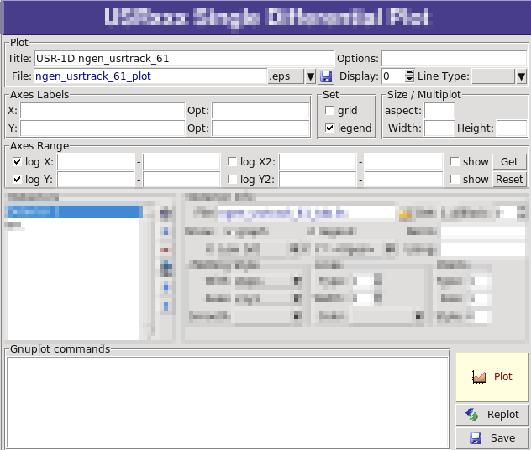
Plotting Frames
All plot types share some common fields: Title + options, Filename, Axis Labels, Legends (Keys) and Gnuplot Commands.
Plot button (Ctrl-Enter) will generate all the necessary files to display the plot, ONLY if they do not exist.
Re-Plot will force the creation of all files regardless their state
Check the gnuplot manual to provide additional customization commands: e.g. To change the title font to Times size=20, add in the Opt: field the command: font ‘Times,20’

Slide 31
General Tips
To set some default parameters for gnuplot, create a file called ~/.gnuplot
The output window displays all the commands sent to gnuplot as well as the errors. In case of a problem always consult the output window!
In the Gnuplot commands you can fully customize the plot by adding manually commands. Please consult the gnuplot manual for available commands
All buttons and fields have tool tips. Move the cursor on top of a field to get a short description

Slide 32
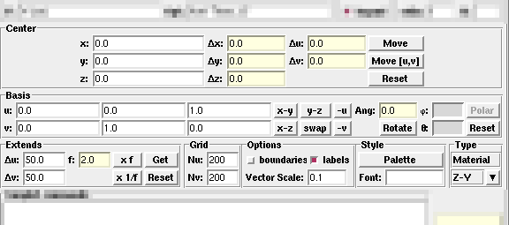
Geometry Plotting
For geometry plotting the following information is needed (Fields with white background):
Center (x,y,z) point defining the center of your plot
Basis (U,V): Two perpendicular axis vectors defining the new system
Extends (DU, DV) of the plot. The total width/height will be twice the extends
Scanning grid (NU, NV): how many points to scan
Plotting type (Only borders, Regions, Materials, …)

Slide 33
Geometry Plotting
All input fields with light-yellow background are used to perform operations on the previous fields. e.g. to rotate the basis-vectors
When the “Plot” button is pressed, flair will create a temporary input file containing only the geometry and the related information together with the appropriate PLOTGEOM card. It will start a FLUKA run, and on exit it will convert the PLOTGEOM file in a format that gnuplot understands

Slide 34
USRBIN
With the USRBIN plotting frame you can perform:
2D projection or region/lattice plot
1D projection or region/lattice plot
1D maximum trace
1D trace scan
of the data or errors from USRBIN data.
Set the usrbin summary file in the File: field
Select from Det: the detector to use.
All the available detector information will be displayed
The information Mininum, Maximum and Integral will be filled after the plot! WARNING: it is always the projection min/max

Slide 35
USRBIN (2D plot)
Select the “2D Projection” type
Select the projection axis, limits, and rebinning
swap: will exchange the plotting X and Y axis
errors: will plot the (uncorrelated) error values as color plot
Get: will get the projection limits from the gnuplot window
Norm: is the normalization value or expression. You can even define a function to use as normalization using as argument x: e.g. 5*x**2+4*x
log: select linear or log in the color bar axis

Slide 36
USRBIN (2D plot) ^{cont.}
The Minimum, Maximum, Colors and CPD (Colors Per Decade) are interconnected.
log10(Max) = log10(Min) + Colors/CPD
Once the value is changed in one field, the Max will be calculated accordingly
Palette: offers a possibility to the user to choose from various predefined palettes. The user can define his own palette using the “set palette” command from the “Gnuplot commands” text box

Slide 37
USRBIN (2D plot) ^{cont..}
Superimposing the geometry can be done
either automatically or manually
Auto: Select –Auto- in the Use: field of the Geometry and the program will try to draw the geometry at the middle of the limits on the projection axis. To change the position modify the Pos: value
Manual: The dropdown listbox will display also a list of all geometry plots in the flair project. Select the one you prefer and the plotting axis. The manual mode can be used in special cases when the usrbin file does not contain the absolute coordinates

Slide 38
USRBIN (1D-plots)
1D Projection
Select the projection axis from “Projection & Limits” as before
WARNING: When making projections the error is typically underestimated.
1D Max
Same as the 1D Projection, but displays only the maximum value on each slice. (eg. on a Z-projection, it will display the maximum on each X-Y slice)
1D Trace H or V
Displays the position of the maximum and also the FWHM on either the horizontal or vertical plane (requires the usbmax.c prg)
Plotting Style: (see USR-1D)

Slide 39
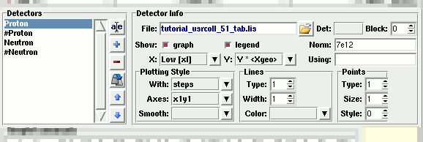
USR-1D Single Differential Plot
USR-1D is able to plot the 1D single differential information from the USRBDX, USRCOLL, USRTRACK and USRYIELD cards (The 2D information is not handled).
The file type in use should have the extension _tab.lis and are generated by the FLUKA data merging tools (See Data Frame)
You can superimpose many scoring output in a single plot.

Slide 40
USR-1D Single Differential Plot
The basic steps to create a plot are:
Add or Clone a _tab.lis file, in the Detectors listbox.
Select the detector to be used from the Det: dropdown listbox
Set a name in the Name: field. Names starting with # will not be displayed as keys in the plot
Select the X: and Y: information to plot as well the Style: X,Y,Style have different values. Note: Different combination will be interpreted in different way from gnuplot, resulting in maybe unwanted results
You have the possibility to select:
Plotting axes
Smoothing of the plot
Color, line type, width, point sizes etc. (Enter the command “test” in the gnuplot command and hit “Plot” you will get a plot of all possible types)
Predefined styles

Slide 41
USR-1D Plots
X: choices: [xl, xh refer to the limits of each individual bin of the histogram]
GeoMean [sqrt(xl*xh)] Geometrical mean. Should be used if X is scored as a log-histogram
Mean [(xl+xh)/2] Normal mean. For linear scoring
Low [xl] Low value of the bin
High [xh] High value of the bin
Y: choices:
Y Y-bin value as given by FLUKA
Y × <X> Y-bin value multiplied by the mean X value of the bin (Isolethargic)
Y × <Xgeo> Y-bin value multiplied by the geometrical X-mean of the bin (Isolethargic)
Y × Xl -//- with the X-low value of the bin
Y × Xh -//- with the X-high value of the bin
Y × DX -//- with the width of the bin

Slide 42
USR-1D Plots
Style: has a huge list of choices as given by gnuplot. You can consult gnuplot manual for the description of the options. Some suggested settings are the following:
To make a line/scatter plot with or without errors X: GeoMean (if scored in log), Mean (if scored in linear) Y: Y × < Xgeo or X>, for isolethargic plotting Style: lines, linespoints, dots, errorbars, yerrorbars, errorlines…
To make a histogram X: Xlow [xl] Y: what ever choice you want to plot Style: steps or X: Xhigh [xh] Style: histeps

Slide 43
USR-1D Plots
You have the possibility to superimpose plots. Useful if you want to show histograms with error bars superimposed.
You can selected angular slices from USRBDX data using the “Block” option
You can superimpose experimental data or any other data file and override all options using the “Using:” input field

