Slide 1

Monte Carlo sampling
FLUKA Beginner’s Course

Slide 2
Overview:
General concepts:
Phase space
The Boltzmann equation
Monte Carlo foundations
Simulation vs. integration
Sampling techniques
discrete
by inversion
by rejection
Results and Errors:
Statistical errors (single histories, batches)
Figure of merit
Notes:
2

Slide 3
Phase space:
Phase space: a concept of classical Statistical Mechanics
Each Phase Space dimension corresponds to a particle degree of freedom
3 dimensions correspond to Position in (real) space: x, y, z
3 dimensions correspond to Momentum: p_{x}, p_{y}, p_{z} (or Energy and direction: E, θ, ϕ)
More dimensions may be envisaged, corresponding to other possible degrees of freedom, such as quantum numbers: spin, etc.
Another degree of freedom is the particle type itself (electron, proton...)
Each particle is represented by a point in phase space
Time can also be considered as a coordinate, or it can be considered as an independent variable: the variation of the other phase space coordinates as a function of time constitutes a particle “history”
Notes:
3

Slide 4
The angular flux Ψ
The angular flux Ψ is the most general radiometric quantity:
particle phase space density × velocity
or also
derivative of fluence Φ(x,y,z) with respect to 3 phase space coordinates: time, energy and direction vector
Ψ is fully differential, but most Monte Carlo estimators integrate it over one or more (or all) phase space dimensions: coordinates, time, energy, angle
Fluence Φ, on the opposite, is the most integral radiometric quantity:
where n = particle density in normal space, v = velocity, t = time

Slide 5
The Boltzmann Equation
All particle transport calculations are (explicit or implicit)
attempts to solve the Boltzmann Equation
It is a balance equation in phase space: at any phase space point,
the increment of angular flux Ψ in an infinitesimal phase space
volume is equal to
sum of all “production terms”
minus
sum of all “destruction terms”
Production:
Sources, Translational motion “in”, “Inscattering'', Particle Production,
Decay “in”
Destruction:
Absorption, Translational motion “out”, “Outscattering'', Decay “out”
(For convenience, we merge into a single term Particle Production and Decay
“in” and in a similar way we put together Absorption and Decay “out”)

Slide 6
The Boltzmann Equation
translation
source
time dependent
absorption
scattering
Σ_{t} = total macroscopic cross section = interaction probability per cm
= 1/λ _{t} = σ_{t}N_{A}ρ/A
λ _{t} = interaction mean free path σ_{t} = interaction probability per atom/cm²
Σ_{s} = scattering macroscopic cross section = σ_{s}N_{A}ρ/A
This equation is in integro-differential form. But in Monte Carlo it is more convenient to put it into integral form, carrying out the integration over all possible particle histories.
A theorem of statistical mechanics, the Ergodic Theorem, says that the average of a function along the trajectories is equal to the average over all phase space. The trajectories “fill” all the available phase space.

Slide 7
Visualizing a 2-D phase space...
In Out
Translational motion: change of position,
no change of energy and direction
Inscattering Outscattering
Scattering: no change of position,
change of energy and direction
dE/dx: change of position and energy
(translation plus many small scatterings
No arrows upwards! (except for thermal neutrons)

Slide 8
The sources and the detectors
To solve the Boltzmann Equation, we must define one or more source
and one or more detectors
A source is a region of phase space: one or more particle types, a range
of space coordinates, a distribution in angle, energy and time (but often
the source is simply a monoenergetic monodirectional point source ― a
“beam”!)
Also a detector is a region of phase space, in which we want to find a
solution of the Boltzmann equation
We can look for solutions of different type:
      at a number of (real or phase) space points
      averages over (real or phase) space regions
      projected on selected phase space hyperplanes
      time-dependent or stationary
      ........
For each solution we must define a detector

Slide 9
Line integration of the Boltzmann Equation
P₀ (x₀,y_{0,}z₀)
s
P₁(x₁,y₁,z₁)
(0,0,0)
Let’s change coordinates along the line s in direction Ω:
where q indicates the scattering integral
(x₀,y₀,z₀)
Ω
r

Slide 10
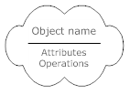
From source to detector without interaction
uncollided term Ψ₀
detector
Ψ=Ψ₀
E, Ω
source S
= optical thickness
e^{-β} = probability to reach detector
without absorption nor scattering
“source” and “detector” are two regions of phase space

Slide 11
From source to detector with one scattering
once-collided term Ψ₁
obtained by summing
(= integrating)
all contributions from
phase space points
reached by
uncollided particles
Ψ₀
detector
Ψ=Ψ₁+Ψ₀
E’,Ω’
source S
Ψ₀
E,Ω
Ψ₀
(K: integral operator)

Slide 12
Neumann series
The solution of the Boltzmann equation in
integral form is obtained by summing:
  the uncollided term Ψ₀
  the once-collided term Ψ₁ = KΨ₀
  the twice-collided term Ψ₂ = KΨ₁
etc...
Each term is derived from the previous one,
adding one scattering
Notice that analytical shielding formulae are written as:
Neumann series:
Ψ₀ = Se^{−β}
Ψ₁= K Ψ₀
Ψ₂= K Ψ₁
.................
Ψ_{n}= K Ψ_{n-1}
where D (dose) is assumed to be proportional to Φ (fluence)
D₀e^{-Σx} is the uncollided term
B (build-up factor) is the sum of all collided terms

Slide 13
Integration efficiency
Traditional numerical integration methods (e.g., Simpson) converge to the true value as N^{-1/n,} where N = number of “points” (intervals) and n = number of dimensions
Monte Carlo converges as N^{-1/2}, independent of the number of dimensions
Therefore:
  n = 1 ➔ MC is not convenient
  n = 2 ➔ MC is about equivalent to traditional methods
  n > 2 ➔ MC converges faster (and the more so the greater the dimensions)
With the integro-differential Boltzmann equation the dimensions are the 7 of phase space, but we use the integral form: the dimensions are those of the largest number of “collisions” per history (the Neumann term of highest order)
Note that the term “collision” comes from low-energy neutron/photon transport theory. Here it should be understood in the extended meaning of “interaction where the particle changes its direction and/or energy, or produces new particles”

Slide 14
Mean of a distribution (1)
In one dimension:
Given a variable x, distributed according to a function f(x), the mean or average of another function of the same variable A(x) over an interval [a,b] is given by:
Or, introducing the normalized distribution f’ :
A special case is that of

Slide 15
Mean of a distribution (2)
In several dimensions:
Given n variables x,y,z,... distributed according to the (normalized) functions f’(x), g’(y), h’(z)..., the mean or average of a function of those variables A(x,y,z) over an n-dimensional domain D is given by:
Often impossible to calculate with traditional methods, but we can sample N values of A with probability f’·g’·h’...and divide the sum of the sampled values by N:
Each term of the sum is distributed like A (Analog Monte Carlo)
In this case the integration is also a simulation!

Slide 16
Central Limit theorem
Central limit theorem:
For large values of N, the distribution of averages (normalized sums S_{N}) of N independent random variables identically distributed (according to any distribution with mean and variance ≠ ∞) tends to a normal distribution with mean and variance

Slide 17
MC Mathematical foundation
The Central Limit Theorem is the mathematical foundation of the Monte
Carlo method. In words:
Given any observable A, that can be expressed as the result of a convolution of random processes, the average value of A can be obtained by sampling many values of A according to the probability distributions of the random processes.
MC is indeed an integration method that allows to solve multi-dimensional integrals by sampling from a suitable stochastic distribution.
The accuracy of MC estimator depends on the number of samples:

Slide 18
Integration? Or simulation?
Why, then, is MC often considered a simulation technique?
Originally, the Monte Carlo method was not a
simulation method, but a device to solve a
multidimensional integro-differential equation by
building a stochastic process such that some
parameters of the resulting distributions would
satisfy that equation
The equation itself did not necessarily refer to a
physical process, and if it did, that process was not
necessarily stochastic

Slide 19
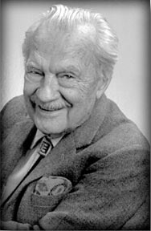
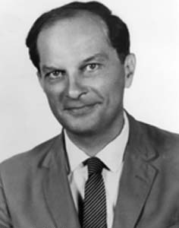
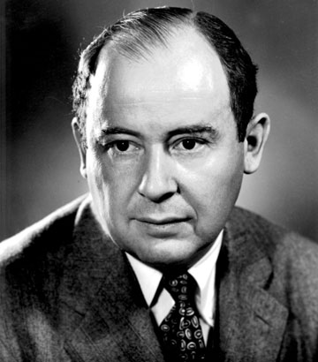
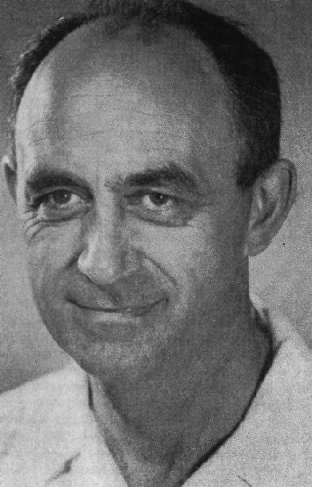
The Monte Carlo method
Invented by John von Neumann, Stanislaw Ulam and Nicholas Metropolis (who gave it its name), and independently by Enrico Fermi
N. Metropolis S. Ulam J. von Neumann E. Fermi

Slide 20

The ENIAC
Electronic Numerical Integrator And Computer

Slide 21
Simulation: in special cases
It was soon realized, however, that when the
method was applied to an equation describing a
physical stochastic process, such as neutron
diffusion, the model (in this case a random walk)
could be identified with the process itself
In these cases the method (analog Monte Carlo)
has become known as a simulation technique,
since every step of the model corresponds to an
identical step in the simulated process

Slide 22
Particle transport
Particle transport is a typical physical process described by probabilities (cross sections = interaction probabilities per unit distance)
Therefore it lends itself naturally to be simulated by Monte Carlo
Many applications, especially in high energy physics and medicine, are based on simulations where the history of each particle (trajectory, interactions) is reproduced in detail
However in other types of application, typically shielding design, the user is interested only in the expectation values of some quantities (fluence and dose) at some space point or region, which are calculated as solutions of a mathematical equation
This equation (the Boltzmann equation), describes the statistical distribution of particles in phase space and therefore does indeed represent a physical stochastic process
But in order to estimate the desired expectation values it is not necessary that the Monte Carlo process be identical to it

Slide 23
Integration without simulation
In many cases, it is more efficient to replace the actual process by a different one resulting in the same average values but built by sampling from modified distributions
Such a biased process, if based on mathematically correct variance reduction techniques, converges to the same expectation values as the unbiased one
But it cannot provide information about the higher moments of statistical distributions (fluctuations and correlations)
In addition, the faster convergence in some user-privileged regions of phase space is compensated by a slower convergence elsewhere

Slide 24
Analog Monte Carlo
In an analog Monte Carlo calculation, not only the mean of the contributions converges to the mean of the actual distribution, but also the variance and all moments of higher order:
Then, partial distributions, fluctuations and correlations are all faithfully reproduced: in this case (and in this case only!) we have a real simulation

Slide 25
Random sampling: the key to Monte Carlo
The central problem of the Monte Carlo method:
Given a Probability Density Function (pdf), f(x), generate a sample of x’s distributed according to f(x) (x can be multidimensional)
f(x)
x
The use of random sampling techniques is the distinctive feature of Monte Carlo
Solving the integral Boltzmann transport equation by Monte Carlo consists of:
Geometry and material description of the problem
Random sampling from probability distributions of the outcome of physical
events

Slide 26
(Pseudo)random numbers
The basis of all Monte Carlo integrations are random numbers, i.e. random values of a variable distributed according to a pdf
In real world: the random outcomes of physical processes
In computer world: pseudo-random numbers
The basic pdf is the uniform distribution:
Pseudo-random numbers (PRN) are sequences that reproduce the
uniform distribution, constructed from mathematical algorithms
(PRN generators).
A PRN sequence looks random but it is not: it can be successfully
tested for statistical randomness although it is generated
deterministically
A pseudo-random process is easier to produce than a really random
one, and has the advantage that it can be reproduced exactly
PRN generators have a period, after which the sequence is identically
repeated. However, a repeated number does not imply that the end of
the period has been reached. Some available generators have
periods >10⁶¹

Slide 27
Sampling from a distribution
Sampling from a discrete distribution:
Suppose we have a discrete random variable x, that can assume
values x₁, x₂, …, x_{n} , … with probability p₁, p₂, …, p_{n} , …
Assume ∑_{i} p_{i} = 1, or normalize it
Divide the interval [0,1) in n subintervals, with limits
y₀ = 0, y₁ = p₁, y₂ = p₁+p₂, ….
Generate a uniform pseudo-random number
Find the i ^{th} y-interval such that
y_{i} -1 ≤ ξ < y_{i}
Select X = x_{i} as the sampled value
Since ξ is uniformly random:
Note the use of the cumulative probability!

Slide 28
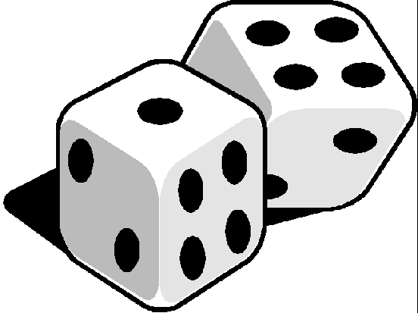
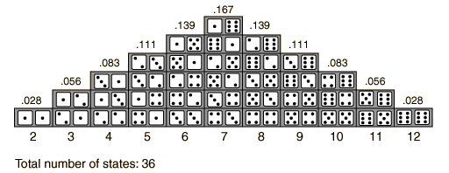
Sampling from a distribution
Example: simulate a throw of dice:
x₁ = 2, x₂ = 3, x₃ = 4, ..., x₁₁ = 12
y₀ = 0, y₁ = 1, y₂ = 1+2 = 3, y₃ = 3+4 = 7, ..., y₁₁ = 35+1 = 36
Normalize:
y₀ = 0, y₁ = 1/36 = 0.028, y₂ = 3/36 = 0.083, y₃ = 0.194, ..., y₁₁ = 1
Get a pseudorandom number ξ , e.g.: 0.125
ξ is found to be between y₂ = 0.083 and y₃ = 0.194
So, our sampled dice throw is x₃ = 4

Slide 29
Sampling from a distribution
Sampling from a generic continuous distribution:
Integrate the distribution function, f(x), analytically or numerically, and normalize to 1 to obtain the normalized cumulative distribution:
Generate a uniform pseudo-random number ξ
Get a sample of f(x) by finding the inverse value X = F^{–1}(ξ), analytically or most often numerically by interpolation (table look-up)
Since ξ is uniformly random:
Again, we use the cumulative probability: remember, MC is integration!

Slide 30
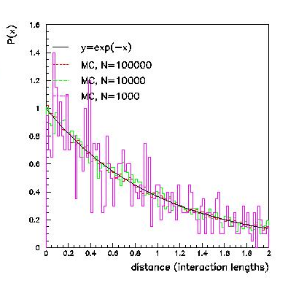
Sampling from a distribution
Example: sampling from an exponential distribution (this is frequently
needed in particle transport, to find the point of
next interaction or the distance to decay)
f(x) = e^{-x/λ} , x є [0,∞)
Cumulative distribution:
Normalized:
Sample a uniform ξ є [0,1), e.g.: 0.745
Sample t by inverting:
But ξ is distributed like 1 – ξ. Therefore our sampled value is:
If we are sampling the next interaction point, we will make a step of
0.294 mfp

Slide 31
Sampling from a distribution:
the rejection technique
The rejection technique
Some distributions cannot be easily sampled by integration and
inversion.
Let f’(x) be one such distribution (normalized) that we want to sample
Let g’(x) be another normalized distribution function that can be
sampled, such that Cg’(x) ≥ f’(x), for all x ∈ [x_{min} , x_{max}]
Generate a uniform pseudo-random number ξ₁ ∈ [0,1) to sample X
from g’(x)
Generate a second pseudo-random number ξ₂
Accept X as a sample of f’(x) if ξ₂ < f’(X)/Cg’(x) , otherwise re-sample
ξ₁ and ξ₂

Slide 32
Sampling with the rejection technique
The probability of X to be sampled from g’(x) is g’(X), the one that ξ₂ passes
the test is f’(X)/Cg’(X) : therefore the probability to have X sampled and
accepted is the product of probabilities g’(X) f’(X)/Cg’(X) = f’(X)/C
The overall efficiency (probability accepted/rejected) is given by
f’(x) is normalized
Proof that the sampling is unbiased (i.e. X is a correct sample from f’(x)):
the probability P(X) dx of sampling X is given by:
g’(X) is generally chosen as a uniform (rectangular) distribution or
a normalized sum of uniform distributions
(a piecewise constant function)
Cg’(x)
f(x)
x

Slide 33
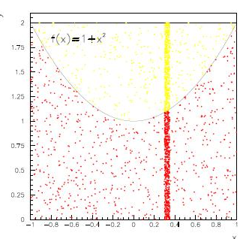
The rejection technique: example
Let be f’(x) = (1+x²), x ∈ [-1,1]
We choose g’(x) to be constant, and:
Cg’(x) = max(f’(x)) = 2
To normalize it:
We obtain C = 2/g’(x) = 4
Generate two uniform pseudo-random numbers ξ₁, ξ₂ ∈ [0,1)
Sample X uniformly: X = –1 + 2ξ₁
Test:
if (1+X²)/Cg’(x) = (1+X²)/2 > ξ₂, accept X
otherwise re-sample ξ₁, ξ₂
X
The efficiency is the ratio of the red area to the total

Slide 34
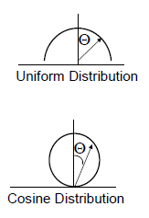
Sampling a uniform isotropic radiation field
Several problems (e.g. concerning
cosmic rays or phantom dosimetry
require to simulate a uniform isotropic
radiation field over a region of space
This can be obtained as follows:
select a random point on the surface a sphere of radius R surrounding the region
sample a random inward direction from a cosine distribution
send the particle from point R in the selected direction

Slide 35
Sampling a uniform isotropic radiation field
P₀
•
Why the cosine distribution?
The solid angle dΩ’ subtended by
the element of sphere surface at
random point P₀ from a generic
point P₁ is = dΩ cosθ , where dΩ
is the solid angle subtended in the
direction of the normal in P₀
θ
•
P₁
•

Slide 36
Particle transport Monte Carlo
Application of Monte Carlo to particle transport and interaction:
Each particle is followed on its path through matter
At each step the occurrence and outcome of interactions are decided by random selection from the appropriate probability distributions
All the secondaries issued from the same primary are stored in a “stack” or “bank” and are transported before a new history is started
The accuracy and reliability of a Monte Carlo depend on the models or data on which the probability distribution functions are based
Statistical accuracy of results depends on the number of “histories"
Statistical convergence can be accelerated by “biasing" techniques.

Slide 37
Particle transport Monte Carlo
Assumptions made by most MC codes:
Static, homogeneous, isotropic, amorphous media and geometry
Problems: e.g. moving targets*, atmosphere must be represented by discrete layers of uniform density, radioactive decay may take place in a geometry different from that in which the radionuclides were produced*.
* These restrictions have been overcome in FLUKA
Markovian process: the fate of a particle depends only on its actual present properties, not on previous events or histories
Particles do not interact with each other
Problem: e.g. the Chudakov effect (charges cancelling in e⁺e– pairs)
Particles interact with individual electrons / atoms / nuclei / molecules
Problem: invalid at low energies (X-ray mirrors)
Material properties are not affected by particle reactions
Problem: e.g. burnup

Slide 38
Practical implementations
particle exits the problem before interaction
Estimators
particle dies
(below transport threshold,
discarded..)
Estimators
Track through geometry
Random distance to interaction
Continuous processes
Estimators
Source: generate the primary particle
Interaction
Generate secondary particles
Estimators
take one particle from stack
and follow it
Empty stack:
end “history”
start with new primary
fill the “stack” with particle ID, E, x, θ….
P₁ | P₂ | P₃ | P₄ | P₅ | P₆ | P₇ | P₈ | P₉ | .. | P_{N}

Slide 39
Statistical Errors:
Can be calculated for single histories (not in FLUKA), or for batches of several histories
Distribution of scoring contributions by single histories can be very asymmetric (many histories contribute little or zero)
Scoring distribution from batches tends to Gaussian for N → ∞, provided σ² ≠ ∞ (thanks to Central Limit Theorem)
The standard deviation of an estimator calculated from batches or from single histories is an estimate of the standard deviation of the actual distribution (“error of the mean”)
How good is such an estimate depends on the type of estimator and on the particular problem (but it converges to the true value for N → ∞)
Notes:
39

Slide 40
Statistical Errors
The variance of the mean of an estimated quantity x (e.g., fluence), calculated in N batches, is:
mean of squares – square of means
N – 1
where:
n_{i} = number of histories in the i ^{th} batch
n = Σn_{i} = total number of histories in the N batches
x_{i} = average of x in the i ^{th} batch:
where x_{ij} is the contribution to x of the j^{th} history in the i^{th} batch
In the limit N = n, n_{i} =1, the formula applies to single history statistics

Slide 41
Statistical Errors
Practical tips:
Use always at least 5-10 batches of comparable size (it is not at
all mandatory that they be of equal size)
Never forget that the variance itself is a stochastic variable
subject to fluctuations
Be careful about the way convergence is achieved: often
(particularly with biasing) apparently good statistics with few
isolated spikes could point to a lack of sampling of the most
relevant phase-space part
Plot 2D and 3D distributions! In those cases the eye is the best
tool in judging the quality of the result

Slide 42
Statistical errors, systematic errors, and... mistakes
Statistical errors, due to sampling (in)efficiency
Relative error Quality of Tally (from an old version of the MCNP Manual)
50 to 100% Garbage
20 to 50% Factor of a few
10 to 20 Questionable
< 10% Generally reliable
Why does a 30% σ mean an uncertainty of a “factor of a few”?
Because σ in fact corresponds to the sum (in quadrature) of two uncertainties: one due to the fraction of histories which don’t give
a zero contribution, and one which reflects the spread of the
non-zero contributions
The MCNP guideline is empirically based on experience, not on a mathematical proof. But it has been generally confirmed also working
with other codes
Small penetrations and cracks are very difficult to handle by MC, because the “detector” is too small and too few non-zero contributions can be sampled, even by biasing

Slide 43
Statistical errors, systematic errors, and... mistakes
Systematic errors, due to code weaknesses
Apart from the statistical error, which other factors affect the accuracy of MC results?
  physics: different codes are based on different physics models. Some models are better than others. Some models are better in a certain energy range. Model quality is best shown by benchmarks at the microscopic level (e.g. thin targets)
  artifacts: due to imperfect algorithms, e.g., energy deposited in the middle of a step*, inaccurate path length correction for multiple scattering*, missing correction for cross section and dE/dx change over a step*, etc. Algorithm quality is best shown by benchmarks at the macroscopic level (thick targets, complex geometries)
  data uncertainty: an error of 1% in the absorption cross section can lead to an error of a factor 2.8 in the effectiveness of a thick shielding wall (10 attenuation lengths). Results can never be better than allowed by available experimental data!

Slide 44
Statistical errors, systematic errors, and... mistakes
Systematic errors, due to user ignorance
Missing information:
  material composition not always well known. In particular concrete/soil composition (how much water content? Can be critical)
  beam losses: most of the time these can only be guessed. Close interaction with engineers and designers is needed
  presence of additional material, not well defined (cables, supports...)
  Is it worth to do a very detailed simulation when some parameters are unknown or badly known?
Systematic errors, due to simplification
Geometries that cannot be reproduced exactly (or would require too much effort)
Air contains humidity and pollutants, has a density variable with pressure

Slide 45
Statistical errors, systematic errors, and... mistakes
Code mistakes (“bugs”)
MC codes can contain bugs:
  Physics bugs: I have seen pair production cross sections fitted by a polynomial... and oscillating instead of saturating at high energies, non-uniform azimuthal scattering distributions, energy non-conservation...
  Programming bugs (as in any other software, of course)
User mistakes
mis-typing the input: Flair is good at checking, but the final responsibility is the user’s
error in user code: use the built-in features as much as possible!
wrong units
wrong normalization: quite common
unfair biasing: energy/space cuts cannot be avoided, but must be done with much care
forgetting to check that gamma production is available in the neutron cross sections (e.g. Ba cross sections)

