Slide 1

Hadronic Interactions
FLUKA Beginner’s Course

Slide 2
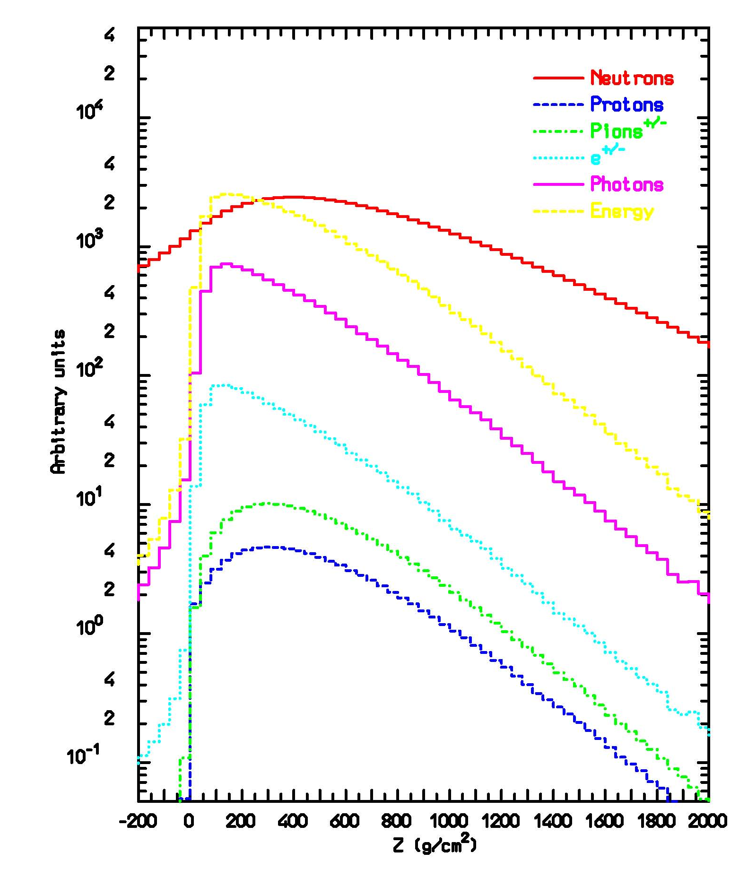
Hadronic showers: many particle species, wide energy range
100 GeV p in a Fe absorber:
space-averaged particle spectra
100 GeV p on Pb
shower longitudinal development

Slide 3
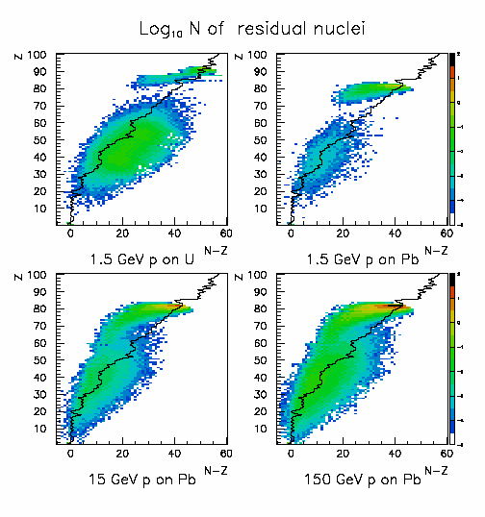
Hadronic showers: we want to simulate also what is left !
The MC should be able to reproduce this complexity, maintaining correlations and cross-talks among the shower components
Hadronic interactions have to be simulated over a wide energy range with an high degree of accuracy
Nuclear effects are essential
=> need detailed nuclear interaction models
=> need checks on simple data (thin target)
A summary of the hadronic interaction models used in FLUKA is given in the following
Residual nuclei distribbution
Following 15 GeV proton interactions on Lead

Slide 4
The FLUKA hadronic Models
Hadron-nucleus: PEANUT
Sophisticated
G-Intranuclear Cascade
Gradual onset of Glauber-Gribov multiple interactions
Preequilibrium
Coalescence
Elastic,exchange
Phase shifts
data, eikonal
P<3-5GeV/c
Resonance prod
and decay
hadron
hadron
low E π,K
Special
High Energy
DPM
hadronization
Evaporation/Fission/Fermi break-up
γ deexcitation

Slide 5
Hadron-nucleon interaction models
Particle production interactions: two kinds of models
p-p and p-n cross section
FLUKA and data
total
Those based on “resonance” production and decays, cover the energy range up to 3–5 GeV
Those based on quark/parton string models, which provide reliable results up to several tens of TeV
elastic
Elastic, charge exchange and strangeness exchange reactions:
• Available phase-shift analysis and/or fits of experimental differential data
• At high energies, standard eikonal approximations are used

Slide 6
Nonelastic hN interactions at intermediate energies
Resonance production
All reactions are thought to proceed through channels like:
h + N → X → x₁ + … + x_{n} → …
h + N → X + Y → x₁ + … x_{n} + y₁ + … y_{m} → …
where X and Y can be real resonances or stable particles (π, n, p, K) directly
(the intermediate state contains at least one resonance)
Resonances can be treated as real particles: they can be transported and then transformed into secondaries according to their lifetime and decay branching ratios
Resonance energies, widths, cross sections, branching ratios
from data and conservation laws, whenever possible.
Inferred from inclusive cross sections when needed
Dominance of the Δ resonance and of the N∗ resonances
FLUKA: ≈ 60 resonances, and ≈ 100 channels in describing p, n, π, pbar, nbar and K induced reactions up to 3-5 GeV/c

Slide 7
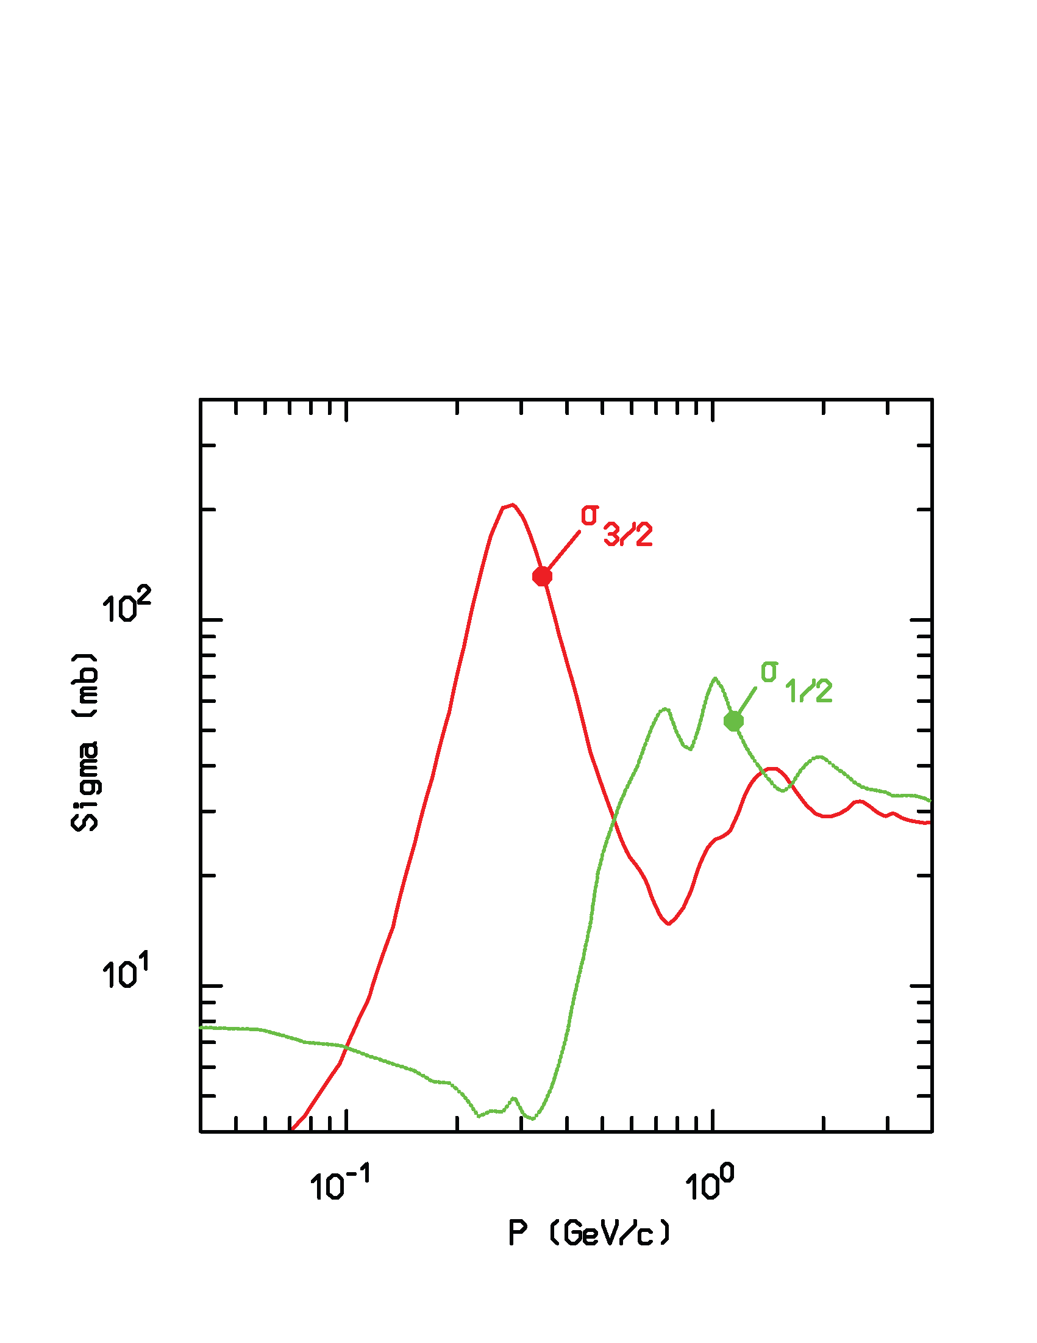
Nonelastic hN interactions at intermediate energies
• N₁ + N₂ → N’ ‘₁ + N’ ‘₂ + π threshold at 290 MeV, important above 700 MeV,
• π + N → π ‘+ π” + N ‘ opens at 170 MeV.
Anti-nucleon -nucleon open at rest !
π-nucleon cross section
Isospin decomposition
N₁ + N₂ → N”₁ + Δ(1232) → N₁’ + N₂’ + π
π + N → Δ(1600) → π’+ Δ(1232) → π’ + π“+ N’
N_{’1+} N₂ → Δ₁(1232) + Δ₂(1232) → N₁’ + π₁ + N’₂ + π₂

Slide 8
Inelastic hN at high energies: (DPM, QGSM, ...)
Problem: “soft” interactions → QCD perturbation theory cannot be applied.
Interacting strings (quarks held together by the gluon-gluon interaction into the form of a string)
Interactions treated in the Reggeon-Pomeron framework
each of the two hadrons splits into 2 colored partons → combination into 2 colourless chains → 2 back-to-back jets
each jet is then hadronized into physical hadrons

Slide 9
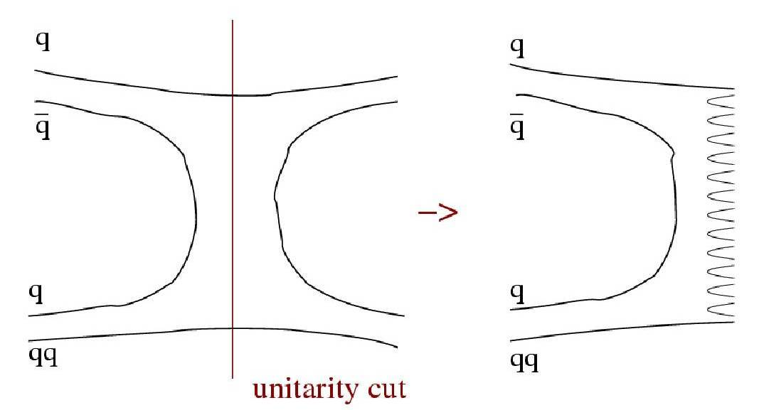
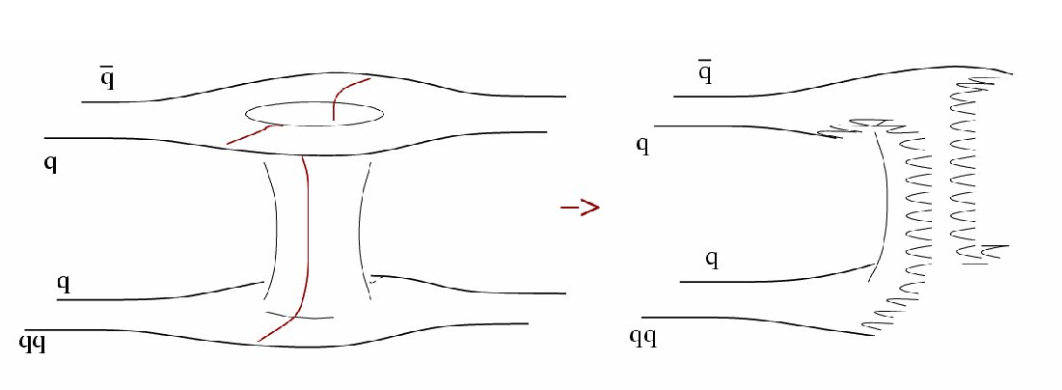
DPM
Parton and color concepts, Topological expansion of QCD, Duality
single chain diagram
Reggeon exchange
- momentum distribution functions
- fragmentation functions
color strings to be “hadronized”
two-chain diagram
single Pomeron exchange

Slide 10
Hadron-hadron collisions: chain examples
momentum fraction
Leading two-chain diagram in DPM
for p-p scattering
The color (red, blue, and green) and quark combination shown in the figure is just one of the allowed possibilities
Leading two-chain diagram in DPM
for pbar-p scattering
The color (red, antired, blue, antiblue, green, and antigreen) and quark combination shown in the figure is just one of the allowed possibilities

Slide 11
Hadron-hadron collisions: chain examples
Single chain diagram in DPM
for π⁺-p scattering
The color (red, antired, blue, and green) and quark combination shown in the figure is just one of the allowed possibilities
Leading two-chain diagram in DPM
for π⁺-p scattering
The color (red, antired, blue, and green) and quark combination shown in the figure is just one of the allowed possibilities
σ ~ 1/√s

Slide 12
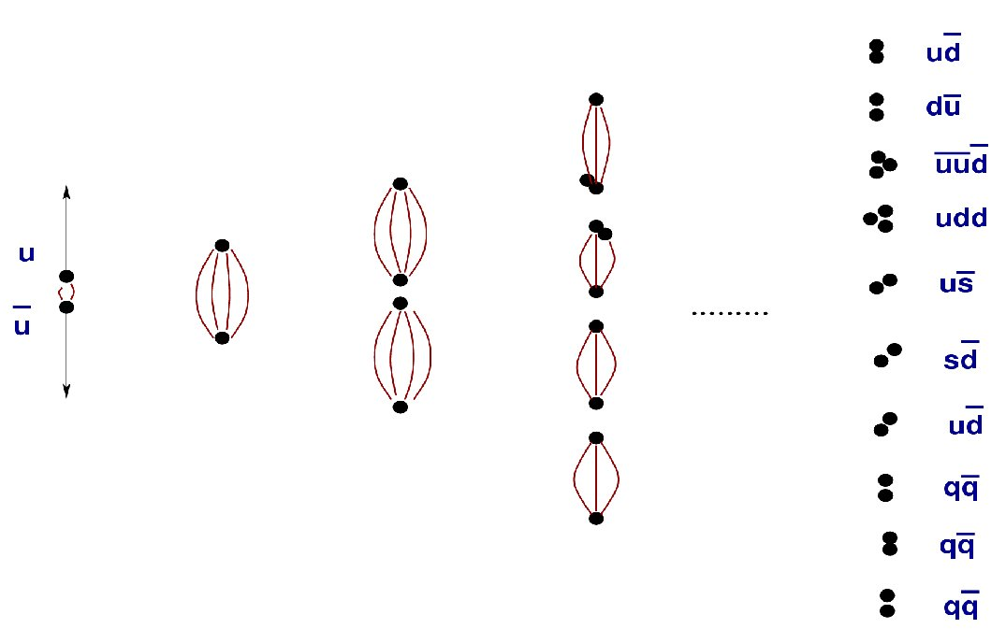
Hadronization example
q-q and qq-qq
pairs generation

Slide 13
DPM and hadronization
from DPM:
Number of chains
Chain composition
Chain energies and momenta
Diffractive events
Almost No Freedom
Chain hadronization
Assumes chain universality
Fragmentation functions from hard processes and e+e− scattering
Transverse momentum from uncertainty considerations
Mass effects at low energies
The same functions and (few) parameters for all reactions and energies

Slide 14
Inelastic hN interactions: examples
π⁺ + p → π⁺ + X (6 & 22 GeV/c)
π⁺ + p → Ch⁺/Ch⁻ + X (250 GeV/c)
Positive hadrons X2
Negative hadrons
Connected points: FLUKA
Symbols w. errors : DATA
Dots: Exp. Data
Histos : FLUKA
6 GeV
22GeV
M.E. Law et. Al, LBL80 (1972)

Slide 15
PEANUT
Target nucleus description (density, Fermi motion, etc)
t (s)
10⁻²³
10⁻²²
10⁻²⁰
10⁻¹⁶
Glauber-Gribov cascade with formation zone
Generalized IntraNuclear cascade
Preequilibrium stage
with current exciton configuration and excitation energy
(all non-nucleons emitted/decayed + all nucleons below 30-100 MeV)
NB: above 5 GeV PEANUT is not the default and must be explicitly selected!
Evaporation/Fragmentation/Fission model
γ de-excitation

Slide 16
WARNING
PEANUT has been extended to cover the whole energy range in late 2006
A less refined GINC model is available for projectile momenta above about 5 GeV/c, and was the only choice until recently
However: the extended peanut is NOT yet the default, mainly because of some ambiguity in the definition of quasi-elastic cross sections.
To activate PEANUT at all energies:
PHYSICS 1000. 1000. 1000. 1000. 1000. 1000. PEATHRESH

Slide 17
Nucleon Fermi Motion
Fermi gas model: Nucleons = Non-interacting Constrained Fermions
Momentum distribution
for k up to a (local) Fermi momentum k_{F}(r) given by
The Fermi energy (k_{F} ≈ 1.36 fm, P_{F} ≈ 260 MeV/c, E_{F} ≈ 35 MeV, at nuclear max. density) is customarily used in building a self-consistent Nuclear Potential
Depth of the potential well ≡ Fermi Energy + Nuclear Binding Energy

Slide 18
Positive kaons as a probe of Fermi motion

Slide 19
(Generalized) IntraNuclear Cascade
Some assets of the full GINC as implemented in FLUKA (PEANUT):
  Nucleus divided into 16 radial zones of different density, plus 6 outside the nucleus to account for nuclear potential, plus 10 for charged particles
  Different nuclear densities (and Fermi energies) for neutrons and protons (shell model ones for A≤16)
  Nuclear (complex) optical potential → curved trajectories in the mean nuclear+Coulomb field (reflection, refraction)
  Updating binding energy (from mass tables) after each particle emission
  Multibody absorption for π^{+/0/-} K^{-/0} μ⁻
  Exact energy-momentum conservation including the recoil of the residual nucleus and experimental binding energies
  Nucleon Fermi motion including wavepacket-like uncertainty smearing, (approximate) nucleon-nucleon, and r ↔ E_{f}(r) correlations
  Quantum effects (mostly suppressive): Pauli blocking, Formation zone, Nucleon antisymmetrization, Nucleon-nucleon hard-core correlations, Coherence length

Slide 20
hA at high energies: Glauber-Gribov cascade with formation zone
Glauber cascade
  Quantum mechanical method to compute Elastic, Quasi-elastic and Absorption hA cross sections from Free hadron-nucleon scattering + nuclear ground state
  Multiple Collision expansion of the scattering amplitude
Glauber-Gribov
  Field theory formulation of Glauber model
  Multiple collisions ↔ Feynman diagrams
  High energies: exchange of one or more Pomerons with one or more target nucleons (a closed string exchange)
Formation zone (=materialization time)

Slide 21
Gribov interpretation of Glauber multiple collisions
The absorption cross section is just the integral in the impact parameter plane of the probability of getting at least one non-elastic hadron-nucleon collision, and it is naturally written in a mutliple collision expansion
with the overall average number of collisions given by
Glauber-Gribov model = Field theory formulation of Glauber model
Multiple collision terms ⇒Feynman graphs
At high energies : exchange of one or more Pomerons with one or more target nucleons
In the Dual Parton Model language (neglecting higher order diagrams):
Interaction with n target nucleons ⇒ 2n chains
  Two chains from projectile valence quarks + valence quarks of one target nucleon ⇒2 valence-valence chains
  2(n-1) chains from sea quarks of the projectile + valence quarks of target nucleons ⇒2(n-1) sea-valence chains

Slide 22
Chain examples
Leading two-chain diagram in DPM
for p-A Glauber scattering with 4 collisions
The color (red, antired, blue, antiblue, green, and antigreen) and quark combination shown in the figure is just one of the allowed possibilities
Leading two-chain diagram in DPM
for π⁺-A Glauber scattering with 3 collisions
The color (red, antired, blue, antiblue, green, and antigreen) and quark combination shown in the figure is just one of the allowed possibilities

Slide 23
Formation zone
Classical INC will never work
J.Ranft applied the concept, originally proposed by Stodolski, to hA and AA nuclear int.
Naively: “materialization" time
Qualitative estimate:
In the frame where p|| =0
Particle proper time
Going to the nucleus system
Condition for possible re-interaction inside a nucleus:

Slide 24
no Glauber, no formation zone
Positive
Negative
π⁺
Positive
Negative
π⁺
Rapidity distributions of charged particles produced in 250 GeV π⁺ collisions on Aluminum (left) and Gold (right)
Points: exp. data (Agababyan et al., ZPC50, 361 (1991))

Slide 25
no Glauber, yes formation zone
Positive
Negative
π⁺
Positive
Negative
π⁺
Rapidity distributions of charged particles produced in 250 GeV π⁺ collisions on Aluminum (left) and Gold (right)
Points: exp. data (Agababyan et al., ZPC50, 361 (1991))

Slide 26
yes Glauber, no formation zone
Positive
Negative
π⁺
Positive
Negative
π⁺
Rapidity distributions of charged particles produced in 250 GeV π⁺ collisions on Aluminum (left) and Gold (right)
Points: exp. data (Agababyan et al., ZPC50, 361 (1991))

Slide 27
yes Glauber, yes formation zone
Positive
Negative
π⁺
Positive
Negative
π⁺
Rapidity distributions of charged particles produced in 250 GeV π⁺ collisions on Aluminum (left) and Gold (right)
Points: exp. data (Agababyan et al., ZPC50, 361 (1991))

Slide 28
Nonelastic hA interactions at high energies: examples
Recent results from the HARP experiment
12.9 GeV/c p on Al
π⁺ production
at different angles
Double differential π+ production for p C interactions at 158 GeV/c, as measured by NA49 (symbols) and predicted by FLUKA (histograms)

Slide 29
Double differential pion production
data from BNL910 experiment

Slide 30
Double differential pion production
data from BNL910 experiment

Slide 31
Double differential pion production

Slide 32
Pions: nuclear medium effects
Free π N interactions ⇒ | ⇒ | Non resonant channel
 | ⇒ | P-wave resonant Δ production
Δ in nuclear medium | ⇒ | decay | ⇒elastic scattering, charge exchange
 | ⇒ | reinteraction | ⇒ Multibody pion absorption
Assuming for the free resonant σ a Breit-Wigner form with width Γ_{F}
An ``in medium'' resonant σ (σ^{A}_{res}) can be obtained adding to Γ_{F} the imaginary part of the (extra) width arising from nuclear medium
(Oset et al., NPA 468, 631)
quasielastic scattering, two and three body absorption
The in-nucleus σ_{t}^{A} takes also into account a two-body s-wave absorption σ_{s}^{A} derived from the optical model

Slide 33
Pion absorption
Emitted proton spectra at different angles , 160 MeV π⁺ on ⁵⁸Ni
Phys. Rev. C41,2215 (1990)
Phys. Rev. C24,211 (1981)
Proton spectra extend up to 300 MeV
Pion absorption cross section on Gold and Bismuth in the Δ resonance region (multibody absorption in PEANUT)

Slide 34
Coalescence
High energy light fragments are emitted through the coalescence mechanism: “put together” emitted nucleons that are near in phase space.
Example : double differential t production from 542 MeV neutrons on Copper
Warning: coalescence is OFF by default
Can be important, ex for . residual nuclei.
To activate it:
PHYSICS 1. COALESCE
If coalescence is on, switch on Heavy ion transport and interactions (see later)

Slide 35
Preequilibrium emission
For E > π production threshold → only (G)INC models
At lower energies a variety of preequilibrium models
Two leading approaches
The quantum-mechanical multistep model:
Very good theoretical background
Complex, difficulties for multiple emissions
The semiclassical exciton model
Statistical assumptions
Simple and fast
Suitable for MC
Statistical assumption:
any partition of the excitation energy E* among N, N = N_{h} +N_{p}, excitons has the same probability to occur
Step: nucleon-nucleon collision with N_{n+1}=N_{n}+2 (“never come back approximation)
Chain end = equilibrium = N_{n} sufficiently high or excitation energy below threshold
N₁ depends on the reaction type and cascade history

Slide 36
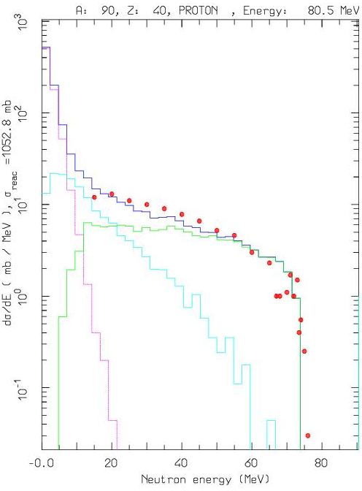
Thin target example
Angle-integrated ⁹⁰Zr(p,xn) at 80.5 MeV
The various lines show the total, INC, preequilibrium and evaporation contributions
Experimental data from
M. Trabandt et al., Phys. Rev. C39, 452 (1989)

Slide 37
Thin target examples
p + ⁹⁰Zr → p + X (80 MeV)
p + Al → π⁻ + X (4 GeV/c)

Slide 38
Equilibrium particle emission (evaporation, fission and nuclear break-up)
From statistical considerations and the detailed balance principle, the probabilities for emitting a particle of mass m_{j,} spin S_{j,}ħ and energy E, or of fissioning are given by:
(i, f for initial/final state, Fiss for fission saddle point)
Probability per unit time of emitting a particle j with energy E
Probability per unit time of fissioning
ρ’s: nuclear level densities
U’s: excitation energies
V_{j}’s: possible Coulomb barrier for emitting a particle type j
B_{Fiss}: fission barrier
Q_{j}’s: reaction Q for emitting a particle type j
σ_{inv}: cross section for the inverse process
Δ’s: pairing energies
Neutron emission is strongly favoured because of the lack of any barrier
Heavy nuclei generally reach higher excitations because of more intense cascading

Slide 39
Equilibrium particle emission
Evaporation: Weisskopf-Ewing approach
  ~600 possible emitted particles/states (A<25) with an extended evaporation/fragmentation formalism
  Full level density formula with level density parameter A,Z and excitation dependent
  Inverse cross section with proper sub-barrier
  Analytic solution for the emission widths (neglecting the level density dependence on U, taken into account by rejection
  Emission energies from the width expression with no. approx.
Fission: past, improved version of the Atchison algorithm, now
  Γ_{fis} based of first principles, full competition with evaporation
  Improved mass and charge widths
  Myers and Swiatecki fission barriers, with exc. en. Dependent level density enhancement at saddle point
Fermi Break-up for A<18 nuclei
  ~ 50000 combinations included with up to 6 ejectiles
γ de-excitation: statistical + rotational + tabulated levels

Slide 40
Residual Nuclei
The production of residuals is the result of the last step of the nuclear reaction, thus it is influenced by all the previous stages
Residual mass distributions are very well reproduced
Residuals near to the compound mass are usually well reproduced
However, the production of specific isotopes may be influenced by additional problems which have little or no impact on the emitted particle spectra (Sensitive to details of evaporation, Nuclear structure effects, Lack of spin-parity dependent calculations in most MC models)

Slide 41
Example of fission/evaporation
1 A GeV ²⁰⁸Pb + p reactions Nucl. Phys. A 686 (2001) 481-524
Data
FLUKA
FLUKA after cascade
FLUKA after preeq
Quasi-elastic
Spallation
Evaporation
Fission
Deep spallation
Fragmentation

Slide 42
Residual nuclei
Experimental and computed
residual nuclei mass distribution
for Ag(p,x)X at 300 GeV
Data from
Phys. Rev. C19 2388 (1979) and
Nucl. Phys. A543, 703 (1992)
The fragmentation model has much improved the FLUKA predictions
Also for A-A interactions
Warning: fragmentation is OFF by default, because it is a cpu-eater. It is NECESSARY to activate it for activation studies:
PHYSICS 3. EVAPORAT
If fragmentation is on, switch on Heavy ion transport and interactions (see later)
42
Notes:
42

Slide 43
Summary of relevant input cards
PHYSICS 1000. 1000. 1000. 1000. 1000. 1000. PEATHRESH
to use the more refined PEANUT model for h-A reactions also above 5GeV
to enable evaporation of heavy fragments
to enable coalescence (at the cascade stage of the reaction, before pre-equilibrium)
PHYSICS 3. EVAPORAT
PHYSICS 1. COALESCE
etc.

Slide 45
Glauber Cascade
Quantum mechanical method to compute all relevant hadron-nucleus cross sections from hadron-nucleon scattering:
and nuclear ground state wave function Ψ_{i}
Total
Elastic
Scattering
Absorption (particle prod.)
Absorption probability over a given b and nucleon configuration

