Slide 1

Ionization and Transport
FLUKA Beginner’s Course

Slide 2
Topics
General settings
Interactions of leptons/photons
  Photon interactions
    Photoelectric
    Compton
    Rayleigh
    Pair production
    Photonuclear
    Photomuon production
  Electron/positron interactions
    Bremsstrahlung
    Scattering on electrons
  Muon interactions
    Bremsstrahlung
    Pair production
    Nuclear interactions
Ionization energy losses
  Continuous
  Delta-ray production
Transport
  Multiple scattering
  Single scattering
These are common to
all charged particles,
although traditionally associated with EM
  Transport in Magnetic field

Slide 3
Ionization energy losses
Charged hadrons
Muons
Electrons/positrons
Heavy Ions
All share the same approach!
… but some extra features are needed for Heavy Ions

Slide 4
Charged particle dE/dx: Bethe-Bloch
∼ln β⁴γ⁴ relativistic rise
Spin 0
(spin1 is similar):
I : mean excitation energy , material-dependent;
δ : density correction;
C : is the shell correction, important at low energies
T_{max} : maximum energy transfer to an electron (from kinematics); Higher order corrections implemented in FLUKA
L₁ : Barkas correction (z³) responsible for the difference in stopping power for particles-antiparticles;
L₂ : Bloch (z⁴) correction
G : Mott corrections
Valid for m>>m_{e,} However, the formulation for electron/positrons is similar, except for the “energetic” collisions with atomic electrons.

Slide 5
Discrete ionization events
Above a pre-set threshold, ionization is modeled as δ ray production (free electrons). The threshold refers to the kinetic energy of the emitted δ ray.
Spin 0 or 1/2 δ-ray production (charged hadrons, muons)
Mott for heavy ions
Bhabha scattering (e⁺)
Møller scattering (e⁻)
How to set this threshold?
Electrons set by EMFCUT card through the PROD-CUT sdum;
Charged hadrons/muons set by DELTARAY card:
where:
δThresh production threshold, (from materials Mat1 to Mat2)
Ntab, Wtab control the accuracy of dp/dx tabulations (advanced user)
PRINT if is set (not def.) dp/dx tabulations are printed on stdout
* ..+....1....+....2....+....3....+....4....+....5....+....6....+....7..
DELTARAY δThresh Ntab Wtab Mat1 Mat2 Step PRINT

Slide 6
Continuous energy losses
Below the δ-ray threshold, energy losses are treated as “continuous”, with some special features:
  Fluctuations of energy loss are simulated with a FLUKA- specific algorithm
  The energy dependence of cross sections and dE/dx is taken into account exactly (see later)
  The latest recommended values of ionization potential and density effect parameters implemented for each element (Sternheimer, Berger & Seltzer), but can be overridden by the user with (set yourself for compounds!)
* ..+....1....+....2....+....3....+....4....+....5....+....6....+....7..
STERNHEI C X0 X1 a m δ₀ MAT
*
MAT-PROP Gasp Rhosc Iion Mat1 Mat2 Step

Slide 7
Ionization fluctuations -I
The Landau distribution is limited in several respects:
Maximal energy of δ ray is assumed to be infinite, therefore cannot be applied for long steps or low velocities;
Cross section for close collisions is assumed to be equal for all particles;
Fluctuations connected with distant collision are neglected, therefore they cannot be applied for small steps;
Incompatible with explicit δ ray production.
The Vavilov distribution overcomes some of the landau limitations, but is difficult to compute if the step length or the energy are not known a priori.

Slide 8
Ionization fluctuations -II
The FLUKA approach:
Based on general statistical properties of the cumulants of a distribution (in this case a Poisson distribution convoluted with dσ/dE);
Integrals can be calculated analytically and exactly a priori (min. CPU time);
Applicable to any kind of charged particle, taking into account the proper spin dependent cross section for δ ray production;
The first 6-moments of the energy loss distribution are reproduced:

Slide 9
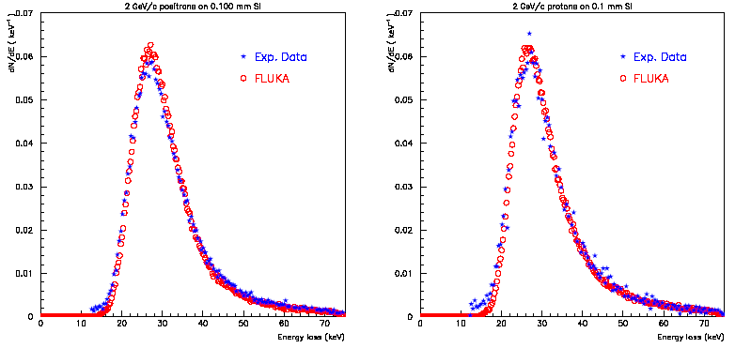
Ionization fluctuations -III
Experimental ¹ and calculated energy loss distributions for 2 GeV/c positrons (left) and protons (right) traversing 100μm of Si
J.Bak et al. NPB288, 681 (1987)

Slide 10
Nuclear stopping power ( NEW)
Besides Coulomb scattering with atomic electrons, particles undergo Coulomb scattering also with atomic nuclei
The resulting energy losses, called nuclear stopping power, are smaller than the atomic ones, but are important for
  Heavy particles (i.e. ions)
  Damage to materials (NIEL, DPA )

Slide 11
dpa: Displacements Per Atom
FLUKA generalized particle name: DPA-SCO
Is a measure of the amount of radiation damage in irradiated materials
For example, means each atom in the material has been displaced from its 3 dpa site within the structural lattice of the material an average of 3 times
Displacement damage can be induced by all particles produced in the hadronic cascade, including high energy photons.
The latter, however, have to initiate a reaction producing charged particles, neutrons or ions.
The dpa quantity is directly related with the total number of defects (or Frenkel pairs):
ρ atoms/cm³
N_{i} particles per interaction channel i
N_{f}^{i} Frenkel pairs per channel
Notes:
11

Slide 12
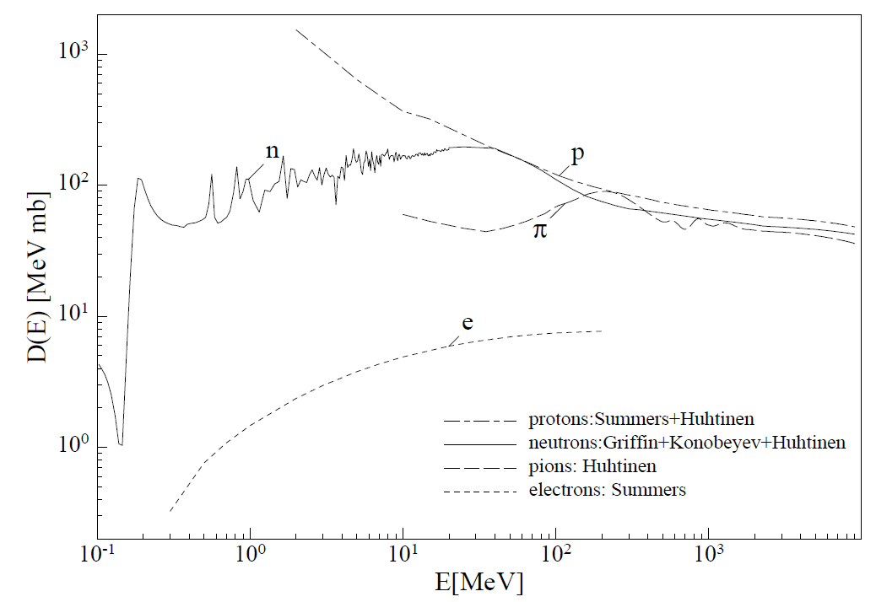
Damage to Electronics
Generalized
particle
Category |  | Scales with simulated/measured quantity
Single Event effects (Random in time) | Single Event Upset (SEU) | High-energy hadron fluence (>20 MeV)* [cm-2]
 | Single Event Latchup (SEL) | High-energy hadron fluence (>20 MeV)** [cm-2]
Cumulative effects (Long term) | Total Ionizing Dose (TID) | Ionizing Dose [GeV/g]
 | Displacement damage | 1 MeV neutron equivalent [cm-2] {NIEL}
HADGT20M
DOSE
SI1MEVNE
* Reality is more complicated (e.g., contribution of thermal neutrons)
** Energy threshold for inducing SEL is often higher than 20 MeV
Notes:
12

Slide 13
Energy dependent quantities I
Most charged particle transport programs sample the next collision point by evaluating the cross-section at the beginning of the step, neglecting its energy dependence and the particle energy loss;
The cross-section for δ ray production at low energies is roughly inversely proportional to the particle energy;
a typical 20% fractional energy loss per step would correspond to a similar variation in the cross section
Some codes use a rejection technique based on the ration between the cross section values at the two step endpoints, but this approach is valid only for monotonically decreasing cross sections.

Slide 14
Energy dependent quantities II
FLUKA takes in account exactly the continuous energy dependence of:
Discrete event cross section
Stopping power
Biasing the rejection technique on the ratio between the cross section value at the second endpoint ant its maximum value between the two end point energies.

Slide 15
Ionization fluctuation options
Ionization fluctuations are simulated or not depending on the DEFAULTS used. Can be controlled by the IONFLUCT card:
* ..+....1....+....2....+....3....+....4....+....5....+....6....+....7..
IONFLUCT FlagH FlagEM Accuracy Mat1 Mat2 STEP
Remember always that δ-ray production is controlled independently and cannot be switched off for e⁺/e⁻ (it would be physically meaningless)

Slide 16
Heavy ions
Ionization energy losses
Up-to-date effective charge parameterizations
Energy loss straggling according to:
  “normal” first Born approximation
  Charge exchange effects (dominant at low energies, ad-hoc model developed for FLUKA)
  Mott cross section
  Nuclear form factors (high energies)
  Direct e+/e- production

Slide 17
Heavy ions dE/dx
Comparison of experimental (R.Bimbot, NIMB69 (1992) 1) (red) and FLUKA (blue) stopping powers of Argon and Uranium ions in different materials and at different energies.

Slide 18
Bragg peaks vs exp. data: ²⁰Ne @ 670 MeV/n
Dose vs depth distribution for 670 MeV/n ²⁰Ne ions on a water phantom.
The green line is the FLUKA prediction. The symbols are exp data from LBL and GSI.
Exp. Data Jpn.J.Med.Phys. 18, 1,1998
Fragmentation products

Slide 19
Bragg peaks vs exp. data: ¹²C @ 270 & 330 MeV/n
Dose vs depth distribution for 270 and 330 MeV/n ¹²C ions on a water phantom.
The full green and dashed blue lines are the FLUKA predictions.
The symbols are exp data from GSI.
Exp. Data Jpn.J.Med.Phys. 18, 1,1998

Slide 20
Bragg peaks vs exp. data: ¹²C @ 270 MeV/n
Close-up of the dose vs depth distribution for 270 MeV/n ¹²C ions on a water phantom.
The green line is the FLUKA prediction with the nominal 0.15% energy spread.
The dotted light blue line is the prediction for no spread, and the dashed blue one the prediction for I increased by 1 eV.
Exp. Data Jpn.J.Med.Phys. 18, 1,1998

Slide 21
Charged particle transport
Notes:
21

Slide 22
Setting particle transport threshold
* ..+....1....+....2....+....3....+....4....+....5....+....6....+....7..
PART-THR Thresh Part1 Part2 Step
Hadron and muon transport thresholds are set with this card (see the manual for details);
The neutron threshold has a special meaning (as shown in the low energy neutron lecture), leave at the default value (1 x 10⁻⁵ eV);
Warning: the behavior of PART-THR for neutrons has changed with the 2008 release!!
The threshold for nbar’s and neutral kaons should always be zero.
Notes:
22

Slide 23
Charged particle transport
Besides energy losses, charged particles undergo scattering by atomic nuclei. The Molière multiple scattering (MCS) theory is commonly used to describe the cumulative effect of all scatterings along a charged particle step. However
  Final deflection wrt initial direction
  Lateral displacement during the step
  Shortening of the straight step with respect to the total trajectory due to “wiggliness” of the path (often referred to as PLC, path length correction)
  Truncation of the step on boundaries
  Interplay with magnetic field
MUST all be accounted for accurately, to avoid artifacts like unphysical distributions on boundary and step length dependence of the results
Notes:
23

Slide 24
The FLUKA MCS
Accurate PLC (not the average value but sampled from a distribution), giving a complete independence from step size
Correct lateral displacement even near a boundary
Correlations:
PLC ⇔ lateral deflection
lateral displacement ⇔ longitudinal displacement
scattering angle ⇔ longitudinal displacement
Variation with energy of the Moliere screening correction
Optionally, spin-relativistic corrections (1st or 2nd Born approximation) and effect of nucleus finite size (form factors)
Special geometry tracking near boundaries, with automatic control of the step size
On user request, single scattering automatically replaces multiple scattering for steps close to a boundary or too short to satisfy Moliere theory. A full Single Scattering option is also available.
Moliere theory used strictly within its limits of validity
combined effect of MCS and magnetic fields
Notes:
24

Slide 25
The FLUKA MCS - II
As a result, FLUKA can correctly simulate electron backscattering even at very low energies and in most cases without switching off the condensed history transport (a real challenge for an algorithm based on Moliere theory!);
The sophisticated treatment of boundaries allows also to deal successfully with gases, very thin regions and interfaces;
The same algorithm is used for charged hadrons and muons.
Notes:
25

Slide 26
Single Scattering
In very thin layers, wires, or gases, Molière theory does not apply.
In FLUKA, it is possible to replace the standard multiple scattering algorithm by single scattering in defined materials (option MULSOPT).
Cross section as given by Molière (for consistency)
Integrated analytically without approximations
Nuclear and spin-relativistic corrections are applied in a straightforward way by a rejection technique
Notes:
26

Slide 27
Electron Backscattering
Energy (keV) | Material | Experim. (Drescher et al 1970) | FLUKA Single scattering | FLUKA Multiple scattering | CPU time single/mult ratio
9.3 | Be | 0.050 | 0.044 | 0.40 | 2.73
 | Cu | 0.313 | 0.328 | 0.292 | 1.12
 | Au | 0.478 | 0.517 |  | 1.00
102.2 | Cu | 0.291 | 0.307 | 0.288 | 3.00
 | Au | 0.513 | 0.502 | 0.469 | 1.59
Fraction of normally incident electrons backscattered out of a surface.
All statistical errors are less than 1%.
Notes:
27

Slide 28
User control of MCS
* ..+....1....+....2....+....3....+....4....+....5....+....6....+....7..
MULSOPT Flag1 Flag2 Flag3 Mat1 Mat2 Step SDUM
Allows to optimize the treatment of multiple Coulomb scattering;
Not needed in shielding problems, but important for backscattering and precision dosimetry;
Can be tuned by material;
Special feature: possibility to suppress multiple scattering (applications: gas Bremsstrahlung, proton beam interactions with residual gas);
Also very important: used to request transport with single scattering (CPU demanding, but affordable and very accurate at low electron energies, can be tuned x material!)
Notes:
28

Slide 29
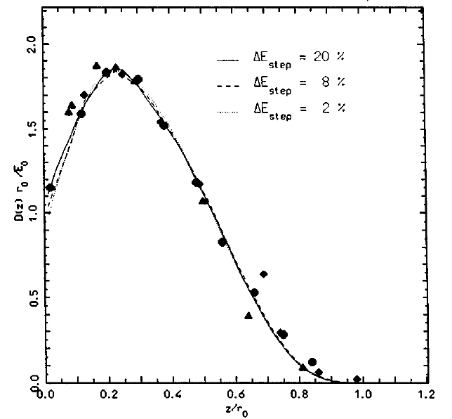
Control of step size
Step size is fixed by the corresponding percentage energy loss of the particle
Thanks to FLUKA mcs and boundary treatment, results are stable vs. (reasonable) step size
Comparison of calculated and experimental depth-dose profiles, for 0.5 MeV e⁻ on Al,
with three different step sizes. (2%, 8%, 20%)
Symbols: experimental data.
r₀ is the csda range
Notes:
29

Slide 30
Control of step size II
Step sizes are optimized by the DEFAULT settings. If the user REALLY needs to change them with:
DEstep should always be below 30%
  In most routine problems, a 20% fraction energy loss gives satisfactory results. For dosimetry, 5-10% should be preferred.
WARNING : if a magnetic field is present, it is important to set also a maximum absolute step length and possibly a precision goal for boundary crossing by means of command STEPSIZE (see later)
For EM
* ..+....1....+....2....+....3....+....4....+....5....+....6....+....7..
EMFFIX Mat1 DEstep1 Mat2 DEstep2 Mat3 DEstep3
For Had/μ
* ..+....1....+....2....+....3....+....4....+....5....+....6....+....7..
FLUKAFIX DEstep Mat1 Mat2 Step
Notes:
30

Slide 31
Magnetic field tracking in FLUKA
FLUKA allows for tracking in arbitrarily complex magnetic fields. Magnetic field tracking is performed by iterations until a given accuracy when crossing a boundary is achieved.
Meaningful user input is required when setting up the parameters defining the tracking accuracy.
Furthermore, when tracking in magnetic fields FLUKA accounts for:
  The precession of the mcs final direction around the particle direction: this is critical in order to preserve the various correlations embedded in the FLUKA advanced MCS algorithm
  The precession of a (possible) particle polarization around its direction of motion: this matters only when polarization of charged particles is a issue (mostly for muons in Fluka)
  The decrease of the particle momentum due to energy losses along a given step and hence the corresponding decrease of its curvature radius. Since FLUKA allows for fairly large (up to 20%) fractional energy losses per step, this correction is important in order to prevent excessive tracking inaccuracies to build up, or force to use very small steps
Notes:
31

Slide 32
How to define a magnetic field
Declare the regions with field in the ASSIGNMAT card (what(5))
Set field/precision with the card MGNFIELD:
IF the field is UNIFORM set its components (tesla) in B_{x}, B_{y,} B_{z}
If not, leave B_{x}=B_{y}= B_{z}=0 and provide a magnetic field pointwise through the user routine MGNFLD (see later)
α, ε, Smin control the precision of the tracking, (see next slides) . They can be overridden/complemented by the STEPSIZE card
* ..+....1....+....2....+....3....+....4....+....5....+....6....+....7..
MGNFIELD α ε Smin Bx By Bz
Notes:
32

Slide 33
Magnetic field tracking in FLUKA
The true step (black) is approximated by linear sub-steps. Sub-step length and boundary crossing iteration are governed by the required tracking precision
The red line is the path actually followed,
the magenta segment is the last substep, shortened because of a boundary crossing
  α= max. tracking angle (MGNFIELD)
  ε = max. tracking/missing error (MGNFIELD or STEPSIZE)
  ε ‘ = max. bdrx error (MGNFIELD or STEPSIZE)
The end point is ALWAYS on the true path,
generally NOT exactly on the boundary, but
at a distance < ε ‘ from the true boundary
crossing (light blue arc)
Notes:
33

Slide 34
Setting the tracking precision I
* ..+....1....+....2....+....3....+....4....+....5....+....6....+....7..
MGNFIELD α ε Smin Bx By Bz
α largest angle in degrees that a charged particle is allowed to travel in a single sub-step. Default = 57.0 (but a maximum of 30.0 is recommended!)
ε upper limit to error of the boundary iteration in cm (ε’ in fig.). It also sets the tracking error ε. Default = 0.05 cm
IF α and/or ε are too large, boundaries may be missed ( as in the plot);
IF they are too small, CPU time explodes....
Both α and ε conditions are fulfilled during tracking.
→ Set them according to your problem
Tune ε by region with the STEPSIZE card
Be careful when very small regions exists in your setting : ε must be smaller than the region dimensions!
Notes:
34

Slide 35
Setting the tracking precision II
* ..+....1....+....2....+....3....+....4....+....5....+....6....+....7..
MGNFIELD α ε Smin Bx By Bz
Smin minimum sub-step length. If the radius of curvature is so small that the maximum sub-step compatible with α is smaller than Smin, then the condition on α is overridden. It avoids endless tracking of spiraling low energy particles. Default = 0.1 cm
Particle 1: the sub-step corresponding to α is > Smin -> accept
Particle 2: the sub-step corresponding to α is < Smin -> increase α
Smin can be set by region with the STEPSIZE card
Notes:
35

Slide 36
Setting precision by region
* ..+....1....+....2....+....3....+....4....+....5....+....6....+....7..
STEPSIZE Smin/ε Smax Reg1 Reg2 Step
Smin: (if what(1)>0) minimum step size in cm Overrides MGNFIELD if larger than its setting;
ε (if what(1)<0) : max error on the location of intersection with boundary.;
  The possibility to have different “precision” in different regions allows to save CPU time.
Smax: max step size in cm. Default:100000. cm for a region without magnetic field, 10 cm without;
  Smax can be useful for instance for large vacuum regions with relatively low magnetic field
  It should not be used for general step control, use EMFFIX, FLUKAFIX if needed
Notes:
36

Slide 37
The magfld.f user routine
This routine allows to define arbitrarily complex magnetic fields:
SUBROUTINE MAGFLD ( X, Y, Z, BTX, BTY, BTZ, B, NREG, IDISC)
Input variables:
x,y,z = current position
nreg = current region
Output variables:
btx,bty,btz = cosines of the magn. field vector
B = magnetic field intensity (Tesla)
idisc = set to 1 if the particle has to be discarded
All floating point variables are double precision ones!
BTX, BTY, BTZ must be normalized to 1 in double precision
Notes:
37

Slide 38
Some warnings about scoring:
Every charged particle step Δx has its length constrained by:
  Maximum fractional energy loss (see FLUKAFIX)
  Maximum step size for that region (see STEPSIZE)
  MCS (or other) physical constraints
  Distance to next interaction (nuclear, δ ray etc)
The average energy loss is computed as a careful integration over the dE/dx vs energy curve and then it is fluctuated → a final ΔE is computed and used for scoring → resulting in a scored average effective ΔE/Δx uniform along that step
The particle energy used for track-length estimators is the average one along the step (E₀-ΔE/2)

Slide 39
USRBIN track apportioning scoring
The energy deposition will be Δl/Δx ΔE
Δl
Δx, ΔE

Slide 40
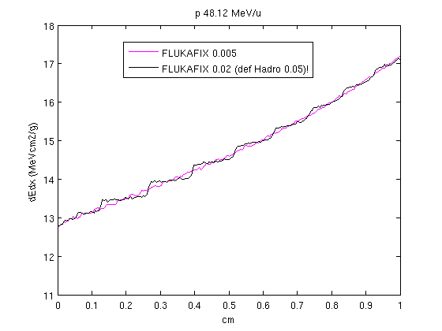
USRBIN track apportioning scoring

Slide 41
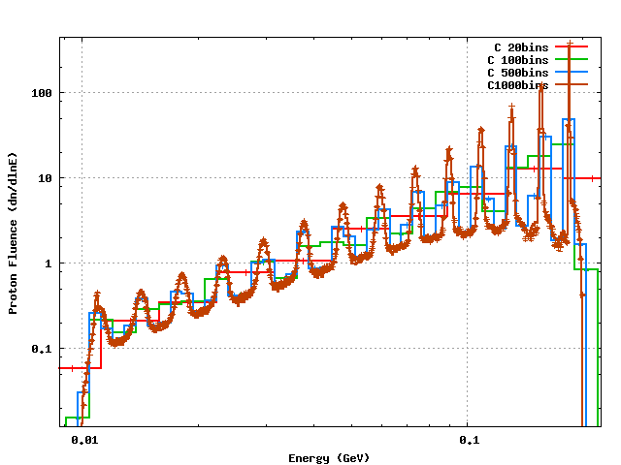
USRTRACK scoring: 200 MeV p on C
Default settings, ≈ 20% energy loss per step

Slide 42
Ionization Transport Cheat Sheet
DELTARAY – Modify Delta-ray effect parameters
STERNHEI - Ionization potential and density effect
MAT-PROP parameters customization
IONFLUCT – Set Ionization fluctuation options
PART-THR - Set particle transport threshold
EMFFIX - Set Step Size control for EM
FLUKAFIX – Set Step Size control for Hadrons/Muons
MGNFIELD - Set magnetic field precision
STEPSIZE - Set stepsize in magnetic field

