Slide 1

Heavy Ions Interactions
FLUKA Beginner’s Course

Slide 2
Overview
The models
DPMJET
RQMD
BME
Input options
Beam definition
Transport thresholds

Slide 3
Heavy ion interaction models in FLUKA - 1
E > 5 GeV/n
Dual Parton Model (DPM)
DPMJET-III (original code by R.Engel, J.Ranft and S.Roesler,
FLUKA-implemenation by T.Empl et al.)
~0.1 GeV/n < E < 5 GeV/n
Relativistic Quantum Molecular Dynamics Model (RQMD)
RQMD-2.4 (original code by H.Sorge et al.,
FLUKA-implementation by A.Ferrari et al.)
E < ~0.1 GeV/n
Boltzmann Master Equation (BME) theory
BME (original code by E.Gadioli et al.,
FLUKA-implementation by F.Cerutti et al.)

Slide 4
Heavy ion interaction models in FLUKA - 2
[even three from BME]

Slide 5
DPMJET
E > 5 GeV/n
Dual Parton Model (DPM)
DPMJET-III (original code by R.Engel, J.Ranft and S.Roesler,
FLUKA-implemenation by T.Empl et al.)
0.1 GeV/n < E < 5 GeV/n
Relativistic Quantum Molecular Dynamics Model (RQMD)
RQMD-2.4 (original code by H.Sorge et al.,
FLUKA-implementation by F.Cerutti et al.)
E < 0.1 GeV/n
Boltzmann Master Equation (BME) theory
BME (original code by E.Gadioli et al.,
FLUKA-implementation by F.Cerutti et al.)

Slide 6
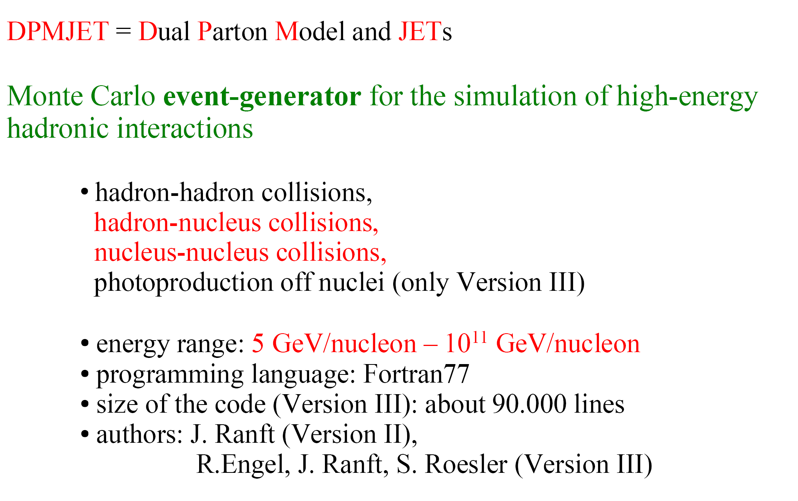
DPMJET – Overview

Slide 7
DPMJET – Main steps of a high energy interaction

Slide 8
DPMJET – The Gribov-Glauber formalism

Slide 9
DPMJET – Intranuclear cascade and fragmentation

Slide 10
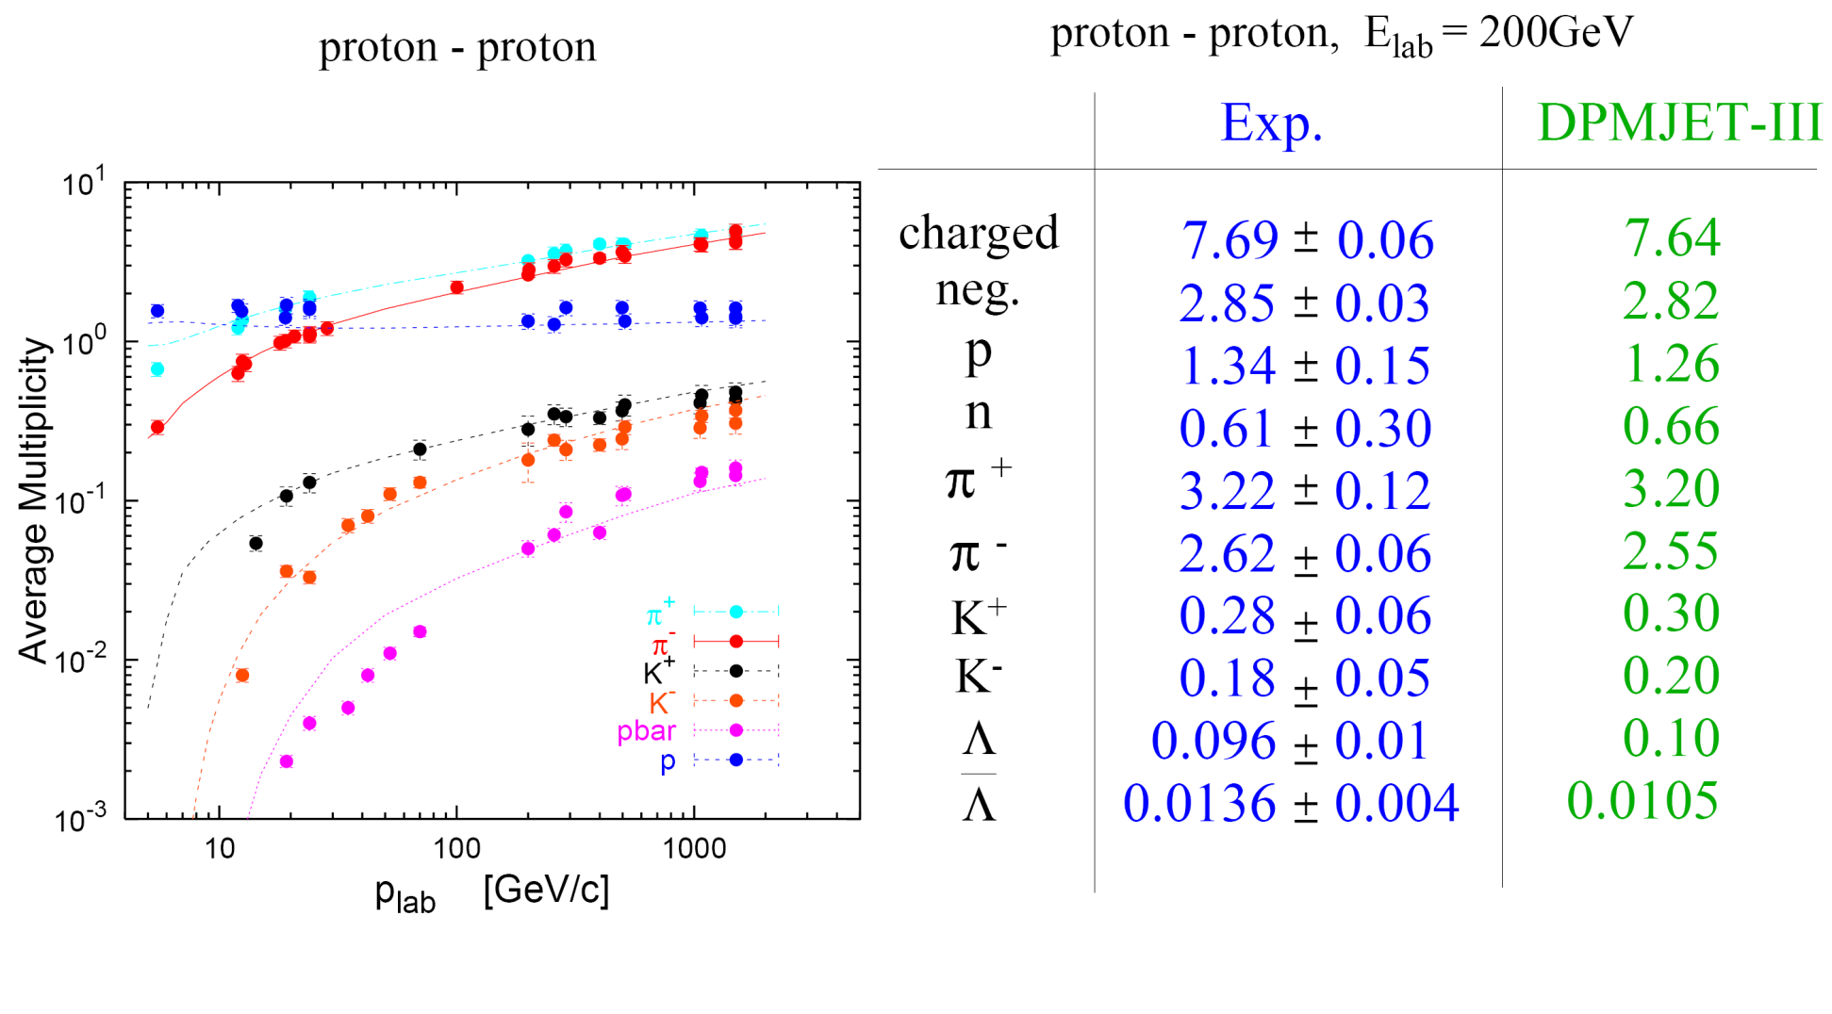
DPMJET – Comparison to data (hadron-hadron)

Slide 11
DPMJET – Comparison to data (hadron-nucleus)

Slide 12
DPMJET – Comparison to data (nucleus-nucleus)

Slide 13
DPMJET – Comparison to data (nucleus-nucleus)
Pseudorapidity distribution of charged hadrons produced in minimum bias d-Au and p-p
collisions at a c.m. energy of 200GeV/A.
Exp. data: BRAHMS- and PHOBOS-Collaborations
J.Ranft, in Proceedings of the Hadronic Shower Simulation Workshop, CP896, Batavia, Illinois (USA), 6-8 September 2006

Slide 14
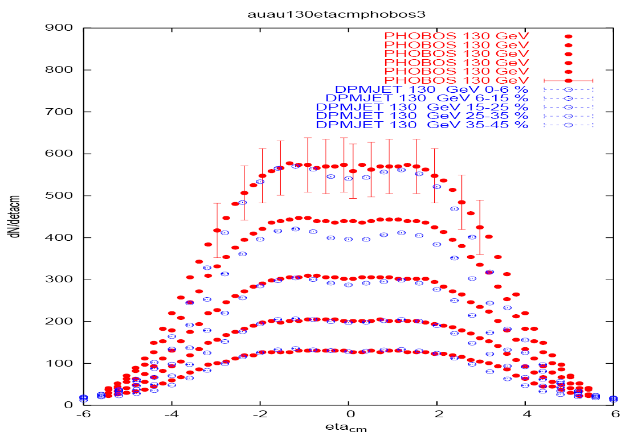
DPMJET – Comparison to data (nucleus-nucleus)
Pseudorapidity distribution of charged hadrons produced in Au-Au collisions at a c.m.
energy of 130GeV/A (left) and 200GeV/A (right) for different ranges of centralities.
Exp. data: PHOBOS-Collaboration
J.Ranft, in Proceedings of the Hadronic Shower Simulation Workshop, CP896, Batavia, Illinois (USA), 6-8 September 2006

Slide 15
DPMJET – Interface to FLUKA

Slide 16
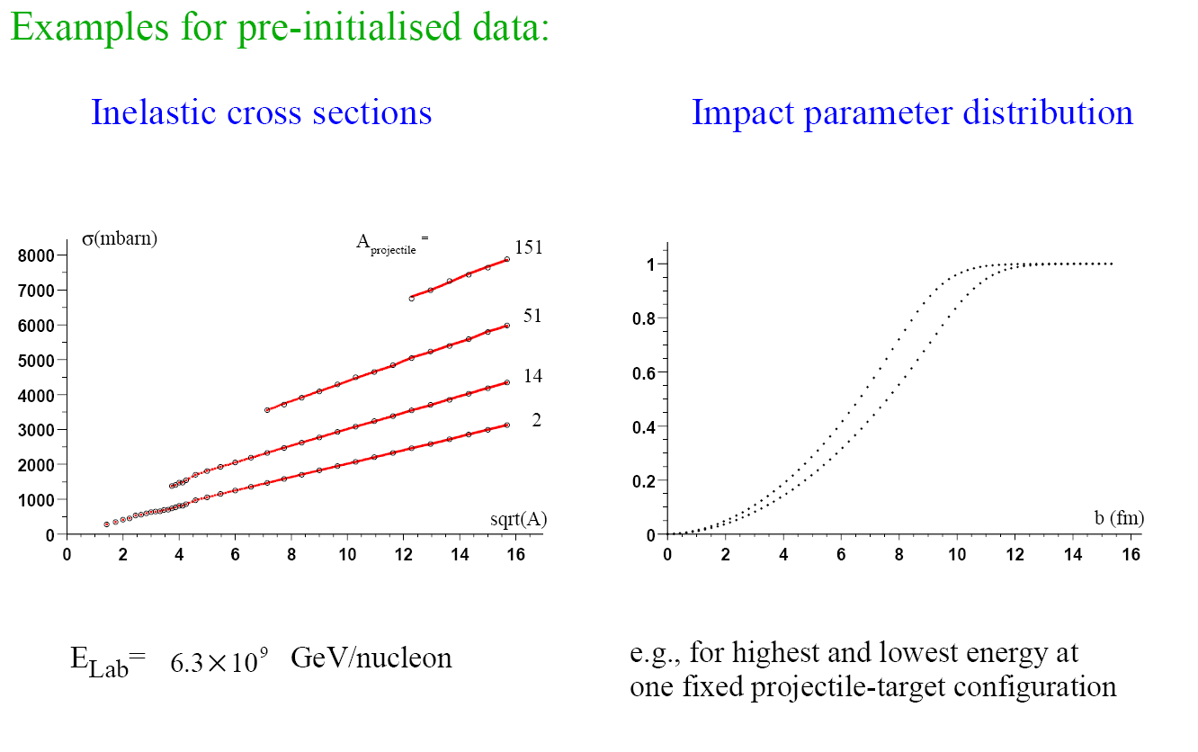
DPMJET – Interface to FLUKA

Slide 17
DPMJET – FLUKA benchmarks
Fragment charge cross sections for
158GeV/n Pb ions on various targets.
FLUKA: solid histogram(total)
dashed histogram (em diss.)
Exp. data: symbols
NPA662, 207 (2000),
NPA707, 513 (2002),
C.Scheidenberger et al. PRC
Z

Slide 18
RQMD
E > 5 GeV/n
Dual Parton Model (DPM)
DPMJET-III (original code by R.Engel, J.Ranft and S.Roesler,
FLUKA-implemenation by T.Empl et al.)
0.1 GeV/n < E < 5 GeV/n
Relativistic Quantum Molecular Dynamics Model (RQMD)
RQMD-2.4 (original code by H.Sorge et al.,
FLUKA-implementation by A.Ferrari et al.)
E < 0.1 GeV/n
Boltzmann Master Equation (BME) theory
BME (original code by E.Gadioli et al.,
FLUKA-implementation by F.Cerutti et al.)

Slide 19
RQMD - References
interface to a suitably modified RQMD model
RQMD-2.4 (H. Sorge, 1998) was successfully applied
to relativistic A-A particle production over a wide energy range
[H. Sorge, Phys. Rev. C 52, 3291 (1995);
H. Sorge, H. Stöcker, and W. Greiner, Ann. Phys. 192, 266 (1989)
and Nucl. Phys. A 498, 567c (1989)]

Slide 20
RQMD – The original code

Slide 21
RQMD – The interfaced code

Slide 22
RQMD – FLUKA benchmarks

Slide 23
RQMD - FLUKA benchmarks

Slide 24
RQMD - FLUKA benchmarks
Isotopic distributions of fragmentation products
fission products excluded
like in the experimental
analysis
exp. data (stars) from J. Benlliure, P. Armbruster et al., Eur. Phys. J A 2, 193 (1998)

Slide 25
BME
E > 5 GeV/n
Dual Parton Model (DPM)
DPMJET-III (original code by R.Engel, J.Ranft and S.Roesler,
FLUKA-implemenation by T.Empl et al.)
0.1 GeV/n < E < 5 GeV/n
Relativistic Quantum Molecular Dynamics Model (RQMD)
RQMD-2.4 (original code by H.Sorge et al.,
FLUKA-implementation by A.Ferrari et al.)
E < 0.1 GeV/n
Boltzmann Master Equation (BME) theory
BME (original code by E.Gadioli et al.,
FLUKA-implementation by F.Cerutti et al.)

Slide 26
BME - References
interface to a Monte Carlo code
founded on the BME theory (E. Gadioli et al.)
[M. Cavinato et al., Nucl. Phys. A 679, 753 (2001),
M. Cavinato et al., Phys. Lett. B 382, 1 (1996)]

Slide 27
BME – The interfaced code
two different main reaction paths have been adopted:
1. COMPLETE FUSION
P_{CF}=σ_{CF}/σ_{R}
composite nucleus formation
2. PERIPHERAL COLLISION
P = 1 - P_{CF}
three body mechanism with possible incomplete fusion
one nucleon break-up and possibly transfer (at high b)
pickup/stripping (for asymmetric systems at low b)
pre-equilibrium de-excitation of the produced fragment(s)
according to the BME theory (where available)
or the PEANUT exciton model
FLUKA evaporation/fission/fragmentation/gamma de-excitation
NB interface to PEANUT pre-eq
not yet distributed!

Slide 28
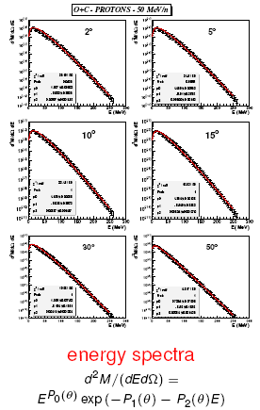
BME – The database for the pre-equilibrium emissions
In order to get the multiplicities of the pre-equilibrium particles and their double differential spectra, the BME theory is applied to several representative systems at different bombarding energies and the results are parameterized.
¹⁶O + ⁶Li, ⁸Li, ⁸B, ¹⁰B, ¹²C, ¹⁴N, ¹⁶O, ¹⁹F, ²⁰Ne, ²⁴Mg, ²⁷Al, ⁵⁶Fe, ¹⁹⁷Au
¹²C + ⁸Li, ⁸B, ¹²C, ²⁷Al, ⁴⁰Ca
@ 12, 30, 50, 70, 100 MeV/n
Work is ongoing to extend it to more massive systems, i.e.
⁴⁰Ca + ¹²⁰Sn
⁵⁶Fe + ²⁸Si, ⁴⁰Ca, ⁴⁸Ca, ¹²⁰Sn
and consequently review the fitting functions
and the extrapolation recipes over a significantly larger mass range

Slide 29
BME – Theoretical framework

Slide 30
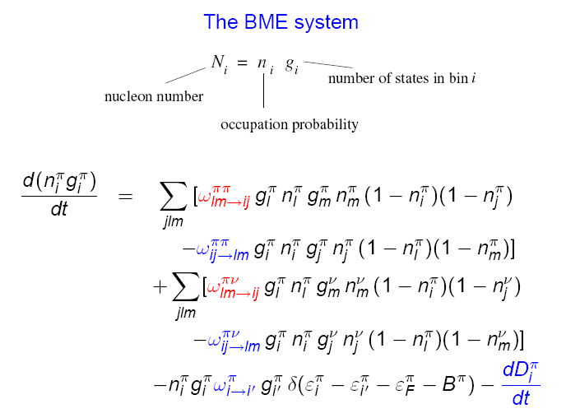
BME – Theoretical framework

Slide 31
BME – Theoretical framework

Slide 32
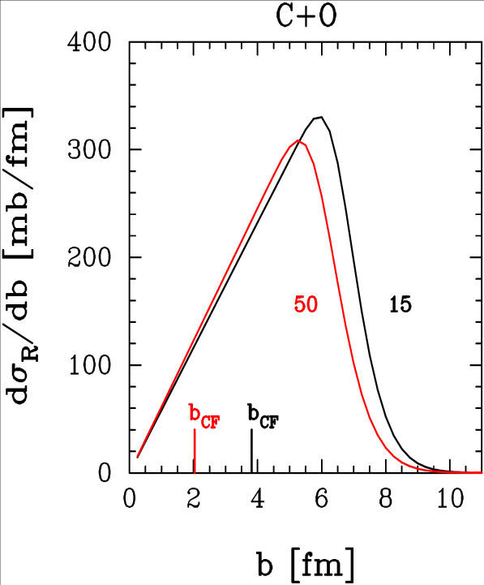
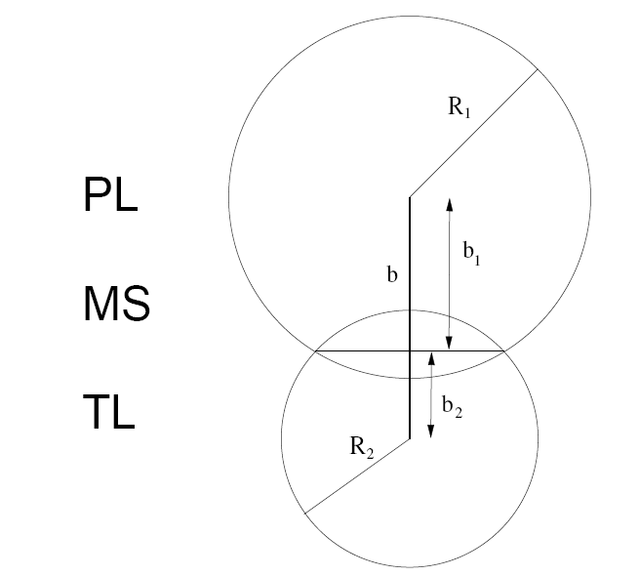
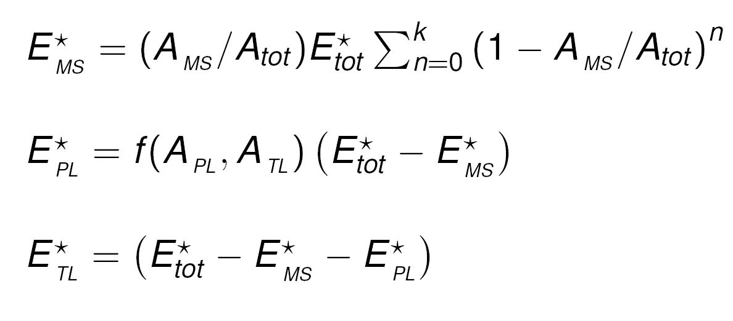
BME – Peripheral collisions
We integrate the nuclear densities of the projectile and the target over their overlapping region, as a function of the impact parameter, and obtain a preferentially excited “middle source” and two fragments (projectile- and target-like). The kinematics is suggested by break-up studies.
i. selection of the impact parameter b
ii. kinematics determination
θ_{PL} , θ_{TL} chosen according to [dσ/dΩ]_{cm} ~ exp(-kθ_{cm})
θ_{MS} momentum conservation
p_{PL} , p_{TL} chosen according to a given energy loss distribution
p_{MS} momentum conservation
φ_{PL} free
φ_{TL} , φ_{MS} same reaction plane
iii. excitation energy sharing
forced on the experimental values
in the discrete level region

Slide 33
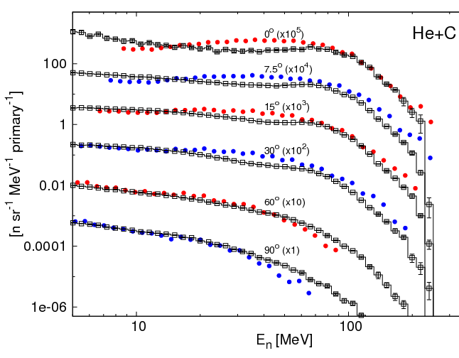
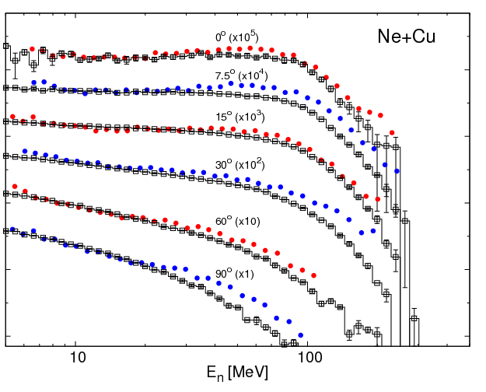
BME – Benchmarking
DOUBLE DIFFERENTIAL NEUTRON YIELDS
FROM 100 MeV/n BEAMS ON THICK TARGETS
FLUKA vs experimental data from T. Kurosawa, N. Nakao, T. Nakamura et al., Nucl. Sci. Eng. 132, 30 (1999)

Slide 34
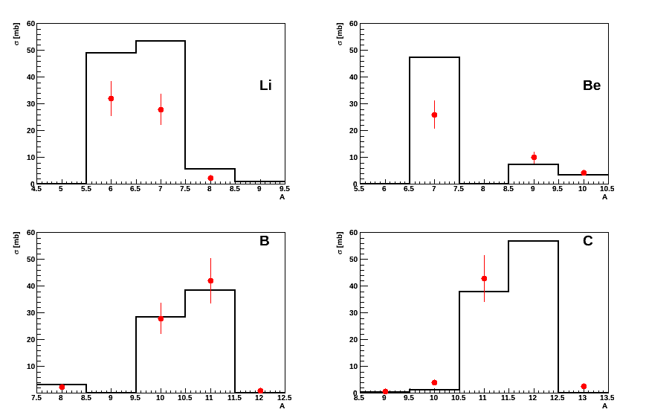
BME – Benchmarking
ISOTOPE YIELDS
FROM C+C at 86 MeV/n
experimental data from H. Ryde, Physica Scripta T5, 114 (1983)

Slide 35
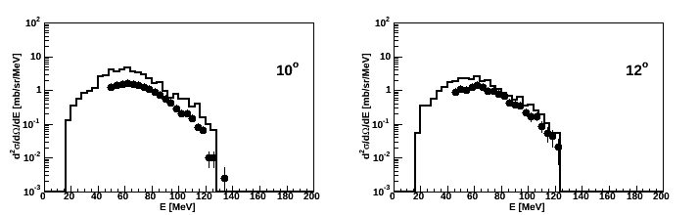
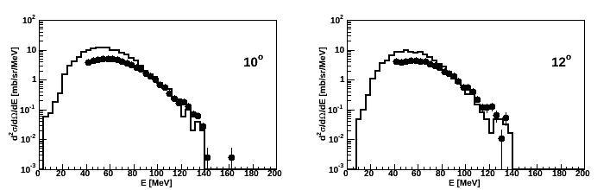
BME – Benchmarking
DOUBLE DIFFERENTIAL FRAGMENT SPECTRA
FROM C+C at 13 MeV/n
Fluorine
Oxygen
experimental data by courtesy of S. Fortsch et al., iThemba Labs, South Africa

Slide 36
Input options - 1
a) define momentum / energy
BEAM -10.0 0.0 0.0 0.0 0.0 0.0HEAVYION
WHAT(1) > 0.0 : average beam momentum (GeV/c)
< 0.0 : average beam kinetic energy (GeV)
WHAT(2) beam momentum spread (GeV/c)
Note: for SDUM = HEAVYION units per nucleon (in fact per nmu)
for SDUM = 4-HELIUM, etc. per nucleus
WHAT(3)-WHAT(6) (as for any other particle)
SDUM = HEAVYION
also 4-HELIUM alpha
3-HELIUM 3-helium
TRITON tritium
DEUTERON deuterium

Slide 37
Input options - 2
b) define charge and mass (required for BEAM/SDUM=HEAVYION)
HI-PROPE 79.0 197.0 0.0 0.0 0.0 0.0
WHAT(1) = Atomic number Z of the heavy ion, Default: 6.0
WHAT(2) = Mass number A of the heavy ion, Default: 12.0
WHAT(3) = if < 0 isomeric state of the heavy ion
c) switch on heavy ion transport and interactions
IONTRANS -2.0 (pleonastic in case of ion beams)
Note: Don’t forget to link the DPMJET/RQMD event generators for enabling ion-ion interactions above 125MeV/n either using FLAIR or $FLUPRO/flutil/ldpmqmd
The BME event generator, covering the low energy range up to 150MeV/n (125MeV/n is the default threshold, that you can change through PHYSICS/SDUM=DPMTHRES), does not need to be linked since it’s already embedded in the main FLUKA library

Slide 38
Input options - 3
Notes:
  The transport momentum threshold for ions (p_{th,HI}) is fixed to that of
  alphas (p_{th,α})
  p_{th,HI} = p_{th,α} x m_{HI}/m_{α} (GeV/c)
  Unless the transport threshold for alphas is defined with a PART-THR card
  (requiring GeV and not GeV per nucleon) it is set equal to 10 MeV
  if DEFAULTS=NEW-DEFA.
  When the energy of an ion becomes lower than the transport threshold,
  and if such threshold is lower than 100 MeV/n, the ion is not stopped,
  but it is ranged out to rest

Slide 39
Input options - 4
Electromagnetic dissociation
PHYSICS 2.0 0.0 0.0 0.0 0.0 0.0EM-DISSO
WHAT(1) : flag for activating ion electromagnetic-dissociation
=< -1.0 : resets to default (no em-dissociation)
= 0.0 : ignored
= 1.0 : (default) no em-dissociation
= 2.0 : projectile and target em-dissociation activated
= 3.0 : projectile only em-dissociation activated
= 4.0 : target only em-dissociation activated
WHAT(2)-WHAT(6): not used

