Slide 1
Advanced Geometry
FLUKA Beginner’s Course

Slide 2
Contents
body transformations
lattice
voxels

Slide 3
Geometry directives
Special commands enclosing body definition:
$Start_xxx
.......
$End_xxx
They provide respectively a coordinate expansion/reduction, a coordinate translation or a coordinate roto-translation of the bodies embedded between the starting and the ending directive lines.
where "xxx" stands for
“expansion“, "translat" or "transform"

Slide 4
Directives in geometry: expansion/reduction
$Start_expansion ... $End_expansion
it provides a coordinate expansion (reduction) factor f for all bodies embedded within the directive
$Start_expansion 10.0
SPH Sphere 5.0 7.0 8.0 50.0
$End_expansion
transforms a sphere of radius 50 centered in (+5,+7,+8)
into a sphere of radius 500 centered in (+50,+70,-80)
Putting the body in its quadric form
A_{xx} x² + A_{yy} y² + A_{zz} z² + A_{xy} xy + A_{xz} xz + A_{yz} yz + A_{x} x + A_{y} y + A_{z} z + A₀ = 0
A_{xx} A_{xy}/2 A_{xz}/2 A_{x}/2 x
A_{xy}/2 A_{yy} A_{yz}/2 A_{y}/2 y
A_{xz}/2 A_{yz}/2 A_{zz} A_{z}/2 z
A_{x}/2 A_{y}/2 A_{z}/2 A₀ 1
the expansion/reduction matrix is T =
and the transformed body equation is r^{T} (T⁻¹)^{T} M_{QUA} T⁻¹ r = 0
or [ x y z 1 ]
= 0 i.e. r^{T} M_{QUA} r = 0
f 0 0 0
0 f 0 0
0 0 f 0
0 0 0 1
4
Notes:
4

Slide 5
Directives in geometry: translation
$Start_translat ... $End_translat
it provides a coordinate translation S_{x},S_{y},S_{z} for all bodies embedded within the directive
$Start_translat -5.0 -7.0 -8.0
SPH Sphere 5.0 7.0 8.0 50.0
$End_translat
transforms a sphere of radius 50 centered in (+5,+7,+8)
into a sphere of radius 50 centered in (0,0,0)
1 0 0 S_{x}
0 1 0 S_{y}
0 0 1 S_{z}
0 0 0 1
the translation matrix is T =
5
Notes:
5

Slide 6
Directives in geometry: roto-translation
$Start_transform ... $End_transform
it applies a pre-defined (via ROT-DEFI) roto-translation to all bodies embedded within the directive
ROT-DEFI , 201.0, 0., +116.5650511770780, 0., 0., 0., cylrot
$Start_transform cylrot
QUA Cylinder 0.5 1.0 0.5 0.0 1.0 0.0 0.0 0.0 0.0 -4.0
$End_transform
transforms an infinite circular cylinder of radius 2 with axis {x=-z,y=0}
into an infinite circular cylinder of radius 2 with axis {x=z/3,y=0} (clockwise rotation)
- it allows to rotate a RPP avoiding the use of the deprecated BOX !
- note that also the inverse transformation can be used T⁻¹
$Start_transform -cylrot
S_{x}
R S_{y}
S_{z}
0 0 0 1
the roto-translation matrix is T =
6
Notes:
6

Slide 7
ROT-DEFIni
The ROT-DEFIni card defines roto-translations that can be applied, in addition to bodies, to i. USRBIN & EVENTBIN and ii. LATTICE. It transforms the position of the tracked particle i. before scoring with respect to the defined binning or ii. into the prototype with the order:
First applies the translation
followed by the rotation on the azimuthal angle
and finally by the rotation on the polar angle.
X_{new} = M_{polar} × M_{az} × (X + T)
WHAT(1): assigns a transformation index and the corresponding rotation axis I + J * 100 or I * 1000 + J
I = index of rotation (WARNING: NOTE THE SWAP OF VARIABLES)
J = rotation with respect to axis (1=X, 2=Y, 3=Z)
WHAT(2): Polar angle of the rotation (0 ≤ ϑ ≤ 180º degrees)
WHAT(3): Azimuthal angle of the rotation (-180 ≤ ϕ ≤ 180º degrees)
WHAT(4), WHAT(5), WHAT(6) = X, Y, Z offset for the translation
SDUM: Optional (but recommended) name for the transformation

Slide 8
Directives in geometry: warnings
$Start_expansion and $Start_translat are applied when reading the geometry → no CPU penalty (the concerned bodies are transformed once for ever at inizialization)
$Start_transform is applied runtime → some CPU penalty
One can nest the different directives (at most one per type!) but, no matter the input order, the adopted sequence is always the following:
$Start_transform StupiRot
$Start_translat -5.0 -7.0 -8.0
$Start_expansion 10.0
QUA WhatIsIt +1.0 +1.0 +1.0 0.0 0.0 0.0 -10.0 -14.0 -16.0 -2362.0
$End_expansion
$End_translat
$End_transform
Directives are not case sensitive (whereas roto-translation names are)
8
Notes:
8

Slide 9
Identifying rotation angles
Let’s define the orientation of a body in the space by a system of 3 orthogonal versors i’, j’, k’ , whose coordinates are expressed with respect to the fixed reference frame X,Y,Z
Then [ i’ j’ k’ ] = (in the ZXZ convention)
where c₁=cos(ψ) c₂=cos(θ) c₃=cos(Φ) s₁=sin(ψ) s₂=sin(θ) s₃=sin(Φ)
k’
j’
i’
here Φ = 45º θ = 30º ψ = -60º
The obtained Euler angles can be input as azimuthal angle of three consecutive rotations (ROT-DEFI)
9
Notes:
9

Slide 10
Lattice
FLUKA geometry has replication (lattice) capabilities
Only one level is implemented (no nested lattices are allowed)
The user defines lattice positions in the geometry and provides transformation rules from the lattice to the prototype region:
in the input with the ROT-DEFI card
in a subroutine (lattic.f)
The lattice identification is available for scoring
Transformations include: Translation, Rotation and Mirroring (the last only through routine).
WARNING:
Do not use scaling or any deformation of the coordinate system

Slide 11
Lattice
The regions which constitute the elementary cell (prototype) to be replicated, have to be defined in detail
The Lattices (replicas/containers) have to be defined as “empty” regions in their correct location. WARNING: The lattice region should map exactly the outer surface definition of the elementary cell.
The lattice regions are declared as such with a LATTICE card at the end of the geometry input
In the LATTICE card, the user also assigns lattice names/numbers to the lattices. These names/numbers will identify the replicas in all FLUKA routines and scoring
Several basic cells and associated lattices can be defined within the same geometry, one LATTICE card will be needed for each set
Non-replicas carry the lattice number 0
Lattices and plain regions can coexist in the same problem

Slide 12
LATTICE card
After the Regions definition and before the GEOEND card the user can insert the LATTICE cards
WHAT(1), WHAT(2), WHAT(3) Container region range (from, to, step)
WHAT(4), WHAT(5), WHAT(6) Name/number(s) of the lattice(s)
SDUM blank to use the transformation from the lattic routine ROT#nn to use a ROT-DEFI rotation/translation from input name the same as above but identifying the roto-translation by the name assigned in the ROT-DEFI SDUM (any alphanumeric string you like)
Example
*...+....1....+....2....+....3....+....4....+....5....+....6....+....7....+...
LATTICE 6.00000 19.00000 101.0000 114.00
Region # 6 to 19 are the “placeholders” for the first set replicas. We assign to them lattice numbers from 101 to 114
LATTICE TARGR1 TargRep 1tra
TARGR1 is the container region using transformation 1tra

Slide 13
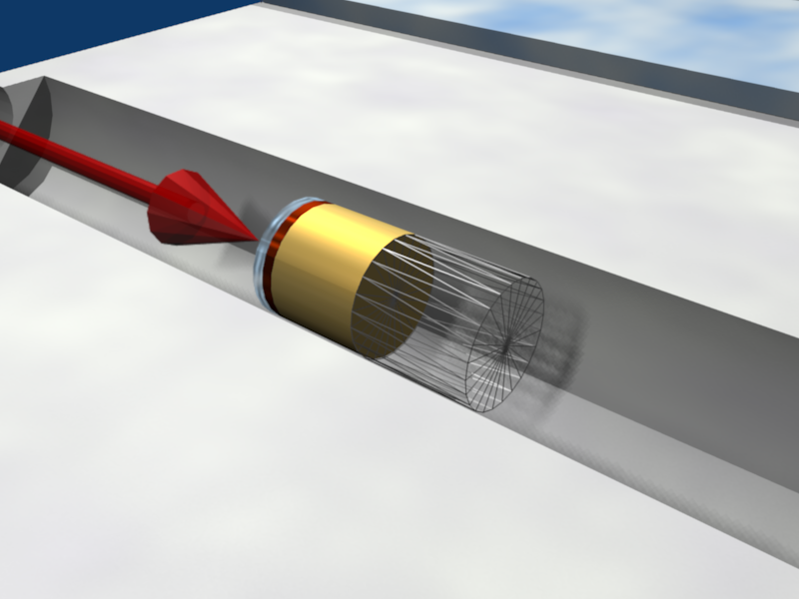
Example
Prototype
regions
Empty
lattice container

Slide 14
Example
Replica
Transformation
Prototype
regions
For every particle
entering the replica
Its coordinates are transformed to the
prototype, where FLUKA performs the tracking

Slide 15
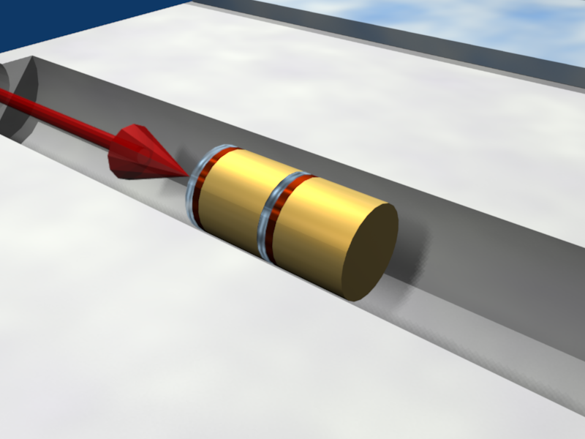
Example
Prototype
cell
Empty
lattice cell
Final
replica

Slide 16
Transformation by input
Rotations/Translations can be defined with the ROT-DEFIni card
Can be assigned to a lattice by name or with ROT#nnn SDUM in the LATTICE card
ROT-DEFIni cards can be consecutive (using the same index or name) to define complex transformations
WARNING:
Since matrix multiplication is not commutative the order of the Rotation/Translation operations in 3D is important.

Slide 17
Numerical Precision
Due to the nature of the floating point operations in CPU, even if the transformation looks correct the end result could be problematic
This small misalignment between lattice/transformation/prototype could lead to geometry errors
Use as many digits as possible to describe correctly the prototype and lattice cells as well as the transformation. It is mandatory that the transformation applied to the container makes the latter EXACTLY corresponding to the prototype
One can use a FREE and FIXED card before and after the ROT-DEFI to input more than 9 digits
GEOBEGIN WHAT(2) allows to relax the accuracy in boundary identification (USE WITH CAUTION)
Prototype
Transformation
Lattice

Slide 18
Lattice: Important remarks
Materials and other properties have to be assigned only to the regions constituting the prototype.
In all (user) routines the region number refers to the corresponding one in the prototype.
The SCORE summary in the .out file and the scoring by regions add together the contributions of the prototype region as well as of all its replicas!
The lattice identity can be recovered runtime by the lattice number, as set in the LATTICE card or available through the GEON2L routine if is defined by name
In particular, the LUSRBL user routine allows to manage the scoring on lattices in the special USRBIN/EVENTBIN structure.

Slide 19
The USRBIN/EVENTBIN special binning
EVENTBIN or USRBIN with WHAT(1)=8 :
Special user-defined 3D binning. Two variables are discontinuous (e.g. region number), the third one is continuous, but not necessarily a space coordinate.
Variable | Type | Default | Override Routine
1st | integer | region number | MUSRBR
2nd | integer | lattice cell number | LUSRBL
3rd | float | zero | FUSRBV

Slide 20
Tips & Tricks
Always remember that the transformation must bring the container onto the prototype and not viceversa!
You can always divide a transformation into many ROT-DEFI cards for easier manipulation.
Rotations are always around the origin of the geometry, and not the center of the object.
To rotate an object, first translate the object to the origin of the axes
Perform the rotation
Move it by a final translation to the requested position. Of course with the inverse order since everything should apply to the replica
In order to define the replica body, you can clone the body enclosing the prototype (assigning it a new name!) and apply to it the $Start_transform directive with the inverse of the respective ROT-DEFI transformation.

Slide 21
Tips & Tricks
GEOBEGIN
...
RPP CollProt -540.0 -460.0 -20.0 20.0 100.0 300.0
$start_transform –rotColl *
RPP CollRepl -540.0 -460.0 -20.0 20.0 100.0 300.0
$end_transform
...
GEOEND
ROT-DEFI, 1.0, 0.0, 0.0, 0.0, 0.0, -350.0, rotColl [A]
ROT-DEFI, 201.0, 0.0, -15.0, 0.0, 0.0, 0.0, rotColl [B]
ROT-DEFI, 1.0, 0.0, 0.0, -500.0, 0.0, 200.0, rotColl [C]
C⁻¹
* Remember: if R=CBA, then R⁻¹=A⁻¹B⁻¹C⁻¹
B⁻¹
A⁻¹
21

Slide 22
(Tips & Tricks)
The Geometry transformation editor in flair can read and write ROT-DEFI cards with the transformation requested
An easy way of creating a replica and the associated transformation is the following:
Select the body defining the outer cell of the prototype
Clone it with (Ctrl-D) and change the name of the clones. Click on “No” when you are prompted to change all references to the original name.
Open the Geometry transformation dialog (Ctrl-T)
Enter the transformation of the object in the listbox
Click on “Transform” to perform the transformation on the clone bodies
Click on “Invert” button to invert the order of the transformation
Enter a name on the “ROT-DEFIni” field and click “Add to Input” to create the ROT-DEFIni cards
Now you have to create manually the needed regions and the LATTICE cards

Slide 23
The FLUKA voxel geometry
It is possible to describe a geometry in terms of “voxels”, i.e., tiny parallelepipeds (all of equal size) forming a 3-dimensional grid
23

Slide 24
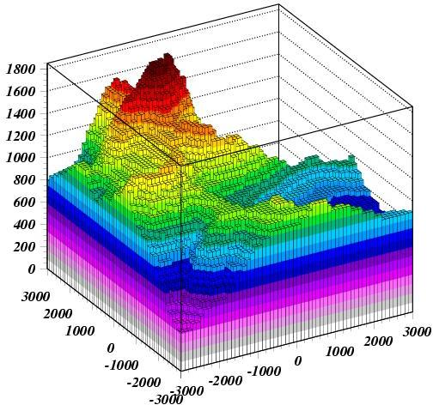
An example
The Gran Sasso in FLUKA

Slide 25
Another example, for medical applications
Voxel geometries are especially useful to import CT scan of a human body, e.g., for dosimetric calculations of the planned treatment in radiotherapy
Commercial TPS
FLUKA
mGy
mGy
[K. Parodi et al., 2007]
25
Notes:
25

Slide 26
Concepts
The CT scan contains integer values “Hounsfield Unit” reflecting the X-ray attenuation coefficient μ_{x}
HU_{x} = 1000 (μ_{x}-μ_{H20}) / μ_{H20} , typically -1000 ≤ HU ≤ 3500
We will use loosely the word “organ” to indicate a group of voxels (or even more than one group) made of the same “tissue” material (same HU value or in a given HU interval)
The code handles each organ as a CG region, possibly in addition to other conventional “non-voxel” regions defined by the user
The voxel structure can be complemented by parts written in the standard Combinatorial geometry
The code assumes that the voxel structure is contained in a parallelepiped. This RPP is automatically generated from the voxel information.
26

Slide 27
Procedure
To describe a voxel geometry, the user must convert his CT scan or equivalent data to a format understood by FLUKA
This stage should :
Assign an organ index to each voxel. In many practical cases, the user will have a continuum of CT values (HU), and may have to group these values in intervals
Each organ is identified by a unique integer ≤32767. The organ numbering does not need to be contiguous (i.e. “holes” in the numbering sequence are allowed.)
One of the organs must have number 0 and plays the role of the medium surrounding the voxels (usually vacuum or air).
The user assigns to each NONZERO organ a voxel-region number. The voxel-region numbering has to be contiguous and starts from 1.
27

Slide 28
Procedure
The information is input to FLUKA through a special unformatted file *vxl containing:
The number of voxels along each coordinate axis
The number of voxel-regions, and the maximum organ number
The voxel dimension along each coordinate axis
A 3D matrix specifying the organ to which each voxel corresponds
in Fortran list-oriented format, with the x coordinate running faster than y, and y running faster than z.
val(1) corresponds to 1,1,1 == organ # of first voxel … … val(N_{x}) corresponds to N_{x},1,1 val(N_{x}+1) corresponds to 1,2,1 … …
val(2*Nx) corresponds to N_{x},2,1 … val(N_{y}*N_{x}) corresponds to N_{x},N_{y},1 … … val(N_{z}*N_{y}*N_{x}) corresponds to N_{x},N_{y},N_{z} == organ # of last voxel
A list of the voxel-region number corresponding to each organ
28

Slide 29
Input file: geometry description
Prepare the usual FLUKA input file.
The geometry is written like a normal Combinatorial Geometry input, but in addition a VOXELS card must be inserted right after the GEOBEGIN card and before the Geometry title card
WHAT(1), WHAT(2), WHAT(3) = x, y, z coordinates chosen as the origin of the “voxel volume”, i.e. the corner of a RPP extending from WHAT(1) to WHAT(1) + NX*DX, … and containing all the voxels
WHAT(4) possible ROT-DEFI transformation applying to the RPP
(WHAT(5), WHAT(6): not used)
SDUM = name of the voxel file
(extension will be assumed to be .vxl)
VOXELS -20.0 -30.0 -40.0 transf ct

Slide 30
Input file: geometry description
One will have
The usual list of NB bodies, not including the RPP corresponding to the “voxel volume” (see VOXELS card above). This RPP will be generated and added automatically by the code as the (NB+1) ^{th} body, with one corner in the point indicated in the VOXELS card, and dimensions NX*DX, NY*DY and NZ*DZ as read from the voxel file.
The usual list of NR regions, with the space occupied by the body named VOXEL or numbered NB+1 (the “voxel volume”) subtracted. In other words, the NR listed regions must cover the whole available space, except the space corresponding to the “voxel volume”. This is easily obtained by subtracting the body VOXEL (or NB+1) in the relevant region definitions, even though this body is not explicitly input at the end of the body list.
* vacuum inside
VACI 5 +SHI +SHTB -SHBT -VOXEL

Slide 31
Voxel Regions
The code will automatically generate NO+2 additional regions, where NO = number of non-zero organs:
Name | Number | Description
VOXEL | NR+1 | sort of a “cage” for all voxels. Nothing should ever be deposited in it. The user shall assign vacuum to it.
VOXEL001 | NR+2 | containing all voxels belonging to organ number 0. There must be at least 2 of such voxels, but in general they should be many more. Typical material assignment to this region is air
VOXEL002 | NR+3 | corresponding to organ 1
VOXEL003 | NR+4 | corresponding to organ 2
VOXEL### | NR+2+NO | corresponding to organ NO

Slide 32
Voxel Material Assignment
The assignment of materials shall be made by the card ASSIGNMAt (and in a similar way for other region-dependent options) referring to the first NR regions in the usual way, and to the additional voxel regions using the correspondence to organs.
ASSIGNMA BLCKHOLE BLKH
ASSIGNMA VACUUM VACO
ASSIGNMA ALUMINUM AL
ASSIGNMA VACUUM VACI
ASSIGNMA VACUUM VOXEL
ASSIGNMA VACUUM VOXEL001
ASSIGNMA TITANIUM VOXEL002
ASSIGNMA AIR VOXEL003
ASSIGNMA COPPER VOXEL004
ASSIGNMA CALCIUM VOXEL005
ASSIGNMA CARBON VOXEL006
ASSIGNMA AIR VOXEL007
cage
0 Organ
6 “Non- zero”
organs

Slide 33
Summary of the relevant input cards
$Start_expansion $End_expansion
$Start_translat $End_translat (inside the geometry input)
$Start_transform $End_transform
to manipulate bodies
ROT-DEFI
to define roto-translations
LATTICE (inside the geometry input)
to declare a region as a replica placeholder and associate it to a given transformation
VOXEL (inside the geometry input)
to introduce a voxel geometry
etc.
33

