Slide 1
Cosmic Rays
Beginner’s FLUKA Course

Slide 2
Galactic Cosmic Rays
Composition:
90% protons, 9% Helium,
< 1% Ions (particles)
64% protons, 25% Helium, 11% Ions (nucleons)
Spectrum:
broad spectrum, peaks around 1 GeV/n
Intensity:
(E > 10 MeV/n) ∼ 5 p/(cm² s) @ Solar Min.
Dose/Dose Equivalent:
~ 0.4 mGy/d, 1 mSv/d (no geomagnetic cut off)

Slide 3
GCR: How To Calculate?
A full (and accurate) calculation requires:
the determination of the spectrum and composition of cosmic rays at the local interstellar medium
the determination of changing conditions in the solar wind magnetic field and the resulting interaction with the inward flow of galactic cosmic rays from the local interstellar medium
the determination of the trajectories of cosmic rays through the Earth's geomagnetic field
the transport of the surviving incident cosmic rays through the Earth's atmosphere to various depths.

Slide 4
GCR in FLUKA
Primary cosmic ray spectra and interplanetary modulation according to measured solar activity on a day-to-day basis are available
Geomagnetic effects are implemented with full multipole expansion
Extensive benchmarks against available muon and hadron measurement data
Used by several laboratories (Frascati, Siegen, Bartol, Houston, GSF,…) for simulating the radiation fields generated by cosmic rays in the atmosphere and/or inside spacecrafts

Slide 5
GCR: How To Calculate with FLUKA
The Galactic Cosmic Ray (GCR) component of the cosmic ray flux can be simulated up to 30 TeV/nucleon (or 500 TeV/n when DPMJET is linked)
The following general options are available concerning the simulation of cosmic ray interactions in FLUKA:
Superposition model: in this approach (All-Nucleon Spectrum) primary nuclei are split into equivalent independent nucleons. See card PHYSICS with SDUM = IONSPLITti
DPMJET interaction model (All-Particle Spectrum): this model simulates the nucleus-nucleus collision above 5 GeV/nucleon. In case DPMJET is chosen for cosmic ray application, it is suggested to avoid the otherwise recommended DPMJET-III choice and to use instead the DPMJET-II.5 version
(linking with the script $FLUPRO/flutil/ldpm2qmd)
The DMPJET and the superposition model can also be used together, by setting the respective energy ranges with the PHYSICS card.

Slide 6
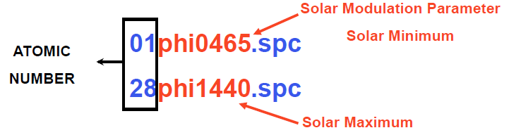
The All-Particle spectrum
The ion composition of the galactic flux is derived from a code (Badhwar & O’Neil 1996) which considers all elemental groups from Z = 1 to Z = 28 (Ni). The spectrum is modified to follow recent data sets from the AMS and BESS experiments up to 100 GeV, according to the so-called ICRC2001 fit.
The spectrum components are written in 28 files:
These spectra are without geomagnetic cutoff. They are used together with an analytical calculation of the rigidity cutoff, according to a centered dipole approximation of the Earth geomagnetic field, adapted to result in the vertical cutoff inserted into the FLUKA input file (SPECSOUR command, SDUM = GCR-IONF, WHAT(2) of the continuation card), at the geomagnetic latitude and longitude of interest.
Spectra of Solar Particle Events of Jan 20th, 2005 and Oct 28th 2003 are also available

Slide 7
The ALL-Nucleon Spectrum (1)
Based on a modified fit of the All-Nucleon flux proposed by the Bartol group, using the All-Particle Spectrum up to 100 GeV and data published in ICRC 2003
For the proton component at energies larger than 100 GeV, using the normalization obtained at 100 GeV, a spectral index γ = -2.71 is assumed
A spectral index γ = -3.11 is assumed above the knee at 3000 TeV
For what concerns the He component, γ = -2.59 is used above 100 GeV and a charge-dependent knee is assumed according to the rule: E_{nucleon} = Z * 3000 TeV/A
Higher Z components have been grouped in CNO, MgSi and Fe sets and treated using an All-Particle spectrum with the above mentioned charge-dependent knee parametrization

Slide 8
The ALL-Nucleon Spectrum (2)
Fluxes are read from a file named "allnucok.dat" giving the total energy (GeV), the fluxes (E.dN/dE) and the neutron/proton ratios
This option ("All Nucleon Flux") is chosen with command SPECSOUR and SDUM = GCR-ALLF
The user can decide whether
  to sample neutrons and protons from the file and to transport them using the superposition model
  or
  to consider all neutrons as being bound in alpha particles and to transport protons and alphas (better for magnetic field effects)

Slide 9
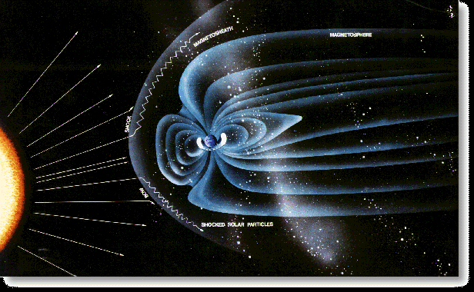
Solar modulation (1)
The deviation from the power law, observed
below 10 GeV, is a consequence of the
influence of the solar wind called solar
modulation.
Flux intensity in this energy range is
anti-correlated to the solar activity and
follows the sun-spot 11-year cycle
The correlation between the solar activity
and the modulation of the cosmic rays flux
has been studied by monitoring the flux of
atmospheric neutrons.
In fact, a flux of low energy neutrons (E ~ 10⁸-10⁹ eV) is produced in the interaction of
primary CRs with the atmosphere and it is mostly due to low energy primaries (1-20 GeV),
due to the rapid fall of the primary flux intensity with energy.
One assumes that far from the solar system there exists an unmodified flux called Local
Interstellar Spectrum, which is modified within the solar system by the interaction with
the solar wind. This interaction is well described by the Fokker-Planck diffusion equation,
that can be obtained describing the solar wind by a set of magnetic irregularities, and
considering these irregularities as perfect elastic scattering centres
For energies above 100 MeV this equation can be solved using the "Force Field
Approximation"

Slide 10
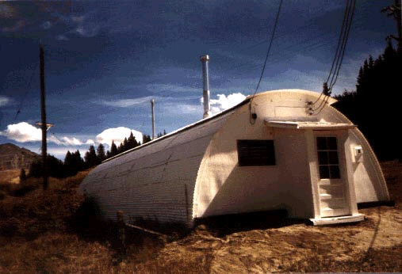
Solar modulation (2)
According to the Force Field Approximation, at a given distance from the Sun,
for example at 1 a.u., the population of CRs at energy E_{interstellar} is shifted at
the energy E₀ as in an energy loss mechanism due to a potential V:
The solar wind potential at a given distance from the Sun depends on only one
parameter, the time: V = V(t). So it doesn't matter what the interstellar flux
is: given a flux on the Earth at a time t, one can find the flux at another time
just from the relative variation of the solar wind potential Φ.
In FLUKA, an offline code uses an algorithm which takes into account
  either a given Φ value expressing the effect of the interplanetary modulation of the local interstellar spectrum
  or the counting rate of the CLIMAX
  neutron monitor to provide the flux
  prediction at a specific date
The model is not a description of the processes and of the way in which they occur, but reasonably predicts the GCR modulation at Earth.

Slide 11
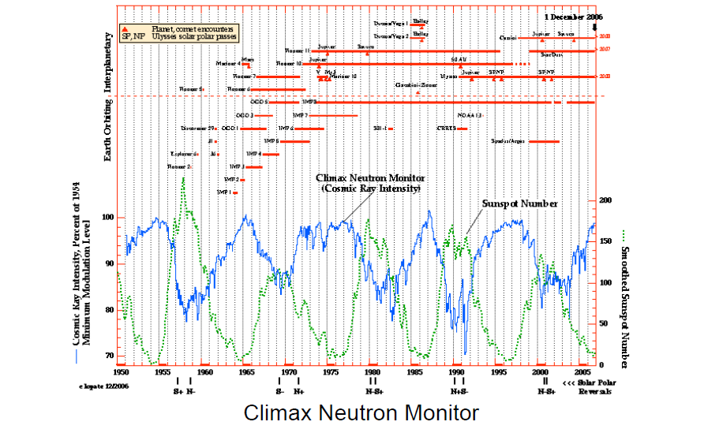
Solar modulation (4)

Slide 12
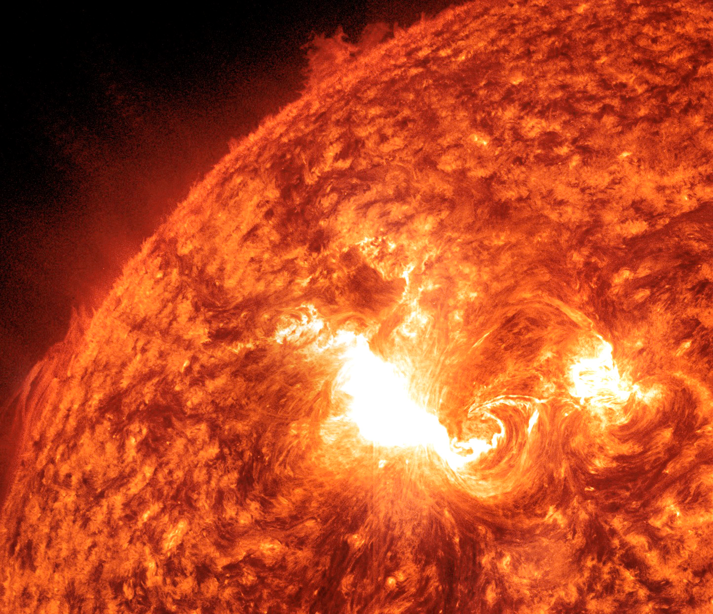
Solar Particle Events
A Solar Flare

Slide 13
Solar Energetic Particle (SEP) events
Integrated fluence: up to 10¹¹ (nucleon/cm²), E > 1 MeV / n
Large variations in spectra
Variable composition: mostly protons (∼90%) and α’s (~9%), but ions up to Iron are not negligible
Variable duration, from hours to days
Rise time from minutes to hours
Dose equivalent up to ~Sv, highly dependent on organ, shielding, and SEP intensity/spectrum
Unpredictable
(from Mewaldt, ICRC2005)
Nightmare scenarios for (manned) missions beyond Earth low orbits

Slide 14
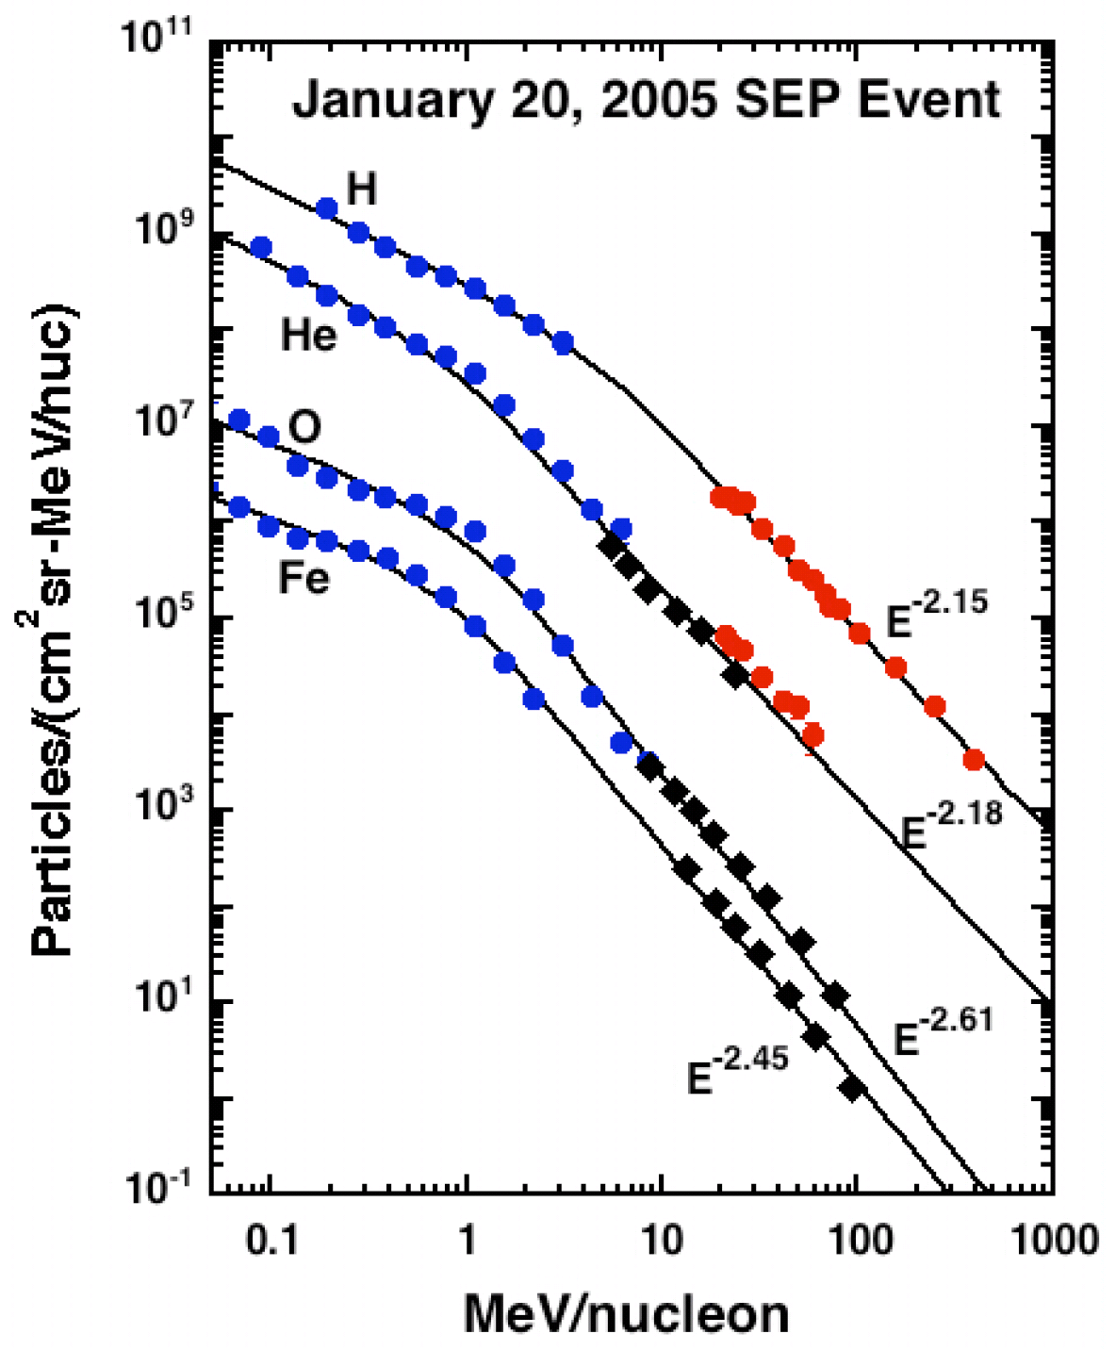
SEP: the “hard” event of 20 Jan 2005
Integrated flux: ∼7 10⁹ (nucleon/cm²), E > 1 MeV / n
The hardest spectrum after the “famous” February 1956 event
Detectable increase in ground level muons above 5 GeV !!!
Very fast rise time (∼ minutes)
Solar Particle Events: lower energies but much higher intensities than Galactic Cosmic Rays
(from Mewaldt, ICRC2005)

Slide 15
Atmospheric model: geometry (1)
The Earth atmosphere model
The FLUKA package makes use of a density vs. height profile of atmosphere
An external program containing a functional fit to this profile is used to generate at the same time an input geometry file, together with the data cards for material description (each atmospheric layer, having its proper density, needs to be assigned a different FLUKA material)
The geometry produced, and distributed with the name atmogeo.cards is a spherical representation of the whole Earth atmosphere.
The material definitions and assigment contained in the file atmomat.cards correspond to the density profile of the U.S. Standard atmosphere. The cards contained in atmomat.cards shall be included by the user in the input file.

Slide 16
Atmospheric model: geometry (2)
The Earth atmosphere model
In addition, the user can specialize this geometry to a given geomagnetic latitude and longitude with the help of the atmloc_2011.f auxiliary program. In this way, the geometry will contain only a slice of the atmosphere, centered on the given position
The local geometry file produced by atmloc_2011.f is named atmloc.geo. The user shall rename this geometry file for further use. More auxiliary files are produced by atmloc_2011.f:
  the file atmlocmat.cards contain additional material assignments to be included in the input together with the ones from atmogeo.cards
  the file atmloc.sur contains data used by FLUKA runtime, and normalization areas

Slide 17
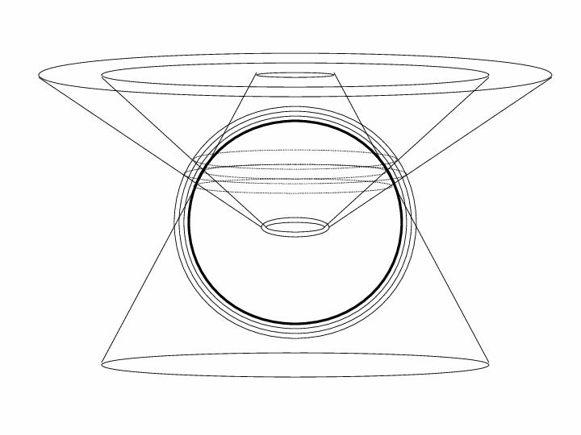
Atmospheric model: geometry (3)
Local atmosphere model
The geometry is built using two truncated cones (TRC) whose vertex is in the center of the Earth, the base out of the atmosphere and the height (considering a geographical location in the northern hemisphere) is in the direction of the Earth radius which passes through the North Pole
The angular span between the two cones contains the atmosphere of interest for the latitude of interest. In addition there is a third cone placed in the opposite direction: its vertex is where the other two cones have the base, its base is out of the atmosphere and its height is in the direction of the Earth radius which passes through the South Pole
A similar geometry can be built for a requested latitude in the southern emisphere.

Slide 18
Atmospheric model: geometry (4)
Local atmosphere model
The user builds the complete geometry of the local model, specialized to a given geomagnetic latitude and longitude, with the auxiliary program atmloc_2011.f.
The geometry (file atmloc.geo), containing only one slice of the atmosphere centered on the given position, will be made of:
a main series of layers made from the
part of the atmospheric shells between
the two cones (this is the part where
the scoring takes place)
two series of side layers made from the part of the atmospheric shells
between one of the two cones and the third one
These additional layers are needed to take into account the primary and secondary particles which don't come from the vertical direction but can anyway reach the region of interest.
A file atmlocmat.cards will contain additional material assignments to be included in the input.

Slide 19
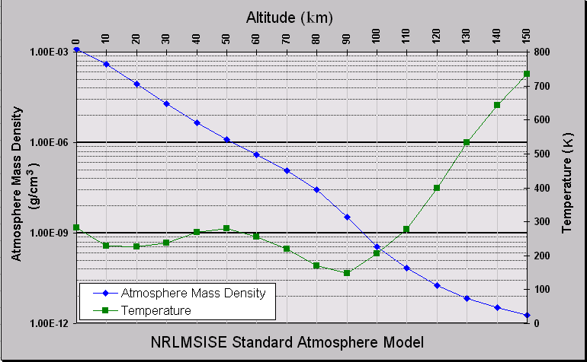
Atmospheric model: density (1)
The atmosphere can be roughly characterized as the region from sea level to about 1000 km altitude around the globe, where neutral gases can be detected.
Below 50 km the atmosphere can be assumed to be homogeneously mixed and can be treated as a perfect gas. Above 80 km the hydrostatic equilibrium gradually breaks down as diffusion and vertical transport become important. The FLUKA atmospheric model, below 70 km, is in the perfect gas region.

Slide 20
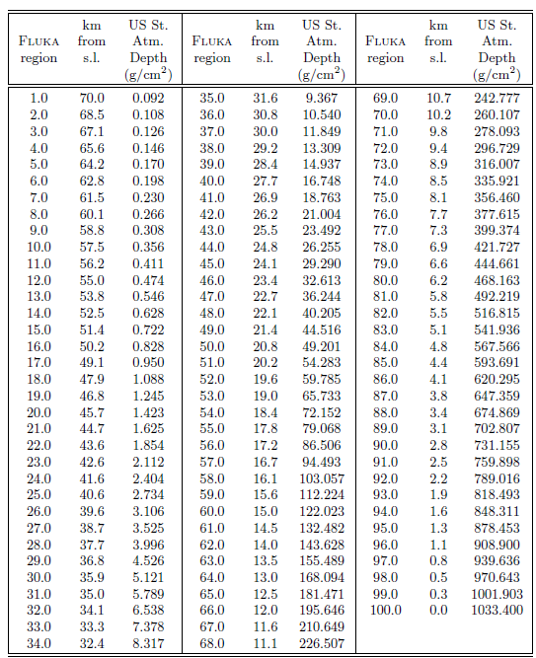
Atmospheric model: density
(2)
This Table shows the U.S. Standard Atmosphere depth vs altitude and vs FLUKA atmospheric layer.
100 layers from 0 to 70 km
above sea level.
They will described as
100 different FLUKA regions, corresponding to 100 different materials (air, with different densities)

Slide 21
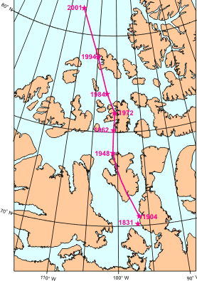
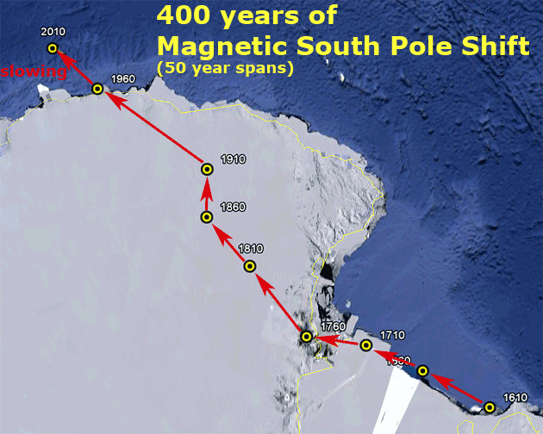
Geomagnetic field (1)
In the last 50 years measurements of the geomagnetic field configuration have been performed regularly with increasing precision, revealing a yearly weakening of the field intensity of 0.07% and a westward drift of ~0.2 degrees per year over the Earth 's surface.

Slide 22
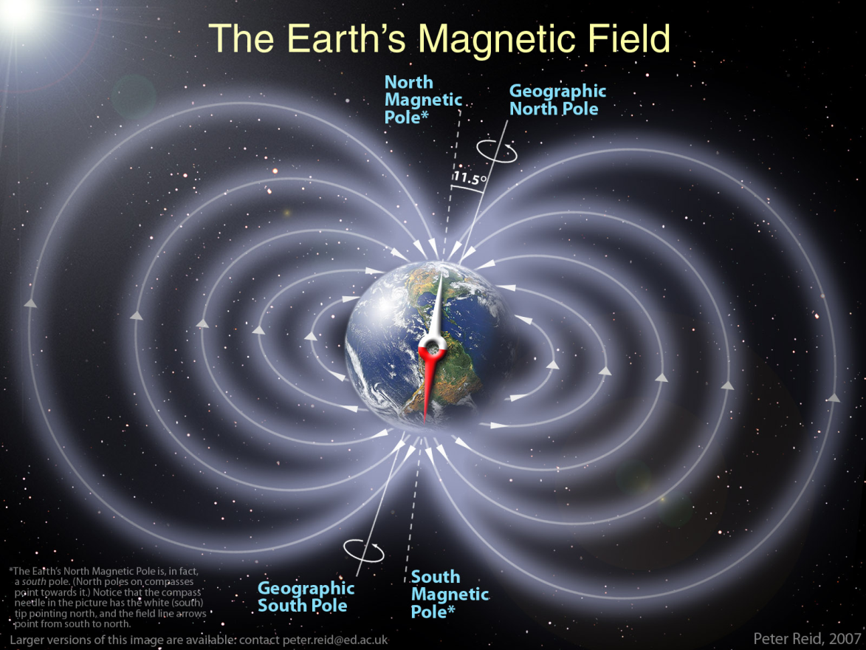
Geomagnetic field (2)
This field can be described, to first order, as a magnetic dipole tilted with respect to the rotation axis by ~11.5 degrees, displaced by ~400 km with respect to the Earth's center and with a magnetic moment M = 8.1× 10²⁵ G cm³ (8.1 × 10²² A m²). The dipole orientation is such that the magnetic South pole is located near the geographic North pole, in the Greenland, at a latitude of 75º N and a longitude of 291º.

Slide 23
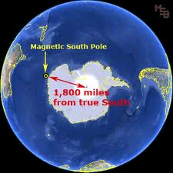
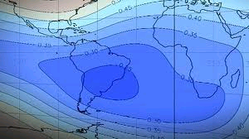
Geomagnetic field (3)
The magnetic North pole is instead near the geographic South pole, on the border of the Antarctica.
The intensity at the Earth's surface varies from a maximum of ~6×10⁻⁵ T near the magnetic poles to a minimum of ~2×10⁻⁵ T in the region of the South Atlantic Anomaly (SAA), between Brazil and South Africa. The complex behavior of the equipotential field lines is mainly a consequence of the offset and tilt.

Slide 24
Geomagnetic field (4)
In FLUKA the geomagnetic field is taken into account in two different stages:
Effect of geomagnetic cutoff which modulates the primary spectrum: at a given location (point of first interaction of primary particles) and for a given direction, a threshold in magnetic rigidity exists. The closer the injection point is to the geomagnetic equator, the higher will be the vertical rigidity threshold. The standard possibility offered to the user is to evaluate the geomagnetic cutoff making use of a dipolar field centered with respect to the centre of the Earth, adapted to give the "correct" vertical rigidity cutoff for the geographic location under examination.
The local geomagnetic field can be taken into account during shower development in the atmosphere. The field is automatically provided by the default MAGFLD FLUKA user routine, in accordance to the option selected in the GCR-SPE card. For local problems, provided the coordinate system is consistently used (that is, geomagnetic coordinates for the dipolar field, geographic ones for the multipolar field) there is no need to provide any orientation or intensity information about the field.

Slide 25
Two commands for Cosmic Rays
GCR-SPE
Initializes Galactic Cosmic Ray or Solar Particle Event calculations
SPECSOUR
defines one of the following special sources:
two colliding beams (SDUM = PPSOURCE, or CROSSASY or CROSSSYM)
Galactic Cosmic Rays (SDUM = GCR-IONF, GCR-SPEC, GCR-ALLF)
Solar Particle Event (SDUM = SPE-SPEC, SPE-2003, SPE-2005)
The usual scoring options (USRBDX, USRYIELD...) can be used to define detectors to calculate the fluence of different radiation fields.

Slide 26
Cosmic ray tools (1)
A number of tools and packages have been developed for the FLUKA environment to simulate the production of secondary particles by primary cosmic rays interacting with the Earth's atmosphere. These tools, in different stand-alone versions, have already been successfully used for fundamental physics research
The set of FLUKA tools for cosmic ray simulation includes a set of core routines to manage event generation, geomagnetic effects and particle scoring, a standalone program, and a number of stand-alone data files
The standalone program
atmloc_2011.f: prepares the description of the local atmosphere geometry with the atmospheric shells initialized by option GCR-SPE. This geometry includes only a slice of the Earth geometry, centered around the geomagnetic latitude input by the user

Slide 27
Cosmic ray tools (2)
The files
atmomat.cards: contains the material definitions for the density profile of the US Standard Atmosphere. These cards must be inserted (or the file included with the #include directive) into the FLUKA input file.
atmogeo.cards: contains an example of a 3D geometrical description of the Earth atmosphere, generated in according with the previous data cards (and corresponding density profile). This geometry includes the whole Earth
<iz>phi<MV>.spc: GCR All-Particle-Spectra for the iz^{th} ion species (iz = 1,...,28), modulated for the solar activity corresponding to a Phi parameter <MV> MegaVolt. Phi=500 MV roughly corresponds to solar minimum, while Phi=1400 MV roughly corresponds to solar maximum
allnucok.dat: GCR All-Nucleon Spectra
sep20jan2005.spc: spectra for the Solar Particle Event of Jan 20th, 2005
sep28oct2003.spc: spectra for the Solar Particle Event of Oct 28th, 2008

Slide 28
Summary from the manual: GCR-SPE
GCR-SPE
Initializes Galactic Cosmic Ray (GCR) or Solar Particle Event (SPE) calculations
WHAT(1) = i0 + 1000 * i1
i0 = 0: centered dipole field, geomagnetic coordinates (used also for computing rigidity
cut-off's in the spectrum generating routine)
= 1: exact multipole fields, geographic coordinates
= 2, >3: undefined, standard MAGFLD user routine called for regions with magnetic field
= 3: dipolar field for infinite plane at given latitude
i1 = number of atmospheric shells
= 10000: no atmospheric shells
= 101: 100 atmospheric shells
Default: centered dipole field, 100 shells
WHAT(2,3,6) = not used
WHAT(4) = Earth radius (Default provided)
WHAT(5) = Earth equatorial magnetic field (Default provided)
SDUM = name identifying both the spectra files (estension .spc) and the data file (estension .sur) produced by the auxiliary program atmloc_2011.f.

Slide 29
Summary from the manual: GCR-SPE, Notes
Notes to GCR-SPE :
1) Cosmic ray calculations, initialized by GCR-SPE are defined by means of command SPECSOUR and a number of auxiliary programs.
2) The cards for the geometry description of the atmospheric shells must be prepared using the auxiliary programs and data cards in the directory $FLUPRO/gcrtools. Program atmloc_2011.f writes a file atmloc.geo, containing the geometry input to be inserted into the FLUKA input file (or to be read by setting WHAT(3) in the GEOBEGIN card), a file atmlocmat.cards containing the extra material assignments, and a file atmloc.sur containing auxiliary data and the scoring areas.
The user shall rename the file atmloc.sur to <xxxxxxx>.sur, where <xxxxxx> is an identifier of exactly 7 characters which must appear also in the input spectra file names: the spectra must have the names <zz><xxxxxxx>.spc, where <zz> is the atomic number of the ion.
The example spectra distributed with FLUKA come with two identifiers: <zz>phi0465 for solar minimum and <zz>phi1440 for solar maximum, and with zz=01-28.

Slide 30
From the manual: SPECSOUR/GCR-ALLF (1)
SPECSOUR: various SDUM options are available:
SDUM = GCR-ALLF: All-nucleon flux
Three different options (average, maximum and minimum flux) are available.
The program reads fluxes from a file named ällnucok.dat" in which are given the total energy (GeV), the fluxes (E.dN/dE) and the neutron/proton ratios.
It is possible to give an energy interval and to choose:
  a starting radius (radius of the emission sphere in case of spherical geometry)
  or
  a starting height (the emission height in case of flat geometry).
It is possible to activate the vertical geomagnetic cutoff and to give the cutoff value at the central latitude, otherwise the geomagnetic cutoff will be not taken into account.
Ions are treated as separate nucleons, or as alphas and protons.

Slide 31
From the manual: SPECSOUR/GCR-ALLF (2)
SPECSOUR:
SDUM = GCR-ALLF: All-nucleon flux
WHAT(1) = 1: central value ; = 2: minimum value; = 3: maximum value
WHAT(2) >= 0: starting radius (cm) ; < 0: starting height (cm)
WHAT(3) = Minimum energy
WHAT(4) = Maximum energy
WHAT(5) = Spectral index for sampling (below transition energy)
WHAT(6) = Transition energy for sampling (above it, sample from 1/E)
Continuation card (SDUM = "&”):
WHAT(1) = 0: no geomagnetic cutoff
= 1: geomagnetic cutoff is requested
= 2: the vertical geomagnetic cutoff is read as WHAT(2)
WHAT(2) = vertical geomag. cutoff at central latitude for WHAT(1) = 2
WHAT(3)-WHAT(5): not used
WHAT(6) =< 0: nucleons are transported separately
> 0: transport as many alphas as can be built by neutrons, and
the remaining protons

Slide 32
From the manual: SPECSOUR/GCR-IONF (1)
SDUM = GCR-IONF: All-particle flux
The particle composition of the flux can be modified by choosing the minimum and maximum atomic number (1 =< Z =< 28).
The spectrum components have been produced by a code for various modulation parameters and written on '.spc' files (Z + <PhiMV> + .spc).
It is possible to give an energy interval and to choose a starting radius (radius of the emission sphere in case of spherical geometry) or starting height (the emission height in case of flat geometry).
It is possible to activate the geomagnetic cutoff (WHAT(7) in SPECSOUR) and to input optionally the vertical cutoff value at the central latitude.
Ions are treated like real ions or can be splitted. The optimized value for spectral index for sampling (below transition energy) is γ = 1.75 (WHAT(5)).
Above transition energy, the spectrum will be assumed to have a 1/E shape.

Slide 33
Summary from the manual: SPECSOUR/SPE-xxxx
SDUM = SPE-SPEC, SPE-2003 or SPE-2005: Solar Particle Event.
SPE-SPEC, SPE-2005 → spectrum is read from file sep20jan2005.spc
SPE-2003 → spectrum is read from file sep28oct2003.spc
The WHATs are the same as for SDUM=GCR-IONF:
WHAT (1) = Z_{max} + 100 * Z_{min} (Z_{min} = 1 if none is defined)
WHAT (2) = Starting radius or starting height (cm)
WHAT (3) = Minimum energy
WHAT (4) = Maximum energy
If max. and minimum energy differ by < 5% then a fixed energy (= Max) is sampled
WHAT (5) = Spectral index for sampling (below transition energy)
WHAT (6) = Transition energy for sampling (above it, sample from 1/E)
Continuation card (SDUM = "&“)
WHAT(1) = 0: no geomagnetic cutoff; = 1: geomagnetic cutoff is requested
= 2: the vertical geomagnetic cutoff is read from WHAT(2)
WHAT(2) = vertical geomagnetic cutoff at central latitude for WHAT(1) = 2
WHAT(3) = number of energy point in the spectra. Default: 50
WHAT(4) = if > 0 vertical run
WHAT(5) = if > 0 probabilities 1/(2xZ) are used for the various ions (1 for Z = 1)
WHAT(6) =< 0: ions are split > 0: ions are treated like real ions

Slide 34
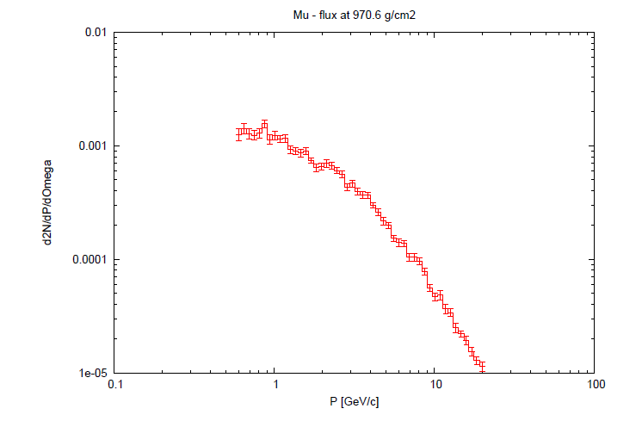
Example of input data cards
An example of user data cards to run a FLUKA cosmic ray problem. is shown here. The example refers to the simulation at geographical coordinates of 36.0 degrees North Latitude and 140.0 degrees East Longitude (Tsukuba, Japan), using the solar modulation of Dec. 23rd 1995: μ⁺ and μ⁻ fluxes at different heights in the atmosphere.
Example available in $FLUPRO/gcrtools/gcrexamples/AllParticleExample
SPECSOUR and SDUM = GCR–IONF (all particle flux):
Z of ions of spectra to be taken into account
- information for sampling energy spectra
- geomagnetic cutoff
- starting radius
GCR-SPE: Initializes Galactic Cosmic Ray
or Solar Particle Event calculations :
- geomagnetic field
- spectra files name

Slide 35
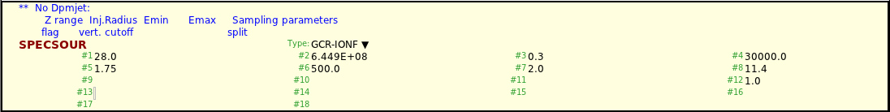
GCR-SPE initializes Galactic Cosmic Ray or Solar
Particle Event calculations
What(1): various options for the magnetic field
What(4): Earth radius
What(5): Equatorial magnetic field
SDUM: name of spectra files
SPECSOUR with SDUM GCR-SPE
calls special GCR source
(SPECSOUR doesn’t only define
GCR spectra – read 16.7)
First card:
(1) Z range, (2) Inj.Radius, (3) Emin, (4) Emax, (5) Sampling index, (6)Transition energy
Second card:
(7) cutoff?, (8) cutoff, (9)(#energy points), (10)(vertical run), (11)(ion probabilities), (12) split

Slide 36
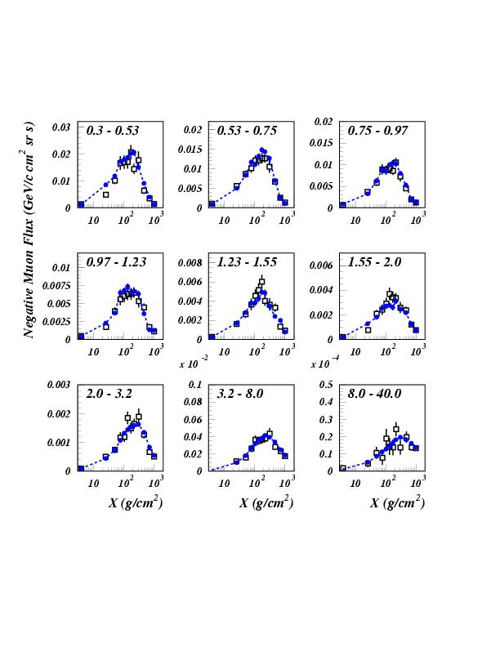
Muon benchmark: CAPRICE
Open symbols: CAPRICE data
Full symbols: FLUKA
Momentum bin (GeV/c)
Primary spectrum normalization ~AMS-BESS
Astrop. Phys., Vol. 17, No. 4 (2002) p. 477
Atmospheric thickness (g/cm²)

Slide 37
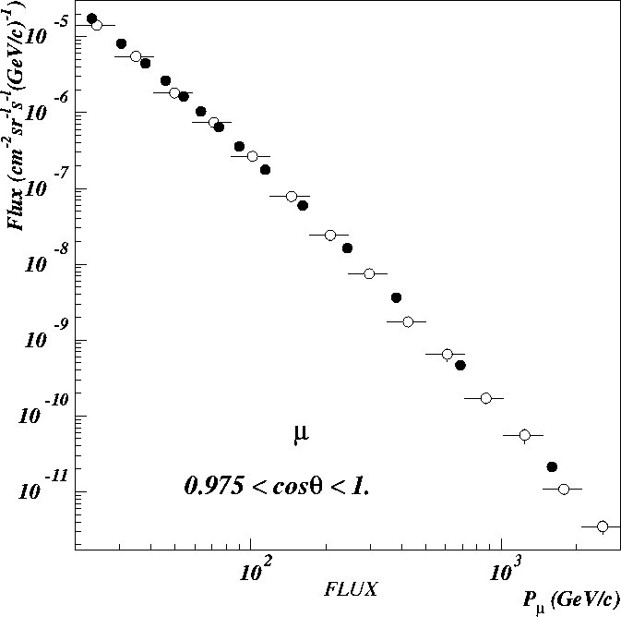
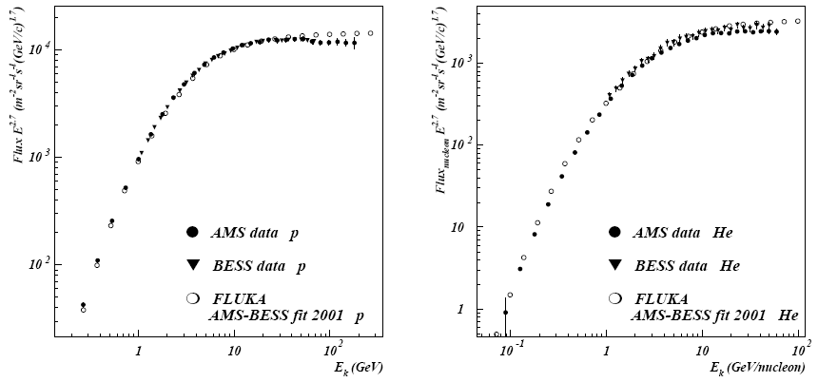
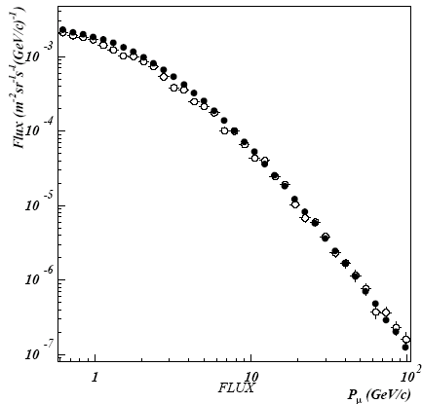
BESS spectrometer
Balloon-borne Experiment with Superconducting Spectrometer
μ⁻
The BESS spectrometer has collected
data at different cut-offs, altitudes,
solar modulation
p
He
Vertical
muons

Slide 38
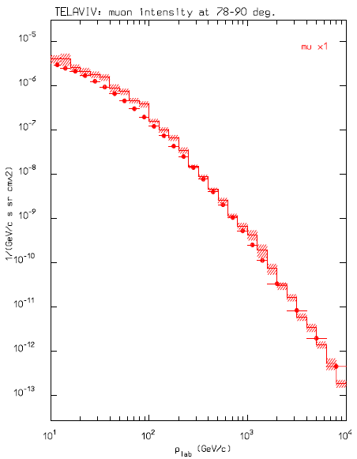
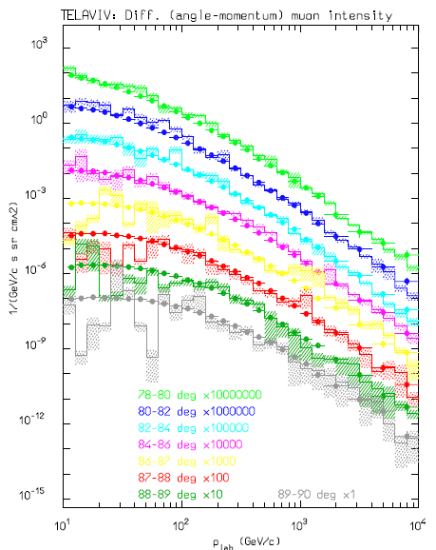
Benchmark Earth Surface
Angle integrated (78-90deg, left) and double differential muon fluxes, measured close to the horizontal line TelAviv. Data from O.C. Allkofer et al. NPB 259,1, (1985).

Slide 39
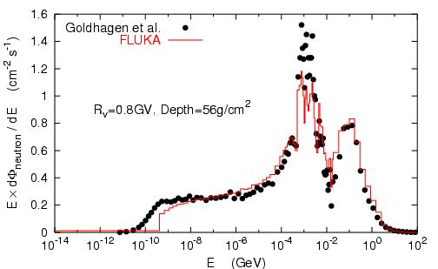
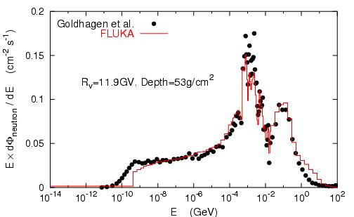
Neutrons on the ER-2 plane at 21 km
Measurements:
Goldhagen et al.,
NIM A476, 42 (2002)
Note one order of magnitude difference depending on latitude
FLUKA calculations:
Roesler et al.,
Rad. Prot. Dosim. 98, 367 (2002)

Slide 40
Doses to aircrew and passengers
AIRBUS 340
Toilet or Galley
Wing fuel tank
Cockpit
Pelliccioni et al, Rad. Prot.
Dosim. 108, 91 (2004)
Business Class
Economic Class
Center fuel tank
Hold

Slide 41
Commercial flight doses: (Pelliccioni et al. RPD93, 101 (2001))
Doses to aircrew and passengers
(x 10000)
(x 1000)
(x 100)
(x 10)
Simulated (FLUKA, red) and measured (blue, NIMA422, 621, 1999) ambient dose equivalent for various altitudes (scaled by one decade) and geomagnetic cut-off’s

Slide 42
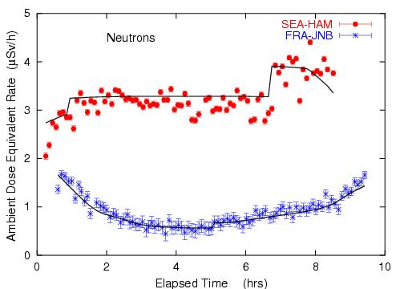
Doses to aircrew and passengers
Roesler et al., Rad. Prot. Dosim. 98, 367 (2002)
Ambient dose equivalent from neutrons at solar maximum on commercial flights from Seattle to Hamburg and from Frankfurt to Johannesburg.
Solid lines: FLUKA simulation

Slide 43
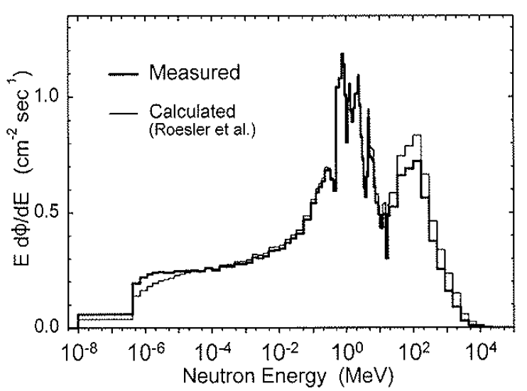
High-Altitude n-Spectra
  Goldhagen et al., COSPAR Proceedings, 2002

