Slide 1

Induced Activity
FLUKA Beginner’s Course

Slide 2
FLUKA-Implementation – Main features
The generation and transport of decay radiation (limited to γ, b-, b+, X-rays, and Conversion Electrons emissions for the time being) is possible during the same simulation which produces the radio-nuclides (one-step method). For that, a dedicated database of decay emissions is used, based mostly information obtained from NNDC, sometimes supplemented with other data and checked for consistency.
As a consequence, results for production of residuals, their time evolution and residual doses due to their decays can be obtained in the same run, for an arbitrary number of decay times and for a given irradiation profile.

Slide 3
FLUKA-Implementation – Main features
up to 4 different decay branching for each isotope/isomer
all gamma lines down to 0.1-0.01% branching, including X-ray lines following conversion electron emissions
all beta emission spectra down to 0.1-0.01% branching: the sampling
of the beta+/- spectra including screening Coulomb corrections
- Auger and conversion electrons
Isomers: the present models do not distinguish among ground state
and isomeric states (it would require spin/parity dependent calculations in evaporation). A rough estimate (equal sharing among states) of isomer production can be activated in the RADDECAY option.
- Different transport thresholds can be set for the prompt and decay
radiation parts, as well as some (limited) biasing differentiation
(see later)

Slide 4
Input options

Slide 5
Input options - Overview
Input card: RADDECAY
requests simulation of decay of produced radioactive nuclides and allows to modify biasing and transport thresholds (defined with other cards) for the transport of decay radiation
Input card: IRRPROFI
definition of an irradiation profile (irradiation times and intensities)
Input card: DCYTIMES
definition of decay (cooling ) times
Input card: DCYSCORE
associates scoring detectors (radio-nuclides, fluence, dose) with different cooling times
Input card: AUXSCORE
allows to associate scoring estimators with dose equivalent conversion factors or/and to filter them according to (generalized) particle identity
…
…
1h
8h
1d
-200d
7d
Index: 1 2 3 4 …
etc.

Slide 6
Particle Types
Name | Number | Units | Description
DOSE | 228 | GeV/g | Dose (energy deposited per unit mass)
DOSE-EQ | 240 | pSv | Dose Equivalent (AUXSCORE)
ACTIVITY | 234 | Bq/cm³ | Activity per unit volume
ACTOMASS | 235 | Bq/g | Activity per unit mass
SI1MEVNE | 236 | cm⁻² | Silicon 1 MeV-neutron equivalent flux
HADGT20M | 237 | cm⁻² | Hadrons with energy > 20 MeV

Slide 7

Card: RADDECAY ^{[1/2]}
* 1) request radioactive decays
RADDECAY 1.0 0 3.0 0000099999 0
WHAT(1) = 1 radioactive decays activated for requested cooling times
Decays: Active “activation study case”: time evolution calculated analytically for fixed (cooling) times. Daughter nuclei as well as associated radiation is considered at these (fixed) times
> 1 radioactive decays activated in semi-analogue mode
Semi-Analogue each radioactive nucleus is treated like all other unstable particles (random decay time, daughters and radiation), all secondary particles/nuclei carry time stamp (“age”)
WHAT(2) > 0 isomer “production” activated
Patch Isom: On
WHAT(3) number of “replicas” of the decay of each individual nucleus
Replicas: #

Slide 8
Card: RADDECAY ^{[2/2]}
WHAT(4) switch for applying various biasing features only to prompt radiation or only to particles from radioactive decays
h/µ Int .. Low-n WW 9 digits, each responsible for a different biasing
Example:
5th digit, e+/e-/gamma leading particle biasing applied
000010000 to prompt radiation only
000020000 to decay radiation only
000030000 to both
Default: 111111111 (or blank as above)
WHAT(5) multiplication factors to be applied to e+/e-/gamma transport energy cutoffs
decay cut: # 10 digits, first five for decay radiation, second five for prompt
prompt cut: # radiation (see manual)
Special cases:
0000099999 kill EM cascade for prompt radiation
9999900000 kill EM cascade for residual radiation

Slide 9

Card: IRRPROFI
* 2) definition of irradiation pattern
* 180days part/s 185days 180days part/s
IRRPROFI 1.5552E7 5.9175E5 1.5984E7 0.0 1.5552E7 5.9175E5
WHAT(1,3,5) irradiation time (second)
Δt: #
WHAT(2,4,6) beam intensity (particles per second)
p/s # Note: zero intensity is accepted and can be used
e.g., to define beam-off periods
Note: Several cards can be combined up to a maximum of 2500 irradiation intervals.
Example (see above):
180 days 185 days 180 days
5.9 × 10⁵ p/s 0 p/s 5.9 × 10⁵ p/s
(beam-off)

Slide 10
Card: DCYTIMES
* 3) definition of cooling times
* 1hour 8hours 1day 7days 1month 4months
DCYTIMES 3600. 28800. 8.64E4 6.048E5 2.592E6 1.0368E7
WHAT(1) – WHAT(6) cooling time (in seconds) after the end of the irradiation
t1 .. t6 Note: Several cards can be defined.
Each cooling time is assigned an index, following the order in which it has been input. This index can be used in option DCYSCORE to assign that particular cooling time to one or more scoring detectors. A negative decay time is admitted: scoring is performed at the chosen time "during irradiation"
Example (see above):
180 days 185 days 180 days
5.9 × 10⁵ p/s 0 p/s 5.9 × 10⁵ p/s
(beam-off)
…
…
1h
8h
1d
7d
-200d
etc.
10

Slide 11
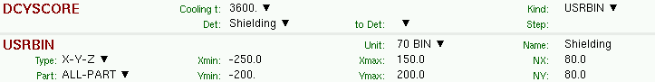
Card: DCYSCORE ^{[1/2]}
* Associate scoring with different cooling times
DCYSCORE 1.0 Shielding USRBIN
USRBIN 10.0 201. -70.0 150.0 200.0 5000.0Shielding
USRBIN -250.0 -200. 0.0 80.0 80.0 1.0&
WHAT(1) Cooling time index to be associated with the detectors
Cooling: # Drop down list of available cooling times
WHAT(4)..WHAT(5) Detector index/name of kind (SDUM/Kind)
Det .. to Det Drop down list of available detectors of kind (Kind)
WHAT(6) step lengths in assigning indices
Step #
SDUM Type of estimator
Kind RESNUCLE, USRBIN/EVENTBIN, USRBDX, USRTRACK…
Units: All quantities are expressed per unit time. For example
RESNUCLE Bq
USRBIN fluence rate / dose rate

Slide 12
Card: DCYSCORE ^{[2/2]}
In the semi-analogue decay mode, estimators can include the decay contribution (on top of the prompt one) through association by DCYSCORE with a cooling time index ≤ -1.0

Slide 13
Card: AUXSCORE
* associate scoring with dose equivalent conversion factors
AUXSCORE USRBIN PHOTON Target EWT74
WHAT(1) Type of estimator to associate with
Type: drop down list of estimator types (USRBIN, USRBDX…)
WHAT(2) particle or isotope to filter scoring
Part: # Particle or particle family list. If empty then flair will prompt for
Z, A, and State for filtering on specific isotopes
WHAT(4,5) Detector range
Det .. to Det Drop down list to select detector range of type WHAT(1)
WHAT(6) Step in assigning indices of detector range
Step: #
SDUM Conversion set for dose equivalent (DOSE-EQ) scoring
Set: Drop down list of available dose conversion sets

Slide 14
Conversion Coefficients
Conversion coefficients from fluence to ambient dose equivalent are based on ICRP74 values and values calculated by M.Pelliccioni. They are implemented for protons, neutrons, charged pions, muons, photons, electrons (conversion coefficients for other particles are approximated by these). AMB74 is the default choice for dose equivalent calculation.
For more info: http://cern.ch/info-fluka-discussion/download/deq2.pdf

Slide 15
Fluence to effective dose coefficients
Conversion coefficients from fluence to effective dose are implemented for three different irradiation geometries:
    anterior-posterior
    rotational
    WORST (“Working Out Radiation Shielding Thicknesses”) is the maximum coefficient of anterior-posterior, posterior-anterior, right-lateral and left-lateral geometries. It is recommended to be used for shielding design.
Implemented for radiation weighting factors recommended by ICRP60 (e.g., SDUM=ETW74) and recommended by M.Pelliccioni (e.g., SDUM=EWTMP). The latter anticipate the 2007 recommendations of ICRP.
Implemented for protons, neutrons, charged pions, muons, photons, electrons (conversion coefficients for other particles are approximated by these)
Zero coefficient is applied to all heavy ions

Slide 16
Fluence to effective dose coefficients

Slide 17
Card: RESNUCLEi ^{[1/3]}
RESNUCLE 3.0 -26. 0 0 FLOOR TUN_FLOO
Scoring of residual nuclei or activity on a region basis
WHAT(1) type of products to be scored
Type: 1.0 spallation products (except from low-energy neutron interactions)
2.0 products from low-energy neutron interactions (provided the
information is available)
3.0 all residual nuclei are scored (if available, see above)
<= 0.0 resets the default (= 1.0)
WHAT(2) logical output unit (Default = 11.0)
Unit:
WHAT(3) Maximum atomic number Z of the residual nuclei distribution
Max Z: Default: according to the Z of the element(s) of the material assigned to the scoring region
WHAT(4) Maximum M = N - Z - NMZ_min
Max M: of the residual nuclei distribution (NMZ_min = -5)
Default: maximum value according to the A, Z of the element(s) of the material assigned to the scoring region.

Slide 18
Card: RESNUCLEi ^{[2/3]}
WHAT(5) scoring region number/name
Reg: (Default = 1.0 ; -1.0 or @ALLREGS all regions)
WHAT(6) volume of the region in cm³
Vol: (Default = 1.0)
SDUM character string identifying the detector
Name: (max. 10 characters)
Notes:
In the case of heavy ion projectiles the default NMZ, based on the region material, is not necessarily sufficient to score all the residual nuclei, which could include possible ion fragments
Residual nuclei from low-energy neutron interactions are only scored if that information is available in the low-energy neutron data set (see Manual)
Protons are scored, together with ²H, ³H, ³He, ⁴He, at the end of their path

Slide 19
Card: RESNUCLEi ^{[3/3]}
**** Isotope Yield as a function of Mass Number ****
**** (nuclei / cmc / pr) ****
A_min: 1 - A_max: 198
A: 186 1.5870372E-08 +/- 9.9000000E+01 %
A: 185 3.7605012E-09 +/- 9.9000000E+01 %
A: 184 1.4581326E-08 +/- 9.9000000E+01 %
A: 183 1.0712972E-08 +/- 9.9000000E+01 %
A: 182 7.4882118E-09 +/- 9.9000000E+01 %
...
**** Isotope Yield as a function of Atomic Number ****
**** (nuclei / cmc / pr) ****
Z_min: 1 - Z_max: 78
Z: 74 5.2413383E-08 +/- 9.9000000E+01 %
Z: 42 3.0072785E-07 +/- 9.9000000E+01 %
Z: 41 4.7906228E-08 +/- 9.9000000E+01 %
Z: 40 3.7605012E-09 +/- 9.9000000E+01 %
Z: 38 3.7605012E-09 +/- 9.9000000E+01 %
...
**** Residual nuclei distribution ****
**** (nuclei / cmc / pr) ****
A \ Z 68 69 70 71 72 73 74 75 76 77 78
186 0.00E+00 0.00E+00 0.00E+00 0.00E+00 0.00E+00 0.00E+00 1.59E-08 0.00E+00 0.00E+00 0.00E+00 0.00E+00
+/- 0.0 % +/- 0.0 % +/- 0.0 % +/- 0.0 % +/- 0.0 % +/- 0.0 % +/-99.0 % +/- 0.0 % +/- 0.0 % +/- 0.0 % +/- 0.0 %
185 0.00E+00 0.00E+00 0.00E+00 0.00E+00 0.00E+00 0.00E+00 3.76E-09 0.00E+00 0.00E+00 0.00E+00 0.00E+00
+/- 0.0 % +/- 0.0 % +/- 0.0 % +/- 0.0 % +/- 0.0 % +/- 0.0 % +/-99.0 % +/- 0.0 % +/- 0.0 % +/- 0.0 % +/- 0.0 %
184 0.00E+00 0.00E+00 0.00E+00 0.00E+00 0.00E+00 0.00E+00 1.46E-08 0.00E+00 0.00E+00 0.00E+00 0.00E+00
+/- 0.0 % +/- 0.0 % +/- 0.0 % +/- 0.0 % +/- 0.0 % +/- 0.0 % +/-99.0 % +/- 0.0 % +/- 0.0 % +/- 0.0 % +/- 0.0 %
183 0.00E+00 0.00E+00 0.00E+00 0.00E+00 0.00E+00 0.00E+00 1.07E-08 0.00E+00 0.00E+00 0.00E+00 0.00E+00
+/- 0.0 % +/- 0.0 % +/- 0.0 % +/- 0.0 % +/- 0.0 % +/- 0.0 % +/-99.0 % +/- 0.0 % +/- 0.0 % +/- 0.0 % +/- 0.0 %
...

Slide 20
Card: PHYSICS
Please activate the following two cards if residuals are of interest:
switch to activate the evaporation of heavy fragments (up to A=24)
PHYSICS 3.0 EVAPORAT
PHYSICS 1.0 COALESCE
special options for coalescence treatment

Slide 21
ISOTOPE ‘beam’
to simulate a radioactive source:
  Radioactive source of ⁶⁰Co (two main γ-emissions: 1332.5 keV and 1173.2 keV)
  cylindrical shape, 2cm diameter, 2mm height along z, centre of base of cylinder at origin
BEAM ISOTOPE
HI-PROPE 27.0 60.0
BEAMPOS 0.0 0.0 0.1 0.0 0.0 0.0
BEAMPOS 0.0 1.0 0.0 0.2 0.0 0.0CYLI-VOL
request decay by the RADDECAY card

Slide 22
Concrete
Geometry modifications - 1
120 GeV
protons
Stainless steel target
Concrete
1) Target only (shielding set to vacuum)
ASSIGNMA BLCKHOLE EXTVOID
ASSIGNMA VACUUM VACTRGT
ASSIGNMA SS316L TARGET
ASSIGNMA CONCRETE SHIELDIN VACUUM
* ..+....1....+....2....+....3....+....4....+....5....+....6....+....7..
2) Shielding only (target set to vacuum)
ASSIGNMA BLCKHOLE EXTVOID
ASSIGNMA VACUUM VACTRGT
ASSIGNMA SS316L TARGET VACUUM
ASSIGNMA CONCRETE SHIELDIN
* ..+....1....+....2....+....3....+....4....+....5....+....6....+....7..
3) Target and shielding
ASSIGNMA BLCKHOLE EXTVOID
ASSIGNMA VACUUM VACTRGT
ASSIGNMA SS316L TARGET
ASSIGNMA CONCRETE SHIELDIN
* ..+....1....+....2....+....3....+....4....+....5....+....6....+....7..

Slide 23
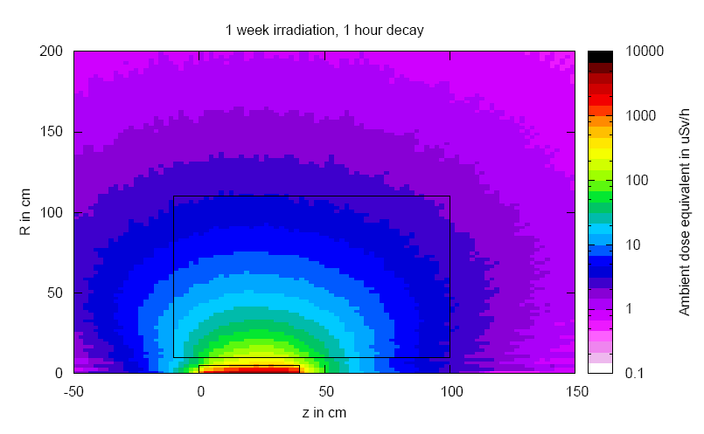
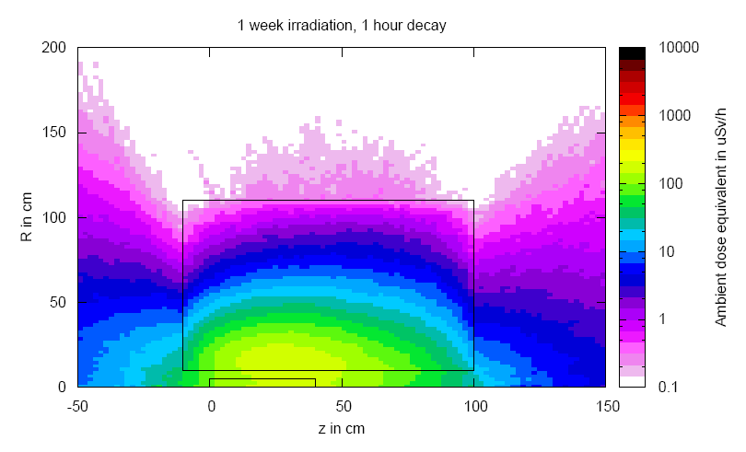
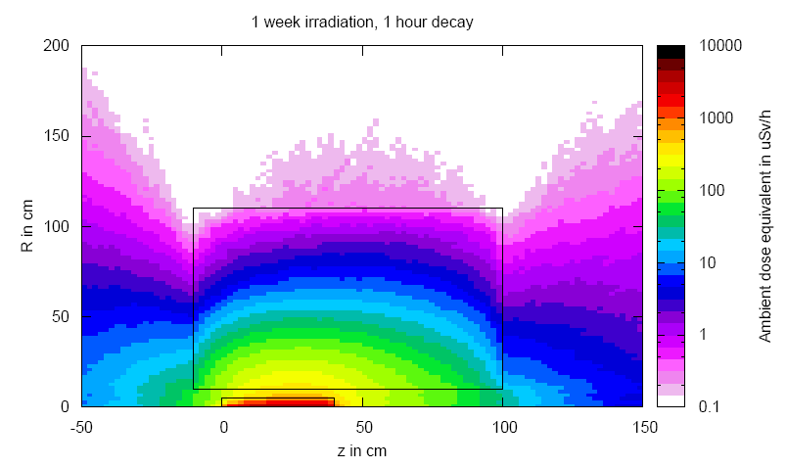
Geometry modifications - 2
target
shielding
total

Slide 24
Summary of main input cards
RADDECAY
requests simulation of decay of produced radioactive nuclides and allows to modify biasing and transport thresholds (defined with other cards) for the transport of decay radiation
IRRPROFI
definition of an irradiation profile (irradiation times and intensities)
DCYTIMES
definition of decay (cooling ) times
DCYSCORE
associates scoring detectors (radio-nuclides, fluence, dose equivalent) with different cooling times
AUXSCORE
allows to associate scoring estimators with dose equivalent conversion factors or/and to filter them according to (generalized) particle identity
PHYSICS
switch to activate the evaporation of heavy fragments (up to A=24) and the simulation of coalescence
etc.

Slide 25
Benchmarks

Slide 26
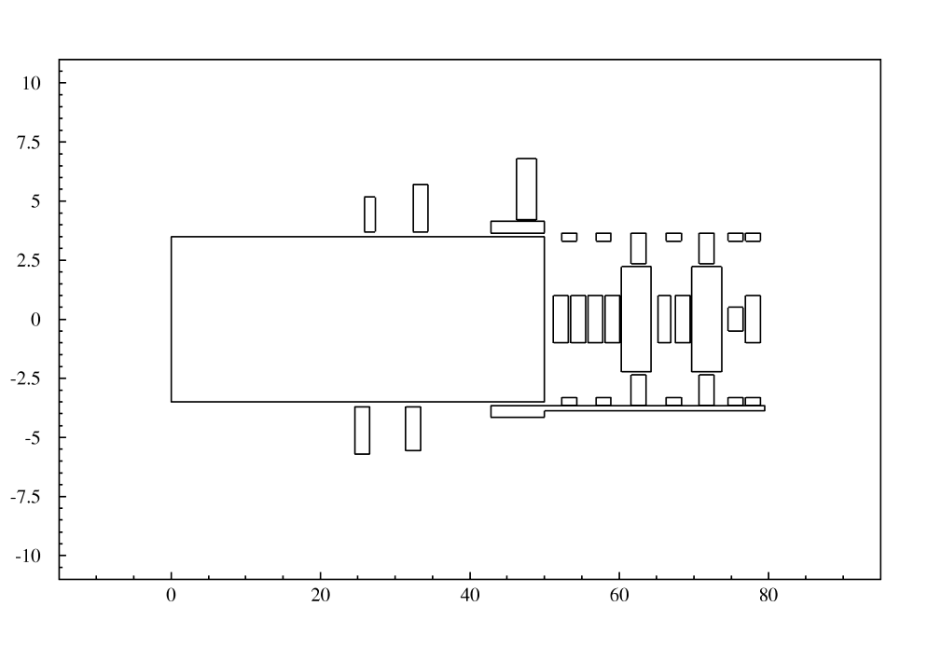
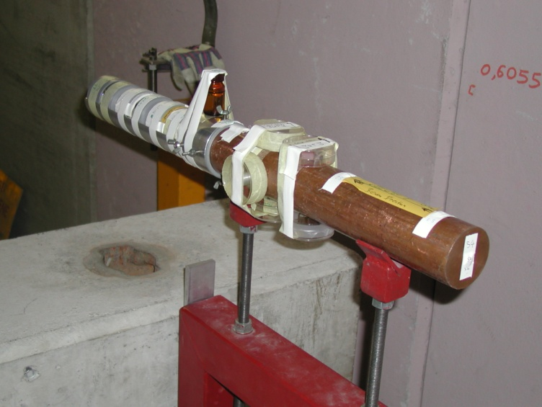
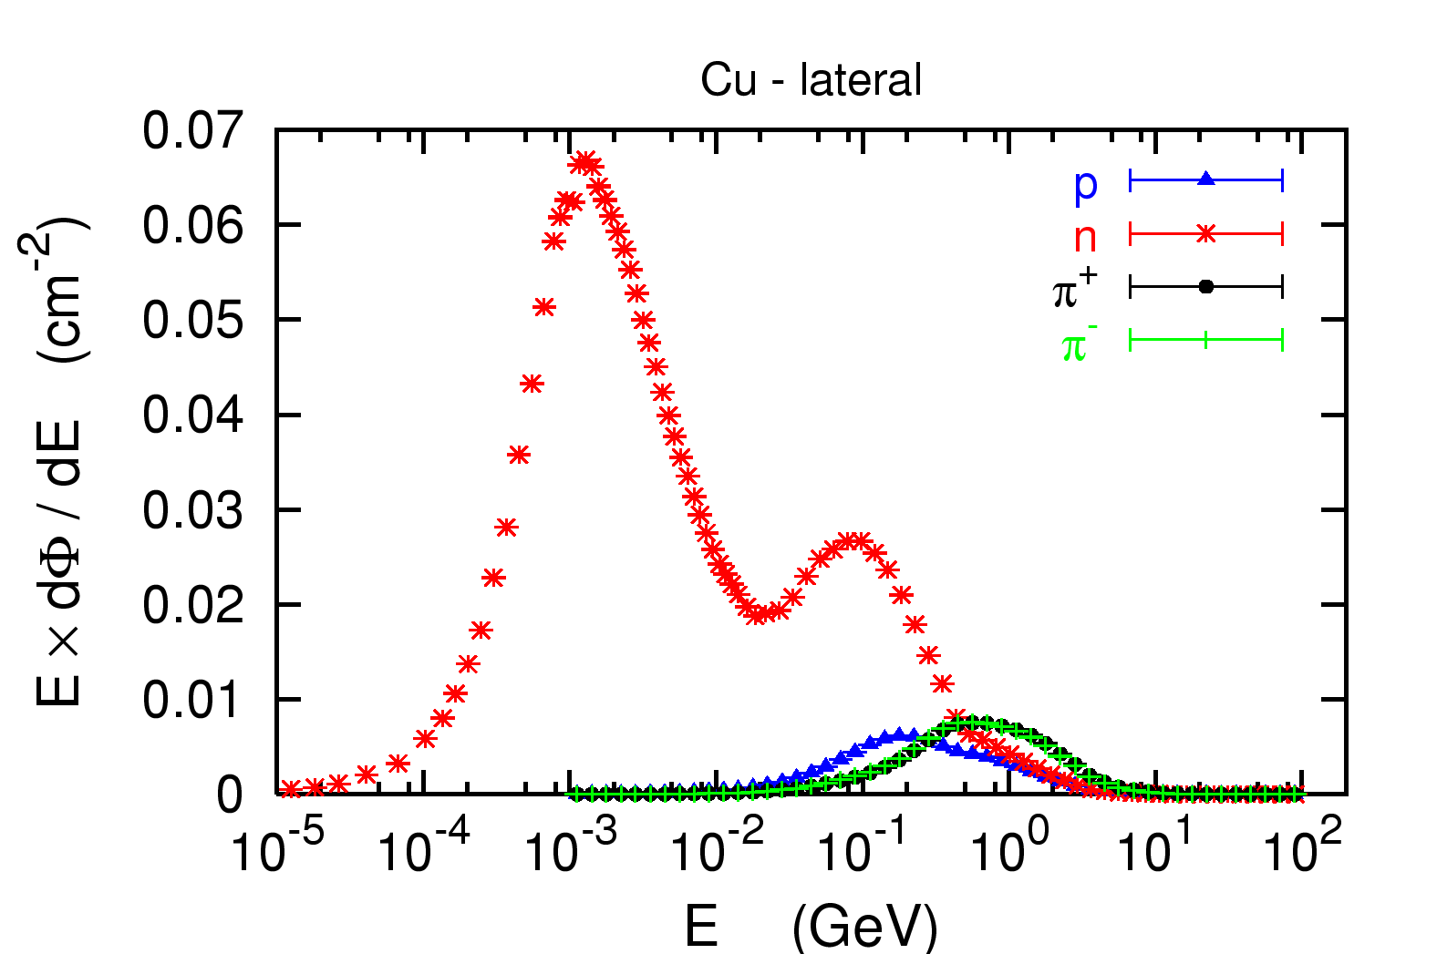
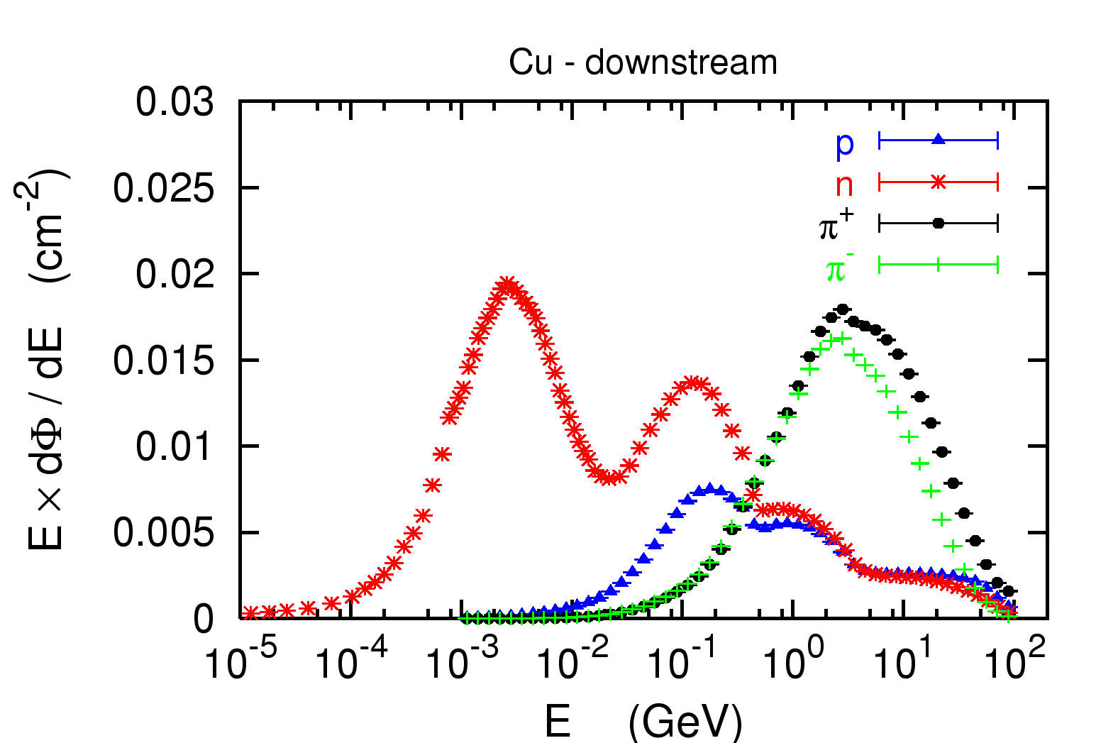
Benchmark experiment
Irradiation of samples of different materials to the stray radiation field created by
the interaction of a 120 GeV positively charged hadron beam in a copper target
Cu target
120GeV
pos. hadrons

Slide 27
Benchmark Experiment
Measurement and calculation of
Specific activities
Residual dose equivalent rates
for different cooling times

Slide 28
Benchmark experiment – Instrumentation 1
Low-background coaxial High Precision Germanium detector (Canberra)
  - use of two different detectors (90 cm³ sensitive volume, 60% and 40% relative
  efficiency)
Genie-2000 (Ver. 2.0/2.1) spectroscopy software by Canberra and
PROcount-2000 counting procedure software
  - include a set of advanced spectrum analysis algorithms, e.g., nuclide identification,
  interference correction, weighted mean activity, background subtraction and
  efficiency correction
  - comprise well-developed methods for peak identification using standard or user-
  generated nuclide libraries. HERE: use of user-generated nuclide libraries, based
  on nuclides expected from the simulation and material composition
Efficiency calibration with LABSOCS
- allows the creation of a corrected efficiency calibration by modelling the sample
taking into account self-absorption inside the sample and the correct detector
geometry
Reference: M. Brugger, S. Roesler, et al., Nuclear Instruments and Methods A 562 (2006) 814-818

Slide 29
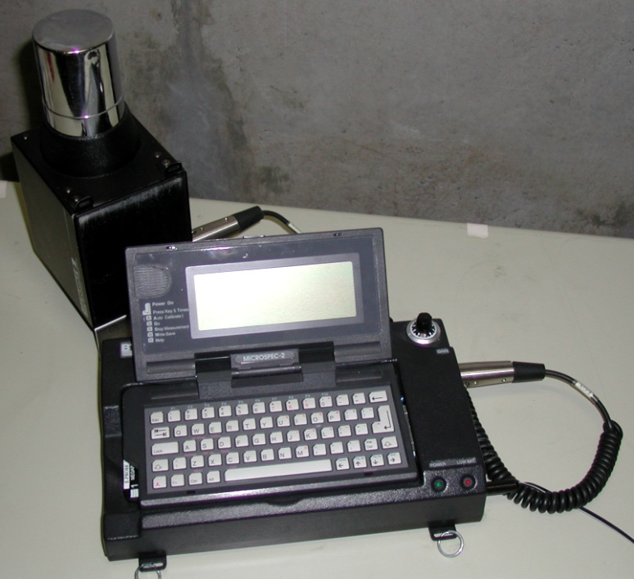
Benchmark experiment – Instrumentation 2
Portable spectrometer Microspec
  NaI detector, cylindrical shape, 5 x 5 cm
  folds spectrum with detector response (“calibrated” with ²²Na source)
  physical centre of detector determined with additional measurements with known sources (⁶⁰Co, ¹³⁷Cs, ²²Na) to be 2.4 cm
Reference: M. Brugger et al., Radiat. Prot. Dosim. 116 (2005) 12-15

Slide 30
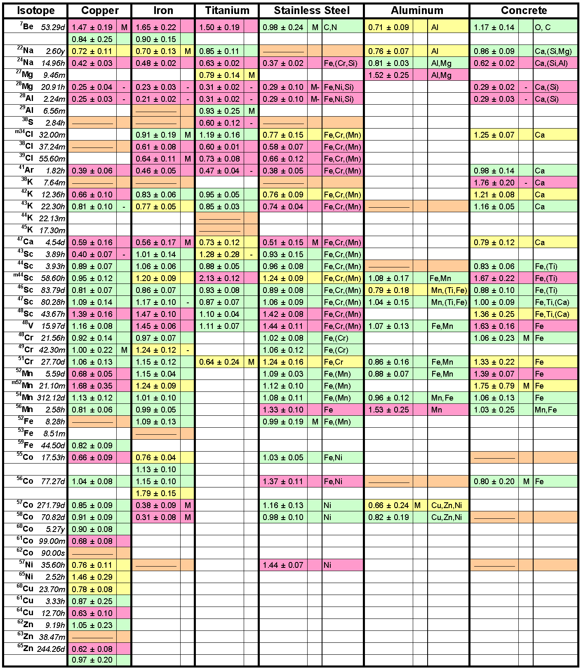




R = Ratio FLUKA/Exp
0.8 < R < 1.2
0.8 < R ± Error < 1.2
Exp/MDA < 1
R + Error < 0.8 or
R – Error > 1.2
Reference:
M. Brugger, S. Roesler et al., Nuclear Instruments and Methods A 562 (2006) 814-818

Slide 31
Benchmark experiment – Results 1
Dose rate as function of cooling time
for different distances between sample and detector
Reference: M. Brugger, S. Roesler et al., Radiat. Prot. Dosim. 116 (2005) 12-15

Slide 32
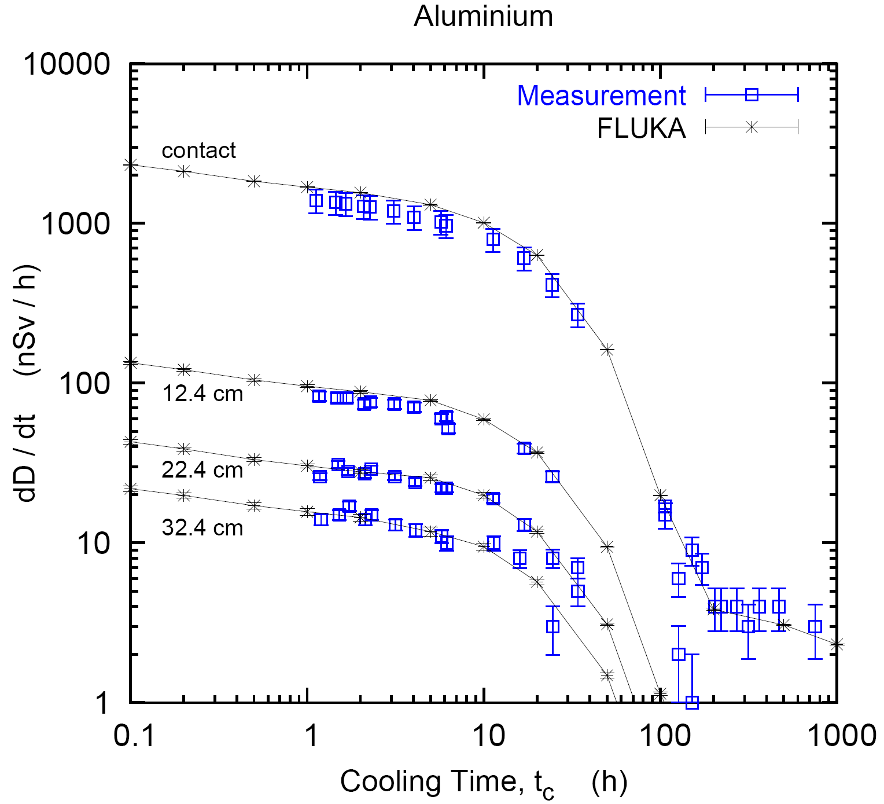
Benchmark experiment – Results 2
Dose rate as function of cooling time
for different distances between sample and detector
Reference: M. Brugger, S. Roesler et al., Radiat. Prot. Dosim. 116 (2005) 12-15

Slide 33
Benchmark experiment – Results 3
Dose rate as function of cooling time
for different distances between sample and detector
Reference: M. Brugger, S. Roesler et al., Radiat. Prot. Dosim. 116 (2005) 12-15

Slide 34
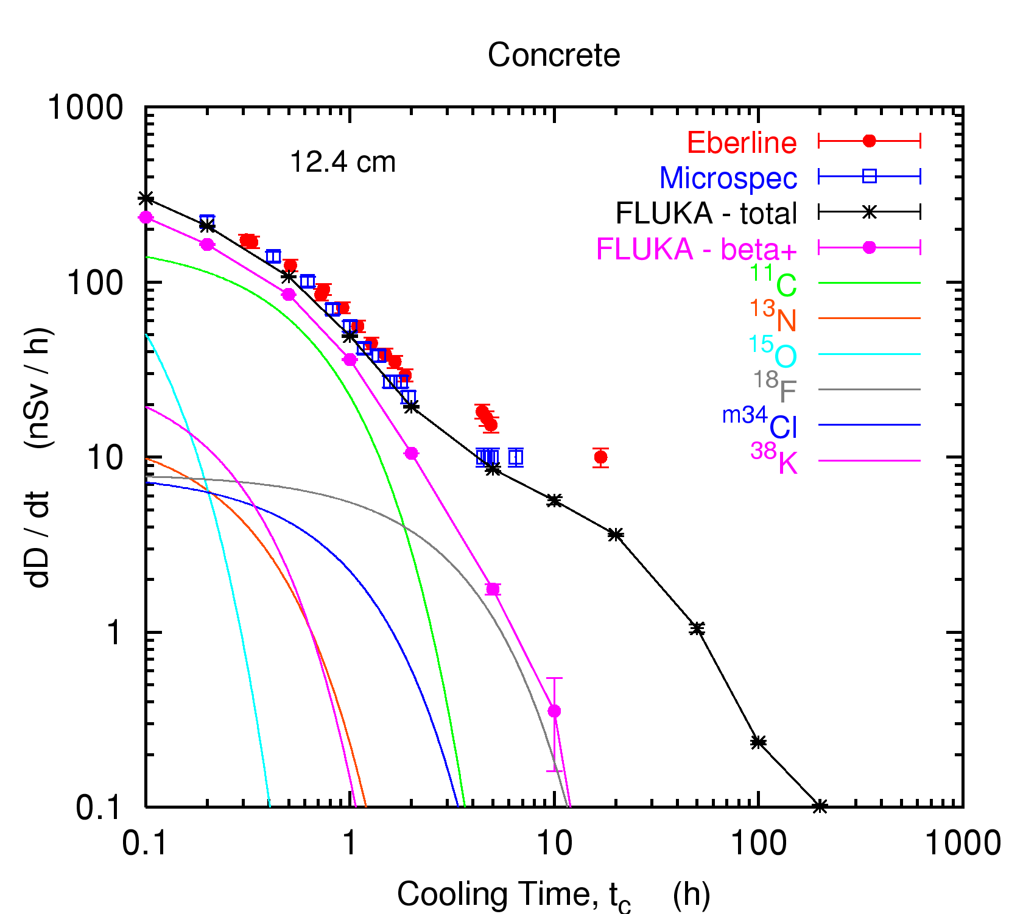
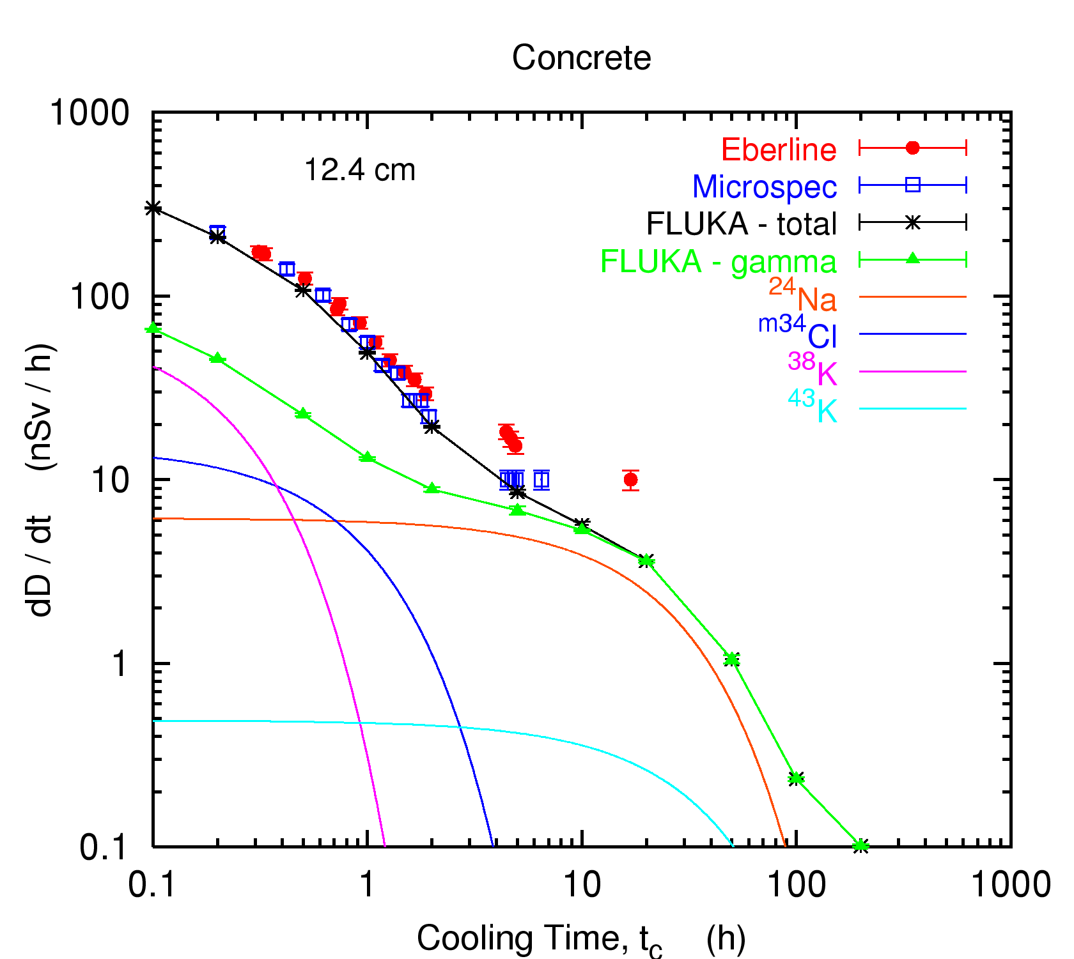
Benchmark experiment
t_{cool} < 2 hours :
beta emitter
(¹¹C, t_{1/2} = 20.38min)
2 hours < t_{cool} < 1 day :
gamma emitter
(²⁴Na, t_{1/2} = 14.96hrs)
6th FLUKA Course - CERN 2008

Slide 35
Applications

Slide 36
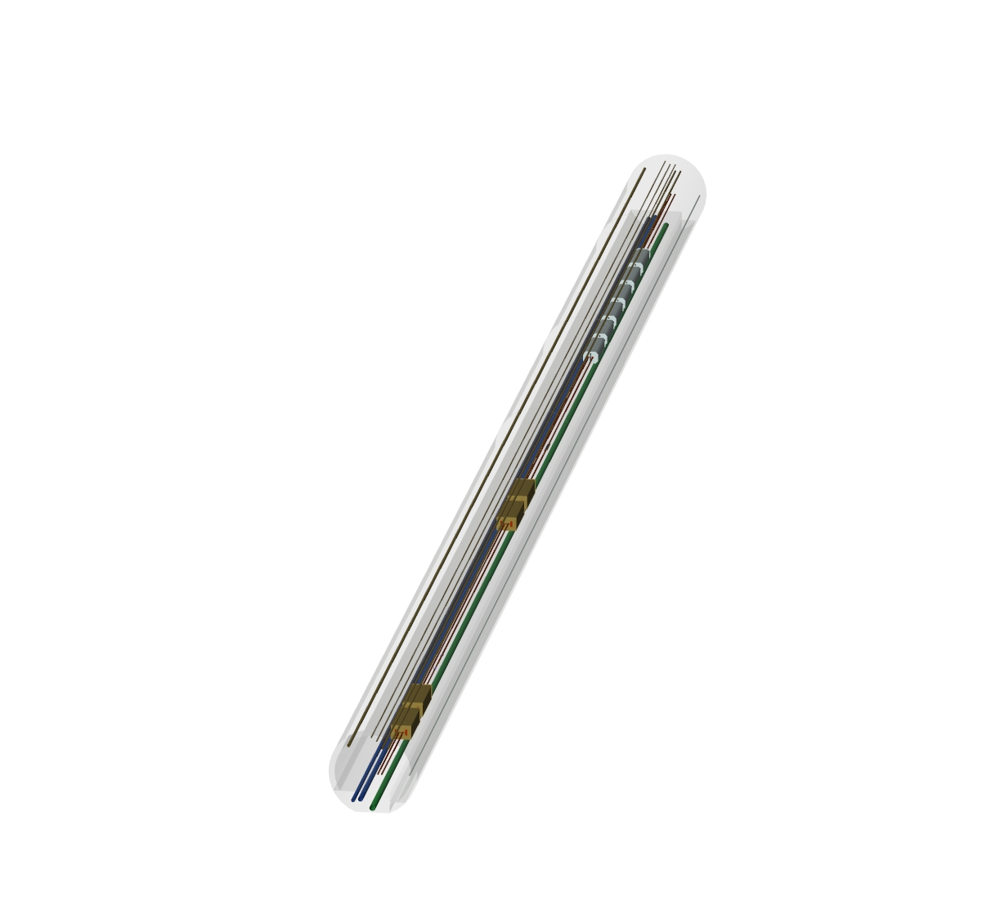
Applications – LHC collimation region
Magnets
Collimators
FLUKA geometry
visualized with
SimpleGeo

Slide 37
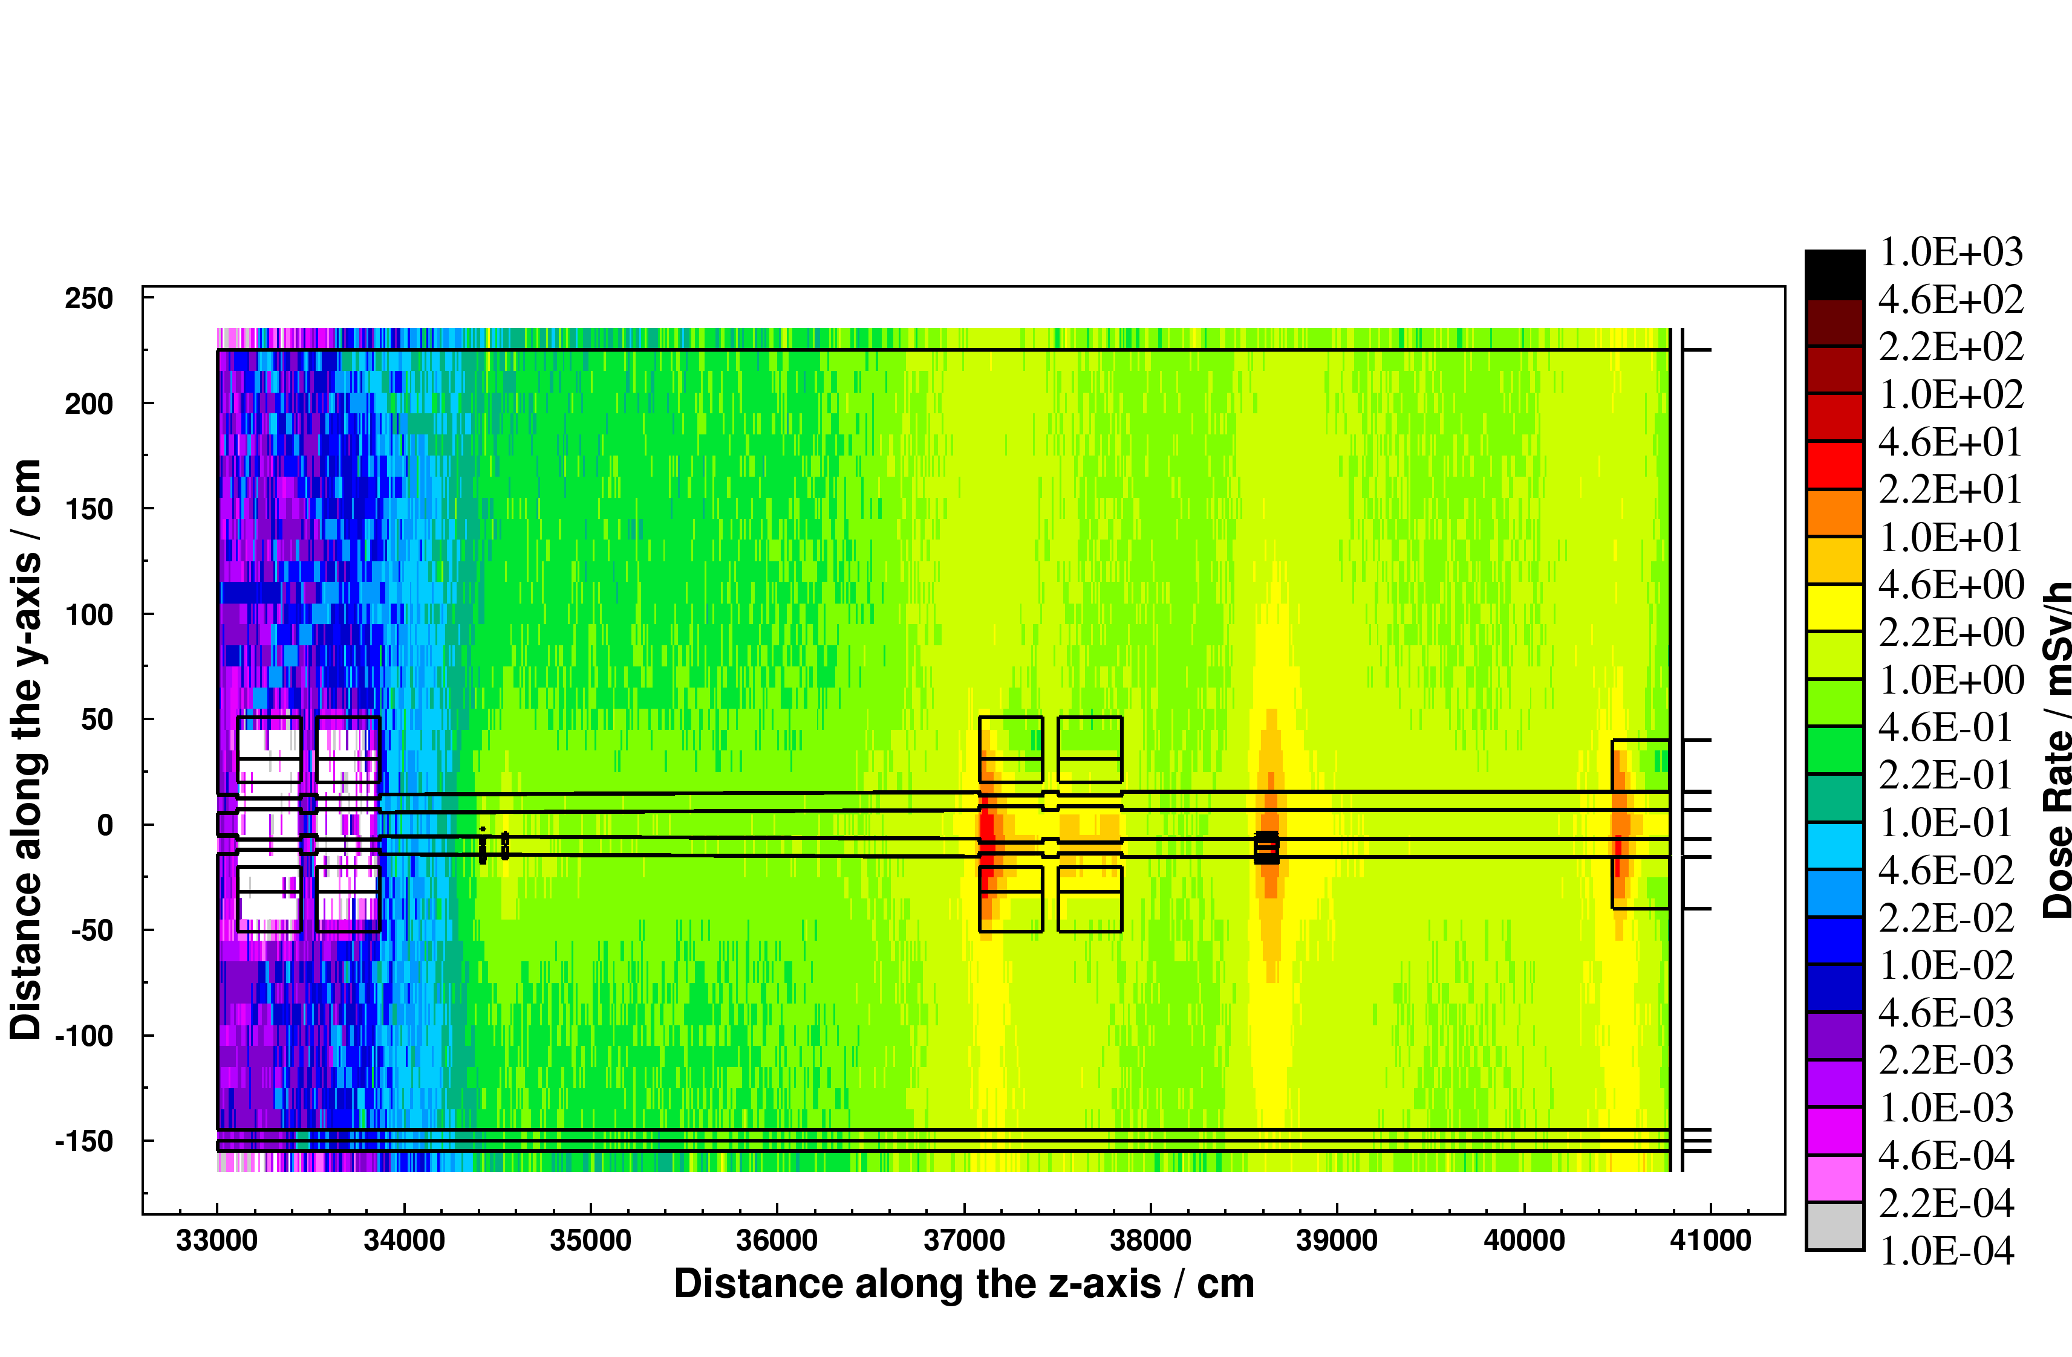
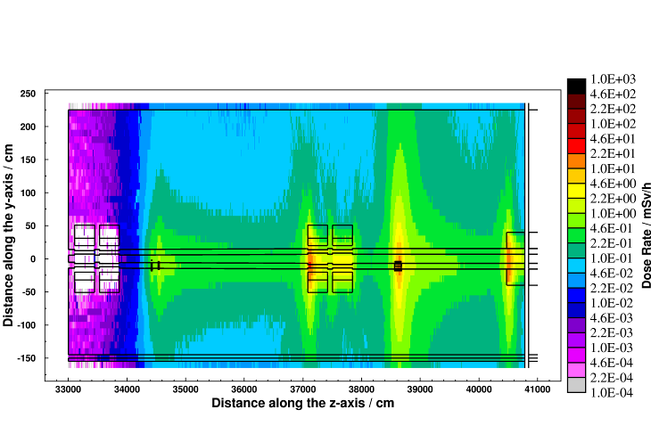
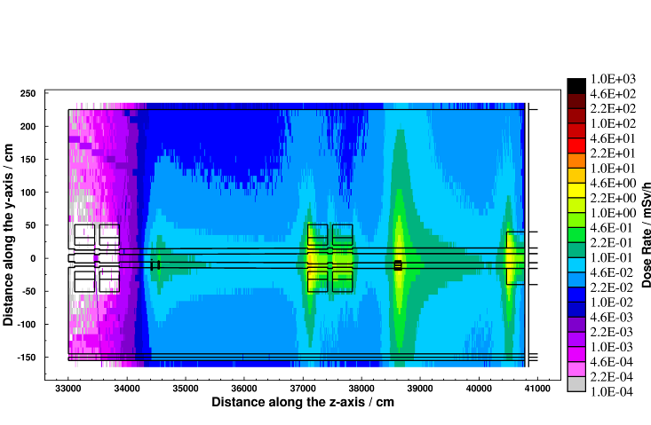
Applications – LHC collimation region
Cooling time
Residual dose rate (mSv/h)
after one year of operation
8 hours
1 week
4 months
CERN-SC-2005-092-RP-TN
37

Slide 38
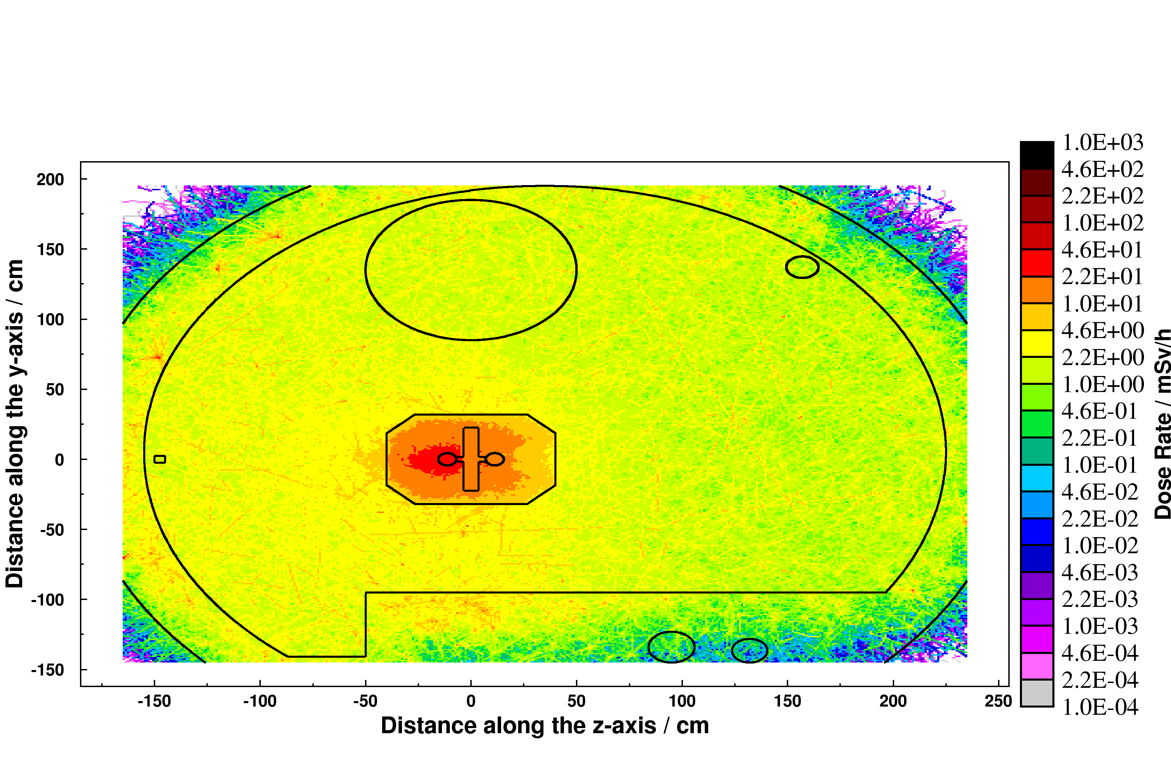
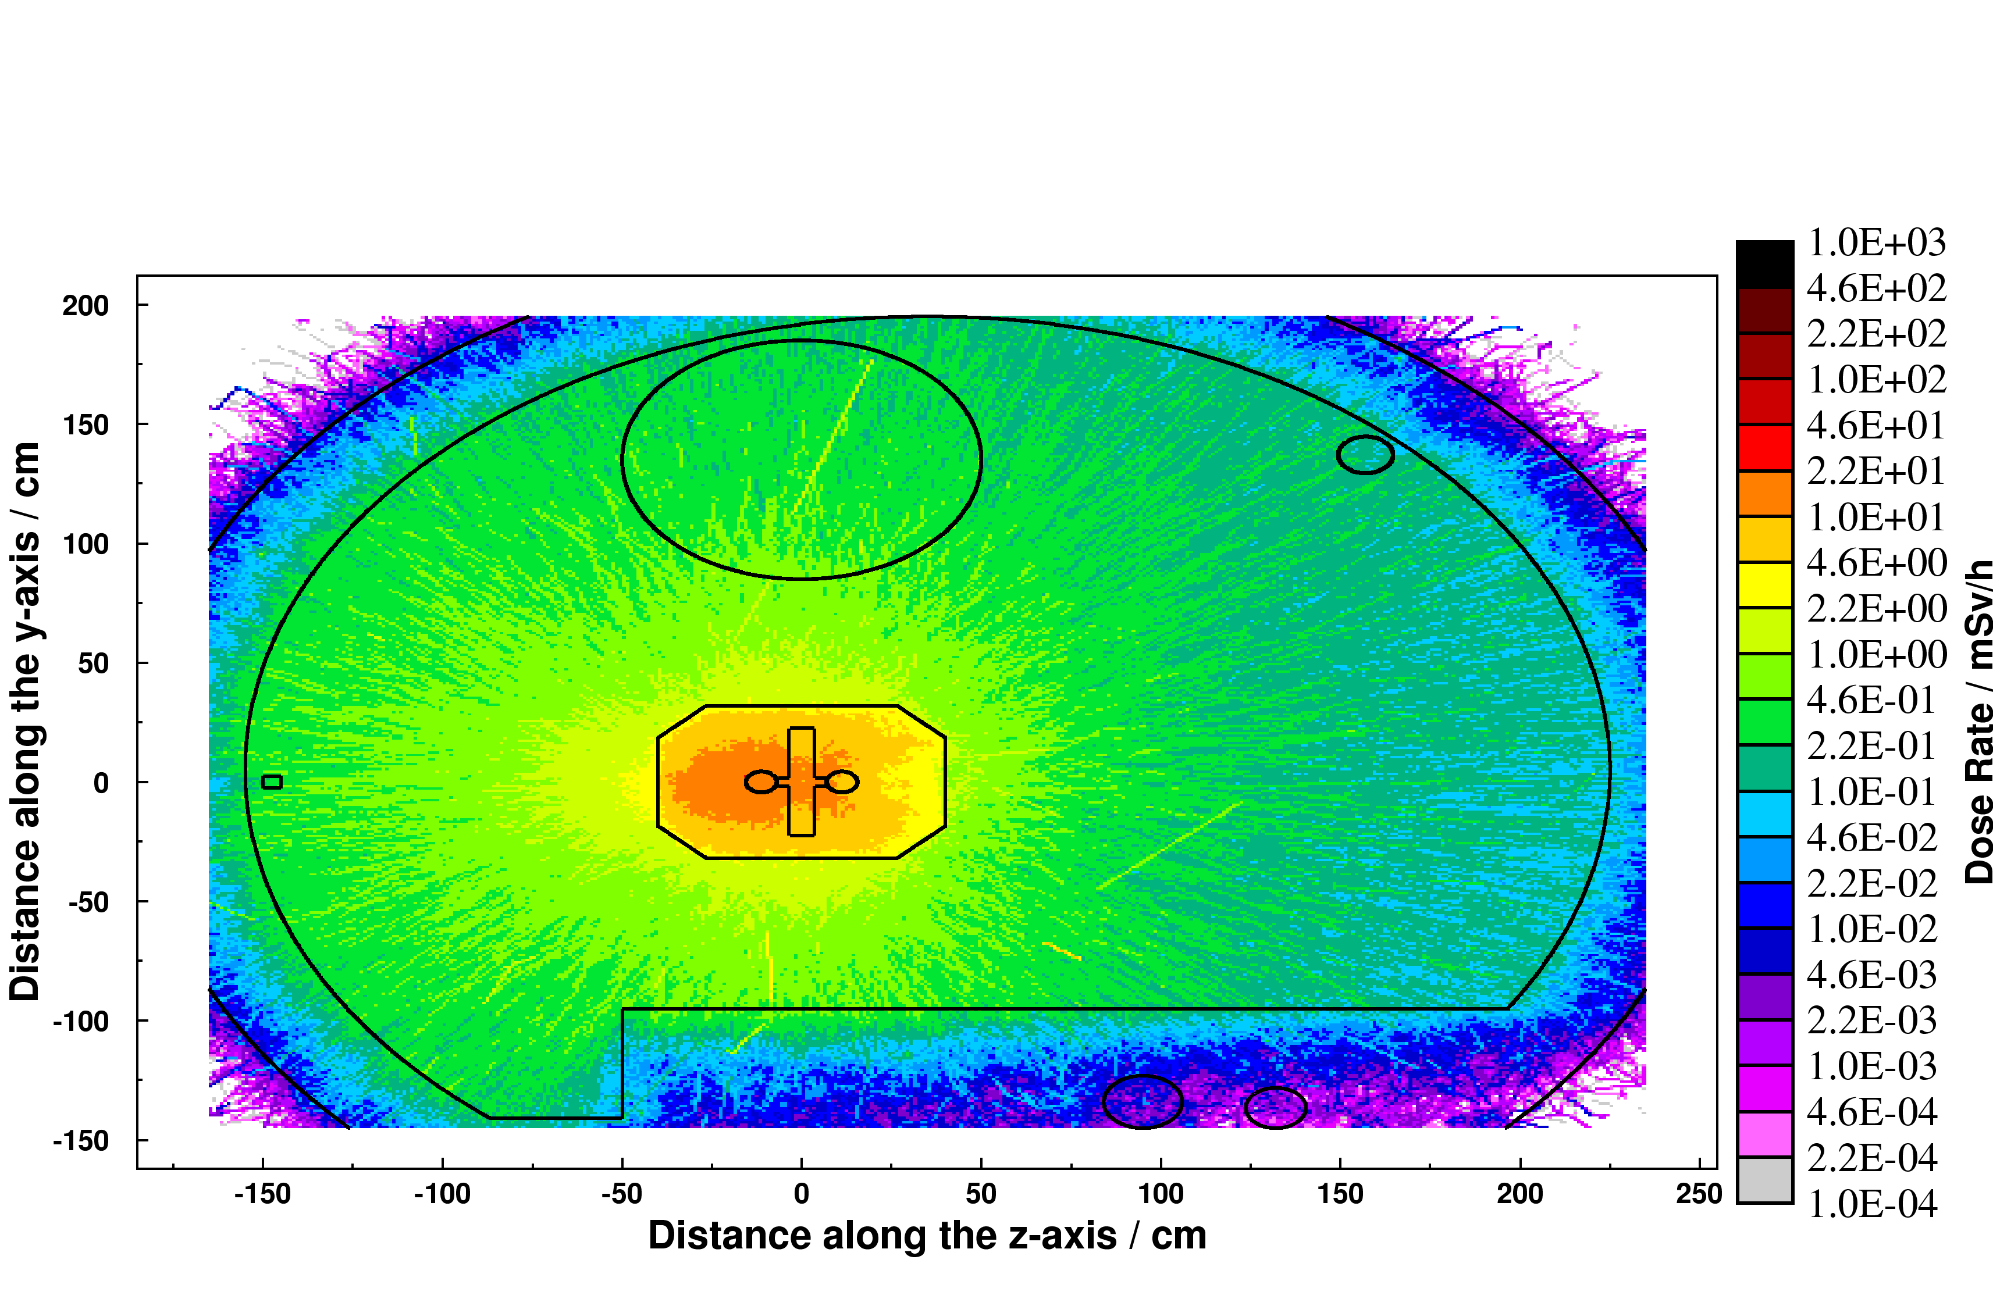
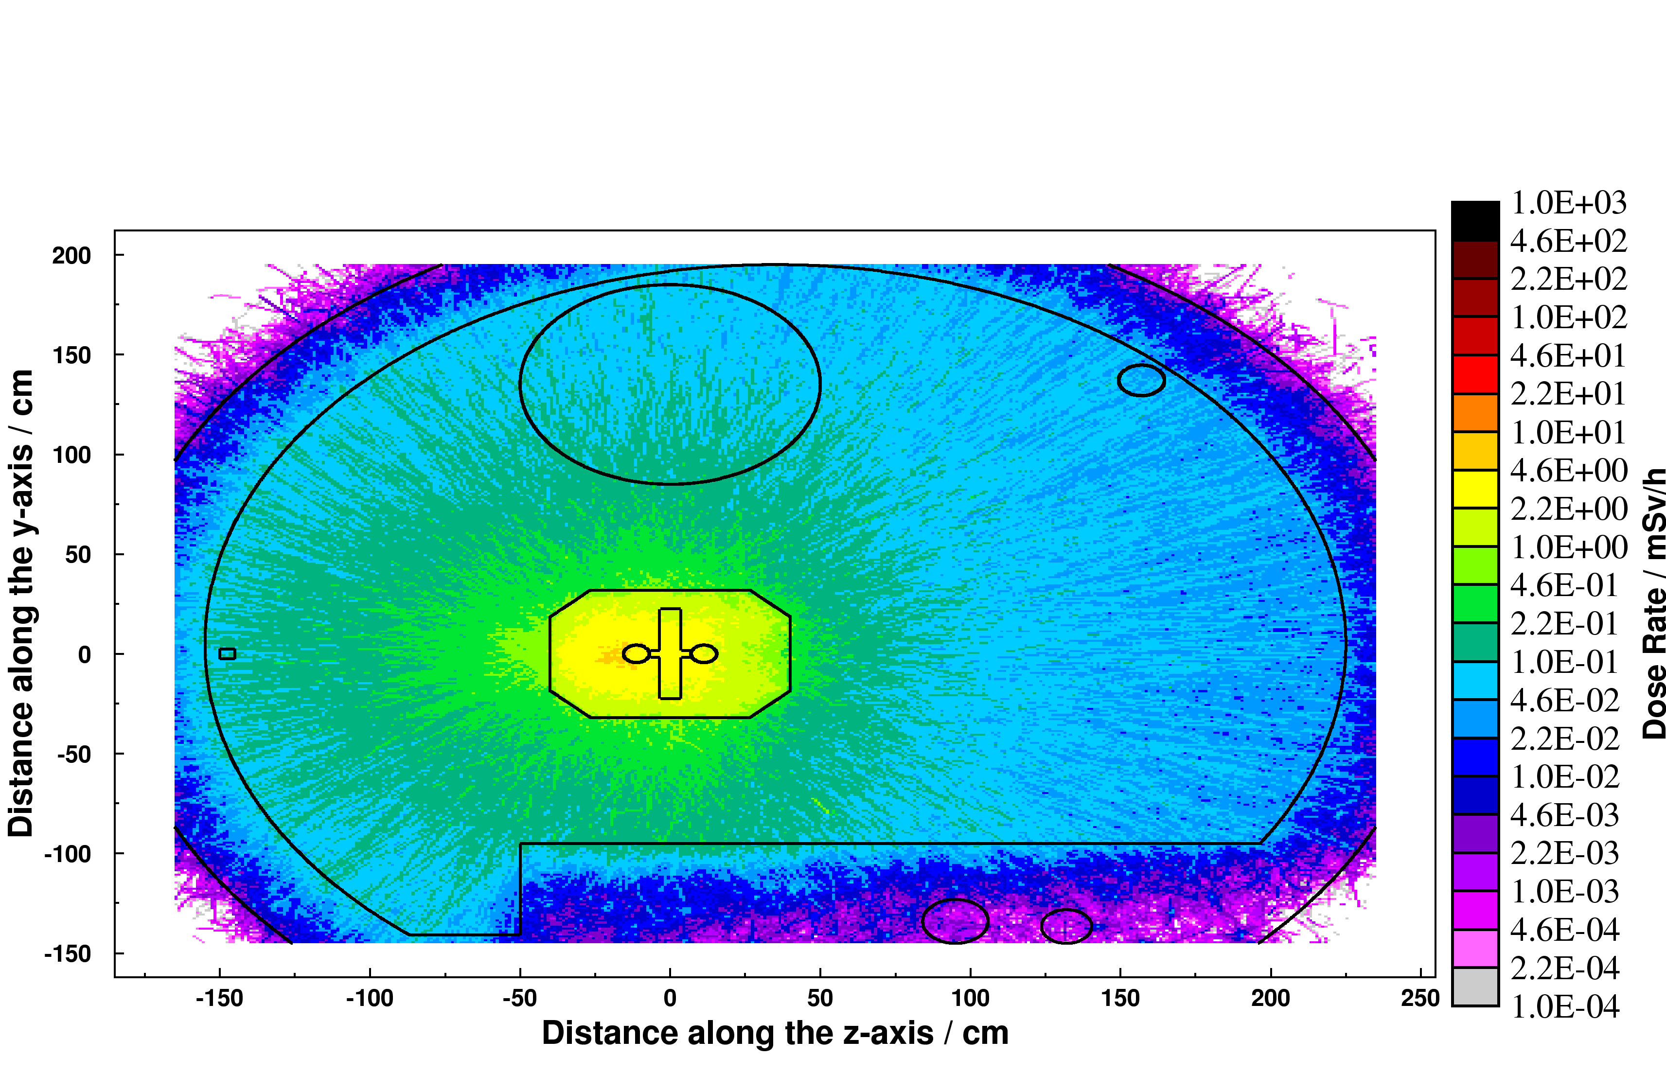
Applications – LHC collimation region
Cooling time
Residual dose rate (mSv/h)
after one year of operation
8 hours
1 week
4 months
CERN-SC-2005-092-RP-TN
6th FLUKA Course - CERN 2008
38

Slide 39
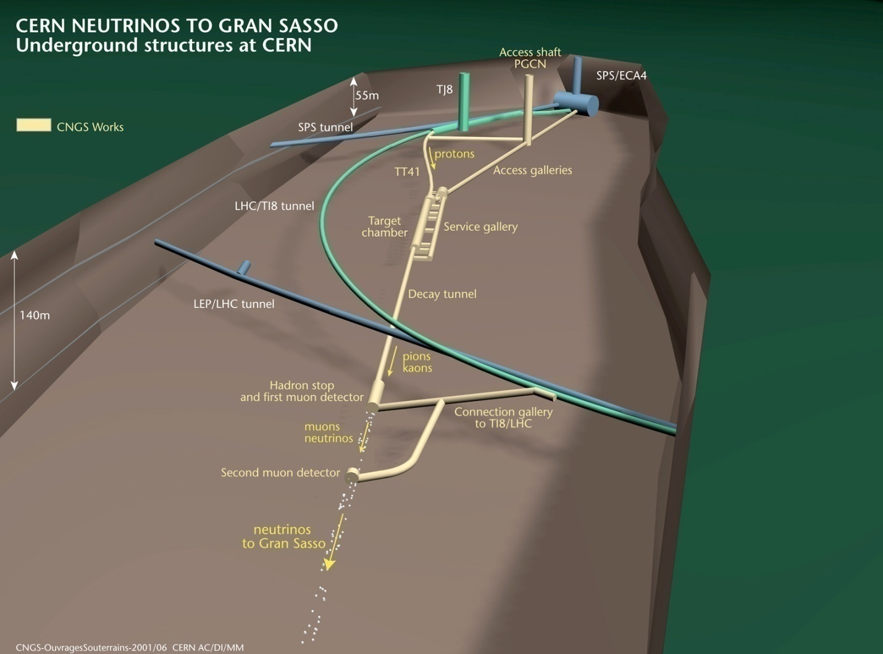
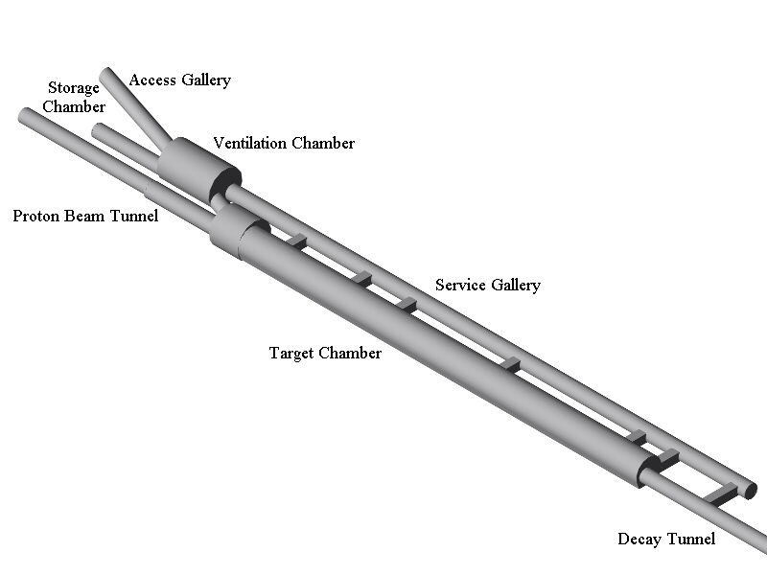
Applications – CNGS

Slide 40
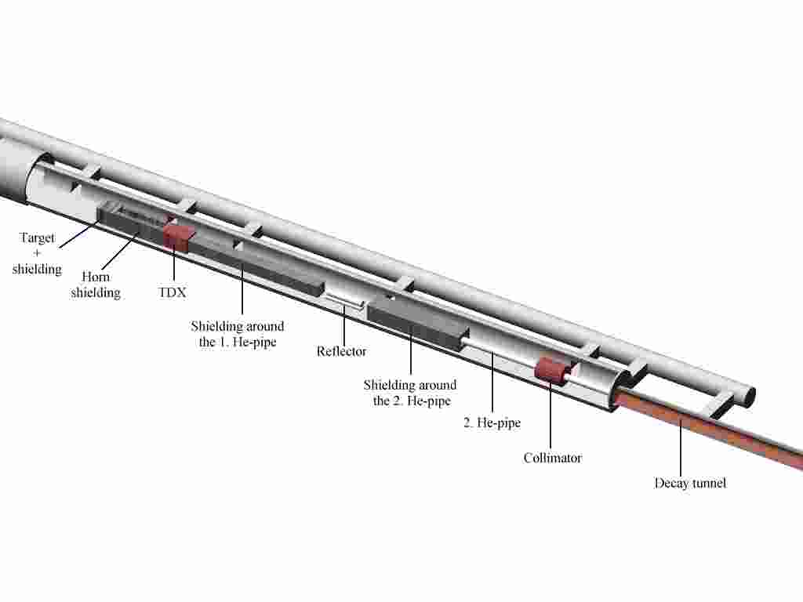
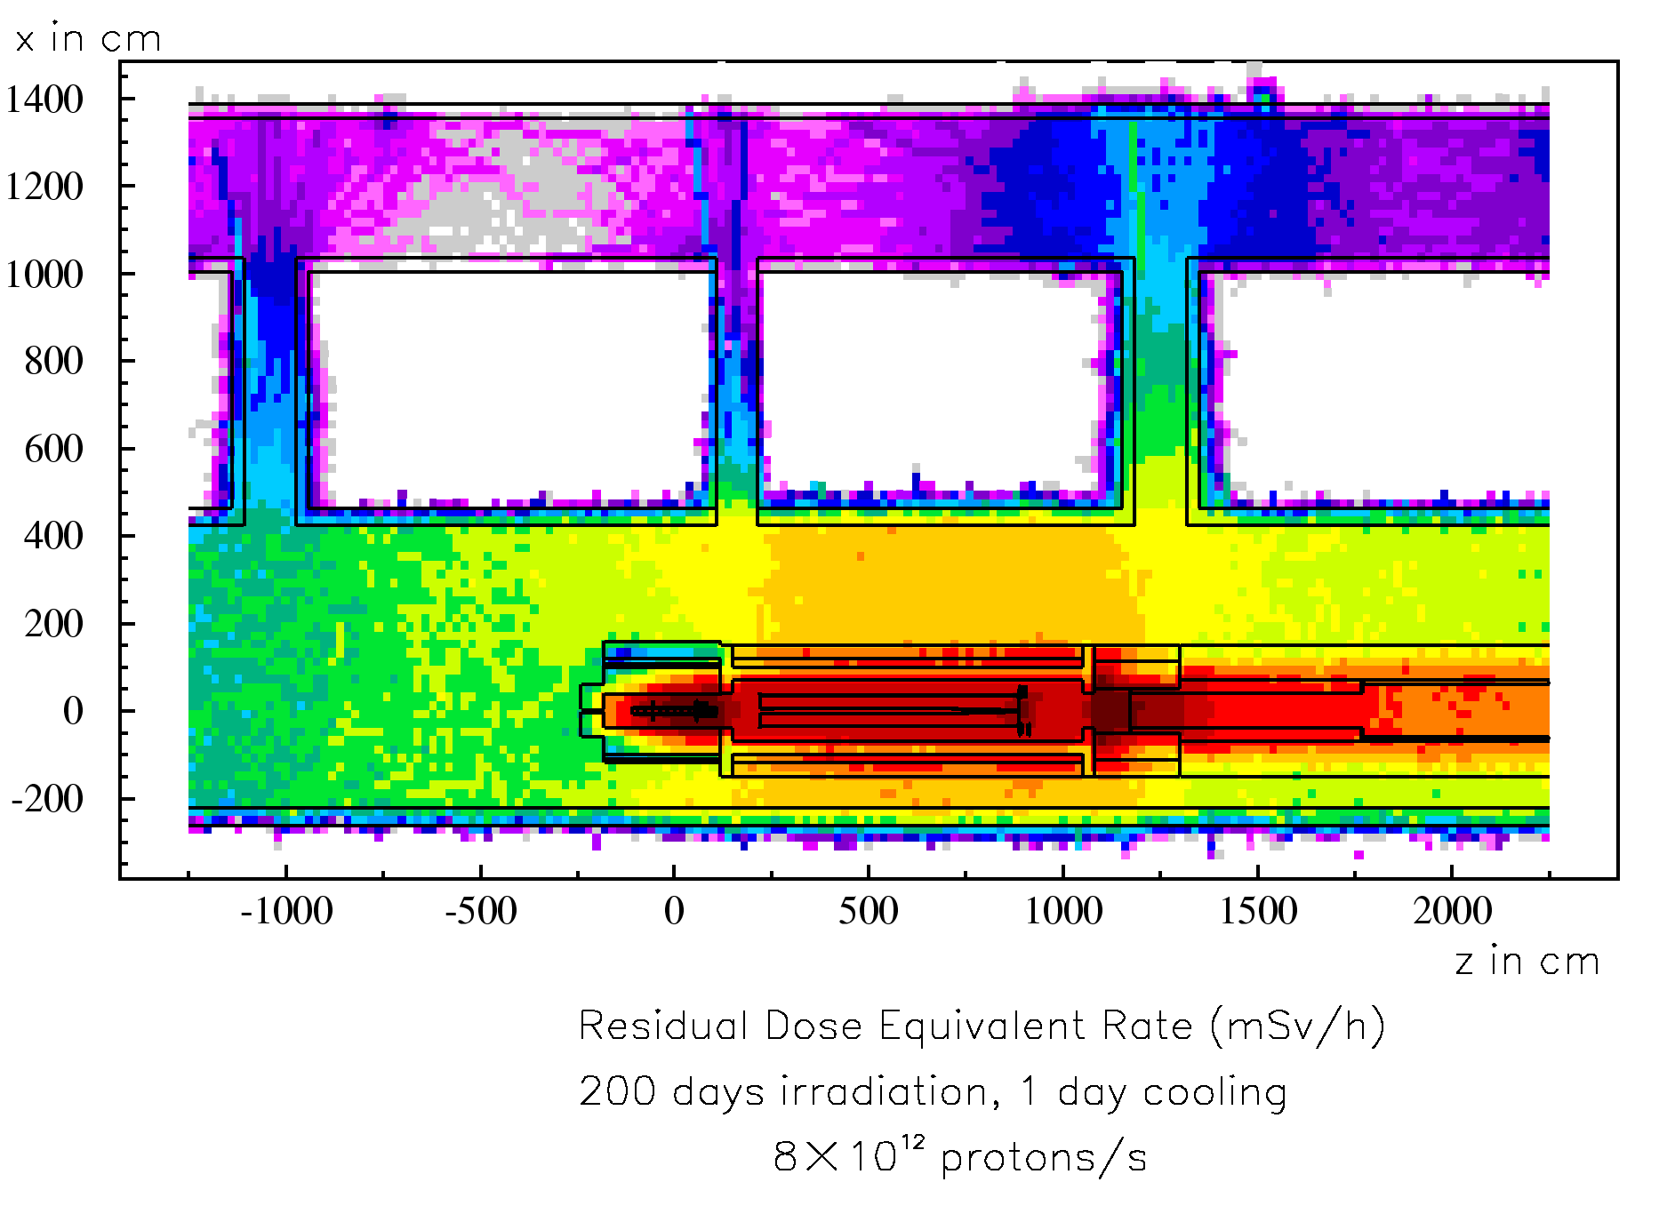
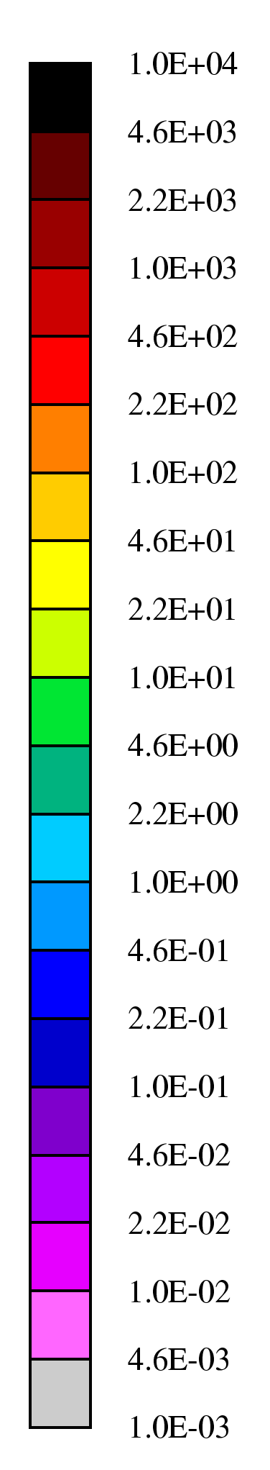
Applications – CNGS
mSv/h
Example:
t_{cool} = 1 day
100
10
1
6th FLUKA Course - CERN 2008

Slide 41
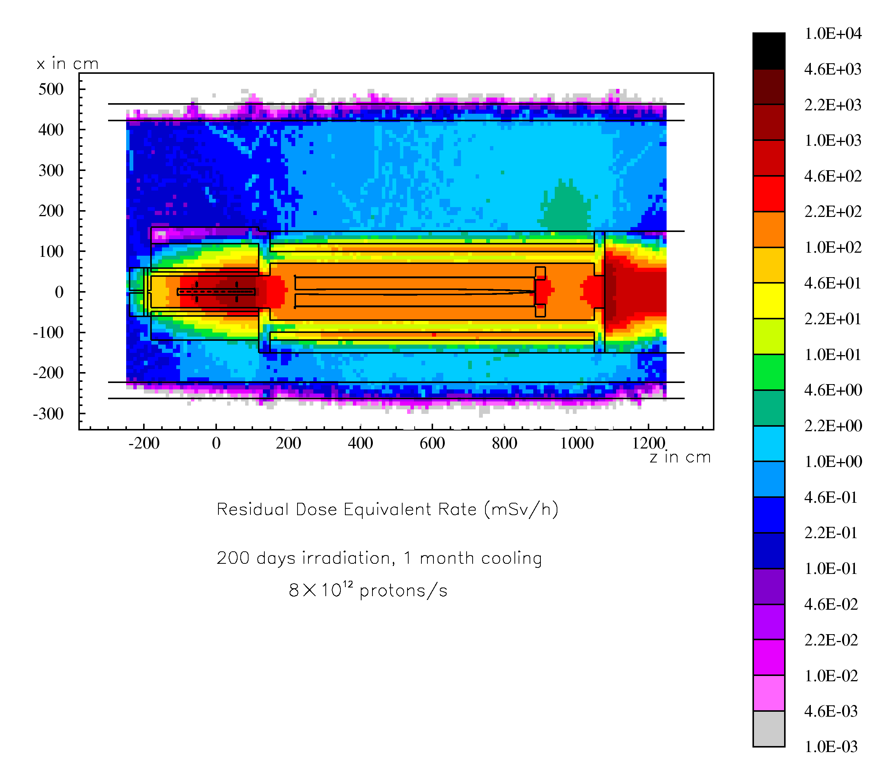
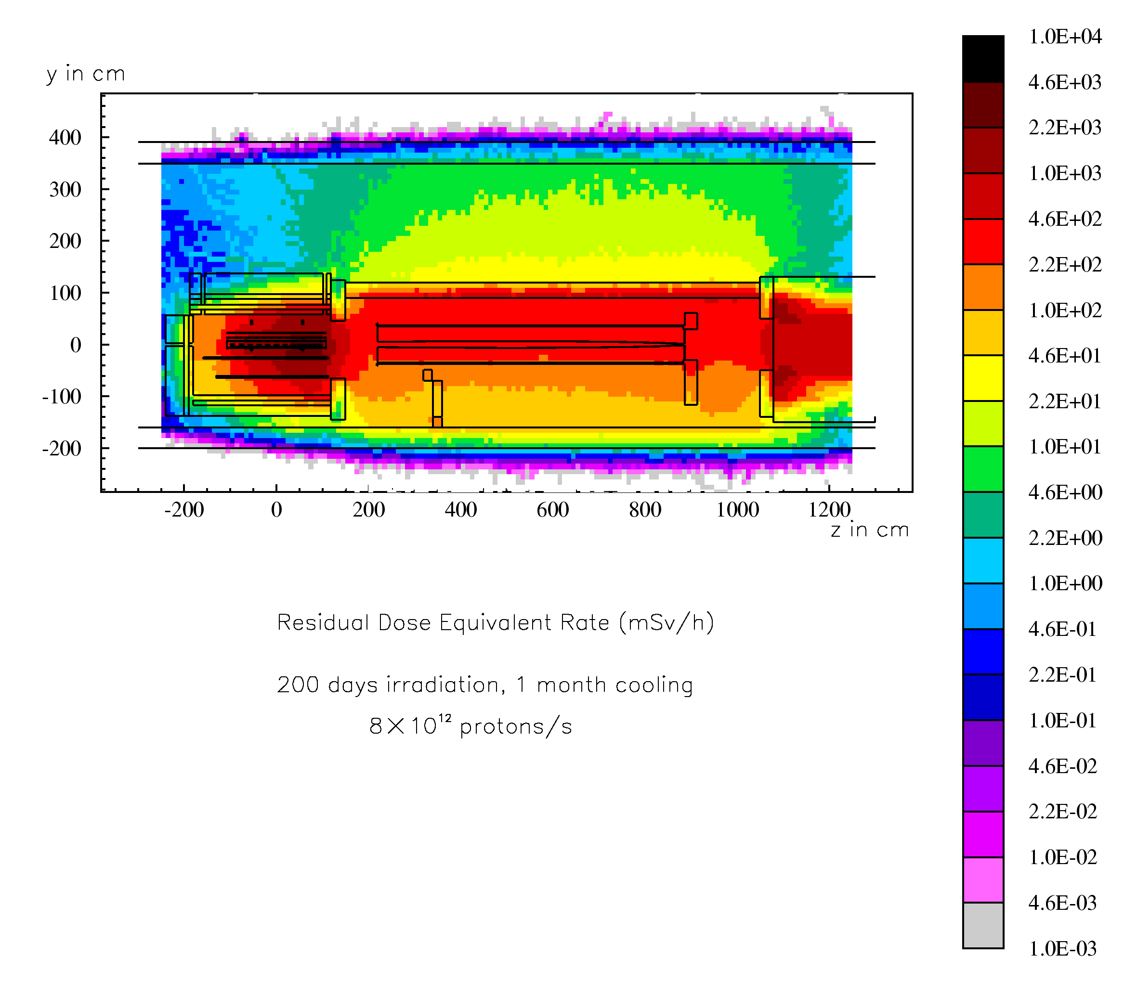
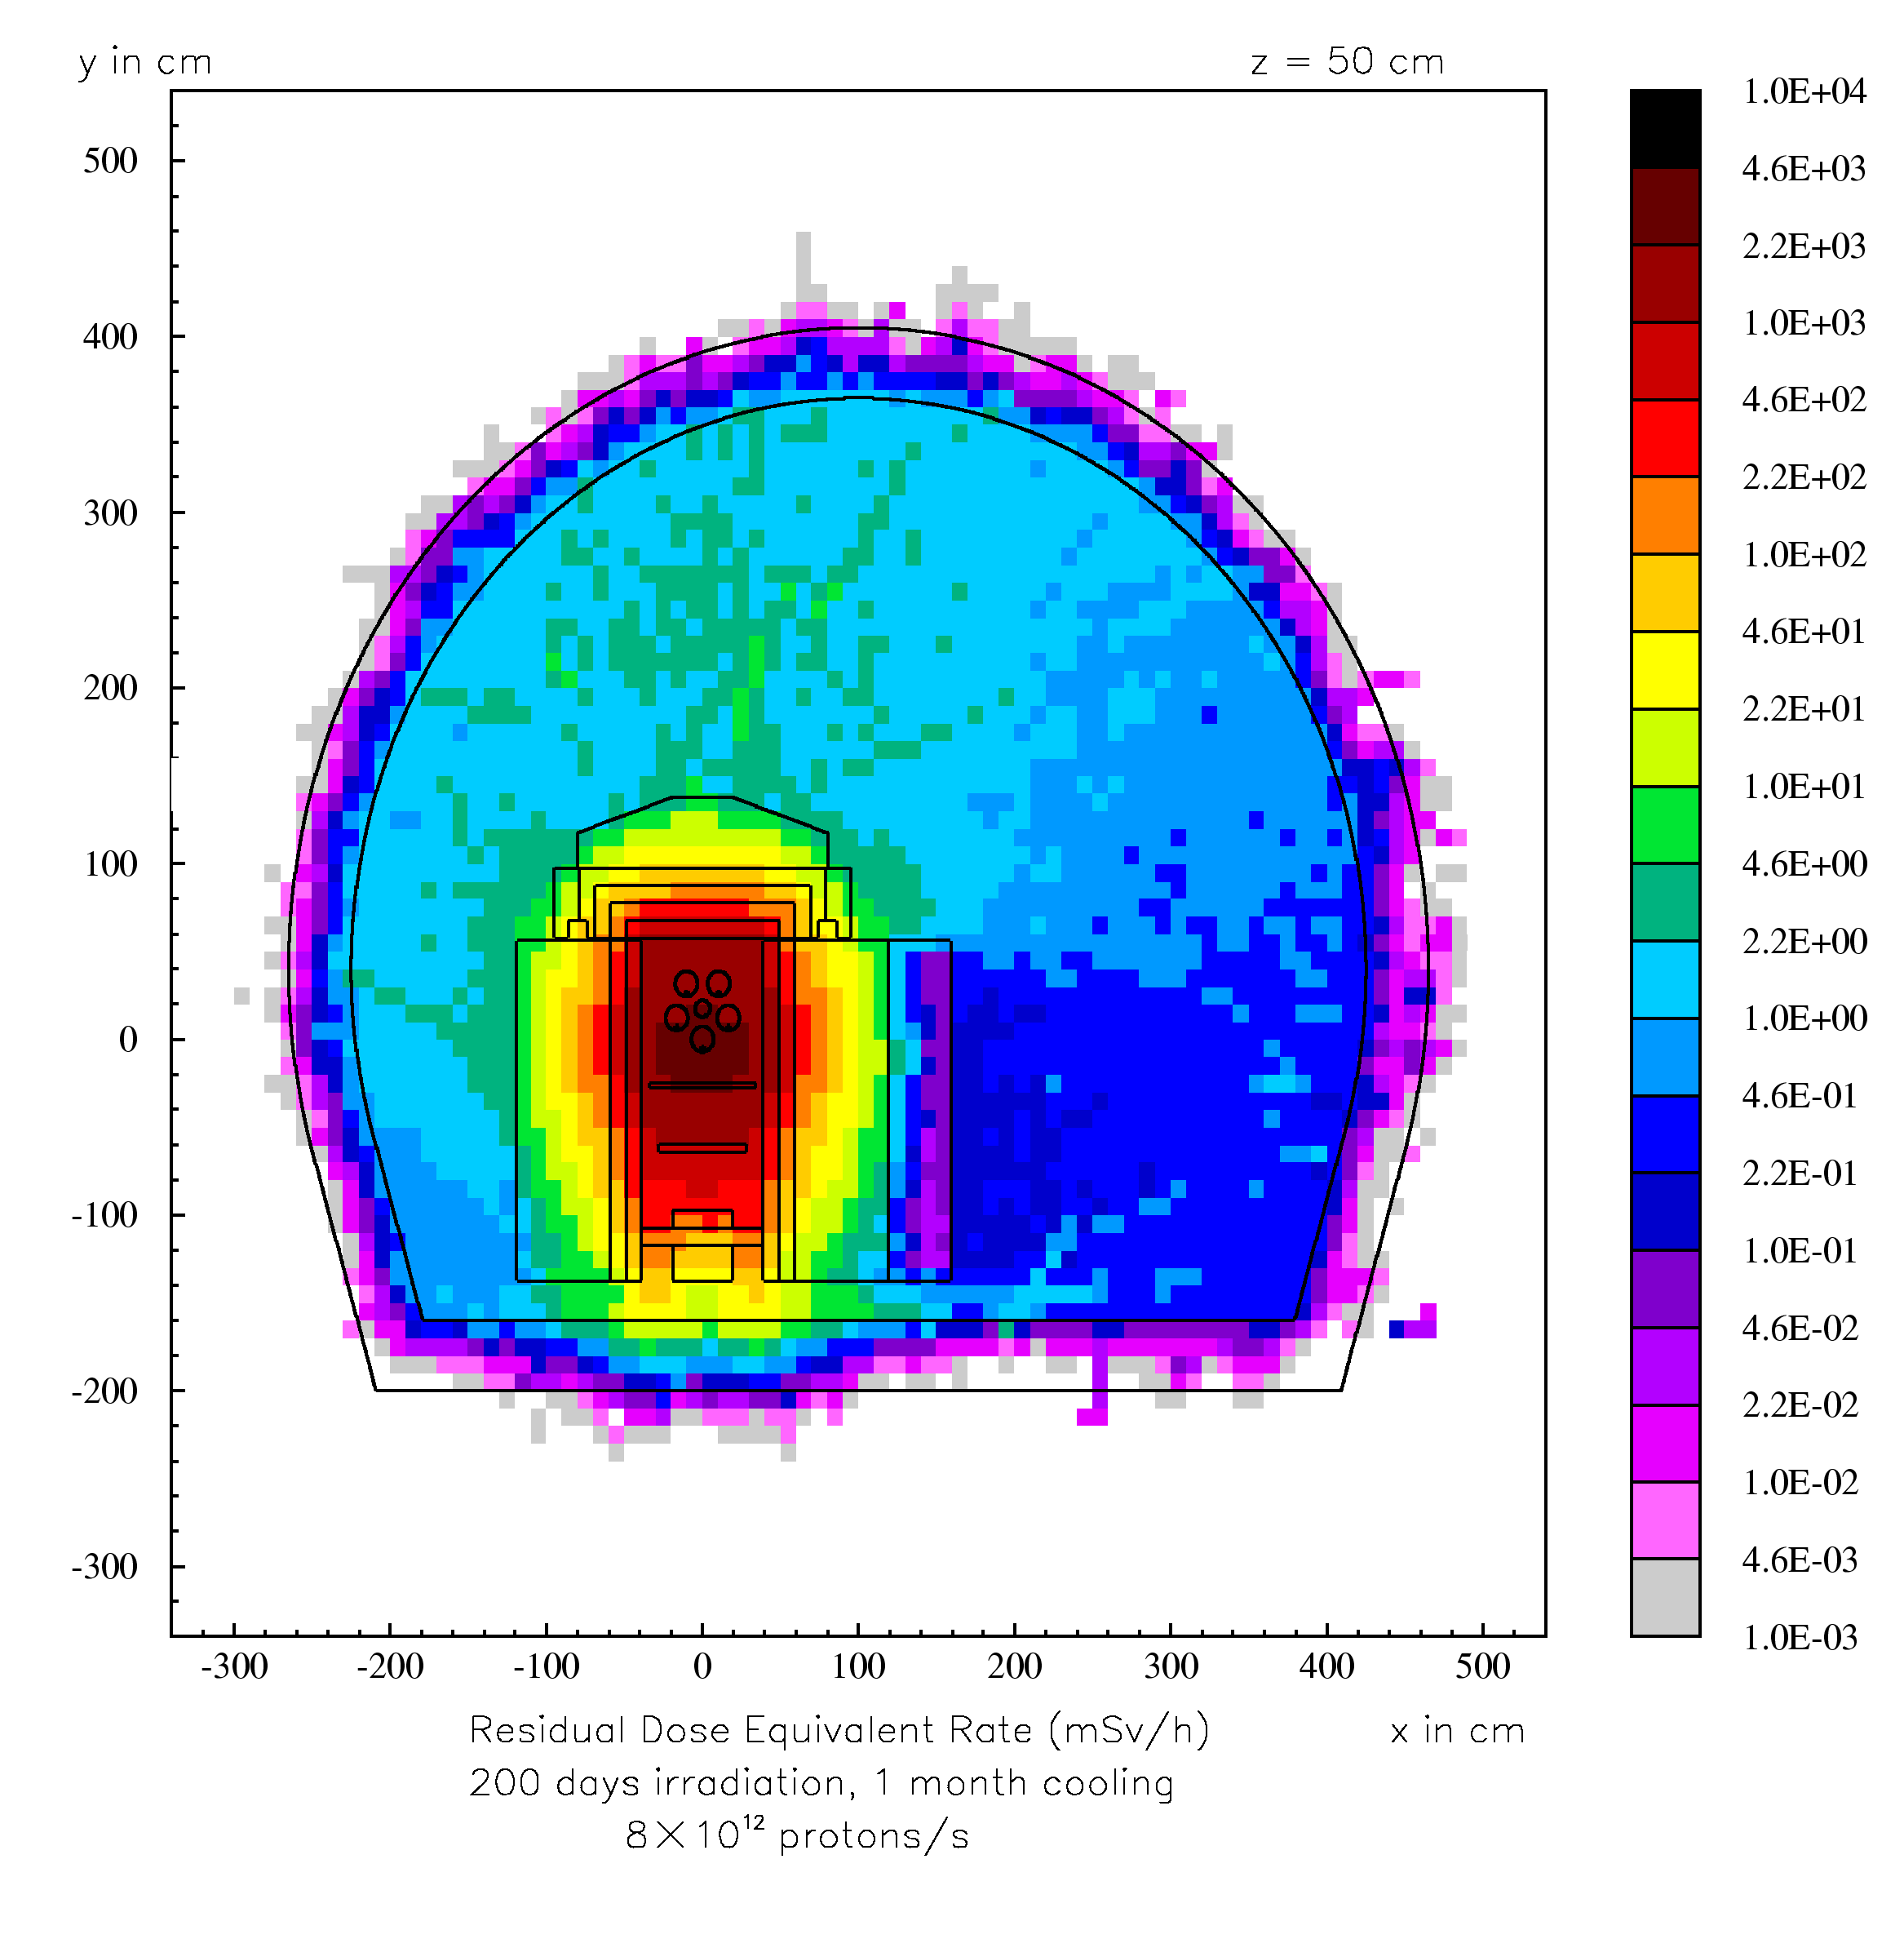
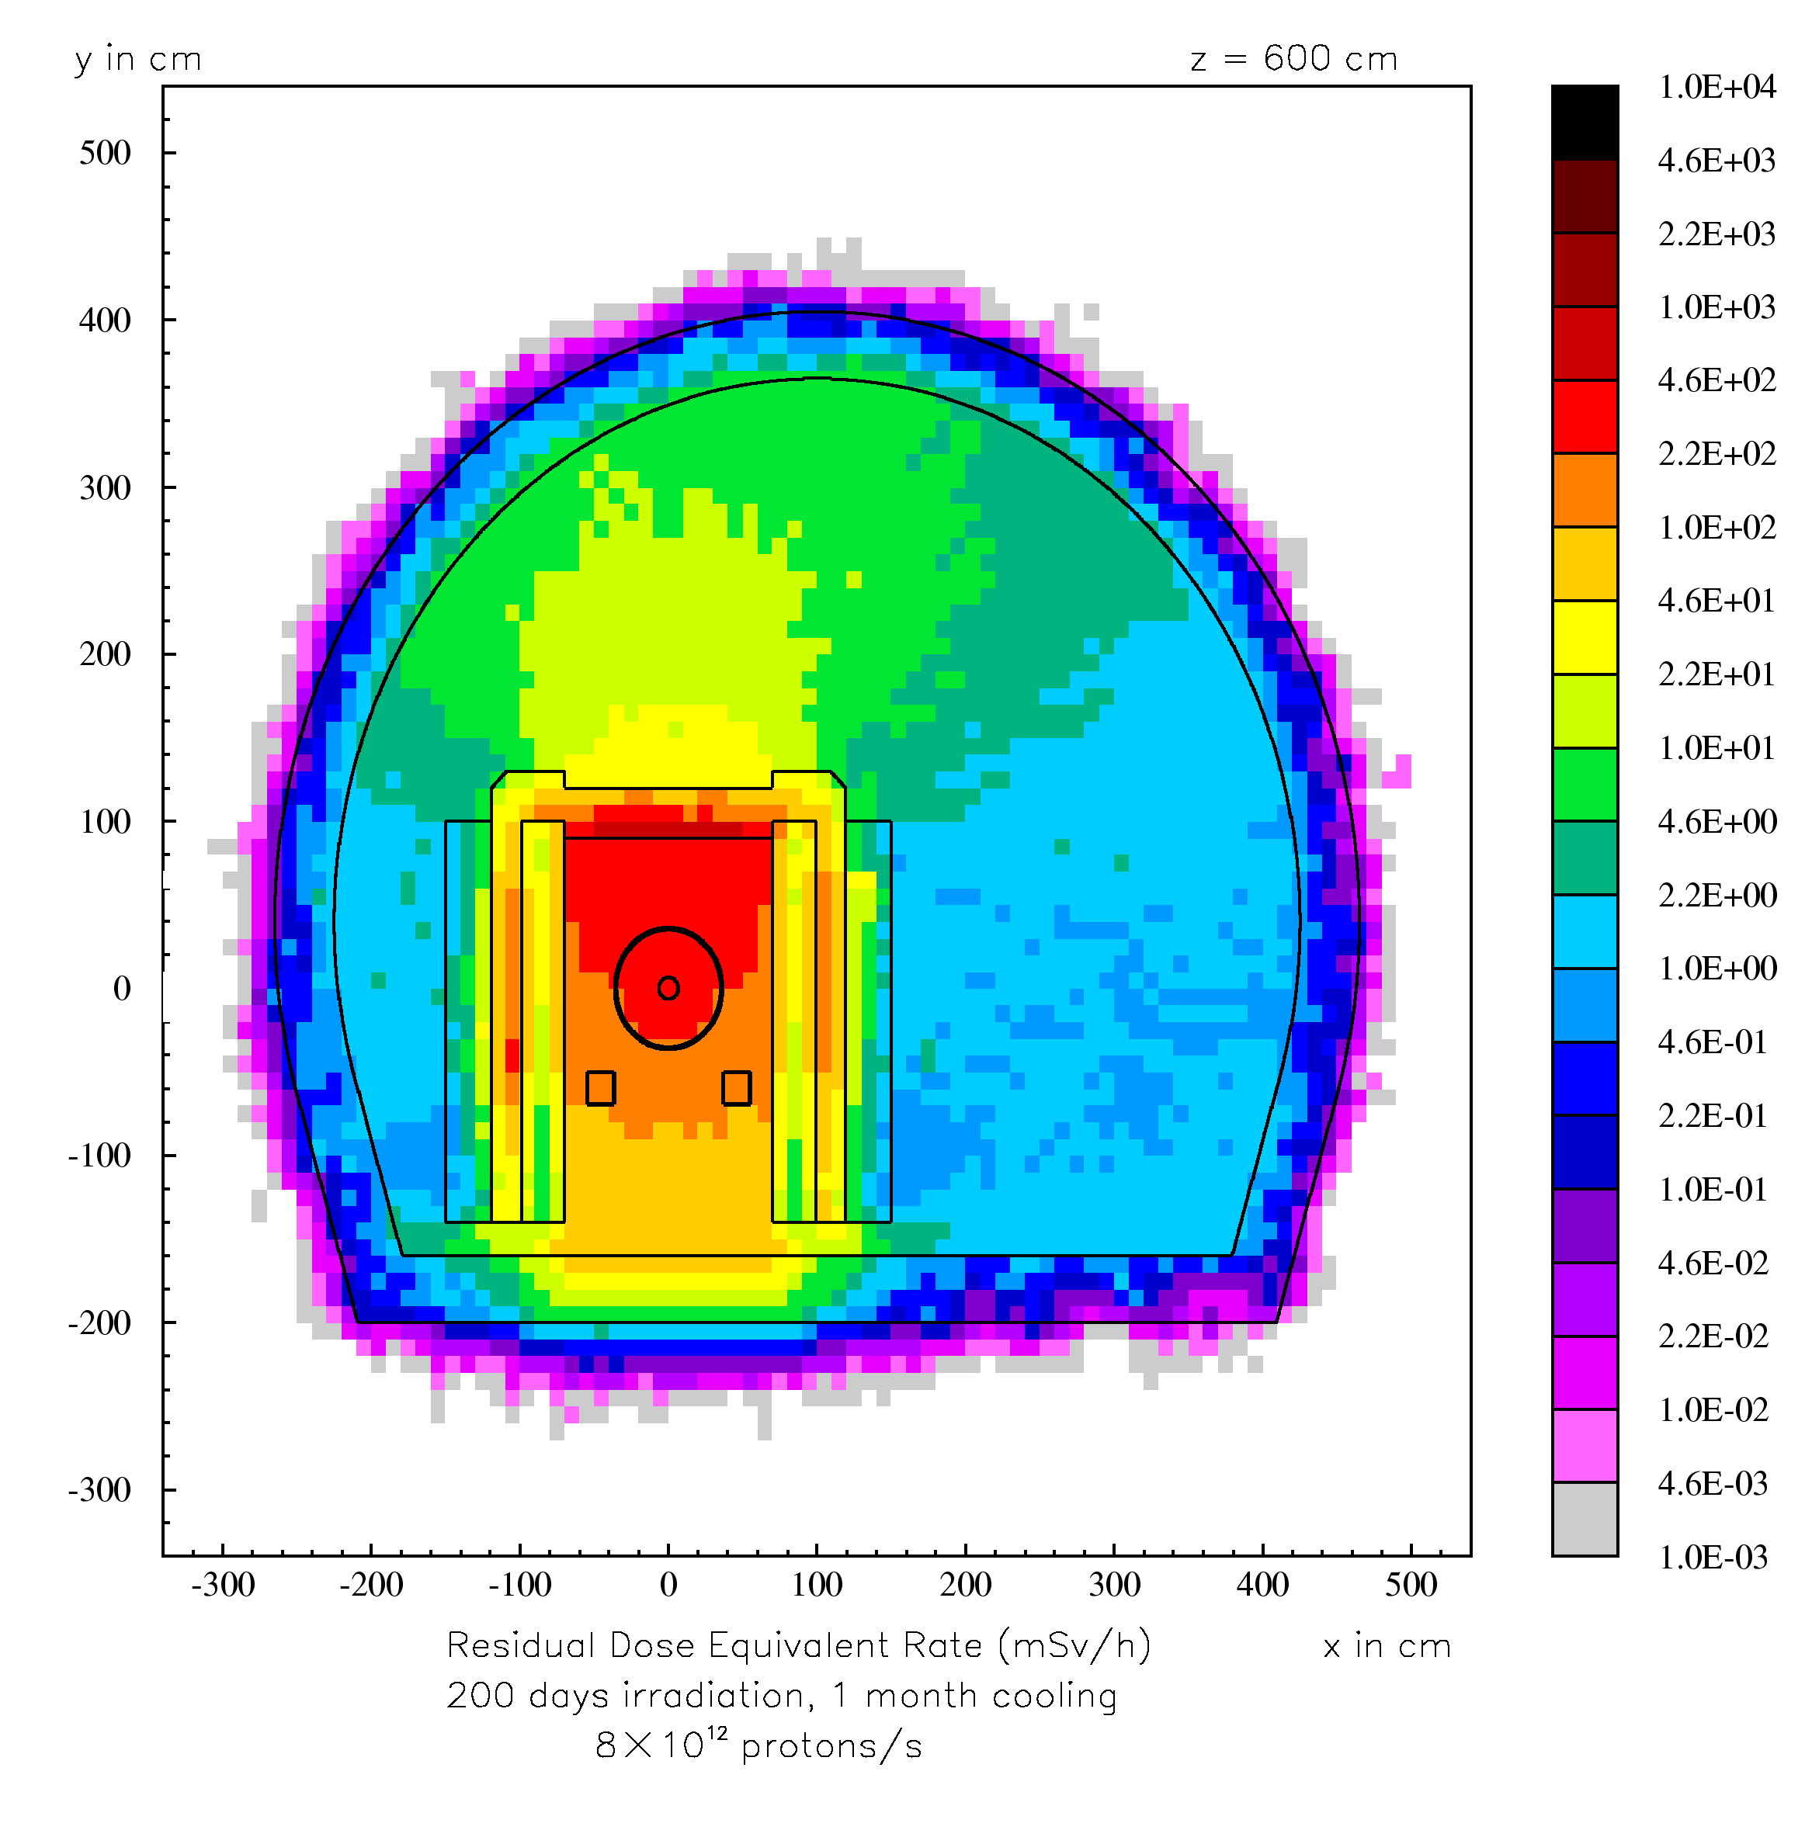
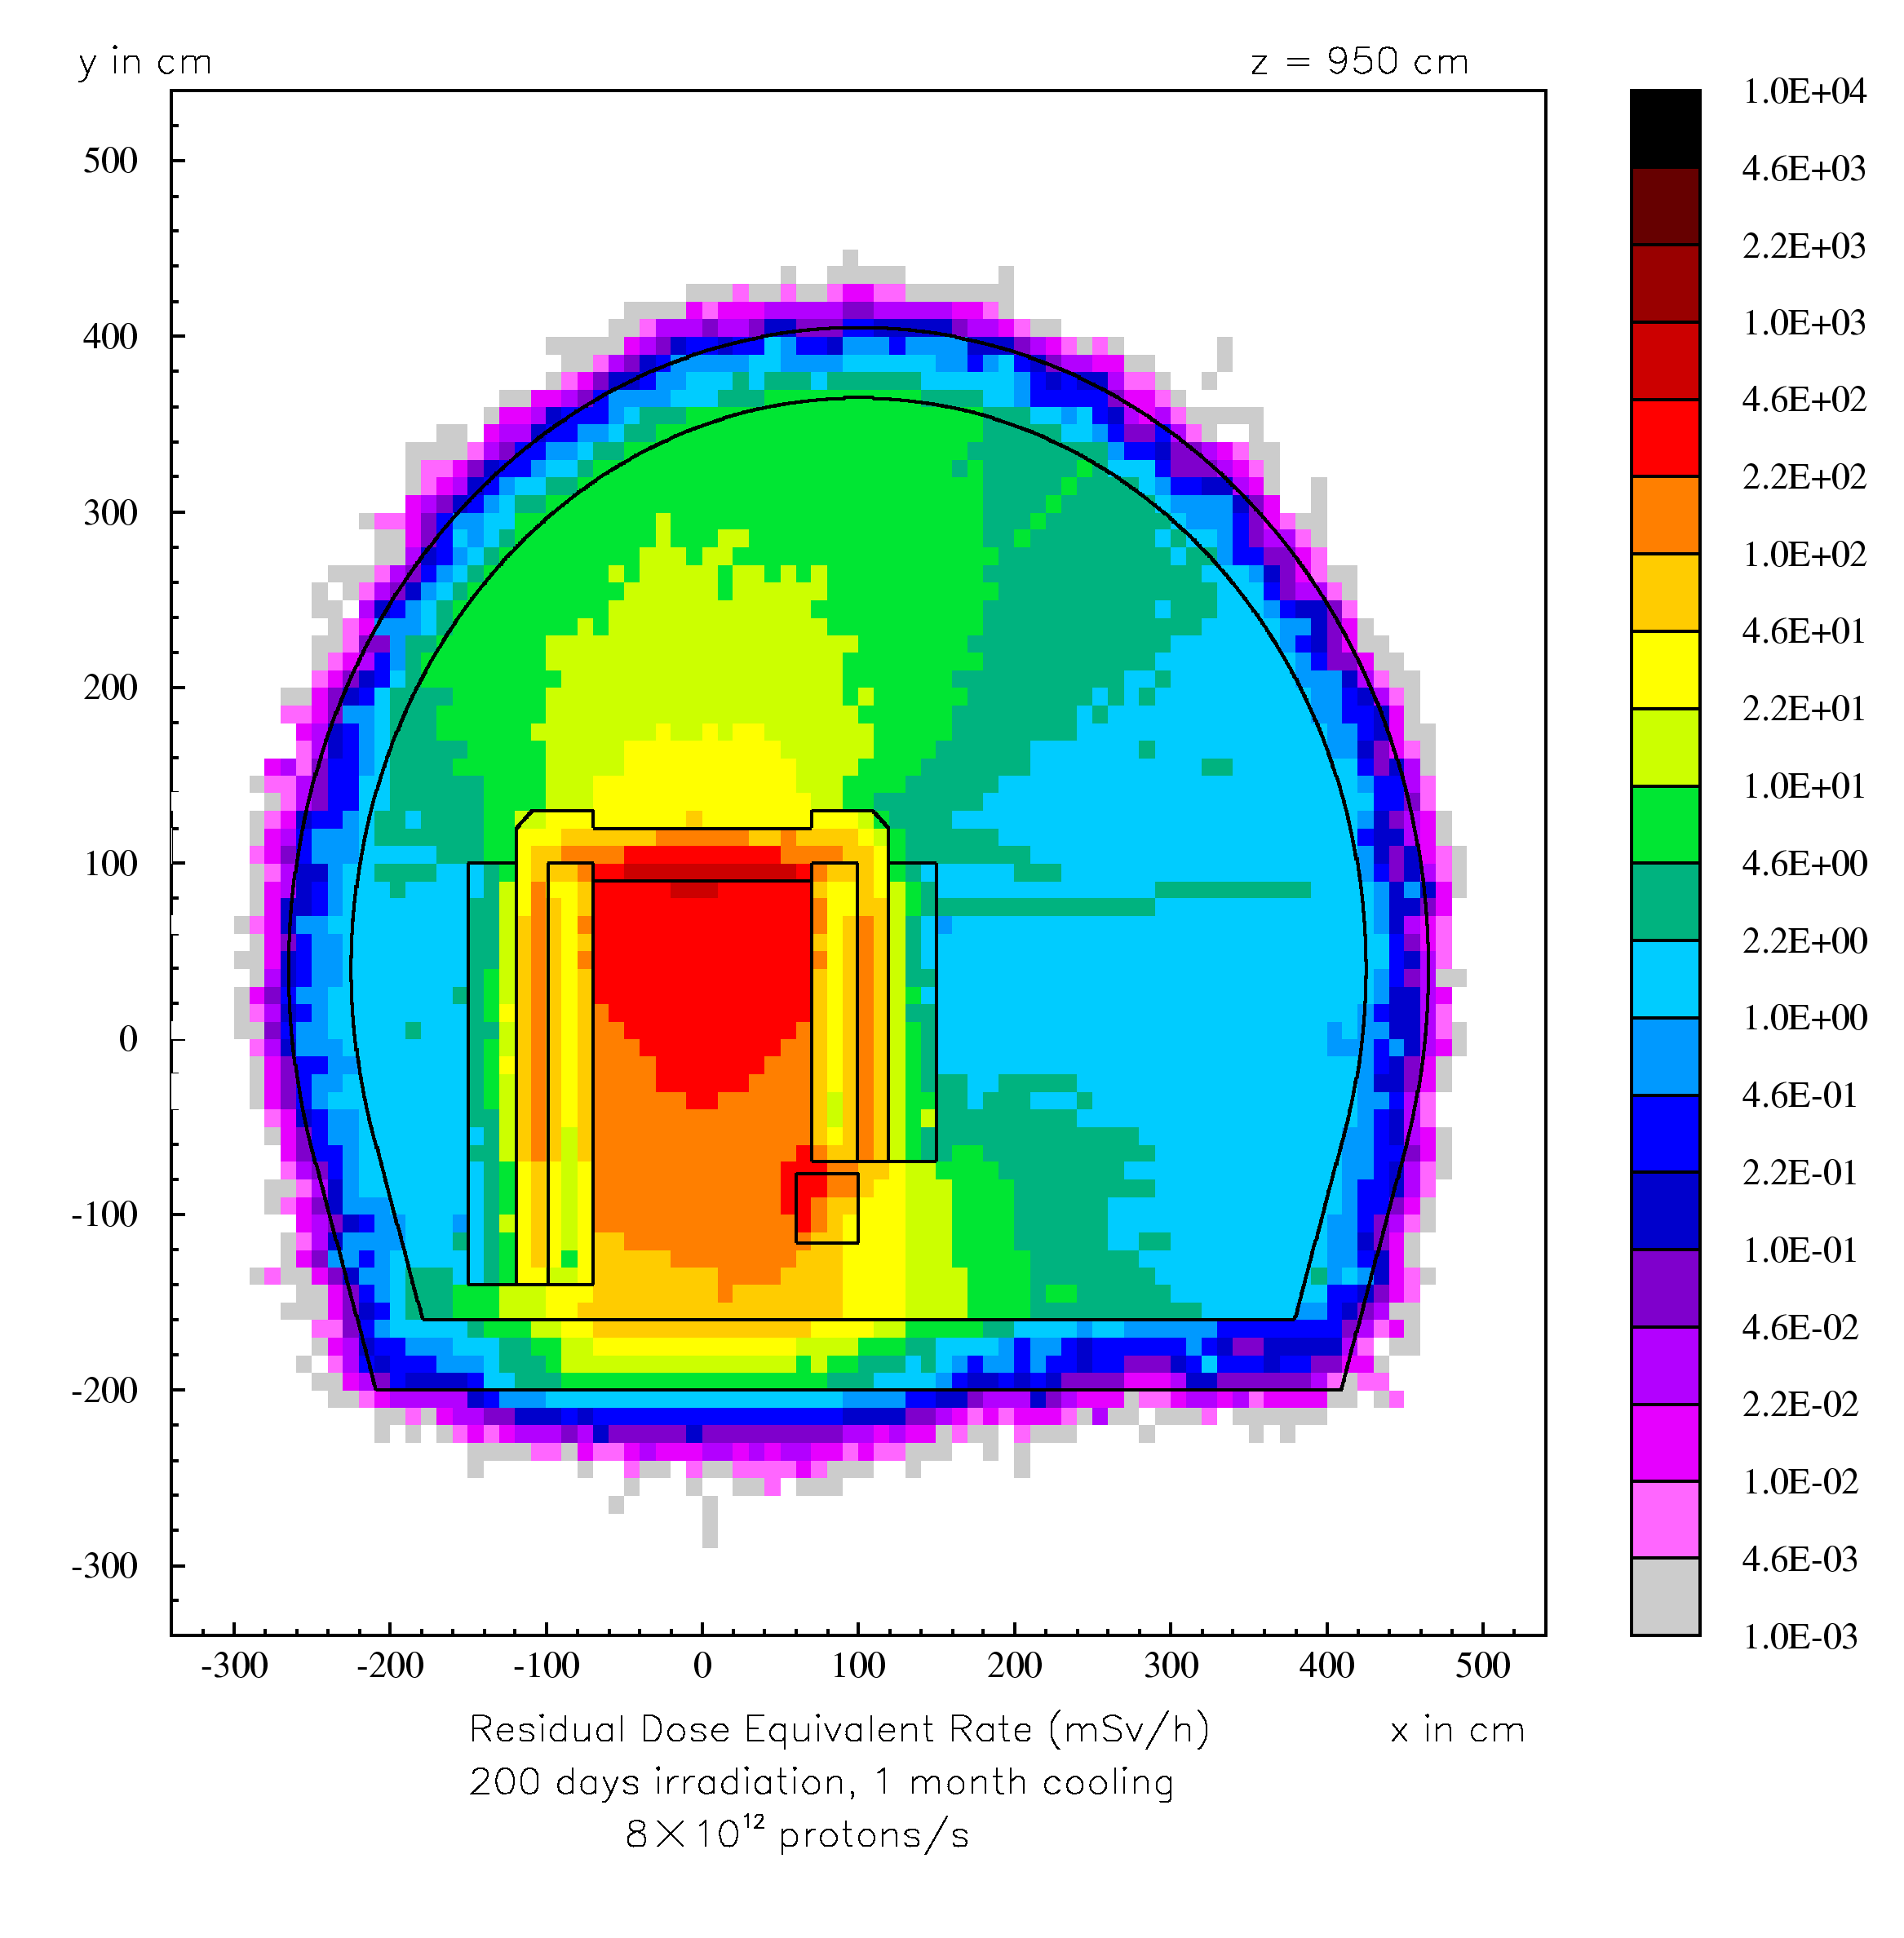
Applications – CNGS
Applications – CNGS
1
2
3
1
2
3
4
5
1
5
2
3
4
6th FLUKA Course - CERN 2008
41

Slide 42
Miscellaneous

Slide 43
FLUKA-Implementation – History - 1
1995 – Offline evolution:
An offline code (usrsuwev.f) is distributed together with FLUKA, which allows
the offline computation of the time evolution of a radionuclide inventory obtained with RESNUCLE for arbitrary irradiation profiles and decay times.
2002 – Two step method:
The offline code has been adapted for online use, each time a residual nucleus is
produced during a particle cascade. This allows storing information on radio-nuclides for certain irradiation parameters and cooling times into an external file. This information can then be read in order to compute residual dose rates due to induced radioactivity (two-step method). Results were benchmarked in numerous irradiation experiments.
2004 - Online:
This capability has been implemented into FLUKA with an exact analytical solution of the Bateman equations describing activity build-up and decay during irradiation and cooling down, for arbitrary irradiation conditions.

