Slide 1
Handling of Errors and Crashes
FLUKA Beginner’s Course

Slide 2
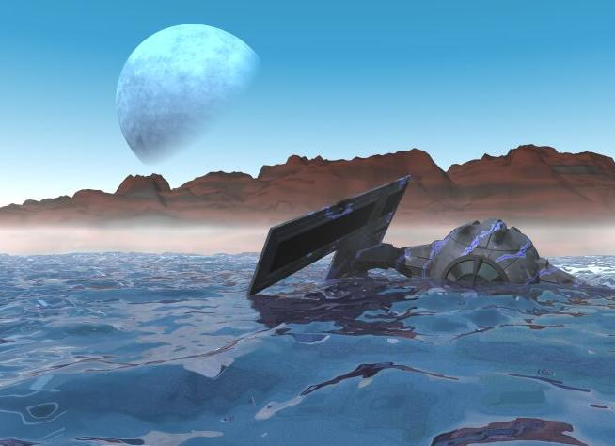
To err is human
… but to really foul things up you need a computer.
Paul Ehrlich

Slide 3
DON’T PANIC

Slide 4
Overview ^{[1/2]}
Sometimes the users get crashes…
Sometimes results look weird…
These are often simple problems that the users can address and solve on their own: the first purpose of this lecture is to help you to spot this type of error.
In a few other cases, a real FLUKA problem is found, and the second purpose of this lecture is to help you to spot this type of error.
The other cases deal mainly with the sensibleness of results and the best approach to simulations: this has nothing to do with the present lecture...

Slide 5
Overview ^{[2/2]}
Typical (trivial?) errors:
Installation problems;
Crashes at run initialization, usually due to mistyping / wrong setting of cards in the .inp file;
Crashes during tracking (typically due to geometry);
Problems found after the end of the simulation, usually due to subtle errors in the .inp file;
NB: (NOT trivial) crashes at runtime NOT explicitly related to geometry issues usually need the use of gdb…

Slide 6
Installation problems
Nothing happens, or “executable not found” message in FLAIR
Check that you have the correct version of FLUKA for your platform and you have all packages needed for compiling and executing fortran programs. Generally, for LINUX distributions, you need:
g77 , compat-gcc-34-g77 or gfortran (check the supported versions on the RELEASE-NOTES file included in the distribution)
libg2c
Verify your $FLUPRO environment variable, then issue a make command in the $FLUPRO directory: all the FLUKA tools and the default executable $FLUPRO/flukahp will be compiled;
The $FLUPRO variable must always be set (in .bashrc, .tcshrc, .cshrc…);
You get the following message (.out file):
Update your version of FLUKA and “make” again; re-link in case of user routines.
**** This version is obsolete and/or ****
**** you are not allowed to use FLUKA ****
**** Please contact Alfredo Ferrari ****
**** CERN-EN/STI, tel.+41-22-76-76119 ****
**** or look for an updated version ****
**** at http://www.fluka.org ****

Slide 7
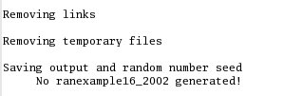
Crashes at run initialization: general
The following message appears on terminal (or in the nohup.out file when running with FLAIR) and no results are produced:
Look at the beginning of the .log file and/or at the end of the .out file:
either in your working dir;
or in the temporary subdir fluka_####;
or in the Output Files window in FLAIR;
and check the error message;

Slide 8
Wrong formatting in the .inp file
Quite easy case: FLUKA echoes all the parsed lines of the *.inp file in the *.out file. In case of problems, the echo stops at the last card correctly interpreted;
FLUKA reads the input file in many passages. Therefore, the order of the echoed cards does not necessarily correspond to the order in the .inp file!
In case the problem is located in the geometry declaration, please have a look also at the fort.16 file in the fluka_#### temp subdir;
WARNING sometimes non visible control characters may appear in a file sent via e-mail (NOT for ALL mail clients): in this case, the “dos2unix” command (specific rpm in LINUX) can remove them (or use simple perl or editor commands);
Remember to always check the first cycle you requested (e.g. *_001.out);
This type of error were very common before the advent of FLAIR;
Keep in mind that the total length of a line in FREE format is 132 characters;

Slide 9
Examples ^{[1/2]}
.inp file in fixed format: the SDUM identifying the particle is not properly aligned
.inp file in fixed format: misalignment in the BLCKHOLE word (the final “E” is lost)
Mistyped ROT-DEFI card: ROT-DEF

Slide 10
Examples ^{[2/2]}
The third WHAT of the card has no decimal point: remember that FLUKA expects ALL numbers with a floating point representation, integers included (except only if they are aligned to the right)
The first WHAT of the card must be aligned to the right, being in exponential format

Slide 11
Errors in USRBIN/EVENTBIN scoring definitions
*** Activity/fission/neutron balance binnings cannot be track-length!!!
USRBIN scoring method:
Track-length quantities, i.e. they can be distributed along a track (fluence, energy deposition… ): WHAT(1)>=10
Point-wise quantities, i.e. they have to be scored on a point, or in the middle of the step (activity, fission, neutron balance…): WHAT(1)<10
******* Fluka stopped in Usrbin: "usr/eventbin" n. 1 *******
******* with zero width 0.000 for axis R ******
Badly defined USRBIN scoring;
Output units:
Never use unit numbers <20 (reserved for internal use of FLUKA) or >99 (Fortran77 limitation);
Never mix the output of different scoring cards in the same unit;
These requests are automatically fulfilled by FLAIR;

Slide 12
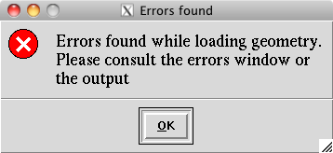
Debugging Geometry Errors ^{[1/3]}
The geometry editor allows to spot geometry errors when the .inp file is parsed/updated (see dedicated lecture!)
A warning window notifies the user about the presence of errors in the geometry;
A warning is also issued for errors not strictly geometrical (i.e. missing material assignment to a region, non recognized card…)

Slide 13
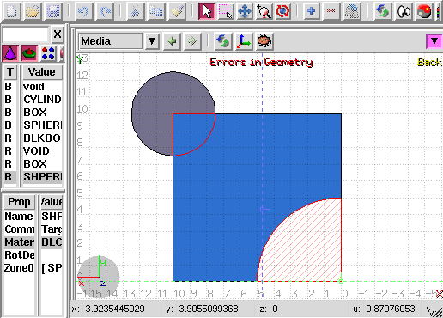
Debugging Geometry Errors… ^{[2/3]}
Presence of errors
Overlapping regions
Missing region definition
The affected areas are surrounded by red lines:
Areas filled with a full color correspond to overlapping regions;
Areas filled with red lines correspond to a missing region definition;
Clicking the icon displays the dialog box with the errors;
Touching surfaces are checked against 10 significant digits;

Slide 14
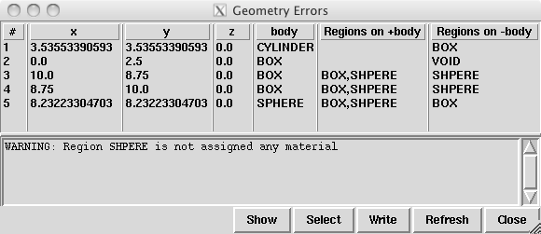
Debugging Geometry Errors… ^{[3/3]}
x, y, z Coordinates of the error (on the surface of the body);
body Body to which the error belongs;
+body Regions that are on the + side of the body;
Regions where the body should be subtracted to remove the error;
-body Regions that are on the – side of the body;
Regions that the body should be intersected to remove the error;
+/- are defined according to the normal to the surface, + refers to inside, - to outside;

Slide 15
Geometry: parentheses expansion
At the initialization of the geometry, you get the following message in the first line of xxx.log file:
Subscript out of range on file line 56, procedure rpnorm.f/rpnorm. Attempt to access the 114705-th element of variable tx.
You have exceeded the maximum expansion limit for parenthesis, set to 100’000.
WARNING even with a simple region expression this limit can be reached, especially if you are using infinite bodies!

Slide 16
LOW-MAT errors ^{[1/2]}
The name of a material breaks the correspondence with the low energy neutron cross section library available in FLUKA (see chap. 10 of the manual). In the present example: POTASS is specified in the SDUM of the LOW-MAT card concerned, instead of POTASSIU
Check the use of LOW-MAT cards in the manual, in particular material names and updated parameters.
NB: Do you really need LOW-MAT?
This card is necessary only in a limited number of cases, and it can be easily misinterpreted if you are not an expert user.
[Read carefully the manual]

Slide 17
LOW-MAT errors ^{[2/2]}
WARNING: the default temperature has changed with respect to older FLUKA distributions:
New library with 260 groups: 296 K
Old library with 72 groups: 293 K
When an error is printed, FLUKA reports the SDUM of the LOW-MAT card concerned. If the SDUM is empty, you will see nothing in the output

Slide 18
Crashes during tracking: geometry ^{[1/2]}
Typical message due to errors in geometry
Did you debug your geometry????????
Look in the .err/.out files to better direct your debugging;
Consider also the use of the RAY particle to trace and analyze your geometry;
Abort called from FLKAG1 reason TOO MANY ERRORS IN GEOMETRY Run stopped!
STOP TOO MANY ERRORS IN GEOMETRY

Slide 19
Crashes during tracking: geometry ^{[2/2]}
Geofar: Particle in region 3 (cell # 0) in position 1.000000000E+00 0.000000000E+00 1.000000000E+00 is now causing trouble, requesting a step of 6.258867675E-07 cm to direction -2.285059979E-01 -9.412338141E-01 2.487245789E-01, error count: 0 [...skipped...] Particle index 3 total energy 5.189748600E-04 GeV Nsurf 0 We succeeded in saving the particle: current region is n. 2 (cell # 0
GEOFAR errors (.out file) during tracking point to:
errors in the geometry;
numerical precision errors;
perpendicularity of the REC and BOX axes (use maximum precision);
FLUKA will always try to “save” the problematic particles: it will stop the run in case of too many issues.
The problematic point is given by position + step * direction
LATTICEs are VERY sensitive to numerical precision: use as many digits as possible to ensure a proper description of the lattice, the related transformation and the prototype.

Slide 20
It runs, but…
something seems wrong…
you do not understand the results…
LOOK in the output file!
what?
everything!
a few examples follow, you’ll find out more yourself…

Slide 21
RANDOMIZ card
You run several cycles and the statistical errors appears to be ZERO.
Most probably you are starting the same histories on every cycle. This is a typical error if the RANDOMIZe card does not exist!
Verify the existence of RANDOMIZe card and that WHAT(1)=1.0
You get the following message in the *.out file
**** No Random file available !!!!!! ****
Abort called from FLRM64 reason NO RANDOM FILE Run stopped!
STOP NO RANDOM FILE
Most probably the error occurred during the previous cycle which didn’t generate a random number seed yet

Slide 22
Cards defining the primary particle
The total/partial energy balance does not meet expectations
Remember that for HEAVY IONS the kinetic Energy or Momentum in the BEAM card is given PER NUCLEON, while in all other cards the energy is the total kinetic one. Verify numbers in the beam section of the .out file;
Check if you selected Energy or Momentum in BEAM;
Verify that your primary source BEAMPOS is NOT defined on a surface boundary, but always inside a region;
If you define a SOURCE routine, the standard FLUKA source is NOT CALLED.
You have to define all the concerned distributions (position, momentum etc...);
You need a BEAM card to define the maximum energy of your problem;

Slide 23
MATERIAL / COMPOUND cards
The total/partial energy balance does not meet your expectations or particle fluences show discontinuities
please check:
the density is defined for all MATERIALs;
Z and A are given in case of a specific isotope;
mixing fractions (and signs!) in COMPOUND cards;
recursion in COMPOUND cards;
Formatting (the NAME-based format is preferred…);

Slide 24
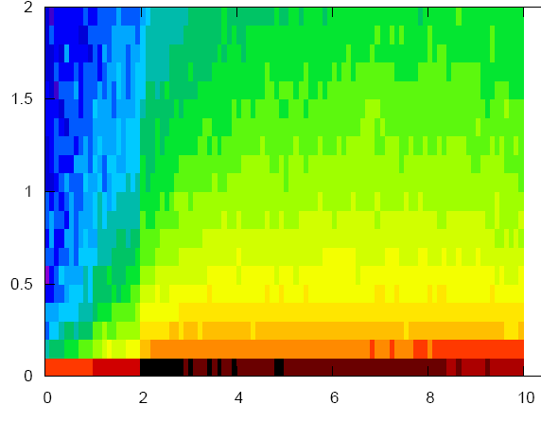
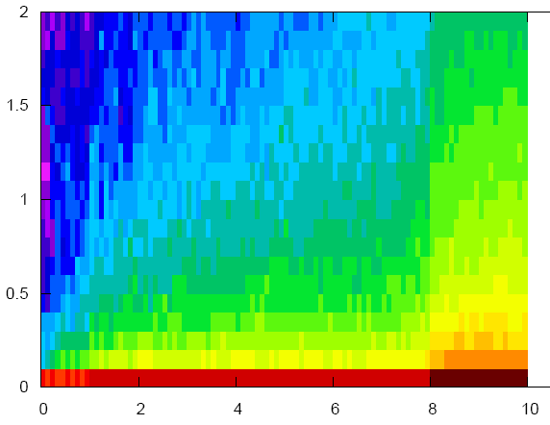
Geometry induced weird results
possible symptoms:
the energy/fluence among different regions is not what’s expected;
problems with boundary-crossing estimators (low fluences, empty data…)
Did you debug your geometry????????
Overlapping regions are NOT detected at initialization, and do NOT cause run-time errors.
Example: in “our” target, make targs2 overlap with targs3

Slide 25
Preprocessor
Preprocessor directives are very powerful, but pay attention to nesting:
every #if directive must have its closing #endif directive;
Up to 10 nested levels are allowed;
Up to 40 variables can be defined;

Slide 26
Heavy Ions
You have a heavy ion beam and no reaction products
Did you link the interaction generators with ldpmqmd?
Check, looking for initialization message like “RQMD initialized” and “DPMJET-3 initialized” in the .out file

Slide 27
Merging cycles from different jobs
Verify that you merge cycles for which the .inp files differ only by the RANDOMIZ card and/or number of primaries;
It’s a good habit to remove the files before starting a run:
Flair offers this possibility from the “Output Files” frame;
It’s good to develop the habit to remove the output files from test runs.

Slide 28
FLUKA users and the manual
All the reported problems so far imply that a FLUKA user lives symbiotically with the Manual....

Slide 29
NOW PANIC

Slide 30
Run time errors with exceptions ^{[1/2]}
You get a message on terminal like:
The temporary fluka_#### subdir remains there, with the *.log, *.out, *.err files, a core.* file and the last random seed
The last random seed allows to restart the run from the configuration occurring at maximum 5 minutes of CPU before the error!
The GNU debugger (gdb) can help in spotting the problem.

Slide 31
Run time errors with exceptions ^{[2/2]}
Suggestions:
Check the end of *.out / *.err files or the beginning of the *.log file:
they may contain important information for you or for the experts;
the code has many internal checks, and some error conditions are recorded;
If you use your own user routines, please check them:
with the hints found at the beginning of the *.log file;
with the help of the gdb debugger;
Maybe there is a very well hidden geometry problem;

Slide 32
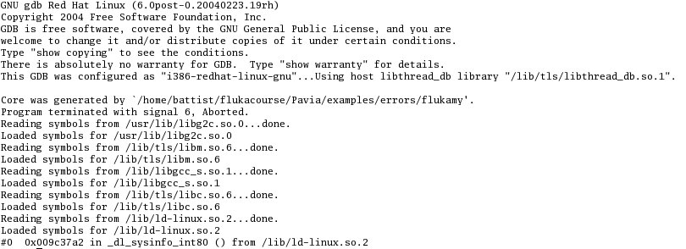
gdb ^{[1/2]}
How to run it:
from terminal:
cd fluka_####
gdb $FLUPRO/flukahp core.*
from FLAIR:
double click on the core file from the “Output Files” Frame;

Slide 33
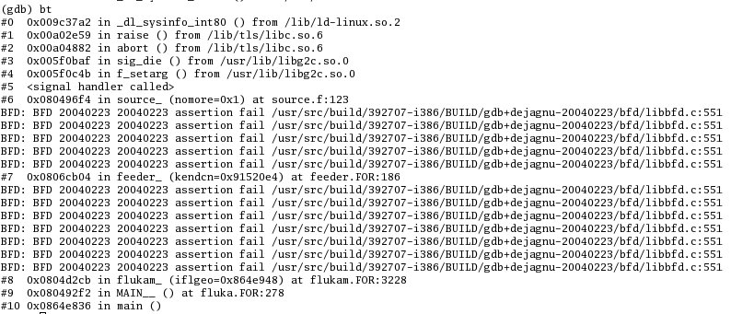
gdb ^{[2/2]}
Basic commands:
bt, for listing the functions which led to the current one and the crash;
f, for switching to a given frame (i.e. interrupted function);
p, for printing the value of a given variable;
Here it is!
frame #6 in source.f
at line 123

Slide 34
Reading errors
On Unit 14: your nuclear.bin file might be corrupted or missing (check all your binary files in $FLUPRO) or doesn’t match the FLUKA distribution
On Unit 1: a problem in the random seed. It typically happens when you start the simulation with a rfluka command with option –N n with n>0: check for the existence of ran***n in the directory where you issue rfluka!

Slide 35
FLUKA bug?
If your crash does not fall in any of the previous categories, and you do not understand what happens, prepare a report with ( possibly ) the gdb results and send it to fluka-discuss@fluka.org together with a tar file containing:
.inp, .out, .log, .err files;
user routines (if any);
additional auxiliary files (if any);
last random seed (ran* file in fluka_####);
and any other possible useful information.

Slide 36
The *.err file
The *.err file will report errors, but also a lot of warning messages which have a meaning mostly for the developers.
For instance: the following messages are not errors!
No. of events
remaining to be simulated
No. of events
simulated so far

Slide 37
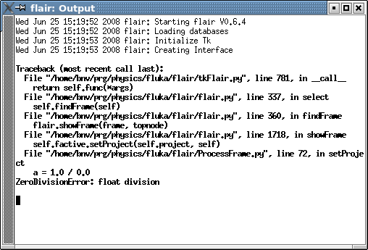
Flair output window
The output window of FLAIR contains all messages from FLAIR, FLUKA, processing and plotting tools.
Always consult it in case of problem or doubts
A Traceback message means that
something went wrong
with FLAIR

Slide 38
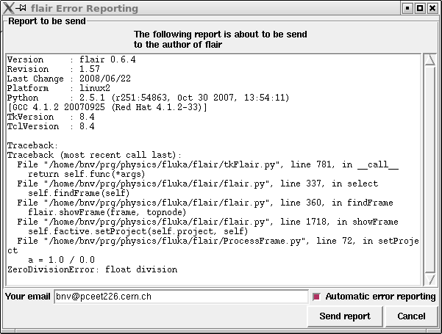
Flair Error Report
In case of Traceback, when closing the program or after too many messages, FLAIR will propose to send the Traceback message to the author for further investigation
Please send this report unless you know the reason for the problem, e.g. opening a problematic .inp, non existing directory etc…
It will be good to provide also a small description on how to reproduce the problem.
The text box can be edited

Slide 39
Remember
In case of technical problems, your best allies are:
the FLUKA manual;
error messages at the end of .out/.err files, and at the beginning of .log file;
In case of doubts on the results:
read the FAQ of FLUKA;
search for a similar problem in the FLUKA discussion list;
if you really cannot understand the issue, or if you need to ask about physics related problems, write to:
fluka-discuss@fluka.org

