Slide 1

Exercise 8:Thresholds
Beginners FLUKA Course

Slide 2
Exercise 8:Thresholds
Aim: “see” the effect of different threshold settings
Easier with thin layers and with interfaces between strongly different materials -> change the layout
Observables:
  dose deposition,
  backscattered electrons
Practice also preprocessor directives in the input file
Instructions
- changes to the geometry/beam
Create a folder called ex8, download the solution of ex5 (only ex5.inp) from the website, rename it to ex6.inp and open it in flair
Change the target layer thicknesses to 50 microns each
Change the target radius to 5 mm
Change the BEAM to 10 MeV electrons
Change the beam size to Annular, 1mm radius
Change the materials of the region TARGS2 to Lead. Change the material of region TARGS3 to Aluminum. (H2O-Pb-Al)
Change the air around to Vacuum

Slide 3
Exercise 8:Thresholds
Instructions
-general settings
thin layers, low thresholds→ need high tracking precision
set PRECISION as default
Switch on single scattering at boundaries (find how..)
-prepare a set of different thresholds, with different “#define”
Define 3 preprocessor variables, for instance HI-T , LOW-T, VLOW-T
Prepare a structure and fill it with EMFCUT and DELTARAY cards to have, in all materials
  #if HI-T
    electrons: 1 Mev kinetic , 5 kev photons
  #elif LOW-T
    electrons: energy corresponding to a range ≈ ½ of the Pb thickness - 5 kev photons
  #elif VLOW-T
    electrons: energy corresponding to a range ≈ z bin size, in Pb, 5 kev photons
  #endif
SAME energy thresholds in all materials
HINT: go to http://physics.nist.gov/PhysRefData/Star/Text/contents.html

Slide 4
Exercise 8:Thresholds
Instructions
-scoring
One USERBIN scoring DOSE over the target, 1 micron bins along z, 5 microns bins in the radial direction
One USRBDX to score electrons and positrons EXITING from the first target layer back into vacuum. One single bin in angle.
-running
in the RUN window of Flair
  click on the + button in the Run/Input frame
  choose a name for the first threshold option , i.e. ex8_ht
  select the correct directive in the “Defines”frame
  run 5 runs , 100000 primaries each
  do the same for the other thresholds

Slide 5
Exercise 8:Thresholds
results
-PLOT
for each threshold: 1-d projection along z of the dose
try to set the same y-scale for the three plots
(set yscale [xx : yy] in the gnuplot options)
compare
for each threshold: the usrbdx output. Try to put all three on the same plot
If you have time
Change the BEAM to 4 MeV protons
run with the proton threshold at 1MeV and 100 keV
plot the dose deposition and see the difference
( using #define )

Slide 6
Exercise 8:Solution
results
“low threshold”
25μ Pb = 2.8 10⁻² g/cm² ➔ 100 keV
very-low threshold
1μ Pb = 1.1 10⁻³ g/cm² → 10 keV (or 12, but we choose a round number for easyness..)
to be set : EMFCUT with PROD-CUT
EMFCUT with BLANK
DELTARAY ( in case we run protons later..)
Warning: to set KINETIC energy in EMFCUT the value must be NEGATIVE, otherwise it sets the TOTAL energy

Slide 7
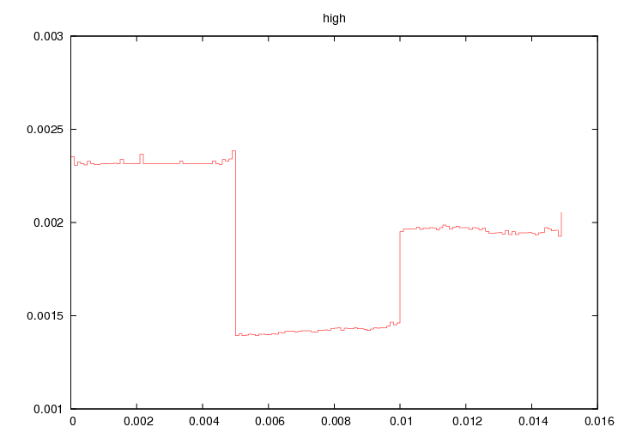
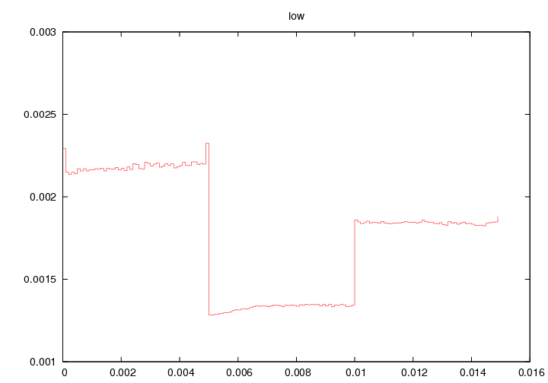
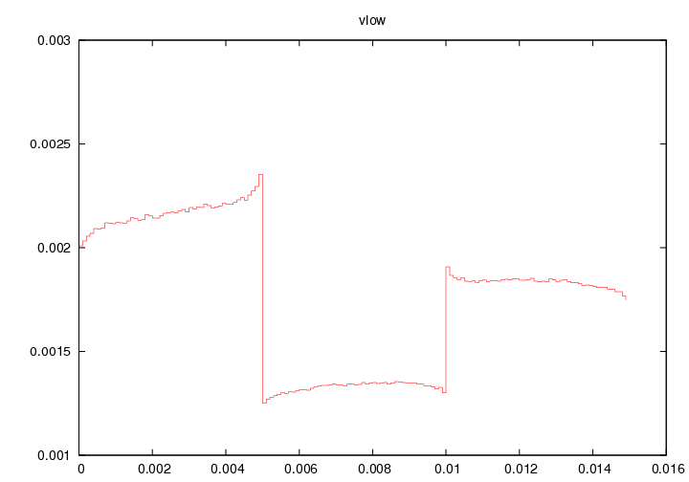
Exercise 8:Solution

Slide 9
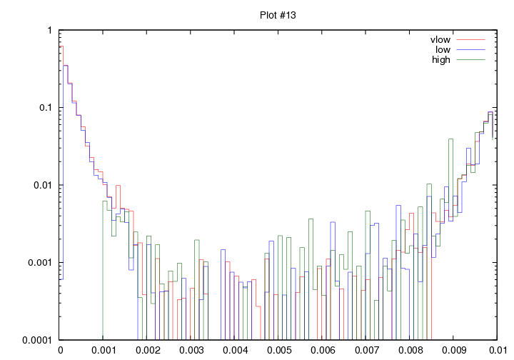
ex 8 : backscattering

Slide 10
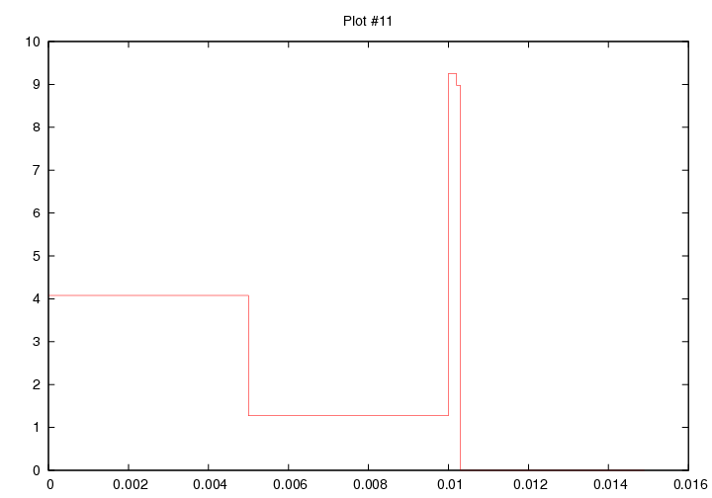
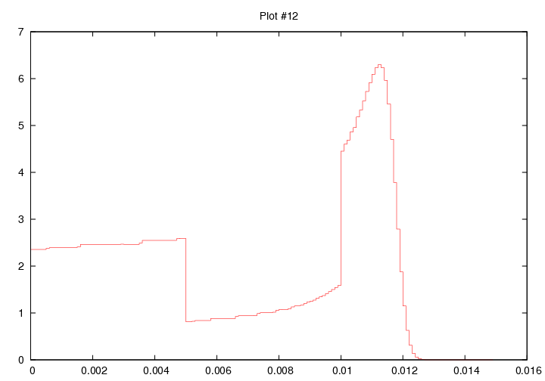
ex8 : protons

