Slide 1

Highlights on advanced topics
Beginners’ FLUKA Course

Slide 2
This is not the end …
As said in the first day, most applications can be run through data-cards only, exploiting the FLUKA built-in capacities
Sometimes, more is needed…
A set of templates User Routines is provided in the $FLUPRO/usermvax directory
These can be modified by the user to fit his input/output needs
We’ll give here some hints of what can be done, more can be found in the manual, in the fluka-discuss archive, or
at the FLUKA workshop and advanced course
to be held in Portugal, autumn 2010

Slide 3
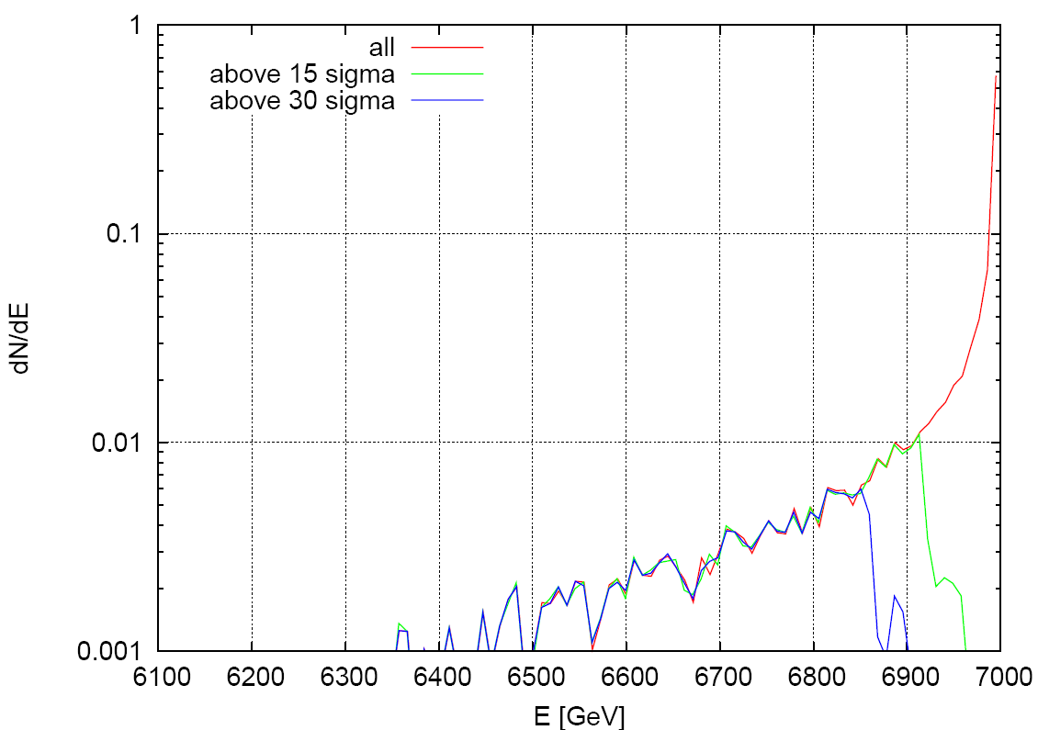
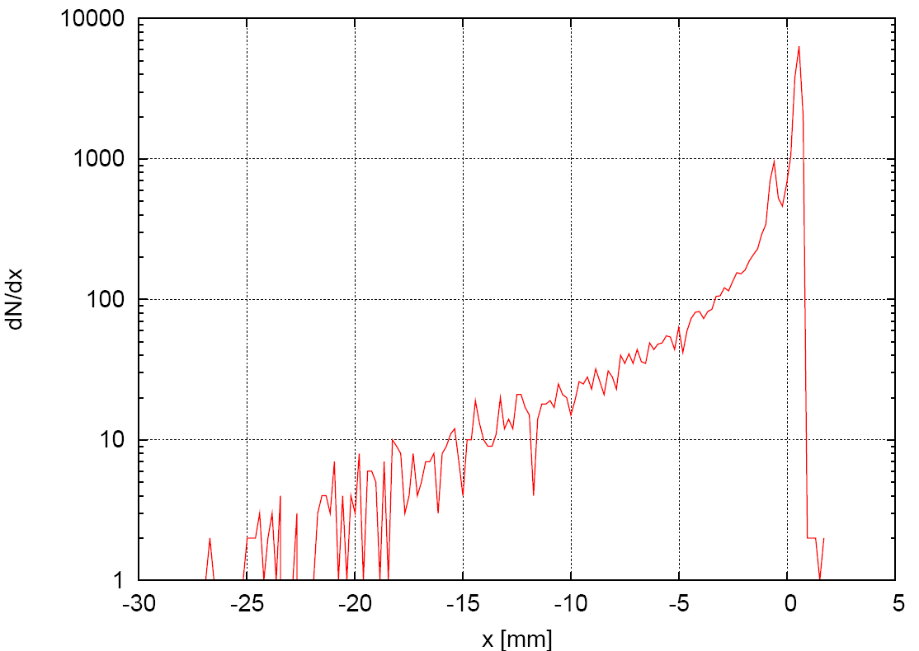
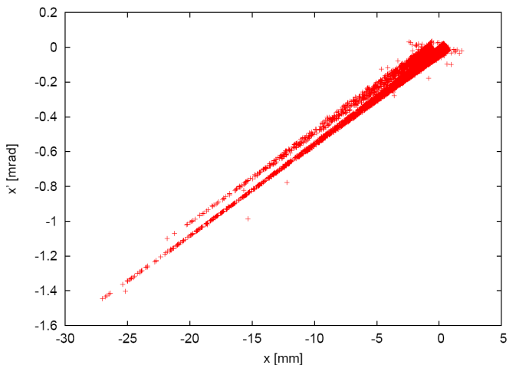
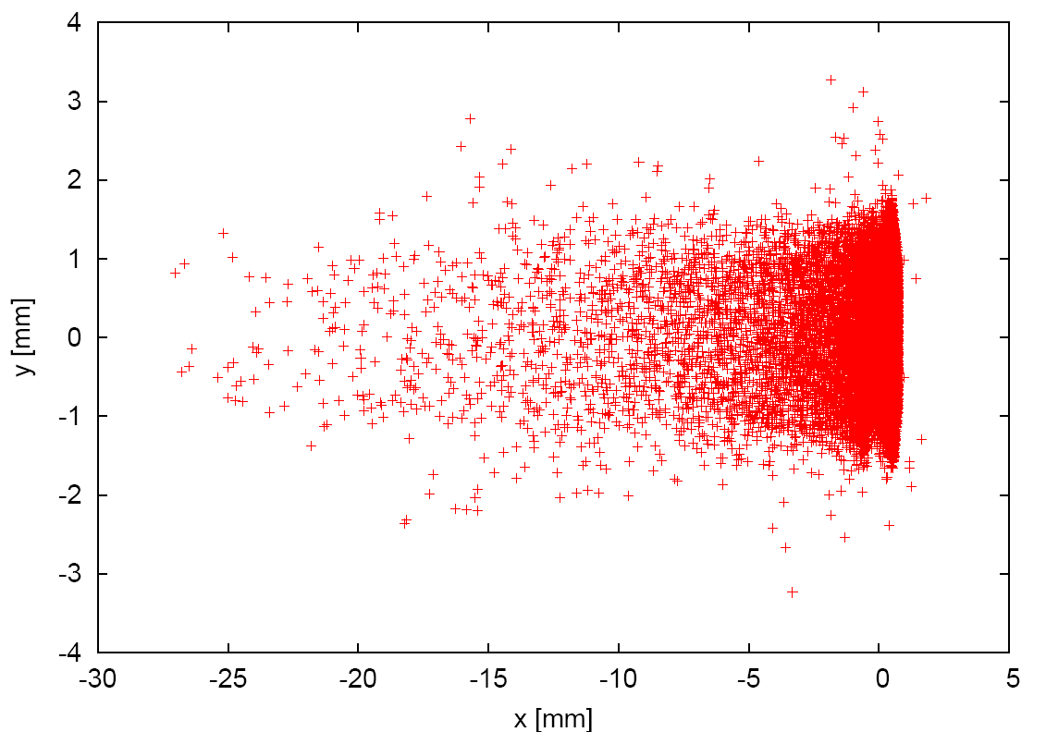
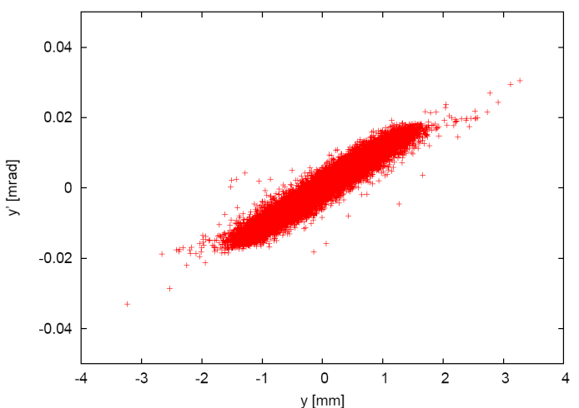
Implementing customized beam distributions - 1
LHC proton beam at the Dispersion Suppressor entrance
16% above 15 sigma
11% above 30 sigma

Slide 4
Implementing customized beam distributions - 2
Input card: SOURCE User routine: $FLUPRO/usermvax/source.f
to be linked in one’s own executable !
In source.f
you can sample beam particle position, direction, and energy
from an external file or any (analytic or numerical) distribution
you can assign different weights to primary particles
you can load reaction products in the same primary history
parameters input in the SOURCE card are available
a BEAM card with a momentum/energy higher than the maximum one is still needed
for initialization purposes (to define the tabulation limit)

Slide 5
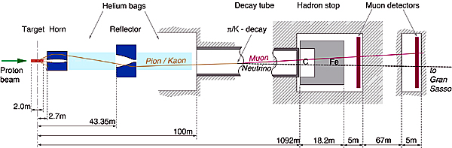
Implementing magnetic field - 1
CERN Neutrino to Gran Sasso
The two magnetic lenses (blue in the sketch) align positive mesons towards the Decay tunnel, so that neutrinos from the decay are directed to GranSasso, 730~km away
Negative mesons are deflected away
The lenses have a finite energy/angle acceptance

Slide 6
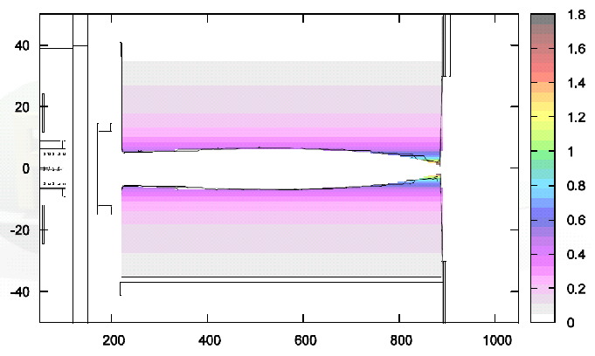
Implementing magnetic field - 2
Input card: ASSIGNMA User routine: $FLUPRO/usermvax/magfld.f
to be linked in one’s own executable !
Magnetic field intensity in the CNGS horn
A current ≈150kA, pulsed, circulates through the
Inner
and
Outer
conductors
The field is toroidal,
B÷1/R

Slide 7
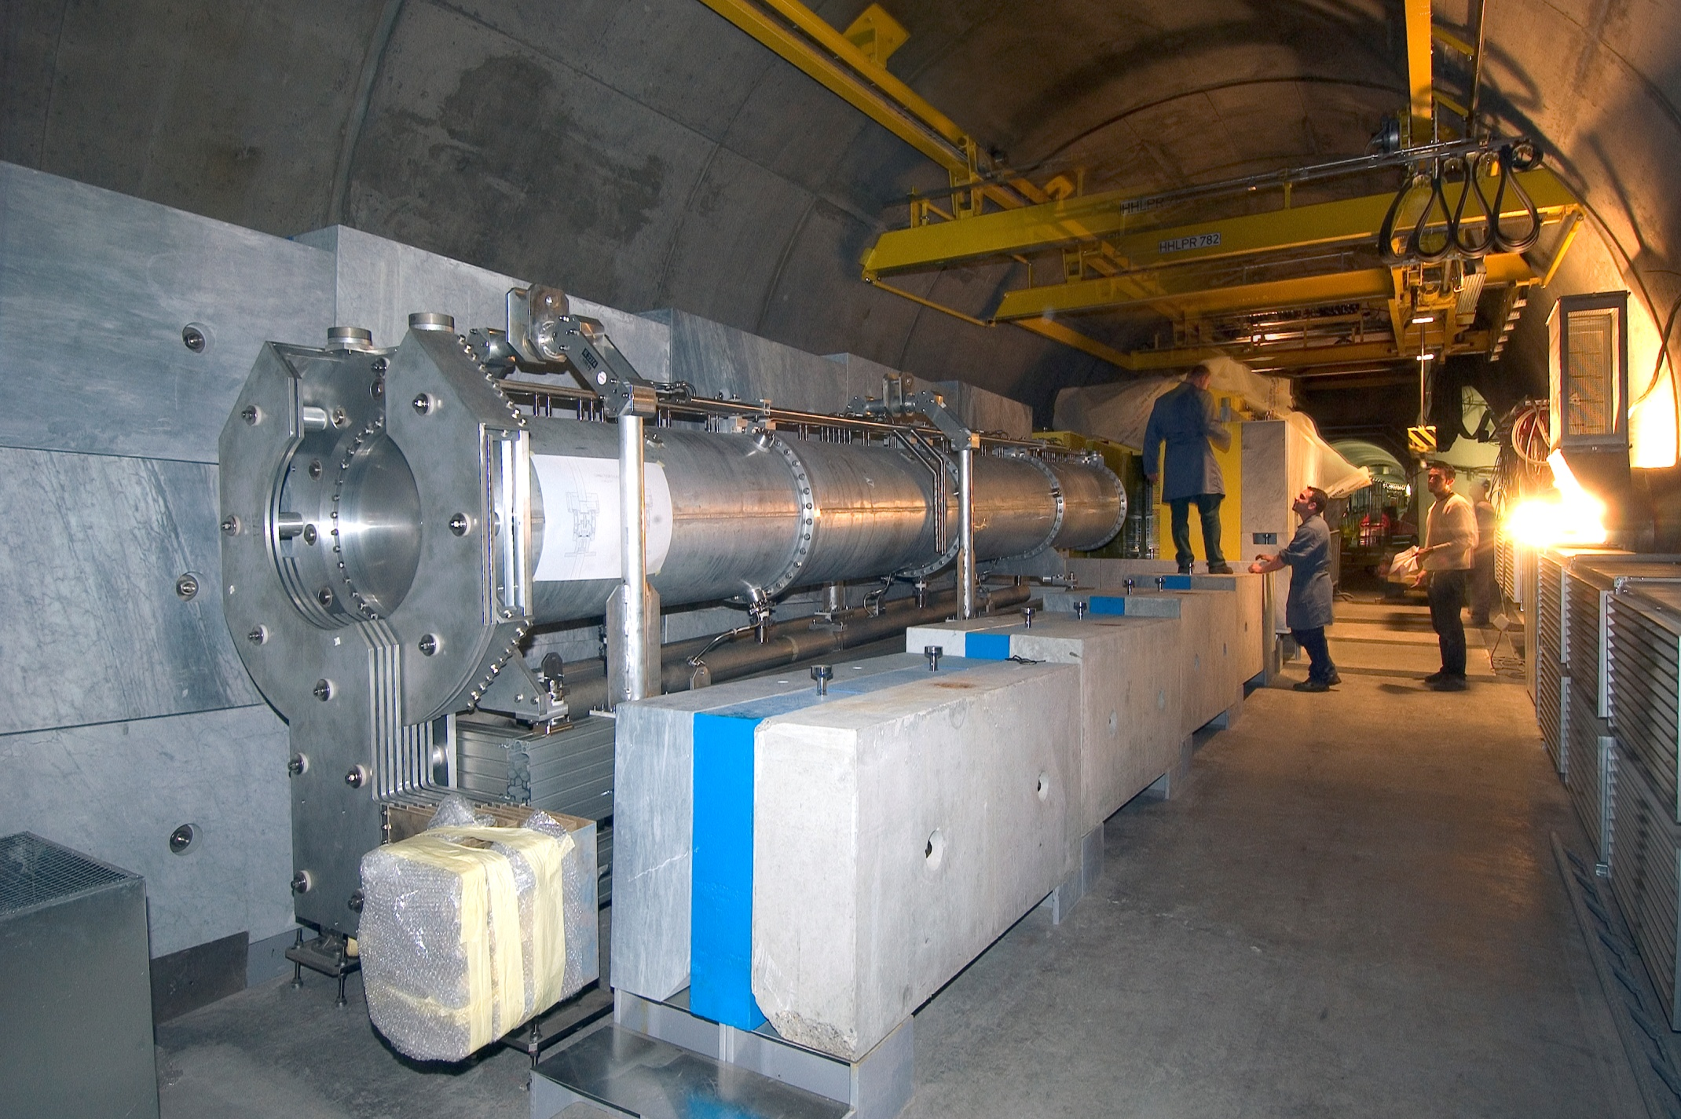
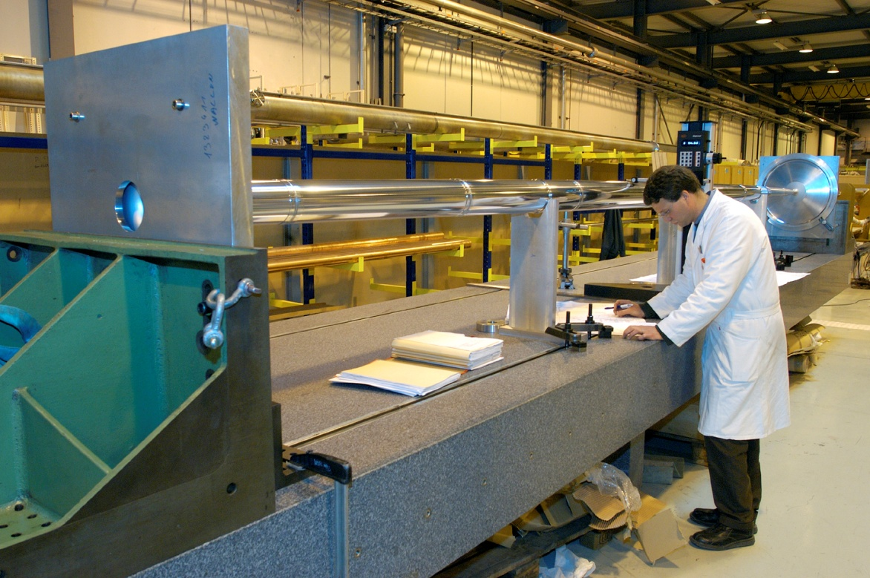

Slide 8
Implementing magnetic field - 4
SUBROUTINE MAGFLD ( X, Y, Z, BTX, BTY, BTZ, B, NREG, IDISC )
IF ( NREG .EQ. NRHORN ) THEN
RRR = SQRT ( X**2 + Y**2 )
BTX =-Y / RRR
BTY = X / RRR
BTZ = ZERZER
B = 2.D-07 * CURHOR / 1.D-02 / RRR
END IF
In magfld.f
you can define the magnetic field analytically or
by interpolating an external map
charged particle tracks in the CNGS geometry
1 event
USRBIN R-Z
Focused
De-focused
Escaping…many

Slide 9
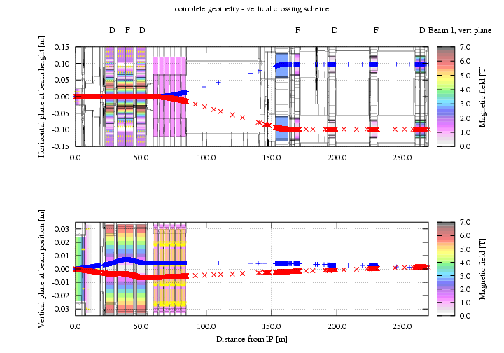
Implementing customized scoring - 1
beam crossing in ATLAS

Slide 10
Implementing customized scoring - 2
Input card: USERDUMP User routine: $FLUPRO/usermvax/mgdraw.f
to be linked in one’s own executable !
In mgdraw.f
you can get particle trajectories and (continuous and local) energy losses
you can go over reaction products
you can access information at each boundary crossing, particle step,
energy deposition event, interaction
In mdstck.f (for which no activating card is needed) as well,
with the additional – dangerous – possibility of influencing
the subsequent transport of secondaries

Slide 11
Implementing customized scoring-3
Input card: USERWEIG User routines: $FLUPRO/usermvax/comscw.f
$FLUPRO/usermvax/fluscw.f
to be linked in one’s own executable !
In comscw.f
you can apply a user defined weight (even discard) on deposited
energy, stars or residual nuclei
you can extract information (and dump it on a file) about the
involved particles
In fluscw.f
same as comscw.f for fluence scoring.

Slide 12
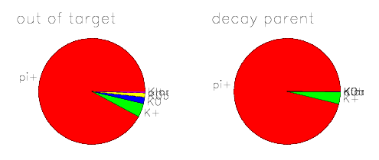
Implementing customized flags
identification of ancestors of muon-neutrinos reaching Gran Sasso
ancestor as exiting the target
parent decaying in ν_{μ}
No input card User routines: $FLUPRO/usermvax/stuprf.f
$FLUPRO/usermvax/stupre.f
to be linked in one’s own executable !
In stuprf.f
you can keep track of the particle origin
stupre.f applies in case of electrons, photons and positrons

