Slide 1

The FLUKA Code

Slide 2
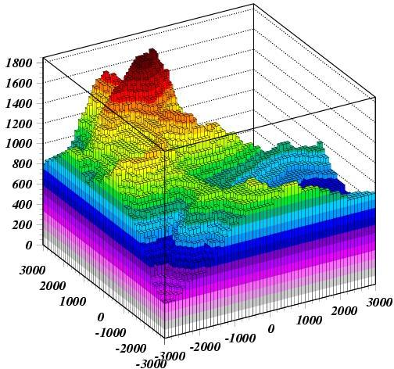
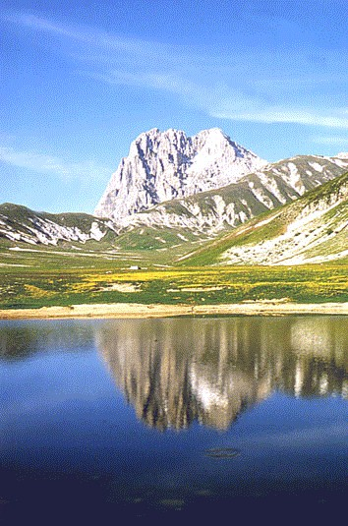
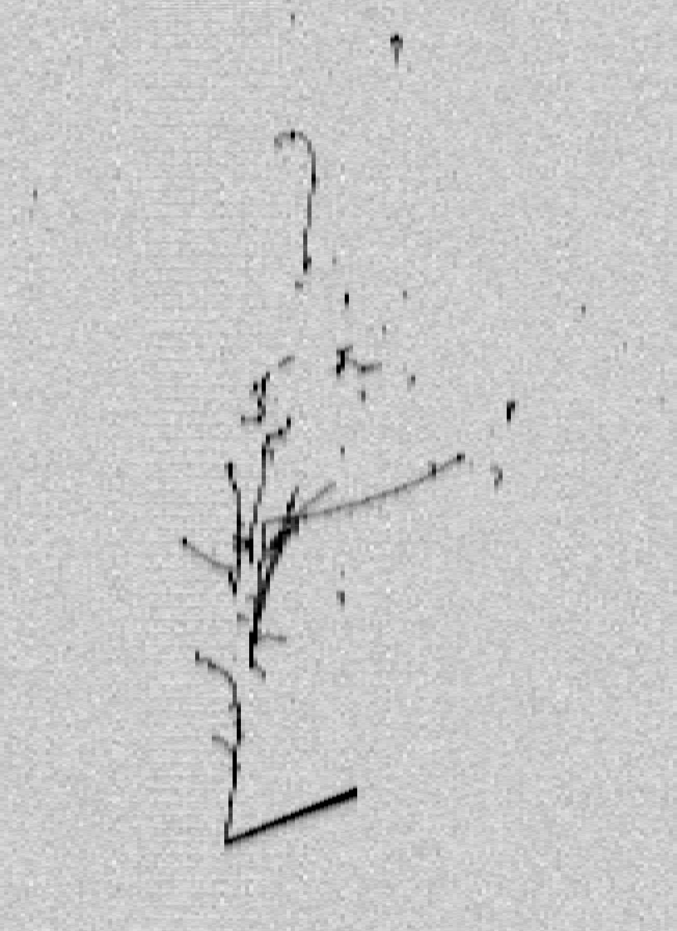
FLUKA
http://www.fluka.org
Interaction and Transport Monte Carlo code
The Gran Sasso in FLUKA
Hadron-nucleus interactions
Nucleus-Nucleus interactions
Electron-photon int.
Muon int. (inc photonuc)
Neutrino int.
Particle Transport
multiple scattering
Ionization
Decay
Low energy neutrons
Combinatorial geo + voxels
Magnetic field
Analogue or biased
Cosmic Rays in atmosphere
50 cm
Κ
ν_{e} in LAr
π
μ
μ
μ
65 cm
e⁻
p
7th FLUKA course, Paris Sept. 29-Oct. 3, 2008
2
Notes:
2

Slide 3
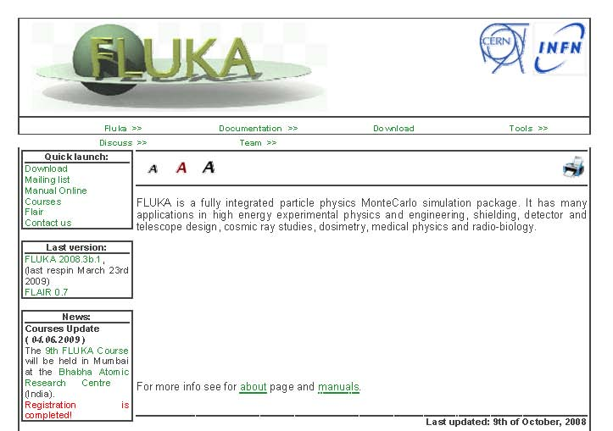
www.fluka.org
Main Authors: A.Fasso`¹, A.Ferrari², J.Ranft³, P.R.Sala⁴
¹ SLAC Stanford, ² CERN, ³ Siegen University, ⁴ INFN Milan
Contributing authors: G. Battistoni, F. Cerutti, A.Empl, M.V.Garzelli, M.Lantz, A.Mairani, V.Patera, S.Roesler, G.Smirnov, F.Sommerer, V.Vlachoudis
Developed and maintained under an INFN-CERN agreement Copyright 1989-2009 CERN and INFN
3
Notes:
3

Slide 4



The FLUKA international Collaboration
M.Brugger, F. Cerutti, A. Ferrari, M. Mauri, G. Lukasik, S. Roesler,, G. Smirnov, F. Sommerer ,C. Theis, S. Trovati, H. Vinke, V.Vlachoudis
CERN
A. Fassò
SLAC, USA
J. Ranft
Univ. of Siegen, Germany
G. Battistoni, F. Broggi, M. Campanella, P. Colleoni, E. Gadioli, S. Muraro, P.R. Sala
INFN & Univ. Milano, Italy
M. Carboni, C. D’Ambrosio, A. Ferrari, A. Mostacci, V. Patera, M. Pelliccioni, R. Villari
INFN Frascati
M.C. Morone
Univ. Roma II, Italy
A. Margiotta, M. Sioli
INFN & Univ. Bologna, Italy
A. Mairani, K. Parodi
DKFZ & HIT, Heidelberg, Germany
A. Empl, L. Pinsky
Univ. of Houston, USA
K.T. Lee, T. Wilson, N. Zapp
NASA-Houston, USA
S. Rollet
ARC Seibersdorf Research, Austria
M. Lantz
Riken Nishina Center, Wako, Japan
6th FLUKA course, CERN 2008
4

Slide 5
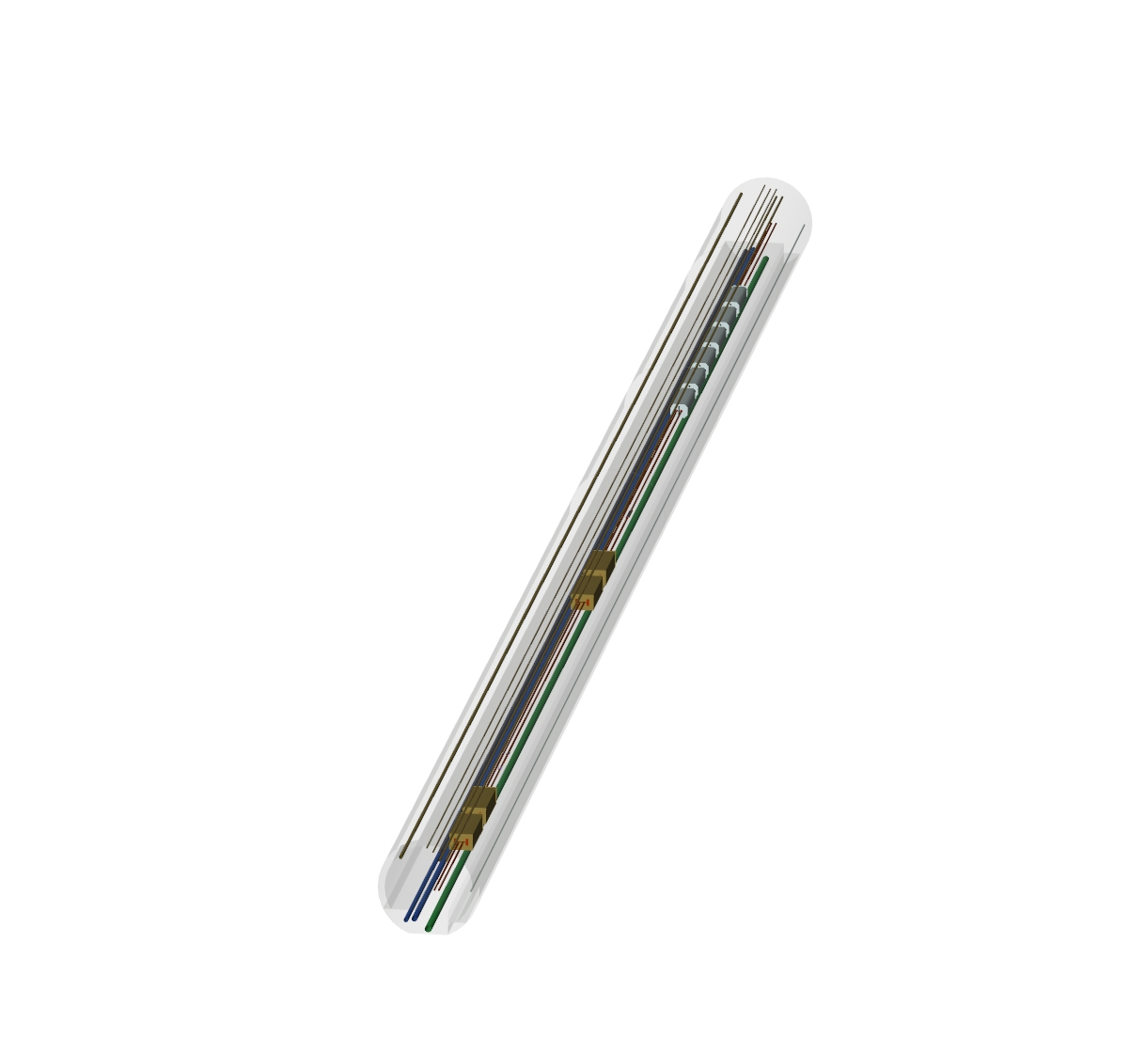
Applications – LHC collimation region
Magnets
Collimators
FLUKA geometry
visualized with
SimpleGeo
7th FLUKA course, Paris Sept. 29-Oct. 3, 2008
5
Notes:
5

Slide 6
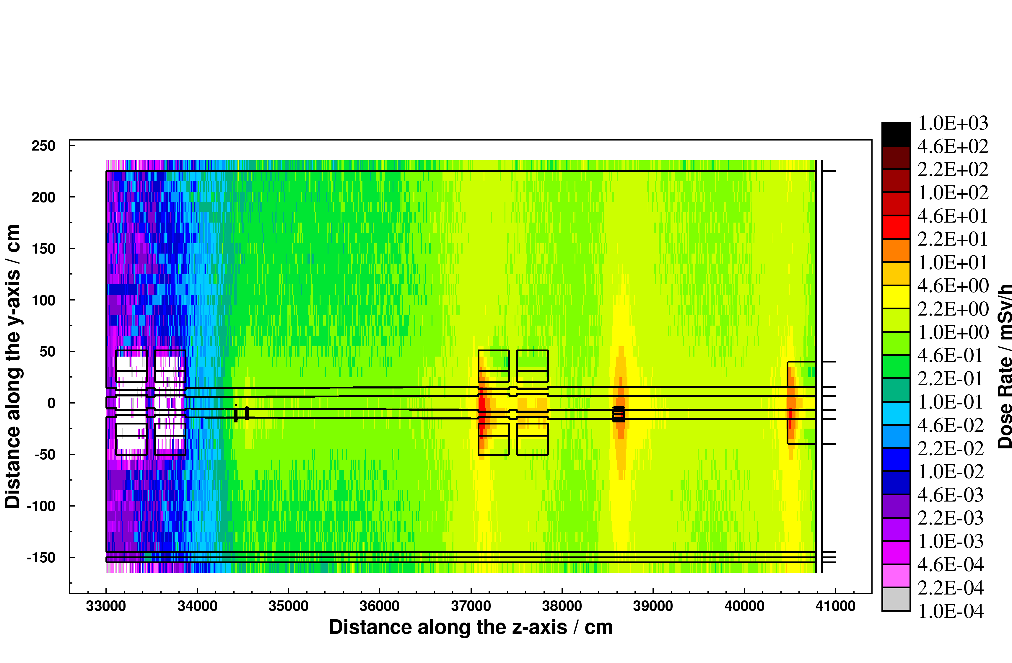
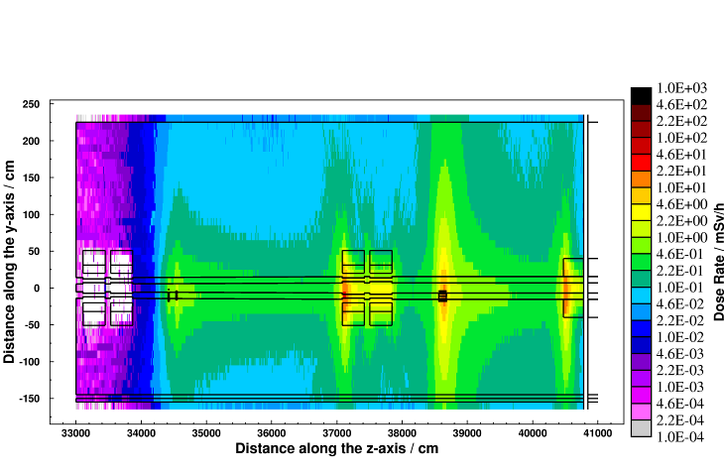
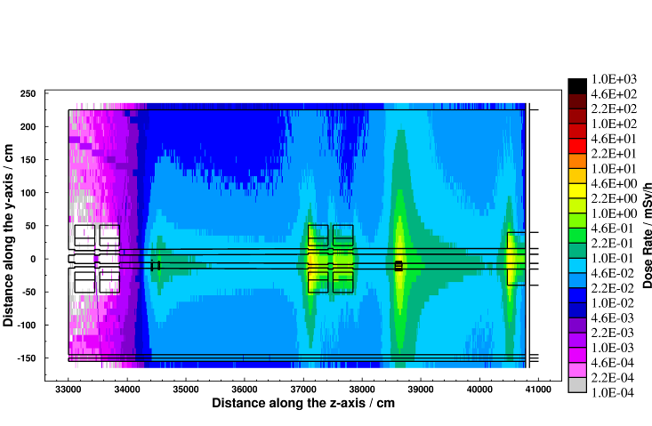
Applications – LHC collimation region
Cooling time
Residual dose rate (mSv/h)
after one year of operation
8 hours
1 week
4 months
CERN-SC-2005-092-RP-TN
7th FLUKA course, Paris Sept. 29-Oct. 3, 2008
6th FLUKA course, CERN 2008
6
6
Notes:
6

Slide 7
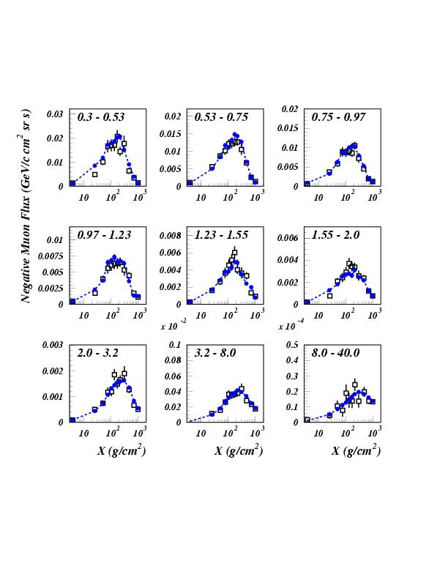
Negative muons at floating altitudes: CAPRICE94
Open symbols: CAPRICE data
Full symbols: FLUKA
primary spectrum normalization ~AMS-BESS
Astrop. Phys., Vol. 17, No. 4 (2002) p. 477

Slide 8
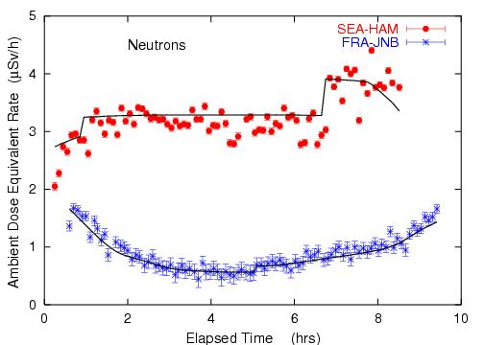
Dosimetry Applications
Roesler et al.,
Rad. Prot. Dosim.
98, 367 (2002)
Ambient dose equivalent from neutrons at solar maximum on commercial flights from Seattle to Hamburg and from Frankfurt to Johannesburg.
Solid lines: FLUKA simulation
8
Notes:
8

Slide 9
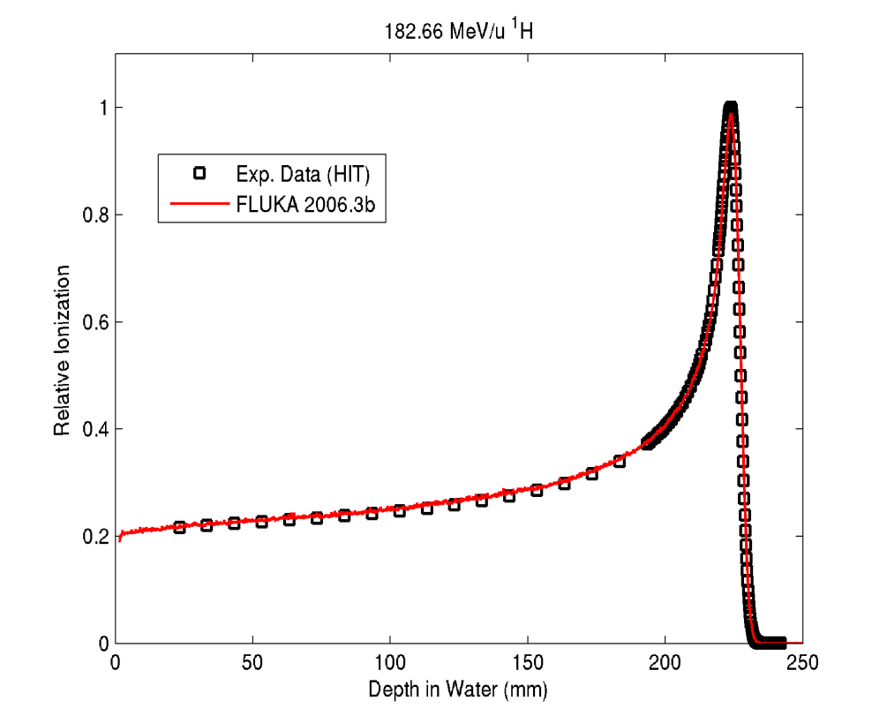
Experimental validation against measured Bragg curve in Proton and Carbon ion therapy
Protons (183 MeV/u) in Water
¹²C ions (400 MeV/u) in Water
FLUKA
Preliminary
Preliminary
Exp. Data (points) taken at HIT:
D. Schardt, P. Steidl, K. Parodi, S. Brons et al.
Simulation: K. Parodi
Exp. Data (points) from Haettner et al, Rad. Prot. Dos. 2006
Simulation: A. Mairani, PhD Thesis, Pavia, 2007
Notes:
Absolute

Slide 10
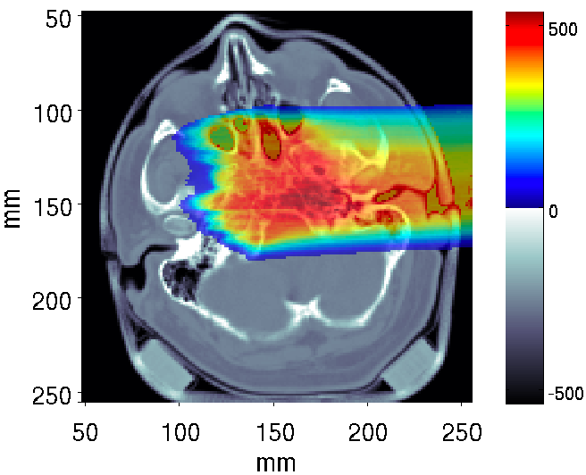
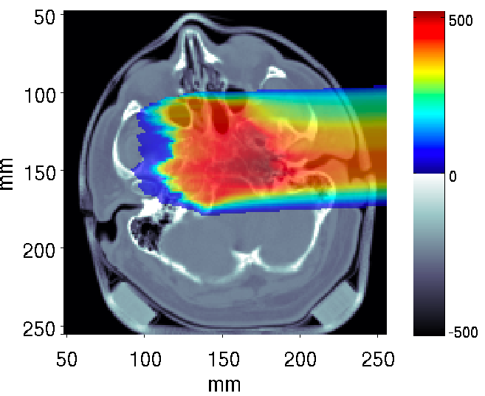
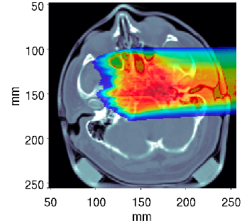
Clivus Chordoma Patient – Absorbed Dose
Validation of TPS in the patient CT system
Validation of TPS in the patient CT system
mGy
mGy
FLUKA
TRiP
A. Mairani et al to be published
Andrea Mairani
From Nuclear Interaction to Biological Dose Calculations: the FLUKA code in C ion Therapy
Notes:
10

Slide 11
end
11

