Slide 1

Ionization and Transport
FLUKA Beginners Course

Slide 2
Topics
General settings
Interactions of leptons/photons
  Photon interactions
    Photoelectric
    Compton
    Rayleigh
    Pair production
    Photonuclear
    Photomuon production
  Electron/positron interactions
    Bremsstrahlung
    Scattering on electrons
  Muon interactions
    Bremsstrahlung
    Pair production
    Nuclear interactions
Ionization energy losses
  Continuous
  Delta-ray production
Transport
  Multiple scattering
  Single scattering
These are common to all charged particles,
although traditionally associated with EM
Transport in Magnetic field

Slide 3
Ionization energy losses
Charged hadrons
Muons
Electrons/positrons
All share the same approach
Heavy Ions
They need some extra features

Slide 4
Discrete ionization events
Above a pre-set threshold, ionization is modeled as δ ray production (free electrons)
  Spin 0 or 1/2 δ-ray production (charged hadrons, muons)
  Bhabha scattering (e⁺)
  Møller scattering (e⁻)
The threshold refers to the kinetic energy of the emitted δ ray
For Electrons : set by EMFCUT with the PROD-CUT sdum
For charged hadrons/muons:
DELTARAY δThresh Ntab Wtab Mat1 Mat2 Step PRINT
δThresh = production threshold, in materials Mat1→ Mat2
Ntab, Wtab control the accuracy of dp/dx tabulations (advanced user)
If PRINT is set (not def.) dp/dx tabulations are printed on stdout

Slide 5
Continuous energy losses
Below the δ-ray threshold, energy losses are treated as “continuous”, with some special features:
  Fluctuations of energy loss are simulated with a FLUKA- specific algorithm
  The energy dependence of cross sections and dE/dx is taken into account exactly (see later)
  Latest recommended values of ionization potential and density effect parameters implemented for elements (Sternheimer, Berger & Seltzer), but can be overridden by the user with (set yourself for compounds!)
STERNHEI C X0 X1 a m δ₀ MAT
MAT-PROP Gasp Rhosc Iion Mat1 Mat2 Step

Slide 6
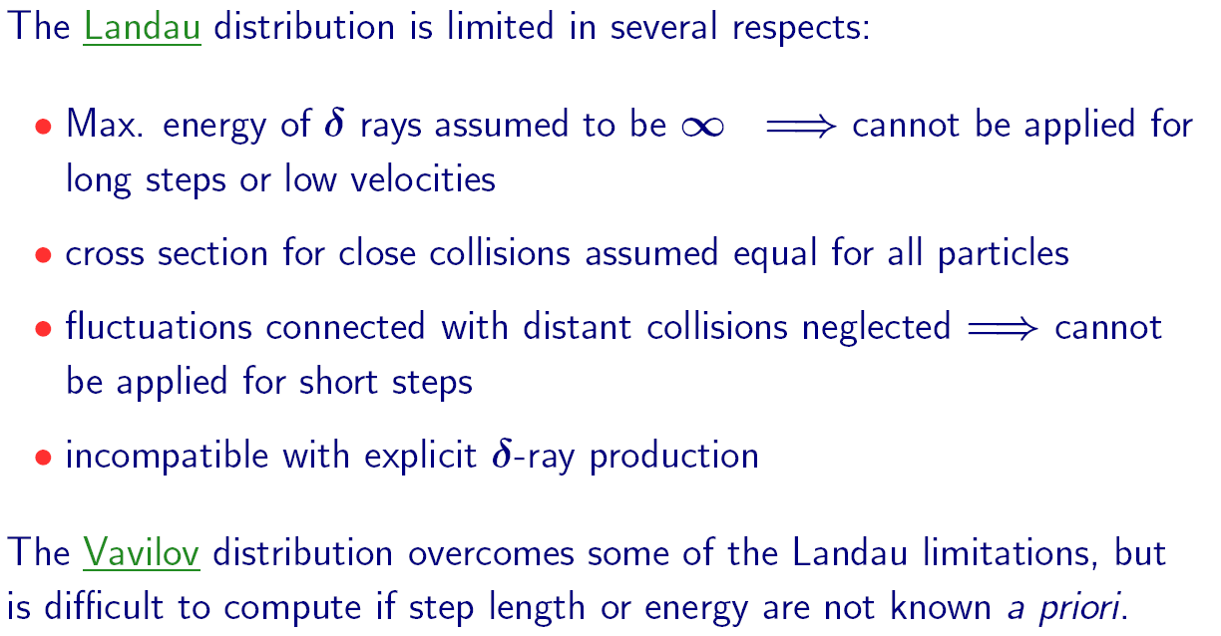
Ionization fluctuations -I

Slide 7
Ionization fluctuations -II

Slide 8
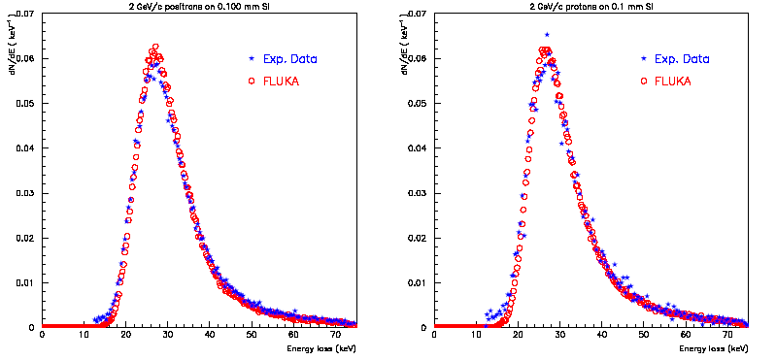
Ionization fluctuations -III
Experimental ¹ and calculated energy loss distributions for 2 GeV/c positrons (left) and protons (right) traversing 100μm of Si J.Bak et al. NPB288, 681 (1987)

Slide 9
Energy dependent quantities I

Slide 10
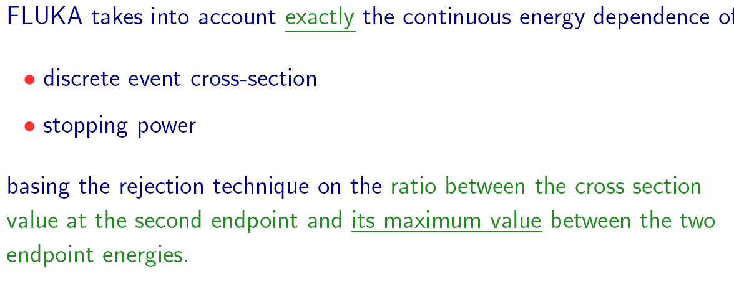
Energy dependent quantities II

Slide 11
Ionization fluctuation options
Ionization fluctuations are simulated or not depending on the DEFAULTS used. Can be controlled by
IONFLUCT FlagH FlagEM Accuracy Mat1 Mat2 STEP
Remember always that δ-ray production is controlled independently and cannot be switched off for e⁺/e⁻ (it would be physically meaningless)

Slide 12
Playing with a proton beam
Dose vs depth
energy deposition
in water for a 200 MeV p beam with various approximations for the physical processes taken into account

Slide 13
Playing with a proton beam II part
Dose vs depth
energy deposition
in water for a 214 MeV real p beam under various conditions.
Exp. Data from PSI

Slide 14
Heavy ions
Ionization energy losses
Up-to-date effective charge parameterizations
Energy loss straggling according to:
  “normal” first Born approximation
  Charge exchange effects (dominant at low energies, ad-hoc model developed for FLUKA)
  Mott cross section (high energies, not yet fully implemented)
  Nuclear form factors (high energies)
  Direct e+/e- production

Slide 15
Heavy ions dE/dx
Comparison of experimental (R.Bimbot, NIMB69 (1992) 1) (red) and FLUKA (blue) stopping powers of Argon and Uranium ions in different materials and at different energies.

Slide 16
Bragg peaks vs exp. data: ²⁰Ne @ 670 MeV/n
Dose vs depth distribution for 670 MeV/n ²⁰Ne ions on a water phantom.
The green line is the FLUKA prediction
The symbols are exp data from LBL and GSI
Exp. Data Jpn.J.Med.Phys. 18, 1,1998
Fragmentation products

Slide 17
Bragg peaks vs exp. data: ¹²C @ 270 & 330 MeV/n
Dose vs depth distribution for 270 and 330 MeV/n ¹²C ions on a water phantom.
The full green and dashed blue lines are the FLUKA predictions
The symbols are exp data from GSI
Exp. Data Jpn.J.Med.Phys. 18, 1,1998

Slide 18
Bragg peaks vs exp. data: ¹²C @ 270 MeV/n
Close-up of the dose vs depth distribution for 270 MeV/n ¹²C ions on a water phantom.
The green line is the FLUKA prediction with the nominal 0.15% energy spread
The dotted light blue line is the prediction for no spread, and the dashed blue one the prediction for I increased by 1 eV
Exp. Data Jpn.J.Med.Phys. 18, 1,1998

Slide 19
Charged particle transport
Notes:
19

Slide 20
Setting particle transport threshold
PART-THR Thresh Part1 Part2 Step
Hadron and muon transport thresholds are set with this card (see the manual for details)
The neutron threshold has a special meaning (as shown in the low energy neutron lecture), leave at the default value (1 x 10⁻⁵ eV)
Warning: the behaviour of PART-THR for neutrons has changed with the 2008 release!!
The threshold for nbar’s and neutral kaons should always be zero
Notes:
20

Slide 21
Charged particle transport
Besides energy losses, charged particles undergo scattering by atomic nuclei. The Molière multiple scattering (MCS) theory is commonly used to describe the cumulative effect of all scatterings along a charged particle step. However
  Final deflection wrt initial direction
  Lateral displacement during the step
  Shortening of the straight step with respect to the total trajectory due to “wiggliness” of the path (often referred to as PLC, path length correction)
  Truncation of the step on boundaries
  Interplay with magnetic field
MUST all be accounted for accurately, to avoid artifacts like unphysical distributions on boundary and step length dependence of the results
Notes:
21

Slide 22
The FLUKA MCS
Accurate PLC (not the average value but sampled from a distribution), giving a complete independence from step size
Correct lateral displacement even near a boundary
Correlations:
PLC ⇔ lateral deflection
lateral displacement ⇔ longitudinal displacement
scattering angle ⇔ longitudinal displacement
Variation with energy of the Moliere screening correction
Optionally, spin-relativistic corrections (1st or 2nd Born approximation) and effect of nucleus finite size (form factors)
Special geometry tracking near boundaries, with automatic control of the step size
On user request, single scattering automatically replaces multiple scattering for steps close to a boundary or too short to satisfy Moliere theory. A full Single Scattering option is also available.
Moliere theory used strictly within its limits of validity
combined effect of MCS and magnetic fields
Notes:
22

Slide 23
The FLUKA MCS - II
As a result, FLUKA can correctly simulate electron backscattering even at very low energies and in most cases without switching off the condensed history transport (a real challenge for an algorithm based on Moliere theory!)
The sophisticated treatment of boundaries allows also to deal successfully with gases, very thin regions and interfaces
The same algorithm is used for charged hadrons and muons
Notes:
23

Slide 24
Single Scattering
In very thin layers, wires, or gases, Molière theory does not apply.
In FLUKA, it is possible to replace the standard multiple scattering algorithm by single scattering in defined materials (option MULSOPT).
Cross section as given by Molière (for consistency)
Integrated analytically without approximations
Nuclear and spin-relativistic corrections are applied in a straightforward way by a rejection technique
Notes:
24

Slide 25
Electron Backscattering
Energy (keV) | Material | Experim. (Drescher et al 1970) | FLUKA Single scattering | FLUKA Multiple scattering | CPU time single/mult ratio
9.3 | Be | 0.050 | 0.044 | 0.40 | 2.73
 | Cu | 0.313 | 0.328 | 0.292 | 1.12
 | Au | 0.478 | 0.517 |  | 1.00
102.2 | Cu | 0.291 | 0.307 | 0.288 | 3.00
 | Au | 0.513 | 0.502 | 0.469 | 1.59
Fraction of normally incident electrons backscattered out of a surface.
All statistical errors are less than 1%.
Notes:
25

Slide 26
User control of MCS
MULSOPT Flag1 Flag2 Flag3 Mat1 Mat2 Step SDUM
Allows to optimize the treatment of multiple Coulomb scattering
Not needed in shielding problems, but important for backscattering and precision dosimetry
Can be tuned by material.
Special feature: possibility to suppress multiple scattering (applications: gas bremsstrahlung, proton beam interactions with residual gas)
Also very important: used to request transport with single scattering (CPU demanding, but affordable and very accurate at low electron energies, can be tuned x material!)
Notes:
26

Slide 27
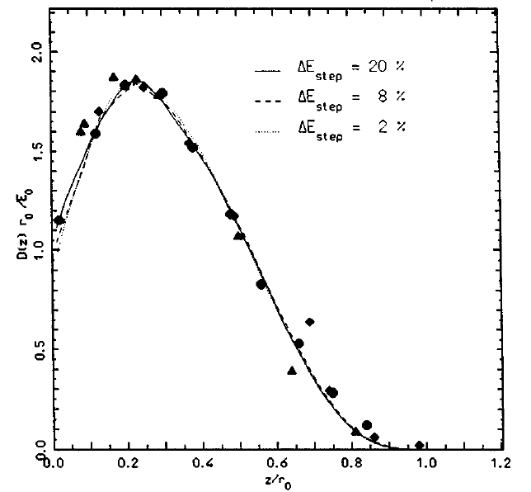
Control of step size
Step size is fixed by the corresponding percentage energy loss of the particle
Thanks to FLUKA mcs and boundary treatment, results are stable vs. (reasonable) step size
Comparison of calculated and experimental depth-dose profiles, for 0.5 MeV e⁻ on Al,
with three different step sizes . (2%, 8%, 20%)
Symbols: experimental data .
r₀ is the csda range
Notes:
27

Slide 28
Control of step size II
Step sizes are optimized by the DEFAULT settings. If the user REALLY needs to change them
EMFFIX Mat1 DEstep1 Mat2 DEstep2 Mat3 DEstep3
EM
Had
μ
FLUKAFIX DEstep Mat1 Mat2 Step
DEstep should always be below 30%
  In most routine problems, a 20% fraction energy loss gives satisfactory results. For dosimetry, 5-10% should be preferred.
WARNING : if a magnetic field is present, it is important to set also a maximum absolute step length and possibly a precision goal for boundary crossing by means of command STEPSIZE (see later)
Notes:
28

Slide 29
Magnetic field tracking in FLUKA
FLUKA allows for tracking in arbitrarily complex magnetic fields. Magnetic field tracking is performed by iterations until a given accuracy when crossing a boundary is achieved.
Meaningful user input is required when setting up the parameters defining the tracking accuracy.
Furthermore, when tracking in magnetic fields FLUKA accounts for:
  The precession of the mcs final direction around the particle direction: this is critical in order to preserve the various correlations embedded in the FLUKA advanced MCS algorithm
  The precession of a (possible) particle polarization around its direction of motion: this matters only when polarization of charged particles is a issue (mostly for muons in Fluka)
  The decrease of the particle momentum due to energy losses along a given step and hence the corresponding decrease of its curvature radius. Since FLUKA allows for fairly large (up to 20%) fractional energy losses per step, this correction is important in order to prevent excessive tracking inaccuracies to build up, or force to use very small steps
Notes:
29

Slide 30
How to define a magnetic field
MGNFIELD α ε Smin B_{x} B_{y} B_{z}
Declare the regions with field in the ASSIGNMAT card (what(5))
Set field/precision :
IF the field is UNIFORM set its components (tesla) in B_{x}, B_{y,} B_{z}
If not, leave B_{x}=B_{y}= B_{z}=0 and provide a magnetic field pointwise through the user routine MGNFLD (see later)
α, ε, Smin control the precision of the tracking, (see next slides) . They can be overridden/complemented by the STEPSIZE card
Notes:
30

Slide 31
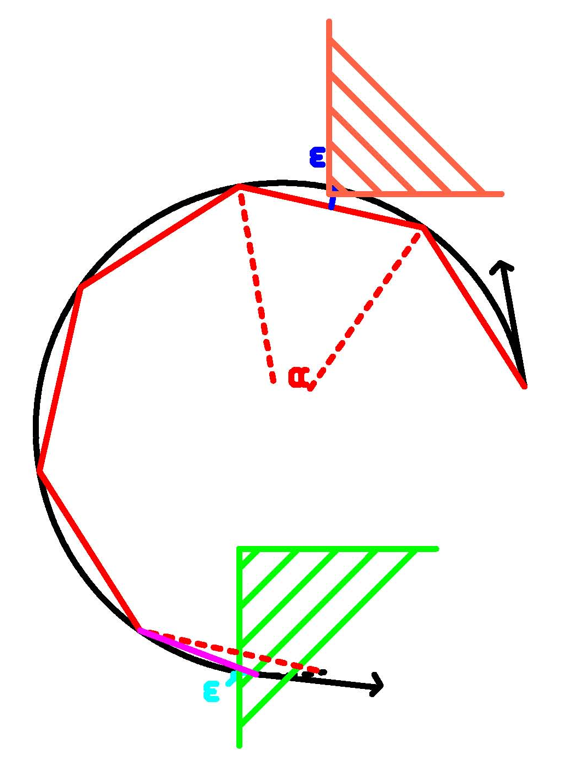
Magnetic field tracking in FLUKA
The true step (black) is approximated by linear sub-steps. Sub-step length and boundary crossing iteration are governed by the required tracking precision
The red line is the path actually followed,
the magenta segment is
the last substep, shortened because of a boundary crossing
  α= max. tracking angle (MGNFIELD)
  ε = max. tracking/missing error (MGNFIELD or STEPSIZE)
  ε ‘ = max. bdrx error (MGNFIELD or STEPSIZE)
Notes:
31

Slide 32
Setting the tracking precision
MGNFIELD α ε Smin B_{x} B_{y} B_{z}
α largest angle in degrees that a charged particle is allowed to travel in a single sub-step. Default = 57.0 (but a maximum of 30.0 is recommended!)
ε upper limit to error of the boundary iteration in cm (ε’ in fig.). It also sets the tracking error ε. Default = 0.05 cm
Smin minimum sub-step length. If the radius of curvature is so small that the maximum sub-step compatible with α is smaller than Smin, then the condition on α is overridden. It avoids endless tracking of spiraling low energy particles. Default = 0.1 cm
MGNFIELD sets the same parameter for all regions with magnetic field
For region-by-region tuning, use STEPSIZE
Notes:
32

Slide 33
Setting precision by region
STEPSIZE Smin/ε Smax Reg1 Reg2 Step
Smin: (if what(1)>0) minimum step size in cm Overrides MGNFIELD if larger than its setting.
ε (if what(1)<0) : max error on the location of intersection with boundary.
  The possibility to have different “precision” in different regions allows to save cpu time
Smax : max step size in cm. Default:100000. cm for a region without mag field, 10 cm with mag field.
  Smax can be useful for instance for large vacuum regions with relatively low magnetic field
  It should not be used for general step control, use EMFFIX, FLUKAFIX if needed
Notes:
33

Slide 34
The magfld.f user routine
This routine allows to define arbitrarily complex magnetic fields:
SUBROUTINE MAGFLD ( X, Y, Z, BTX, BTY, BTZ, B, NREG, IDISC)
. Input variables:
x,y,z = current position
nreg = current region
Output variables:
btx,bty,btz = cosines of the magn. field vector
B = magnetic field intensity (Tesla)
idisc = set to 1 if the particle has to be discarded
All floating point variables are double precision ones!
BTX, BTY, BTZ must be normalized to 1 in double precision
Notes:
34

Slide 35
Some warnings about scoring:
Every charged particle step Δx has its length constrained by:
  Maximum fractional energy loss (see FLUKAFIX)
  Maximum step size for that region (see STEPSIZE)
  MCS (or other) physical constraints
  Distance to next interaction (nuclear, δ ray etc)
The average energy loss is computed as a careful integration over the dE/dx vs energy curve and then it is fluctuated → a final ΔE is computed and used for scoring → resulting in a scored average effective ΔE/Δx uniform along that step
The particle energy used for track-length estimators is the average one along the step (E₀-ΔE/2)

Slide 36
USRBIN track apportioning scoring
The energy deposition will be Δl/Δx ΔE
Δl
Δx, ΔE

Slide 37
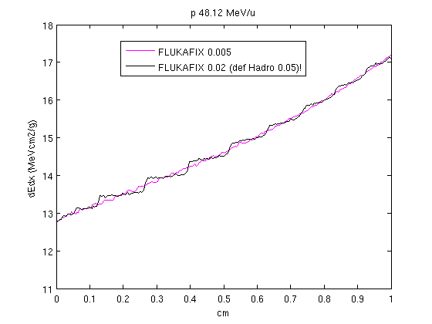
USRBIN track apportioning scoring

Slide 38
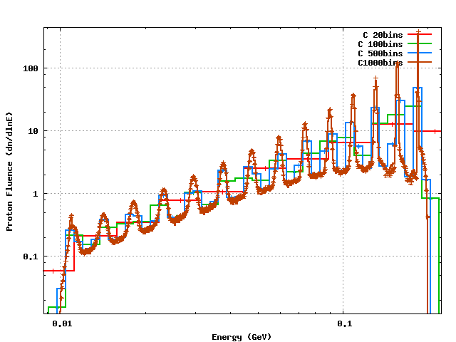
USRTRACK scoring: 200 MeV p on C
Default settings, ≈ 20% energy loss per step

