Slide 1

Heavy Ion Interactions
Beginners’ FLUKA Course

Slide 2
Overview
The models
DPMJET
RQMD
BME
Input options
Beam definition
Transport thresholds

Slide 3
Heavy ion interaction models in FLUKA - 1
E > 5 GeV/n
Dual Parton Model (DPM)
DPMJET-III (original code by R.Engel, J.Ranft and S.Roesler,
FLUKA-implemenation by T.Empl et al.)
0.1 GeV/n < E < 5 GeV/n
Relativistic Quantum Molecular Dynamics Model (RQMD)
RQMD-2.4 (original code by H.Sorge et al.,
FLUKA-implementation by A.Ferrari et al.)
E < 0.1 GeV/n
Boltzmann Master Equation (BME) theory
BME (original code by E.Gadioli et al.,
FLUKA-implementation by F.Cerutti et al.)

Slide 4
Heavy ion interaction models in FLUKA - 2
[even three from BME]

Slide 5
DPMJET
E > 5 GeV/n
Dual Parton Model (DPM)
DPMJET-III (original code by R.Engel, J.Ranft and S.Roesler,
FLUKA-implemenation by T.Empl et al.)
0.1 GeV/n < E < 5 GeV/n
Relativistic Quantum Molecular Dynamics Model (RQMD)
RQMD-2.4 (original code by H.Sorge et al.,
FLUKA-implementation by F.Cerutti et al.)
E < 0.1 GeV/n
Boltzmann Master Equation (BME) theory
BME (original code by E.Gadioli et al.,
FLUKA-implementation by F.Cerutti et al.)

Slide 6
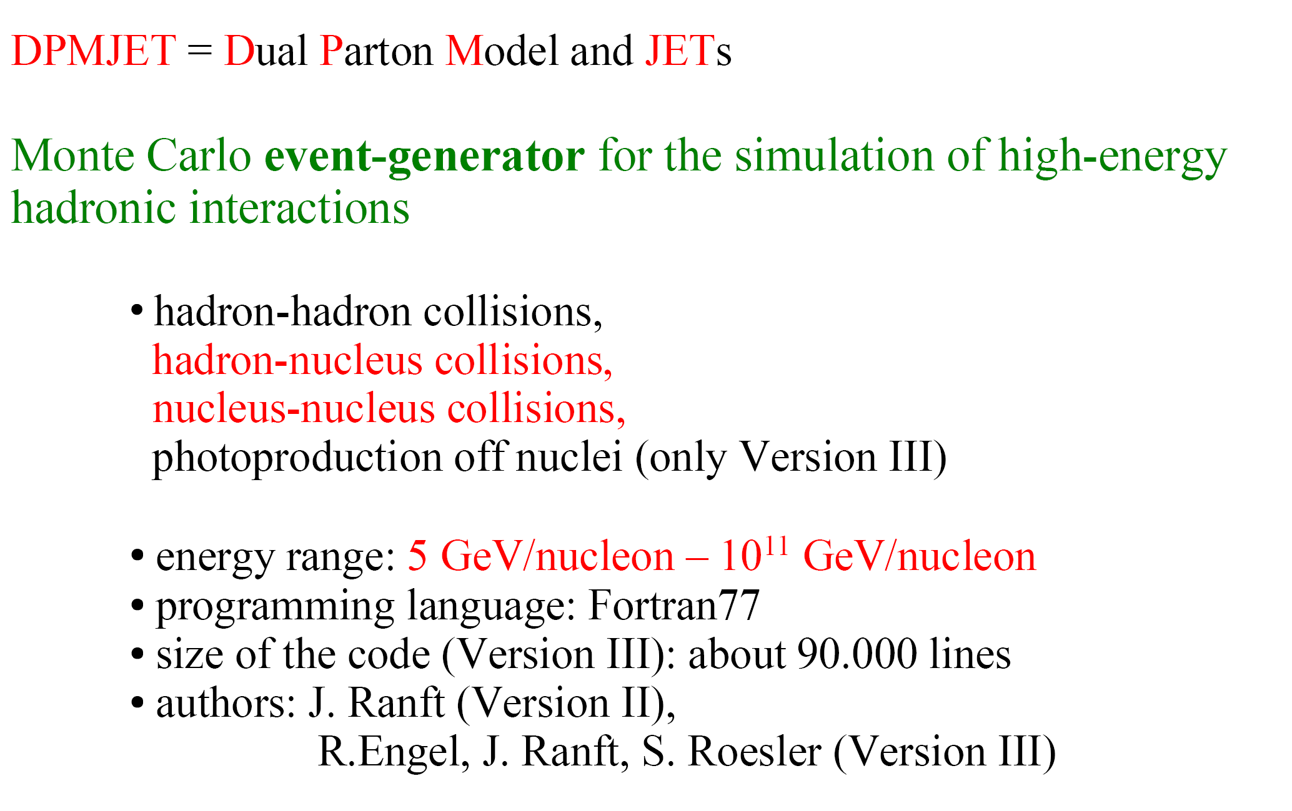
DPMJET – Overview

Slide 7
DPMJET – Main steps of a high energy interaction

Slide 8
DPMJET – The Gribov-Glauber formalism

Slide 9
DPMJET – Intranuclear cascade and fragmentation

Slide 10
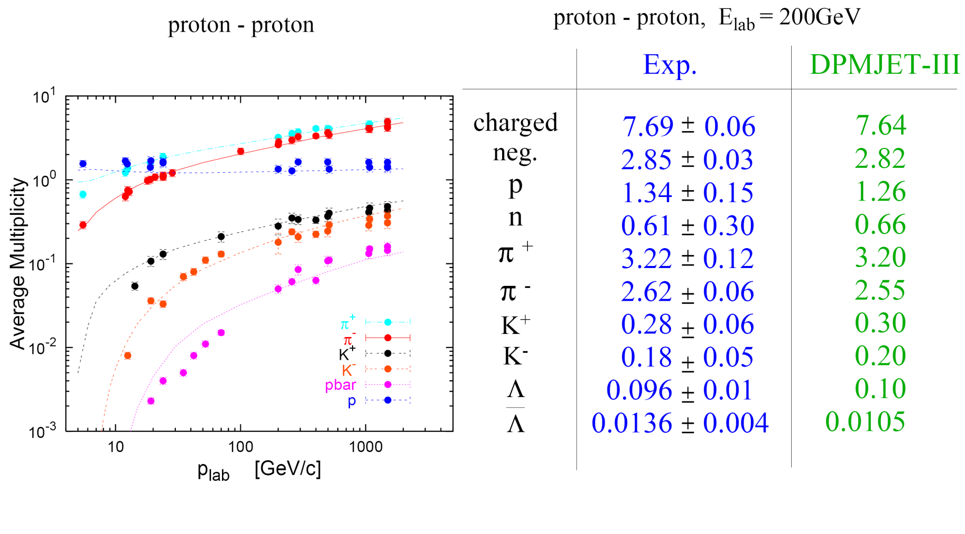
DPMJET – Comparison to data (hadron-hadron)

Slide 11
DPMJET – Comparison to data (hadron-nucleus)

Slide 12
DPMJET – Comparison to data (nucleus-nucleus)

Slide 13
DPMJET – Comparison to data (nucleus-nucleus)
Pseudorapidity distribution of charged hadrons produced in minimum bias d-Au and p-p
collisions at a c.m. energy of 200GeV/A.
Exp. data: BRAHMS- and PHOBOS-Collaborations
J.Ranft, in Proceedings of the Hadronic Shower Simulation Workshop, CP896, Batavia, Illinois (USA), 6-8 September 2006

Slide 14
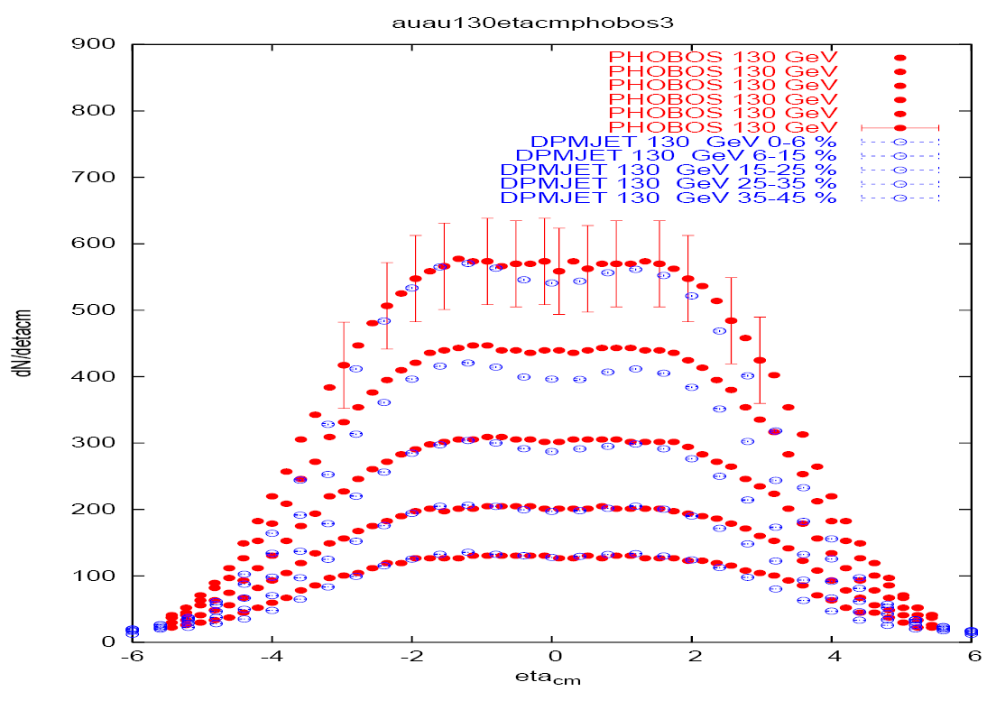
DPMJET – Comparison to data (nucleus-nucleus)
Pseudorapidity distribution of charged hadrons produced in Au-Au collisions at a c.m.
energy of 130GeV/A (left) and 200GeV/A (right) for different ranges of centralities.
Exp. data: PHOBOS-Collaboration
J.Ranft, in Proceedings of the Hadronic Shower Simulation Workshop, CP896, Batavia, Illinois (USA), 6-8 September 2006

Slide 15
DPMJET – Interface to FLUKA

Slide 16
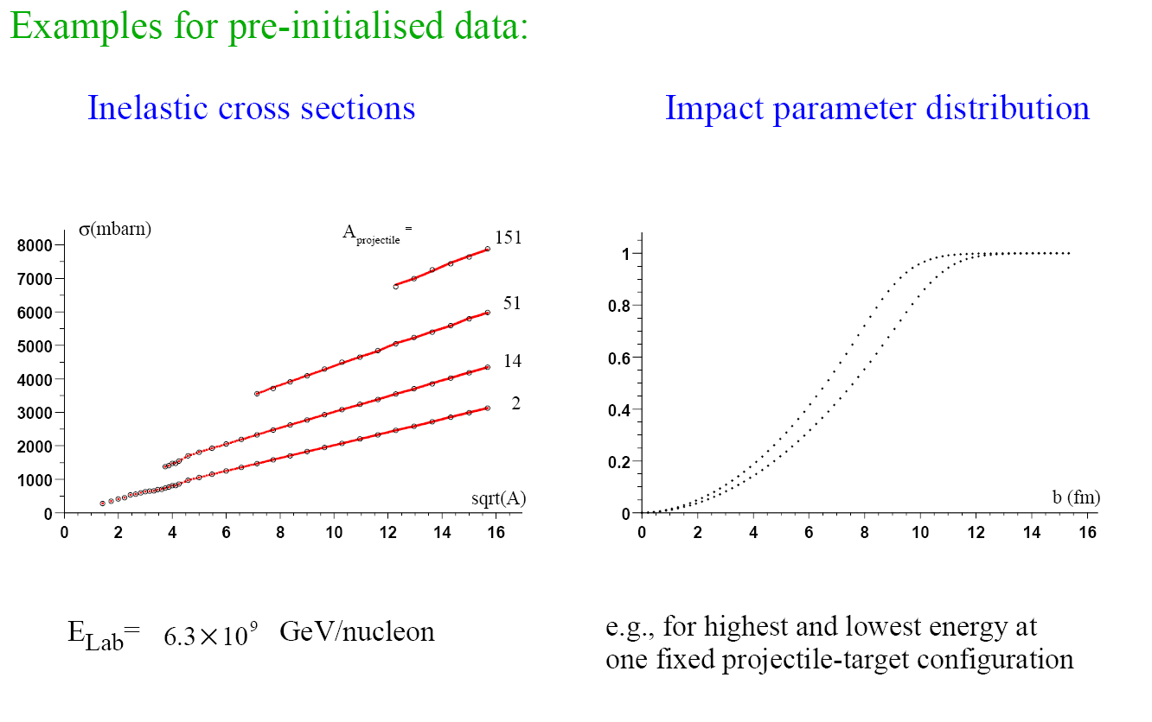
DPMJET – Interface to FLUKA

Slide 17
DPMJET – FLUKA benchmarks
Fragment charge cross sections for
158GeV/n Pb ions on various targets.
FLUKA: solid histogram(total)
dashed histogram (em diss.)
Exp. data: symbols
NPA662, 207 (2000),
NPA707, 513 (2002),
C.Scheidenberger et al. PRC
Z

Slide 18
RQMD
E > 5 GeV/n
Dual Parton Model (DPM)
DPMJET-III (original code by R.Engel, J.Ranft and S.Roesler,
FLUKA-implemenation by T.Empl et al.)
0.1 GeV/n < E < 5 GeV/n
Relativistic Quantum Molecular Dynamics Model (RQMD)
RQMD-2.4 (original code by H.Sorge et al.,
FLUKA-implementation by A.Ferrari et al.)
E < 0.1 GeV/n
Boltzmann Master Equation (BME) theory
BME (original code by E.Gadioli et al.,
FLUKA-implementation by F.Cerutti et al.)

Slide 19
RQMD - References
interface to a suitably modified RQMD model
RQMD-2.4 (H. Sorge, 1998) was successfully applied
to relativistic A-A particle production over a wide energy range
[H. Sorge, Phys. Rev. C 52, 3291 (1995);
H. Sorge, H. Stöcker, and W. Greiner, Ann. Phys. 192, 266 (1989)
and Nucl. Phys. A 498, 567c (1989)]

Slide 20
RQMD – The original code

Slide 21
RQMD – The interfaced code

Slide 22
RQMD – FLUKA benchmarks

Slide 23
RQMD - FLUKA benchmarks

Slide 24
RQMD - FLUKA benchmarks
Isotopic distributions of fragmentation products
fission products excluded
like in the experimental
analysis
exp. data (stars) from J. Benlliure, P. Armbruster et al., Eur. Phys. J A 2, 193 (1998)

Slide 25
BME
E > 5 GeV/n
Dual Parton Model (DPM)
DPMJET-III (original code by R.Engel, J.Ranft and S.Roesler,
FLUKA-implemenation by T.Empl et al.)
0.1 GeV/n < E < 5 GeV/n
Relativistic Quantum Molecular Dynamics Model (RQMD)
RQMD-2.4 (original code by H.Sorge et al.,
FLUKA-implementation by A.Ferrari et al.)
E < 0.1 GeV/n
Boltzmann Master Equation (BME) theory
BME (original code by E.Gadioli et al.,
FLUKA-implementation by F.Cerutti et al.)

Slide 26
BME - References
interface to a Monte Carlo code
founded on the BME theory (E. Gadioli et al.)
[M. Cavinato et al., Nucl. Phys. A 679, 753 (2001),
M. Cavinato et al., Phys. Lett. B 382, 1 (1996)]

Slide 27
BME – The interfaced code
two different reaction paths have been adopted:
1. COMPLETE FUSION
P_{CF}=σ_{CF}/σ_{R}
pre-equilibrium
according to the BME theory
2. PERIPHERAL COLLISION
P = 1 - P_{CF}
three body mechanism
pickup/stripping (for asymmetric systems at low b)
inelastic scattering (at high b)
work in progress
FLUKA evaporation
1. In order to get the multiplicities of the pre-equilibrium particles and their double differential spectra, the BME theory is applied to a few representative systems at different bombarding energies and the results are parameterized.
2. The complete fusion cross section decreases with increasing bombarding energy. We integrate the nuclear densities of the projectile and the target over their overlapping region, as a function of the impact parameter, and obtain a preferentially excited “middle source” and two fragments (projectile- and target-like). The kinematics is suggested by break-up studies.

Slide 28
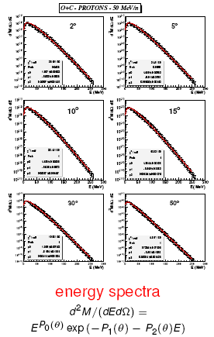
BME – The database for the pre-equilibrium emissions
¹⁶O + ⁶Li, ⁸Li, ⁸B, ¹⁰B, ¹²C, ¹⁴N, ¹⁶O, ¹⁹F, ²⁰Ne, ²⁴Mg, ²⁷Al, ⁵⁶Fe, ¹⁹⁷Au
¹²C + ⁸Li, ⁸B, ¹²C, ²⁷Al, ⁴⁰Ca
@ 12, 30, 50, 70, 100 MeV/n

Slide 29
BME – Theoretical framework

Slide 30
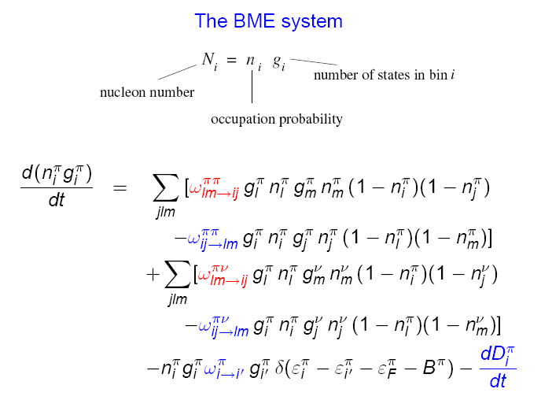
BME – Theoretical framework

Slide 31
BME – Theoretical framework

Slide 32
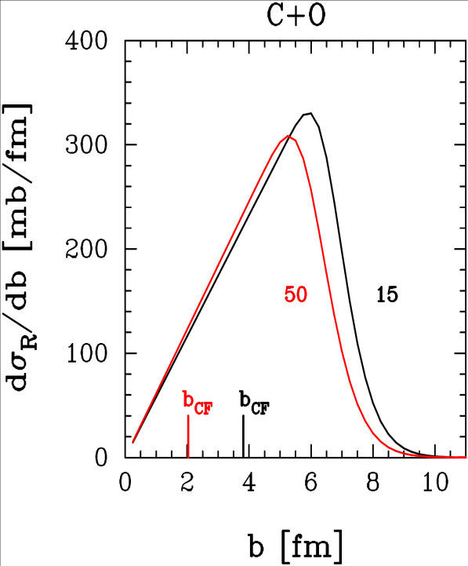
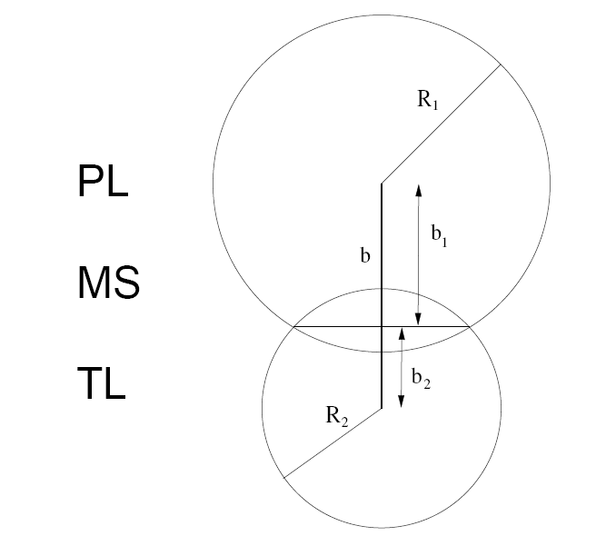
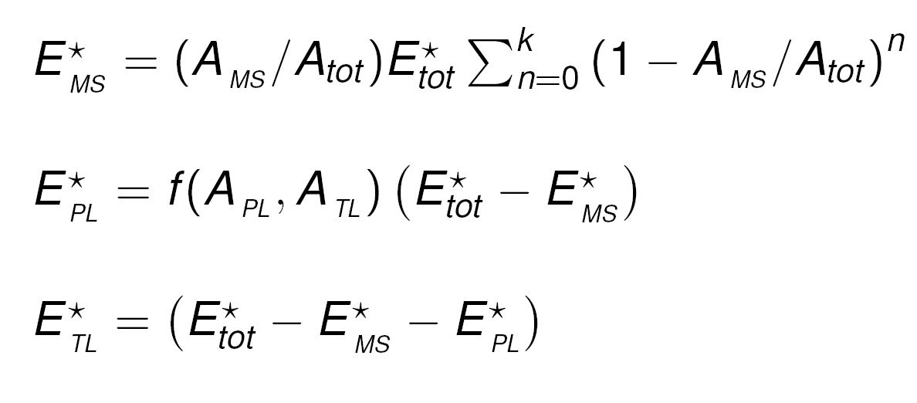
BME – Peripheral collisions
i. selection of the impact parameter b
ii. kinematics determination
θ_{PL} , θ_{TL} chosen according to [dσ/dΩ]_{cm} ~ exp(-kθ_{cm})
θ_{MS} momentum conservation
p_{PL} , p_{TL} chosen according to a given energy loss distribution
p_{MS} momentum conservation
φ_{PL} free
φ_{TL} , φ_{MS} same reaction plane
work in progress
iii. excitation energy sharing

Slide 33
BME – Benchmarking
work in progress

Slide 34
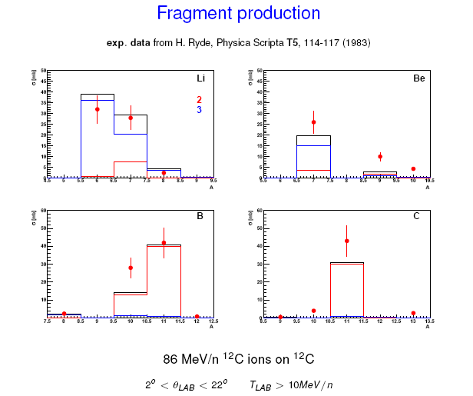
BME – Benchmarking
work in progress

Slide 35
Input options - 1
a) define momentum / energy
BEAM -10.0 0.0 0.0 0.0 0.0 0.0HEAVYION
WHAT(1) > 0.0 : average beam momentum (GeV/c)
< 0.0 : average beam kinetic energy (GeV)
WHAT(2) beam momentum spread (GeV/c)
Note: for SDUM = HEAVYION units per nucleon (in fact per nmu)
for SDUM = 4-HELIUM, etc. per nucleus
WHAT(3)-WHAT(6) (as for any other particle)
SDUM = HEAVYION
also 4-HELIUM alpha
3-HELIUM 3-helium
TRITON tritium
DEUTERON deuterium

Slide 36
Input options - 2
b) define charge and mass (required for BEAM/SDUM=HEAVYION)
HI-PROPE 79.0 197.0 0.0 0.0 0.0 0.0
WHAT(1) = Atomic number Z of the heavy ion, Default: 6.0
WHAT(2) = Mass number A of the heavy ion, Default: 12.0
WHAT(3) = if < 0 isomeric state of the heavy ion
c) switch on heavy ion interactions
EVENTYPE 0.0 0.0 2.0 0.0 0.0 0.0DPMJET
Note: Don’t forget to link the DPMJET/RQMD modules.
either using FLAIR or
$FLUPRO/flutil/ldpmqmd –m fluka –o <executable name>

Slide 37
Input options - 3
Notes:
  The transport momentum threshold for ions (p_{th,HI}) is fixed to that of
  alphas (p_{th,α})
  p_{th,HI} = p_{th,α} x m_{HI}/m_{α} (GeV/c)
  Unless the transport threshold for alphas is defined with a PART-THR card
  (requiring GeV and not GeV per nucleon) it is set equal to 10 MeV
  if DEFAULTS=NEW-DEFA.
  When the energy of an ion becomes lower than the transport threshold,
  and if such threshold is lower than 100 MeV/n, the ion is not stopped,
  but it is ranged out to rest

Slide 38
Input options - 4
Electromagnetic dissociation
PHYSICS 0.0 0.0 0.0 0.0 0.0 0.0EM-DISSO
WHAT(1) : flag for activating ion electromagnetic-dissociation
=< -1.0 : resets to default (no em-dissociation)
= 0.0 : ignored
= 1.0 : (default) no em-dissociation
= 2.0 : projectile and target em-dissociation activated
= 3.0 : projectile only em-dissociation activated
= 4.0 : target only em-dissociation activated
WHAT(2)-WHAT(6): not used

