Slide 1

Lattice
Beginners’ FLUKA Course

Slide 2
Lattice
FLUKA geometry has replication (lattice) capabilities
Only one level is implemented (No nested lattices are allowed)
In a future release there will be the possibility of a second level
The user defines lattice positions in the geometry and provides transformation rules from the lattice to the prototype region:
  in the input with the ROT-DEFI card
  in a subroutine (lattic.f)
The lattice identification is available for scoring
Transformations should include:
Translation, Rotation and Mirroring (only through routine).
WARNING:
Do not use scaling or any deformation of the coordinate system

Slide 3
In the geometry
The regions which constitute the elementary cell (prototype) to be replicated, have to be defined in detail
The Lattices (replicas) have to be defined as “empty” regions in their correct location.
WARNING: The lattice region should map exactly the outer surface definition of the elementary cell.
The lattice regions are declared as such with a LATTICE card at the end of the geometry input
In the LATTICE card, the user also assigns lattice names/numbers to the lattices. These names/numbers will identify the replicas in all FLUKA routines and scoring
Several basic cells and associated lattices can be defined within the same geometry, one LATTICE card will be needed for each set
Non-replicas carry the lattice number 0
Lattices and plain regions can coexist in the same problem

Slide 4
LATTICE card
After the Regions definition and before the GEOEND card the user can insert the LATTICE cards
  WHAT(1), WHAT(2), WHAT(3)
  Container region range (from, to, step)
  WHAT(4), WHAT(5), WHAT(6)
  Name/number(s) of the lattice(s)
  SDUM
  blank to use the transformation from the lattic routine
  ROT#nn to use a ROT-DEFI rotation/translation from input
  name use a rotation by names. You can name a rotation using
  as SDUM in ROT-DEFI any alphanumeric string you like
Example
*...+....1....+....2....+....3....+....4....+....5....+....6....+....7....+...
LATTICE 6.00000 19.00000 101.0000 114.00
Region # 6 to 19 are the “placeholders” for the first set replicas. We assign to them lattice numbers from 101 to 114
LATTICE TARGR1 TargRep 1tra
TARGR1 is the container region using transformation 1tra

Slide 5
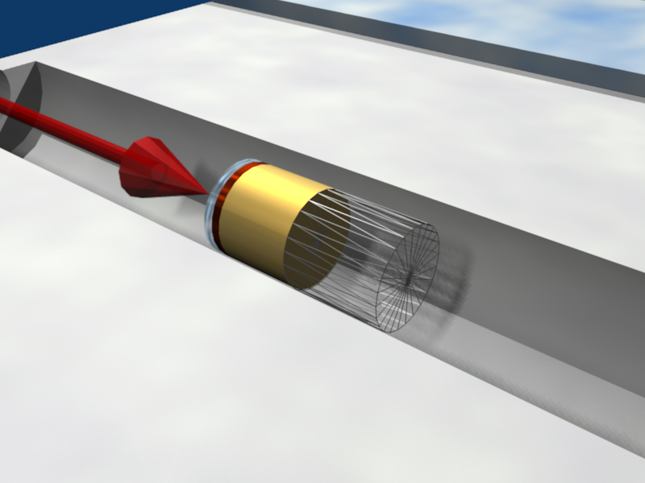
Plot of the Example
Prototype
cell(s)
Empty
Lattice cell

Slide 6
Plot of the Example
Replica
Transformation
Prototype
cells
For every particle
entering the replica
Its coordinates are transformed to the
prototype, where FLUKA performs the tracking

Slide 7
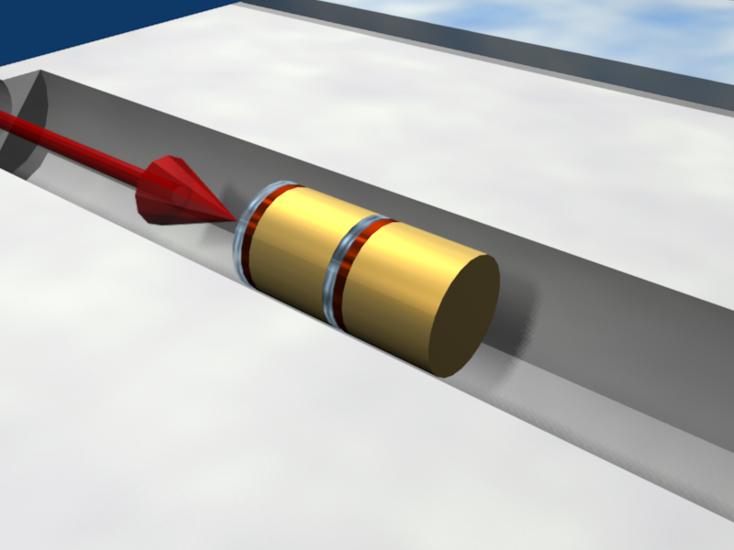
Plot of the Example
Prototype
cell
Empty
Lattice cell
Final
Replica

Slide 8
Transformation by input
Rotations/Translations can be defined with the
ROT-DEFIni card
Can be assigned to a lattice by name or with ROT#nnn SDUM in the LATTICE card
ROT-DEFIni cards can be cascaded (using the same index or name) to define complex transformations
WARNING:
Since matrix multiplication is not commutative the order of the Rotation/Translation operations in 3D is important.

Slide 9

ROT-DEFIni
The ROT-DEFIni defines roto-translations that can be applied to USRBIN, EVENTBIN and LATTICE. It transforms the position of the tracked particle to place of interest scoring or elementary cell (prototype) with the order:
  First applies the translation
  Followed by the rotation on the azimuthal angle
  and finally by the rotation on the polar angle.
  X_{new} = M_{polar} × M_{az} × (X + T)
WHAT(1): assigns a transformation index and the corresponding rotation axis I + J * 100 or I * 1000 + J
I = index of rotation (WARNING: NOTE THE SWAP OF VARIABLES)
J = rotation with respect to axis (1=X, 2=Y, 3=Z)
WHAT(2): Polar angle of the rotation (0 ≤ ϑ ≤ 180º degrees)
WHAT(3): Azimuthal angle of the rotation (-180 ≤ ϕ ≤ 180º degrees)
WHAT(4), WHAT(5), WHAT(6) = X, Y, Z offset for the translation
SDUM: Optional (but recommended) name for the transformation

Slide 10
Numerical Precision
Due to the nature of the floating point operations in CPU even if the transformation is correct the end result could be problematic
This small misalignment between lattice/transformation/prototype could lead to geometry errors
Use as many digits as possible to describe correctly the prototype and lattice cells as well as the transformation.
Is important that the lattice with the transformation corresponds EXACTLY to the prototype
In case of need use a FREE and FIXED card before and after the ROT-DEFI to use more than 10 digits
GEOBEGIN WHAT(2) will relax the geometry errors (USE WITH CAUTION)
Prototype
Transformation
Lattice

Slide 11
Input file, and output quantities
Materials and other properties have to be assigned only to the regions constituting the basic cell(s).
In all (user) routines the region number refers to the corresponding one in the elementary cell.
This applies also to the summary output in the .out file, and in the scoring by regions (i.e. the results for a prototype region include also the contribution from its replicas).
The lattice identity can be recovered by the lattice number, as set in the LATTICE card, or by GEON2L subroutine if is defined by name
In particular, the LUSRBL routine allows to manage the scoring on lattices in the special USRBIN/EVENTBIN structure.

Slide 12
The USRBIN/EVENTBIN special binning
EVENTBIN or USRBIN with WHAT(1)=8 :
Special user-defined 3D binning. Two variables are discontinuous (e.g. region number), the third one is continuous, but not necessarily a space coordinate.
Variable | Type | Default | Override Routine
1st | integer | region number | MUSRBR
2nd | integer | lattice cell number | LUSRBL
3rd | float | pseudorapidity* | FUSRBV
* Presently it scores: n=-ln(tan(0.5 arctan(sqrt(x²+y²)/z))
Subject to change to default=zero in the next release

Slide 13
Tips & Tricks ^{[1/2]}
Always remember that the transformation refers to the particles and not to the geometry!
You can always divide a transformation into many
ROT-DEFI cards for easier manipulation.
Rotations are always around the center of the geometry, and not the center of the object.
  To rotate an object, first translate the object to the origin of the axes
  Perform the rotation
  Final translation to the requested position.
  Of course with the inverse order since everything should apply to the particle

Slide 14
Tips & Tricks ^{[2/2]}
The Geometry transformation editor in flair can read and write ROT-DEFI cards with the transformation requested
An easy way of creating a replica and the associated transformation is the following:
  Select the body defining the outer cell of the prototype
  Clone it with (Ctrl-D) and change the name of the clones. Click on “No” when you are prompted to change all references to the original name.
  Open the Geometry transformation dialog (Ctrl-T)
  Enter the transformation of the object in the listbox
  Click on “Transform” to perform the transformation on the clone bodies
  Click on “Invert” button to invert the order of the transformation
  Enter a name on the “ROT-DEFIni” field and click
  “Add to Input” to create the ROT-DEFIni cards
  Now you have to create manually the correct regions and the LATTICE cards

