Slide 1

Voxels and Medical Applications
FLUKA Beginners course

Slide 2
The FLUKA voxel geometry
It is possible to describe a geometry in terms of “voxels”, i.e., tiny parallelepipeds (all of equal size) forming a 3-dimensional grid

Slide 3
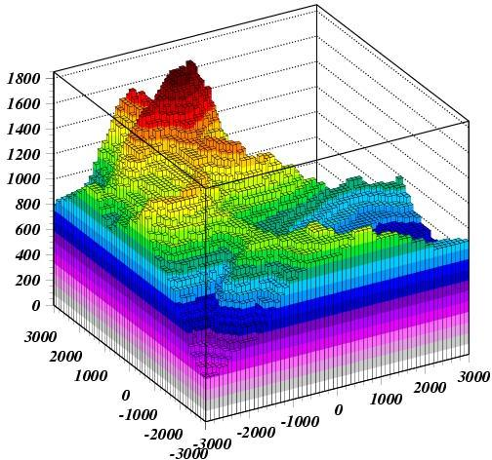
Voxel geometries: examples
The Gran Sasso in FLUKA

Slide 4
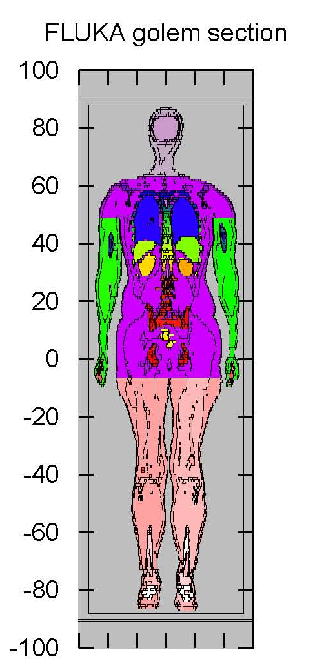

Voxel geometries: examples
The anthropomorphic GOLEM phantom
Implementation in FLUKA
(radioprotection applications)
Petoussi-Henss
et al, 2002
Notes:
4

Slide 5
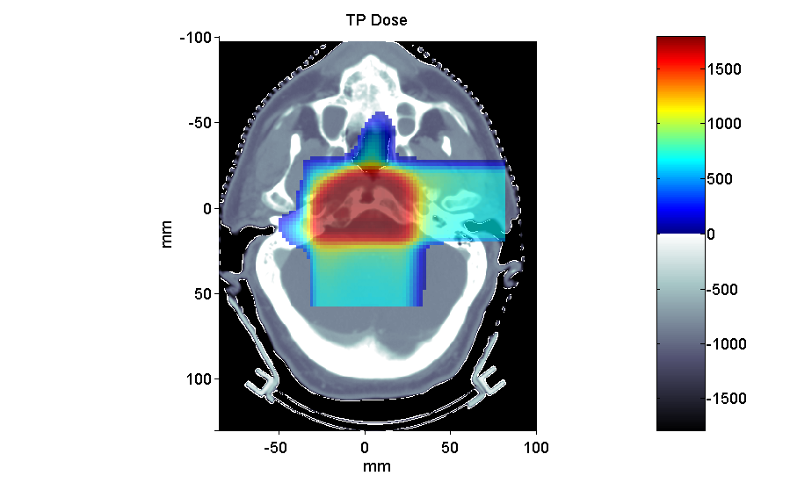
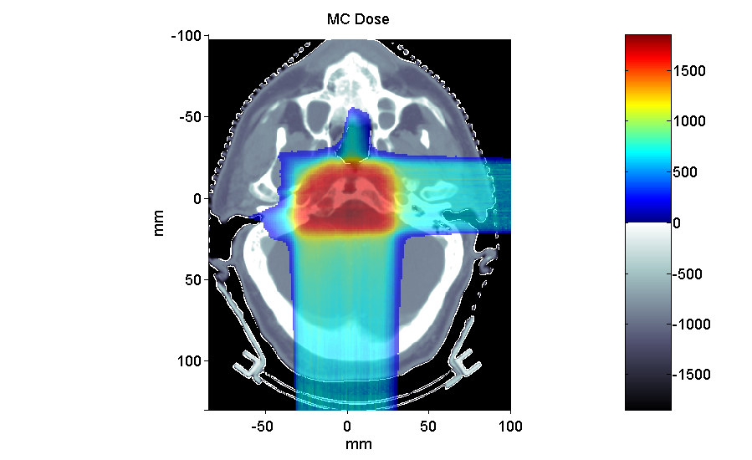
Voxel geometries in medical applications
Voxel geometries are especially useful to import CT scan of a human body, e.g., for dosimetric calculations of the planned treatment in radiotherapy
Commercial TPS
FLUKA
mGy
mGy
Parodi et al., 2007
Notes:
5

Slide 6
The FLUKA voxel geometry
The CT scan contains integer values “Hounsfield Unit” reflecting the X-ray attenuation coefficient m_{x}
HU_{x} = 1000 (m_{x}-m_{H20}) / m_{H20} , typically 1000 ≤ HU ≤ 3500
We will use loosely the word “organ” to indicate a group of voxels (or even more than one group) made of the same “tissue” material (same HU value or in a given HU interval)
The code handles each organ as a CG region, possibly in addition to other conventional “non-voxel” regions defined by the user
The voxel structure can be complemented by parts written in the standard Combinatorial geometry
The code assumes that the voxel structure is contained in a parallelepiped. This RPP is automatically generated from the voxel information.
Notes:
6

Slide 7
The FLUKA voxel geometry
To describe a voxel geometry, the user must convert his CT scan or equivalent data to a format understood by FLUKA
A prototype of conversion program is in writect.f
This stage should :
  Assign an organ index to each voxel. In many practical cases, the user will have a continuum of CT values (HU), and may have to group these values in intervals
  Each organ is identified by a unique integer ≤32767. The organ numbering does not need to be contiguous (i.e. “holes” in the numbering sequence are allowed.)
  One of the organs must have number 0 and plays the role of the medium surrounding the voxels (usually vacuum or air).
  The user assigns to each NONZERO organ a voxel-region number. The voxel-region numbering has to be contiguous and starts from 1.

Slide 8
The FLUKA voxel geometry
The information is input to FLUKA through a special file *vxl containing:
  The number of voxels in each coordinate
  The number of voxel-regions, and the maximum organ number
  The voxel dimension in each coordinate
  A list of the organ corresponding to each voxel
  in Fortran list-oriented format, with the x coordinate running faster than y, and y running faster than z.
  val(1) corresponds to 1,1,1 == organ n. of first voxel
  … …
  val(Nx) corresponds to Nx,1,1
  val(Nx+1) corresponds to 1,2,1
  val(2*Nx) corresponds to Nx,2,1
  …
  val(Nx*Ny) corresponds to Nx,Ny,2
  … …
  val(Nx*Ny*Nz) corresponds to Nx,Ny,Nz == organ n. of last voxel
  A list of the voxel-region number corresponding to each organ

Slide 9
Voxels Example
in the directory ct of the examples
ascii.ct: dummy scan, representing an egg-shaped body with 6 different material zones
(HU: 0,1,2,3,8,10,12)
writect.f: the program to get the .vxl file
ct.vxl: the file generated by writect
ct.geo: the geometry that embeds the voxel “box” in a shielding structure
ct.inp: the input file

Slide 10
Modifying writect
The writect.f program has to be adapted to the user's need: The user will have to adapt the reading of the scan, and if needed to group continuous values
The user will need to modify the values of the parameters DX, DY DZ, NX, NY, NZ (respectively voxel size and number of voxels for each coordinate).
writect.f takes also care of re-compacting the original organ numbers by eliminating all gaps in the sequence, and writes a translation table to the screen:
WRITE(*,'(A,2I10)') 'New number, old number: ', NO, IC

Slide 11
writect.f
For each voxel
PROGRAM WRITECT
IMPLICIT DOUBLE PRECISION ( A-H, O-Z )
* COLUMNS: FROM LEFT TO RIGHT
* ROWS: FROM BACK TO FRONT
* SLICES: FROM TOP TO BOTTOM
PARAMETER ( DX = 2.0D+00 )
PARAMETER ( DY = 3.0D+00 )
PARAMETER ( DZ = 4.0D+00 )
PARAMETER ( NX = 20 )
PARAMETER ( NY = 20 )
PARAMETER ( NZ = 20 )
DIMENSION CT(NX,NY,NZ)
INTEGER*2 CT
DIMENSION VXL(NX,NY,NZ)
INTEGER*2 VXL
CHARACTER TITLE*80
DIMENSION IREG(1000), KREG(1000)
INTEGER*2 IREG, KREG
*
CALL CMSPPR
DO IC = 1, 1000
KREG(IC) = 0
END DO
OPEN(UNIT=30,FILE='ascii_ct',STATUS='OLD')
READ(30,*) CT
*
*
NO=0
MO=0
DO IZ=1,NZ
DO IY=1,NY
DO IX=1,NX
IF (CT(IX,IY,IZ) .GT. 0) THEN
IO= CT(IX,IY,IZ)
VXL(IX,IY,IZ) = IO
MO = MAX (MO,IO)
DO IR=1,NO
IF (IREG(IR) .EQ. IO) GO TO 1000
END DO
NO=NO+1
IREG(NO)=IO
KREG(IO)=NO
WRITE(*,'(A,2I10)')' New number, old number: ', NO, IO
1000 CONTINUE
END IF
END DO
END DO
END DO
* NO = number of different organs
* MO = max. organ number before compacting
*
WRITE(*,*) ' NO,MO',NO,MO
OPEN(UNIT=31,FILE='ct.vxl',STATUS='UNKNOWN',FORM='UNFORMATTED')
TITLE = 'Egg-like CT scan'
WRITE(31) TITLE
WRITE(31) NX,NY,NZ,NO,MO
WRITE(31) DX,DY,DZ
WRITE(31) VXL
WRITE(31) (KREG(IC),IC=1,MO)
STOP
END
Assign organ IO to this voxel
Number and
Dimensions of voxels
If new organ: assign new region NO to organ IO
read the original CT scan
In this example, the organ number is simply set equal to the CT number for each voxel
Write the file for FLUKA

Slide 12
Modifying writect
In the considered example the CT numbers 0,1,2,3,8,10,12
have been converted to
- organs “IO” 0 1 2 3 8 10 12 (Max. MO=12)
- regions “NO” 0 6 5 4 3 2 1 ( ...because of the order of appearance)
After having modified the program (assumed to be in a file writect.f), compile it and link with the FLUKA library, and then execute:
ct > \$FLUPRO/lfluka -o writect writect.f
ct > ./writect
The result will be a file ct.vxl (or equivalent name chosen by the user) which will be referred to by a special command line in the geometry input

Slide 13
Input file
Prepare the usual FLUKA input file. The geometry must be written like a normal Combinatorial Geometry input (in any of the allowed formats, as part of the normal input stream or in a separate *geo file), but in addition must include:
  VOXELS card as a first line, before the Geometry title card, with the following information:
  WHAT(1), WHAT(2), WHAT(3) = x, y, z coordinates chosen as the origin of the “voxel volume”, (i.e. of a region made of a single RPP body extending from WHAT(1) to WHAT(1) + NX*DX, …) which contains all the voxels
  WHAT(4), WHAT(5), WHAT(6): not used
  SDUM = name of the voxel file
  (extension will be assumed to be .vxl)
VOXELS -20.0 -30.0 -40.0 ct

Slide 14
Voxel Body
The usual list of NB bodies, not including the RPP corresponding to the “voxel volume” (see VOXELS card above). This RPP will be generated and added automatically by the code as the (NB+1) ^{th} body, with one corner in the point indicated in the VOXELS card, and dimensions NX*DX, NY*DY and NZ*DZ as read from the voxel file.
The usual region list of NR regions, with the space occupied by body named VOXEL or numbered NB+1 (the “voxel volume”) subtracted. In other words, the NR regions listed must cover the whole available space, excepted the space corresponding to the “voxel volume”. This is easily obtained by subtracting body VOXEL or NB+1 in the relevant region definitions, even though this body is not explicitly input at the end of the body list.
* vacuum inside
VACI 5 +SHI +SHTB -SHBT -VOXEL
Example
ct.geo

Slide 15
Voxel Regions
The code will automatically generate and add several regions:
NO additional regions, where NO = number of non-zero organs:
Name | Number | Description
VOXEL | NR+1 | sort of a “cage” for all voxels. Nothing should ever be deposited in it. The user shall assign vacuum to it.
VOXEL001 | NR+2 | containing all voxels belonging to organ number 0. There must be at least 2 of such voxels, but in general they should be many more. Typical material assignment to this region is air
VOXEL002 | NR+3 | corresponding to organ 1
VOXEL003 | NR+4 | corresponding to organ 2
VOXE### | NR+2+NO | corresponding to organ NO

Slide 16
Voxel Material Assignment
The assignment of materials shall be made by command ASSIGNMAt (and in a similar way other region-dependent options) referring to the first NR regions in the usual way, and to the additional regions using the correspondence to organs as explained before.
ASSIGNMA BLCKHOLE BLKH
ASSIGNMA VACUUM VACO
ASSIGNMA ALUMINUM AL
ASSIGNMA VACUUM VACI
ASSIGNMA VACUUM VOXEL
ASSIGNMA VACUUM VOXEL001
ASSIGNMA TITANIUM VOXEL002
ASSIGNMA IRON VOXEL002
ASSIGNMA AIR VOXEL003
ASSIGNMA COPPER VOXEL004
ASSIGNMA CALCIUM VOXEL005
ASSIGNMA CARBON VOXEL006
ASSIGNMA AIR VOXEL007
cage
0 Organ
6 “Non-
zero”
organs

Slide 17
Energy deposition in the voxel structure, cut at z=0,
10 GeV protons, through cartesian USRBIN

Slide 18
Practical issues for Medical Applications
General problems for MC calculations on CT scans
How to assign realistic human tissue parameters (= materials) for MC Calculation ?
How to find a good compromise between the number of different HU values (~ 3000-5000) and the materials to be considered in the MC ?
(issues on memory and computation speed when attempting to treat each HU number as a different material !!!)
How to preserve continuous, HU-dependent information when segmenting the HU numbers into intervals sharing the same “tissue” material ?
(critical for ion range calculation in charged hadron therapy !!!)
Notes:
18

Slide 19
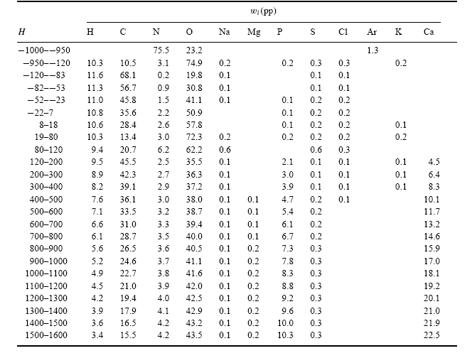
CT stoichiometric calibration (I)
CT segmentation into 27 materials of defined elemental composition (from analysis of 71 human CT scans)
Air, Lung,
Adipose tissue
Soft tissue
Skeletal tissue
Schneider et al PMB 45, 2000
Notes:
19

Slide 20
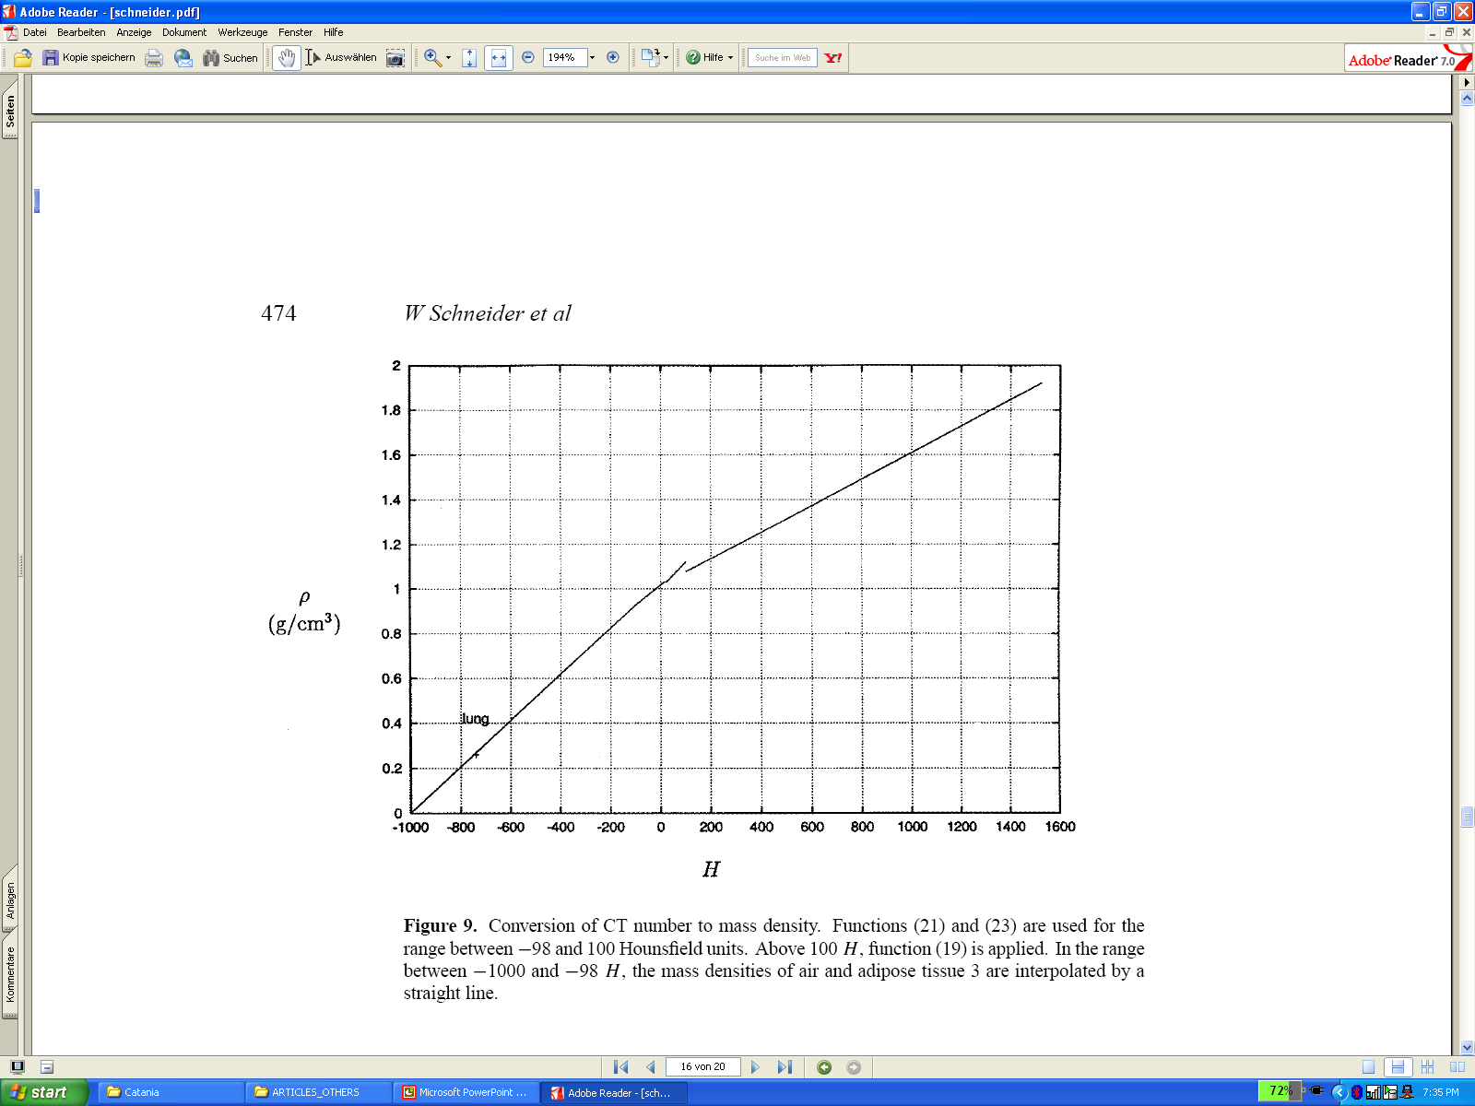
CT stoichiometric calibration (II)
Assign to each material a “nominal mean density”, e.g. using the density at the center of each HU interval (Jiang et al, MP 2004)
Schneider et al
PMB 45, 2000
But “real density” (and related physical quantities) varies continuously with HU value !!!

Slide 21
The region-dependent CORRFACT card
“CORRFACT” card allows to alter material density for dE/dx and nuclear processes
First two inputs specify a density scaling factor (restricted to the interval [2/3,3/2]) for charged particle ionization processes (WHAT(1)) and for all other processes (WHAT(2)) to the region(s) specified by the inputs WHAT(4-6) [cf. manual]
This is especially important in ion beam therapy to force the MC to follow the same semi-empirical HU-range calibration curve as the Treatment Planning System (TPS) for dosimetric comparisons

Slide 22
How to account for HU-dependent dEdx
In writect.f identify each HU value of CT as an organ IO to which the region number KREG(IO) is assigned
CT scan dependent
READ(30,*) HU
MINHU=-1000
NO=0
MO=0
DO IZ=1,NZ
DO IY=1,NY
DO IX=1,NX
IF (HU(IX,IY,IZ)-MINHU .GT. 0) THEN
IO= HU(IX,IY,IZ)-MINHU
VXL(IX,IY,IZ) = IO
MO = MAX (MO,IO)
DO IR=1,NO
IF (IREG(IR) .EQ. IO) GO TO 1000
END DO
NO=NO+1
IREG(NO)=IO
KREG(IO)=NO
WRITE(*,'(A,2I10)')' New number, old number: ', NO, IC
1000 CONTINUE
END IF
END DO
END DO
END
MINHU (e.g., air HU ~ –1000)
goes into 0 organ!
Correspondence HU ⇔ Region NR,
where HU=IO+MINHU

Slide 23
How to account for HU-dependent dEdx
In the INPUT
  Let several regions share the same material composition
  and mean density according to CT segmentation (reduced number of materials to save memory / initialization time)
  ASSIGNMA BONE VOXEL005 (region number 25)
  ASSIGNMA BONE VOXEL016 (region number 31)
  Use CORRFACT to impose the desired correction for stopping power (⇒ ion range!) in the regions KREG corresponding to different organs IO (i.e., different HU values) sharing the same MATERIAL assignment
  CORRFACT 0.85 0.0 0.0 25
  CORRFACT 1.3 0.0 0.0 31
Region #25 corresponds
to “softer” bone than #31

Slide 24
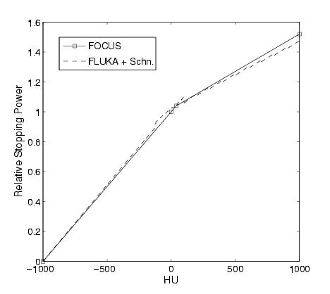
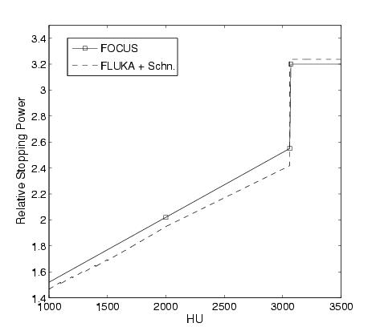
Forcing FLUKA to follow the same range calibration curve as TPS for p @ MGH Boston
The CORRFACT ionization scaling factors were obtained from the
dEdx ratio between TPS and FLUKA (+ Schneider “mass density”)
Ti
Schneider’s segmentation
Extrapolation to Ti
24 Materials,
2600 regions
(HU values)
3 Materials,
1900 regions
(HU values)
1000
Parodi et al MP 34, 2007, Parodi et PMB 52, 2007

Slide 25
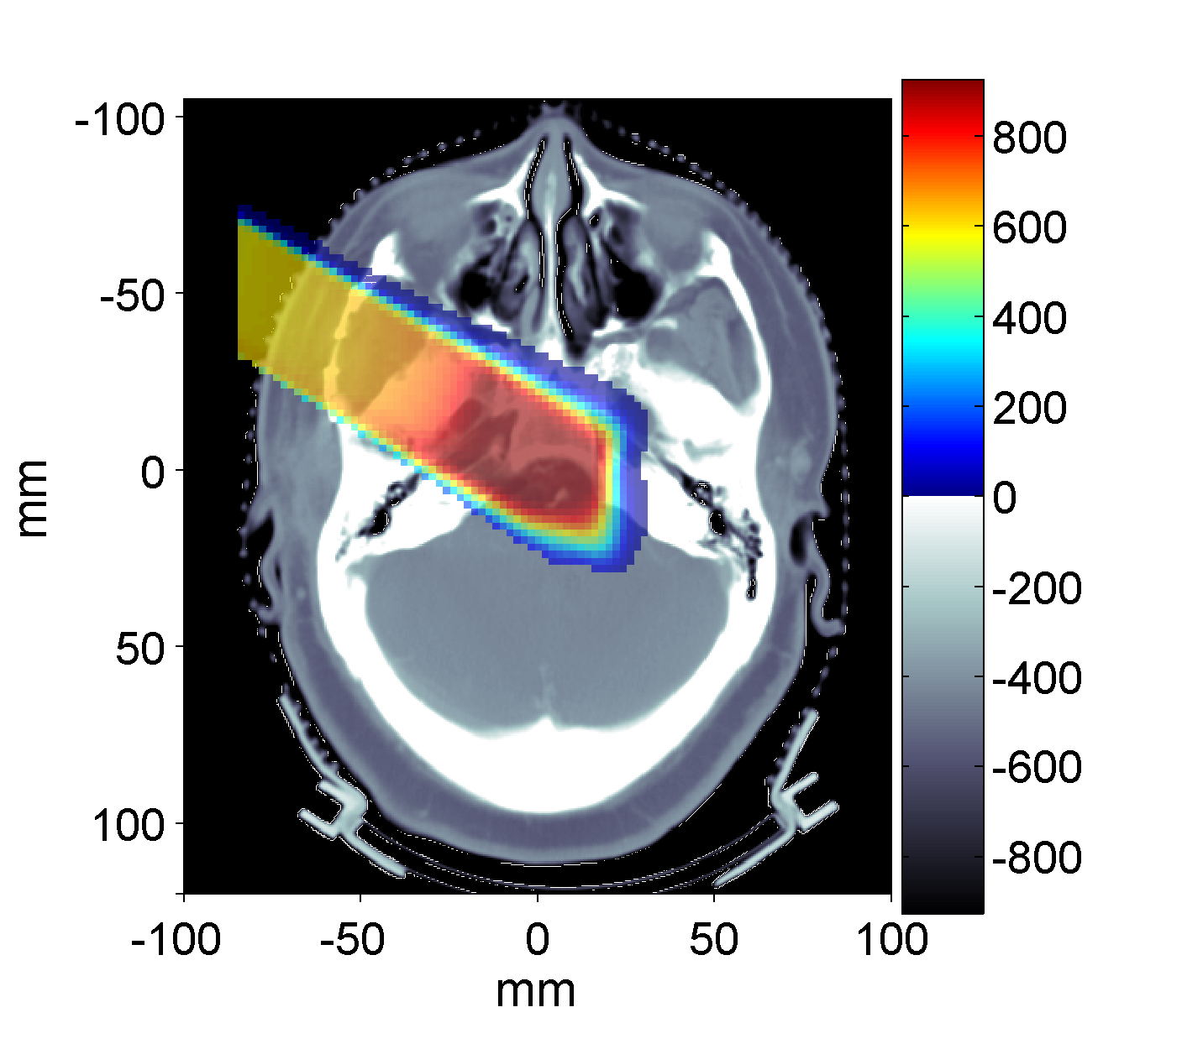
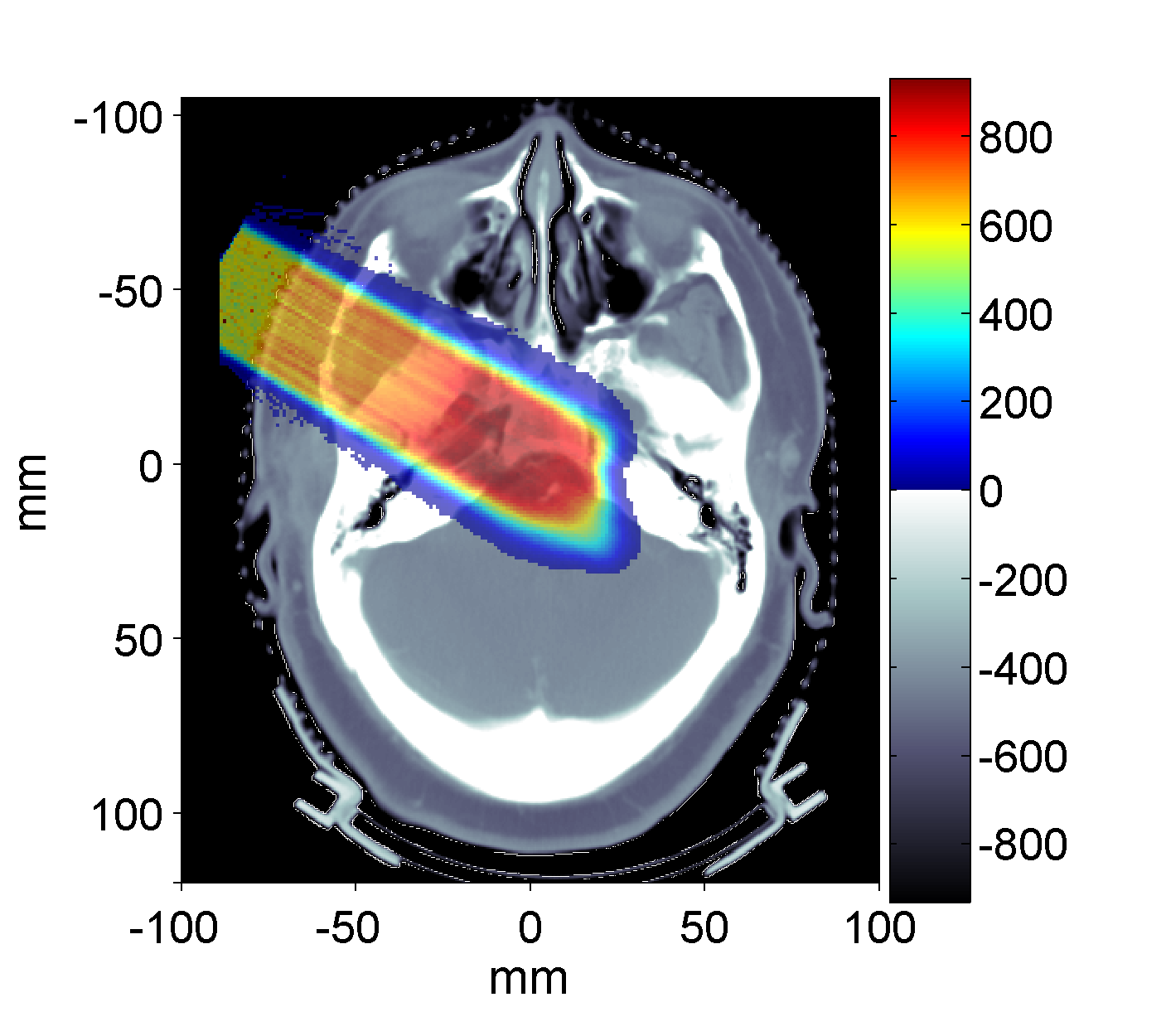
Applications of FLUKA to p therapy @ MGH
Input phase-space provided by H. Paganetti, MGH Boston
TPS
mGy
FLUKA
mGy
Parodi et al, JPCS 74, 2007
Prescribed dose: 1 GyE
MC : ~ 5.5 10⁶ protons in 10 independent runs
(11h each on Linux Cluster mostly using 2.2GHz Athlon processors)

Slide 26
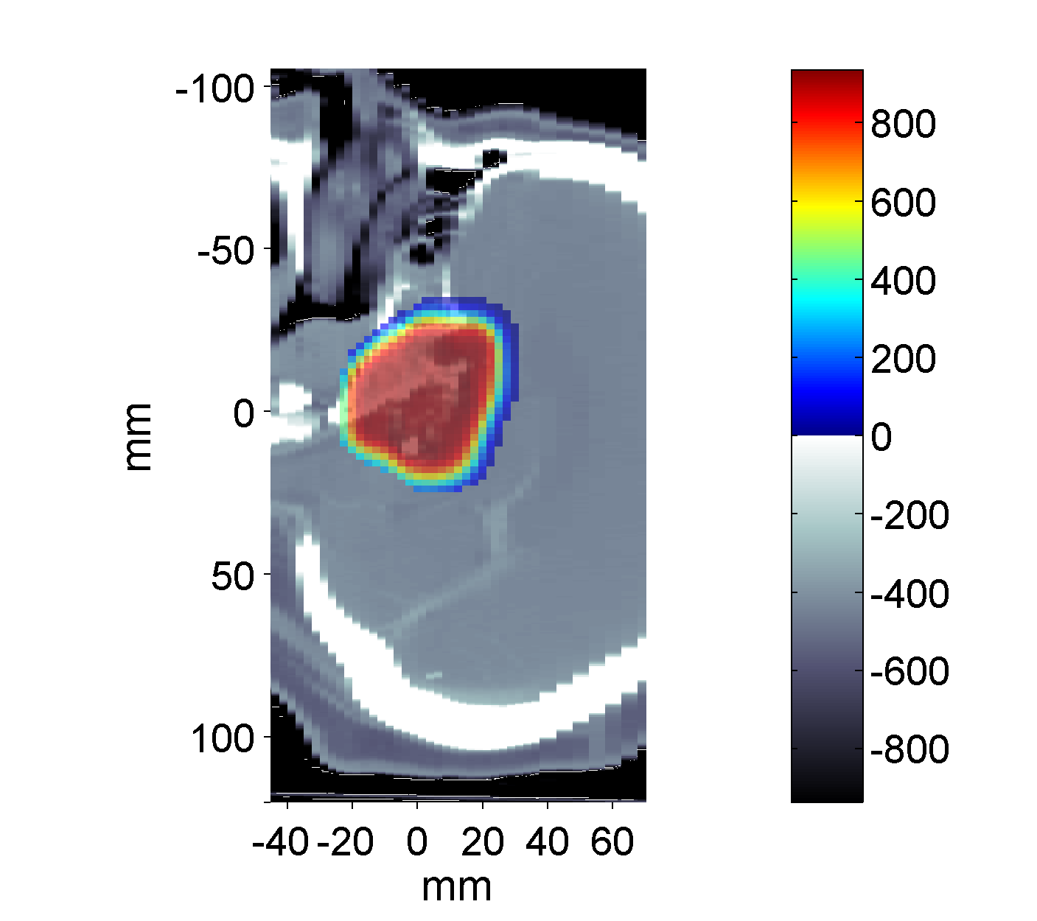

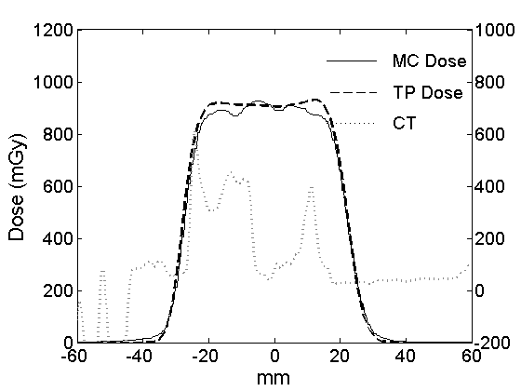
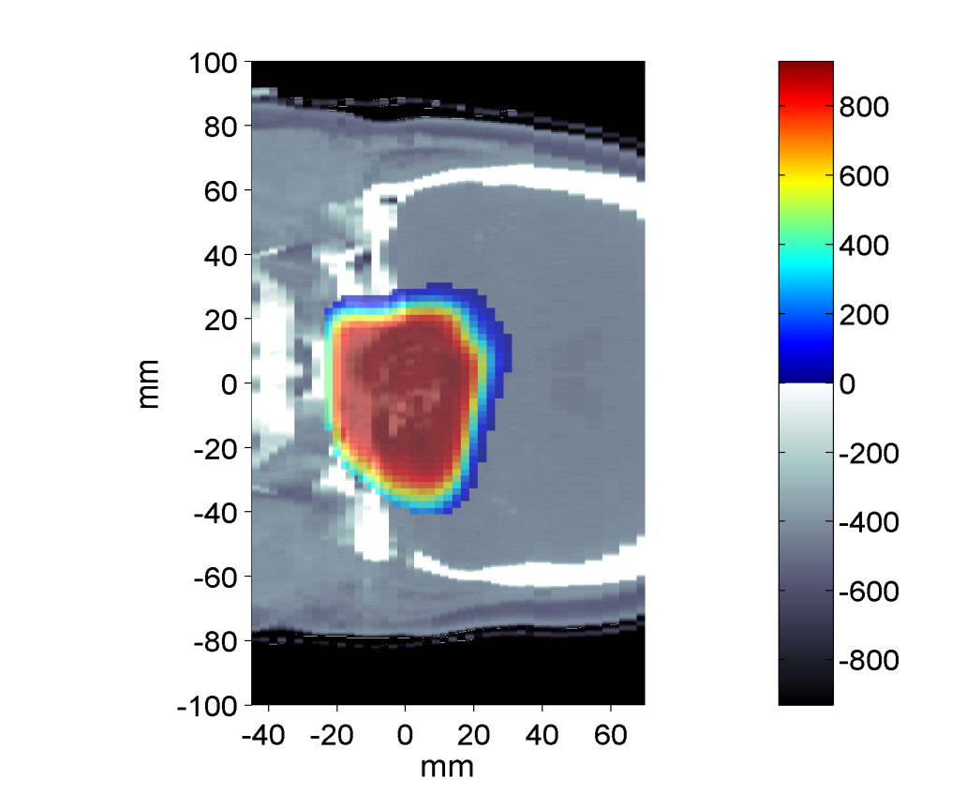
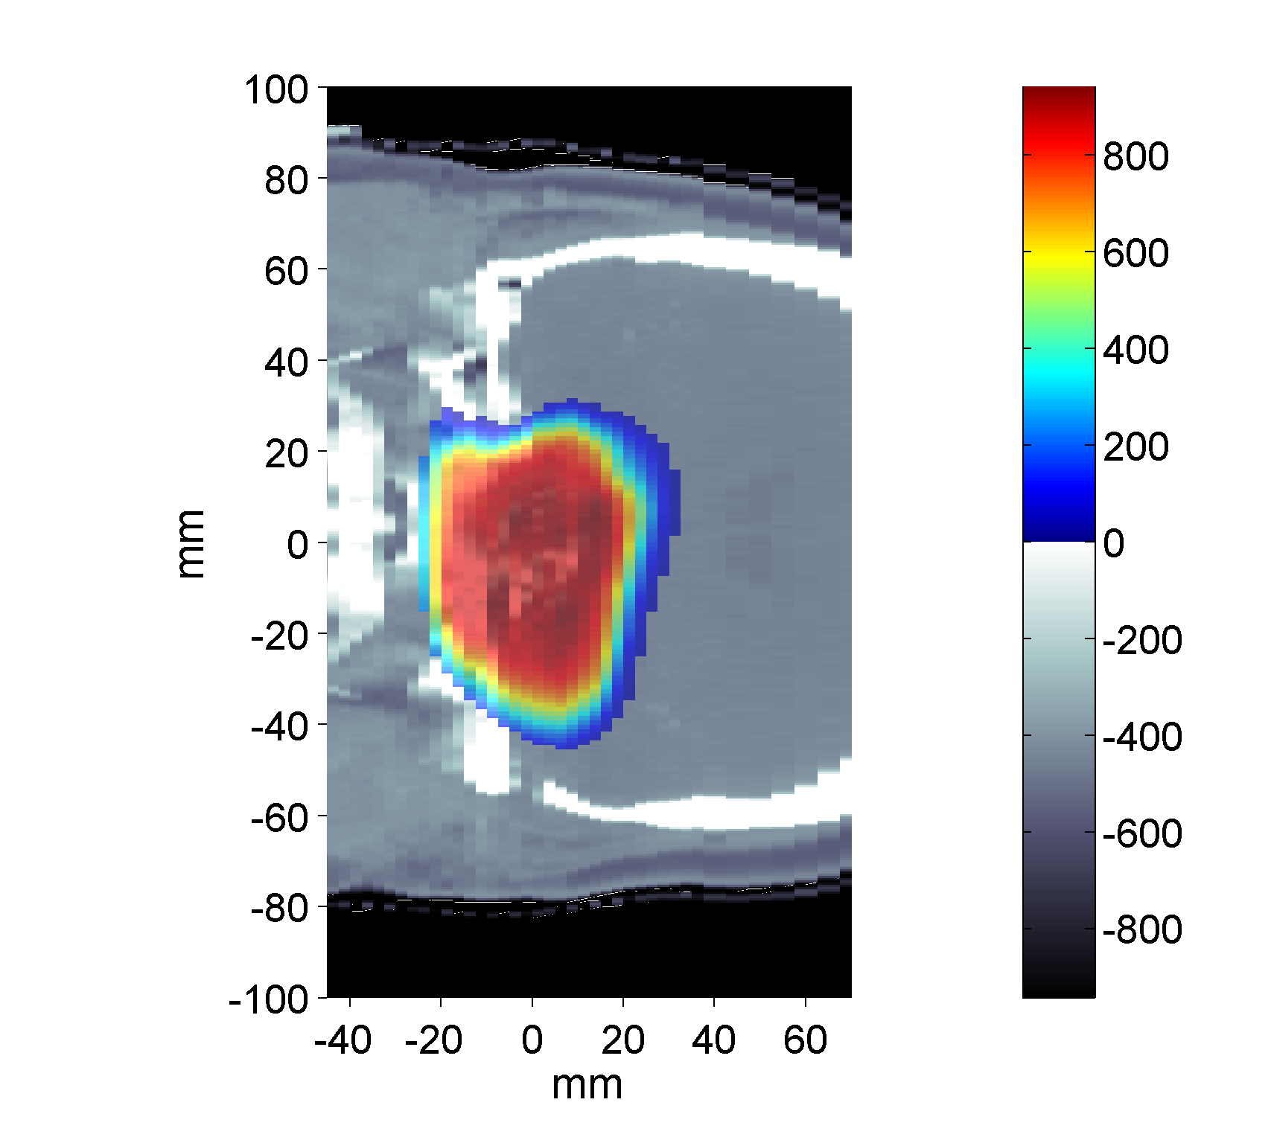
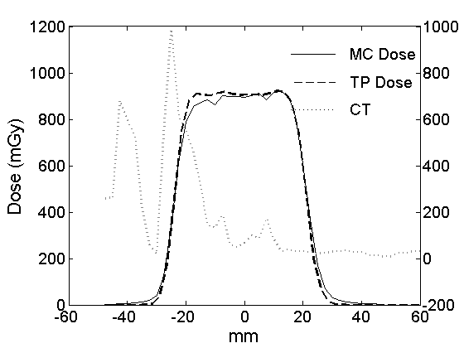
Applications of FLUKA to p therapy @ MGH
mGy
mGy
Parodi et PMB 52, 2007
TPS
FLUKA
mGy
mGy
TPS
FLUKA

Slide 27
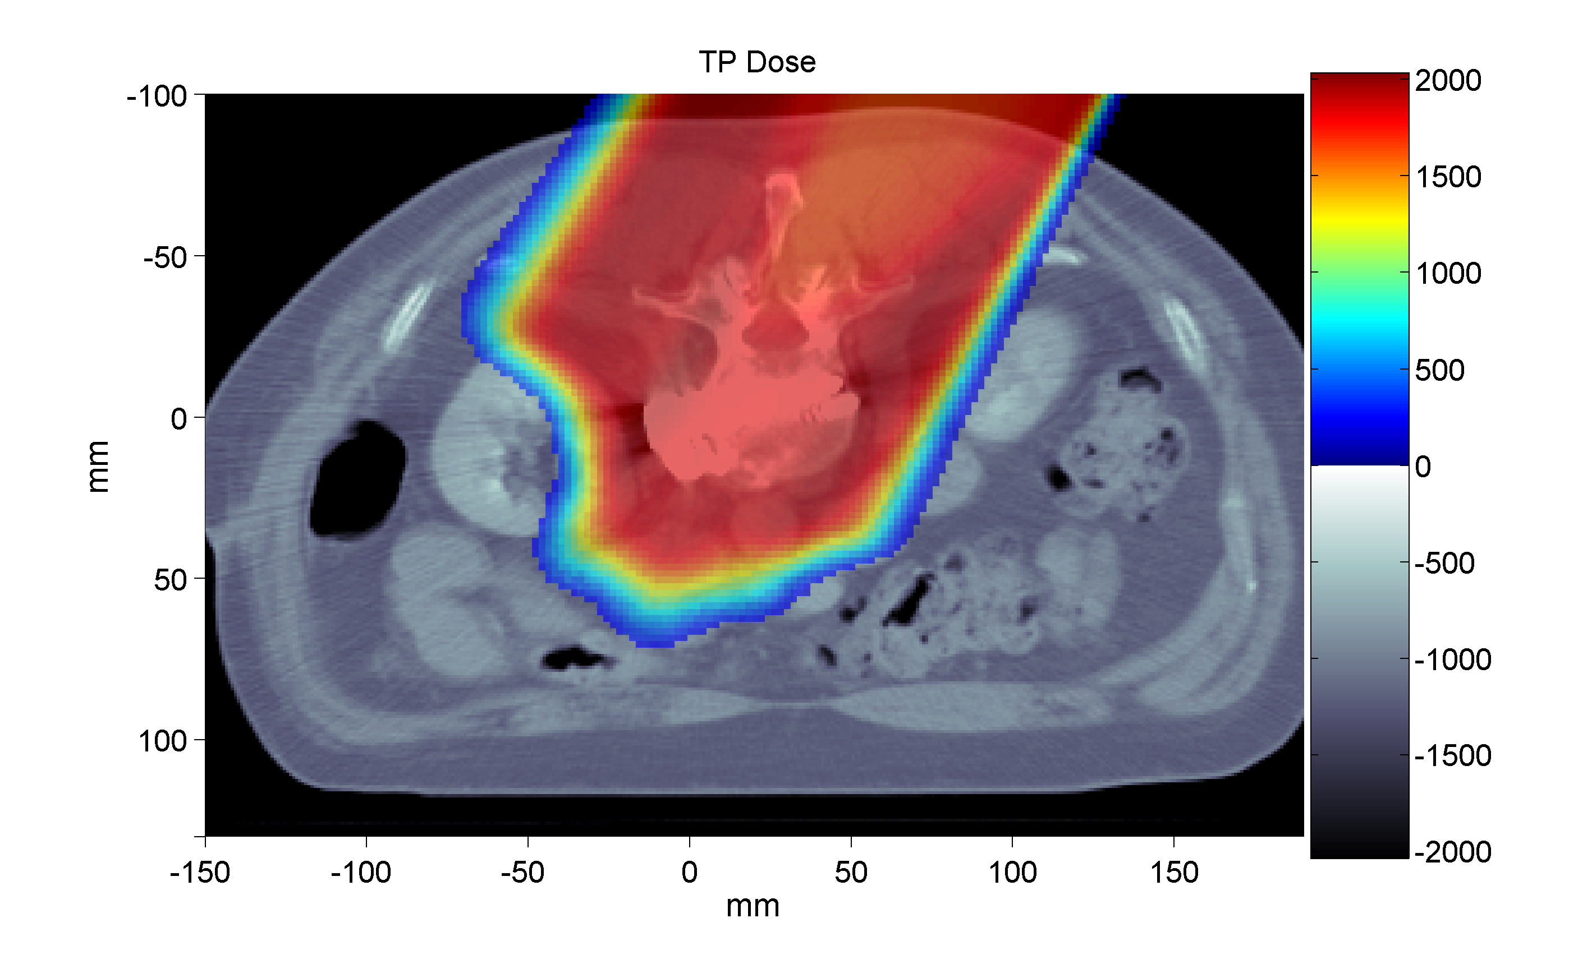
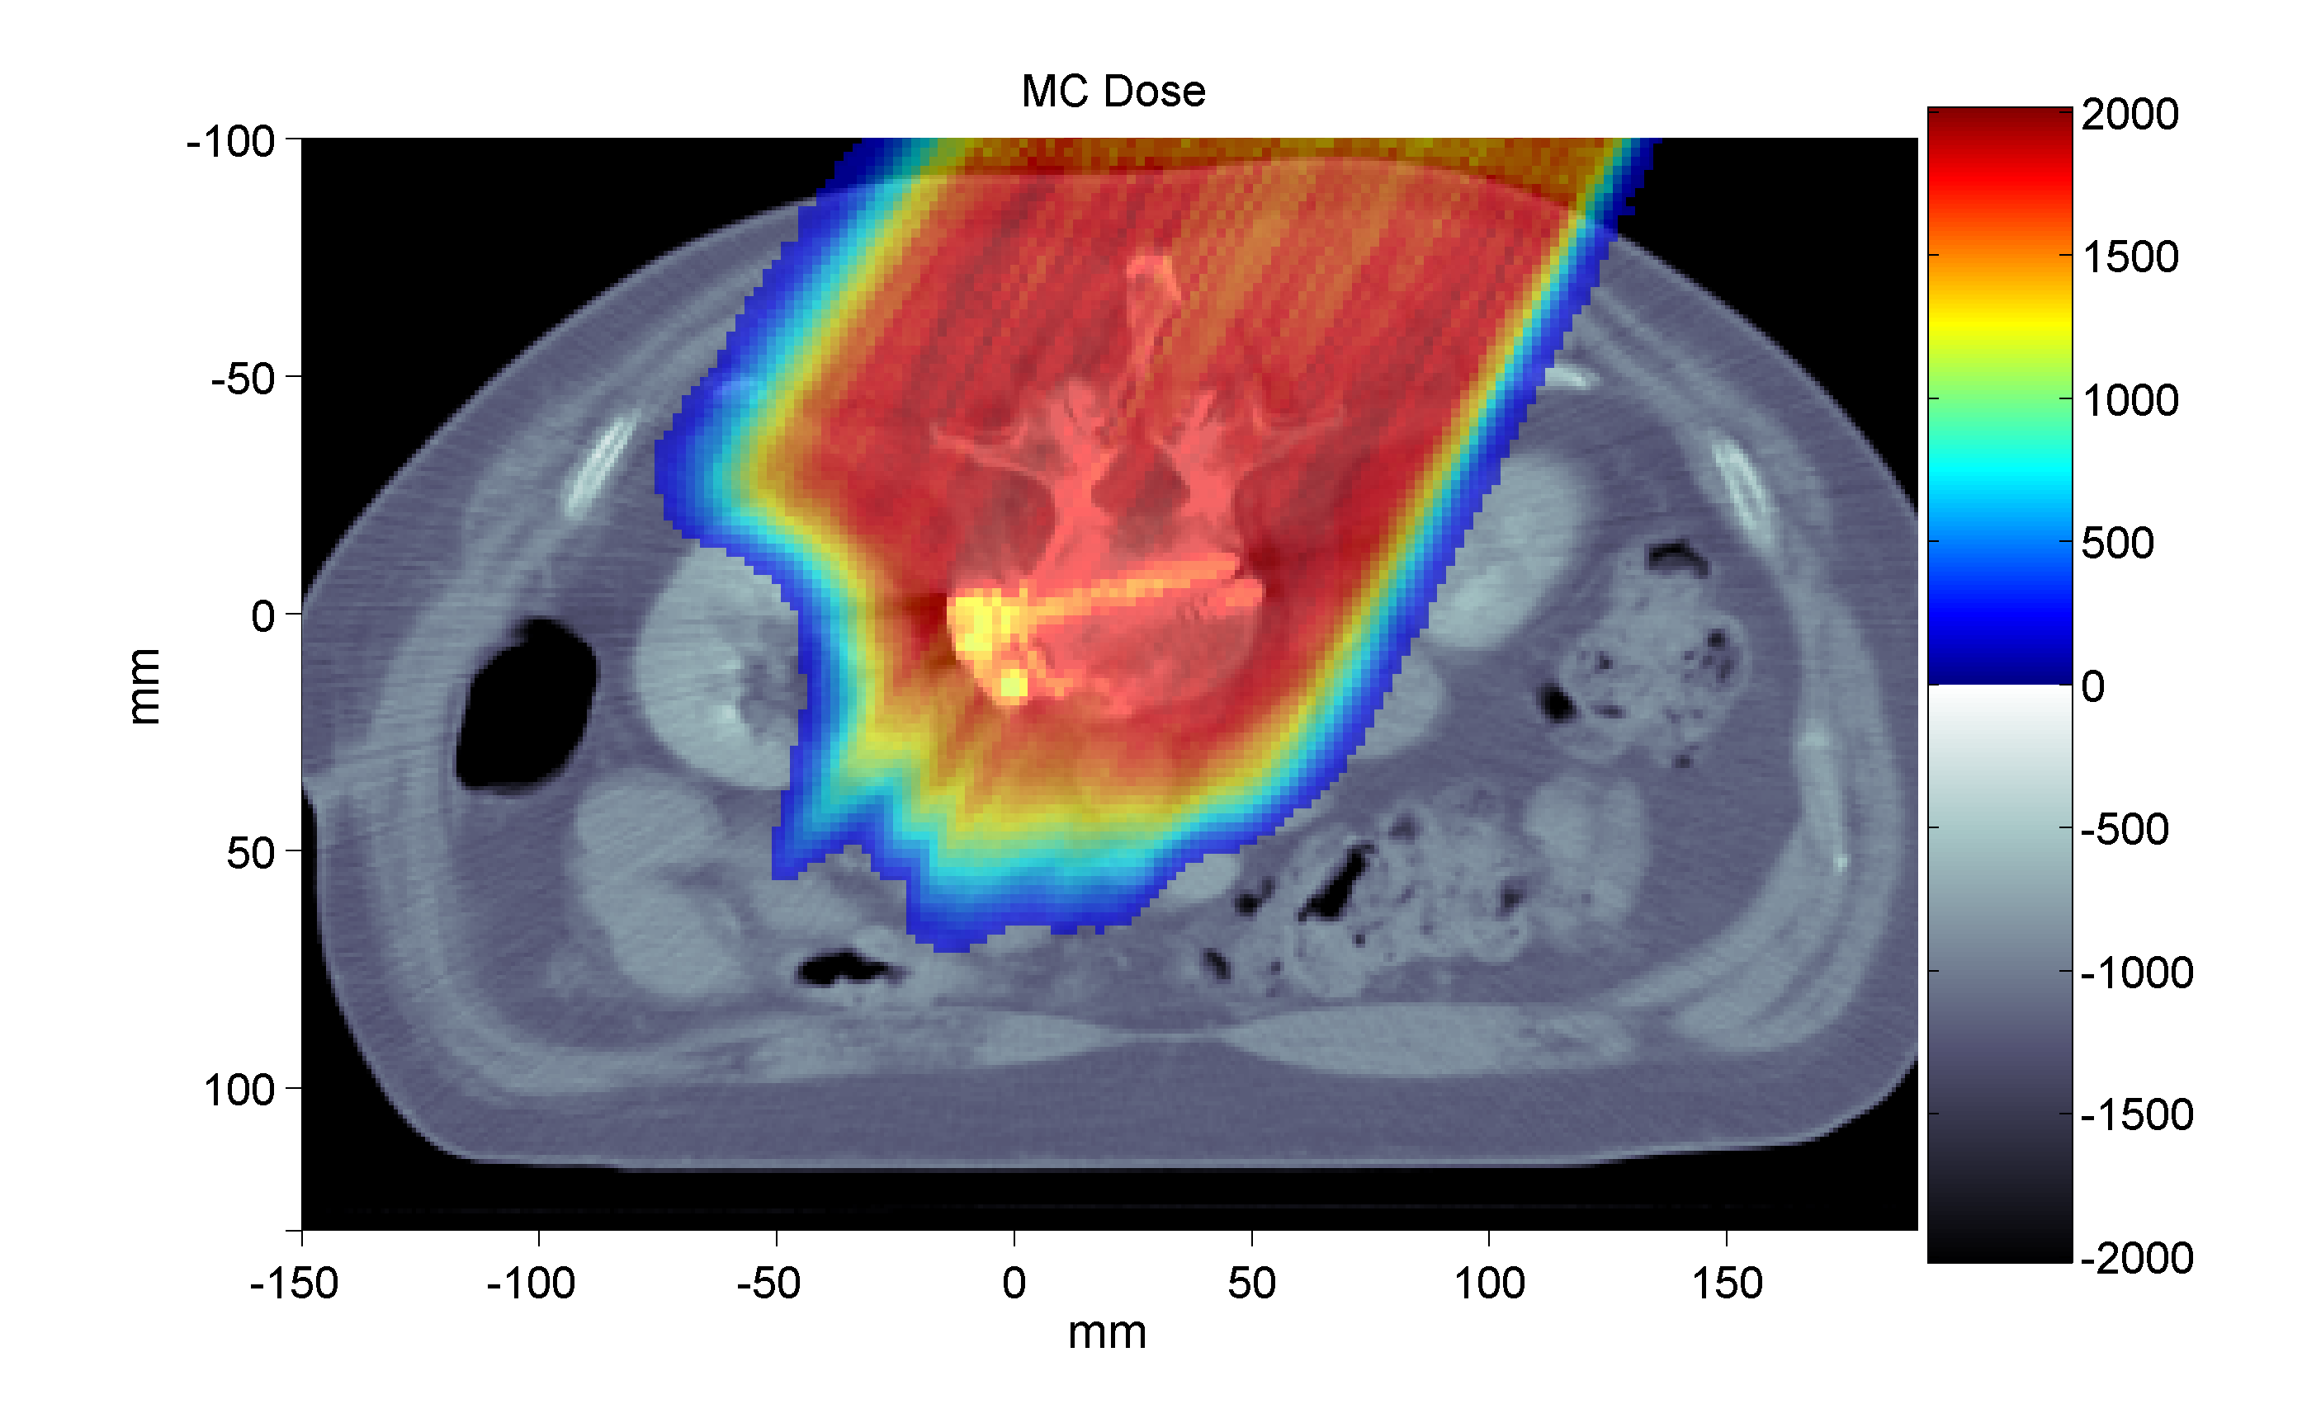
TPS
mGy
Applications of FLUKA
to p therapy @ MGH
mGy
FLUKA
metallic
implants
Prescribed dose: 2 GyE
MC : ~ 7.4 10⁷p in 12 independent runs (~ 130h each on 2.2 GHz Linux cluster)
K. Parodi et al, IJROBP 2007

Slide 28
Applications of FLUKA to p therapy @ MGH
Planned dose
Clival Chordoma, 0.96 GyE / field
mGy
mGy

Slide 29
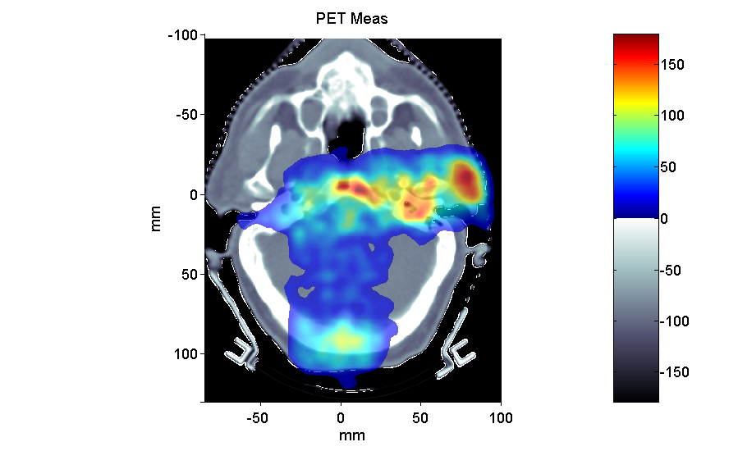
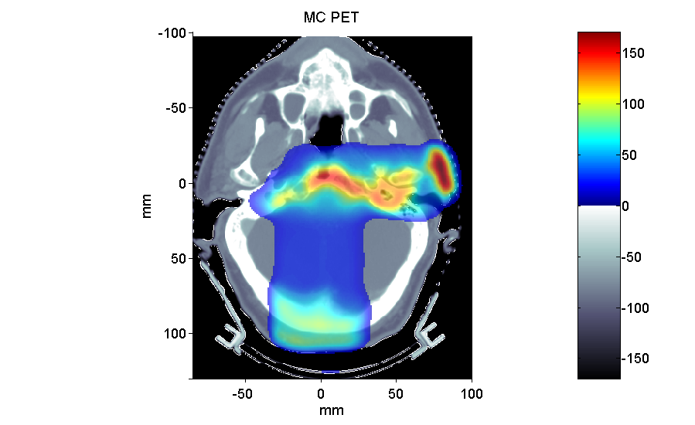
Post-radiation PET/CT @ MGH
Average Activity
Clival Chordoma, 0.96 GyE / field, ΔT1 ~ 26 min, ΔT2 ~ 16 min
Bq / ml
Bq / ml
2 Field
1 Field
K. Parodi et al, IJROBP 2007

