Slide 1
Exercise 3: Geometry
Beginners FLUKA Course

Slide 2
Exercise 3: Geometry
download the solution of ex2.inp from the website into a new ex3 directory and rename it to ex3.inp
open it using FLAIR
convert the cylinder to an infinite one
use a ZCC body for the cylinder
use two XYP planes, at z=0. and z=10.cm, to cut it
re-define the regions TARGET and VAC
run

Slide 3
Exercise 3: Geometry
segment the target into three pieces by two transverse cuts
first segment: from z=0. to z=1.cm (new XYP needed)
second segment: from z=1.cm to z=2.cm (new XYP needed)
third segment: from z=2.cm to z=10.cm (no further bodies needed)
define the 3 target regions
assign them water, ALUMINUM (pre-def), and LEAD (pre-def)
activate the geometry debugging with a 1mm grid from (x,y,z)=(-6.,0.,-6.) to (x,y,z)=(6.,0.,11.)
see in the manual the GEOEND card
run, search for Geometry debugging in the .out file, and enjoy the lack of errors
perform the same operation by the dedicated FLAIR Process/Debug frame

Slide 4
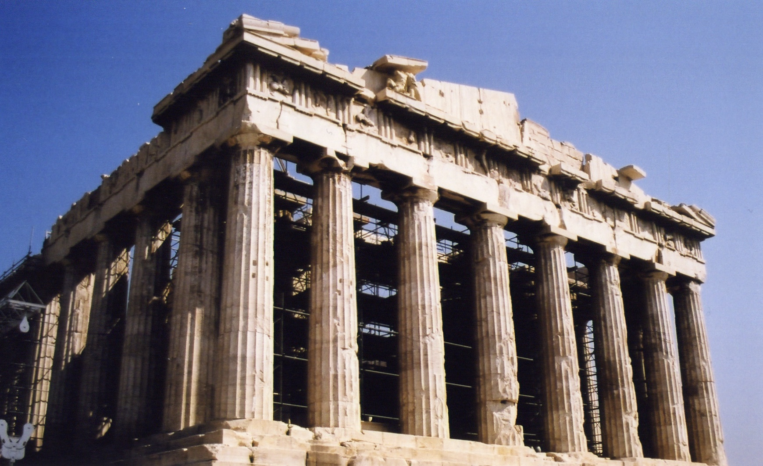
Exercise 3: Advanced & Homework
create a bit more realistic and complex geometry

